Slide 1
New Readout Scheme
I.Laktineh
IP2I, Lyon, France

Slide 2
RPC are excellent muon detectors:
They are Fast timing detectors
They can be built with large surface, with excellent homogeneity and very small dead zone
They are very cheap.
Several ways to read out RPC:
Using pick-up strips (either one direction on the anode side as for current CMS RPC or two directions one on the anode and one on the cathode as for ATLAS)
or 2-D readout using excellent time measurement as the ne we propose for CMS iRPC upgrade project
Using pick-up PADs as for SDHCAL (CALICE)
To measure time with excellent precision in particular with the MultiGap version.

Slide 3
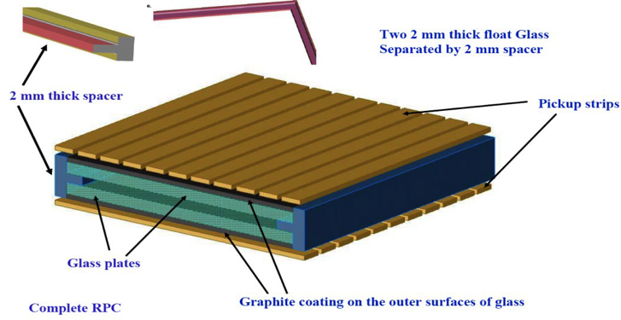
RPC-based Muon system
(CEPC)
X-Y strips-based readout proposed for the RPC muon system is ok.
For tail catcher this may face the problem related to ghost particles.

Slide 4
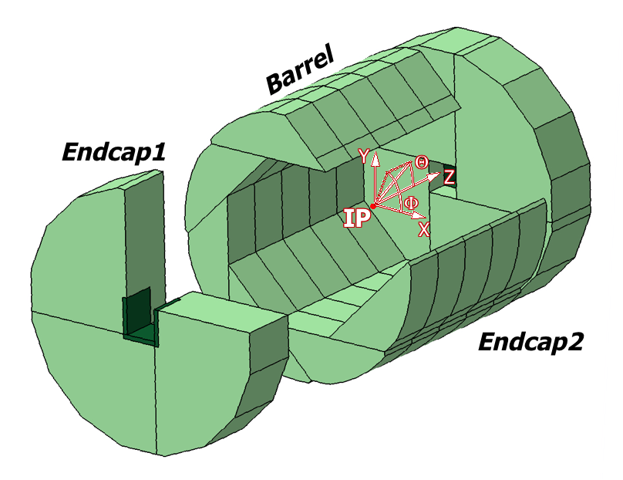
ILC, CEPC SDHCAL calorimeter system baseline
The ILC, CECP calorimeter baselines are all high-granularity based.
SDHCAL is one of the HCAL baselines with tens of millions of channels
Only about 10³ will be fired for each collision. So the channels are idle almost all of the time but will continue to consume power and to produce heat, necessitating in case of circular collider active cooling → reduced PFA performance
This statement applies for all high granular calorimeters other options.

Slide 5
Reducing the number of pads/pixels is not an option since this leads to less granularity → bad PFA.
Can we do something to save power and money without impacting the physics
?

Slide 6
There is a solution
PCT/EP2018/053561
Connect the pads/pixels in a special way: woven strips
Two neighboring pixels are connected to two different strips
Each strip is connected to one electronic channel
Share the charge among a few ones
Crossing the fired strip to determine the position
NXN → 3N : Reduction of electronic channels, power consumption and occupancy

Slide 7
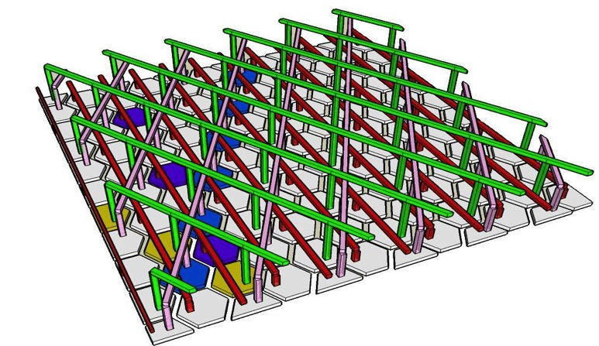
Several shapes of pads/pixels can be used: triangles, lozenges, pentagons, hexagons the most convenient is the triangular shape
The pad/pixel size should be a slightly smaller to the charge extension to feed at least two. In gaseous detector this is always possible.
Having 3 or more directions allows one to eliminate ambiguities (ghost particles)

Slide 8
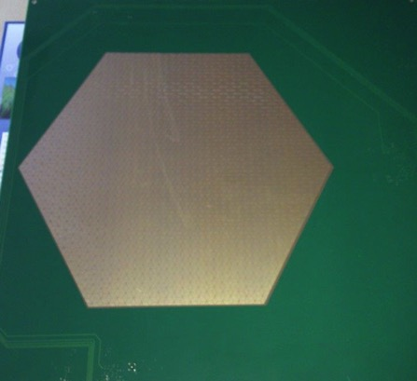
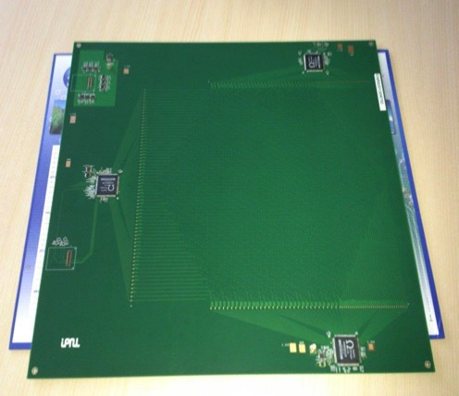
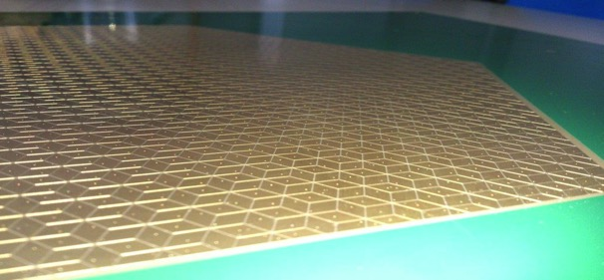
The new scheme was used to design a new PCB with lozenges structure and 3 directions. The readout electronics was set on the same PCB.
30 cm
3 HR2 ASICs rather than 20 for the same surface
Better granularity
Lozenge’s large diagonal : 1 cm

Slide 9
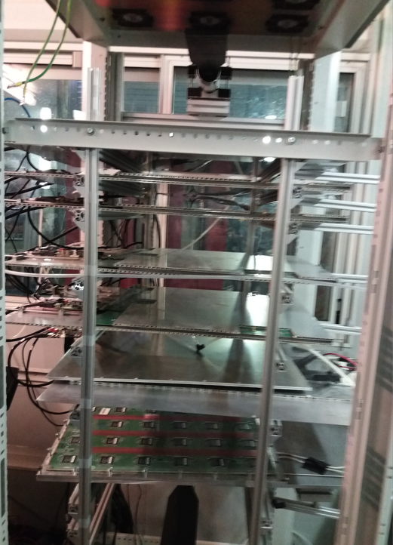
Setup with 5 detectors equipped with the new scheme

Slide 10
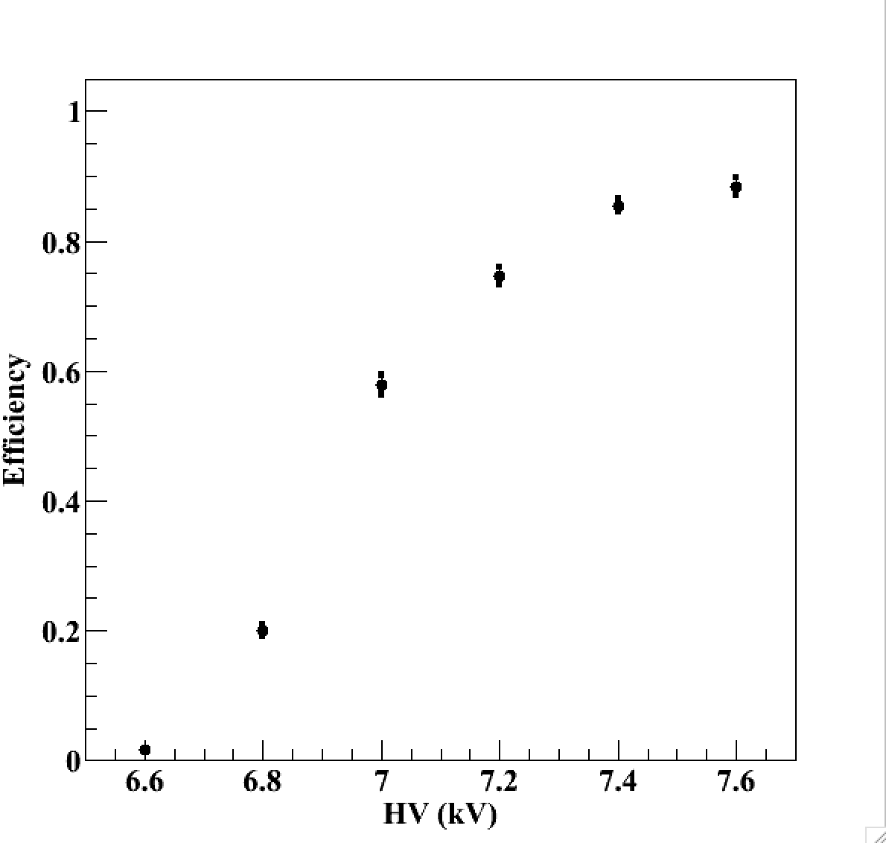
Efficiency vs HV
Threshold ≈ 60 fC
TFE(93%)
CO2 (5%)
SF6 (2%)

Slide 11
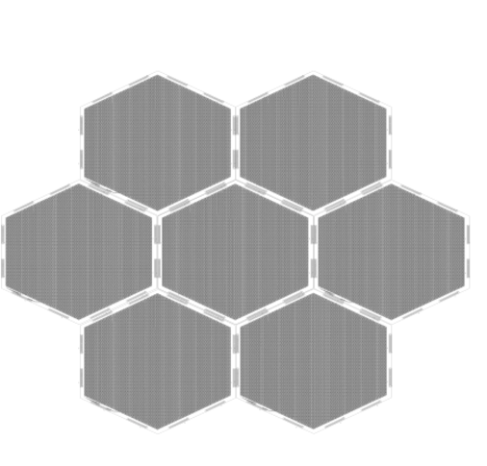
Large surface detectors
To instrument very large gaseous detectors the readout electronics could not be part of the PCB. A solution to separate strips panels from the readout electronics is needed:
Here is the scheme:
FEB
Well matched impedance will help to keep the signal in good shape for long distances

Slide 12
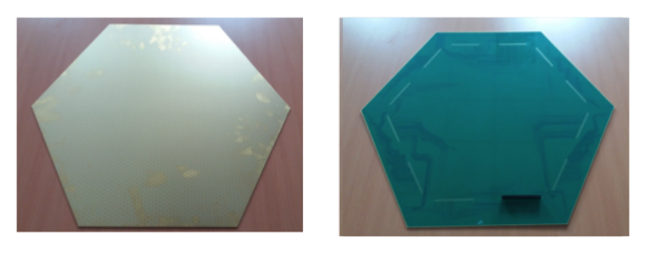
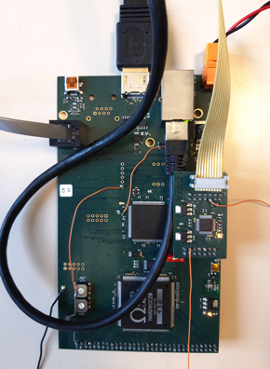
Large surface detectors
62 cm
A board hosting
One Hardroc ASIC
One Microcontroller
To be plugged directly on the back of the PCB, on the edge to read out 64 woven strips (1 HR2 ASIC).

Slide 13
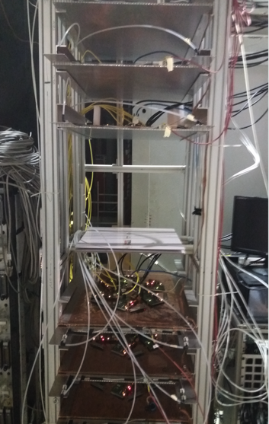
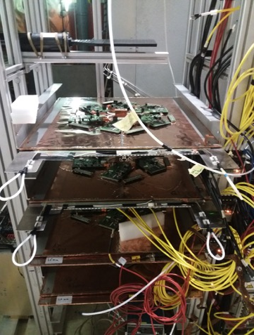
SETUP
The new readout scheme was tested first using a SC-PMT and in a standalone mode.

Slide 15
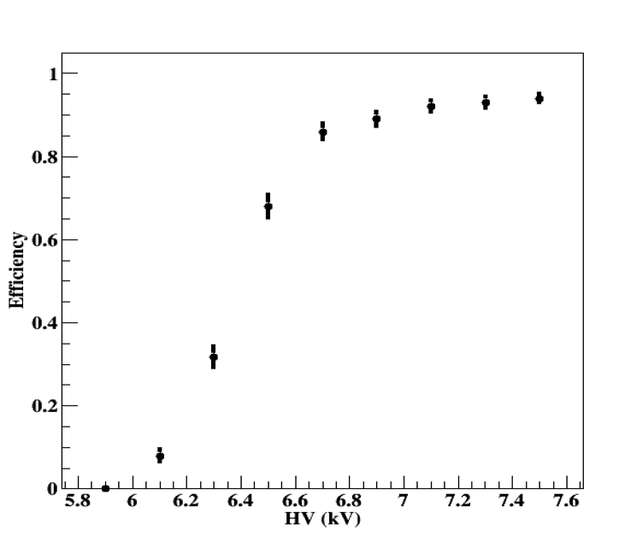
Efficiency with the new scheme
TFE(95.2%)
CO2 (4.5%)
SF6 (0.3%)

Slide 16
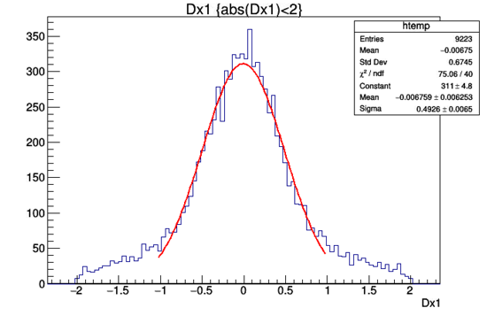
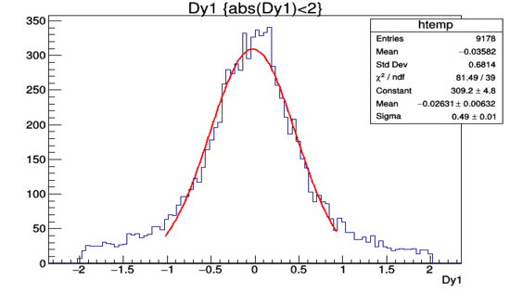
X-residuals (cm)
Y-residuals (cm)

Slide 17
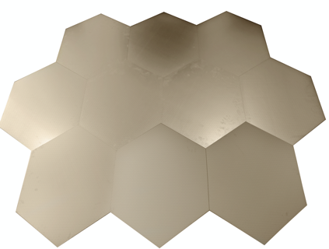
Next Step
We would like to build large detectors similar to those to be used in the Endcaps of ILC, CEPC and FCC muon systems and use the new readout scheme to validate completely the concept.

Slide 18
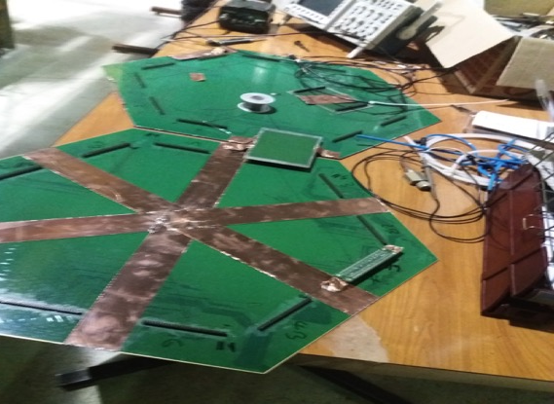
Connecting two neighboring PCBs using impedance-matched connectors will allow to cover a large detector easily.
No signal loss was observed by injecting a signal on the furthest end of the first PCB and detecting it on the opposite side of the second PCB

Slide 19
Conclusion
A new scheme allowing a reduced cost and reduced power consumption without reducing the granularity is proposed to equip large RPC detectors
This solution is very useful if one wants to use the muon detectors as a tail catcher
Study to assess the possibility to use it in SDHCAL is ongoing.
Large RPC detectors will be built and equipped with the new scheme soon.
The scheme could be applied to any MPGD in principle

Slide 20
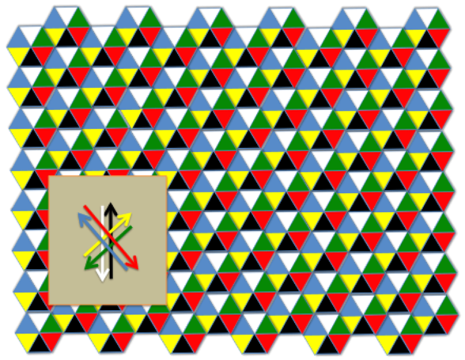
One can read the signal from both sides and get profit of the difference in time arrival to improve the position resolution and get the absolute time as well.

Slide 21
3 crossings
5 crossings
8 crossings

