Slide 1
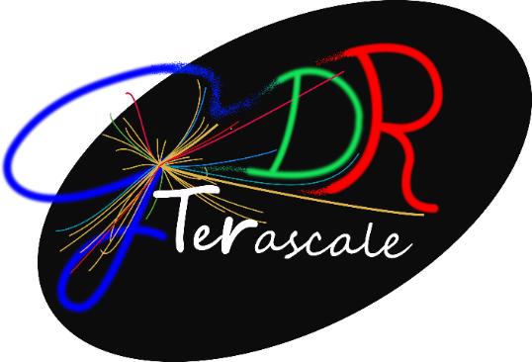
IRN Terascale
Gilbert Moultaka, Tilman Plehn, Dirk Zerwas
Discussion with Patrice Verdier and Laurent Vacavant
General Agreement that the scientific scope of the IRN Terascale is well defined:
Higgs
BSM
Dark Universe
Tools
Formal steps :
No MoU only a support letter needed
Need to come up with a list
Bonn, Brussels, Durham and Heidelberg “set” (if you agree)
Suggest to check with all current international partners (VUB, DESY,…) and interested (KIT, INFN-Turin, Pisa, Florence and Roma-Tre thanks to Marco)
French institutions may also receive the letter if helpful for funding (eg U Montpellier,…)
Calendar:
March 2021 start of DERCI activity
Need a definitive list of letter recipients
Scientific project (order 5-10 pages as before)

Slide 2
New agreement: LETTER sent by DERCI
Conducting research in all fields of knowledge, the CNRS promotes international research collaboration. This includes the support to International Research Networks. These refer to initiatives gathering scientists from organizations of various countries jointly involved in a theme-based scientific dialogue by means of international scientific seminars and workshops.
I would like to inform you hereby that, under this scheme, the CNRS has selected the International Research Network “Terascale" involving scientists from list of organizations, countries. The scientific programme of the said Network is scheduled to run from 2022 to end 2026 (5 years) and is attached to this letter. Subject to performance and availability of funds, the CNRS plans to specifically devote €amount to it for its duration.
Typically, CNRS grants its support to these networks after evaluating proposals submitted by members of CNRS-affiliated research units in conjunction with other participating scientists. This evaluation takes into account the scientific interest and potential outcomes of the projected joint activities as well as existing ties and complementarity amongst the participating scientists. CNRS support takes the form of dedicated financing aiming at covering part of the international extra cost arising from the conduct of the networks (i.e. international travel and living expenses, meeting organizational costs), which complements costs directly contributed by the participating laboratories and research teams.
Besides, these Networks are to meet the following conditions:
Publications related to the work carried-out in common within a Network shall mention it and the connection with the organizations involved.
Any information exchanged within a Network and identified as confidential shall be kept strictly confidential for the duration of the said Network and for five (5) years after its completion.
We hope your organization will share interest in this Network too and could provide it with financial support. In this case, I would be grateful if you could kindly inform the CNRS by emailing a letter of support specifically relating to the aforementioned Network to email secteur DERCI. For your convenience, an optional template is attached herewith.
For any further information; please do not hesitate to contact: chargée de coopération, email, tel.

Slide 3
Search Committee:
Boundary conditions :
Budget is allocated by the IN2P3
Budget transferred to the IRN director’s lab
Affiliation of director/coordinator to an IN2P3 lab mandatory
End of year financial and scientific report written and sent to DERCI
International partners :
Represented by Tilman
No formal duties (reports)
Suggest to assure continuity (if you agree)
Suggestion on scope:
Leadership team (Director/Coordinator and French deputy)
Our feeling: exp+theory preferred
Convergence by Mid-January
Outgoing French team:
Leading the IRL Helmholtz-IN2P3 is incompatible with IRN
Gilbert is willing to help, but is not a candidate to head the IRN
Suggestions for search committee:
Jean Orloff
Ulrich Goerlach
Emmanuel Moulin
Michel Tytgat

