Slide 1
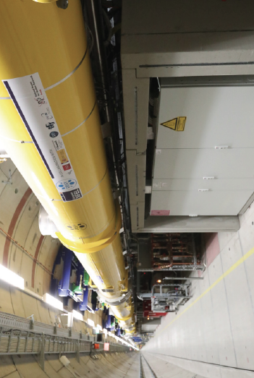
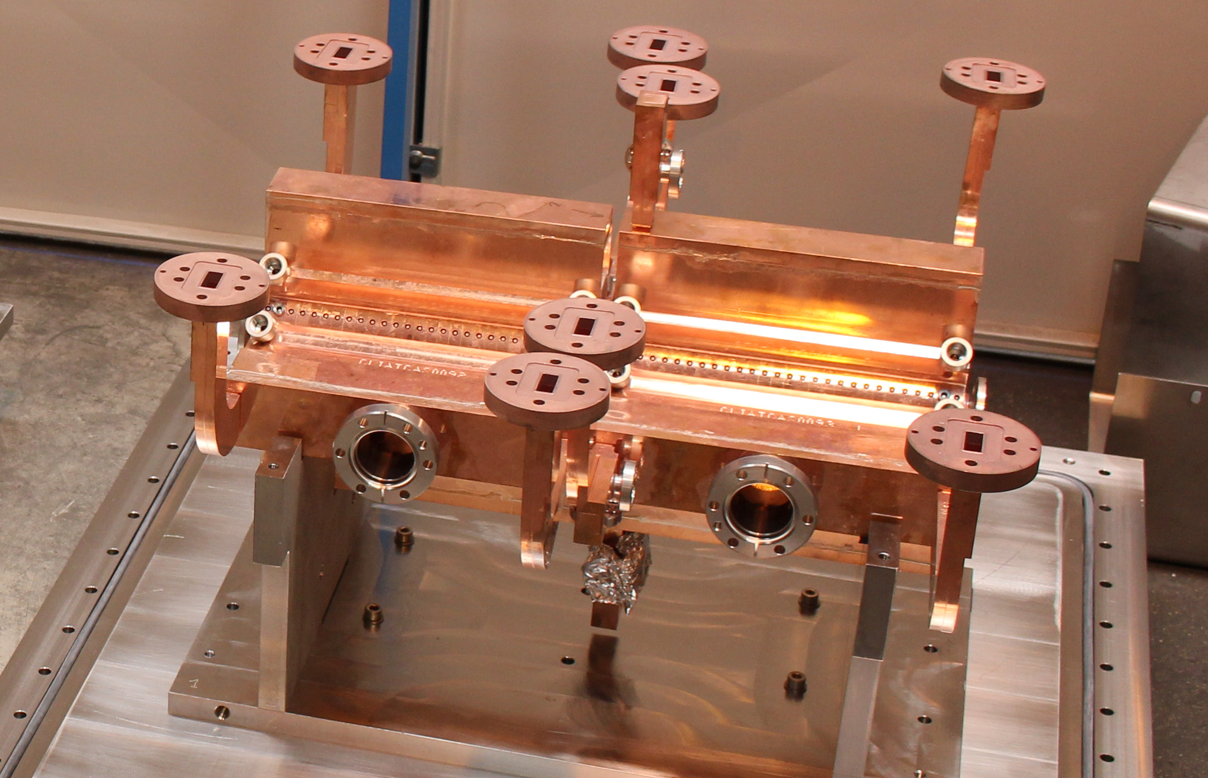
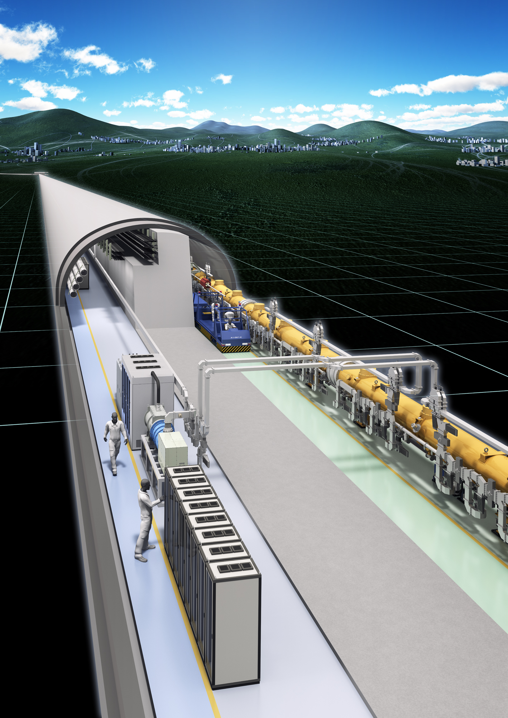

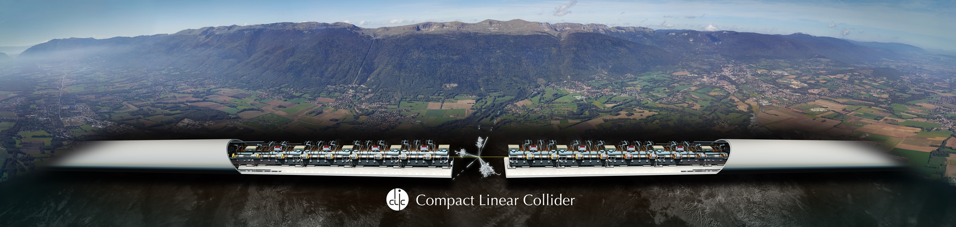
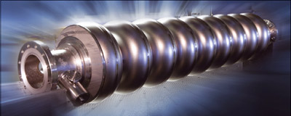
3
ATF3 BPM report and next
A. Faus-Golfe

Slide 2
CBPMs
ATF2 (2020-2023)
Calibration process upgrade for current CBPMs:
- duration of calibration
- lifetime - degradation of calibration over time
New time and phase invariant digital processing software could be developed, algorithm could first be tested on simulated data.
Detailed implementation on site: 6 months + beam time for bootstrapping and testing.
Help of a PhD student would be very welcome (happy to train a Japanese student). Possibility to ask for a JSPS grant for Alexey to perform the upgrades in Fall 2021

Slide 3
CBPMs
ATF2 (2020-2023)
Other issues:
- does it make sense to install all the CBPMs ???
- ...

Slide 4
CBPMs
ATF3 (2023-2024)
Possible Hardware changes in current CBPMs:
Add separate fast small movers for centering and position calibration
- this action requires a mechanical study given the fact that BPMs are brazed to the beam pipe inside quads.
- movers relatively low spec: ~10kg load and um resolution, still ~$10k/cavity – prioritise high beta regions?
Centering would reduce the wakefield contribution.
Need better mover cost/FTE/duration estimates.
Electronics: analogue electronics reliable, but may need more spares if CBPMs are re-installed – AL to contact SLAC
Digitizers: 20-year old model, higher resolution ADCs would increase the dynamic range.
Need cost and duration estimates.

Slide 5
CBPMs
ATF3 (2023-2024)
New CBPMs ideas:
Test of integrated CBPM electronics from Instrumentation Technologies, best with ILC type cavities (info about ILC cavities ?)
Off-the-shelf (FMB-Oxford-Instrument technologies) triplet of CBPMs. Some tests have been made at VELA-Daresbury with these (2a = 20 mm) cavities and home made electronics.
Low-wakefield wavegide BPMs, aperture/resolution issues to be estimated (sensitivity degrades as 1/a)

Slide 6
ATF3 meeting Plan
30 October 2020: kickoff
6 November 2020: Vacuum and Magnets upgrade (Nobuhiro)
13 November 2020: CBPMs upgrade (Alexey) / beam tuning (Toshiyuki))
20 November 2020: CBPMs (Alexey/Angeles)
27 November 2020: 2nd order correction/wakefields (Kiyoshi), Continuous monitoring and stabilization (Laurent), IP-BSM laser upgrade (Alex)
4 December 2020: ultra-low beta studies (Rogelio) / Assessing ATF3 beam-dynamics driven specifications (machine design robust to static and dynamic imperfections) and DFS/WFS implementation and other tuning techniques. (Andrea)
11 December 2020
18 December 2020
8 January 2020
15 January 2020
8 December IDT- WG2 DR/BDS/DUMPS ATF3

Slide 7
ATF2 (2020-2023)
Beam orbit tuning techniques (Okugi)
Wakefield evaluation and mitigation techniques
Low-b studies: 2nd order aberration, (10 β_{x}, β_{y} ) extension to bigger β_{x},..
Shintake monitor laser upgrade
Continuous ground motion monitoring – Laurent ?
.....

Slide 8
ATF3 (2024-2025)
CBPMs upgrades for ATF3
Assessing ATF3 beam-dynamics driven specifications (machine design robust to static and dynamic imperfections) - Andrea
DFS/WFS implementation and other tuning techniques –Andrea
Ultra-low b studies - Rogelio
FD girders and stabilization - Laurent
Upgrade for FONT for ATF3 - Phil
IP-BPMs
Instrumentation: multi-OTR upgrade?, ODR/OTR system, combined yag/otr/wire?, collimator...
Injection/extraction kicker
Injection linac powering upgrade
Injection/extraction magnet (septum)
...

Slide 9
Let’s start the discussion

