Slide 1
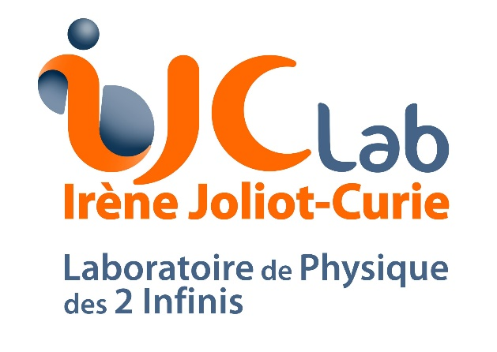
How will we first measure the Neutrino Mass Ordering?
João Coelho
IJCLab - Orsay
12 February 2021

Slide 2
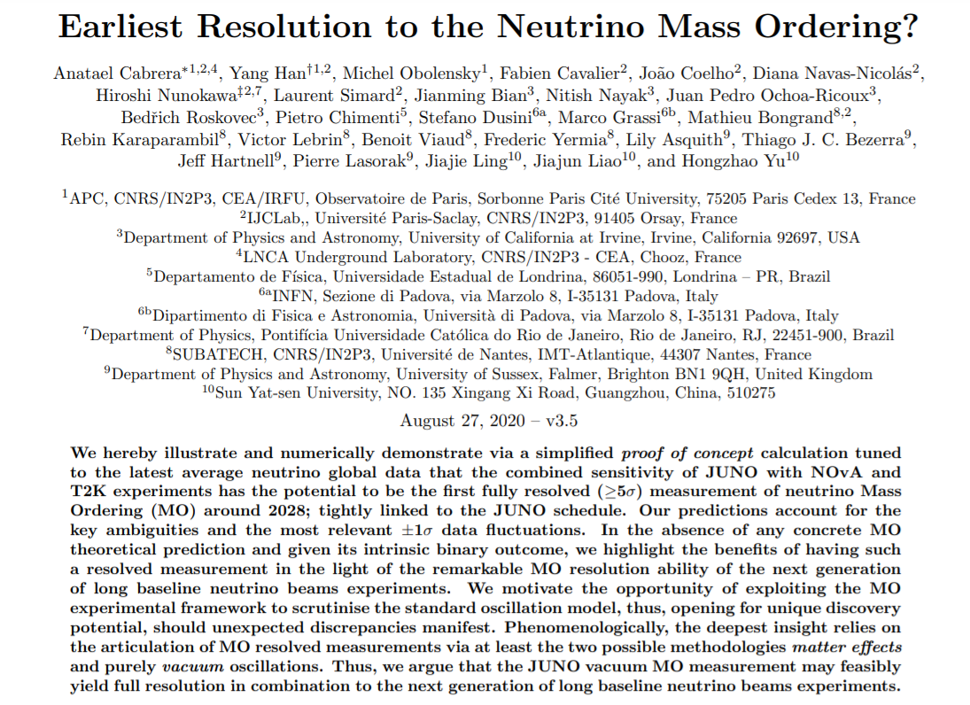
Mostly based on…
https://inspirehep.net/literature/1813376

Slide 3
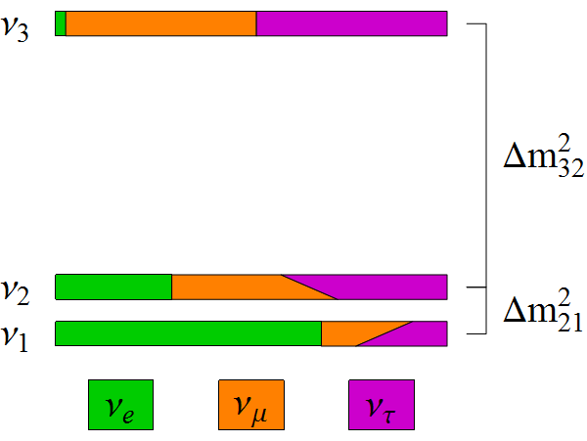
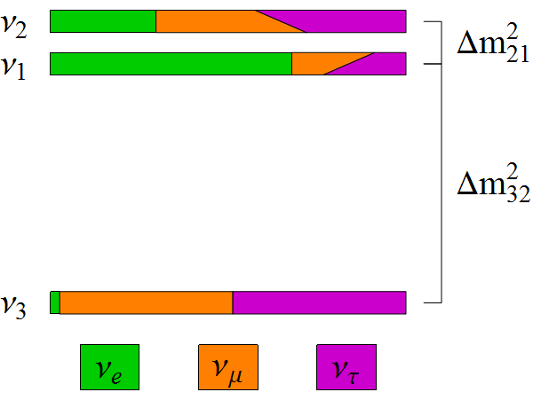
What’s all this about NMO?
Normal Ordering
Inverted Ordering
Which
one
is it?
Neutrino mass implies new physical interactions
Determining the mass hierarchy rules out ~½ of the models of mass generation
Also important consequences for cosmology, 0νββ decay, super-nova astronomy, earth tomography, etc.

Slide 4
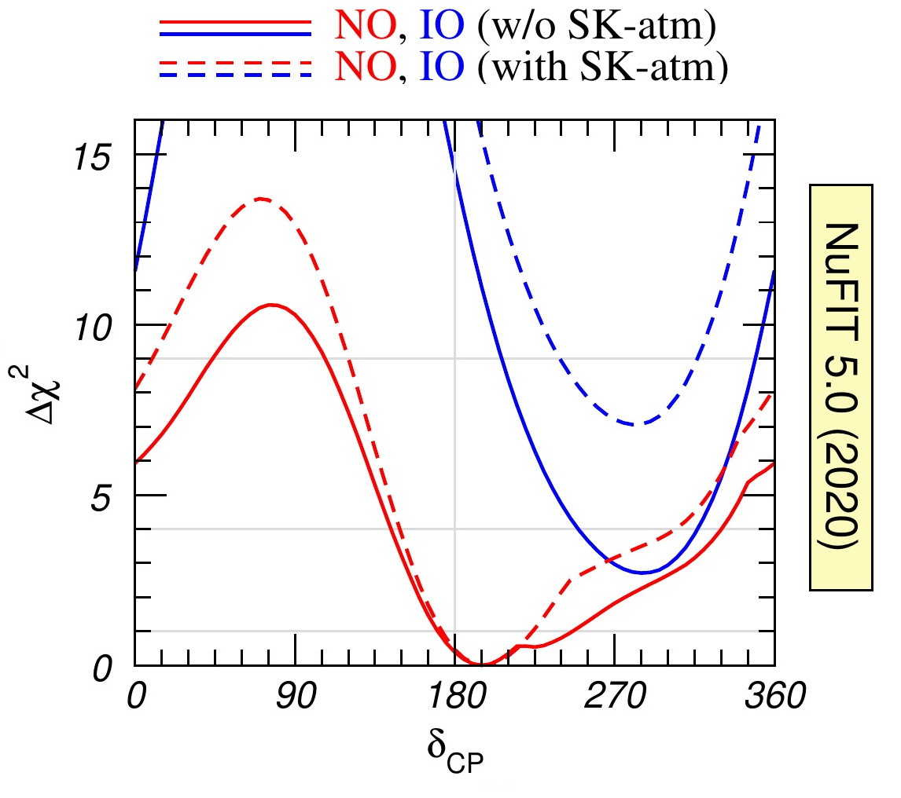
What’s the status of NMO?
New SK data
will push this
down to ~2.5 σ
2.7 σ
nu-fit.org
1.6 σ

Slide 5
How do we know this?
H₀
V
e
Matter
e

Slide 6
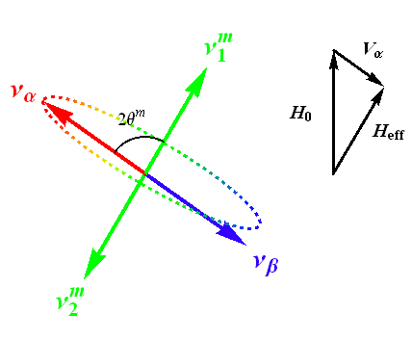
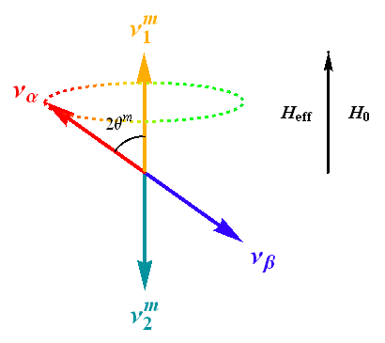
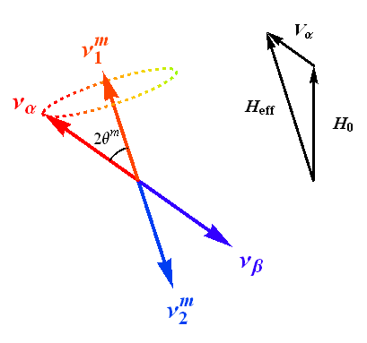
Tilted Oscillations
H_{eff} = H₀ - V_{α}
H_{eff} = H₀ + V_{α}

Slide 7
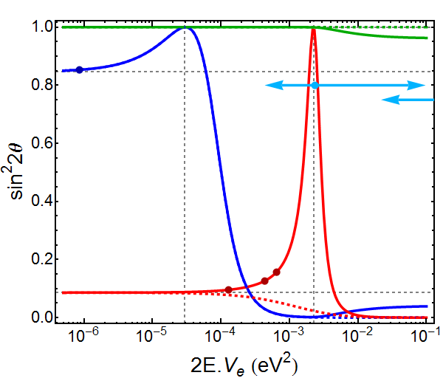
Resonances
θ₂₃
ORCA
JUNO
θ₁₂
DUNE
θ₁₃
NOvA
T2K

Slide 8
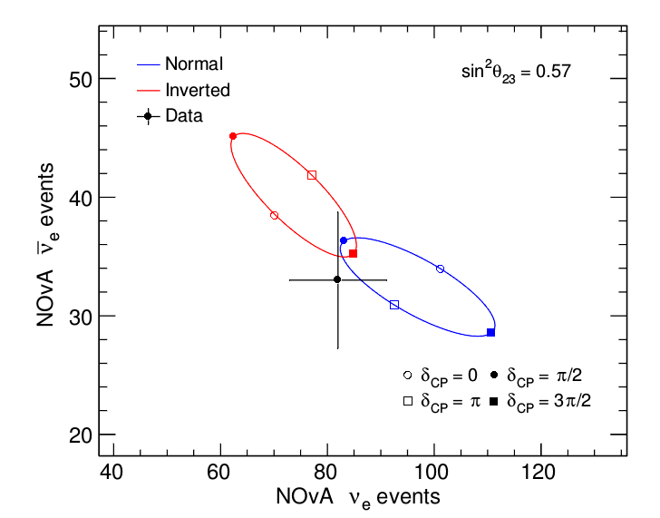
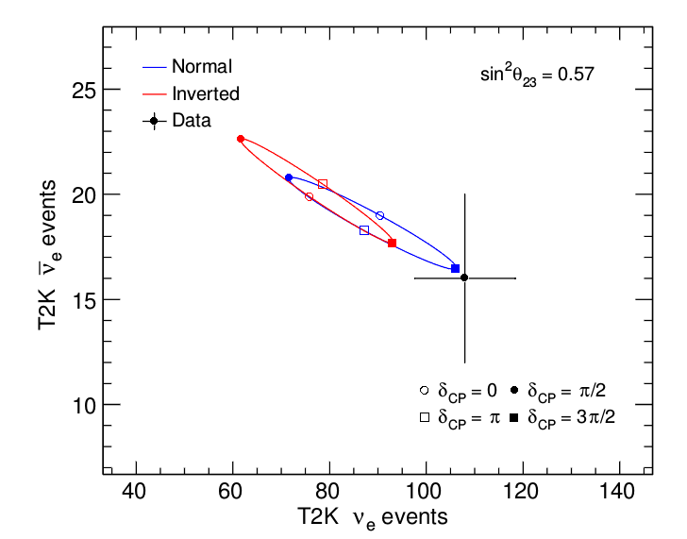
Effect on LBL ν_{e} appearace
NOvA
T2K

Slide 9
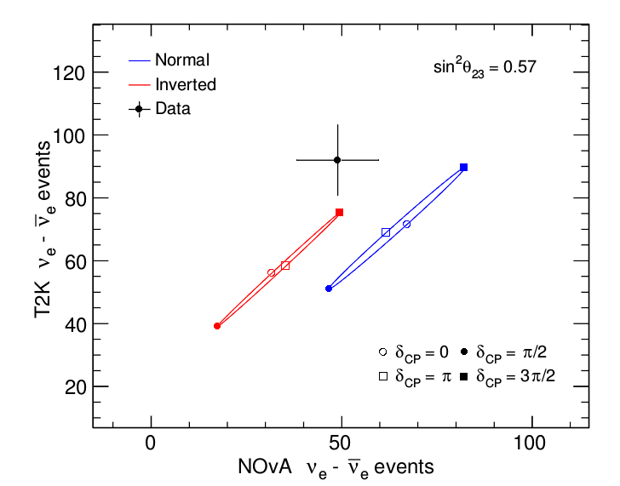
Effect on LBL ν_{e} appearace
Joint view

Slide 10
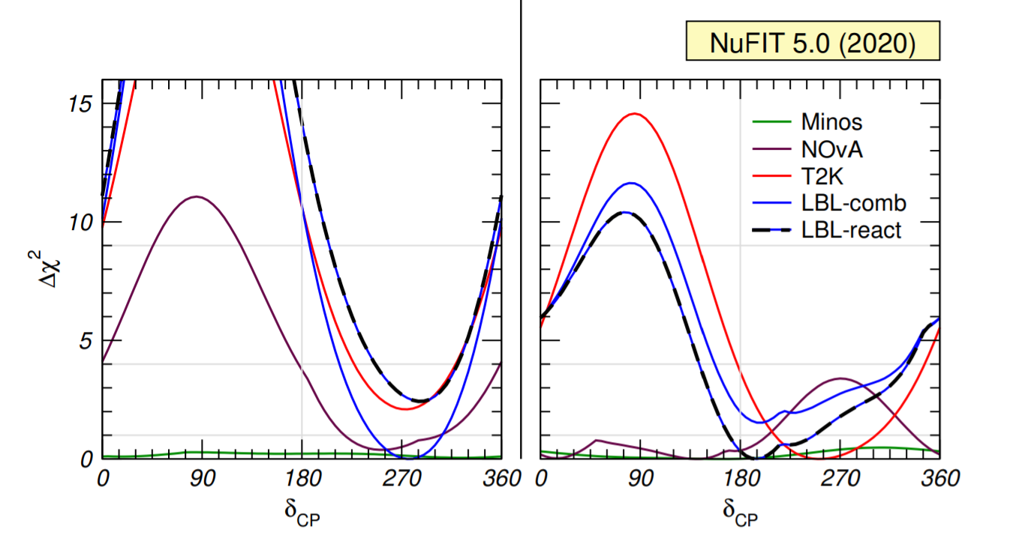
How come NuFIT says Normal?
Inverted
Ordering
Normal
Ordering
1.2 σ
nu-fit.org
1.6 σ
Preference flips!
More on that later…

Slide 11
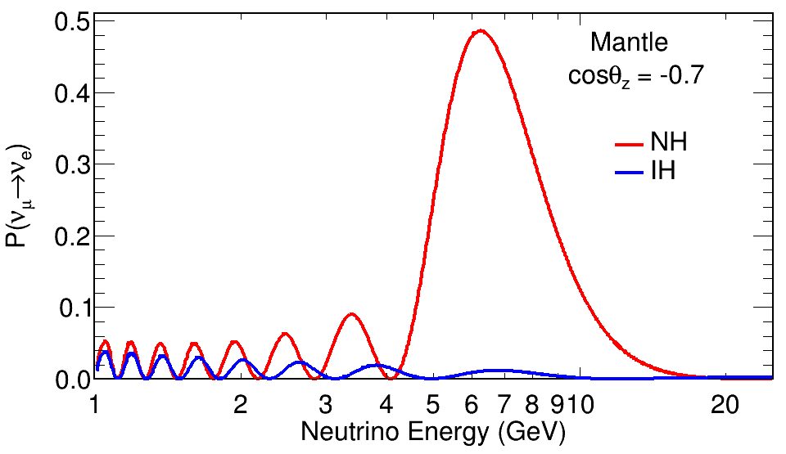
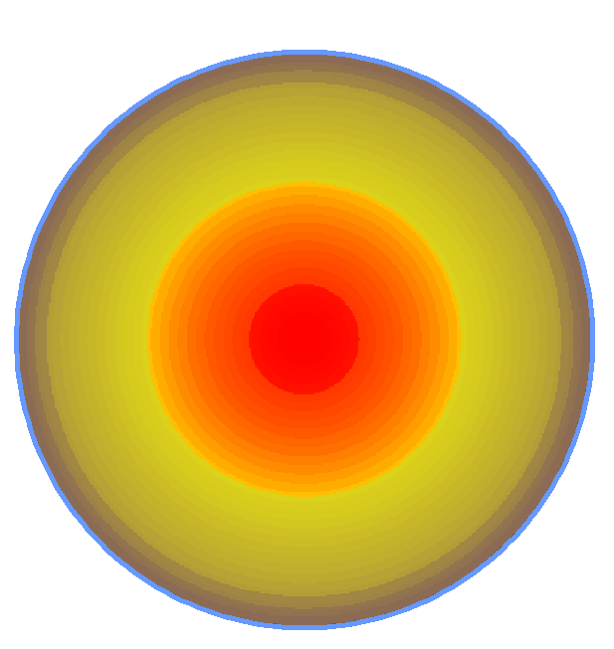
What about atmospherics?
Huge effect for mantle-crossing neutrinos
core
mantle

Slide 12
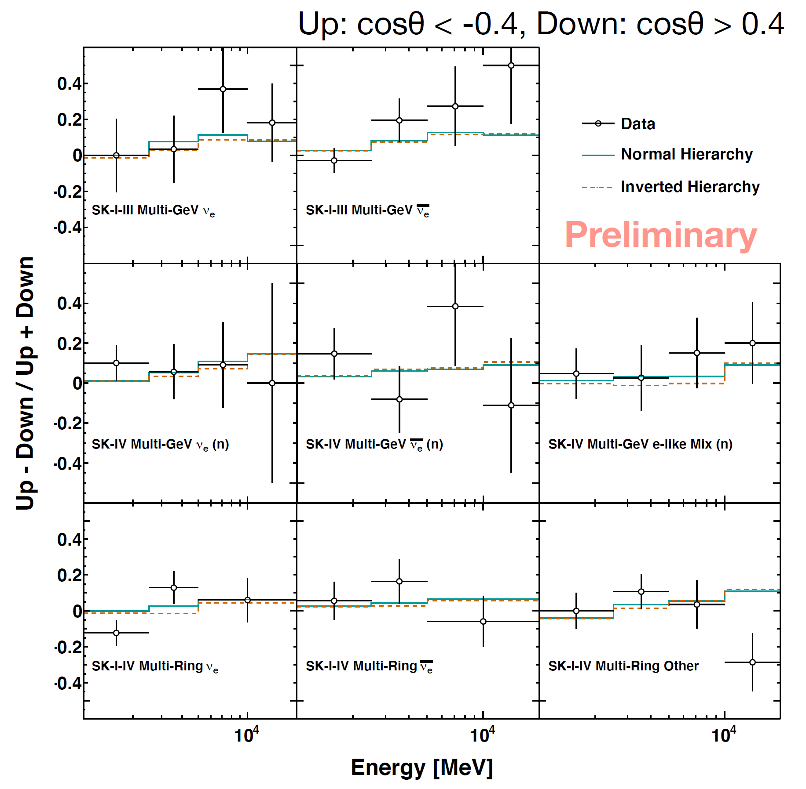
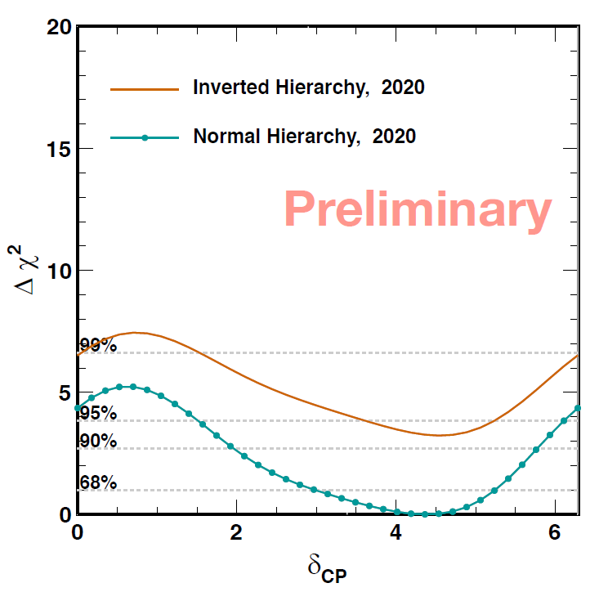
What about atmospherics?
But reality is a lot more complicated
Exposure: 364.8 kton-years
(~16 years)
Super-Kamiokande
1.8 σ
Y. Nakajima – Neutrino 2020

Slide 13
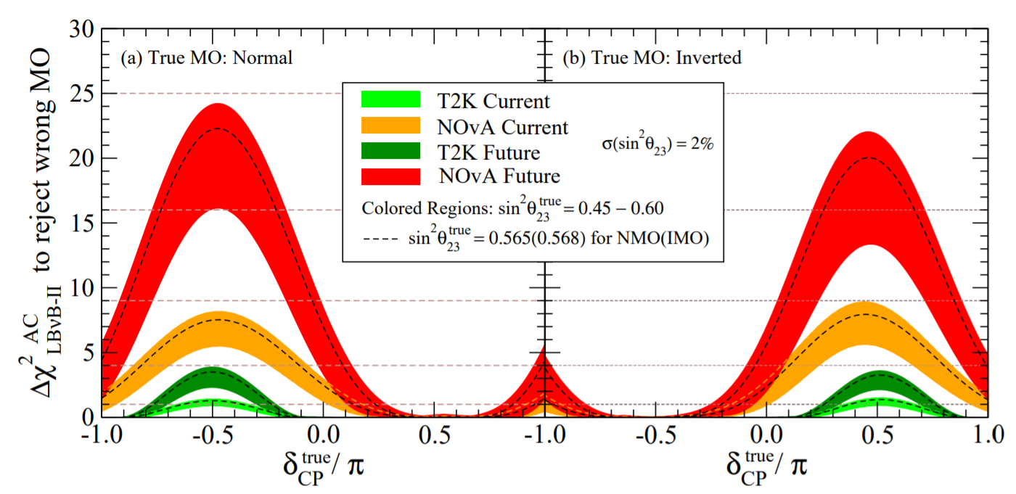
What to expect before DUNE?
Super-K gets diminishing returns after 25 years running
NOvA dominates from LBL, but T2K plays important role
Combined 5σ potential, but not in current preferred region
Max Δχ²: NOvA ~ 23 units, T2K ~ 3 units, SK ~ 3 units
Preferred
Preferred

Slide 14
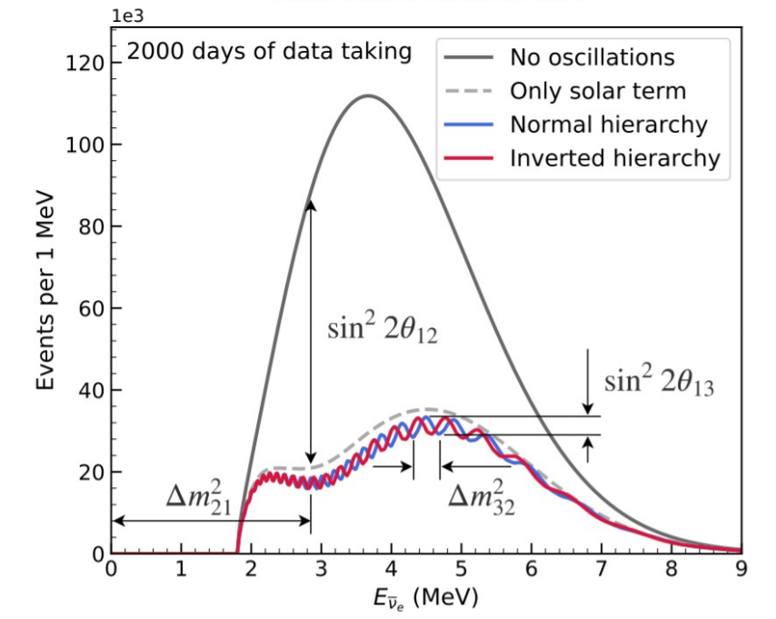
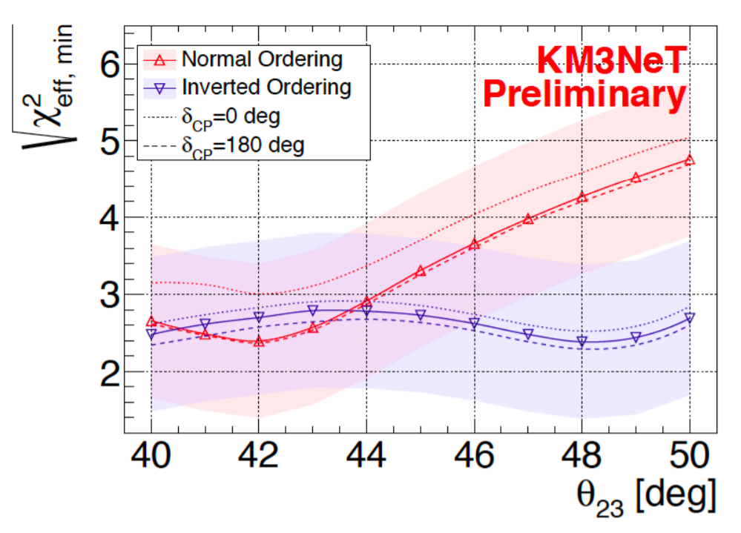
What about the near future?
JUNO ~ 3 σ
ORCA ~ 2.5 – 4.5 σ
(Depending on true ordering)
3 years
CERN Courier
D. Samtleben – Neutrino 2020
At face value, if the true ordering is inverted, not 5σ
Δχ²: NOvA+T2K ~ 0 units, SK ~ 3 units?, JUNO ~ 9 units, ORCA ~ 6-9 units Total ~ 20 units (4.5 σ)

Slide 15
A closer look at NMO in vacuum
NMO

Slide 16
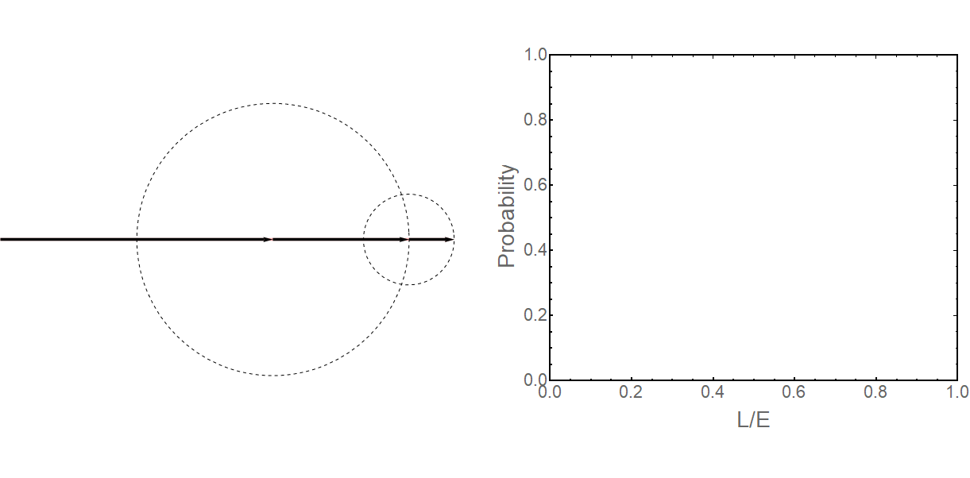
A closer look at NMO in vacuum
(A.U.)

Slide 17
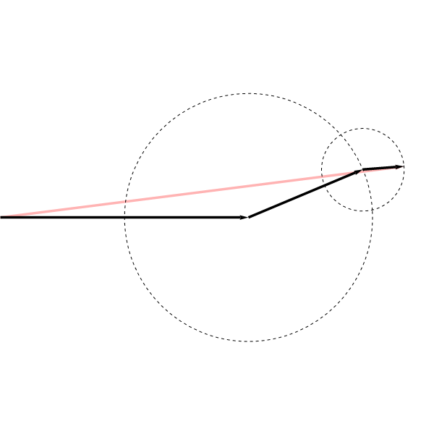
A closer look at NMO in vacuum
Normal Ordering
Inverted Ordering
Slower
More than one turn
to reach maximum
Faster
Less than one turn
to reach maximum

Slide 18
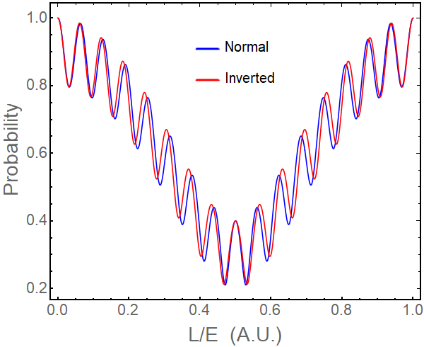
A closer look at NMO in vacuum
NMO can be determined by oscillation frequency
However…

Slide 19
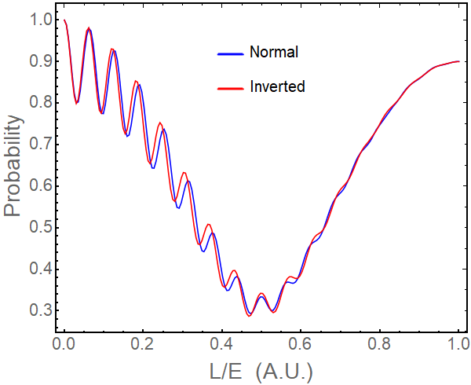
A closer look at NMO in vacuum
NMO can be determined by oscillation frequency
However… energy resolution and…

Slide 20
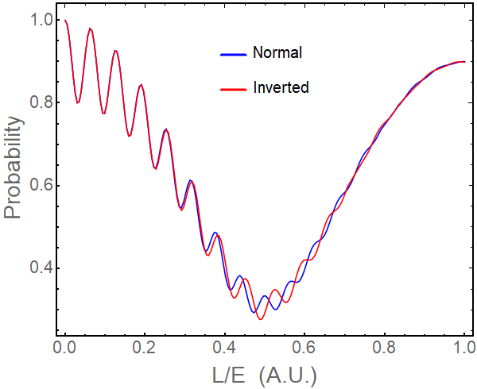
A closer look at NMO in vacuum
NMO can be determined by oscillation frequency
However… energy resolution and… unknown freq. scale

Slide 21
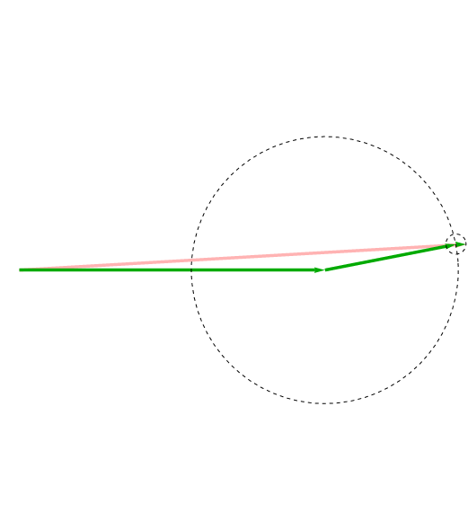
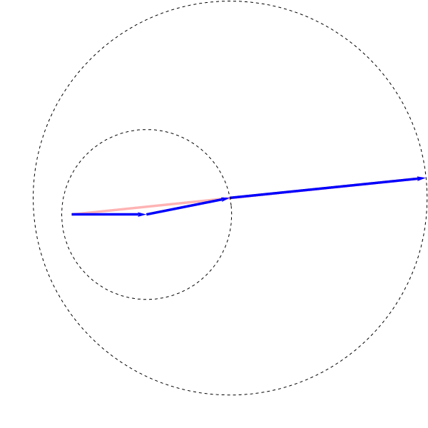
ν_{μ} ↔ ν_{e} synergy
Mixing structure leads to different effective frequencies
ν_{μ}
ν_{e}

Slide 22
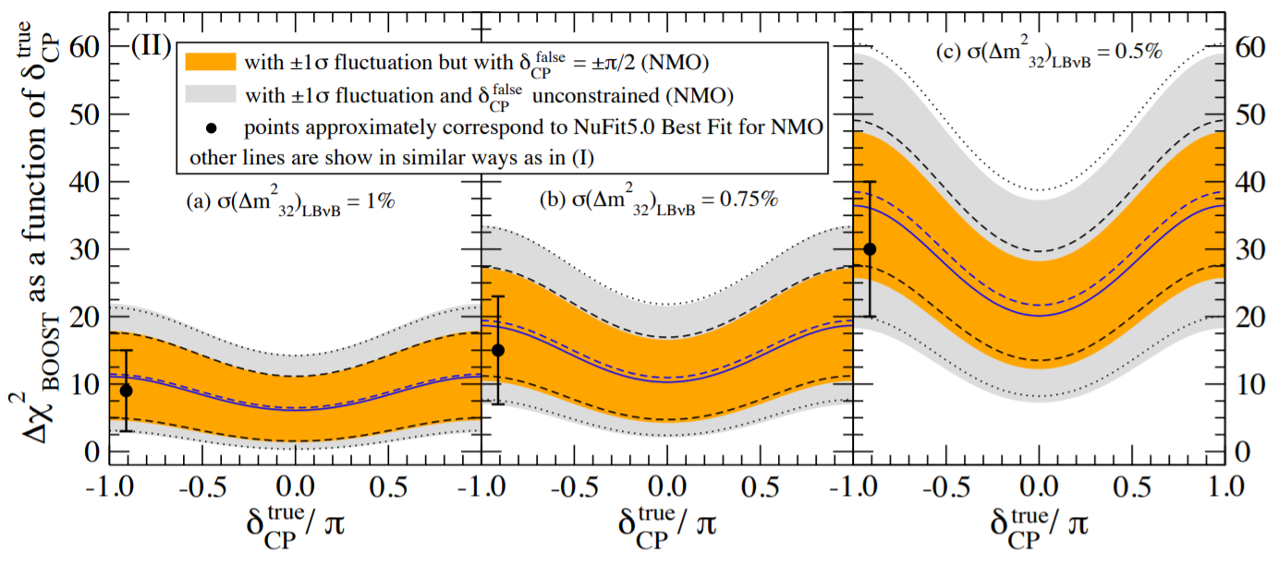
How much do we stand to gain?
Synergy between JUNO and LBL can add 10 – 40 units of χ²
Exploits extra data from LBL disappearance to probe NMO
Effect highly dependent on precision of LBL on Δm²₃₂
Hard
Doable
Easy?

Slide 23
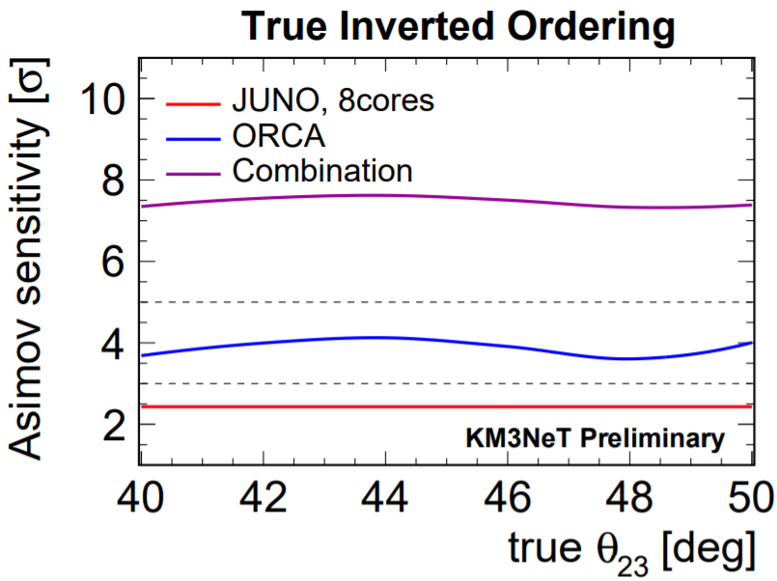
And it’s not just LBL either
Synergies between JUNO and ORCA, for example, can add even more boosting to the NMO determination (~40 units of χ²)
N. Chau – Neutrino 2020

Slide 24
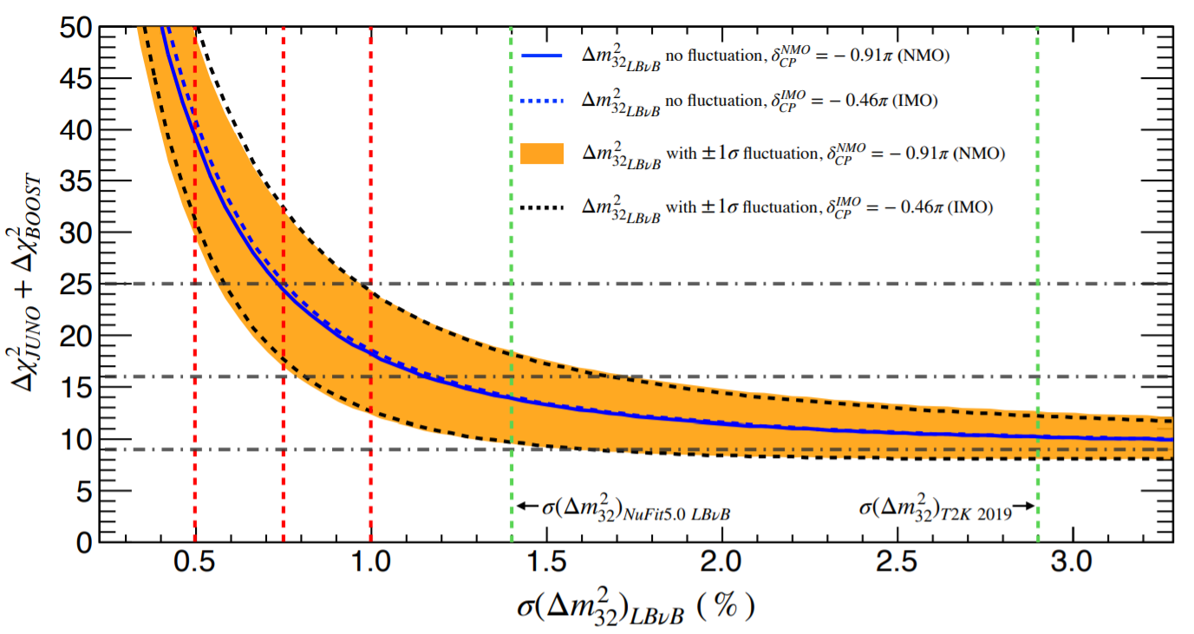
What’s the lesson here?
No single experiment is likely to reach 5σ on NMO by 2028
The ν_{μ} disapp. channel may provide the extra boost needed
LBL and atmospheric experiment should keep in mind the importance of Δm²₃₂ resolution in their future planning
5σ

Slide 25
Thank you!

