Slide 1
A machine learning technique for dynamic aperture computation
17 March, 2021
Mehdi Ben Ghali, Barbara Dalena

Slide 2
Outlook
Introduction
I – Linear Readout Echo-state Network
II – LSTM Echo-state Network
Conclusion

Slide 3
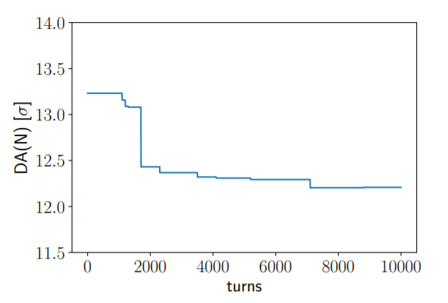
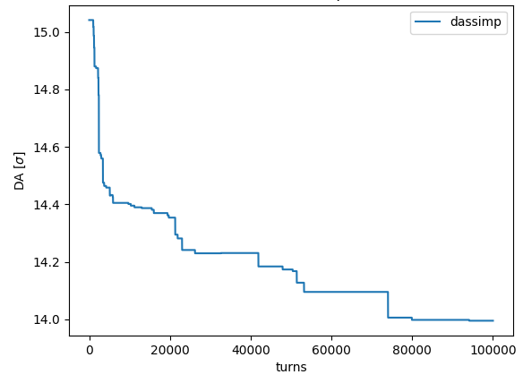
Dynamic Aperture of circular accelerators
-Dynamic Aperture represents the area of stable motion of a particle in an accelerator. It is currently determined using large HPC tracking simulations.
-Datasets provided by tracking simulations
- DA computed for different machines configurations (defined by randomly distributed magnetic field errors), called seeds
- 60 seeds of each type : with DA values for 10000 and 100000 turns respectively

Slide 4
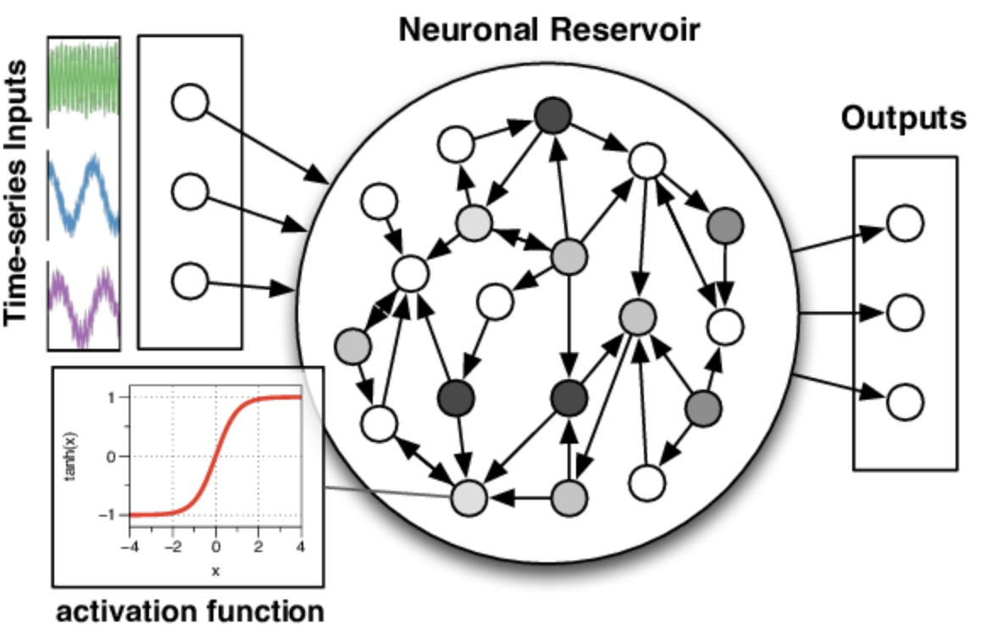
Echo-state Network
-An input is represented by a reservoir “state”, a random fixed representation into a higher space
-Successive reservoir states are then calculated recurrently using previous states and new inputs
-The reservoir output is then obtained using trainable output weights
Output
Update formula
Ridge Regression Readout :

Slide 5
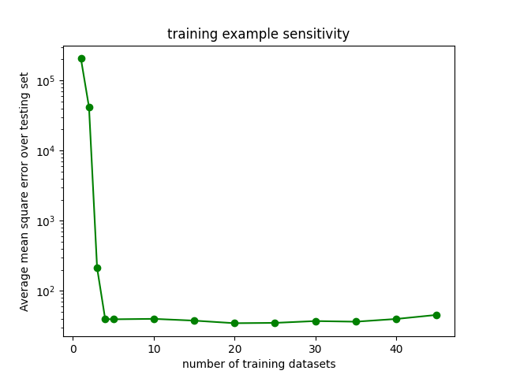
I – Linear Echo-State Network - Training
Traditionally : Use the first points in a series for the training. The remaining points are predicted recurrently from the last reservoir state.
Unsuccessful in our case , so we use a different process :
Weights are randomly initiated, all are fixed except output
Training seeds are reserved
For each training seed :
> Start a new reservoir
> Updated for all data points
> Save states in global state matrix
Training (once) : Compute output
weights using Ridge regression
Prediction (for each test seed) :
> Initiate a new reservoir
> Updating using the first data points of the seed
> Run it “generatively” to predict the remaining points
5

Slide 6
I – Linear Echo-state network – Hyperparameter optimization
Summary
Grid search parameters | pairs | all
Spectral radius | 0.37 | 0.35
Connectivity | 0.95 | 0.8
Leaking rate (a) | 0.04 | 0.25
Tanh leak (t) | 0.35 | 1
Ridge coefficient (lambda) | 5 | 5
Score | 0.094 | 0.086
6

Slide 7
I – Linear Echo-state network – Model customization
New additions :
Teacher-forcing
Data sampling
Fixing random generator seed
Data Scaling
Introducing a polynomial component to the regression
Dropping the first reservoir states
The latter two had a minor effect on performance. Data scaling and teacher-forcing improve performance.
7

Slide 8
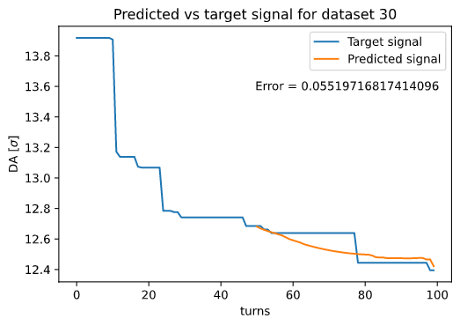
I – Linear Echo-state network – Performance
The model has an improved performance compared to the minimal
With the following parameters :
a = 0.25, t =1
Connectivity = 0.8
Spectral radius = 0.35
250-unit reservoir
[-1,1] min max scaling
teacher forcing
Ridge regression, 5.0 coefficient
20 training seeds, 30 test seeds
Capable of yielding non-linear solutions.
Good average error scores (0.048) (within the error margin allowed for DA applications)
8

Slide 9
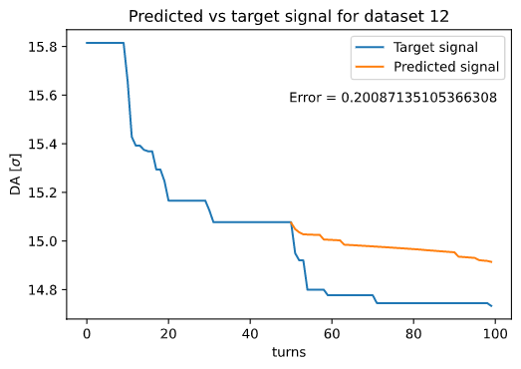
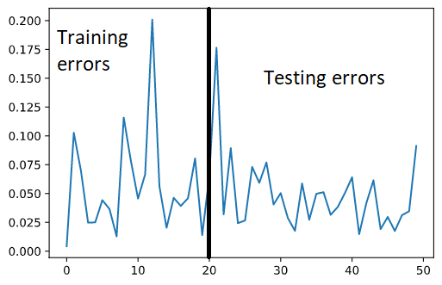
I – Linear Echo-state network – Shortcomings
- Some strong outliers have predictions that are out of target range and make model unreliable for real use cases.
- Comparable training and testing error
9

Slide 10
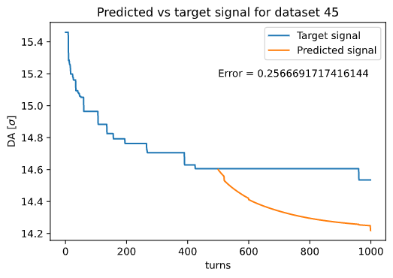
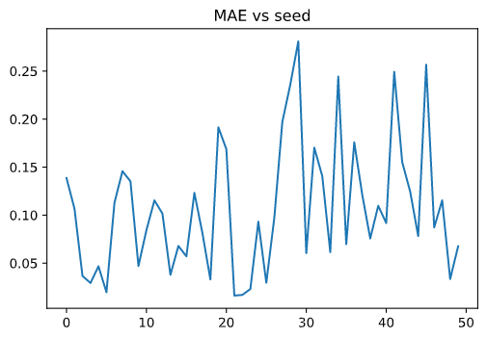
I – Linear Echo-state network – Testing on long seeds
Performance is worse when we run model with long seeds
- Higher error values
- Many of the seeds diverge from real values
With a 20/30 train/test split :
Less error on training data (overfitting)
10

Slide 11
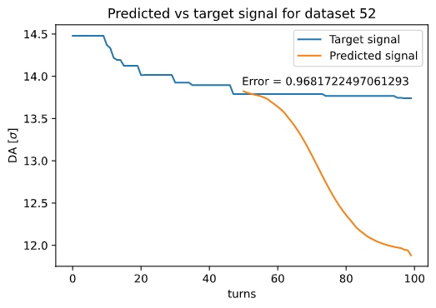
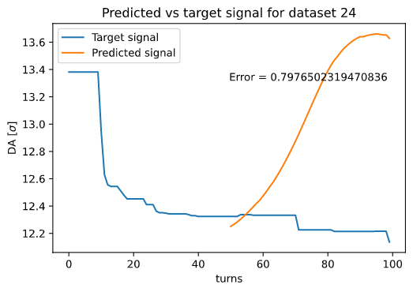
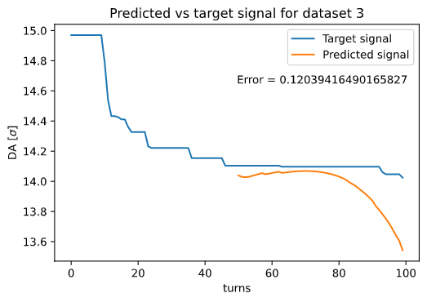
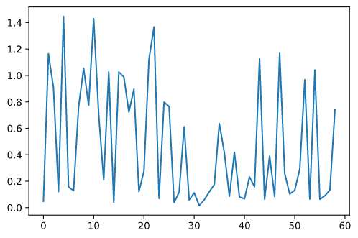
I – Linear Echo-state network – No training seeds
11

Slide 12
II – LSTM Echo-state network
A type of recurrent network the that keeps track of prediction history using a “memory”
In a recent paper¹, a similar structure using reservoirs to track the long-term and short-term history of the model shown great results in predicting time series data.
We reproduce the principle with the following architecture :
> A short-term reservoir : At one reservoir step, initiated using past n inputs and updated n times before being used to compute current state
> A long-term reservoir : Only updated every few steps using the last long state and output
> A regular reservoir
States are then stacked, and used for training and prediction
(1) K. Zheng, B. Qian, S. Li, Y. Xiao, W. Zhuang and Q. Ma, "Long-Short Term Echo State Network for Time Series Prediction," in IEEE Access, vol. 8, pp. 91961-91974, 2020, doi: 10.1109/ACCESS.2020.2994773.
12

Slide 13
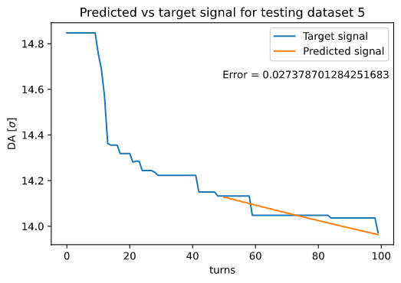
II – LSTM Echo-state network – Overall performance
Model almost only results in linear predictions.
More training than test error.
To achieve better performance than the regular reservoir model, we need a lot of training examples (50 seeds). A 50-50 split results in comparable performance to previous model, only linear.
This means we use a lot of data to make only a few predictions.
13

Slide 14
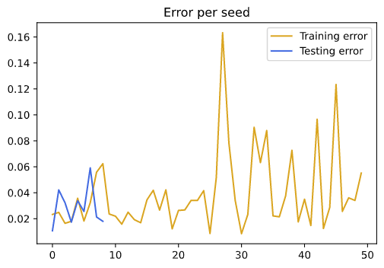
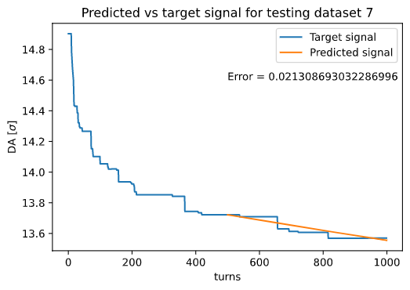
II – LSTM Echo-state network – Prediction on long seeds
- The best performance on long seeds yet
- Even lower testing error than on short seeds : this could be explained by the fact that the LSTM model responds well to more data
But :
- Higher training error than shorter seeds (meaning specific seeds still influence prediction)
14

Slide 15
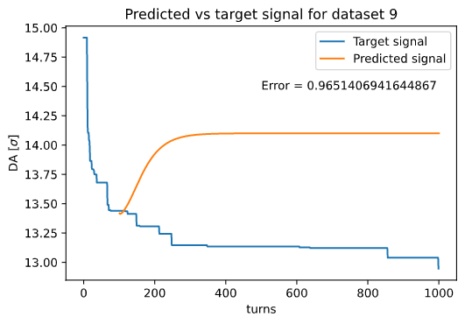
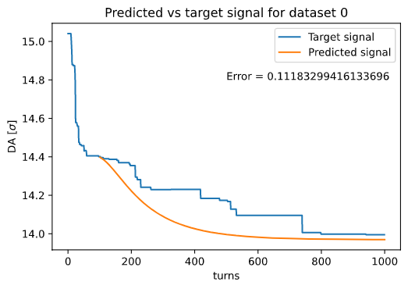
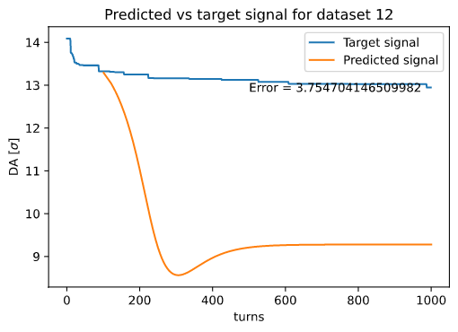
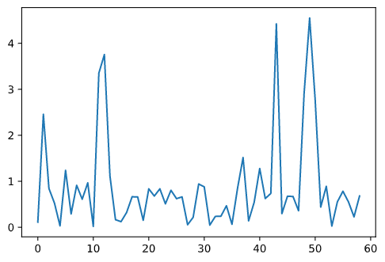
II – LSTM Echo-state network – No training seeds
15

Slide 16
Conclusions and perspective
ESN shows strong potential for dynamic aperture computation.
DA data scarcity limits technique effectiveness however. A model which does not need as much data as current examples must be achieved.
In the future :
Benchmark model on reference time series data
ANN readout layer
Several réservoirs for one seed
Try time series decomposition solutions with current models (statsmodels tsa library)
16

Slide 17
Merci de votre attention

