Slide 1
Considerations for timing precision of solid state devices
in trackers at future e-e collider experiments
FCC-France workshop, Annecy, December 2 - 2021
D. Contardo, IP2I, with help of A. Besson (ILC), D. Dannheim (CLIC), E. Perez (FCC-ee)

Slide 2
Outline
Timing precision current assessment at different e-e collider projects
Possible timing implementations (State of Art)
Outlook on timing optimization studies

Slide 3
ILC timing precision - current assessment
Beam Induced Background at 250 GeV https://arxiv.org/abs/2003.01116
e-e incoherent pair creation rates dominate at low p_{T} in Vertex Detector
𝛾𝛾 hadrons p_{T} ≤ 2 GeV in Central Tracker at low rates
8 BC background overlay maintains reconstruction performance
1 µs integration window - 2 BX for x4 Safety Factor
Hit rates ≃ 50 MHz/cm² within Bunch Trains (inner VD layer r= 1.6 cm, x4 SF) & ≃ 180 kHz/cm² average
Triggerless readout
Case for sub-µs timing
Further BIB rejection in VD - to approach Beam Line?
PID at low p_{T} with ToF in VD/CT? – scale ≤ 100 ps*
ILC
* ≃ 10 ps @ 2m provides ≥ 3𝜎 _{π/K} separation for p_{T} ≤ 5 GeV - effect of Multiple Scattering on p_{T} resolution to be considered

Slide 4
CLIC timing precision - current assessment
Beam Induced Background at 3TeV https://arxiv.org/abs/1202.5940
e-e incoherent pair creation dominates with low p_{T} dominates in Vertex Detector
𝛾𝛾 hadrons p_{T} ≤ 5 GeV in Central Tracker at low rates
20 BC background with x 5 SF at 3 TeV maintain reconstruction performance
10 ns integration window
≃ 5 GHz/cm² hit rate within BTs (inner VD layer r=3 cm), x5 SF) & ≃ 44 kHz/cm² average
Triggerless readout
Case for sub-ns timing
Further BIB rejection in VD to approach Beam Line?
PID at low p_{T} with ToF in VD/CT? – scale ≤ 100 ps*
Bunch train
BX 0.5 ns
CLIC
* ≃ 10 ps in outer layer for 3𝜎 π/K separation at 2m up to 5 GeV - effect of Multiple Scattering on p_{T} resolution to be considered

Slide 5
FCC-ee timing precision - current assessment
Beam Induced Background https://arxiv.org/pdf/1911.12230.pdf
e-e incoherent pair creation dominates with low p_{T} dominates in Vertex Detector
𝛾𝛾-hadrons p_{T} ≤ 2 GeV in Central Tracker at low rates
50 BC background with x5 SF at Z–peak maintain reco. performance
1 µs integration integration window
≃ 20 MHz/cm² (inner VD layer r = 1.7 cm, x5 SF)*
Triggerless readout, possible but may affect X/X₀ (trade-off with high precision acceptance)
Case for sub-µs timing (BC spacing 20 ns)
Further BIB rejection in VD to approach BL, to improve multiple vertices ID in flavor physics?
Sub-BC (collision time spread is ≃ 40 ps –set a precision scale ≃ 10 ps**
@ Z-peak, 100 kHz of Z is 0.1 Pile-Up within 1 µs, total energy and vertex precision (≃ 300 µs) should allow to identify PU events and separate vertices – interest to study potential effect of track overlaps in benchmark final states
Could allow check of CM energy spread in head-head, middle-middle , tail-tail collisions
PID at low p_{T} with ToF in VD/CT? – scale ≤ 100 ps***
* May become critical closer to the BL → already foreseen to be reduced to ≃ 1.2 cm = x 2-3 rate increase
** Doesn’t necessarily requires timing within VD/CT
*** ≃ 10 ps in outer layer for 3𝜎 π/K separation at 2m up to 5 GeV - effect of Multiple Scattering on p_{T} resolution to be considered

Slide 6
Chip examples O (µs) and O(ns) precision scale
MIMOSIS (CBM) MAPS 180 nm TowerJazz (A. Besson LCWS 2021 https://indico.cern.ch/event/995633/)
Similar as ALPIDE (ITS), synchronous data driven architecture
Zero suppression with priority encoder in pixel matrix
Data concentration (buffering) in digital part at periphery
5 µs integration, peak rate 70 MHz/cm² (≥ 2 Gbps per chip of 4.2 cm²)
Power consumption 40-70 mW/cm²*
Close to baseline ILC and FCC specs,
Transposition to 65 nm TJ started (CERN WP1.2), target 25 mW/cm²
CLICTD MAPS 180 nm TJ https://cds.cern.ch/record/2751113
30 x 35.7 µm² pitch - 30 µm epitaxial layer thinned to 40 µm
10 ns timing with ToA (8 bit) and ToT features (or of 8 channels)
𝜎_{t} ≃ 6 ns - 𝜎_{hit} ≃ 5 µm (ToT allows CoG estimate)
TimePIX evolution foreseen in 65 nm TJ, target ≤ 50 mW/cm²
average with power pulsing**
MIMOSIS
504 x 1024 pixels = 16 super regions
1 super-region = 4 read-out regions of 16 double columns
* 20-50 mW/cm² ballpark for gas-flow cooling
** Power pulsing reduction also applies to ILC see back-up slide

Slide 7
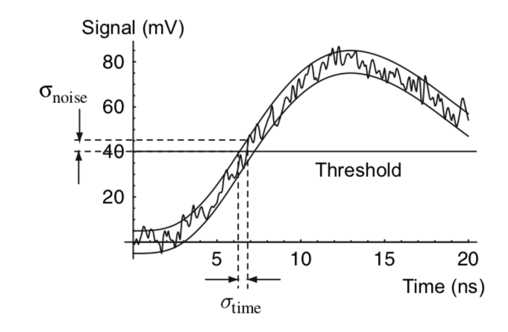
Technology considerations O(100ps) precision scale
σ_{t} = σ_{sign} ⊕ σ_{elec} = σ_{sign} ⊕ σ_{jitter} ⊕ σ_{time-walk} ⊕ σ_{TDC} ⊕ σ_{clock}
Sensors w/o amplification
Planar large electrodes limited by Landau fluctuation (σ_{sign}) & S/N (σ_{jitter})
Planar small electrodes limited by Landau fluctuation & pulse shape variation with hit distance to electrode (σ_{sign})
3D large electrodes limited by S/N (σ_{jitter}) (no Landau fluct. crossing // to elect.)
Sensors w/ low amplification
LGADs limited by Landau fluct. worse than w/o ampl. but S/N (σ_{jitter}) reduced
Sensors w/ avalanche amplification
SPADs-like to minimize Landau fluctuation at high S/N for σ_{t} ≤ 10 ps?
Time over Thres.
t₀
CERN EP seminar W. Riegler: https://indico.cern.ch/event/1083146/

Slide 8
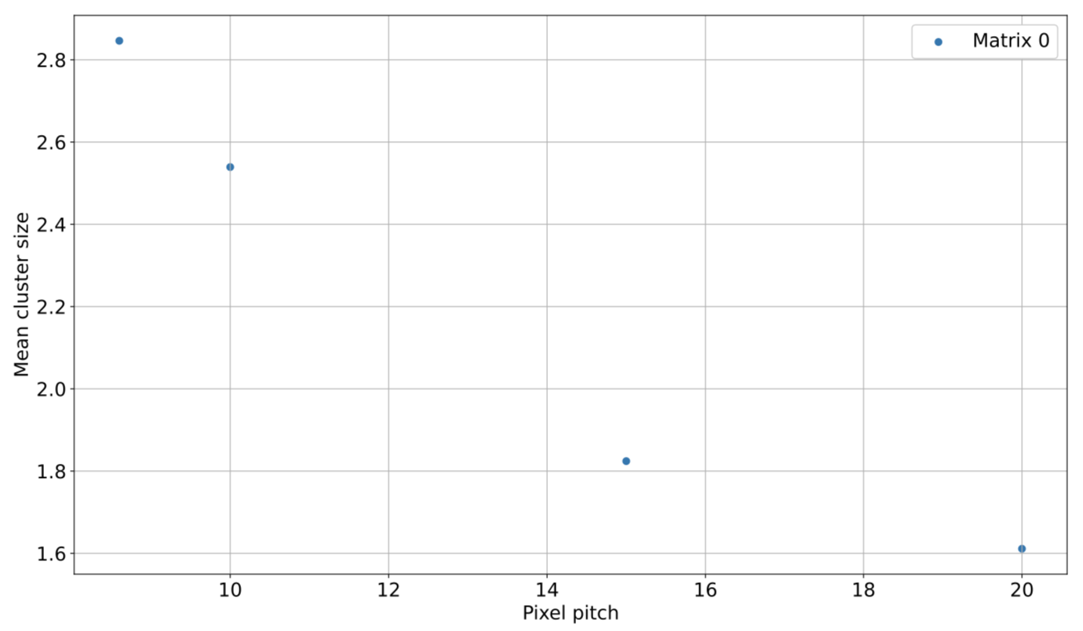
Chip examples for O(100ps) scale
Hybrid planar sensor (large electrode)
σ_{t} ≤ 70 ps for S/N ≥ 10 (ultimate ≃ 10 ps) CMS diode test
NA62 hybrid design VD achieved ≃ 115 ps
Hybrid 3D sensors (large elctrodes)
TimeSpot achieved 𝜎_{t} ≃ 20 ps @ 150 µm thickness 50 µm pitch
MAPS large electrodes
Cactus 150 nm LFoundry 1mm² pads, target ≃ 60 ps @ 100 µm thickness
MAPS small electrodes 180 m TJ*
FASTPIX small elec. (D ≃ 2 µm) most advanced doping profile and hexagonal
geometry achieved 𝜎_{t} ≃ 120(140) ps - 20(10) µm pitch epi layer ≤ 30 µm
LGADS
ATLAS/CMS achieved 𝜎_{t} ≃ 30 ps @ 50 µm thickness 1.3 mm² pads
FASTPIX
FASTPIX
* MAPS best candidate for high position precision @ lowest X/X₀ – possible room for improvement of 𝜎_{t} in sensor design
In CT, sensor thickness is not the dominant factor of X/X₀ (cooling, printed boards, mechanics…)

Slide 9
Outlook on timing optimization studies
Reconstruction with x5 SF works well with 1 µs @ ILC - FCC-ee and 5 ns offline @ CLIC
trade-off for higher precision is to maintain (improve) IP and/or p_{T} precision (master X/X₀)
Case for higher precision
Improved IP precision with smaller inner layer radius - understand if higher occupancy closer to BL can be tolerated and/or if improved 𝜎_{t} would be needed/beneficial, at which scale?
Physics case that could benefit from lower background in reconstruction (VD), at which time scale?
Physics case for low p_{T} PID within CD O(≤100) ps
Pile-Up mitigation at FCC-ee that could benefit from sub-bunch crossing resolution O(10) ps for low p_{T} tracks (eg within CT rather than at periphery)
Experimental performance - best effort approach
Model (map) power consumption with granularity and timing precision (as a function of rates)
Check effect of rates in triggerless readout at FCC-ee
Model impact of power consumption on cooling (X/X₀)
Airflow cooling at FCC-ee challenging, power pulsing could allow release power constraint in inner layers at ILC - CLIC
Model system scenarios including sensor technology & design (electrode size & pitch/thickness…) considering position/timing precision trade-off

Slide 10
Power considerations ex. MIMOSIS A. Besson this meeting

