Slide 1
CTA_Archive status
Frederic GILLARDO, Berkay Turk
Lapp/CNRS
01 Decembre 2020

Slide 2
Presentation ESCAPE
Au LAPP, nous réalisons un POC pour l’implémentation de l’archive de CTA dans le cadre d’un projet européen : ESCAPE (escape2020.de)
Le but de ESCAPE : Permettre à plusieurs expériences (HL LHC, SKA, Virgo, LSST, …), ayant des besoins similaires dans le domaine de l’archivage de données, de mutualiser leurs ressources humaines et leurs infrastructures afin d’implémenter et tester un concept de ‘DataLake’.
Notes:
Besions similaire :
Volume / fichier et de donnée (plusieur PB million fichier)
Production onsite (SKA, LSST)
Regle de replication
QoS (tape)
Authentification …

Slide 3


Today’s DataLake deployment
RUCIO for ATLAS 440 PB in 2018
In the LAPP we support 3 end points of storage : dCache, DPM, and a light solution (designed to be the ‘onsite’ storage end point)

Slide 4
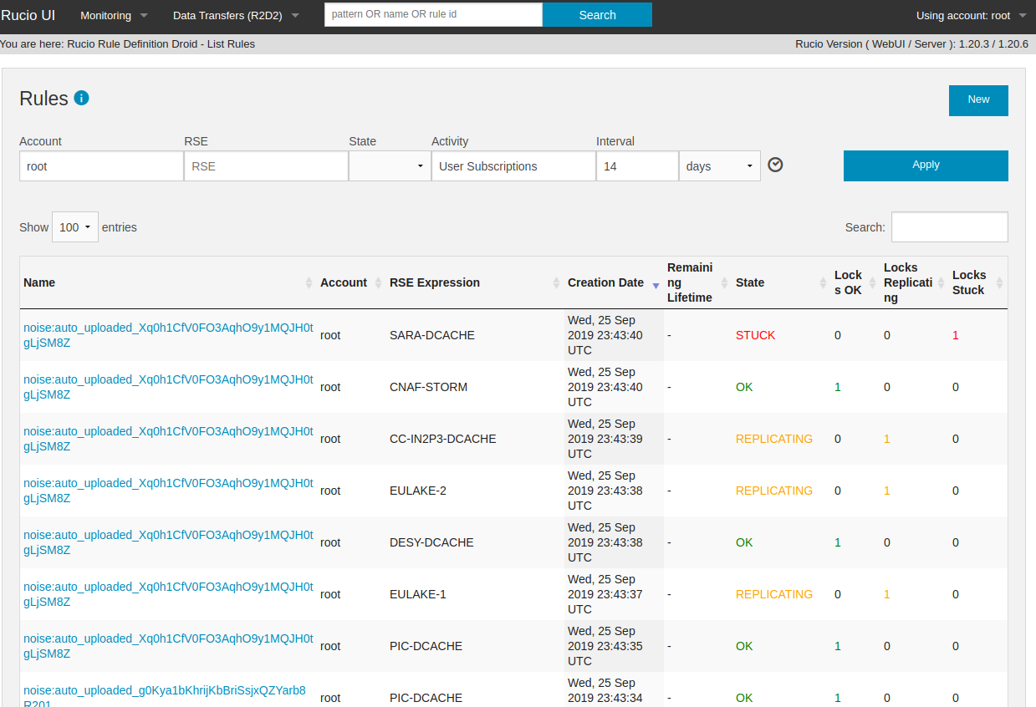
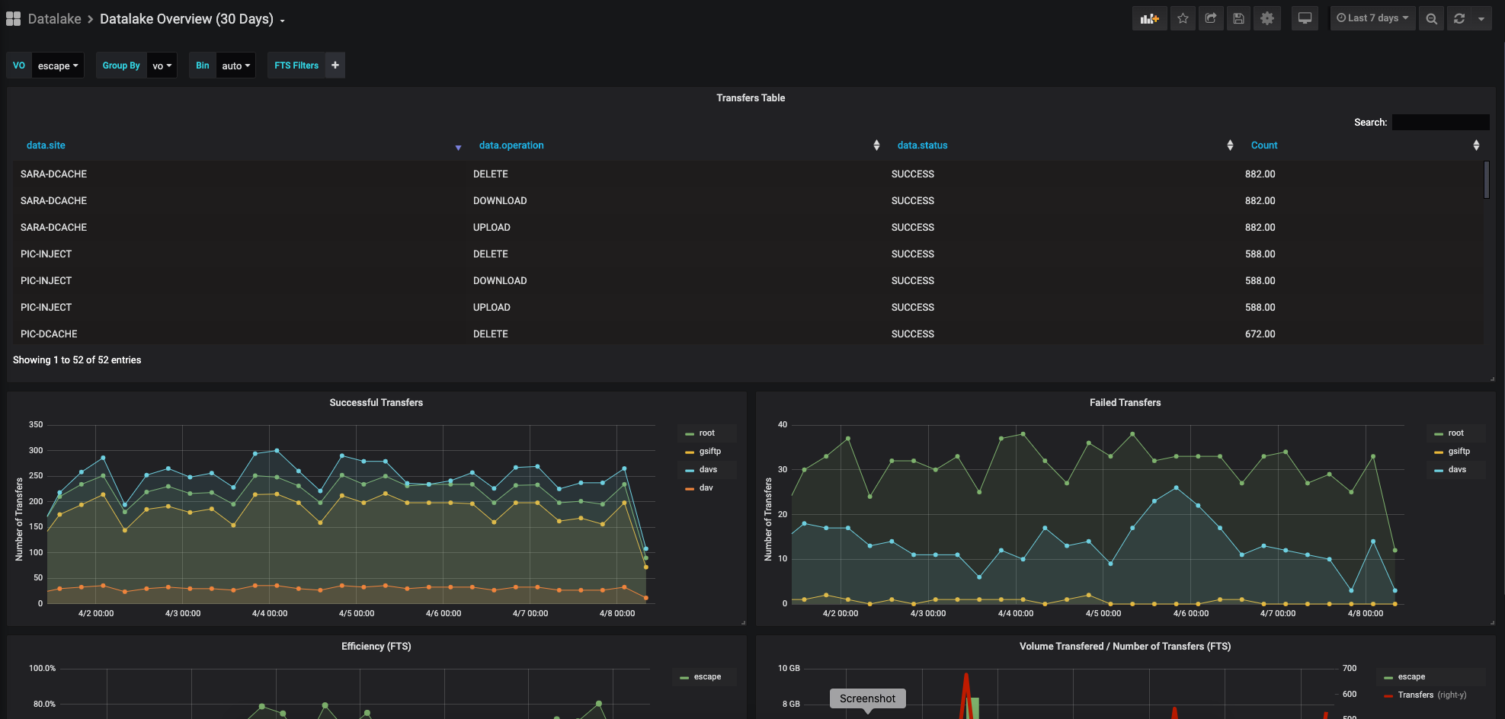
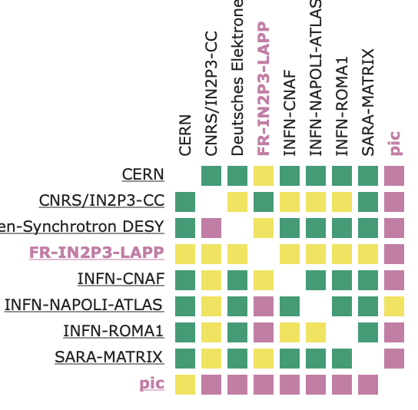
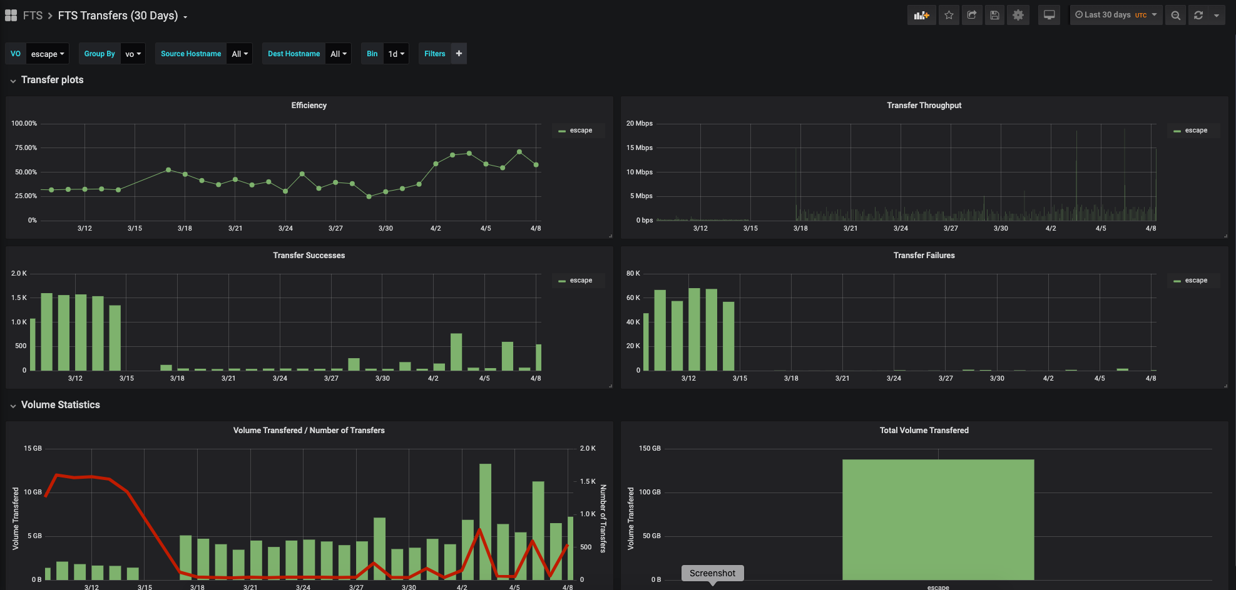

Monitoring from datalake
Rucio WebUI as interface for ESCAPE users
ESCAPE DataLake dashboard
FTS dashboard
low level network monitoring

Slide 5
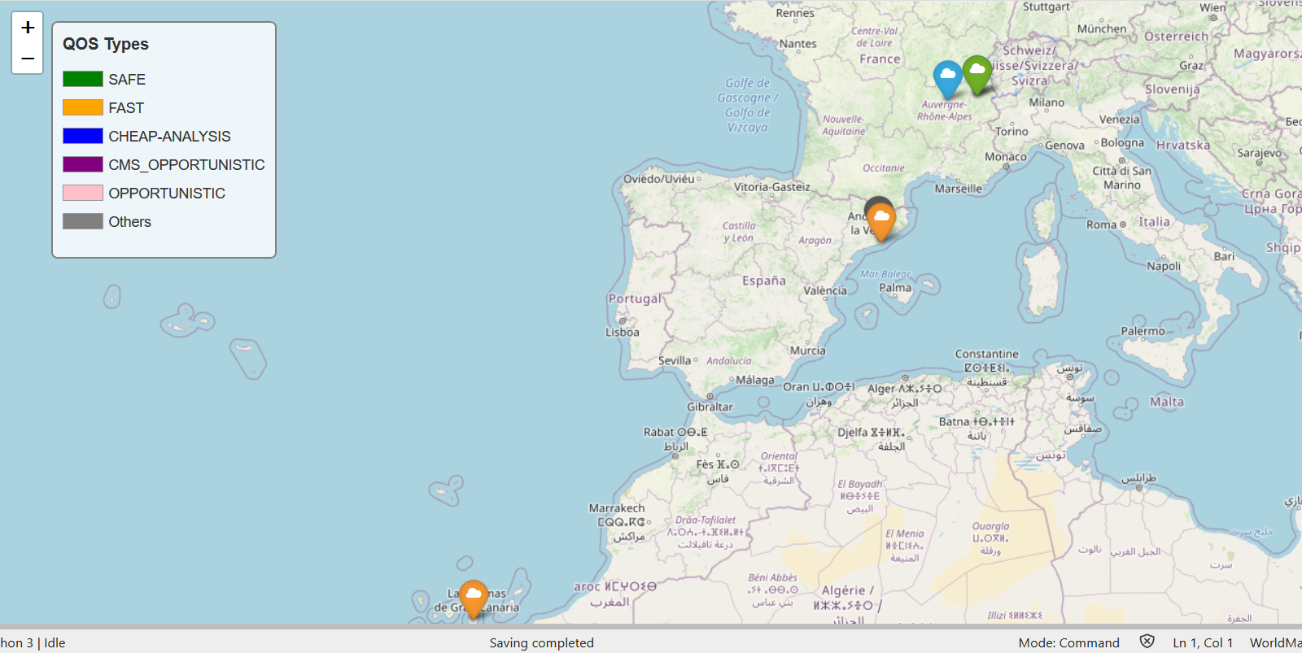
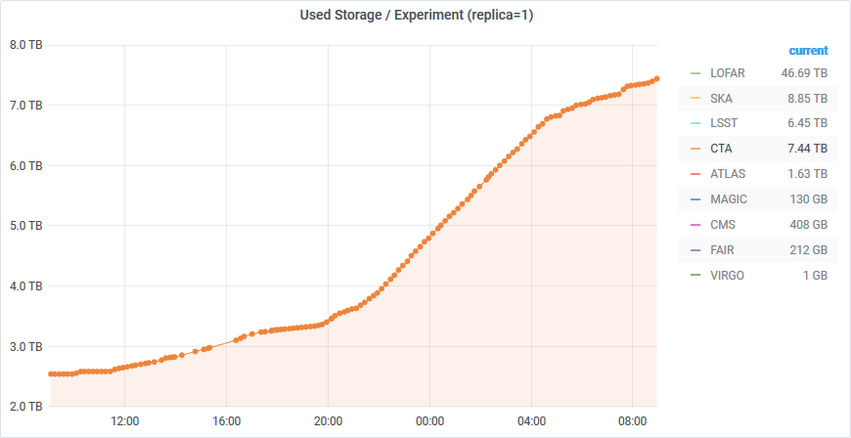
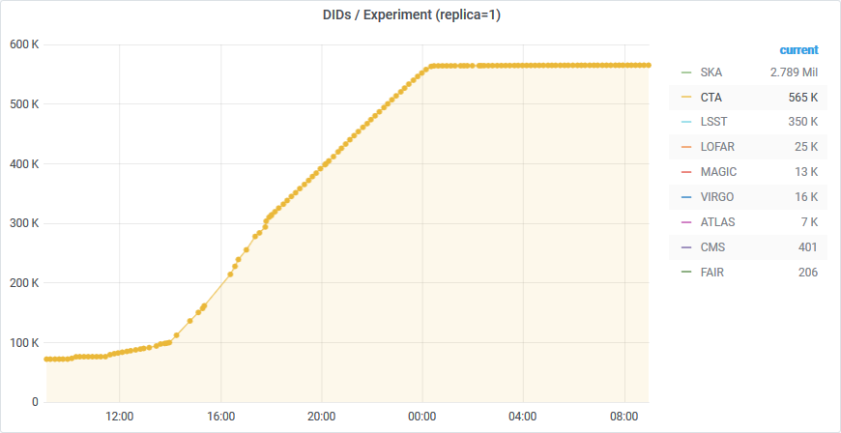
First data challenge 17/11/2020
Simulation of ingest for ~ 1 night of data from one site (5,5TB, 500 000 files):
All experiments :
  73 TB
  3,5 Millions de fichiers

Slide 6
Road Map
Phase 1 : Test if the DataLake interface can implement the CTA’s archive interface:
  Targeted date : end Q2 2020
  Ingest : Done
  manage metadata to file : Blocked with current version of RUCIO
  Replication policy : Done
  OpenID authentication: Not yet tested
  Retrieve files : Done
Phase 2 : use the DataLake ‘s interface in in batch job to pull and push files using a Singularity container
  Targeted date : end Q4 2020
  Data challenge : Use storage resources from LAPP, CC-IN2P3, PIC
  Archive jobs are executed on MUST ressources using htcondor as job manager
Phase 3 : use Dirac with the DataLake interface (RUCIO/DIRAC integration)
  Targeted date : end Q1 2021
  Using the DIRAC instance from the CC-IN2P3
Phase 4 : use CTA partners infrastructures
  Targeted date : end Q2 2021
  Setup a datalake end point in La Palma for the ingest operation
  Execution of CTA pipe

