Slide 1
The Hyper Kamiokande WG4
Time Distribution System

Slide 2
A little History
The R&D has started on April 2019 when IN2P3 presented the CDR concept
The University of Tokyo was developing a solution based on a concept used in Super Kamiokande (direct solution)
During the HK collaboration meeting (Feb. 2020) INFN joined the effort and the three institutes have decided to work together.
Since then, there is only one R&D program and a commitment to work together on the selected item

Slide 3
Time Distribution basics and constraints
All the PMTs in the far detector have to be synchronized to reconstruct the particles interaction events from their signals. For that it is needed:
A very stable local clock
A time reference accorded to the UTC
A method to distribute them to all the Front End boards
A bidirectional communication channel for critical slow control

Slide 4
Time Distribution Requirements
Preliminary version. To Be Approved
The final tests have to be done on an engineering prototype connected to at least 2 FE board or their surrogates

Slide 5
Proposed Architecture
The time distribution system consists of 2 main parts:
A system that generates the local time base correlated to the Universal Time Coordinated (UTC).
A distribution network that delivers the clock to all the front-end nodes and establish a communication link for critical slow control.
The R&D is carried out by IN2P3 (FR), INFN (IT) and Tokyo University (JP)

Slide 6
The Local Time Base
This study is performed in collaboration with SYRTE Lab, part of the Paris Observatory (https://syrte.obspm.fr)

Slide 7


GNSS/UTC – Key components
Time distribution
GNSS receiver
Atomic
clock
Atomic Clock
Multi GNSS receiver and Antenna
Distribution system between Atomic Clock and GNSS receiver
Software correction for UTC correlation

Slide 8
Atomic Clock
Time distribution
GNSS receiver
Atomic
clock
The atomic clock is the foundation of the local time base
Needs to be as stable as possible
A good tradeoff between cost and performance is a “Passive Hydrogen Maser”
  Frequency stability: 5⁻¹³s @ 1s, 4⁻¹⁵s @ 1day
  Jitter equivalent: 0.5 ps on RF signals, <40 ps on PPS
  Frequency Drift: 1⁻¹⁵s per 1day (many 1⁻¹³s in a year)
The main problem of this kind of atomic clocks is the medium-long term frequency drift
(can be mitigated by the GNSS receiver)

Slide 9
Multi GNSS Receiver and Antenna
The GNSS receiver is needed to:
  accord the local base to UTC
  Correct the medium/long term drifts of the atomic clock
Time distribution
GNSS receiver
Atomic
clock
The GNSS receiver is driven by the atomic clock to enhance stability.
A multi GNSS receiver provides a larger satellites catalog (not only GPS but also GALILEO and QZSS/ Michibiki (みちびき))
A common view technique will be developed to “trigger” the far detector when the beam is active
A mobile system is needed to study the orography (before start) and check the ”resident” system (every 2/3 years)

Slide 10
Status and next steps
The GNSS receiver (Septentrio PolaRx 5) has arrived at LPNHE.
It will be characterized at SYRTE (group 1 lab) to measure the internal delays. We aspect a precision at less 2 ns.
The equipment will be installed at LPNHE and other tests will be done
A common view technique will be developed to “trigger” the events from the J-PARC accelerator.
The receiver will be installed at SK site to test it “in situ”

Slide 11
The Time distribution Network

Slide 12
Time Distribution Basic Concepts
Two concepts are subject of our R&D:
  Direct distribution SK-like.
  Clock embedded into data (clock and data recovery concept)
    Custom solution
    White Rabbit

Slide 13
Direct distribution
Clock is sent directly on one dedicated fiber.
Time information is sent on another fiber in form of counters.
Master
Slave
Clk ? MHz*
Clk ? MHz*
Clk ? MHz*
0x0B
0x16
0x0B
0x16
0x0B
0x16
Data
Data
Data

Slide 16
Clock and data recovery
8b10b
encoder
Deserializer
(clock recovery)
8b10b
decoder
Serializer
Clk 125 MHz*
Clk 125 MHz*
Clk 1.25 GHz*
Clk 125 MHz*
1101001011
0110101011
0110101011
1101001011
10 possible
phases
0x0B
0x16
0x0B
0x16
Serial data 1.25 GHz*
Data 8bits
Data 10bits
Data 8bits
*Not in scale
The phase distance is only dependent on the lasers and fiber that connect the master and slave.
Temperature variations are negligible in our case
Custom solution
White Rabbit solution
The phase distance between the sent and reconstructed clock is continuously compensated

Slide 17
CERN White Rabbit
A possible architecture
2 Gbps Eth links
DAQ
2 Gbps Eth links
clock distribution edge
WR switch
WR switch
…
FE
FE
FE
FE
…
…
…
…
…
…
24
24
24
24
14
14

Slide 18
Custom Solution - 1
A possible architecture (same as WR)
2 Gbps Eth links
DAQ
2 Gbps Eth links
clock distribution edge
Custom Concentrator
Custom Concentrator
…
FE
FE
FE
FE
…
…
…
…
…
…
24
24
24
24
14
14

Slide 19
Custom Solution - 2
A possible architecture (clock fanout)
2 Gbps Eth links
DAQ
2 Gbps Eth links
clock distribution edge
Custom Concentrator
Alternative CLK fanout
Custom Concentrator
FE
FE
FE
FE
…
…
…
…
…
…
24
24
24
24
14
14

Slide 20
First R&D results

Slide 21
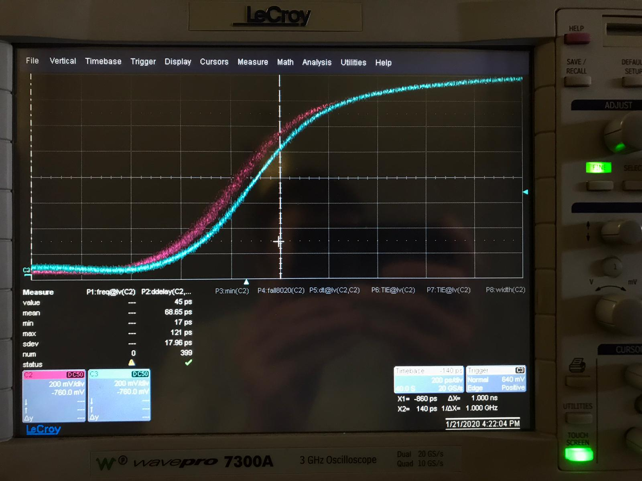
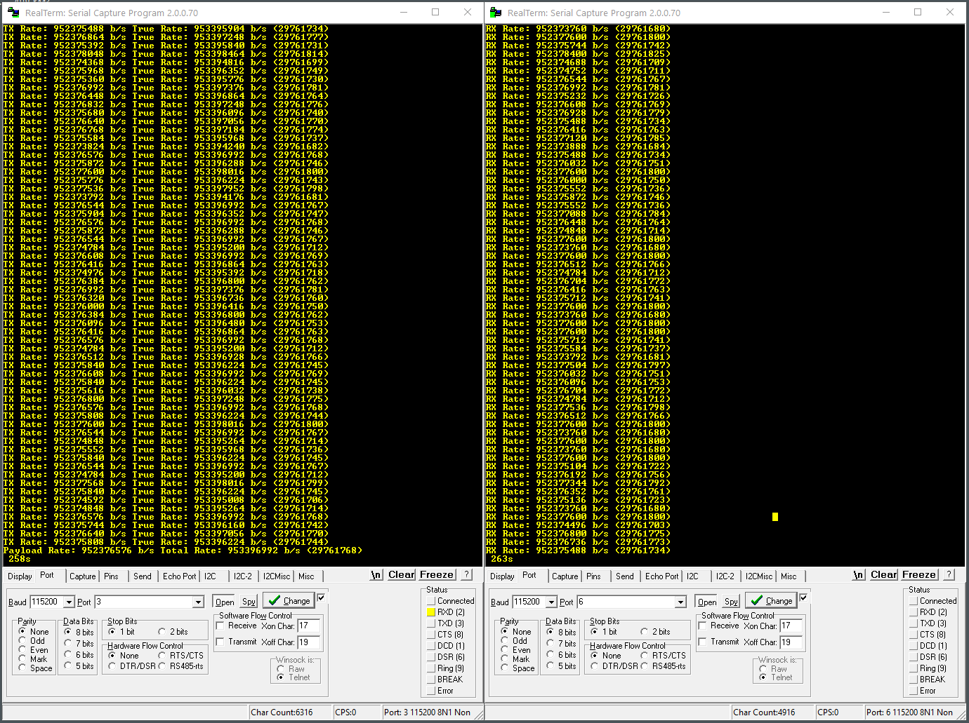
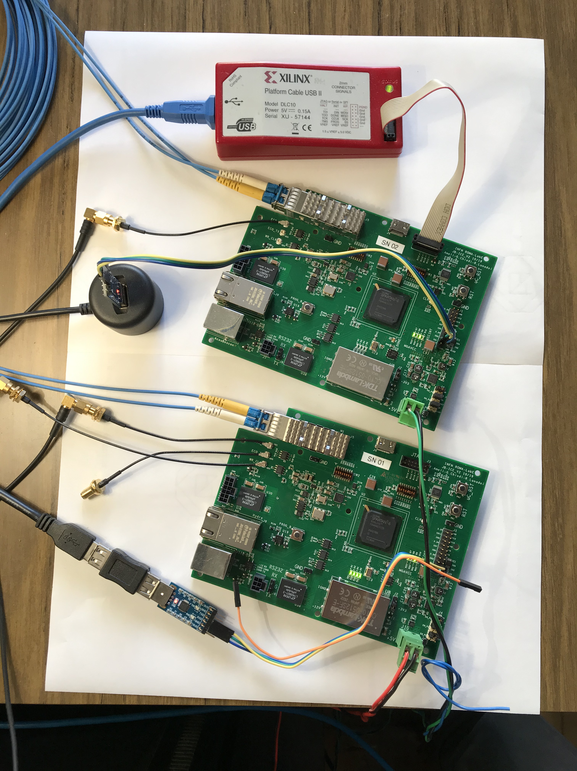
White Rabbit R&D
PPS total jitter = 17.96 ps
Measured sustained bandwidth > 953Mbps

Slide 22
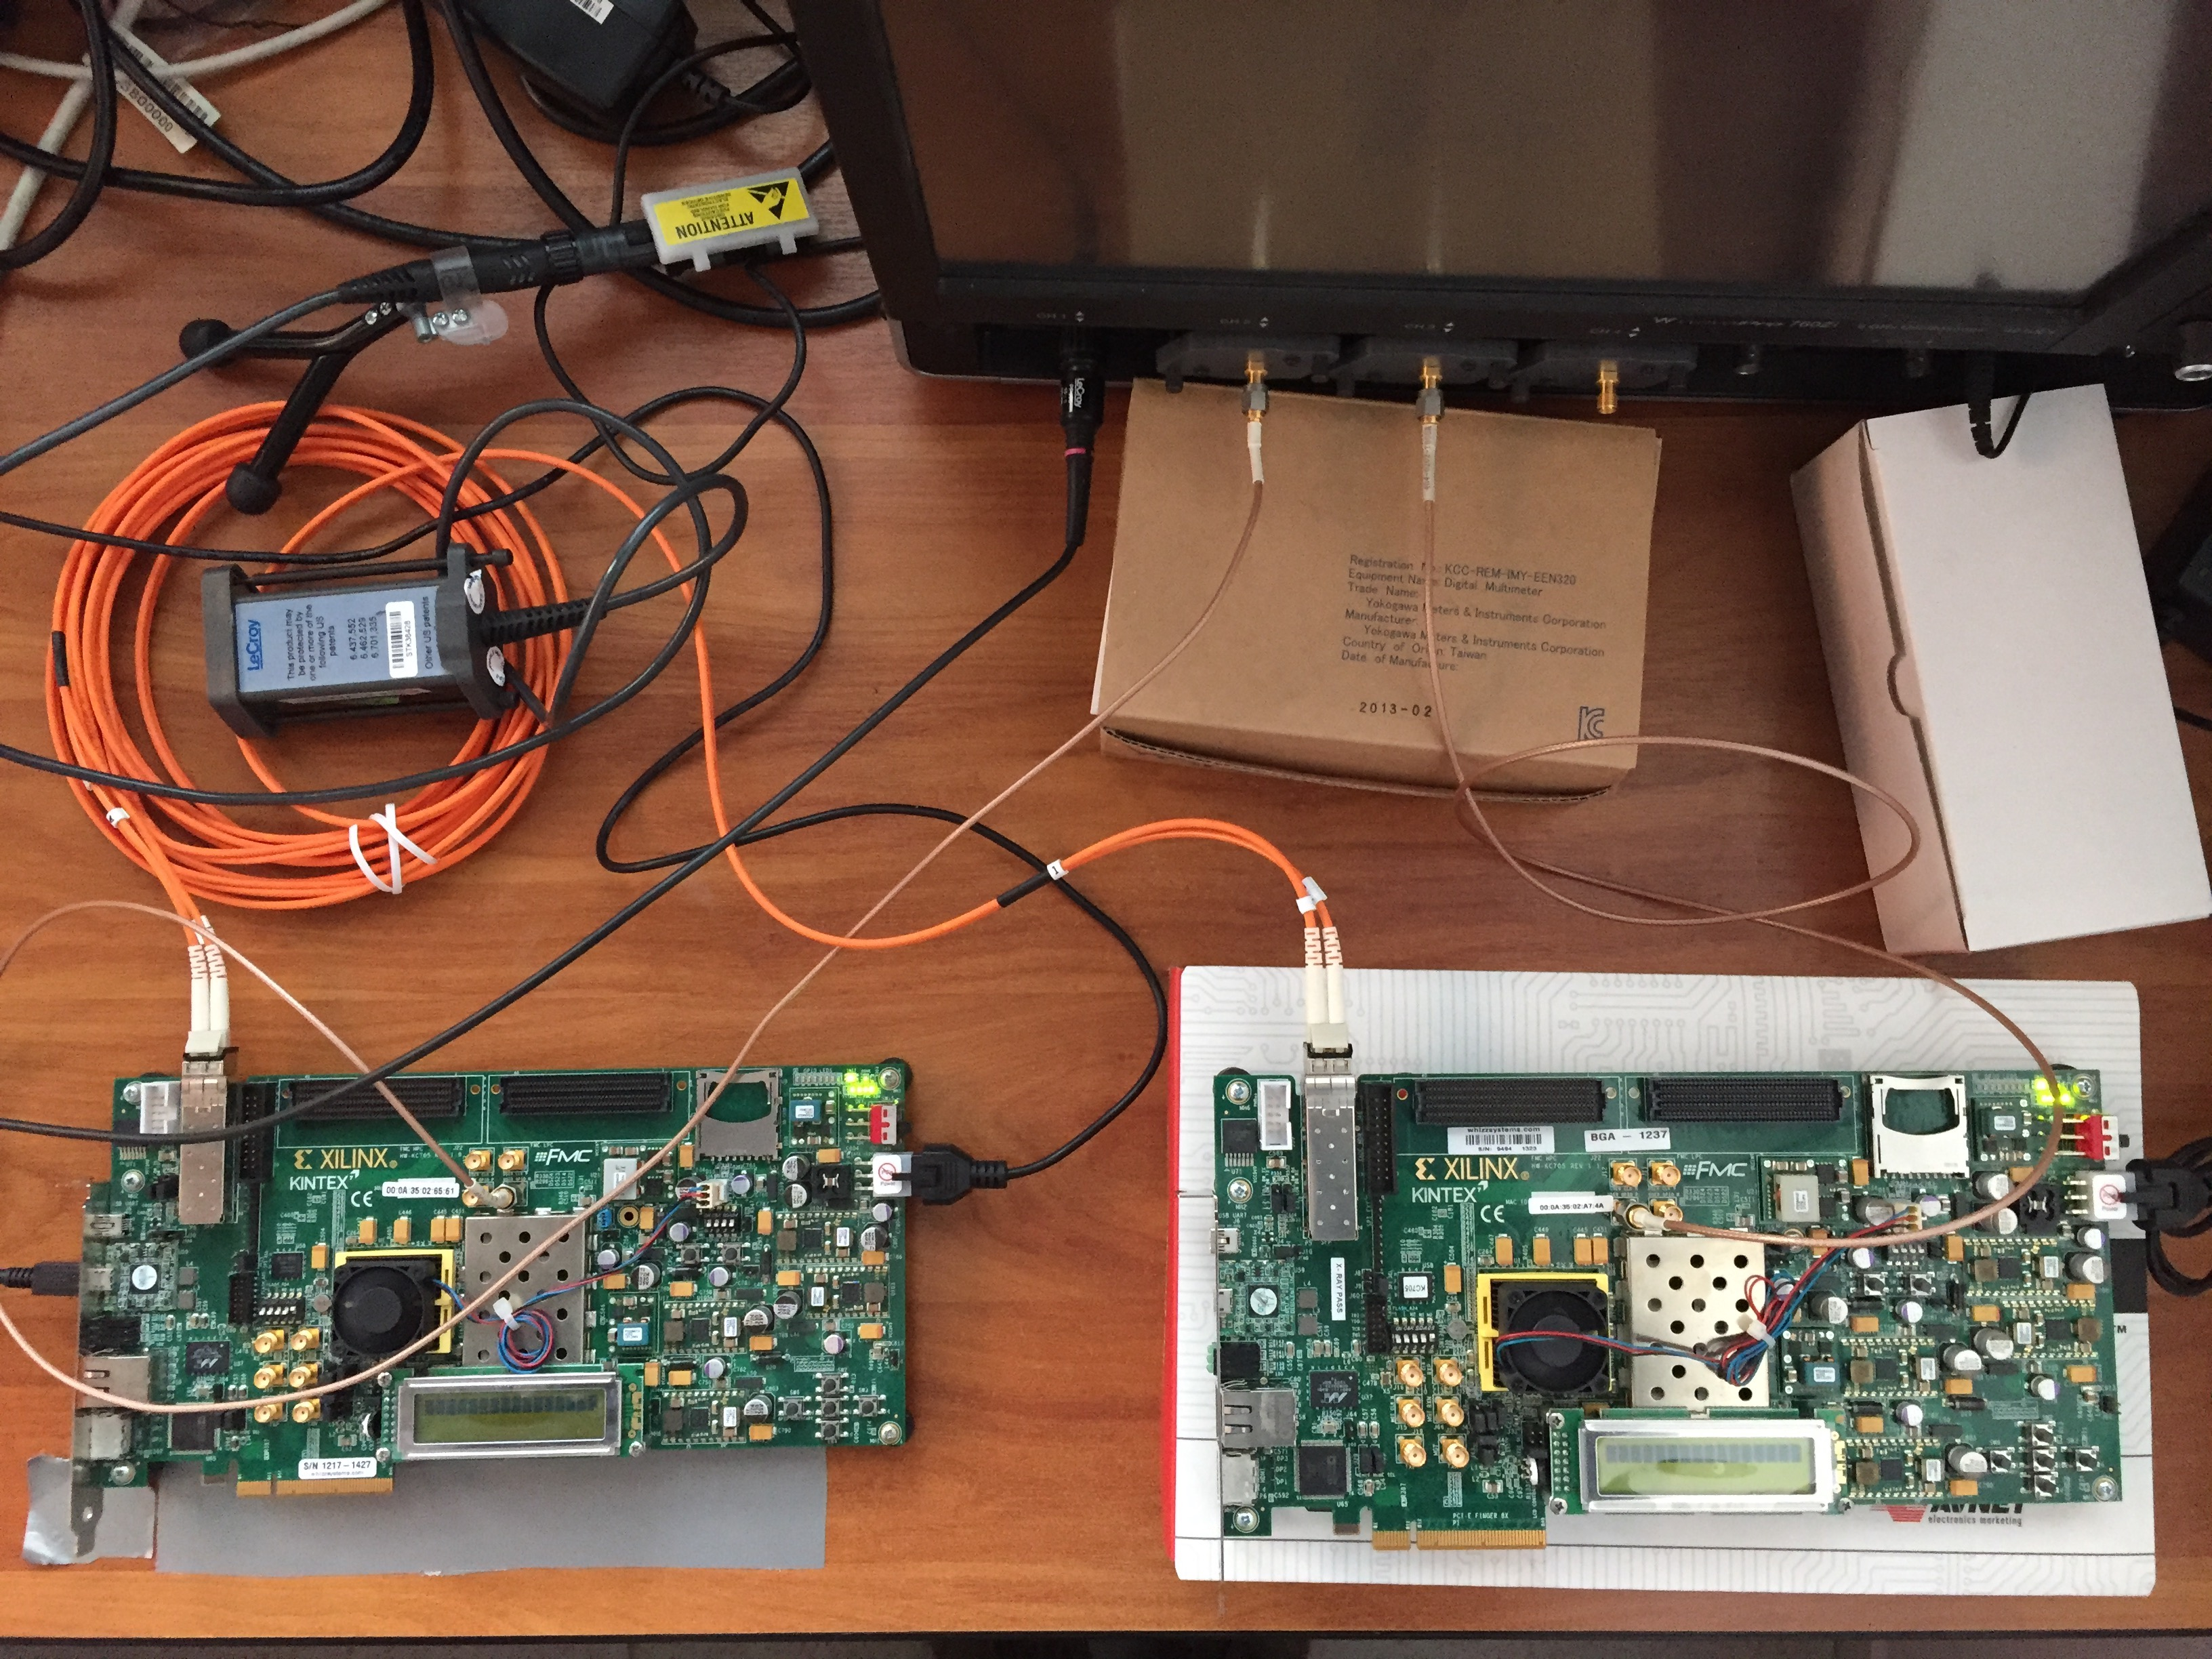
Custom Solution: Jitter Test on KC705 boards
Tx clk
Rx clk
Test done with 2 Xilinx EVB KC705
and the LeCroy scope
Wavepro 760Zi 6 GHz 40Gsps
RX board
TX board
The clock is sent embedded into data from the board on the left and reconstructed by the board on the right

Slide 23
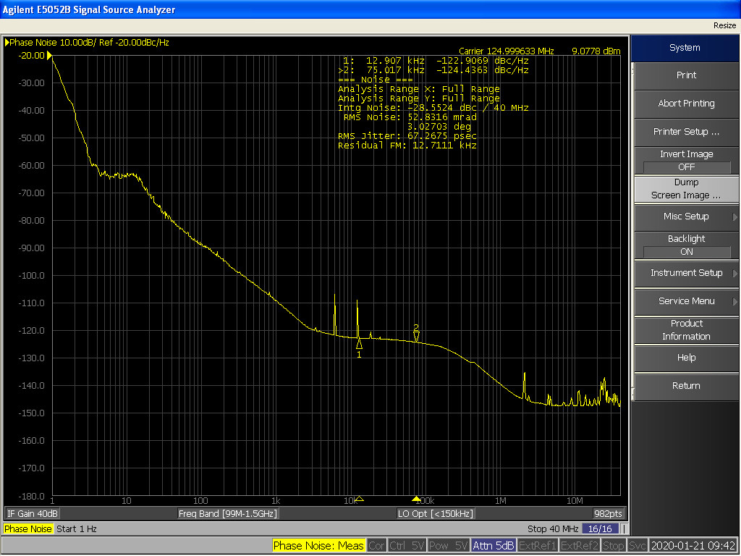

White Rabbit R&D
The total jitter on reconstructed clock is 67.26 ps RMS
The biggest part is concentrated between 1 and 10 Hz. Seems a local oscillator problem

Slide 24
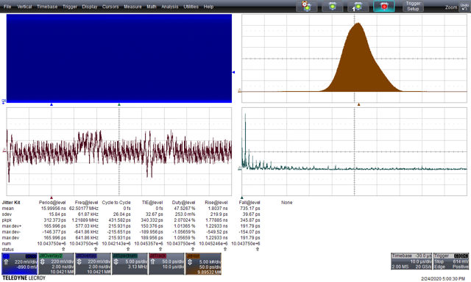
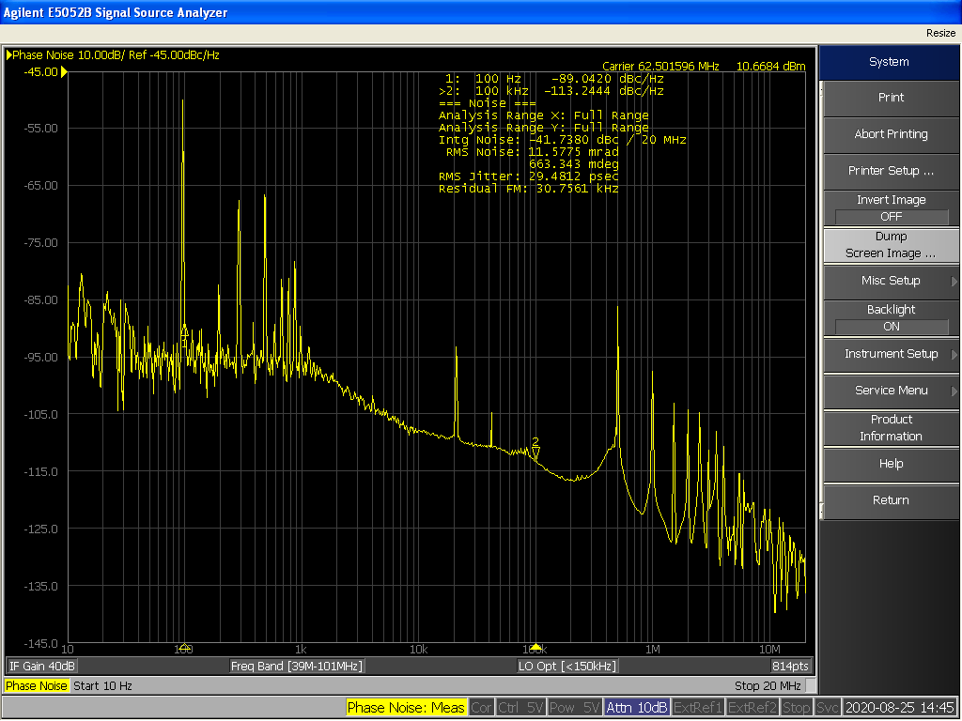
TX clock Time Interval Error
Time Domain
Frequency Domain
Time Interval Error 32 ps rms
RMS noise 29.5 ps
Noise at 500 kHz
and its harmonics

Slide 25
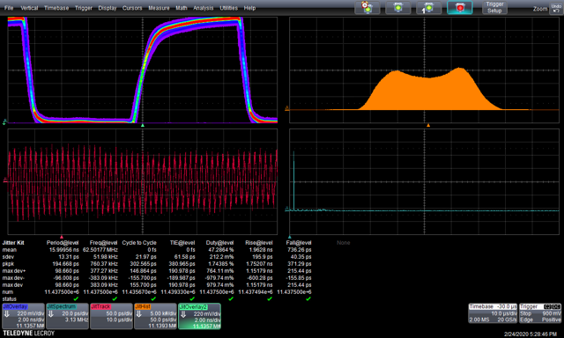
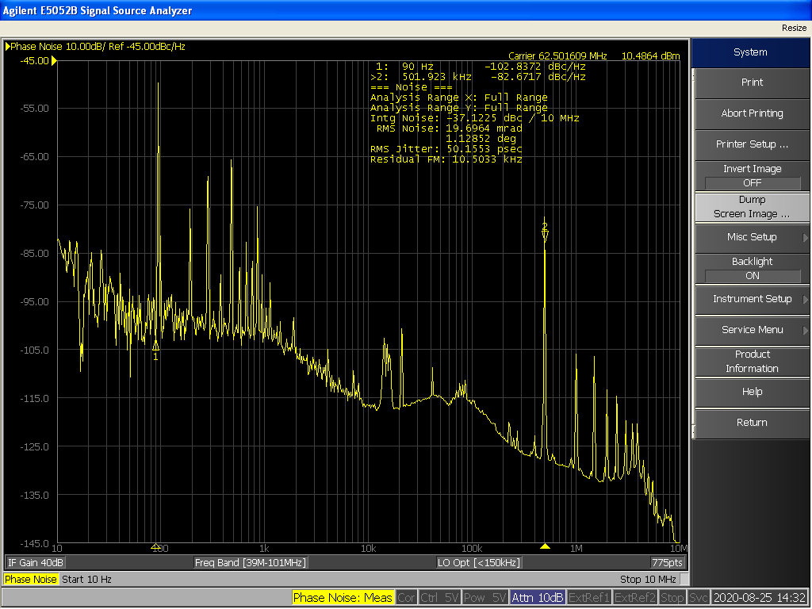
RX clock Time Interval Error
Time Domain
Frequency Domain
Time Interval Error 61.5 ps rms
RMS noise 50.1 ps
More noise at 500 kHz and its harmonics
due to DC\DC modulation

Slide 26
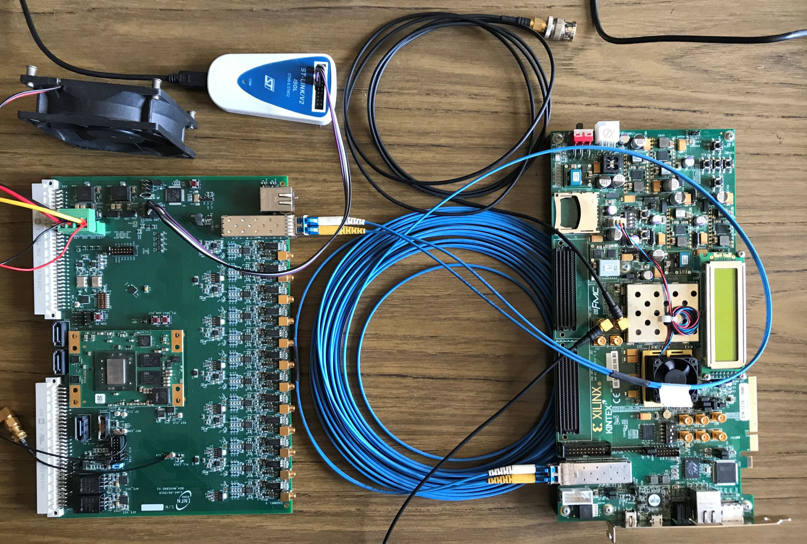
Custom solution: Jitter Test on KC705-Waveboard
TX board
RX board
The TX board is the same KC705 while the RX board is a custom board developed by INFN-Roma for BDX experiment (zynq 7000)

Slide 27
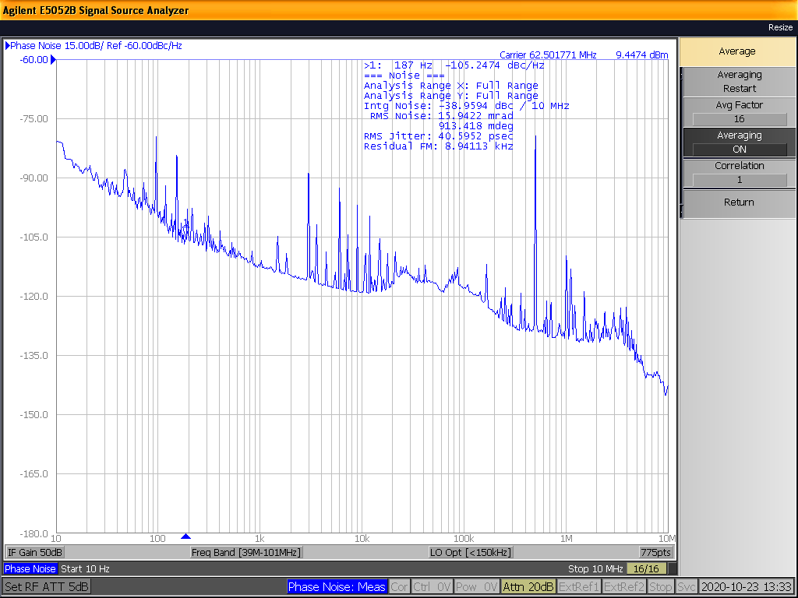
RX clock Time Interval Error (Frequency Domain)
Still noise at 500 kHz due to the TX side. There are no spurious from the RX board.
RMS noise 40.6 ps (with KC705 was 50.1)

Slide 28
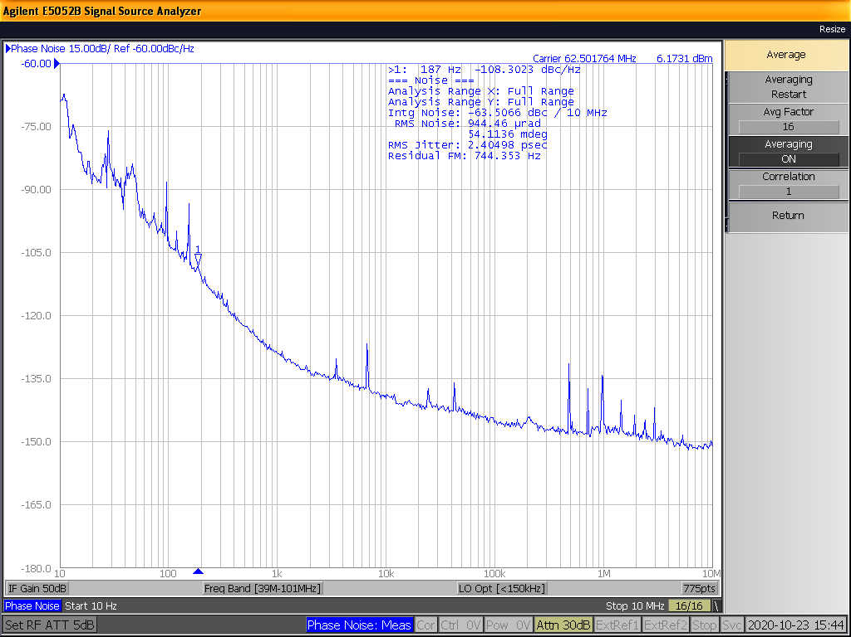
RX clock Time Interval Error Cleaned by PLL
The received clock is sent to the jitter cleaner PLL SI5345 and its output is measured
RMS noise 2.4 ps

Slide 29
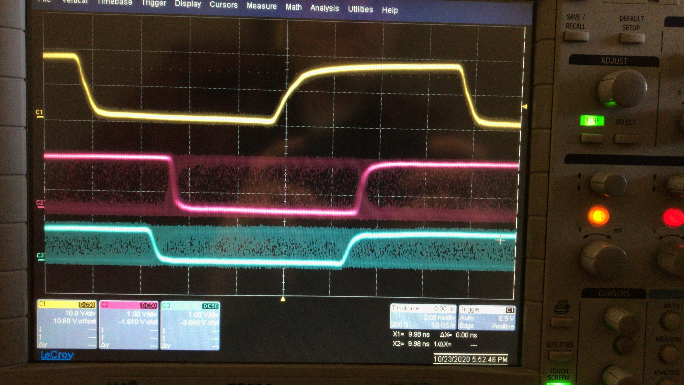
Phase Stability After Reset Test
TX clock
RX clock
RX clock after PLL
The phase difference between TX and RX remains constant after each reset

Slide 30
Discussion
Custom solution on KC705-KC705:
The jitter seen on this setup was generated by the boards itself (not design dependent).
No PLL available on-board to clean the recovered clock.
Custom solution on KC705-WaveBoard:
As expected, the WaveBoard PLL (SI5345) is very effective in cleaning the noise in most of the frequency bands.
In the custom solution the phase is fixed as expected
This test proved also the compatibility between different FPGA families
The R&D is becoming mature and we are confident to bring the total jitter at a level that gives a negligible contribution to the final measure.

Slide 31
Next steps
A white rabbit switch has been acquired and will be characterized at beginning of next year
A discussion with CERN colleagues is ongoing to evaluate the new low jitter switch
The “final” engineering model for the custom solution has been acquired (Trenz TE0808 zynq ultrascale plus + mother board + SFP expansion) capable to drive up to 6 FEs
The “final” engineering firmware is under development.
We are confident to conclude our R&D well ahead of the schedule and start supporting the FE designs for the time distribution integration

Slide 32
Preliminary cost estimation
 | total number of PMTs | PMT per FE | Total number of FE (Time distribution nodes) | Number of nodes per distributor | Number of distributors | Distributor cost per unit | Total istributor's cost
outer detector | 8 000 | 24 | 333 | 8 | 42 | 3 000 | 126 000
Inner detector | 20 000 | 24 | 833 | 8 | 105 | 3 000 | 315 000
MultiPMT | 20 000 | 24 | 833 | 8 | 105 | 3 000 | 315 000
Total distributor's cost | 756 000
Atomic Clock cost | 70 000
GNSS recevier | 13 000 |  | quote septentrio
Antenna + cable | 4 000 |  | quote septentrio
Total clk ref cost | 87 000
Total cost | 843 000
Contigency | 20%
Gran total | 1 011 600
Numbers may vary depending on the required redundancy
An agreement has been reached with INFN to share the total cost 80% to 20%

Slide 33
What else to be done?
The time distribution establish a link between the out-of-water facility and the on-water electronics.
This link will be used for critical slow control and (in our mind) as a backup for the main DAQ system.
A data infrastructure to handle this information must be created.
This is a major item that can be as complex as the main DAQ.
We have started to sketch some ideas but a major contribution will be very welcome (needed)
See Mathieu talk for details

