Slide 1
LAPP 2021-2025 strategy G. Lamanna 18 January 2021

Slide 2
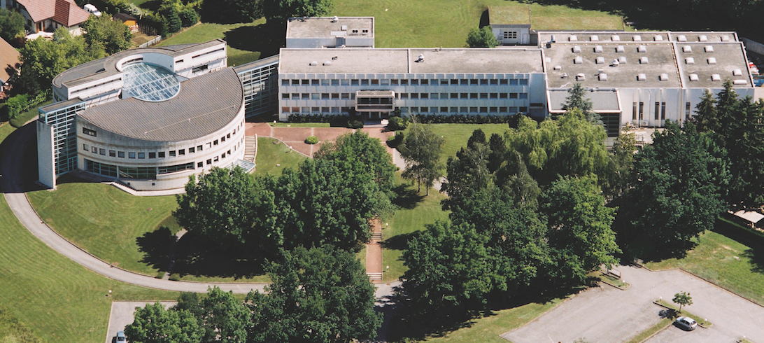
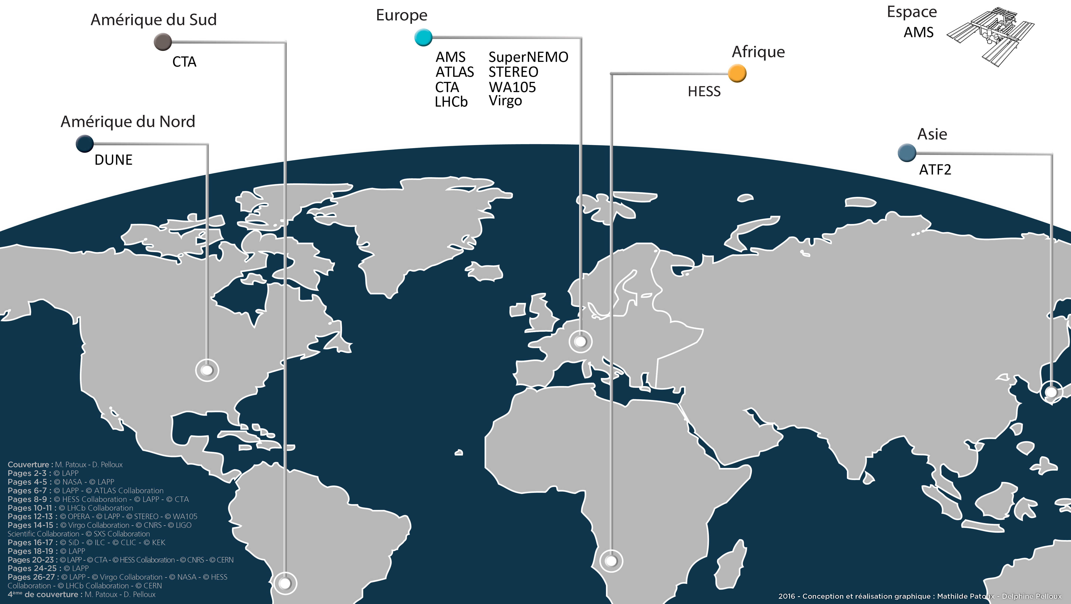
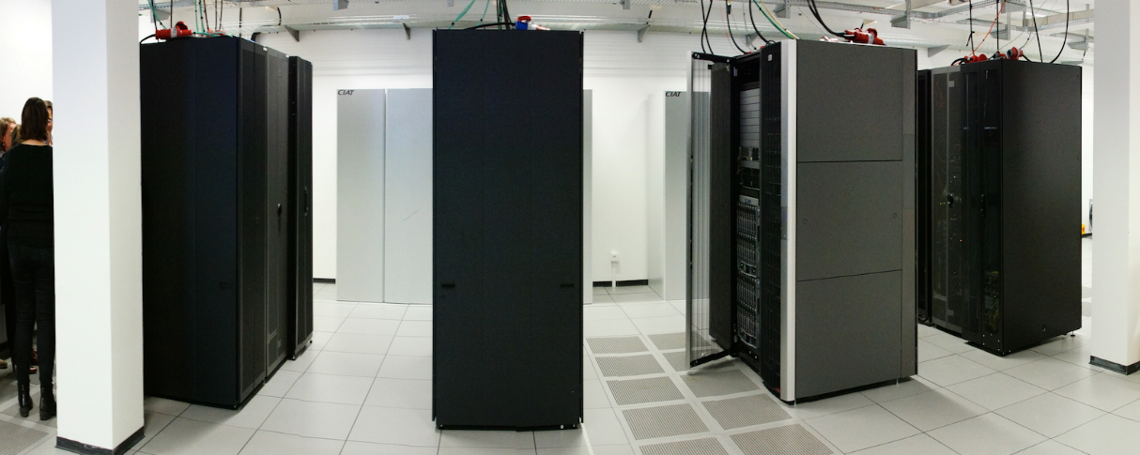
Fundamental research in Annecy
Created in 1976 by CNRS physicists from the Paris region attracted by the proximity of CERN, LAPP is a laboratory of the CNRS National Institute for Nuclear and Particle Physics (IN2P3) and University Savoie Mont Blanc (USMB) and member of the University Grenoble Alps (UGA) community
LAPP research domains:
Particle and Astroparticle physics.
Combination of the experimental
investigations of the two infinities,
from the largest-scale structures
in the observable Universe
to the most fundamental particles.
Within large international collaborations.
Experimental sites all over the world.
Frontier technologies in different fields:
mechanics, electronics, computer science.
A CNRS-USMB labelled digital platform (MUST)
LAPP, 17/01/2021
G. Lamanna
2

Slide 3
LAPP
ATLAS
LHCb
Neutrinos
At LHC, CERN
At LHC, CERN
Matter-antimatter asymmetry
Neutrino properties: oscillation, 4th family, matter-antimatter asymmetry
Search for new physics
Higgs boson discovery, 2012
STEREO, SuperNEMO and WA105/DUNE
Search for new physics
AMS
HESS & CTA
Virgo
Search for dark matter and antimatter in the Universe
Search for dark-matter
GW detection
LSST
On the ISS
Telescopes in Namibia, Chile and La Palma
Study of high energy cosmic rays sources
Interferometer installed in Pisa, Italy.
General relativity, gravitational astronomy
Chile.
Dark matter and dark energy studies
Opening up Cosmology and Multi-λ astrop.
Particle physics in Space
Outstanding results and Important involvement in the upgrading for the HL-LHC
Long-term involvement In ν-physics
A key role in CTA and one of the major French contributions
27 years involvement. Pioneer and a reference leading role in Virgo.
One of the major French contributions in ATLAS
LAPP, 17/01/2021
G. Lamanna
3

Slide 4
Next five-year LAPP scientific programme
Multi-probe approach to fundamental questions
Accelerator-based search
for New Physics
[New particles; Electroweak baryogenesis; matter/ anti-matter asymmetry; CP-violation; DM]
Some promising paths:
Higher precision on the Higgs couplings to fermions and to vector bosons. Higgs self-couplings; non-SM CP violating rare decays. NP search novel strategies
GW and γ-rays
for Violent Universe
[Binary systems physics; BH; Blazars; Gen. Relativity]
Some promising paths:
Connection between compact binary mergers, GRBs and kilonovae; Blazars population studies; BH spectroscopy and structure of neutron stars (equation of state of ultra-dense matter), transients alerts follow up, probing HE emission of GC
Neutrinos
for New Physics and Violent Universe
[ν nature, NP, CP; cosmic]
Some promising paths:
Neutrinoless double-β decay; CP violation in the neutrino sector; neutrinos from Galactic supernovae
Multi-messengers observations
for Dark Sector
[DM, DE; Cosmology]
Some promising paths:
Indirect search, GW sources contribution to DM, Dwarf galaxies studies, measuring the Hubble constant, large redshifts galaxies via image stacking, wide-field DE survey

Slide 5
Structure, workforce and scientific orientations
HEP - Particle accelerator studies of the Standard Model and search for new particles.
Work force: 19 researchers
Established master projects: ATLAS, LHCb
Executive summary:
LAPP deeply engaged in LHC and HL-LHC programs;
Responsibilities in the upgrade of ATLAS and LHCb detectors as well as in physics analyses.
Next contract objectives:
- Finalise all the current upgrade activities.
- Physics: ATLAS and LHCb will start to operate in the LHC-Run 3 (2021-2023) with data taking at
centre-of-mass energies of sqrt(s)=13-14 TeV, to reach 300 fb-1 of recorded integrated
luminosity.
A long shutdown of two years, from 2023 to 2025.
Installation of the detector upgrades required for the HL-LHC phase.
Starting HL-LHC in 2027.
LAPP, 17/01/2021
G. Lamanna
5

Slide 6
Structure, workforce and scientific orientations
NEU - Investigation of the major properties of the neutrino.
Work force: 5 researchers Established master projects: WA105-ProtoDUNE
Next project: DUNE
Closing projects/activities: STEREO, SuperNEMO
Executive summary:
LAPP focus is on demonstrating the potential of dual phase technology (ProtoDUNE-DP at CERN) and largely contributing to the French participation in DUNE (formally defined in 2020); willing to play an important role.
STEREO and SuperNEMO will be finalised (2021 and 2023 repsectevely).
Next contract objectives:
- Preparing and building the DUNE experiment.
LAPP, 17/01/2021
G. Lamanna
6

Slide 7
Structure, workforce and scientific orientations
ApC - Astroparticle physics and Cosmology
Work force: 20 researchers Established master projects: HESS, CTA, LSST, Virgo
Expected/next explored projects: ET
Executive summary:
AstroGamma
CTA-North (with LST-1++ MSTs) early science in progress; H.E.S.S. will continue until 2023.
Combination of multi-telescope and multi-wavelength data analysis (DM, GRBs, Blazars …).
LSST
Deploying a complete pipeline (software as part of a scientific project.)
LSST survey in the period 2023-2025; Develop the Dark Energy science project within DESC.
Virgo
Improving sensibility on runs O4 (2021-22) and O5 (2024-25). Advanced Virgo+ phase 1 upgrade in 2020-21 and phase 2 upgrade in 2023 to start the O5 run in 2024. Multi-antenna (Kagra 2020, L-India 2024).
Next contract objectives:
AstroGamma
- LAPP deeply committed in CTAO construction (2021-2024); running the real-time pipelines; CTA early science.
LSST
- Tel. commissioning; implementation of Science Analysis Platform at the European level.
Virgo
- Pipelines and on-line LIGO-Virgo; multi-messenger (Binaries, GRBs, ..); Major expected science breakthroughs.
- Phase 1 upgrade reducing the quantum noise by increasing the laser power.
- Phase 2 upgrade reducing the thermal noise improving the mirror and optics.
LAPP, 17/01/2021
G. Lamanna
7

Slide 8
Structure, workforce and scientific orientations
ATLAS - New scientific thematic, etc.: Development of new machine learning based analysis techniques; Capitalise on existing technical expertise in some of the strategic R&D developments for detectors at future HEP colliders, like e.g. CO2 cooling, high performance FPGAs or high-speed data transmission.
LHCb - New scientific thematic, etc.: The development of big-data management services and deep learning software could participate in opening up the LAPP towards interdisciplinary cooperation.
Design an electromagnetic calorimeter for the LHCb Phase-II Upgrade to operate in 2031 to fully exploit the flavour potential of HL-LHC.
NEU - New scientific thematic, etc.: The detailed definition of the technical commitments of LAPP in DUNE as well as a regional (by leveraging the LabEx ENIGMASS) and national (@IN2P3) strategy, will come during the next few months.
CTA - New scientific thematic, etc.: The team would privilege a structuring internal cooperation at LAPP with LSST and Virgo for multi-messenger physics as well as within the LabEx ENIGMASS an largely within the UGA PAGE pole. The perspective of upgrading the baseline design of the LST cameras with SiPM should be considered in cooperation with INFN and Max Planck.
LSST - New scientific thematic, etc.: Structuring internal cooperation at LAPP with CTA and Virgo for multi-messenger physics as well as within the LabEx ENIGMASS. Access to LSST images contributing to the EOSC concept and LAPP role; to play an important bridge role between LSST and the European scientific community.
Virgo - New scientific thematic, etc.: Structuring internal cooperation at LAPP with CTA and LSST (for i.e. GRB multi-messenger alerts management and analysis) as well as within the LabEx ENIGMASS;
E.T. R&D.
LAPP, 17/01/2021
G. Lamanna
8

Slide 9
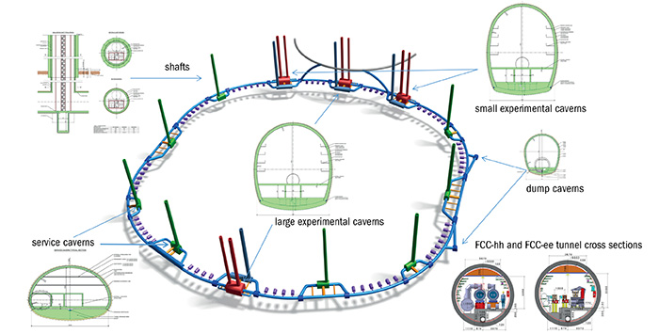
Structure, workforce and scientific orientations
FCC
We are part of the EU H2020 FCCIS – The Future Circular Collider Innovation Study international consortium. (grant agreement no. 951754).
After having supported CLIC,
LAPP among the French (IN2P3 and CEA) institutes supporting the FCC option:
First the FCC-ee from the Z-pole (90 GeV) to 400 GeV, covering both the electroweak, Higgs and top sectors, in order to obtain ultimate precisions on Standard Model parameters and observe deviations pointing to a new physics scale. The FCC-hh collider at 100 TeV centre-of-mass energy, would follow.
(A tunnel of 100 km circumference would be drilled for 75% of its extension
in our French Haute Savoie department, with an interaction point located
a few km from LAPP.)
CERN
FCC
LAPP
LAPP, 17/01/2021
G. Lamanna
9

Slide 10
Structure, workforce and scientific orientations
HEP - Particle accelerator studies of the Standard Model and search for new particles. Future master project: FCC
Executive summary
Accelerators:
LAPP committing in the FCC-ee accelerator layout study and Machine Detector Interface - MDI collaboration (mechanical design of the final focus system and impact of vibrations on the accelerator performance).
Further potential implications (TBD)
Detectors:
Potential R&D on noble liquid sampling calorimeter and a new concept of vertex detector.
Next contract objectives:
H2020 FCCIS (2021-2025) :
MDI studies
Responsible for local-regional scientific, environmental and economic impact studies..;
a reference for public engagement and education.
Design of a possible “CERN-French operation centre/technopole ” of FCC.
LAPP, 17/01/2021
G. Lamanna
10

Slide 11
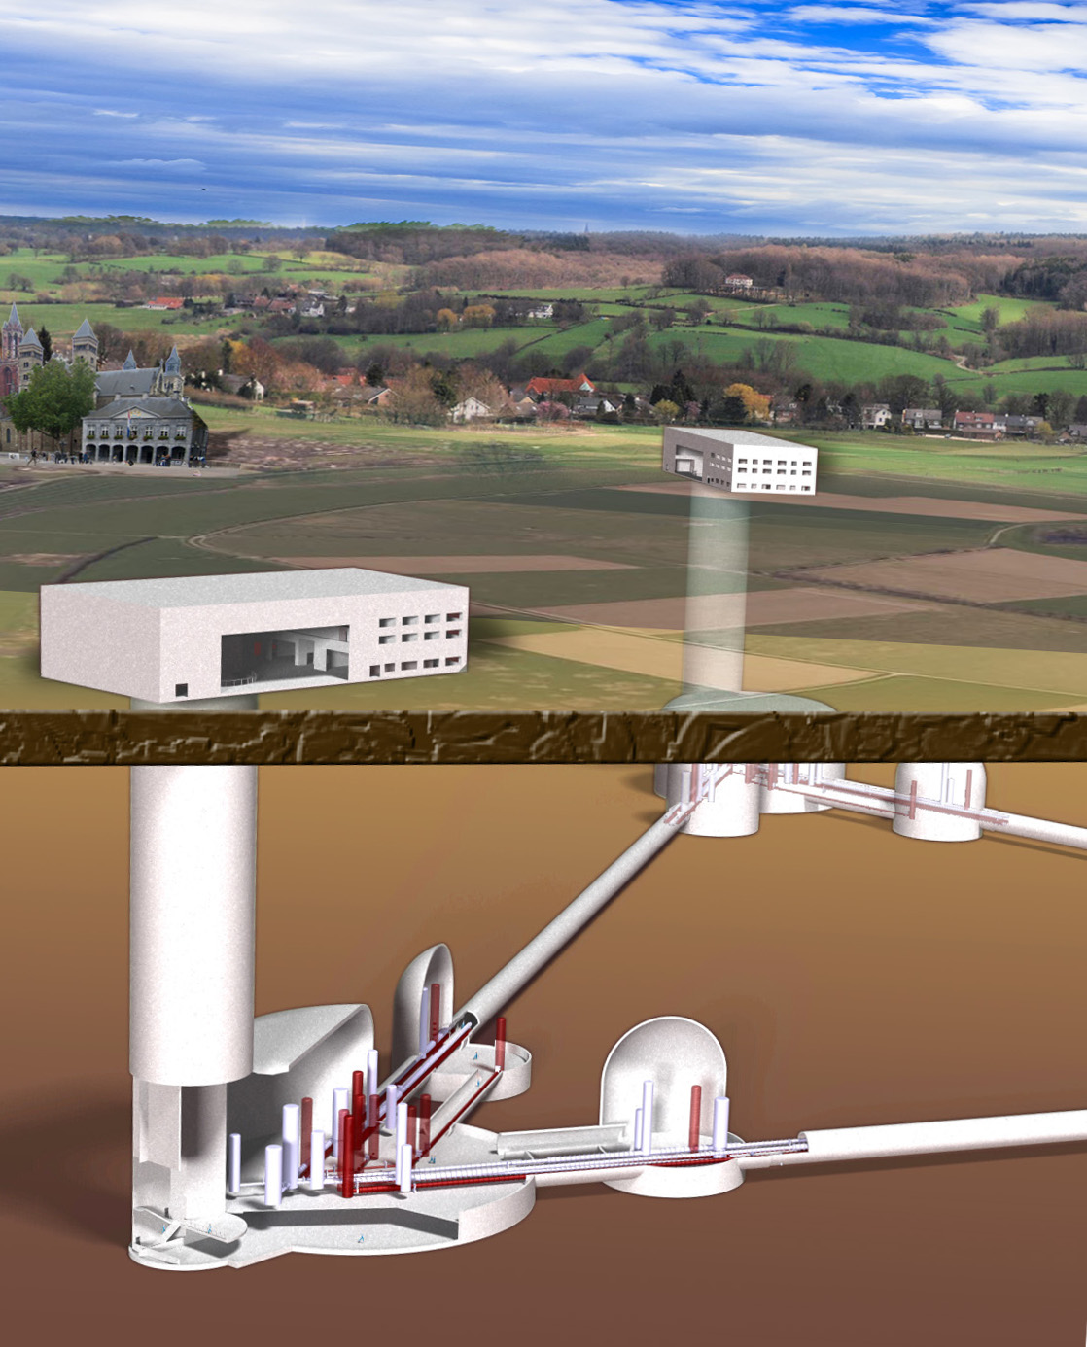
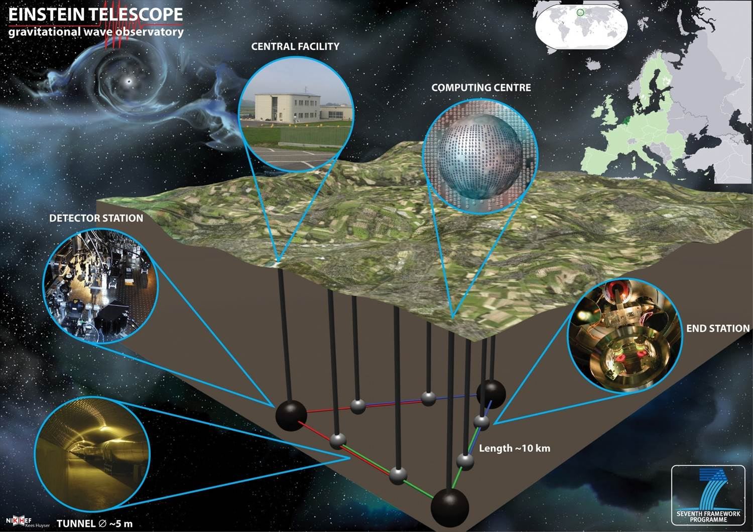
Structure, workforce and scientific orientations
ET
The Einstein Telescope (ET), a 3rd generation detector (2030), combining several interferometers on the same site, and using an underground infrastructure to reduce the contribution of seismic and Newtonian noises.
Advanced technologies: cryogenics and high power laser..
Advanced tests of the theory of general relativity and strong impact in astrophysics and cosmology.
EC FP7 Design Study, Conceptual Design Concept,
ET letter of intent towards ESFRI in 2020.
From experiment to Observatory (as per CTA…)
LAPP, 17/01/2021
G. Lamanna
11

Slide 12
Structure, workforce and scientific orientations
ApC - Astroparticle physics and Cosmology Future Master project: Einstein Telescope (ET)
Executive summary
Potential R&D:
reduction of optical losses of diffuse light sources on the detection benches : a 3D opto-mechanical simulation of the detector
low-noise fast digital controls, low consumption electronics and no-contact transmission of power and data, or bigger in vacuum isolated benches.
control of the bench position (thanks to the accelerator vibrations control expertise at LAPP)
Next contract objectives:
H-Europe Preparatory Phase Study (2021-2025) ? :
Some technical work R&D (as continuation of Virgo work + some new ones); leverage the Maastricht test-bench; potential cooperation with CERN.
Planning new cleaner work areas, training by-doing and by-research programme.
LAPP, 17/01/2021
G. Lamanna
12

Slide 13
THANK YOU !
LAPP, 17/01/2021
G. Lamanna
13

