Slide 1
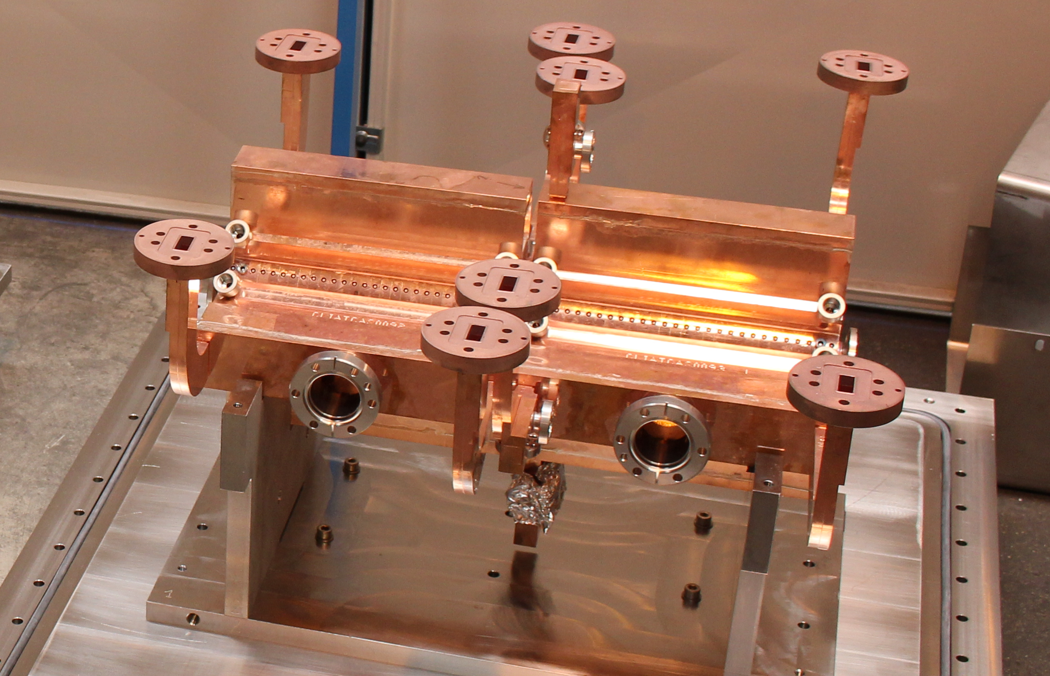
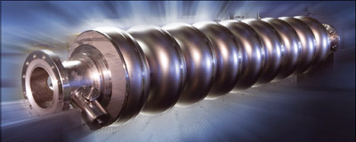
From ATF2 to ATF3
A. Faus-Golfe
Notes:
On behalf of many people

Slide 2
Outline
ATF2 review
ATF2 close out
Perspectives: ATF3

Slide 3
ATF2 review
https://agenda.linearcollider.org/event/8626/
International Review Panel
K. Oide (chair)- KEK-CERN
V. Shiltev - FNAL
Z. Zao - SARI
T. Pieloni - EPFL
M. Kato - Hiroshima U.
Notes:
“Distinguished” review International Panel.
The talks are available in the indico page and the 6 October was the close out

Slide 4
ATF2 close-out I
Overview
Q1: Scientific results at ATF/ATF2
Outstanding and unique results achieved in ATF/ATF2:
Pioneering developments on various accelerator components:
The smallest spot size, 40 nm, in any accelerators.
Intra-train bunch orbit feedback (FONT).
Vertical emittance in the ring, 4 pm, smallest at the beginning of the century.
Fast extraction kickers with rise/fall time less than 3 ns
Laser wires measuring 1 μm beam size
Cavity BPMs with 20 nm resolution
Single- and multi- OTR/ODR beam profile monitors
Q2: Future ATF operation for LC R&Ds
Other components which will benefit the ILC preparation:
Intensity dependent effects on the spot size
Optical aberrations <<< β_{x}*
Beam halo and collimation
Smaller spot sizes with higher chromaticities
Polarized e- source, transport, and storage in the DR
Beam collimation study using fancy devices such as using a laser or another beam
Beam feedback within one turn of the ring circulation to simulate a fast feedback at the extraction of the ILC DR
Q3: Future ATF operation (other than LC)
Remarks
ATF team to expand this effort internationally (conflict with the preparation of the ILC).
KEK should not consider any shutdown before exploring the full scientific possibility of ATF
Contradiction between ILC preparation plan for the ILC in coming years and operation history of ATF in the past five years
Cannot judge the feasibility of ILC future plan of the ILC, but still expresses heavy concern on the situation.

Slide 5
ATF2 close-out II
ATF2 ultra-low beta optics
Timeline
Continue the exploration of the ultra-low β optics and scaling of beam size with different optics with reduced β_{x} value (larger aberrations).
Improve stability of beam size measurements (IPBSM) to resolve beam sizes even below 40 nm.
Explore the method with a longer L* optics to keep the beam size resolution.
Small beam tuning (below 50 nm) with nominal optics should be demonstrate to possibly demonstrate the octupole effectiveness
Refine the goal of ATF3 whether to cover other subjects presented in the review.
ATF Introduction, Instrumentation R&Ds
Improve the instrumentation with AI technology application
ATF2 small beam, Wakefield
Develop a long L* optics to evaluate optical aberrations.
Try to squeeze βx* for a better understanding of the optics
ATF2 stabilization (FONT)
Give priority (and additional beam time) to allow optimization of the feedback system performance and detailed study of long-term beam trajectory control

Slide 6
ATF2 future R&D
Operational status and concerns
Develop a detailed resource-loaded plan for the ILC-related studies in the ILC preparatory period, under the given limited operation budget, availability of experts, and beam operation time.
Consider an opportunity to carry out SC elements (magnets and cavities) in some other facility with existing cryogenic capability.
Consider merging activities at ATF, STF, cERL, etc., and flexibly use the limited budget and manpower
Continue the efforts to get funds from outside of KEK
Pay full attention by the entire KEK members to avoid repeating accidents
R&D other than LC
Continue the effort on collecting research subjects other than ILC. The calling for proposals should be open and international
Try to find more applications which require the flatness of the beam at ATF.
Start to think about a possibility to convert ATF to a flexible, multi-purpose facility as exploring the possibility to collaborate with other facilities, institutes or universities.

Slide 7
Perspectives: ATF3
Building on the achievements of the ATF2 project a follow-on, upgraded facility “ATF3” for pursuing R&D aimed at maximizing the luminosity potential of ILC is necessary.
“ATF3” would hence provide the opportunity to attract additional resources from overseas collaborating institutes to deliver the program described above in a modular and sensibly time-ordered fashion.
Notes:
Finally what are the perspectives and what about the idea of ATF3.

Slide 8
Personal Notes from Review discussion
How unique is ATF/ATF2/ATF3??
Feasibility of the plan taking into account the ILC uncertainty, What to do between now and the “green light” for ILC???
2021 run??? (re-start difficulties after shutdown)
What is the budget/personnel/operation time needed? (summary table will be welcome, priority list...)
Aging of the operating personnel, no transfer of knowledge, no new Japanese PhDs
ATF3 R&D open facility as FACET, ATF-BNL, CLEAR...
Collaboration with other ILC facilities in KEK: SRF and SCF ?
Notes:
For finalize some comments/questions made during the review panel.

Slide 9
Personal Notes from “others” discussions
Operational support during runs for overseas collaborators
Communication problems
Lack of Coordination and Support between different activities
Problems with work visibility for PhDs
.....
Notes:
Some other notes from “others discussions”

Slide 10
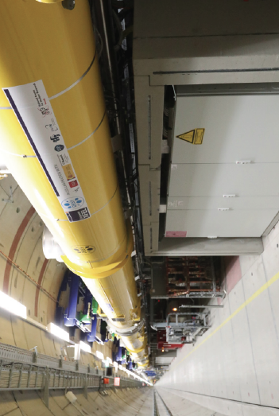
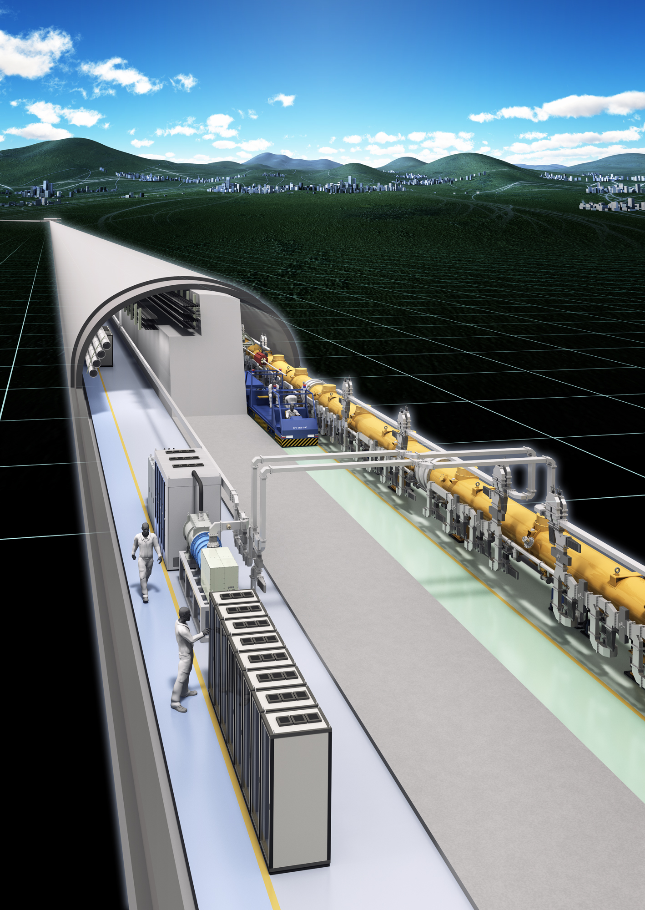
Let’s start the discussion

