Slide 2
LOFAR use case in the FDR
Yan, Pandey

Slide 3
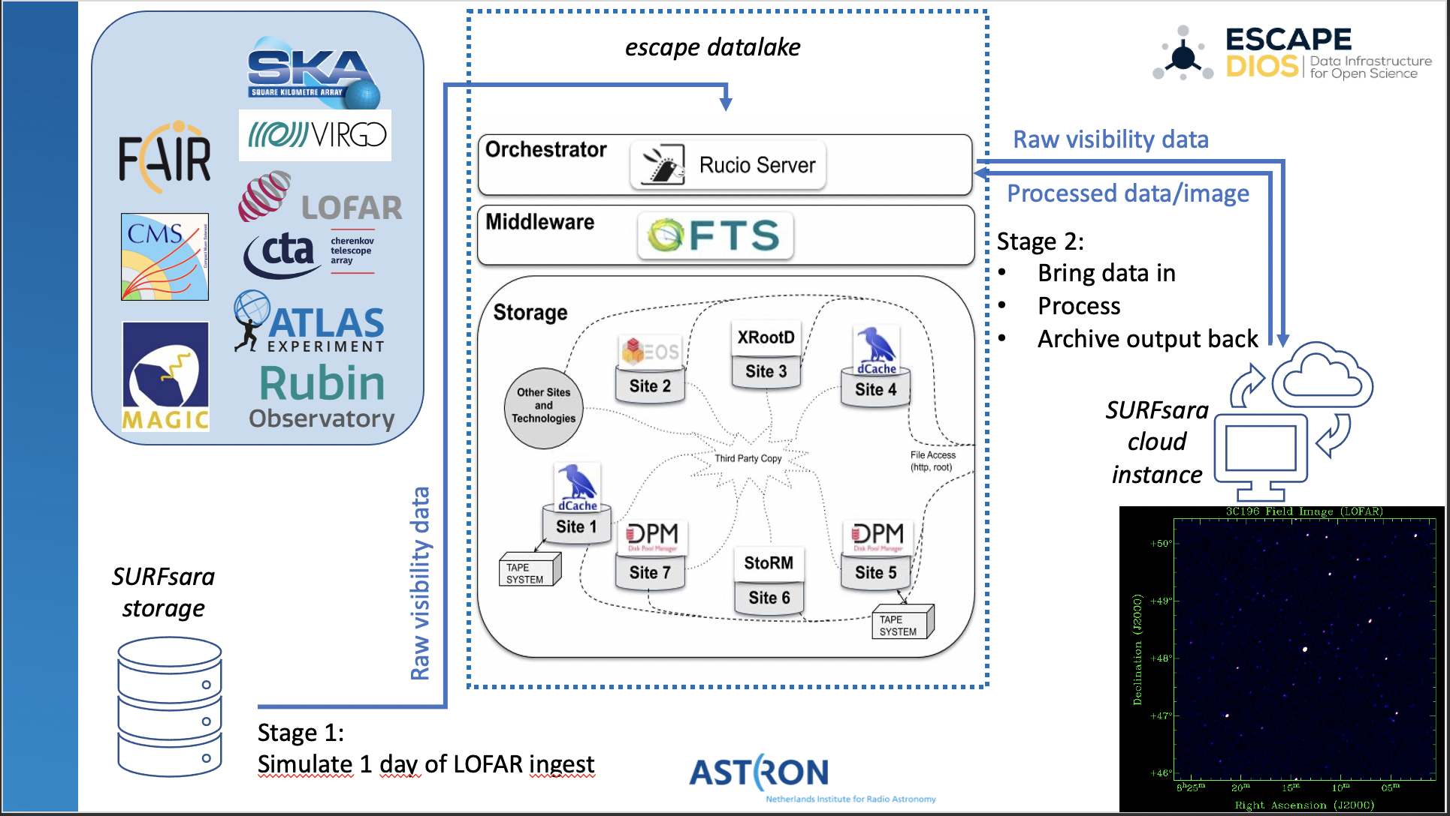
Use case description

Slide 4
What went well, and essons learned
Rucio is pretty a neat tool overall
Bandwidth to CERN was around 3Gbit, within SURFsara of course close to 10Gbit.
We didn’t even get to do the QOS life cycle.
Timeouts in storage encountered
Would need to be changed in the settings of the remote location -> Jira issue open
Need for a way to communicate downtime ☺

Slide 5
Stage2 –EULAKE1->CloudBox(process)->EULAKE1
 | Start Time | Success# (download) | Transfer (download) | Sucees (upload) | Transfer (upload) | Comments / Remarks
1 | Nov 16 14:50 | 1/23 | 40MB/s | - | - | Gsiftp starts, requested service unavailable, unknown exception*
2 | Nov 18 09:23 Nov 18 11:52 | 0/23 1/1 | - 23MB/s | - | - | Similar* (logs:–vvv online document clues ?), At 11:52 It started working
3 | Nov 19 10:43 | 19/19 | 113MB/s | 19/19 | 60MB/s | Success!
4 | Nov 24 10:45 | 18/23 | 120MB/s | 18/18 | 55 MB/s | Download – datalake down
5 | Nov 30 10:39 | 0/23 | - | - | - | Rucio down - connection time out
6 | Dec 01 16:41 | 23/23 | 130MB/s | 23/23 | 68MB/s | Success!
7 | Dec 02 11:18 | 23/23 | 140MB/s | 23/23 | 71MB/s | Success!
8 | Dec 07 10:22 | 23/23 | 130MB/s | 23/23 | 63MB/s | Success!
9 | Dec 08 16:03 | 4/4 | 140MB/s | 4/4 | 70MB/S | Success!
Single file Download size:6.1GB, Upload size:650MB
# (No. of Measurement Sets (tar file))

Slide 6
Planned changes for FDR2 (?)
Ingest to EULAKE-1 i.s.o. SARA because this is more in line with the whole concept of the Data lake
Need to fix the timeout issue first of course
We do want to do the QOS life cycle ☺
When stable data downloads: do data transfer an processing in parallel
Would be nice if we’d monitor the network (or grab the data from opennebula during the tests iso a day later…)

Slide 7
Feedback (or lack of knowledge)
Rucio error messaging could be more detailed (each step explicit in debug version would be really awesome!)
Transfer of list of files seems to block for a long time before the data stream starts. We now do in a script file by file, but then it feels like transfer management is not too efficient.
Overwriting files after processing?
In general maybe some better mutual understanding of how files are handled?

Slide 8
Ideas for future development
Convo with Paul Millar and Hanno Holties (LTA expert) on technical details.
Ideas on how to iprove our production work flow, and also the experimental one.
More understanding of our use cases and choices
(hopefully both)
‘LTAcp’ integration with FTS is certainly an interesting idea!
Thinking about other features (Direct data access from data lake? File system messaging? Need some extra brainstorming on our side…)
“real” QoS levels (i.e. having either a real tape drive, or a disk with some software delays)
AAI – The levels we would like, who can manage access ,etc.
Data hierarchy
Non-deterministic storage
Adding an external location as RSE (thinking of LTA here)?

