Slide 1
Software Deployment & Data Analysis for R3B-NeuLAND
Maisam M. Dadkan
WP5 Progress Meeting, 26 October 2020

Slide 2
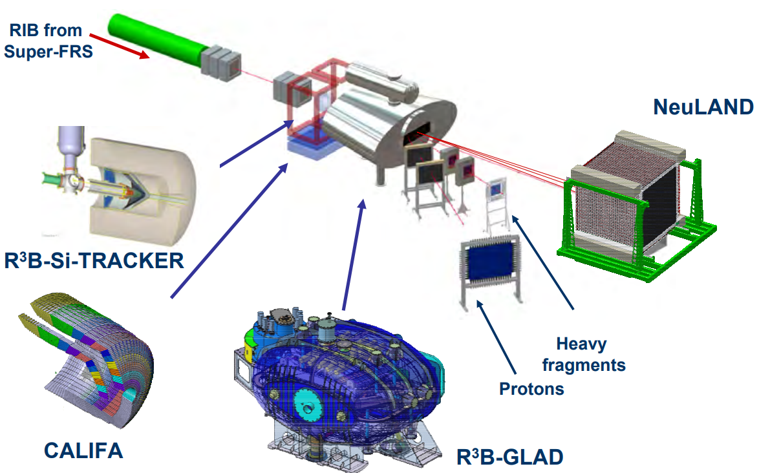
R3B-NeuLAND
R3B (Reactions with Relativistic Radioactive Beams)
(Neu Large-Area Neutron Detector)

Slide 3
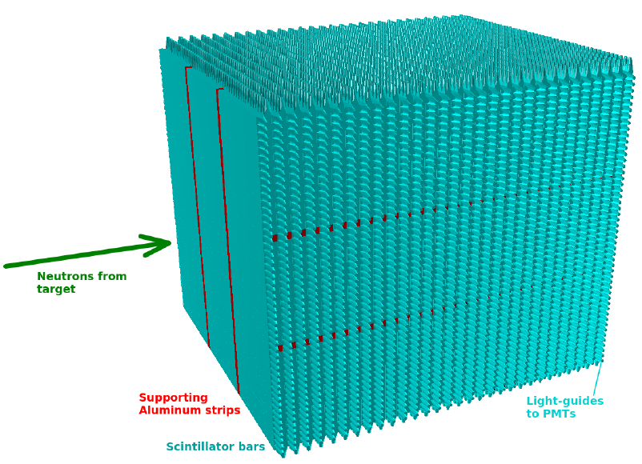
R3B-NeuLAND
30 doubleplane (dp)
100 V-H scintillators/dp
2.5*2.5 m2

Slide 4
R3B-NeuLAND
Multiplicity determination
Shower head determination

Slide 5
R3B-NeuLAND
Multiplicity determination
Shower head determination

Slide 6
R3B-NeuLAND
Multiplicity determination
Shower head determination
Analysis methods:
Technical Design Report (TDR)
Deep Neural Network (DNN)

Slide 7
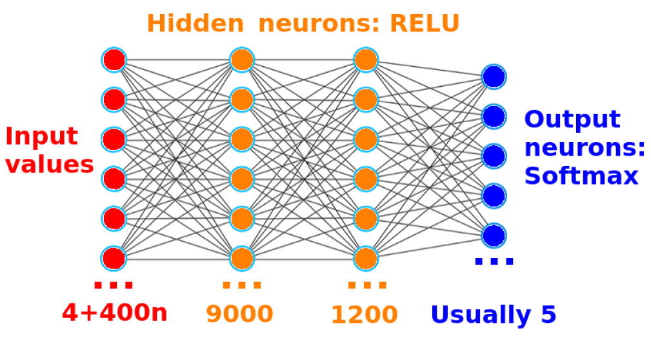
R3B-NeuLAND
Multiplicity determination
Shower head determination
Analysis methods:
Technical Design Report (TDR)
Deep Neural Network (DNN)

Slide 8
R3B-NeuLAND
DNN & TDR
R3BRoot
FAIRRoot
FAIRSoft(Root, Geant,…)
OS
docker pull maisammd/r3bneuland_py3hub:latest

Slide 9
R3B-NeuLAND
DNN & TDR
R3BRoot
FAIRRoot
FAIRSoft(Root, Geant,…)
OS
docker pull maisammd/r3bneuland_py3hub:latest
Some Jupyter NBs have been provided (mostly in PyROOT)
~ 16 TB of data have been generated.
Deploying a JupyterHub service at RUG is in progress.
Notes:
After a primary beam is produced at the SIS100 Ring Accelerator, the isotopes to be studied are produced at the Rare Isotope Production Target. Afterwards, they
are separated in-fight by the Super-FRS [2], until an almost pure secondary beam of a single (short-lived) isotope is obtained. With the intended infrastructure, a secondary beam of any isotope up to uranium can be produced with an energy of up to 1:5 GeV/u.
The general goal of the R3B experiment is to then provide a kinematically complete reconstruction of all particles participating
in the reaction, so that the nuclear structure of the beam isotope can be studied.
CALIFA (CALorimeter for In-Flight detection of gamma-rays and high energy charged pArticles)
Finally, the neutrons produced at the target, which are generally also very forward-boosted, are detected by
Upon completion, NeuLAND will consists of 30 individual modules [10]. Each module,
called a doubleplane (dp), consists of 50 horizontally oriented scintillator bars of
5 cm 5 cm 250 cm, followed by 50 of such scintillators in vertical orientation.
Hence, each module has an active area of 2:5 m 2:5 m and has a thickness of 10 cm.
NeuLAND (Neu Large-Area Neutron Detector)

Slide 10
Next steps
Providing a compelete set of Jupyter NBs.
Deploying the JupyterHub service at RUG IT center.
Deploying the existing data at RUG data center.
Integrating this service with ESAP platform.
Notes:
After a primary beam is produced at the SIS100 Ring Accelerator, the isotopes to be studied are produced at the Rare Isotope Production Target. Afterwards, they
are separated in-fight by the Super-FRS [2], until an almost pure secondary beam of a single (short-lived) isotope is obtained. With the intended infrastructure, a secondary beam of any isotope up to uranium can be produced with an energy of up to 1:5 GeV/u.
The general goal of the R3B experiment is to then provide a kinematically complete reconstruction of all particles participating
in the reaction, so that the nuclear structure of the beam isotope can be studied.
CALIFA (CALorimeter for In-Flight detection of gamma-rays and high energy charged pArticles)
Finally, the neutrons produced at the target, which are generally also very forward-boosted, are detected by
Upon completion, NeuLAND will consists of 30 individual modules [10]. Each module,
called a doubleplane (dp), consists of 50 horizontally oriented scintillator bars of
5 cm 5 cm 250 cm, followed by 50 of such scintillators in vertical orientation.
Hence, each module has an active area of 2:5 m 2:5 m and has a thickness of 10 cm.
NeuLAND (Neu Large-Area Neutron Detector)

Slide 11
Thank you!

