Slide 1
Using CbmRoot in Jupyterhub containerized environment ESCAPE WP5 Progress Meeting
Evgeny Lavrik, for CBM experiment
Facility for Antiproton and Ion Research in Europe

Slide 2
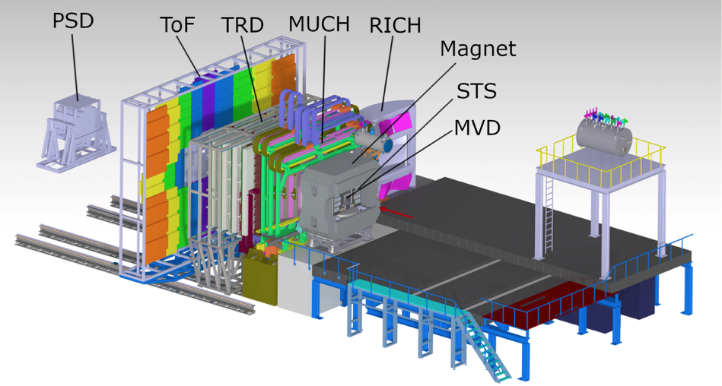
CBM Experiment at FAIR
High energy physics experiment, collisions of Au ions at 12 AGeV
HEP analysis is traditionally done in C++ within the ROOT framework
Interactive analysis and exploratory coding was long on our wishlist
Especially in the view of mCBM currently running in GSI at SIS18 accelerator: data quality, live plots, etc.
Detector systems of CBM experiment

Slide 3
Introduction
Project Jupyter provides the interactive programming environments in the web for data scientists – base for exploratory coding
Mainly in Python, but other languages such as R and C++ are there
ROOT project has support for Python since a while and Jupyter notebook integration since 2015 with ever-improving functionality
CERN developed SWAN - Service for Web based Analysis, which harnesses the power of this technology to the full – code, submit jobs, monitor your analysis – in the cloud
https://www.youtube.com/watch?v=CTfp2woVEkA
https://indico.cern.ch/event/773049/contributions/3581373/attachments/1939661/3215578/chephiggs.pdf

Slide 4
Introduction, cont.
SWAN uses Jupyterhub under the hood – lets try it out
CbmRoot is a complex software framework with many dependencies
Dockerized version is a good way for binary distribution too
Container image available at elavrik/cbmroot-jupyterhub:latest

Slide 5
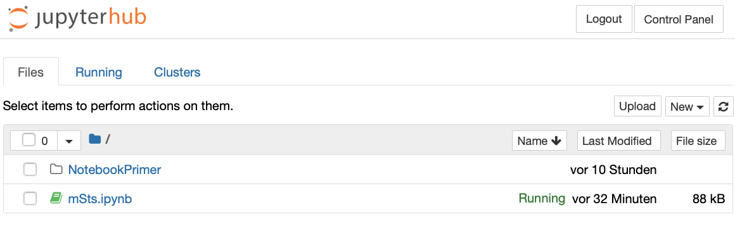
What is Jupyterhub
Service for multi-user notebook environment
Allows execution on code in a context of notebooks
Provides as well a terminal shell
Provides immediate visualization
Best way to learn: is the official
ROOT Primer

Slide 6
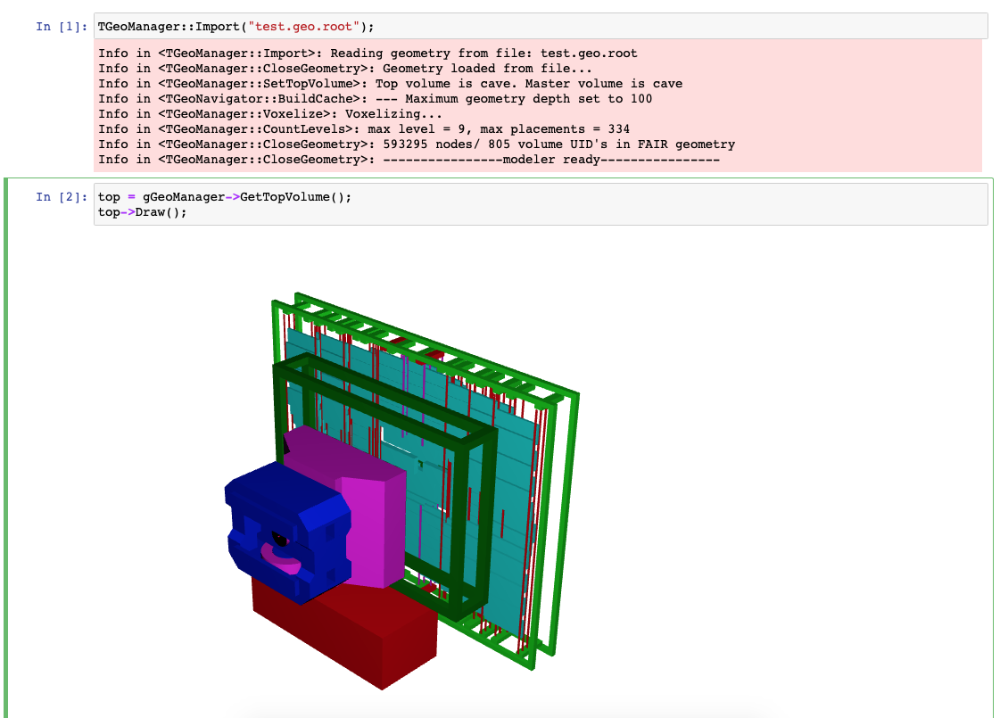
Geometry
Can be used for geometry visualisation
Not without issues though

Slide 7
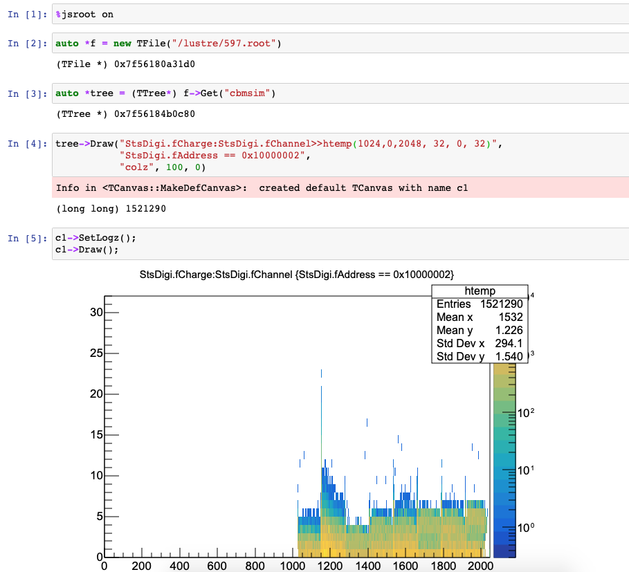
Data analysis
Perfect tool to skim the data
different variables
different data cuts
data sample sizes
etc

Slide 8
C++ Issues - variables
Kek
Solution: Restart kernel or scope out the declarations

Slide 9
C++ Issues - functions
Kek
Solution: Restart kernel, wrap the function into a class inside a scope or declare function as lambda

Slide 10
Conclusions & Outlook
CbmRoot was successfully integrated with Jupyterhub
Data access is local and through GSI DataLake, integration with Rucio based DataLake is work in progress
Authentication is local to instance, other mechanism are possible - LDAP, Kerberos, JSONWebToken and others
Custom authentication through ESCAPE services is possible
Submitting jobs from notebooks - should be possible

Slide 11
Extra
$ git clone https://git.cbm.gsi.de/evgeny.lavrik/cbmroot-hub.git && cd cbmroot-hub
$ docker pull elavrik/cbmroot-jupyterhub:latest
$ export UID
$ docker-compose up jupyterhub
# navigate with your browser to localhost:8000
# used default credentials – user: user, password: test

