Slide 1
Rucio ESAP integration
WP5 progress meeting 26-27 oct 2020

Slide 2
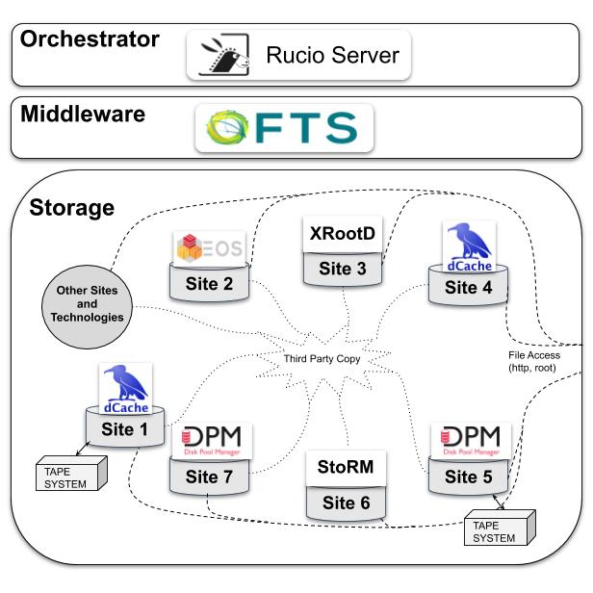
Context and recap
Rucio is the Orchestration service in the WP2 architecture
Rule-based engine
Ensure that the data is where it needs to be
Independent of underlying storage technology

Slide 3
Goals of the integation
Data access is needed to be able to do any processing.
Access to Rucio from the ESAP platform
Access from within notebooks in the Analysis part
AAI is part of this
Currently, our instance only supports X509 certificates
Intention to have OpenID Connect tokens available during the project
First step is to link to the existing API from the ESAP GUI (will demo this later on)
“Whow. This is quite a bit of security by obscurity, isn’t it? If a hacker manages to get access at all, I would say they deserve it.” – Colleague on slack

Slide 4
Status of relevant work
We’ll give some demos after this talk.
Rucio UI is now linked from the ESAP GUI
The “GSOC” Jupyter notebook integrated in the Analysis platform through Jupyter hub installation by SKAO
For this we have Docker containers which can be converted to Singularity
Within WP2 the involved projects are working through assignments to interact with the data lake, including simple work flows.
It would be neat to have the LOFAR work flow executed from ESAP

Slide 5
Looking forward
The testing period of WP2 is coming soon
The GSOC notebook is part of the things we want to show
Workflows provided by the projects
In prep to the tests, we are working through a set if execises
The exercises are a nice way to get a good feeling of interaction with Rucio. As soon as we have other AAI than X509, it would make it even easier to involve the experiments that are not part of WP2.
This afternoon -> hackathon to try and implement interactions with the REST API in the ESAP framework

Slide 6
Small glossary
RSE: Rucio Storage Element: A storage end point
DID: Data IDentifier: A name for a dataset, container or file. Generally follows the format scope:name
scope: top-level namespace for the data
dataset: A dataset is a collection of files that can be manipulated together
container: A collection of datasets (or containers ☺ )

Slide 7
Demos
GSOC Jupyterlab and Jupyter hub integration (Rob)
Integration of the Rucio UI in esap-gui
The Rucio container
Show python code examples of talking to Rucio
Show the REST API demo

