Slide 1
Virgo-LIGO Data analysis activities at IP2I Lyon
R. Chierici, V Sordini

Slide 2
Why?
The confirmation of the existence (and the subsequent study and understanding) of Gravitational Waves (GW) is of utmost importance for:
Testing general relativity
Studying the deep sky with a brand-new (non-electromagnetic) source of signals
This has immediate and far-reaching consequences in the domains of astrophysics, cosmology, nuclear matter, particle physics
The only detectable GWs on earth can be of astrophysical origin
We must resort to the most violent astrophysical events
Coalescent compact binaries are good GW radiators
They occur frequently in the universe and they are the loudest expected GW sources (in their frequency band)
Best candidates are Black Holes (BHs) and Neutron Stars (NSs)

Slide 3
The power of Compact Binary Coalescences (also known as CBCs)
The direct observation of CBC signals has multiple implications
Confirmation of the existence of gravitational waves
Direct determination of the rate of these occurrences in the observable space
Assessment on rates and population of BH and NS
CBC waveforms encode much more information
Masses and spins of the individual object and the final object
Test the uncertain BH mass distribution and the maximum allowed mass for a NS
Information on tidal deformations
Constrain nuclear matter of state for NS
Help in constraining other cosmological facts
Infer the Hubble constant via an estimation of the redshift of the GW
Check counterparts for completing the information on the source (multi-messenger astronomy)
Electromagnetic: Direct redshift information, check for coincident gamma ray burst emission for BN-X mergers
Neutrinos: information from inner regions of astrophysical engines
Probe dark matter candidates in coalescences
Primordial black holes, axions, ultralight bosons forming compact self-gravitating configurations…
Possible deviation from GR expectations…

Slide 4
Keep in mind: not only CBC…
There are different types of searches for GW signals in LIGO-Virgo
Many other astrophysical sources: pulsars, supernovae, unknown sources?
Transient sources
Coalescences of compact binaries (known waveform assumed)
Generic GW bursts (poorly modeled)
Persistent sources
Continuous waves (from pulsars)
Stochastic (relic GW from early evolution of the Universe)

Slide 5
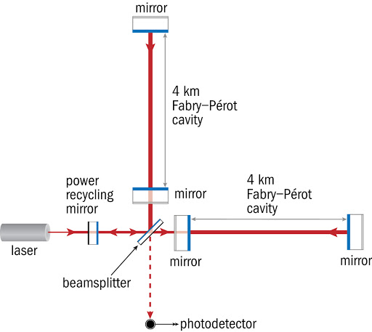
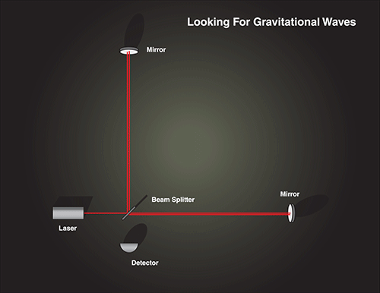
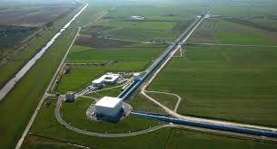
How? Principle
Gravitational waves are distortions of the spacetime curvature happening in a plane orthogonal to the wave direction
Their passage induces an apparent distortion of the mutual distances of particles in our reference frame
Use an interferometer to study them
The wave amplitude is physically represented by a (dimensionless) strain
Measure the strain (O(10⁻²¹ !!) by the shift in wave-phase
Need Km-scale arm lengths !

Slide 6
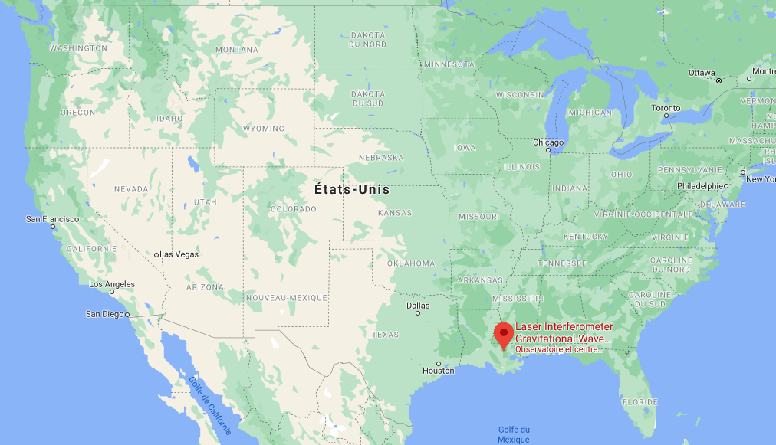
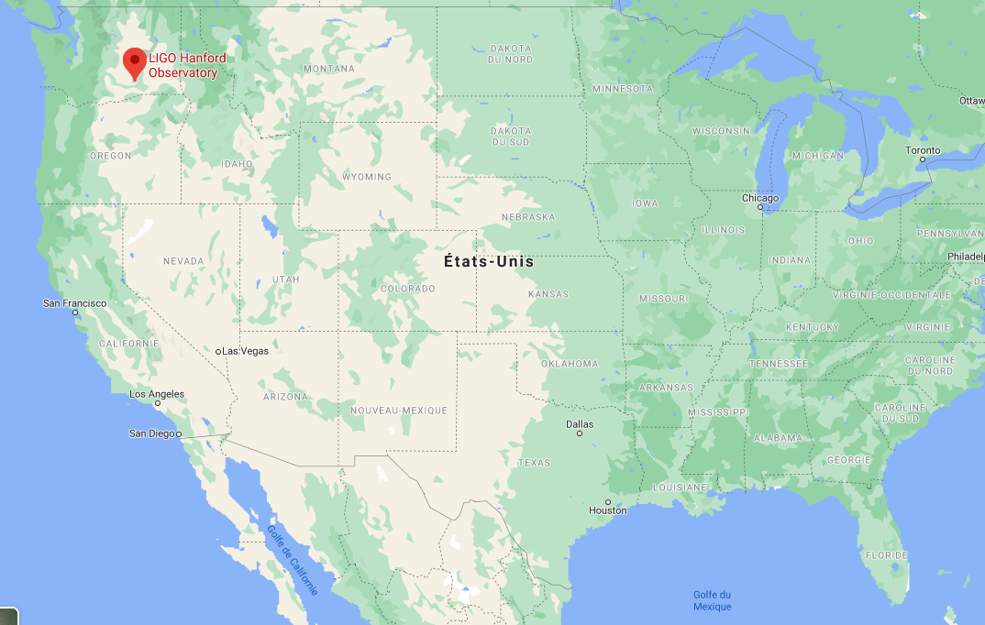
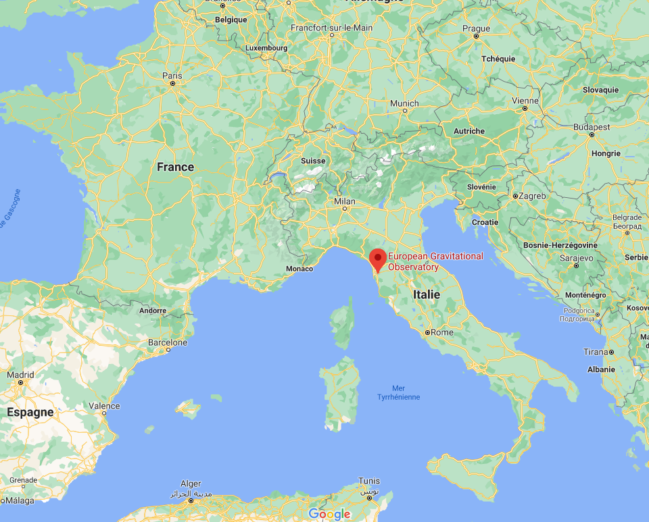
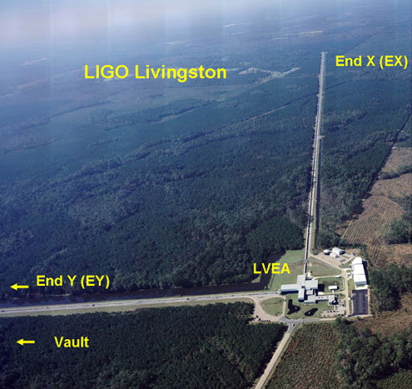
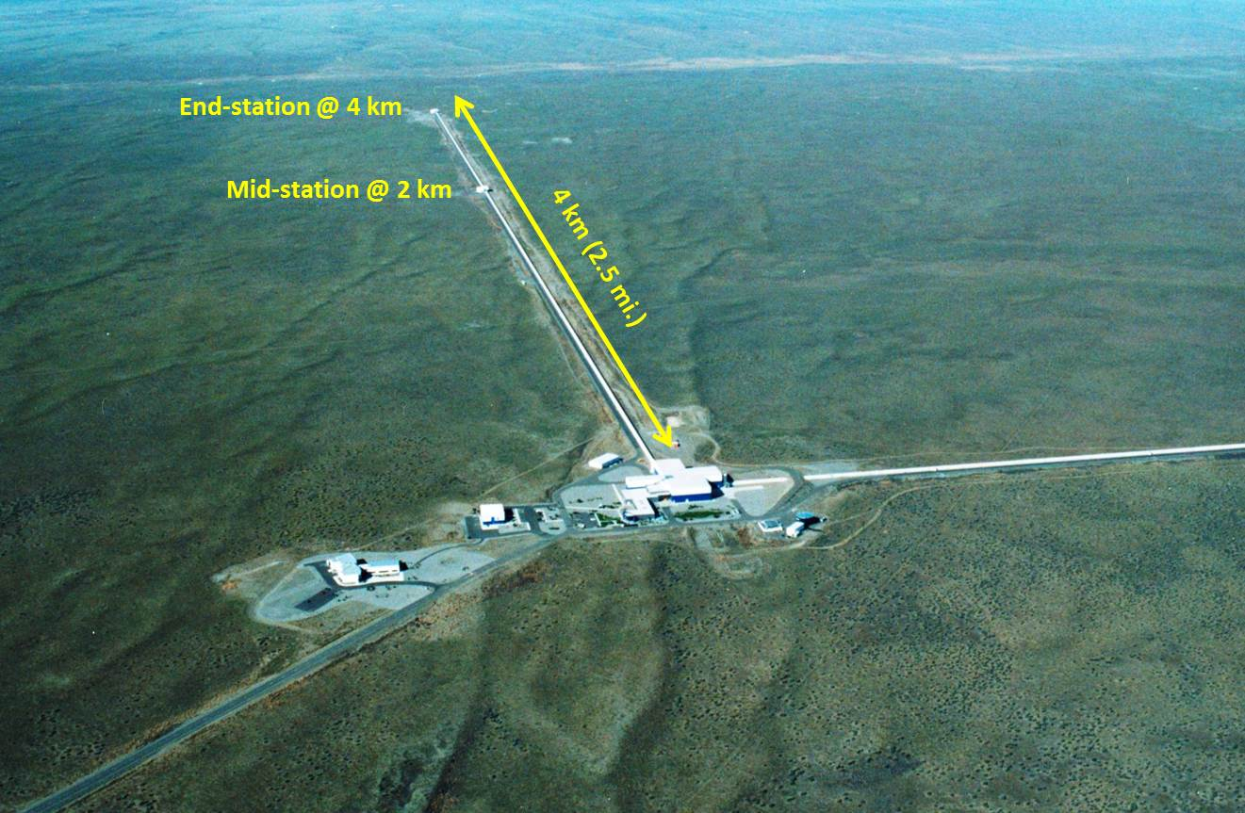
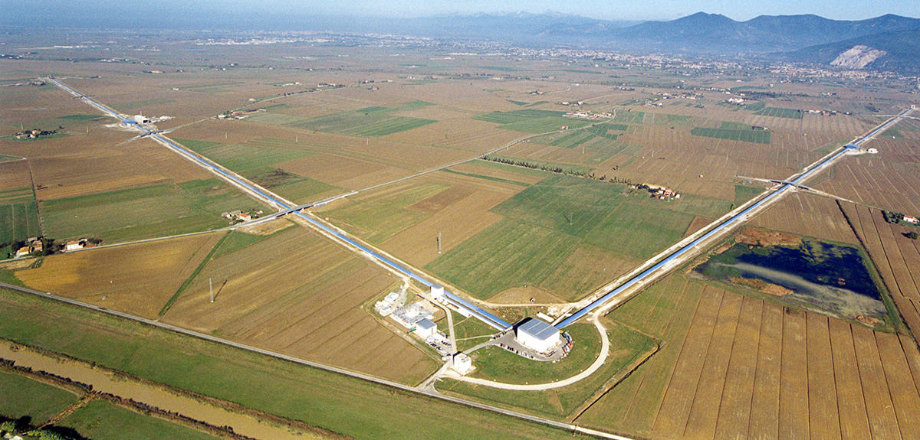
How? Detectors running in O3 (2019-2020)
LIGO Livingston
LIGO Hanford
Virgo

Slide 7
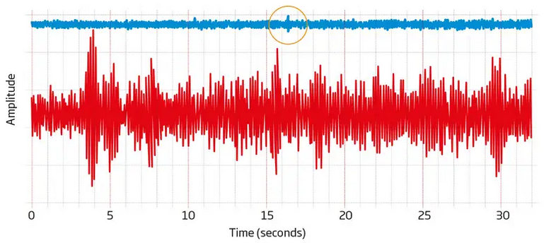
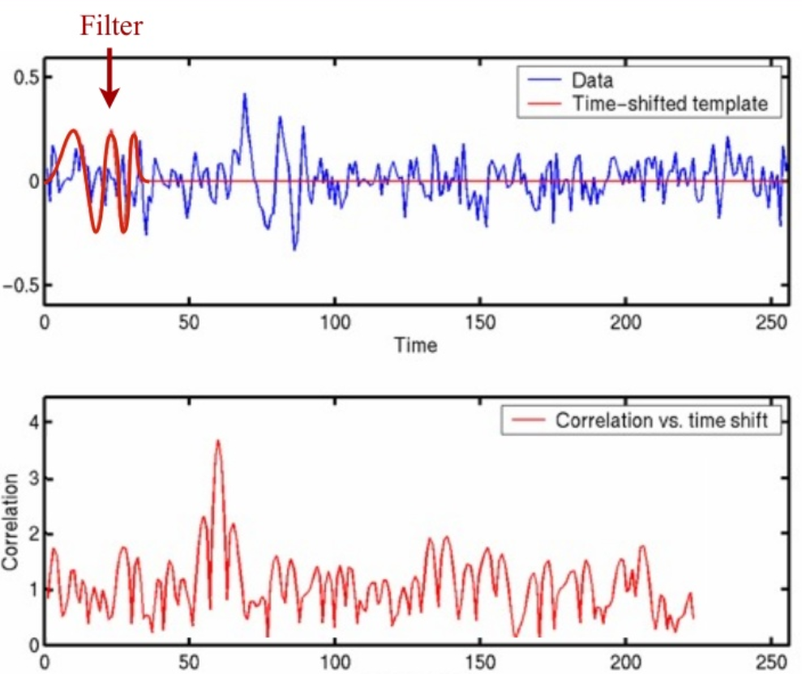
How? Data analysis (1/2)
The time series (h(t)) from the interferometers’ signals are very sensitive to many undesired “earthly” effects: seismic noise, human noise, optical noise
The signals we look for are transient events of typical durations 0.5-100 seconds
The kind of waveform and duration are quite different according to the type of coalescence
BH-BH, BH-NS, NS-NS
function of their masses, possibly their spins
Strategy for digging out a signal
h(t) is whitened
known noise subtracted
The signal is calibrated
the presence of waveforms looked for by matched filtering techniques (using known waveforms as signal templates)

Slide 8
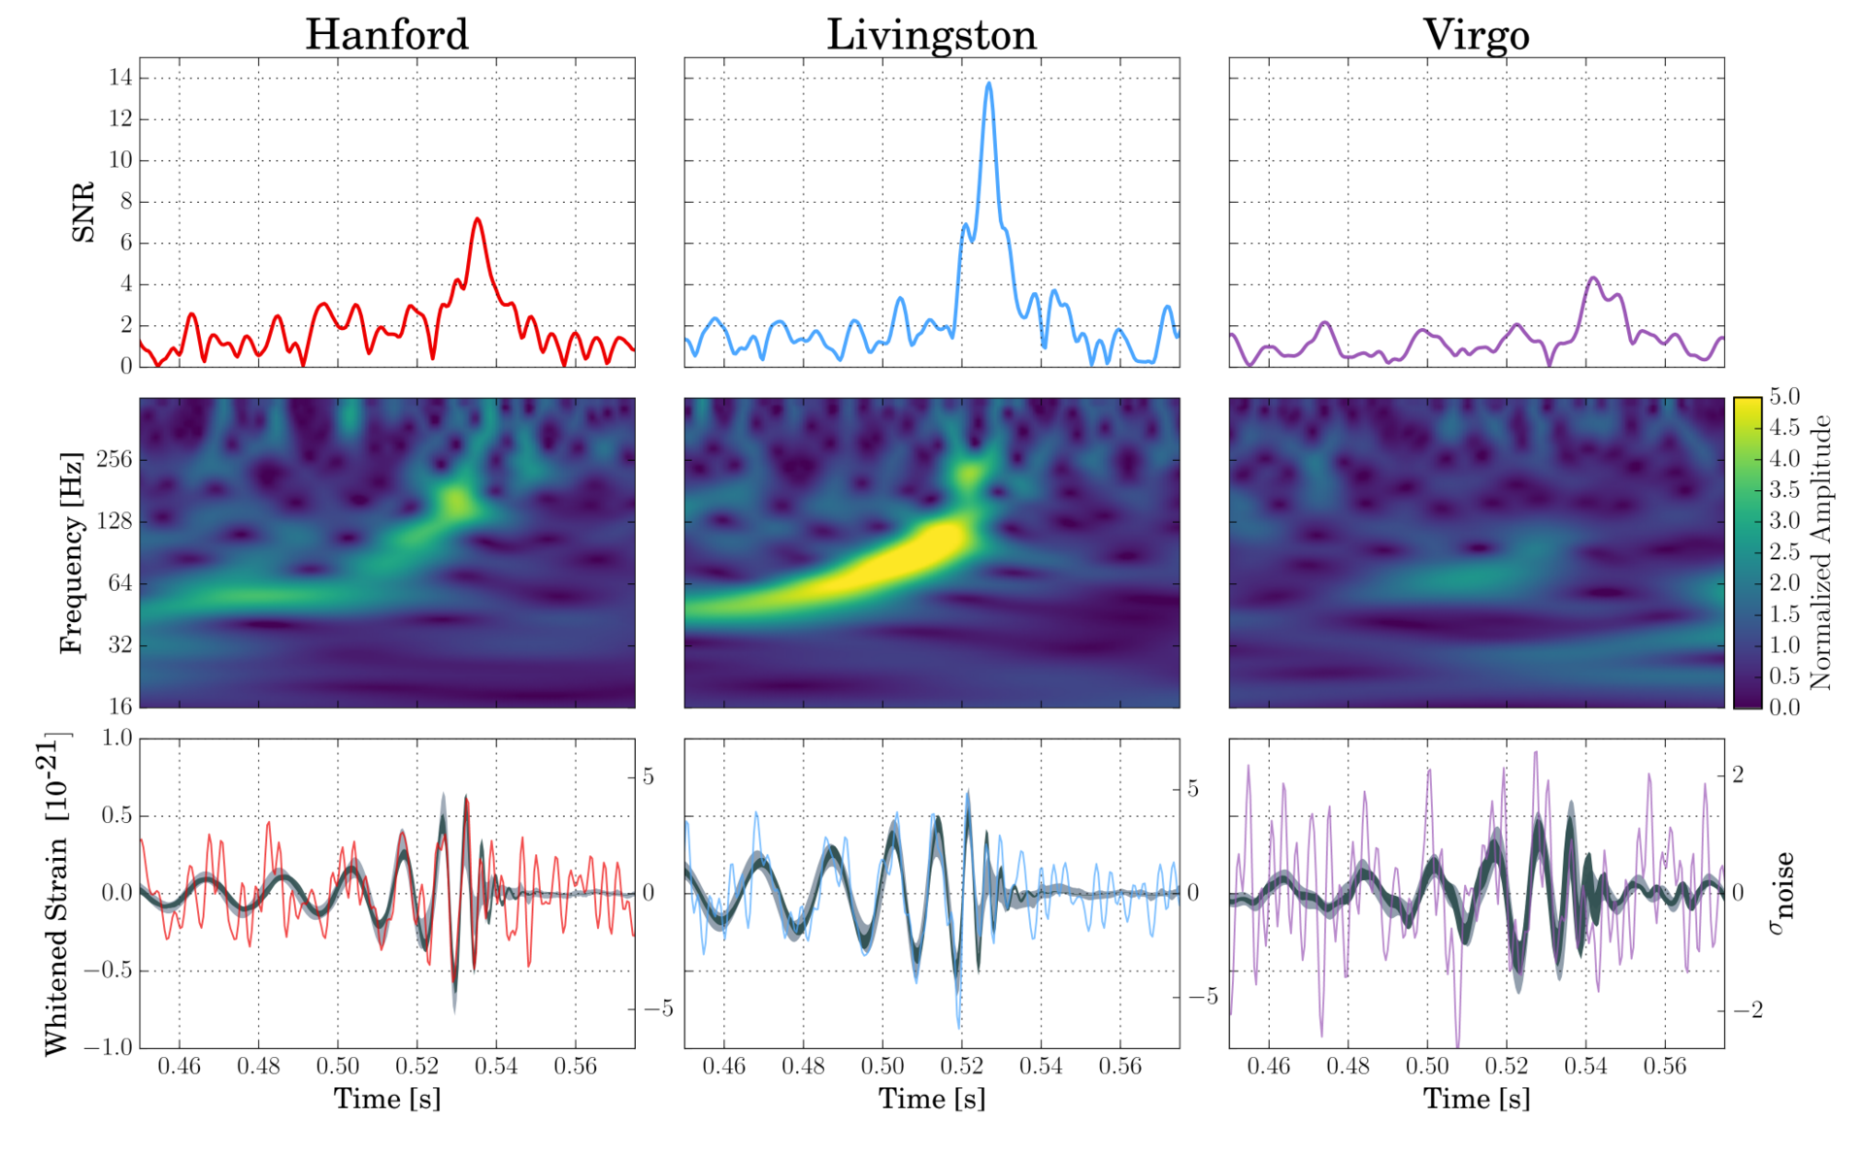
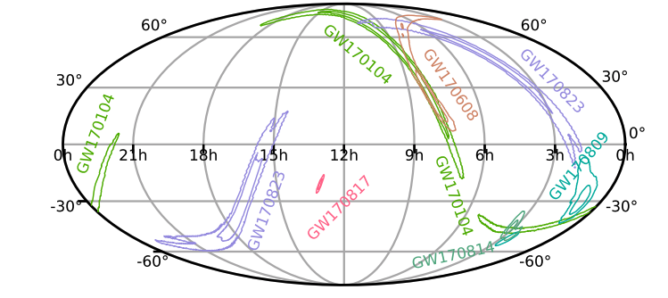
How? Data analysis (2/2)
Example event GW170814
Use the coincidences of multiple detectors to drastically reduce local noise
Check if the same template waveforms is consistent with data across time-shifted h(t) from different detectors
Information from many places on earth also allows sky localization
Several observations of CBC signals have been already made by LIGO-Virgo in the O2 (2016-2017) run
More observations in O3 from the improved sensitivities of the detectors
A few papers on exceptional events already out

Slide 9
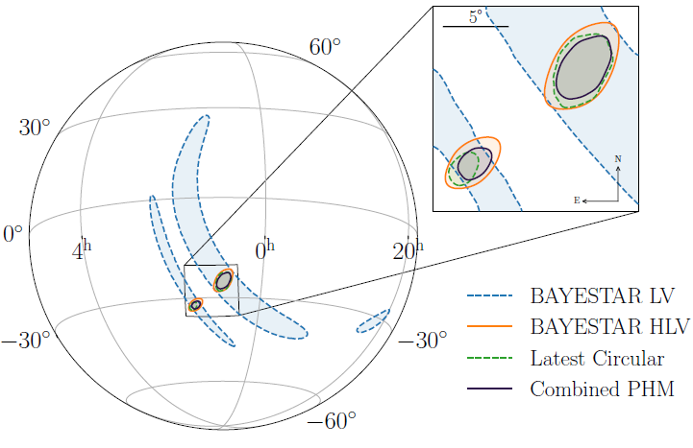
Online and offline data analysis(CBC)
Analyses running « online » (low-latency, fast-response) for alerts
Three pipelines during O2
GstLAL, PyCBC from LIGO groups
MBTA from Virgo groups (LAPP, Urbino)
Essential for multi-messenger astronomy
Analyses running « offline » for publications
Use of the official final data calibration
Use updated data-quality vetoes
Refined monitoring of efficiency and fake rate
Better determination of the parameters
Only two pipelines during O2
Only the LIGO ones
Example event GW190814
GW signal (BH-? coalescence)
Most asymmetric coalescence to date
Spatial resolution: 18.5 deg²

Slide 10
Who?
Analysis-wise, the LIGO and Virgo collaboration(s) (LVC) work together
The data stream is accessible for analysis to any of the groups belonging to the LVC
I.e. Virgo data are accessible to scientific groups belonging to LIGO, and vice-versa
Meetings to present and discuss the results, as well as to plan publications and dedicated studies, are common
The IP2I group has entered recently (2019) the Virgo collaboration and is contributing to the LVC CBC analysis via the Multi-Band Template Analysis (MBTA)
Two persons full time to analysis, previous experience from high energy physics
One student recently joined
Work in collaboration with members from groups in Annecy, Strasbourg, Urbino
This group also participates to the characterization of the detector and monitoring of the quality of the data (in collaboration with EGO/LAL)

Slide 11
Analysis timeline and activities
Main current aim: port the MBTA pipeline offline for the search of CBC signals
Participate to the analyses (and subsequent papers) of the O3 observation run (2019-2020)
First Virgo analysis on offline detection of coalescent binaries
Task is not straightforward: many new challenges for offline…
Handle massive runs and test performance on simulation before looking at the data
…but also opportunities
No tight latency constraints, may loosen thresholds to increase in acceptance w.r.t. the online version, use more background time to reach lower fake rate values for significant events,…
A lot has happened since last year
Analysis ported and running at the French CCIN2P3
Tuning of parameters, configuration, analysis flow and strategy
Systematic characterization of the analysis on simulation, comparison with other groups
Successfully run over all the O3 data
Work now ongoing for the interpretation of the results
Group integrated in the LVC CBC community; regular reports ongoing

Slide 12
Multi-Band Template Analysis
Novelty: use several matched filters to extract the GW signal from the data by a split in the frequency domain
Split across two (or more) frequency bands
Bands chosen so to ~equally share the signal-to-noise ratio (SNR)
Each band is analyzed independently, and the results are then combined coherently
Reduce computational costs, with ~no loss in SNR wrt single-band analyses
Less number of templates needed, the size of the FFT is reduced

Slide 13
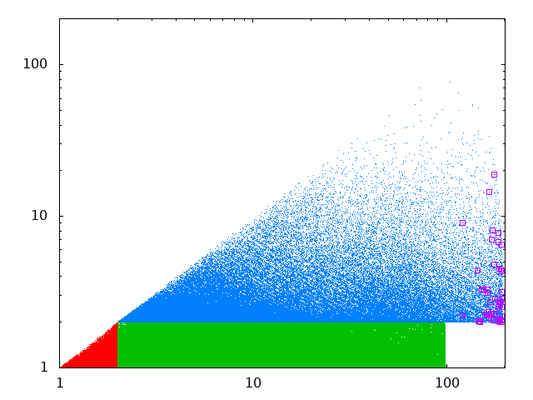
Multi-Band Template Analysis
The filtering is done by testing a huge number of signal templates from known astrophysical sources (NS-NS, BH-NS, BH-BH)
Template banks:
BNS: 26170 templates
BHNS: 522934 templates
BBH: 169427(standard)+9000(ungated) templates
The searches are performed independently
Results put together a posteriori
Computationally very intense
m₂ (m)
BBH-2
BBH-1
BNS
NSBH
m₁(m)

Slide 14
Multi-Band Template Analysis
MBTA filtering
- Low+high frequency
- Corrections to data
- Background determination
- Build coincidences
- Clustering
h’_{j}(t)
Single triggers
Data pre-processing
Frequency filtering
Adding injections
Gating channels
Coincidences
Final analysis, interpretation
FAR
h’_{j}(t)+injections
Single triggers
MBTA filtering
- Low+high frequency
- Corrections to data
- Build coincidences
- Clustering
Plots
Tables
Web pages
Presentations
Coincidences
Full chains running at the CCIN2P3
1 year of data taking analyzed
60K injections/week analyzed in parallel

Slide 15
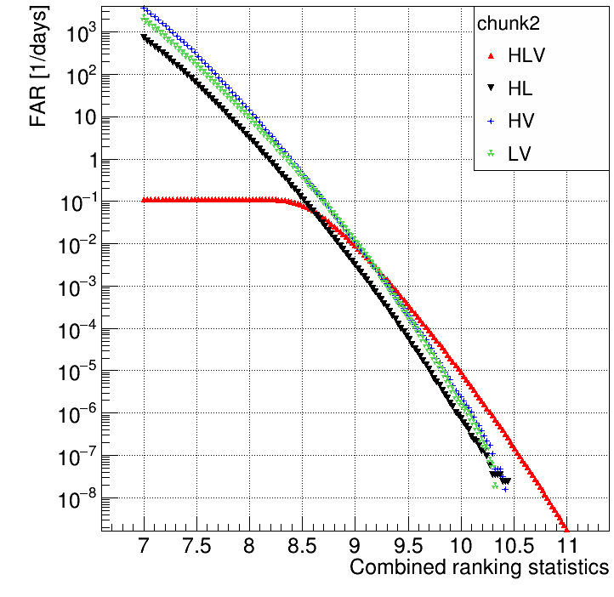
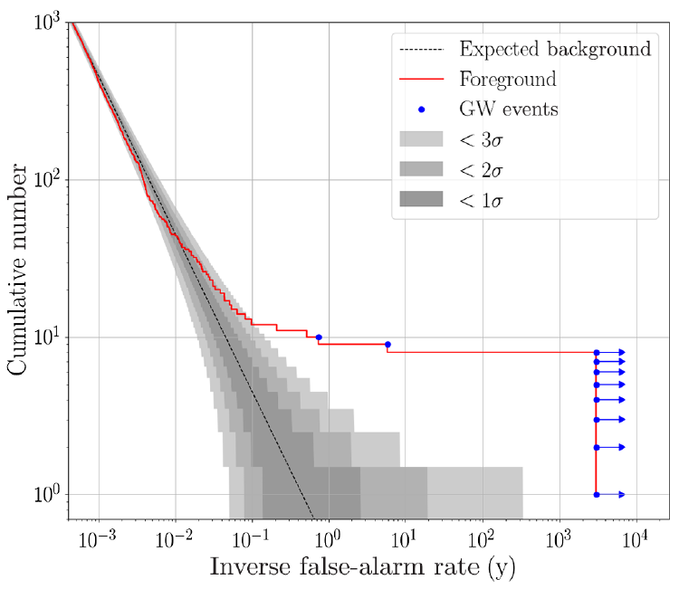
Background determination by using the data
In order to determine the fake rate (FAR), the probability of getting an accidental coincidence between two (or three) detectors above a certain SNR threshold is determined by using single trigger information
They are overwhelmingly dominated by background, but real signals can be subtracted
Combinatorial approach: count the rate of random combinations of single triggers from the same template and coming from two (or three) different detectors which gives rise to a combined SNR larger than a threshold
Real astrophysical signals would appear as outliers in a cumulative FAR/IFAR plot
$$\int_{y}^{∞}{n\left(IFAR\right)dIFAR}$$
$$FAR("SNR")$$
Expectation in case of only background

Slide 16
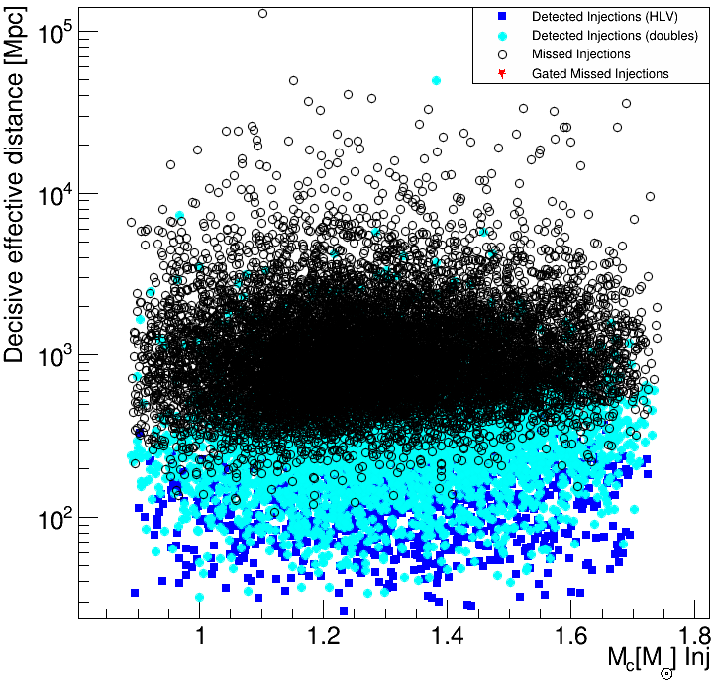
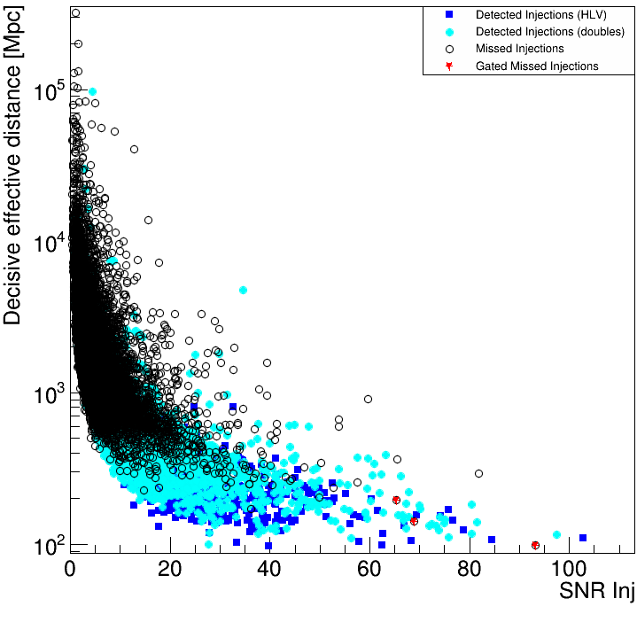
Performance on simulation (1/2)
The detection chain is systematically tested on simulated “injections”
Known waveforms superimposed to background at known times
The ability to detect them is investigated as a function of several parameters
BNS
BBH
BNS:=[1 M,2 M]x [1 M,2 M]
BHNS:=[1 M,2 M]x [2 M,100 M]
BBH:=[2 M,200 M]x [2 M,200 M]

Slide 17
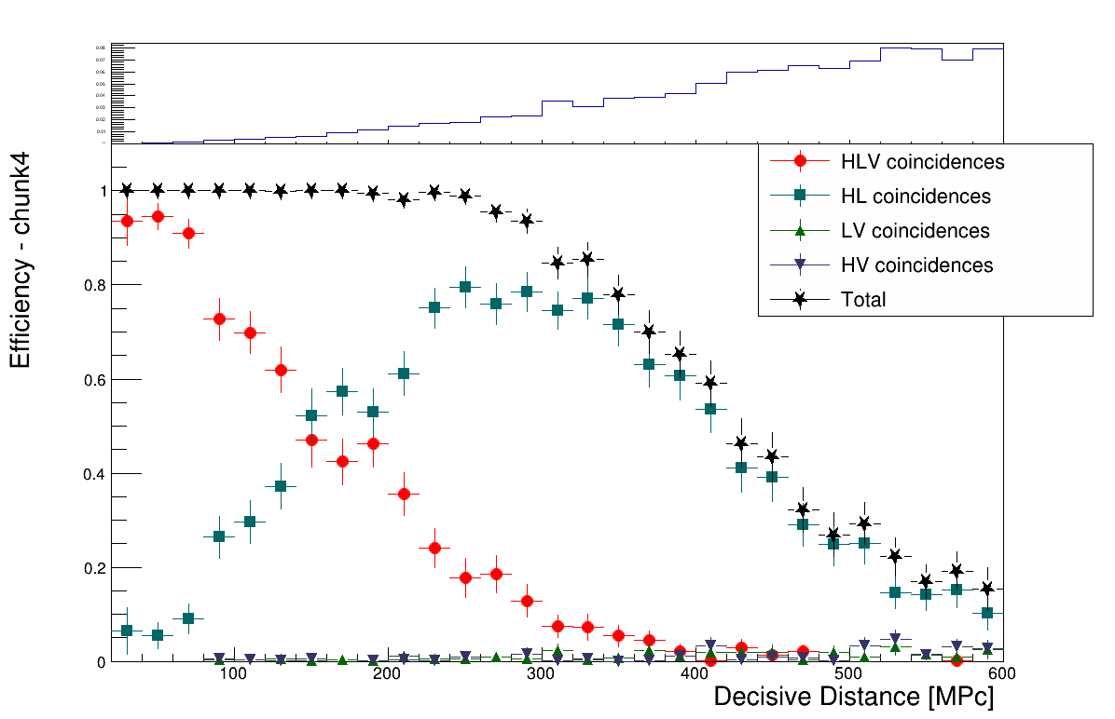
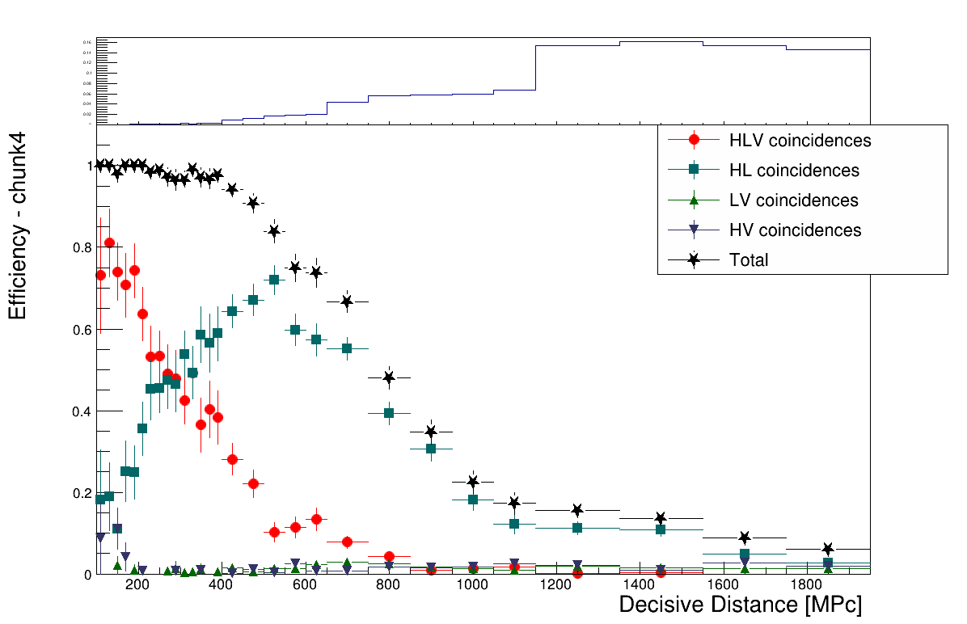
Performance on simulation (2/2)
The “hit and miss” plots are easily converted in efficiency figures
Needed to quantify performance
Presentable differentially in the interesting variable(s)
BNS
BHNS

Slide 18
Stay tuned
New group at IP2I has joined the existing Virgo activities
2 people, started 1.5 years ago
Now reinforced with one more student
Mainly dedicated to LIGO-Virgo data analysis
Well on track to participate to O3 data analysis for CBC searches
We are regularly presenting our results on candidates in O3 data
Participate to the O3 catalog papers, possibly on rates and population papers
Contribute to other papers on exceptional events (if any ☺)
Busy and exciting times, stay tuned…

Slide 19
Backup

Slide 20
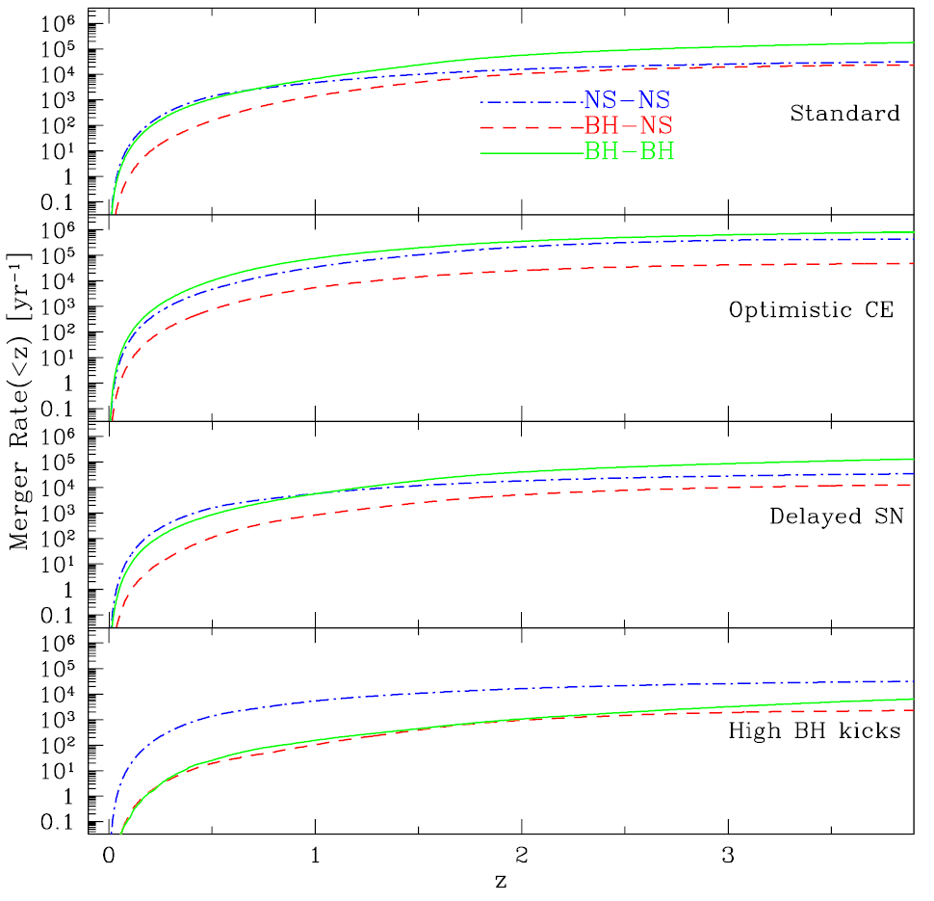
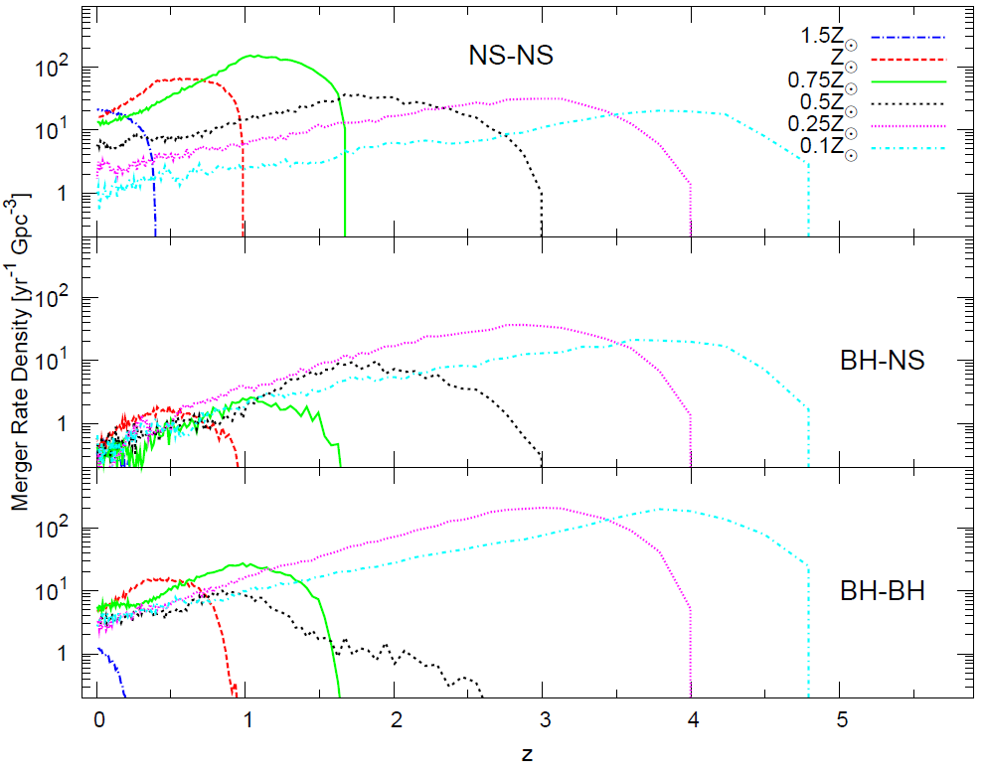
Predicted rates
Study merger event rates as a function of redshift and metallicity, in several binary evolution scenarios. Results from arXiv:1308.1546v3

Slide 21
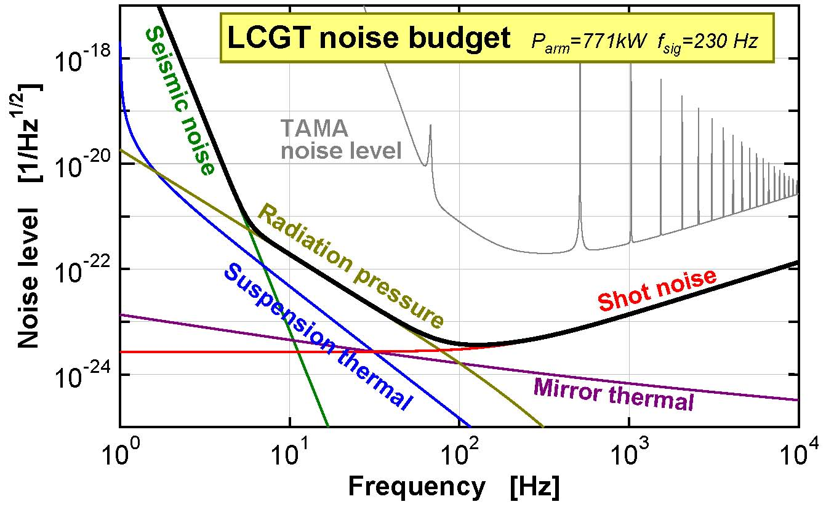
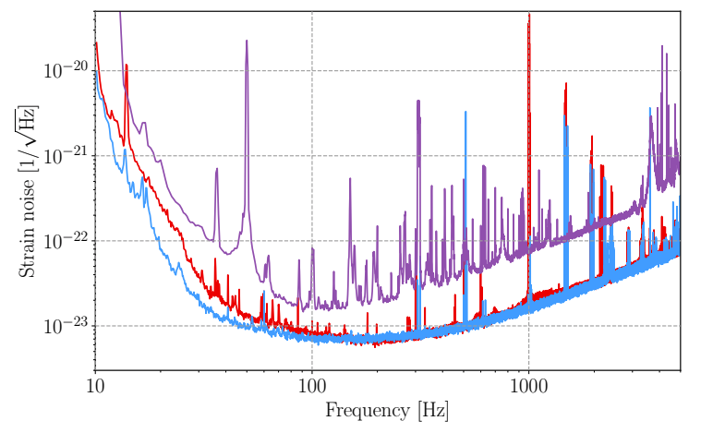
Noise profile
At low frequencies dominated by seismic noise
At high frequency we lose sensitivity because of the limited arm length, making the shot noise from individual photons become the dominant noise source
Typical sensitivity to CBC signals in the 10-1000 Hz regime

Slide 22
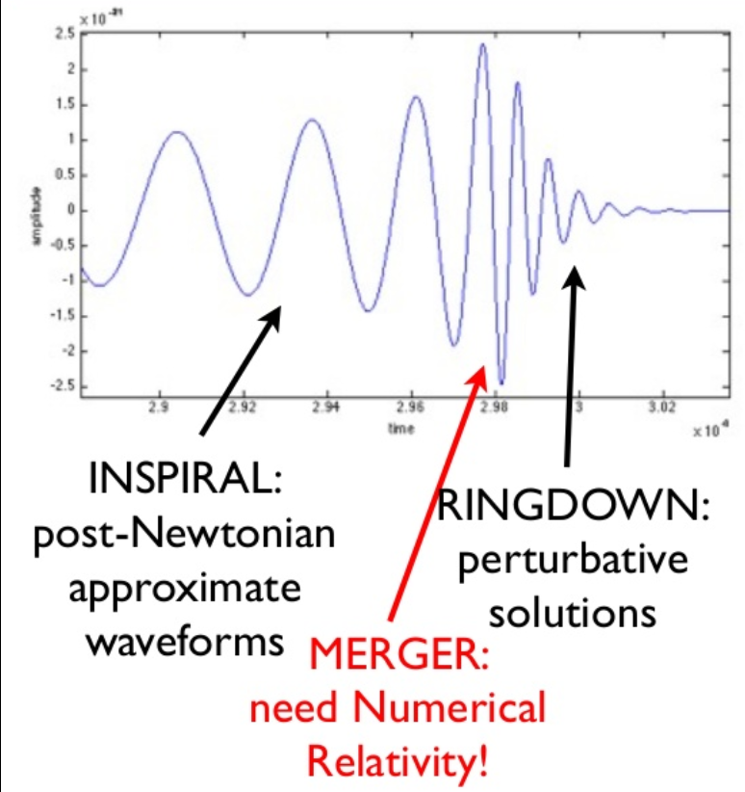
Waveforms basics
Typical frequency scales with 1/M
For massive systems (>50 M) merger and ringdown features may contribute significantly to the signal SNR
Spins, as well as matter effects, may add complications
The number of parameters to describe a CBC waveform, θ, is large
Coalescence time and phase
Masses m1 and m2
Distance (=amplitude of the signal)
Spins s1 and s2
Sky position (RA and dec (α and δ), for instance)
Inclination of the orbiting plane (ι and ψ: inclination and orientation)
Eccentricity (typically small → neglected)
Matter distribution and parameters of the EOS (irrelevant for a search)
Directional sensitivities of the interferometers
Strains from the GW
Chirp mass
pN-corrected GW phase
Effective distance: a degenerate parameter encoding several ones

