Slide 1
ITK Pixel Mechanic activities
Laurence Caillat, Jea-Philippe Logier, Mathieu Niclas, Francoise Riviere, Eric Vigeolas

Slide 2
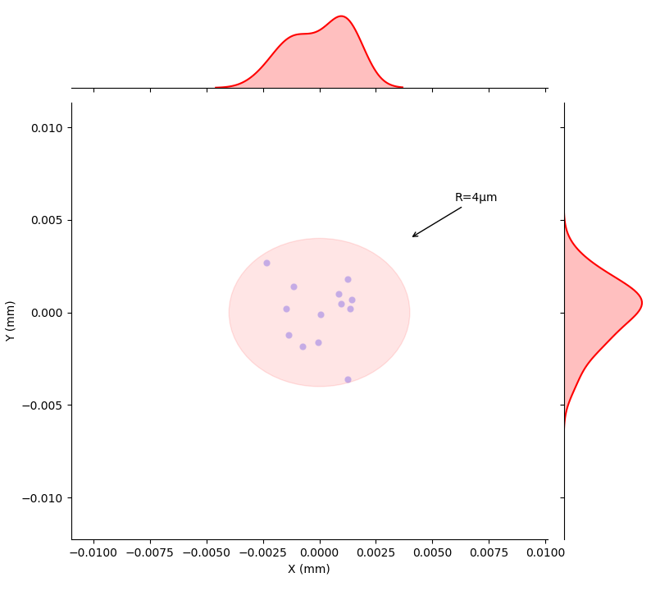
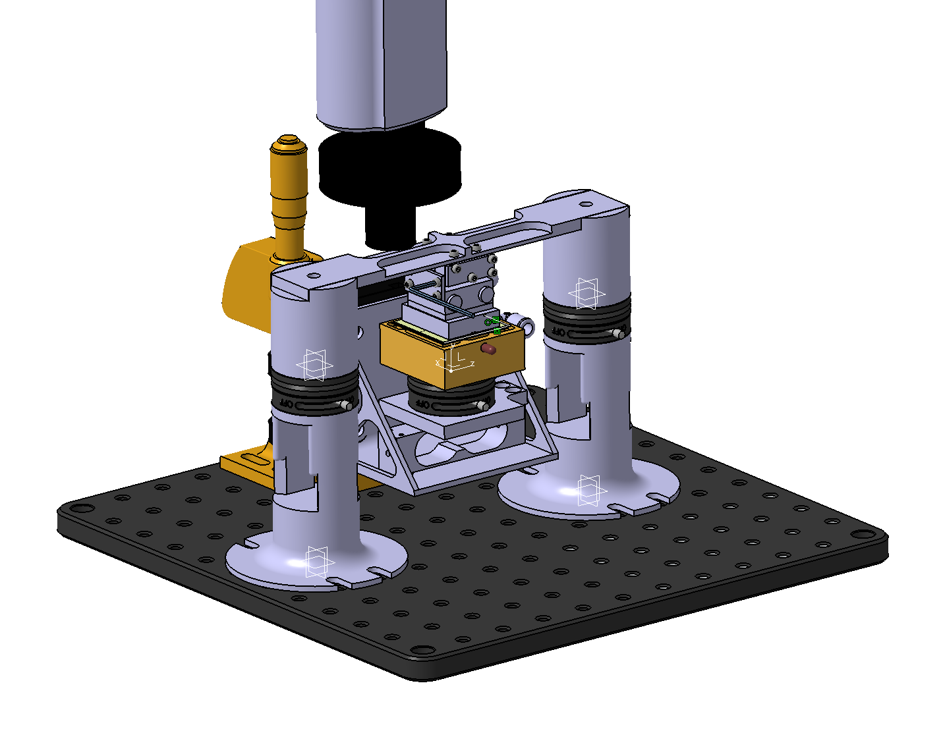
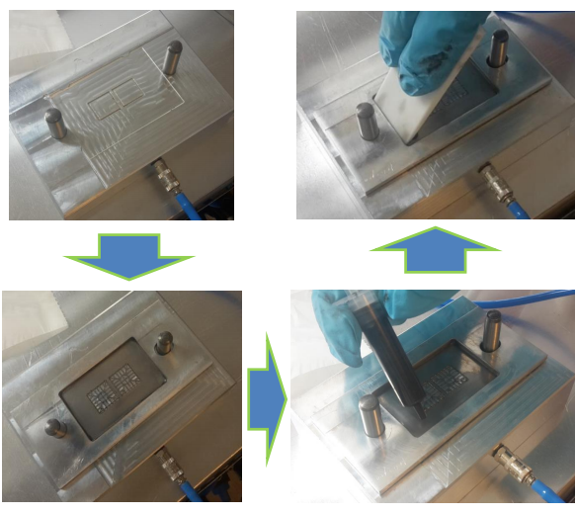
Module loading
A pre-qualification exercise is ongoing to qualify sites which will be involved in the RD53A module loading for slice prototypes production
This exercise aim is to qualify the glue deposition technic (deposition uniformity, glue thickness after module assembly and chip glue coverage) and the module deposition technic (module loading precision)
Load Glass tiles (~5 good) on aluminum cells
Load Glass tiles(~3 good) on graphite cells
Measure glue thickness, coverage area and pattern
Load Silicon dummies (~5 good) on aluminum cells
Measure position of tile
Load Silicon heaters (~10) on graphite cells
Measure thermal performances
During this test campaign, all information will be stored on a google doc to train the data tracking as an database trial exercise
CPPM will be the reference site to measure placement accuracy and glue thickness and surface coverage for all the sites
@ CPPM we are currently qualifying the placement accuracy which was note measure in none of the sites up to now→ accuracy reached ±0.03mm with a repeatability of 4 µm (the current goal is ±0.05 mm)
A new module loading had been designed and manufactured
We do have the capability to perform manual stencil glue deposition and automated glue deposition
Planar repeatability measurements
New cell loading
tool design
Tencil deposition tool (LPSC)

Slide 3
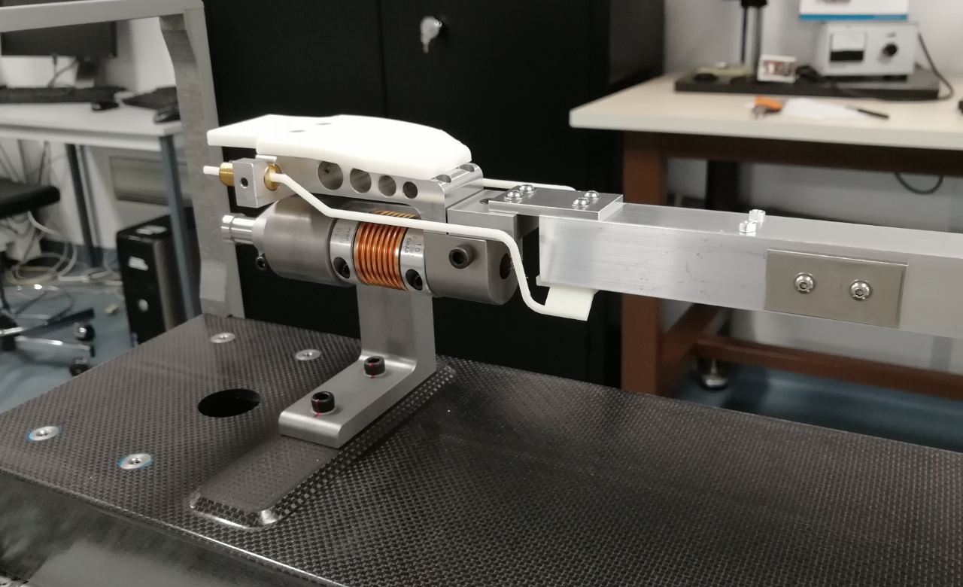
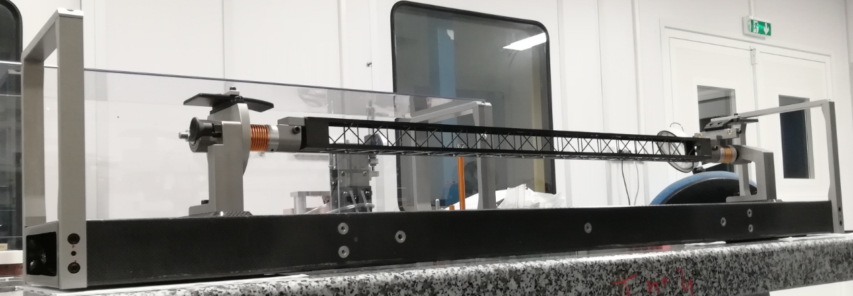
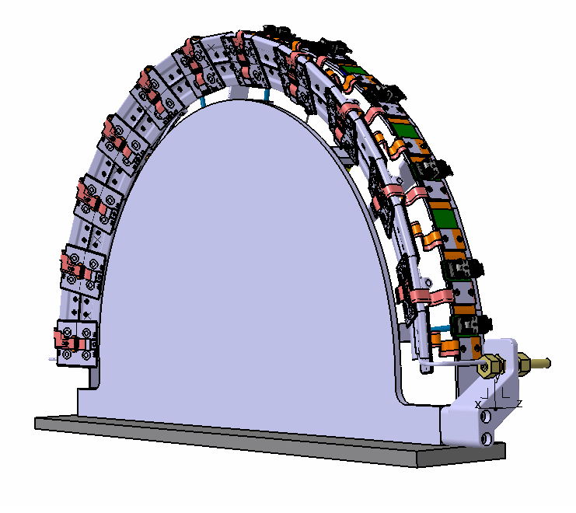
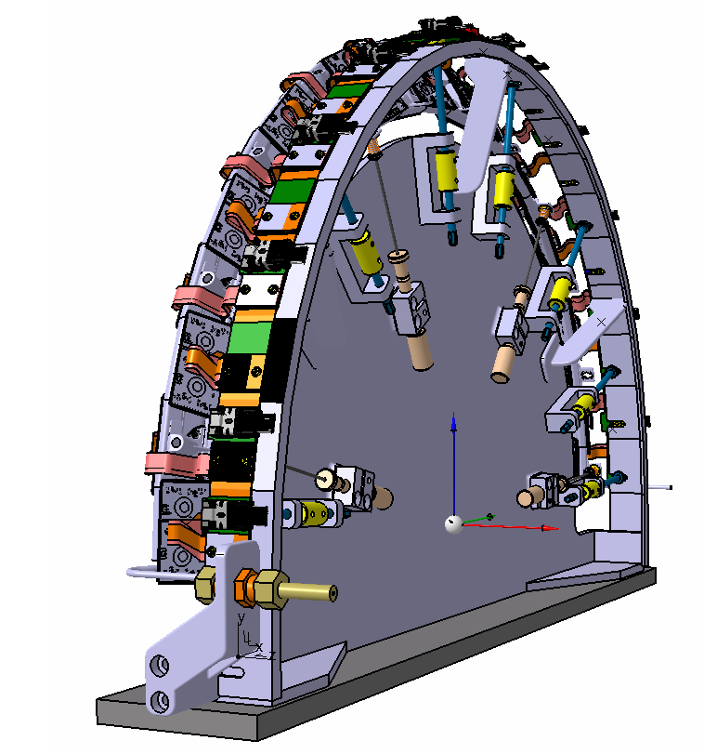
Handling Frame
Longeron handling Frame has bee manufactured and is currently under qualification
Geometrical qualification
Thermal qualification
Shipment qualification
Functional qualification
No show stopper found, the manufacturing quality is above our best whishes
A new batch of 2 handling frame “longeron” will be manufacture by end of this year, these HF will be used for the prototypes and tool design ongoing at CERN, LAPP, LPSC and CPPM
Inclined ring handling frame design is almost completed, final validation with CERN and the manufacturing company will be done soon

Slide 4
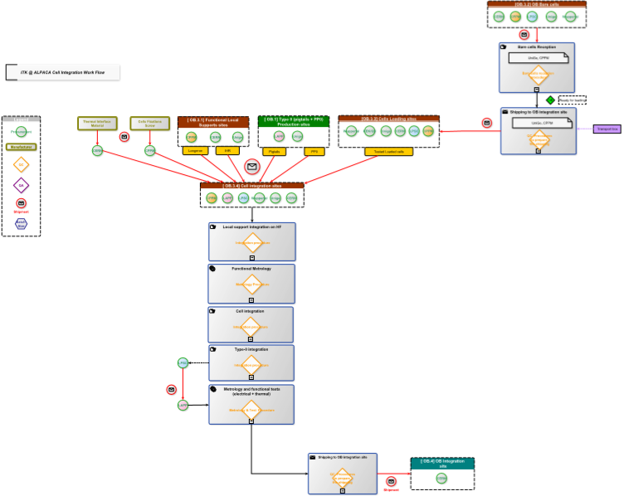
Production Room setting
We are working on the clean room setting for the production
Set rules to set the room as a clean environment
Room users (external to Atlas) management has been set and a close control of the room accessibility will be defined (agenda and authorization when sensible elements will be presents)
Room equipment procurement (gaze control equipment, dry storage environment, glue area with safe aeration, setting all equipment (chair, tables ..) to ESD protection state
We are working on the process flow chart
Tasks procedures
QC points and DataBase interaction
Shipment and storage processes
The workflow process will help to finalized the CPPM documentation database (Atrium), the nomenclature and data management

Slide 5
Incoming actions
Cppm is involved in local support design and qualification. All thermo mechanical measurements will be done in our lab this is mandatory for the Local Support (LS) FDR (26/04/2021)
Cell loading will be an important action for both LS FDR and loaded Local support FDR (28/10/2021) for with services will be qualified on slice prototypes
CPPM will participate to local support production by performing metrological control on longerons and inclined rings (05/2022 → 09/2023)
Cell loading and integration preproduction will start in 03/2022, all tools and equipments will have to be fully qualified by this date. Full module loading task will start 07/2023 –02/2025)
On important involvement of CPPM is the global mechanic coordination. The PDR is foreseen in Dec 2020 and FDR in Jan 2022, This will be an important activity in parallel of local support development

