Slide 1
Rucio-SWAN Integration Project
Google Summer of Code 2020 with CERN-HSF
Muhammad Aditya Hilmy
mhilmy@hey.com
Notes:
What I want audience to know:
“A tool to make procuring scientific data as easy as online shopping and how it works”
Introduce myself
Name, major, university, country, “GSoC”

Slide 2
How can we help scientists work productively in the Exabyte-scale era?
THE BIG QUESTION
Notes:
The big question is how can we help scientists to work productively in the exabyte-scale era? Especially when in the coming years we will have High Luminosity LHC coming online, which will produce LOTS of data.

Slide 3
Rucio
Keeps track of data locations
Moves data around as needed
De facto standard for scientific data management
SWAN
Online interactive Jupyter notebook
No installation needed
Enables collaboration through notebook sharing
Notes:
To face this challenge, we have two tools at our disposal:
On one hand, we have Rucio which manages data at scale; it knows where the data is located, how to access it, and it moves the data around as needed. (explain more)
On the other hand, we have SWAN/Jupyter which enables scientists to perform computation and analysis with minimum effort to get it going. (explain more)
The natural step would be to integrate these two tools, so that we can have scientists perform analyses on large data with ease.

Slide 4
Integrating those would enable scientists to perform analyses on large datasets with ease. No installation and configuration needed.
INTEGRATING RUCIO AND SWAN

Slide 5
What it takes to use Rucio-managed data in SWAN
Download the data on your local machine and upload it back to SWAN
This is the simplest way of doing this
Suitable for end user analysis
If the work is shared, everyone running the notebook should do the same
There is no association between the Logical File Name (LFN) and notebook

Slide 6
What it takes to use Rucio-managed data in SWAN (2)
Download the data directly from SWAN using Rucio CLI client
This is more practical than download-reupload
Requires users to install rucio-clients
Adds clutter to the notebook
If the work is shared, everyone running the notebook should do the same
There is no association between the Logical File Name (LFN) and notebook

Slide 7
What it takes to use Rucio-managed data in SWAN (3)
Use Rucio to move the data to a network storage attached to SWAN
Users can use rucio-cli or Rucio web interface
The CLI and web interface are feature-packed
But might not be relevant to scientists
There is no association between the Logical File Name (LFN) and notebook
Notes:
Or.. You could use the Web UI—which is great btw—but still loaded with plenty of features that might be irrelevant for some scientists.

Slide 8
Notes:
It could be frustrating if you do it repeatedly.
Procuring the data, in the context of core vs context, is context. It uses up time and energy scientists could use somewhere better.
Rucio and SWAN are very helpful already, but we can do better.

Slide 9
What if, we can make it as easy as online shopping?
Notes:
What if we can make the process of procuring the data, as easy as online shopping?
Users can just pick whichever data to use, and do a simple “add to cart” click.

Slide 10
Introducing, Rucio JupyterLab Extension.
(I haven’t thought of a cool name for this project, so let’s stick to this extraordinarily ordinary name)
Notes:
So that’s what we did.

Slide 11
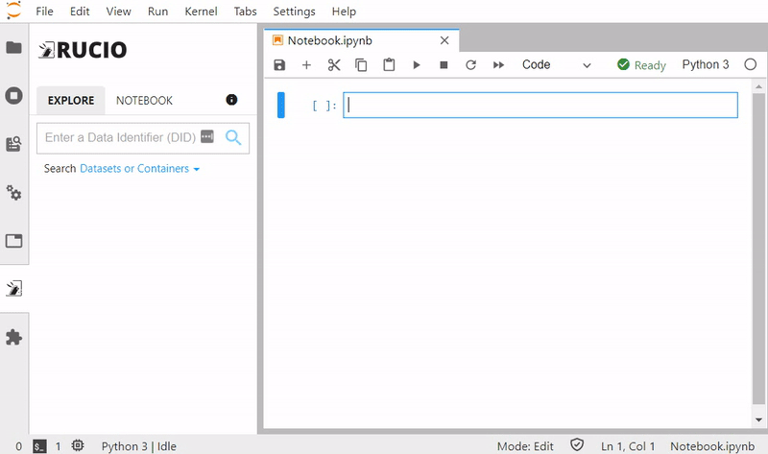
Notes:
So this is how it looks like.
The extension lives on the left sidebar of the JupyterLab interface.
Users can find the data they need directly from the JupyterLab interface
They can simply click on “Make Available” to procure the data.
They can click on “Add to Notebook” to inject the path string into a variable accessible from within the notebook.

Slide 12
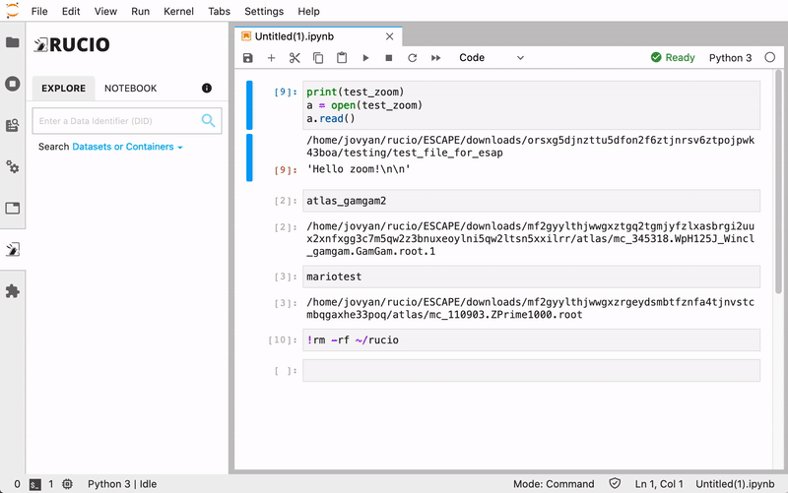
Notes:
This is what happens when you share the notebook with your colleague and the files hasn’t been made available there.
Your colleague can simply click the “Make Available” button again.

Slide 13
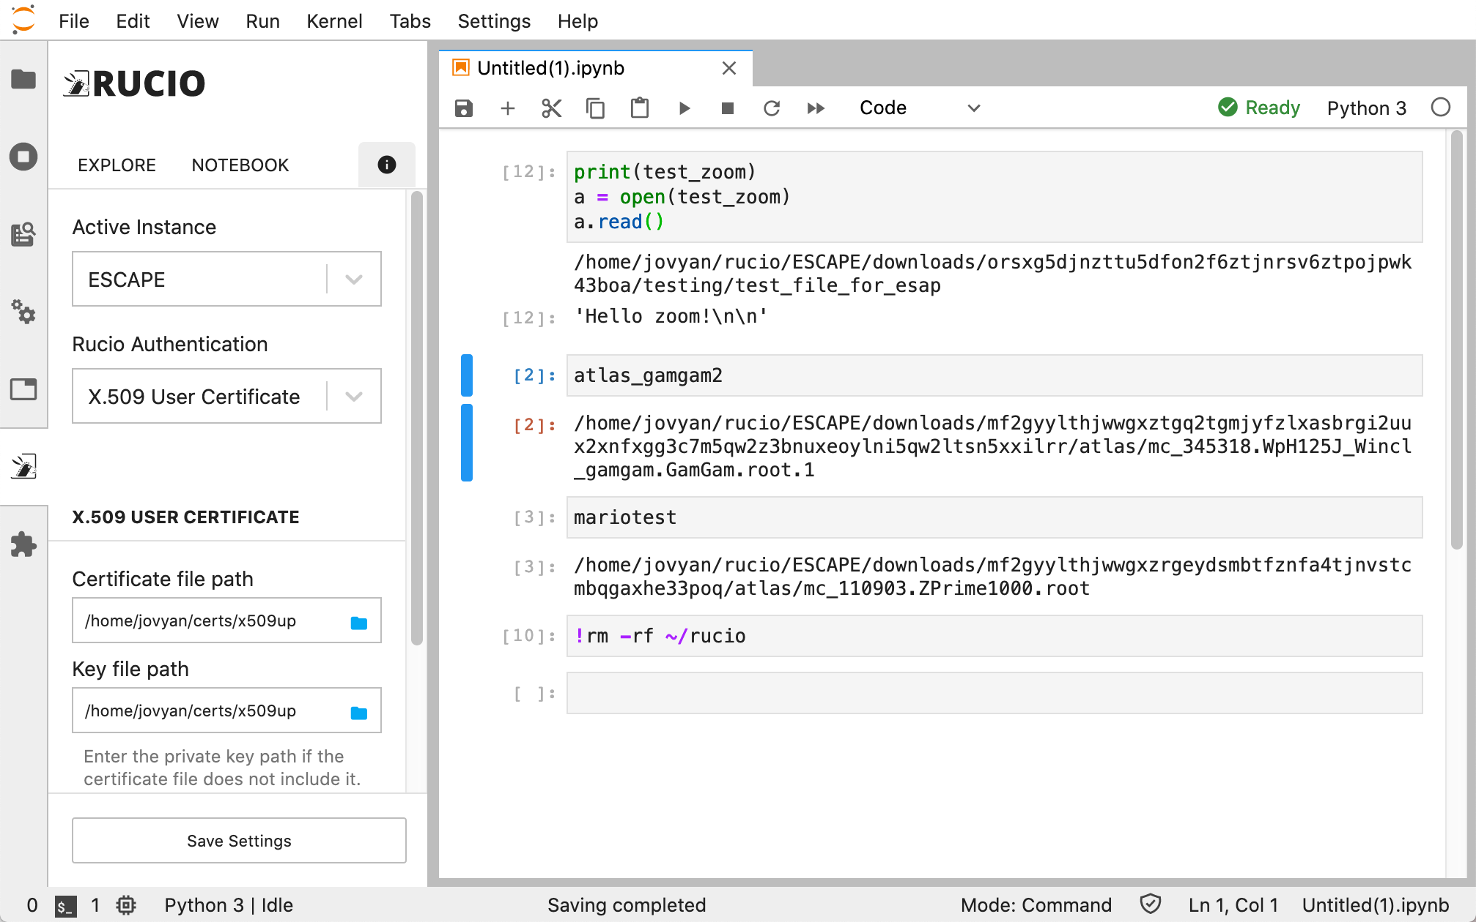
Notes:
The only thing that the user needs to configure is their authentication credentials.

Slide 14
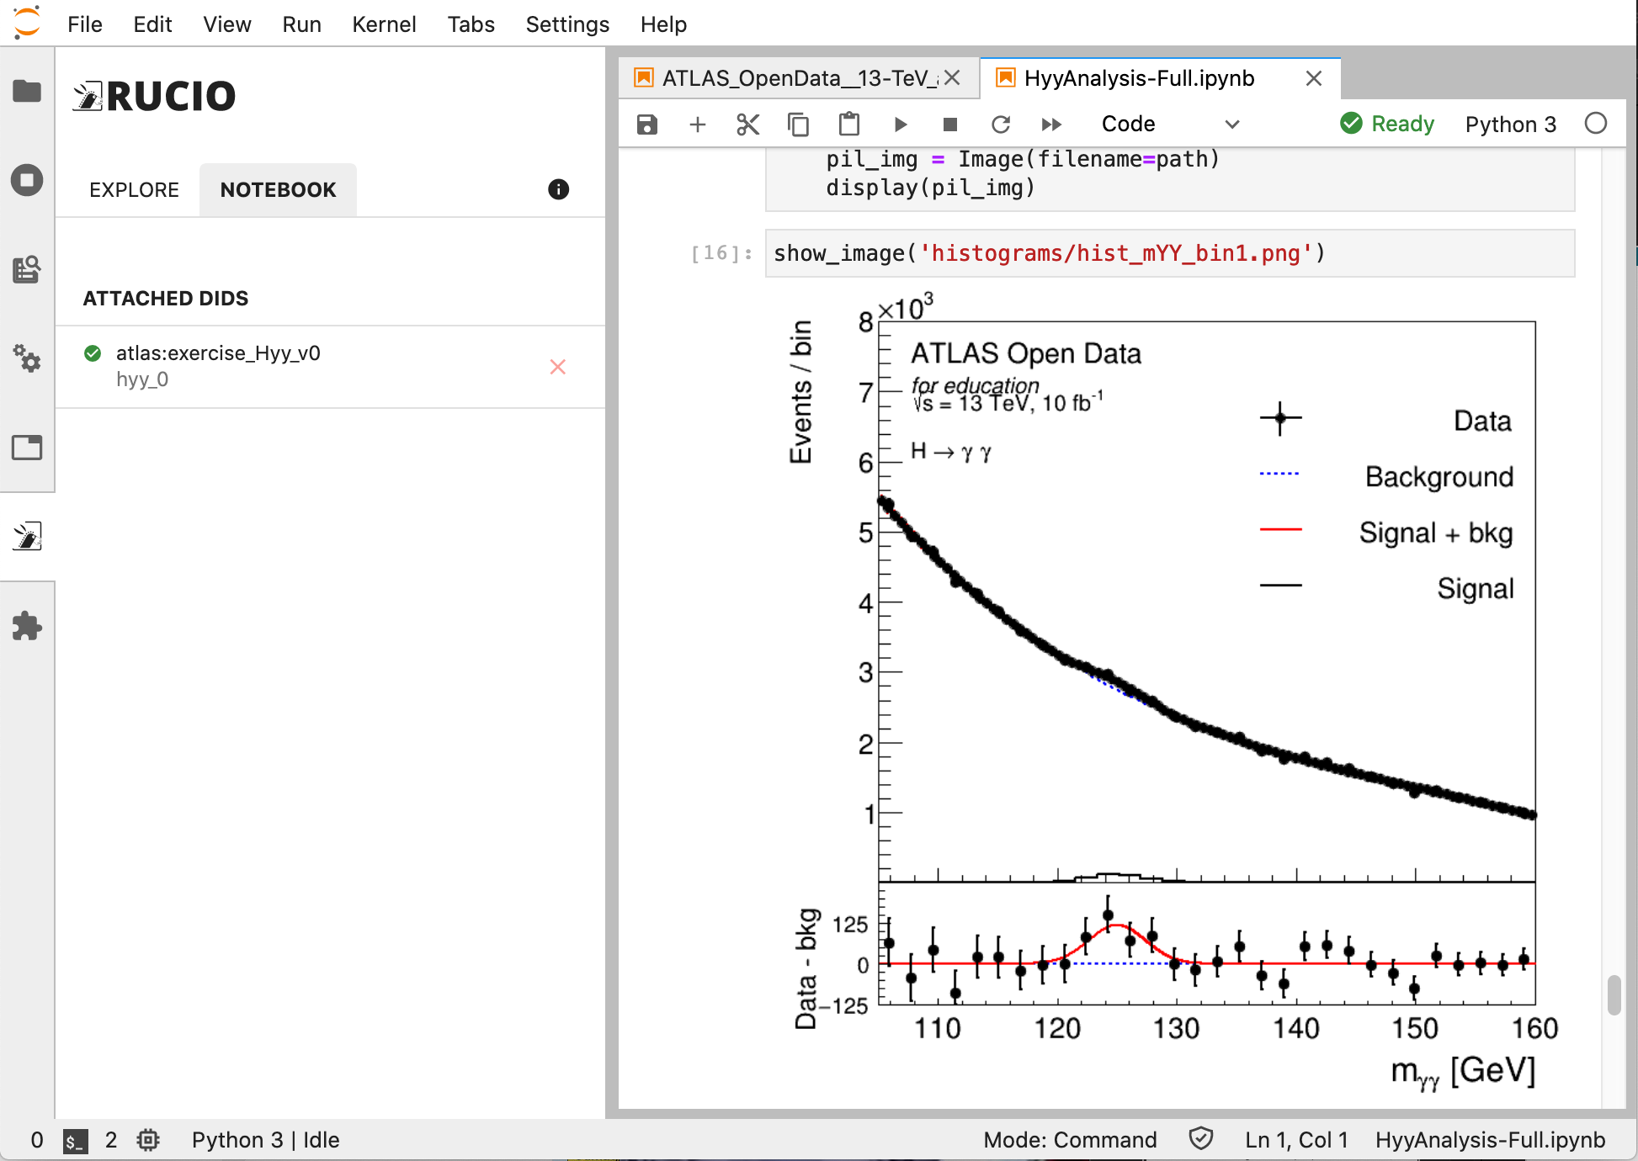
ATLAS Open Data
SHOWCASE
Hyy analysis using ATLAS Open Data
No hardcoded path to file
Notes:
“Higgs-to-gamma-gamma”
Stress that this is an actual research workflow, using real data that is available in the ESCAPE data lake, and that we used the extension to run the analysis.

Slide 15
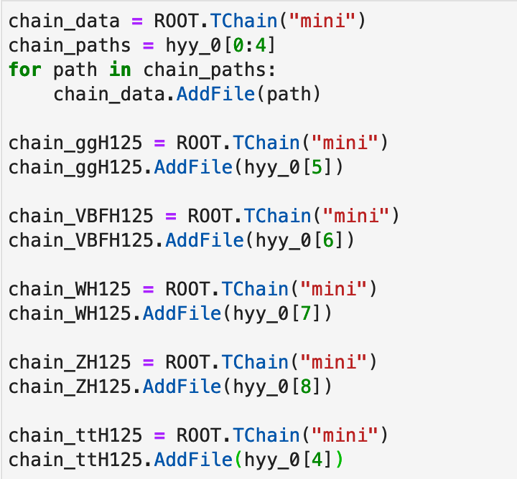
ATLAS Open Data (2)
SHOWCASE
This is the code to load the ROOT files (in PyROOT).
No need to know the file paths
hyy_0 is an array of paths to files in dataset atlas:exercise_Hyy_v0 in ESCAPE datalake.
The paths are injected by the extension automatically.
Notebook preview on https://nbviewer.jupyter.org/gist/didithilmy/28400804ed55b1e4ff683902fa1cc58d

Slide 16
Key Features
Browse Rucio data from the Lab sidebar
Replicate data with just one click
Resolves file path automagically
Inject path to notebook as a variable
Supports two methods of authentication (currently):
Username & Password
X.509 User Certificate (or Proxy)
Supports two modes of operation:
Replica mode: uses network-attached storage as a Rucio Storage Element (RSE), utilizes Rucio’s file transfer capability.
Download mode: downloads data directly to the user’s directory using Rucio clients.
Remote configuration
Notes:
Elaborate the key features one by one.
Show that scientists need to only configure their credentials, and the rest of the configs are taken care by site admins. Also show the possibility of remote configuration for administrative easiness.

Slide 17
Replica Mode
Uses a Rucio Storage Element (RSE) mounted via FUSE, shared with multiple users.
Uses existing file transfer infrastructure to make files available.
Extension creates a new replication rule when making data available.
Suitable for larger installations with pre-existing data transfer infrastructure.

Slide 18
Replica Mode
Mount via FUSE
File Transfers
SWAN
Network Attached Storage
Rucio
Some other storages
REST API call
Notes:
This is a massive simplification

Slide 19
Download Mode
Uses Rucio download client to make files available.
JupyterLab server downloads the file directly from the RSE to the user’s directory
No need for mounted RSE.
Self-contained within the JupyterLab installation.
Suitable for simpler installations that don’t have existing data transfer infrastructure.
In Download mode, multiple users can download the same files.
Here, placing a caching layer would reduce network traffic.

Slide 20
Download Mode
Direct Download
File Transfers
SWAN
Rucio
Storage Elements
REST API call
Notes:
This is a massive simplification

Slide 21
Using XCache in Download Mode
Rucio has native support for XCache using root-proxy-internal config.
It will prepend a cache prefix (e.g. root://xcache:1094//) to the PFN if the client is on a different site.
The extension (utilizing Rucio DownloadClient) will retrieve files from that cache, when applicable.
Site admins need to specify a site name in the extension config.
Site jakarta
DID info, Get replica PFNs
Rucio
Site geneva
File download
XCache
XRootD storage node
Local dir

Slide 22
XCache Support in Rucio
Assign a site name to existing RSE
rucio-admin rse set-attribute --rse XRD1 --key site --value geneva
Register XCache host + port to Rucio
rucio-admin config set --section root-proxy-internal --option jakarta --value xcache:1094
Site name
Cache prefix

Slide 23
Architecture
JupyterLab
The server extension uses SQLite to store user config and cache Rucio responses.
Frontend extension communicates with kernel extension to inject path string into Python variables.
JupyterLab (frontend) extension
Jupyter notebook server extension
HTTP call
HTTP REST
API call
Rucio
WebSocket / Kernel Comm
Protocol-specific calls
IPython kernel extension
SQLite DB
Storage Elements

Slide 24
Multi-VO Support
The extension supports multi-VO deployments
Site admins can configure the VO name
The extension will include the VO option when authenticating with Rucio.
When using X.509 User Certificate credential in Download mode, the extension can generate a Proxy certificate using voms-proxy-init.
The Proxy cert will be stored in a temporary directory and its path will be set as X509_USER_PROXY env variable when downloading the files.

Slide 25
Installing the Extension
It comprises of several components:
Jupyter notebook server extension
JupyterLab (frontend) extension
IPython kernel extension
The extension can be installed from Python Package Index (PyPI)
Simply do pip install rucio-jupyterlab
Complete installation instructions on https://github.com/didithilmy/rucio-jupyterlab
Prebuild Docker image is also available for quick setup (see repo README)

Slide 26
Quick Docker installation
docker run -d -p 8888:8888 \
--name jupyterlab \
-e RUCIO_MODE=download \
-e RUCIO_BASE_URL=https://escape-rucio.cern.ch:32300/ \
-e RUCIO_AUTH_URL=https://escape-rucio.cern.ch:32301 \
-e RUCIO_DISPLAY_NAME=ESCAPE \
-e RUCIO_NAME=ESCAPE \
-e RUCIO_CA_CERT=/certs/ca.pem \
-e RUCIO_WILDCARD_ENABLED=1 \
-v /etc/grid-security/:/etc/grid-security/ \
-v /root/ca.pem:/certs/ca.pem:z,ro \
-v /root/x509up:/home/jovyan/certs/x509up:z,ro \
didithilmy/rucio-jupyterlab:latest

Slide 27
Configuring the Extension
The extension uses standard Jupyter configuration system
Can be placed on ~/.jupyter/jupyter_notebook_config.json
Refer to Jupyter docs
Supports remote configuration
Config JSON placed in a static file, accessible via HTTP from the JupyterLab server
More on this later
Notes:
Emphasize that the configuration will need to be done once, by the site admins.

Slide 28
Configuring the Extension (2)
Configurable items:
Name & Display Name
Rucio URL & Auth URL
Wildcard search enable/disable
Destination RSE
Mount path prefix
Replication rule lifetime
Rucio CA path
VO, VOMS vomsdir, VOMS certdir, VOMS vomses, VOMS enabled
Site name
App ID
Mode of operation
More on this: https://github.com/didithilmy/rucio-jupyterlab/blob/master/CONFIGURATION.md

Slide 29
Remote Configuration
Rucio and JupyterLab instances can be managed by different site administrators
If a configuration item changes, it’s a challenge to coordinate both teams.
To address this, the extension supports reading a configuration remotely.
{
"instances": [
{
"name": "experiment.cern.ch",
"display_name": "Experiment",
"$url": "https://url-to-rucio-configuration/config.json"
}
]
}

Slide 30
Future Developments
More Kernel compatibility
Octave, R, ROOT C++
More authentication methods
OAuth/OpenID Connect
Share notebooks across JupyterLab installations
Allows any JupyterLab instance to connect to publicly-accessible Rucio installations and their RSEs
Fetches Rucio configuration on-the-fly, URL known from notebook metadata

Slide 31
Conclusion
This extension has the capability to bridge an exascale data management platform (Rucio) and an online data analytics platform (SWAN/JupyterLab).
It could become an important piece to enable easy data access from an analysis platform to ESCAPE datalake.
The development of the extension has benefited from ESCAPE’s expertise and R&D.
The development of this extension was aligned with the current challenges in distributed computing.
The Rucio JupyterLab Extension can help to assess the new models and infrastructures being prototyped to address the future exabyte-scale and multi-experiment computing scenarios.

Slide 32
Acknowledgements
Huge thanks to my CERN mentors:
Aristeidis FKIARAS
Riccardo DI MARIA
Martin BARISITS
Diogo CASTRO
Mario LASSNIG
Enric TEJEDOR SAAVEDRA
Enrico BOCCHI

Slide 33
Thank you.
Muhammad Aditya Hilmy
mhilmy@hey.com
didithilmy
Attributions:
CERN-HSF logo courtesy of hepsoftwarefoundation.org
Rucio logo courtesy of rucio.github.io
SWAN logo courtesy of swan.web.cern.ch
ESCAPE logo courtesy of projectescape.eu

