Slide 1
The Hubble tension and Early Dark Energy
Marc Kamionkowski
(Johns Hopkins University)

Slide 2
Collaborators
Tanvi Karwal (JHU PhD 2019 → U Penn postdoc)
Vivian Poulin (JHU postdoc → CNRS Montpelier)
Tristan Smith (Swarthmore College)
Kimberly Boddy (JHU postdoc --> UT Austin)
Jose Luis Bernal (JHU postdoc)
Simeon Bird (JHU postdoc → UC Riverside)

Slide 3
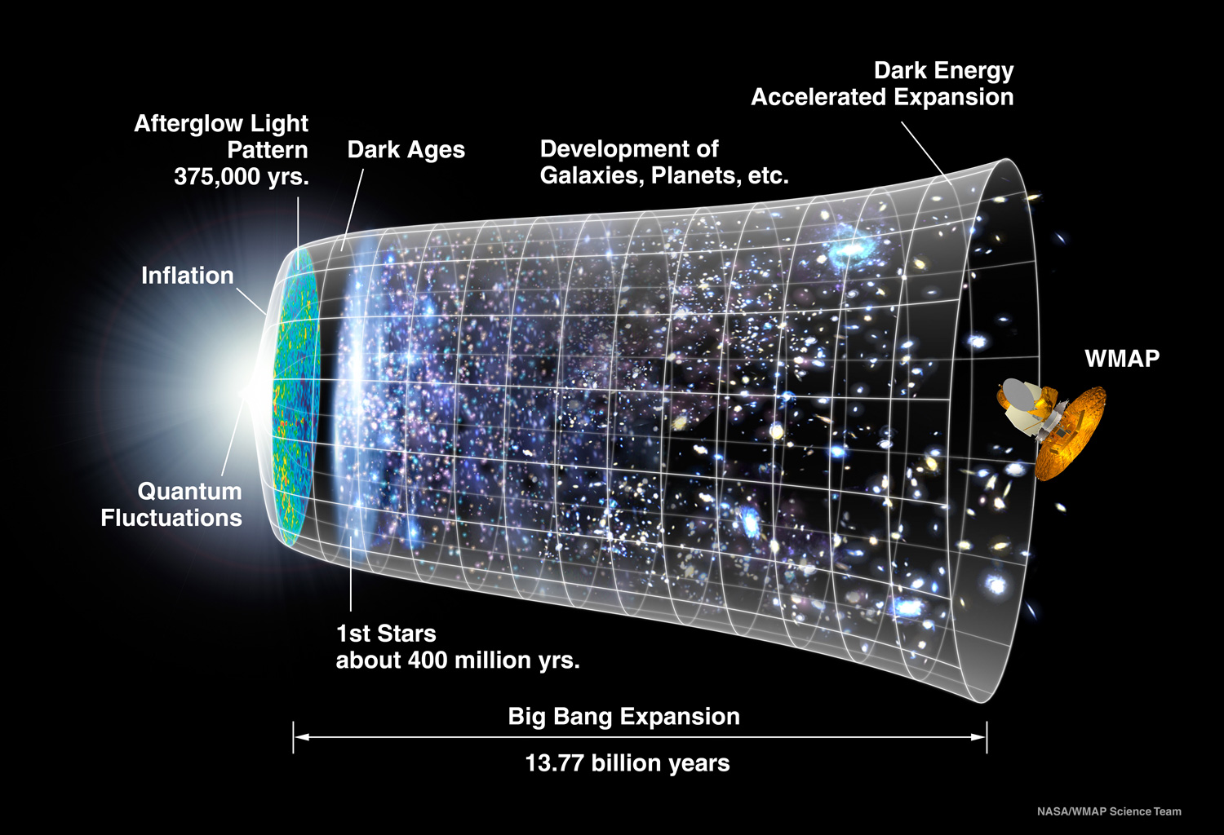
Notes:
WHEN WE LOOK AT MORE DISTANT OBJECTS ARE LOOKING AT EARLIER TIMES

Slide 4
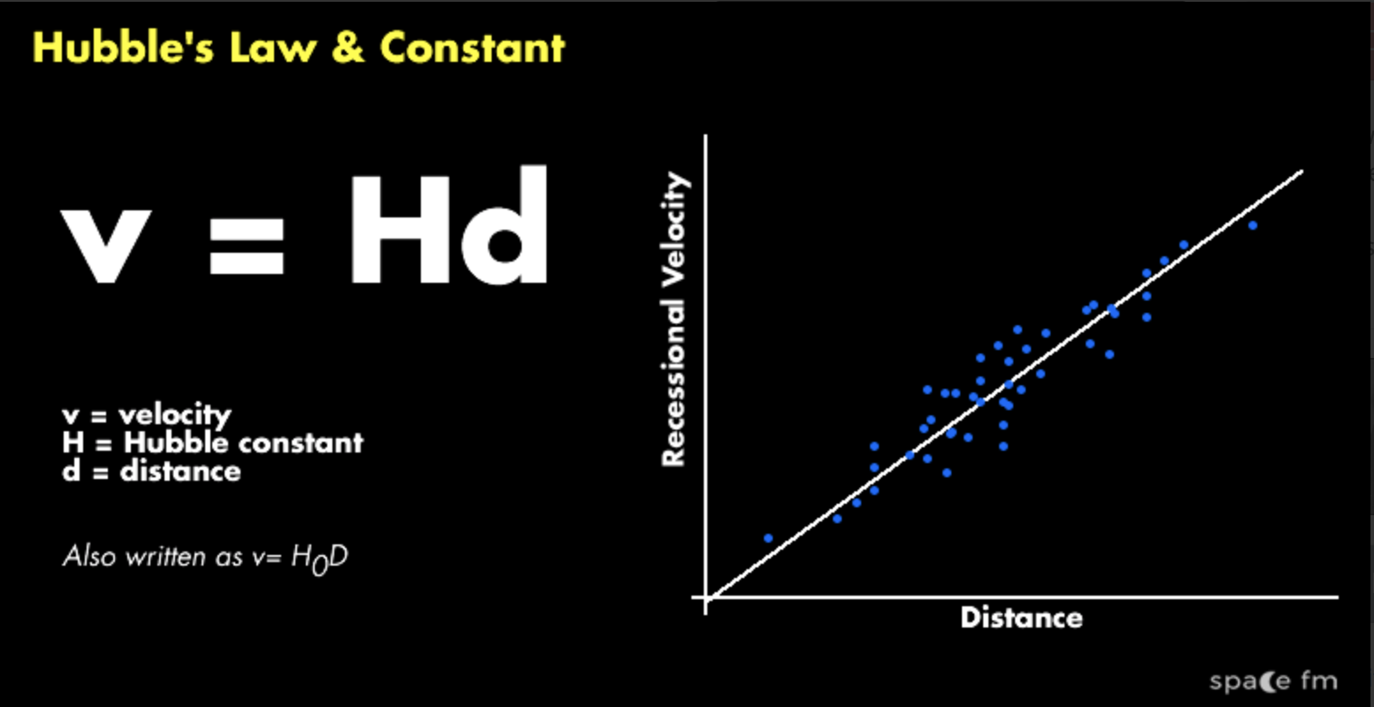
Hubble law

Slide 5
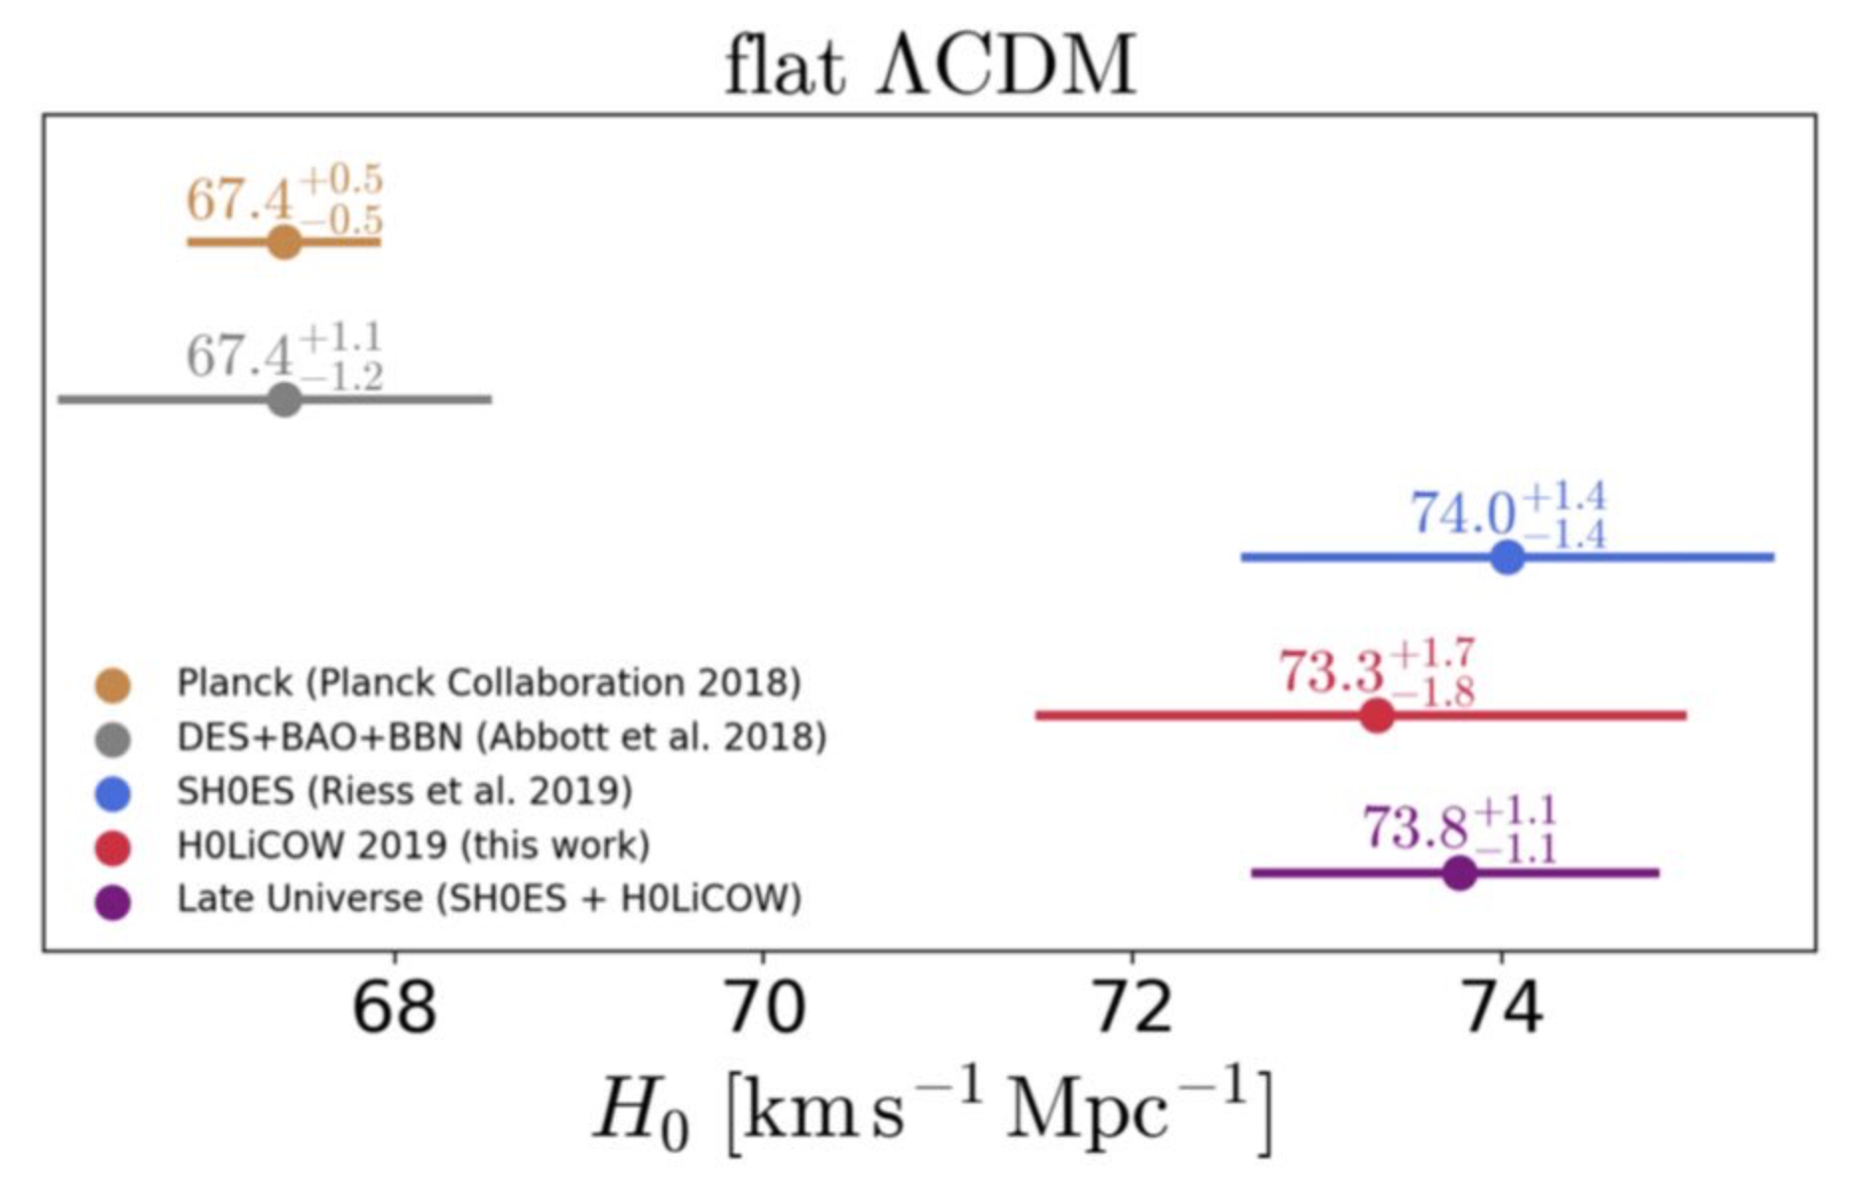

Slide 6
What the ?????

Slide 7
The Hubble “tension”: Why does the expansion rate inferred from the CMB differ from that observed locally?
Problem with local measurements?
Problem with CMB measurements?
Problems with both?
New physics?

Slide 8
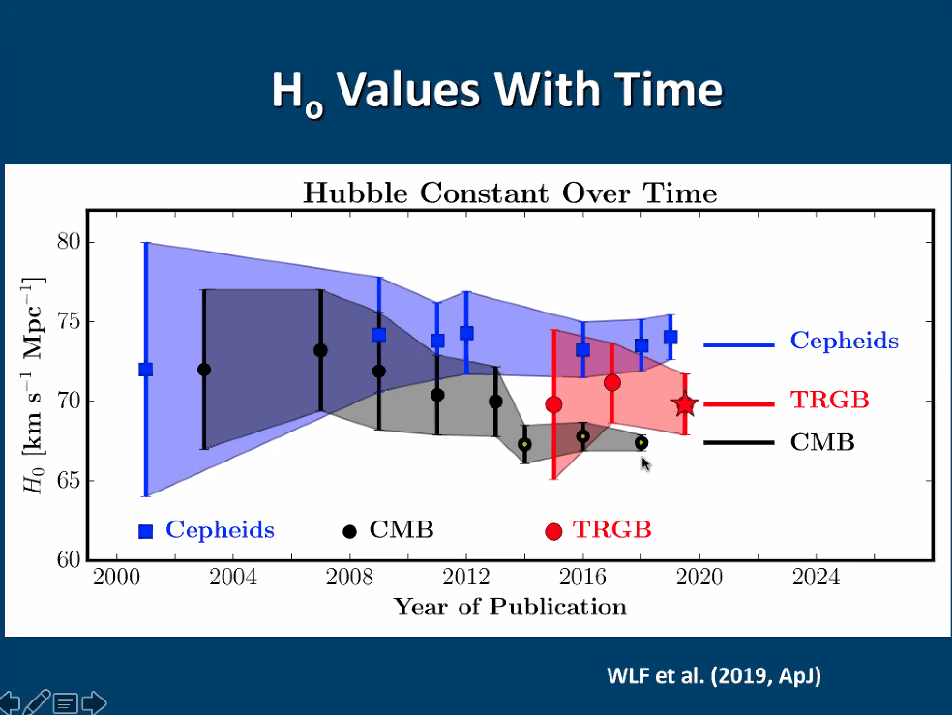

Slide 9
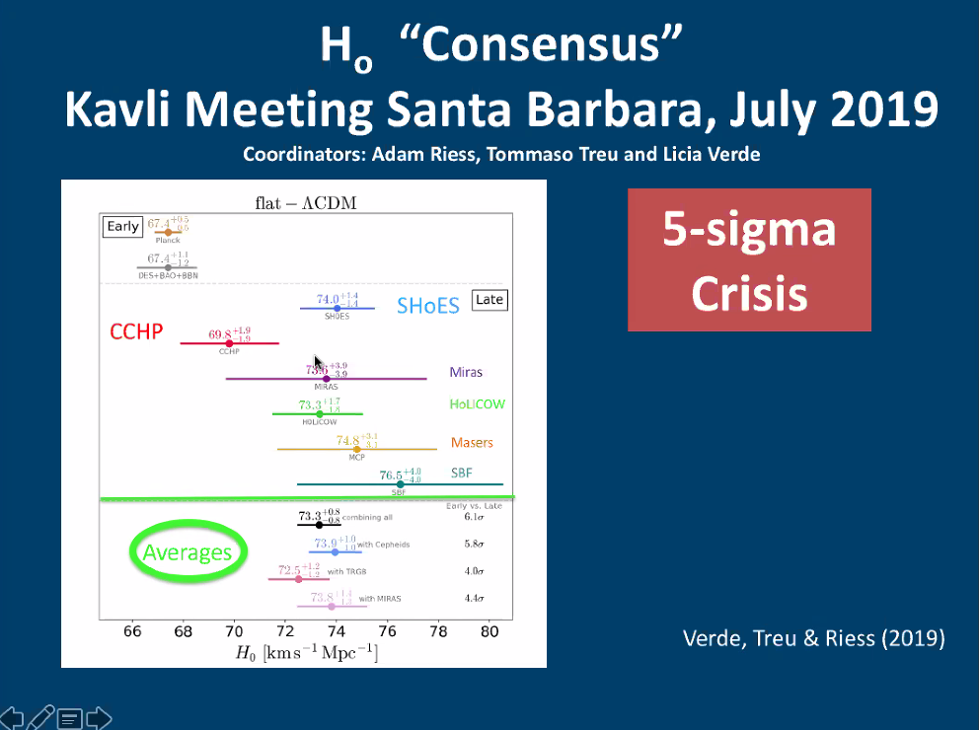

Slide 10

!!THEORY TALK!!

Slide 11

The Hubble “tension”: Why does the expansion rate inferred from the CMB differ from that observed locally?
Problem with local measurements?
Problem with CMB measurements?
Problems with both?
New physics?

Slide 12
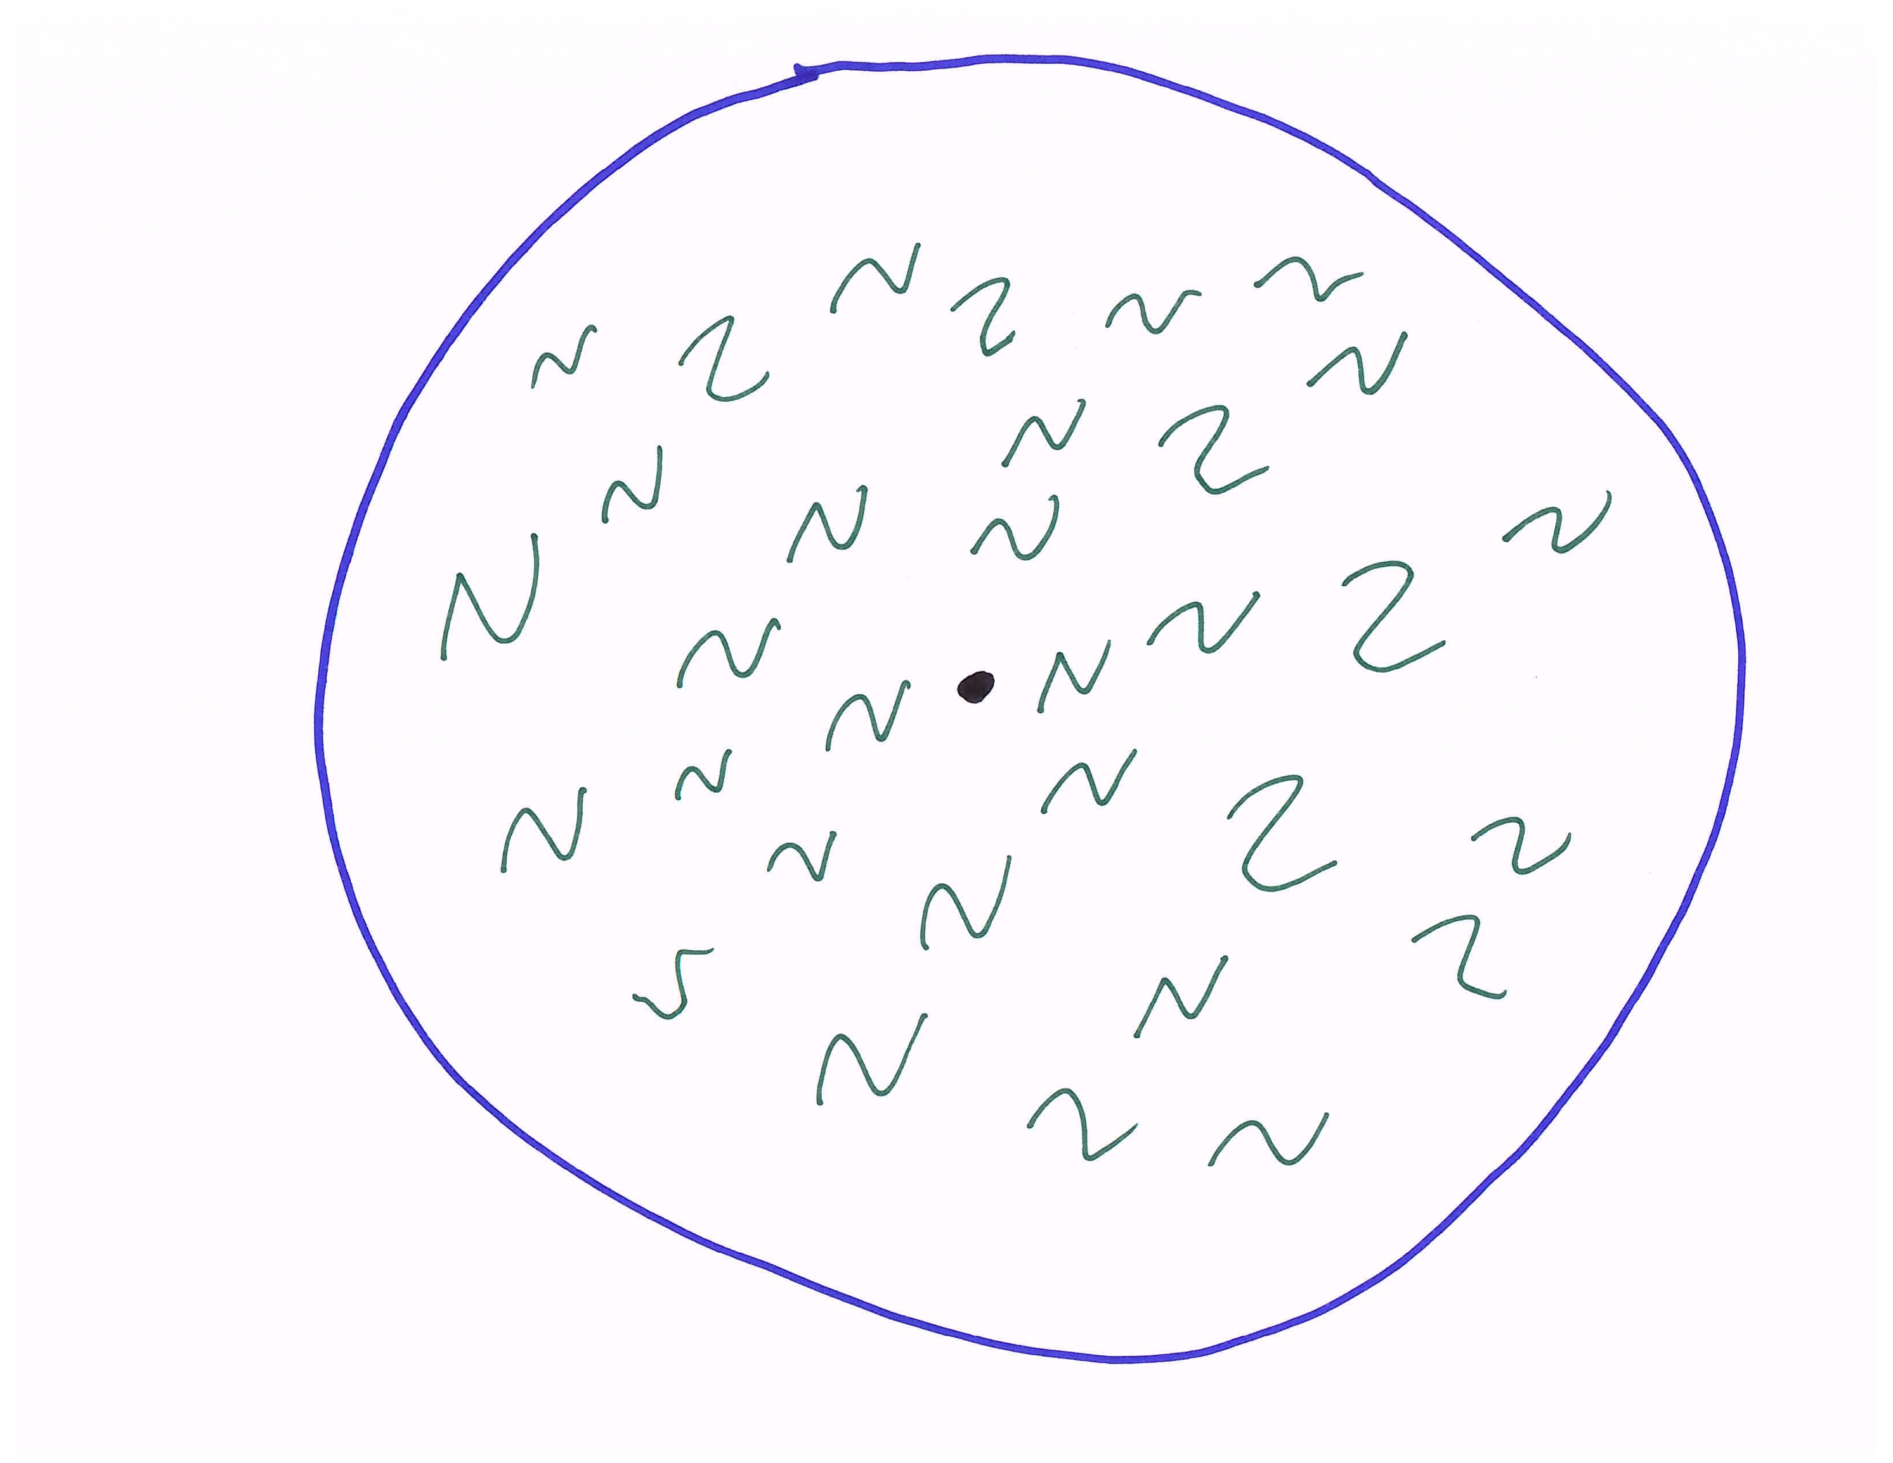
opaque
transparent
13.8 billion
light-years
CMB: Snapshot of Universe
380,000 years after big bang
Notes:
Larger distance, earlier times; CMB is glow from big bang, like glow from cooling embers

Slide 13
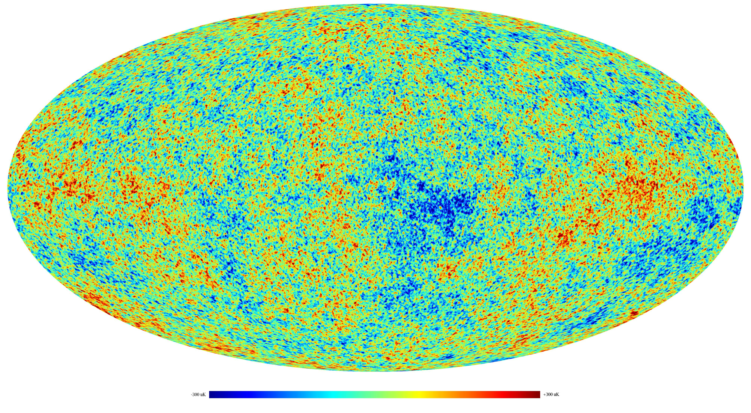

Slide 14
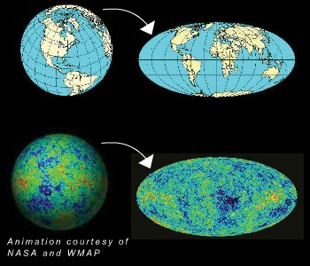

Slide 15
opaque
transparent
13.8 billion
light-years
CMB: Snapshot of Universe
380,000 years after big bang
Notes:
Larger distance, earlier times; CMB is glow from big bang, like glow from cooling embers

Slide 17
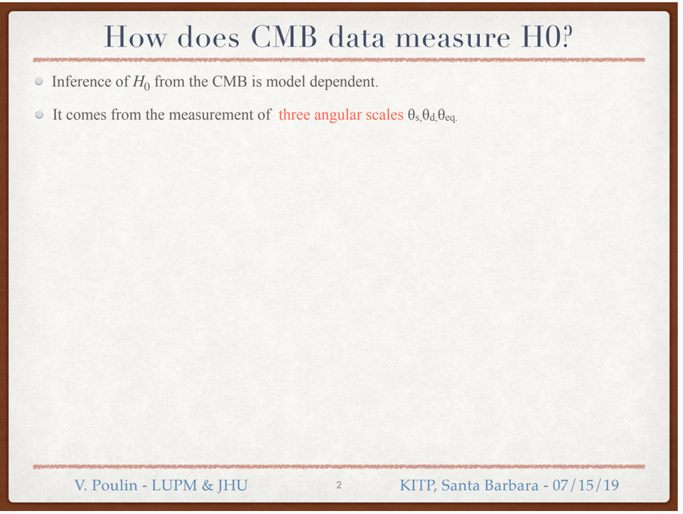

Slide 18
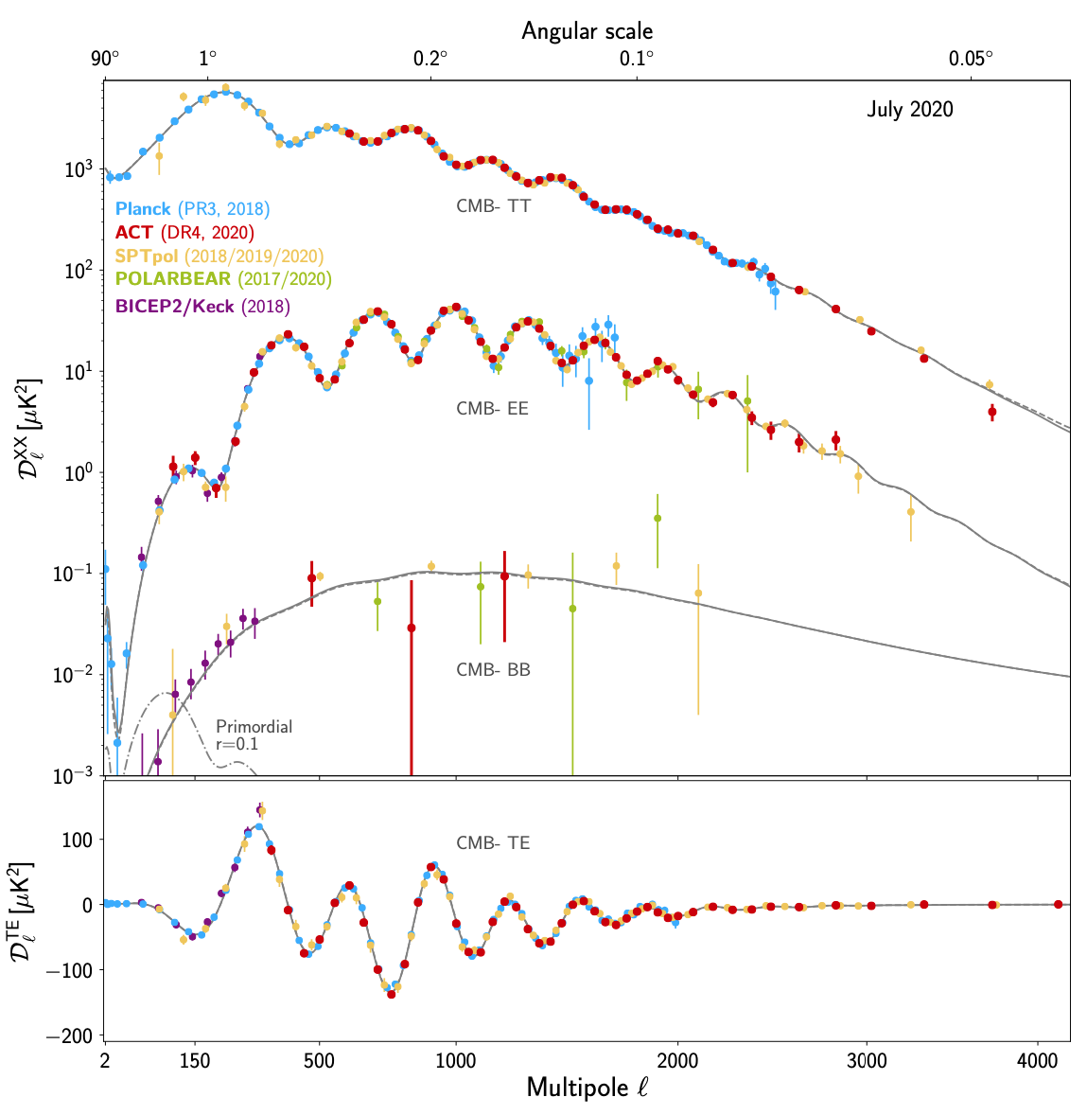
CMB power spectrum:
~ |Fourier transform|²

Slide 19
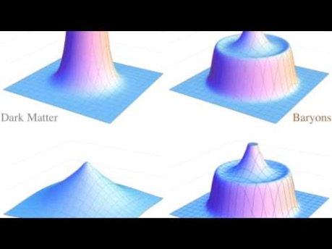

Slide 20
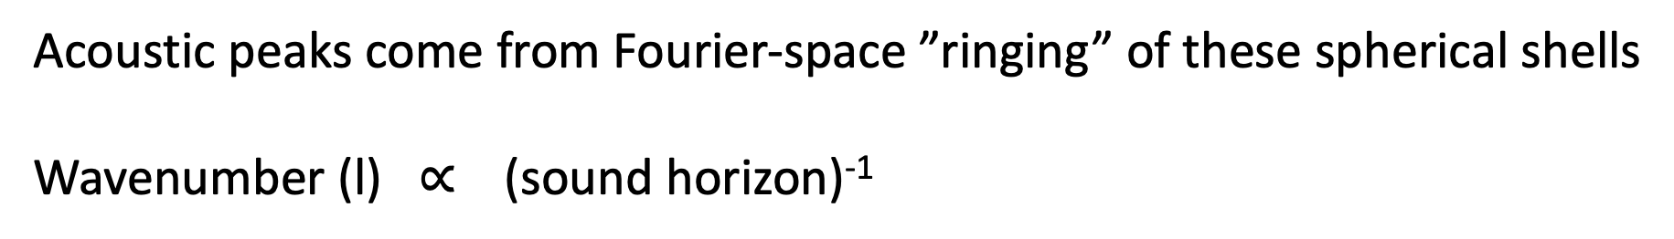
Acoustic peaks come from Fourier-space ”ringing” of these spherical shells
Wavenumber (l) $∝$ (sound horizon)⁻¹

Slide 21
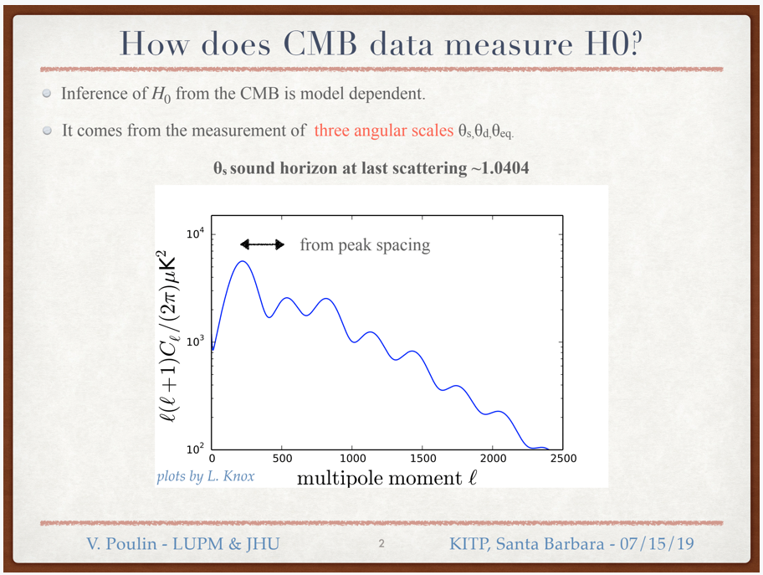

Slide 22
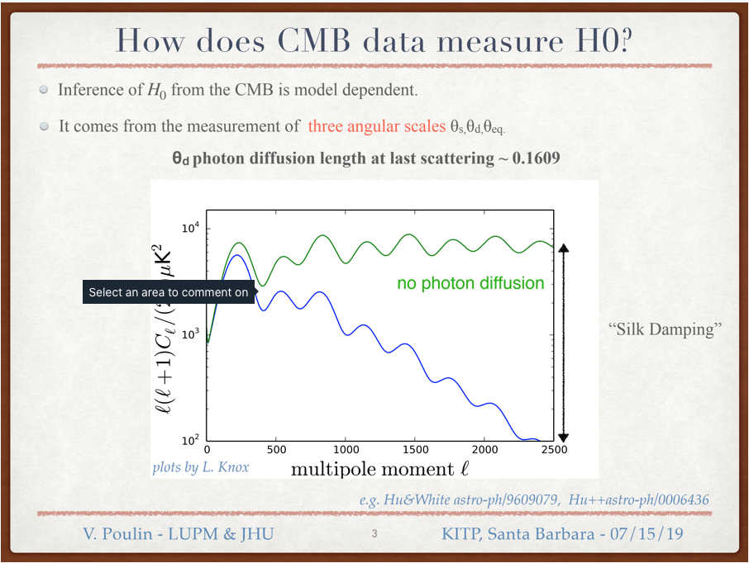

Slide 23


opaque
transparent
13.8 billion
light-years
CMB: Snapshot of Universe
380,000 years after big bang
Notes:
Larger distance, earlier times; CMB is glow from big bang, like glow from cooling embers

Slide 24
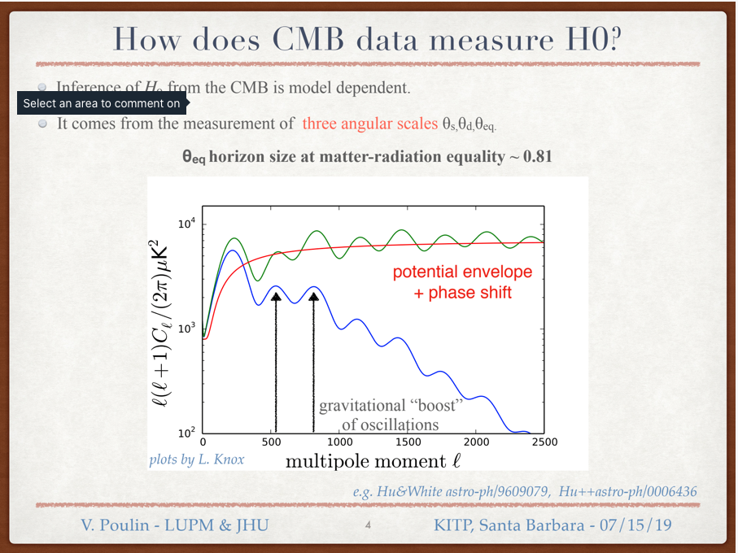

Slide 25
How does CMB measure H₀?
Three angles:
  sound horizon
  damping scale
  MR equality
depend on
  dark-matter density
  baryon density
  Hubble constant
Of three angles, sound-horizon angle determined best (1 part in 10⁴)

Slide 26
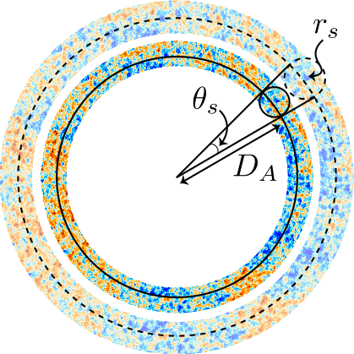

Slide 28
To increase H₀, can
Decrease matter density at late times
Decrease sound speed in early Universe
Increase matter density at early times

Slide 29
To increase H₀, can
Decrease matter density at late times (late-time solutions)
Decrease sound speed in early Universe
Increase matter density at early times

Slide 31
Late-time solutions
Modify late expansion history to increase D_{A}
e.g., exotic dark energy; phantom energy; exotic dark matter;
Requires energy density smaller than in standard model: negative-density matter?!?! Violation of null energy condition?!?!

Slide 32
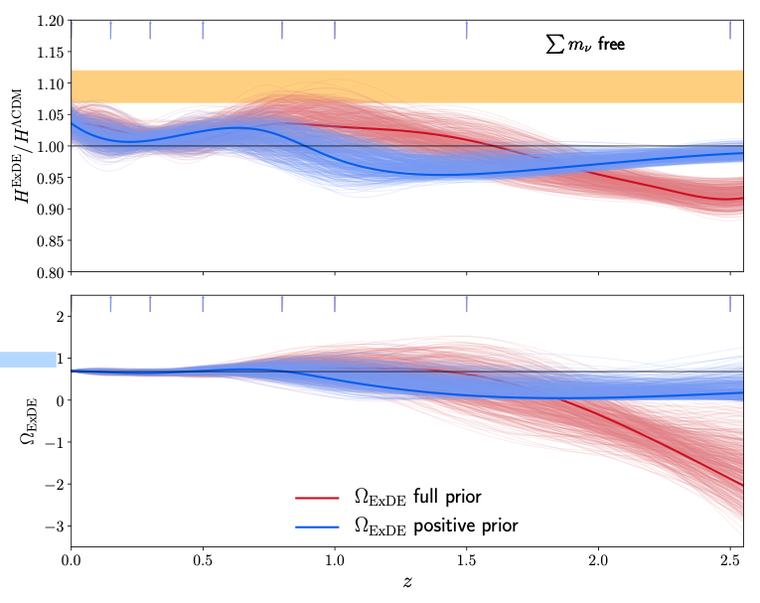
Poulin, Bird, Boddy, MK, arXiv:1803.02474

Slide 33
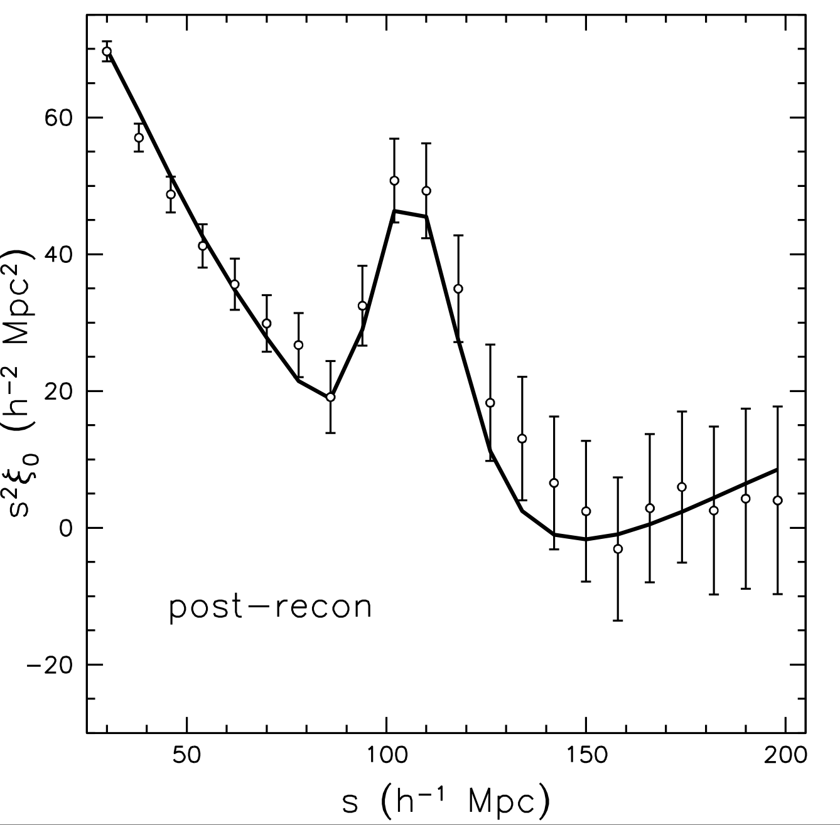
Late-time solutions: Empirically disfavored by BAO in galaxy distribution
Sound horizon imprinted
on galaxy distribution
measured in “redshift
space”
Provides standard ruler
to infer H₀ --> lower H₀
SDSS-BOSS Collaboration
Anderson et al. 2013

Slide 34
To increase H₀, can
Decrease matter density at late times (late-time solutions)
Decrease sound speed in early Universe (not workable yet)
Increase matter density at early times

Slide 35
A problem with local measurements?
“I keep reminiscing how similar and different this is to 1998—I find the measurement side probably stronger than then….”
(Adam Riess, email, 31 July 2020)

Slide 36
To increase H₀, can
Decrease matter density at late times (late-time solutions)
Decrease sound speed in early Universe (not workable yet)
Increase matter density at early times (early dark energy)

Slide 37
Early dark energy (Karwal & MK, 2016)

Slide 38
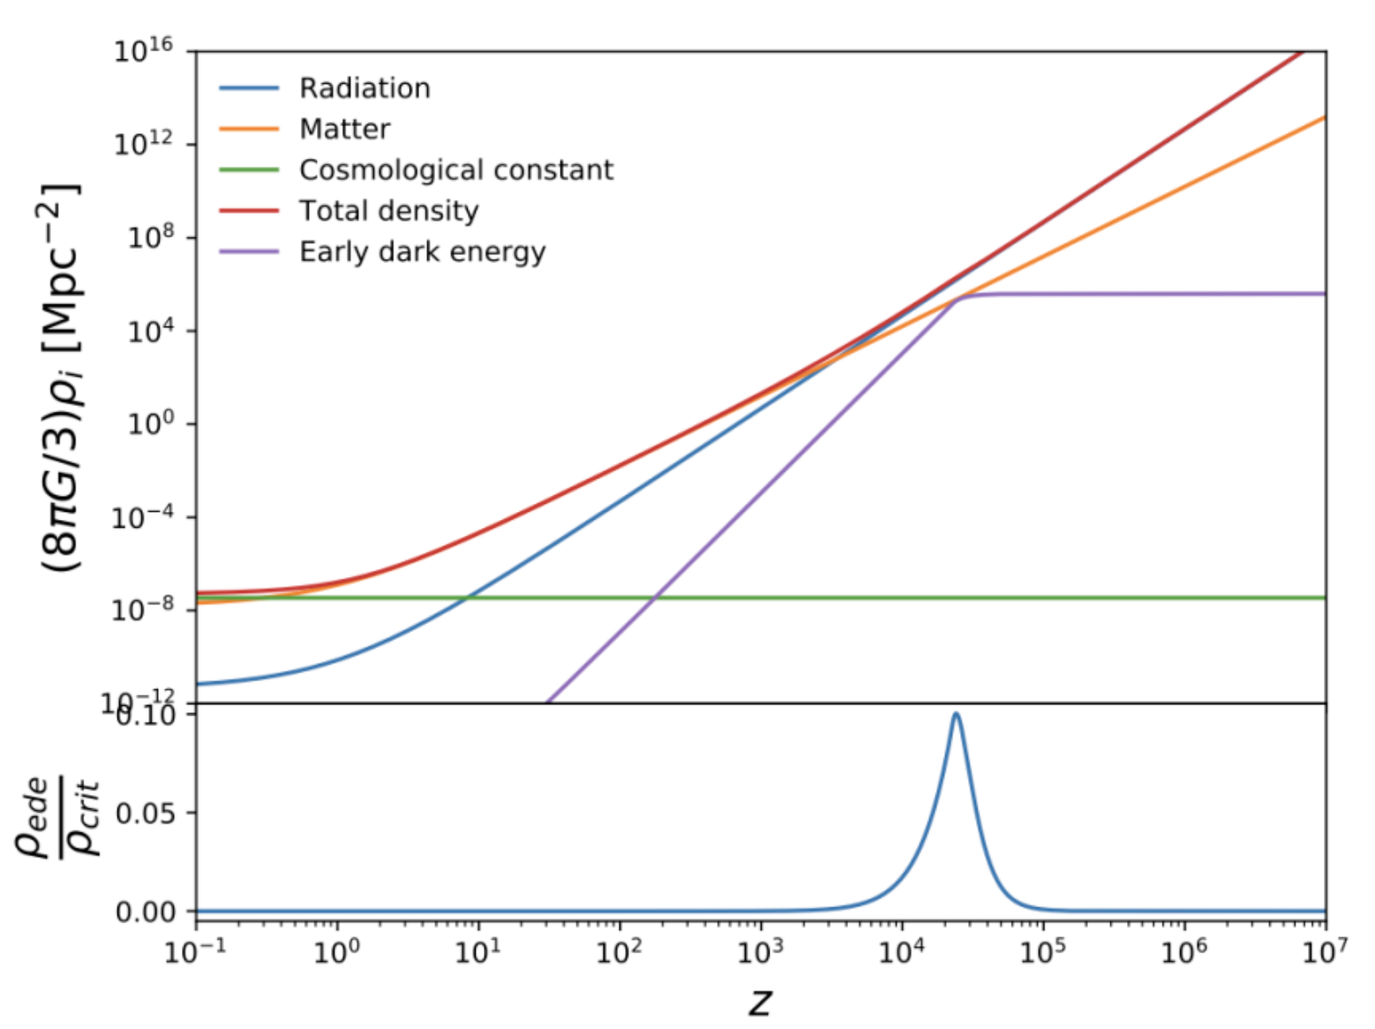
CMB

Slide 39
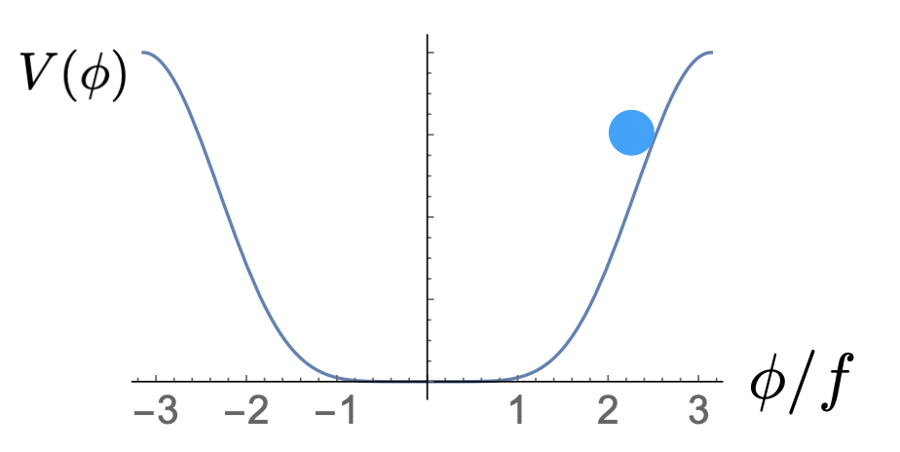
The (postulated) physics of DE
Behaves like cosmological constant at late times; decays as
at late times (MK, Pradler & Walker, 2014)

Slide 40
or

Slide 41
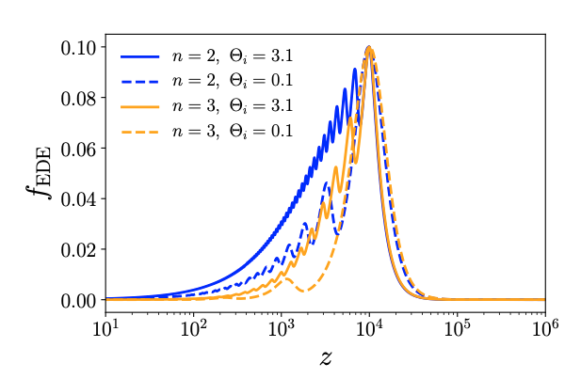
From Smith, Poulin, & Amin, 2019

Slide 42
Devil is in the details:
Need detailed calculations to show that model predictions are consistent with CMB measurements (Poulin, Karwal, Smith, MK, fall 2018)

Slide 43
Calculations
For each combination of cosmological/EDE parameters (DM density, baryon density, Hubble parameter, scalar amplitude/spectral index, reionization optical depth; scalar-field potential parameters, initial field value)….
Evolve (in time, from big bang to present) coupled differential equations for evolution of
dark-matter density and velocity
(moments of) photon distribution function
neutrino distribution function
baryon density and velocity
scalar field
gravitational potential(s)
For each spatial Fourier mode
Use modified version (Poulin, Smith, Grin, Karwal, MK 2018) of publicly-available CLASS

Slide 44
Calculations
for oscillating-field model, slow-roll model, and phenomenological description in terms of “generalized dark matter” (Hu 1998)
Products:
CMB temperature/polarization power spectra
Galaxy power spectrum
Analysis
Determine likelihood for each parameter combination; use MCMC to find peaks in likelihood and seek parameter combinations with high Hubble parameter that provide good fits to data

Slide 46
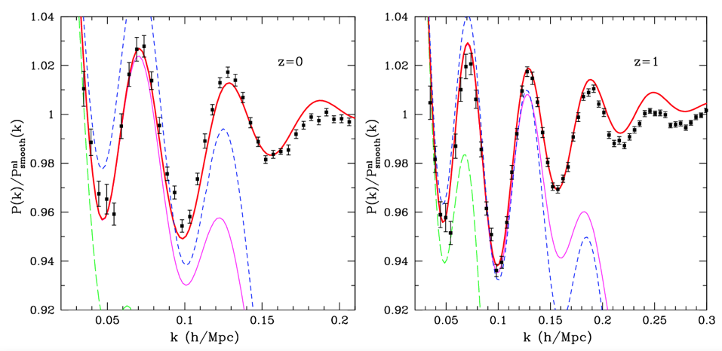
Figure from Crocce & Scoccimarro, arXiv>0704.2783

Slide 47
Product
Fig from Smith et al., in prep

Slide 48
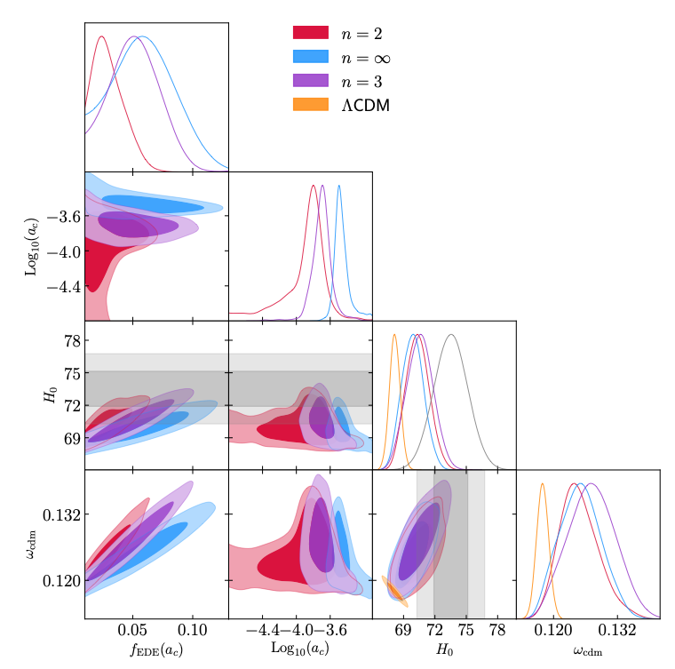
Poulin et al. 2018

Slide 49
New tests of scenario:
Measurements of fine-grain features of CMB polarization by ACTPol/SPT3G/Simons/CMB-S4/etc

Slide 50
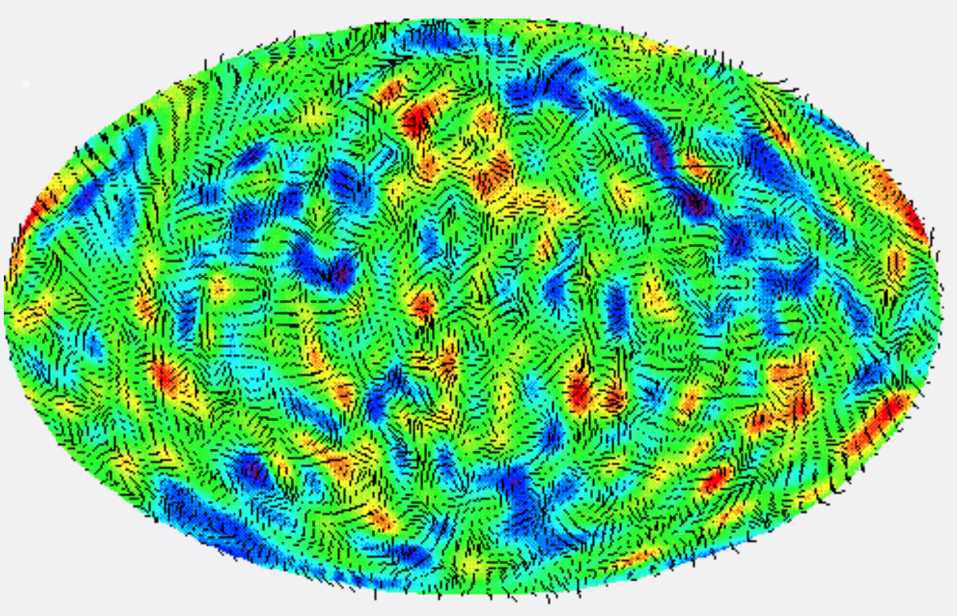

Slide 51
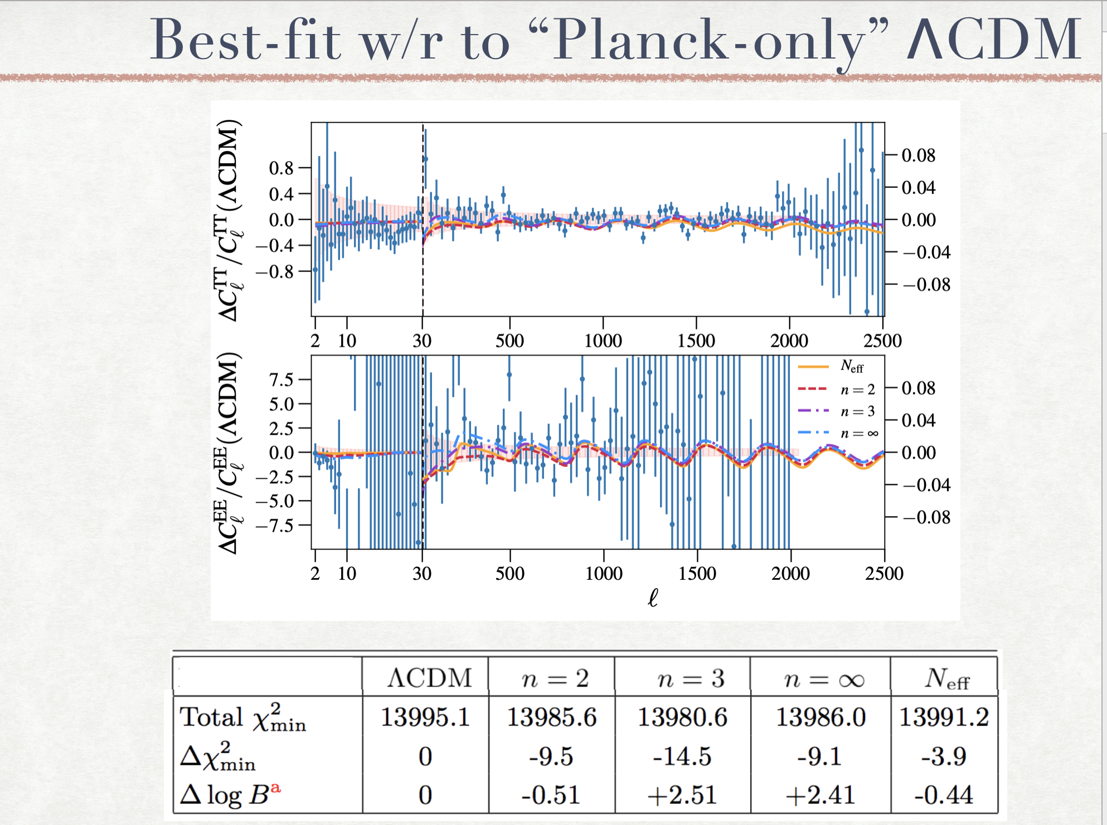

Slide 52
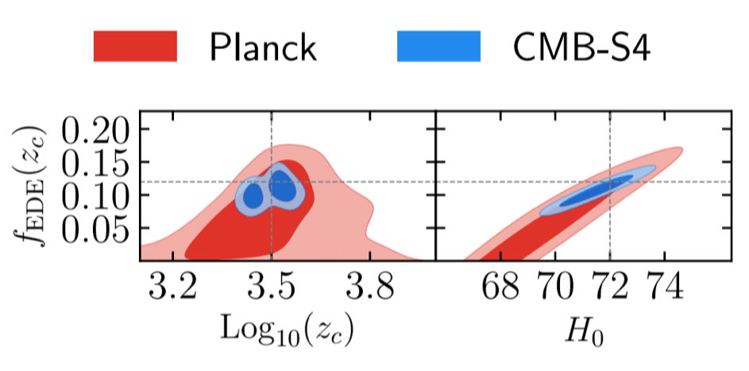
Fig courtesy V. Poulin

Slide 53
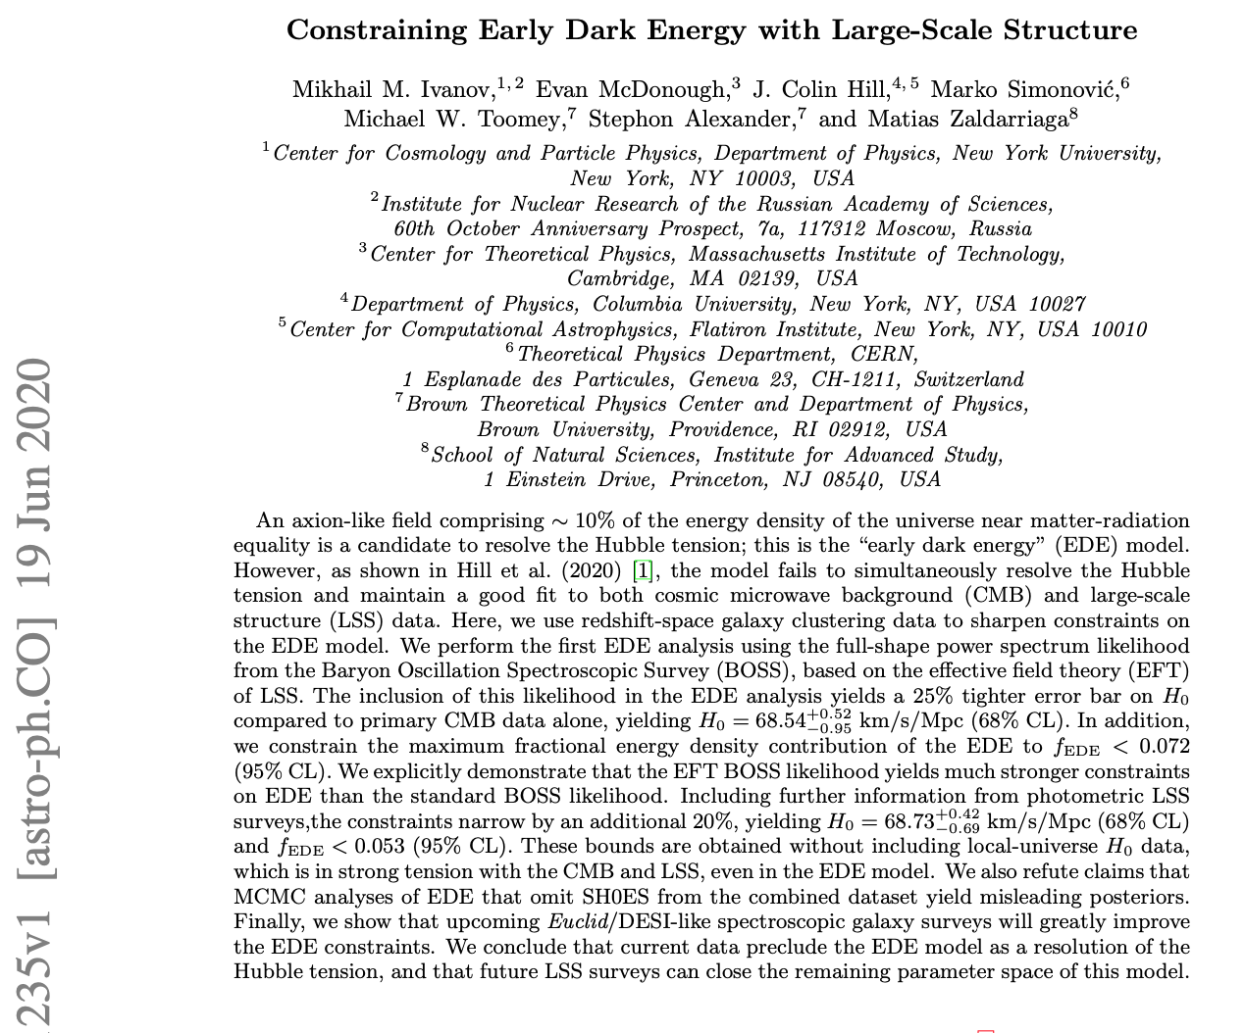
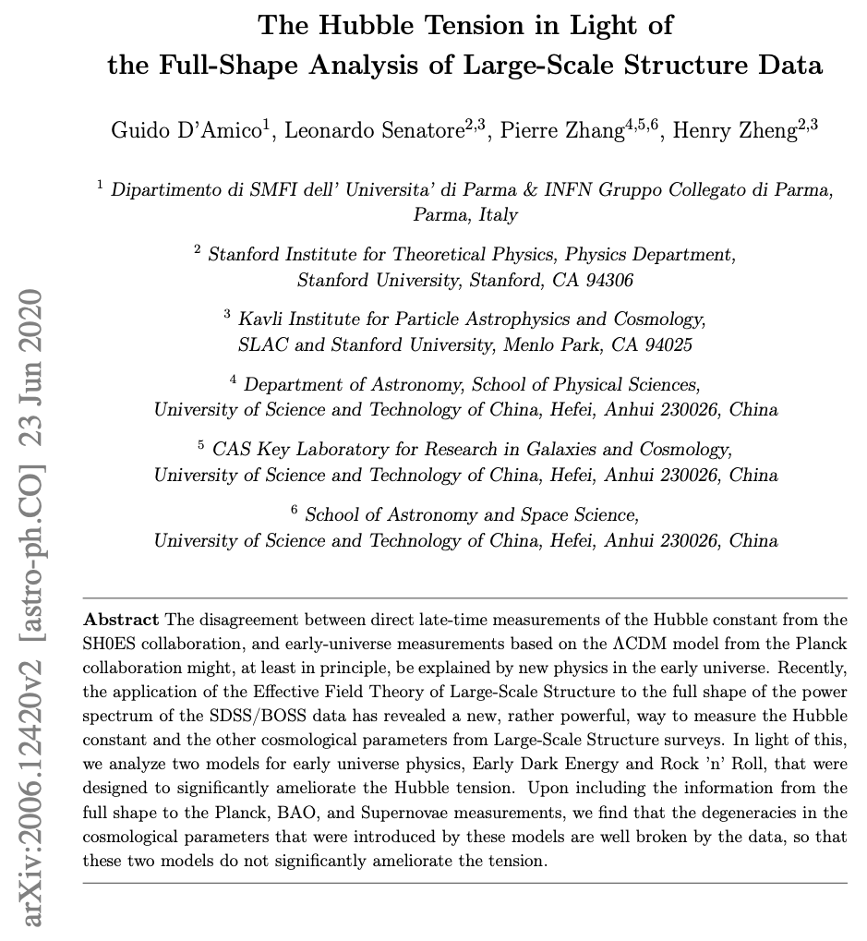
EDE ruled out by large-scale structure?

Slide 54

EDE’s
X

Slide 55
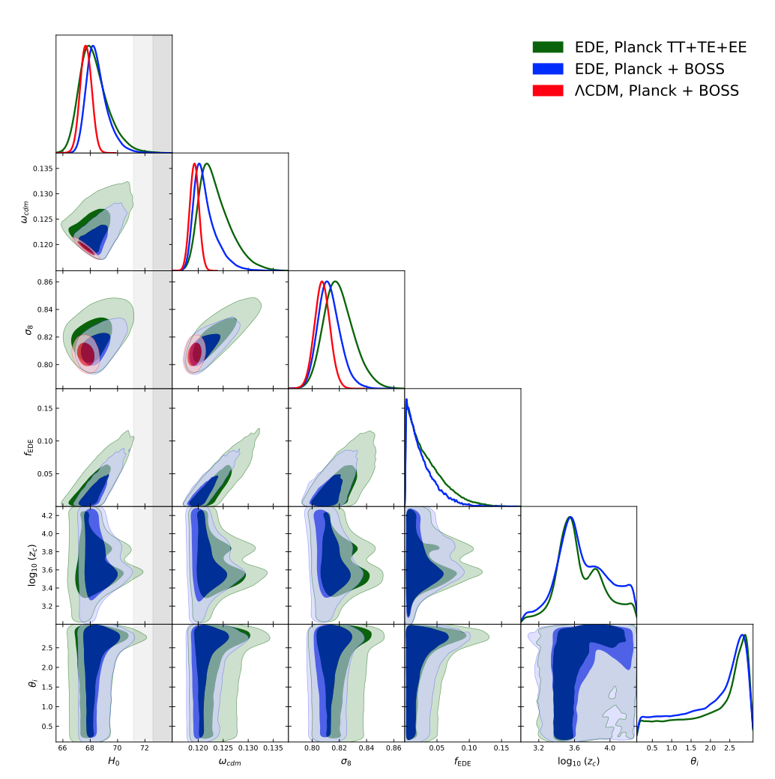
We disagree:
Conclusions follow from their choice of measure on the EDE parameter space.
Best-fit EDE model provides as good a fit to data as LambdaCDM
(Smith et al., in prep)

Slide 56
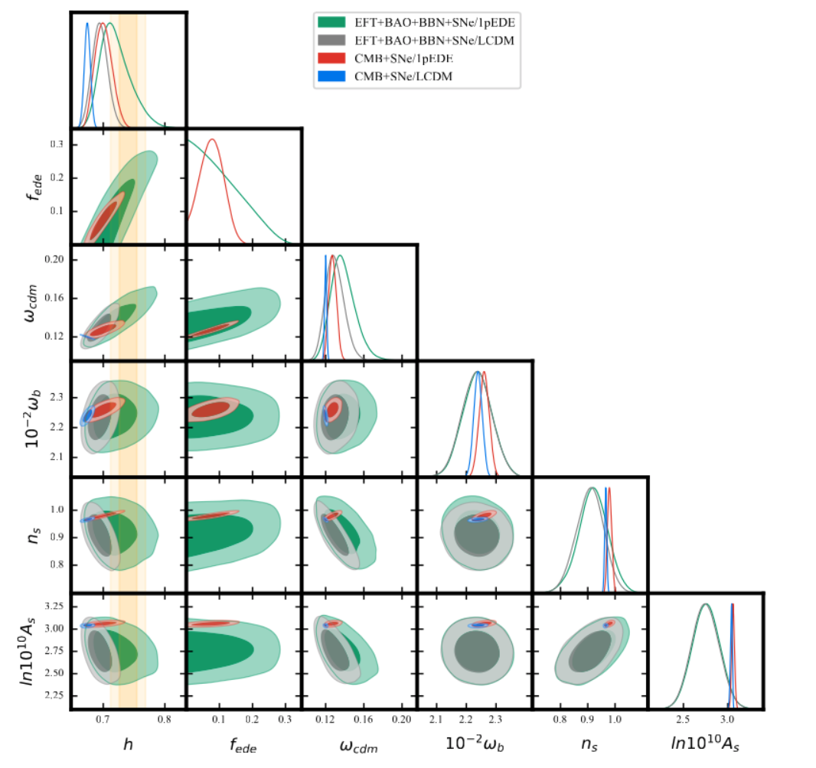
Power-spectra amplitudes
inferred from CMB and LSS
in tension, even in
LambdaCDM
Smith et al., in prep

Slide 57
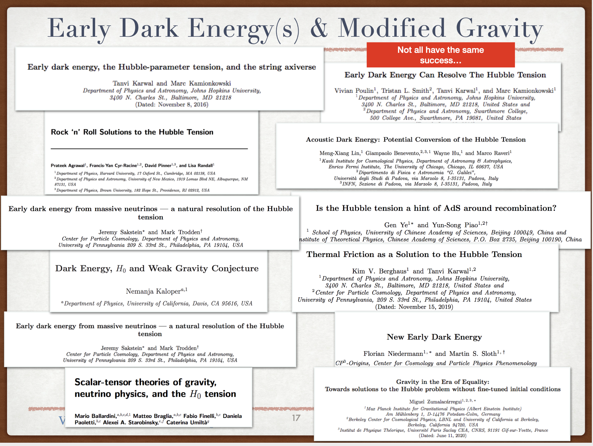

Slide 58
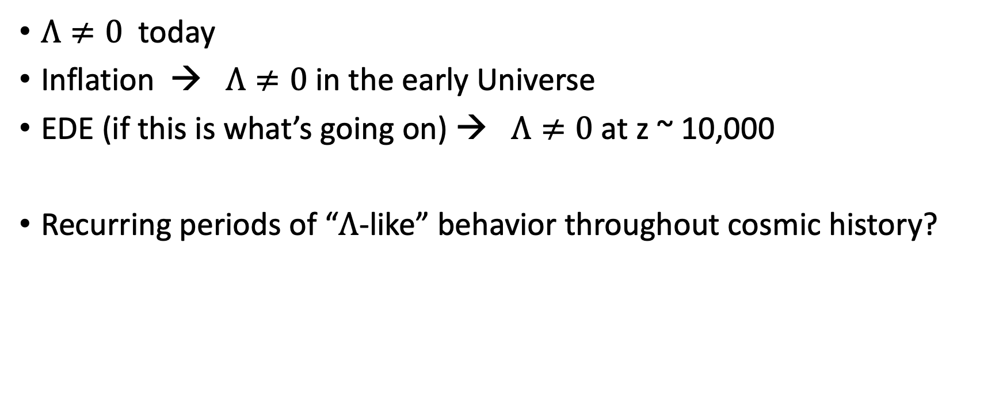
Recurrent dark energy?
$Λ≠0$ today
Inflation → $Λ≠0$in the early Universe
EDE (if this is what’s going on) → $Λ≠0$at z ~ 10,000
Recurring periods of “$Λ$-like” behavior throughout cosmic history?

Slide 59
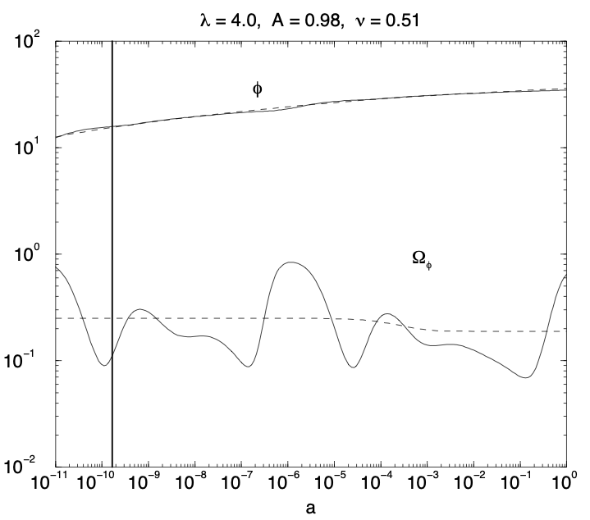
E.g. tracking oscillating energy (Dodelson, Kaplinghat, Stewart, astro-ph/0002360; Griest, astro-ph/0202052)

Slide 60
String Axiverse? (MK, Pradler, Walker, 2014; based on Arvanitaki et al., 2009; Svrcek & Witten, 2006 )
String theory may imply ~100 axion fields
  Possibly with masses distributed logarithmically
At each Log(Hubble time) there’s some chance that axion field, if sufficiently displaced from its minimum, may act (at least briefly) like dark energy

Slide 61
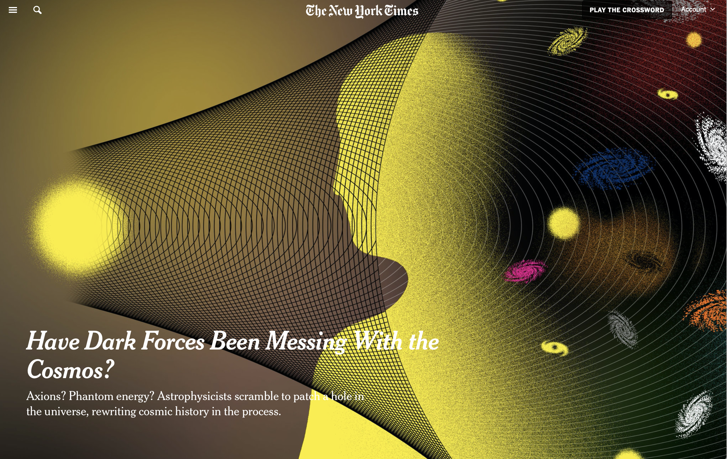

Slide 62
Summary
Local observed cosmic expansion rate disagrees with that inferred from cosmic microwave background
One possible explanation is early dark energy, a modification to early-Universe dynamics
Hypothesis to be tested soon with new data
If correct, implies recurrent periods of something like a cosmological constant throughout cosmic history

