Slide 1
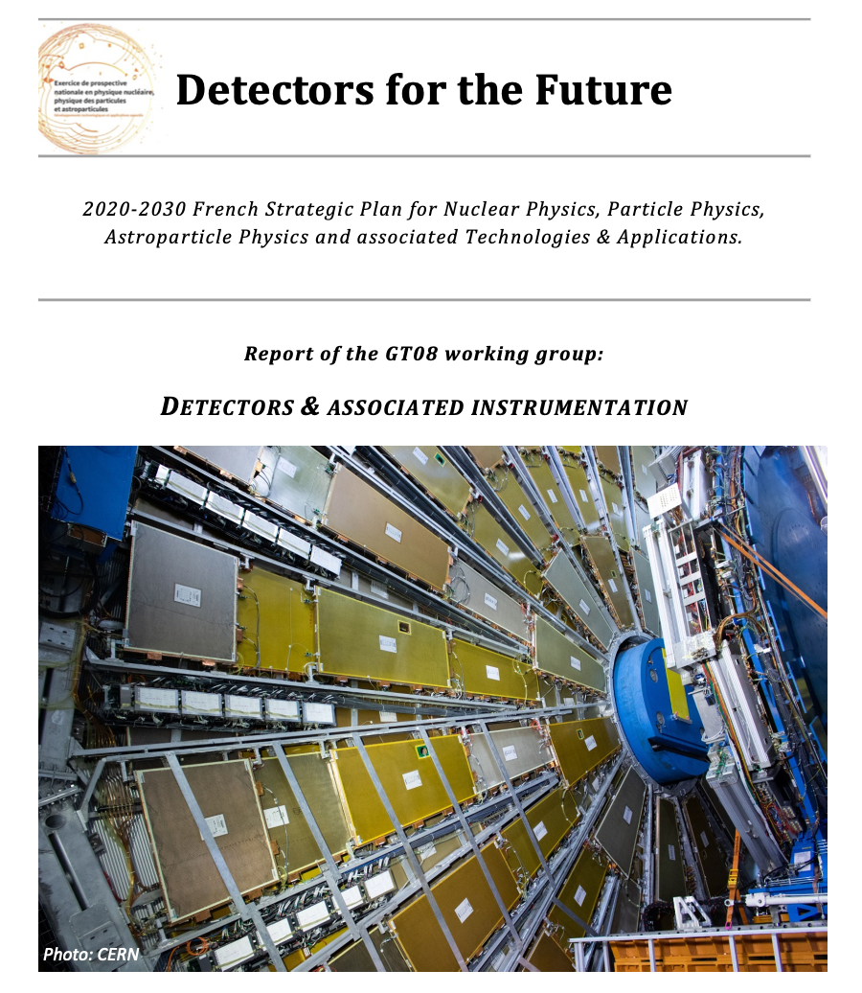
IN2P3 Perspectives
Detector and Associated instrumentation – GT08
Authors of of the report:
Jean-Luc Biarrotte (CNRS/IN2P3)
Rodolphe Clédassou (CNRS/IN2P3)
Didier Laporte (CNRS/LPNHE)
Julien Pacin (GANIL)
Véronique Puill (CNRS/IJCLab)
Laurent Serin (CNRS/IJCLab)
Slides presented by:
Giulia Hull (CNRS/IJCLab)
Mariangela Settimo (CNRS/SUBATECH)

Slide 2
Outline
Introduction
Context and organization
Science drivers
Semi-conductor detectors
Gaseous detectors
Cryogenic detectors
Photo-detectors
Calorimeters
Gravitational wave detectors
Transverse technologies
Conclusions

Slide 3
Introduction - Context
IN2P3 call for contribution (11/2019): ~40 EoI received, half on particle physics instrumentation, half on astro-particle and few in Nuclear Physics
Workshop at IJCLab (01/2020): https://indico.in2p3.fr/event/19979/
Report issued on 07/2020: organized in 7 sections and providing 20 recommendations.
EoI mostly focalized on R&D project not associated to a specific physics experiment
« The GT08 report is a working paper that will be used by the direction of the French National Institute for Nuclear Physics and Particle Physics (CNRS/IN2P3) as an input to define the strategic national priorities for the next 10 years in the IN2P3 scientific fields.
It is based on the written contributions received from the French detector R&D teams and on the talks & discussions that have happened during the dedicated GT08 seminar, organized at Orsay on January 23-24, 2020. (https://indico.in2p3.fr/event/19979/)»

Slide 4
Introduction – Detectors R&D
The research activity in the domain of interest for IN2P3 fully relies on the use of very complex detector systems based on several advanced technologies.
The mission of IN2P3 detector teams is to focus their main effort on the design, development and construction of detectors able to address the IN2P3 research programs, and on the associated R&D
The development of a new detector technology follows quite a long cycle that can last over a decade:
Generic ‘Blue-Sky’ R&D
Prototyping
Technological demonstrator
Production/
Industrialization
Installation and commissioning
R1: It is of paramount importance to anticipate this long development cycle and maintain a strong detector R&D activity so as to maintain leading-edge knowledge, push the associated technologies beyond state-of-the-art and meet the challenges of future IN2P3 scientific research.

Slide 5
Introduction – Science Drivers
Detectors can use very diverse technologies that require the development of dedicated R&D programs capable of leading to cutting-edge technological breakthroughs in these fields.
Science Drivers (SD) of these R&D programs:
SD#1 Enhanced sensitivity and lower background
➽ to detect very rare and/or low signal-to-noise ratio events
SD#2 Better energy, time and space resolution
➽ to improve particle identification
SD#3 Higher efficiency , lower greenhouse emissions, increased reliability and lifetime
➽ For use in extreme conditions
SD#4 High-rate and high-speed read-out with efficient DAQ
➽ For HEP and nuclear physics experiments

Slide 6
Semi-conductor detectors
Widely used in particle, nuclear and astroparticle physics:
Higher position accuracy (a few μm resolution with smaller pixels), high speed and rate readout, low material budget and radiation hardness are the main drivers of these R&Ds (SD#2, SD#3 & SD#4).
A new paradigm with accurate time measurement (a few tens of ps) allows for improved 4-D tracking algorithms.
In astroparticle physics, the main direction is to provide larger size instruments (SD#1)
Hybrid devices with a dedicated ASIC bonded to the sensor. R&D driven by LHC. Still solution for the HL-LHC pixel detector upgrade. (Planar Pixel, LGAD)
Monolithic Active Pixel Sensors (MAPS) : integrating the sensor and the readout electronics (compromise between charge collection and signal read-out speed)
Depleted Monolithic Active Pixel Sensors (DeMAPS) (high radiation hardness and read-out speed as in hadronic environment) : provides a large signal and fast collection
Silicon carbide (SiC): Low leakage current, a good stability versus radiation and usually no need for cooling system. neutron detection, alternative to diamond detectors in nuclear physics.
22/10/2020

Slide 7
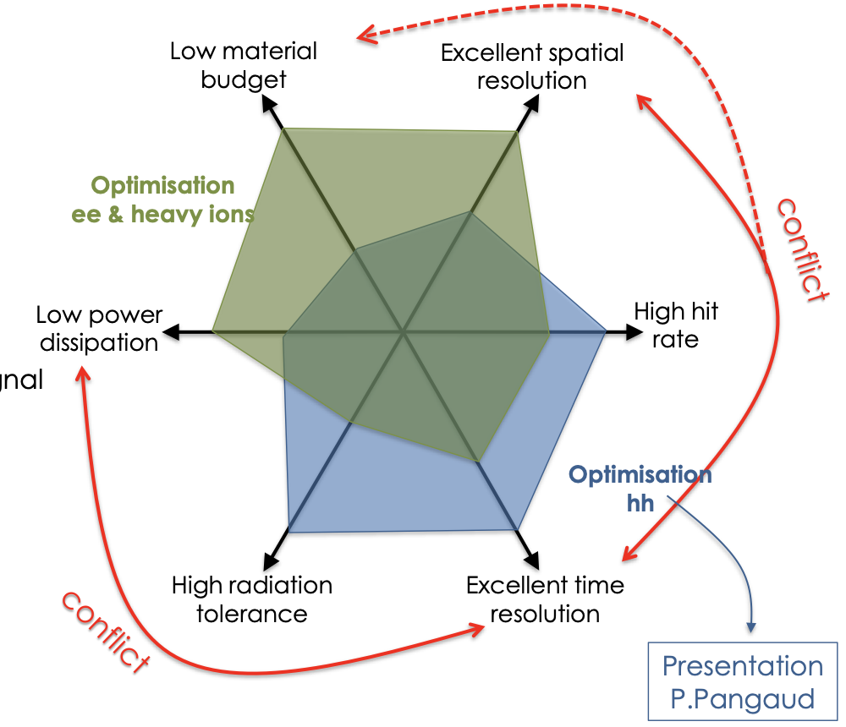
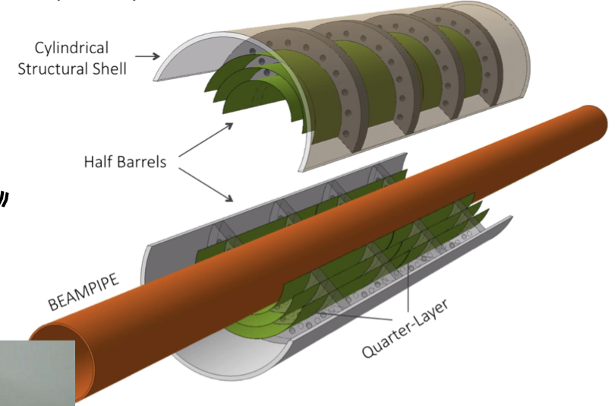
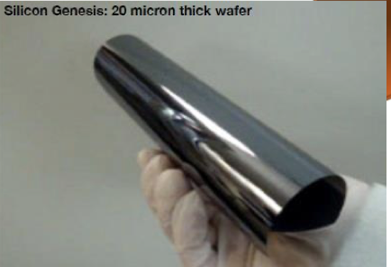
Semi-conductor detectors - MAPS /DeMAPS
Granularity (improved resolution)
Low material budget (0.37X0 -> 0.05X0)
Radiation hardness, low consumption
CMOS technology (Monolithic)
High rate (~100MHz/cm² ->GHz/cm²)
Fast signal collection
Time resolution (10-100 ps)
Radiation hardness 10¹⁵n/cm²
➽
DeMAPS
Examples of future application in HEP : VTX Belle II, ALICE ITS, ILC, FCCee, FCChh,..
ALICE-ITS3
R2: With a well-established 5-year program, the promising R&D on MAPS & DeMAPS detectors should be strongly supported by IN2P3, while still keeping the current expertise on hybrid detectors.
22/10/2020

Slide 8
Semi-conductor detectors
In astroparticle physics CCDs instead of bolometers:
Massive detectors → > 10 kg
Thicker devices → up to 5 mm
Faster read-out → one order of magnitude
Lower leakage current → 3 to 4 orders of magnitude
Skipper CCDs
DAMIC, …
R3: Considering the existing expertise at IN2P3 a R&D program on skipper CCDs could have a visible impact if a large enough team is identified.
In cosmology or astrophysics: large size infrared detector/cameras are needed.
Post-EUCLID, …
R4: A better national coordination between the different existing infrastructures addressing IR/visible/UV detectors characterization is strongly recommended.
22/10/2020

Slide 9
Gaseous detectors
Widely used in nuclear and particle physics:
Tracking (spatial and timing) usually at high fluxes
Particle identification through momentum or energy measurements
Gas medium can also be the reaction target (e.g., ACTAR or neutron detection MIMAC-n)
Most of them exploit the capabilities of electron avalanches in gas under high electric field
Several families of gaseous detectors:
Parallel plate chambers and wire chambers: low material budget and big size capabilities (ALERT project)
Ionization chambers (no gaseous avalanche performed): good DE/E PID capabilities (SCALP)
Spherical chambers: low noise/threshold detection, well adapted to dark matter detection (6N/xNSPC)
GRPC (Gaseous Resistive Plate Chambers): spark protection, high fluxes, good time resolution (SDHCAL5D)
MPGD: Micro Pattern Gaseous Detectors like Micromegas or GEMS and last generation (Glass-GEM, Thick-GEM, MicroBulk Mircomegas, Piggyback Micromegas, resistive micromegas…): used when possible in replacement of wire chambers for their high fluxes capabilities with longer life time, low background…(MIMAC, ACTAR)
22/10/2020

Slide 10
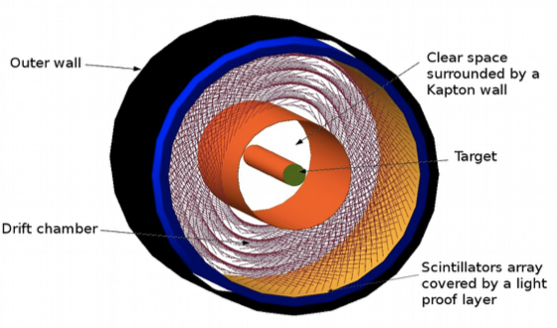
Gaseous detectors - Wire Chambers
Started as R&D for the wire chamber of the ALERT project
Other wire chambers in nuclear physics experiments, ALICE, Belle II
Minimization of wire density (C or Al instead of W-Au)
Improve detection efficiency of light particle
decrease mechanical constraints
position sensitivity thanks to C wire
CHANGE
New generation of wire chambers: the thinner wires add some additional difficulties (e.g., fixation system)
C-wires very resistant, possible applications for other detectors?
22/10/2020

Slide 11
Gaseous detectors
Extreme versatility thanks to their parameters (geometry, size, gas, pressure...) that can be optimized case by case.
Small systems not designed and manufactured in private companies.
R5: The pursuit of a minimum R&D effort is essential to ensure the long-term sustainability of ‘small- scale’ gaseous detectors and of the associated skills at IN2P3.
R&D to couple ionization chamber and the measure of the light produced in the gas
➽ for cross section measurements for nuclear reactor physics
R6: The detection concept coupling the ionization signal and the photo-detection of the emitted light is very promising for the forthcoming years and should be further explored.
22/10/2020

Slide 12
Cryogenic detectors
Measure the power or energy deposited in the absorber by induced thermal effects
Temperature ( < 4 K, Liquid He)
Massive Bolometer:
from g to kgs
Mostly hand-made
Individual particle detection
Main applications: rare event detection (dark matter, 0𝜈ββ, CE𝜈NS)
Bolometer matrix:
1 ➙ 100k «pixels»
Collective production process
Individual particle detection or global flux detection
Astro with Sub-mm (50-600 GHz), X detection, Low-Energy single photon
From R&D phase towards complex scientific instruments:
Increasingly deep integration between detectors: higher number, more pixels
Mechanics: compactness, low radioactivity
Cryogenics: “dry” cryostat, high dissipation power at low temperature, management of microphonic noise induced by thermal machines
Front-end electronics: dedicated ASIC, multiplexing, consumption
22/10/2020
Notes:
https://indico.in2p3.fr/event/19979/attachments/55521/73888/JUILLARD_GT08_IN3P3_2020_ProspectivesDetecteursCryoEtInstrumentations.pdf

Slide 13
R&D on thermal sensors
Ge-NTD: Neutron transmutation doping of Ge, metal/insulator transition
Use of research reactors in France to make NTD: (e.g., LUMEN, ANR 2015)
Currently no new production, new prod. chain to be found
R&D Optimisation:
- Metallization, cutting and gluing processes
- 1000s of NTDs needed for next 10 years
Nb_{x}Si_{1-x}: alloy close to metal/insulator transition or even supra
Micro-lithography process for matrix manufacturing (QUBIC) and high mass bolometers (EDELWEISS/Ricochet).
R&D:
QUBIC
- Minimize specific heat by mixing active zone with phonons trap
- Veto for low energy surface event (super «metastable» state)
R7: IN2P3 teams and their main French partners are developing very diverse and innovative R&D projects. These activities should be strongly supported in the long term to address the needs of future astroparticle and cosmology experiments, but should better focus on the most promising and priority developments.
22/10/2020

Slide 14
Photodetectors
Photodetectors + Scintillator material or Cherenkov radiator
Commonly used photodetectors:
Photomultipliers (PMT)
Micro-Channel Plate PMT (MCP-PMT)
Silicon Photomultiplier (SiPM)
Large detection area
Precise timing (PID or TOF)
Single photon detection, low operating voltage and insensitive to magnetic fields
Higher level of precision in light detection and high efficiency over a large dynamic range (SD#1, SD#2, SD#3)
Ultra-fast and radiation hard scintillators
Compact photodetector with high dynamic range and sensitivity
Precise timing sensors with O(10 ps) resolution
Large area, inexpensive and improved photosensor for VUV light
Novel technical solutions for n/𝛾 detection/discrimination
➽ HE Physics
➽ PID, TOF
➽ Neutrino physics
➽ Nuclear physics
R&D activity on Li-based elpasolite crystals

Slide 15
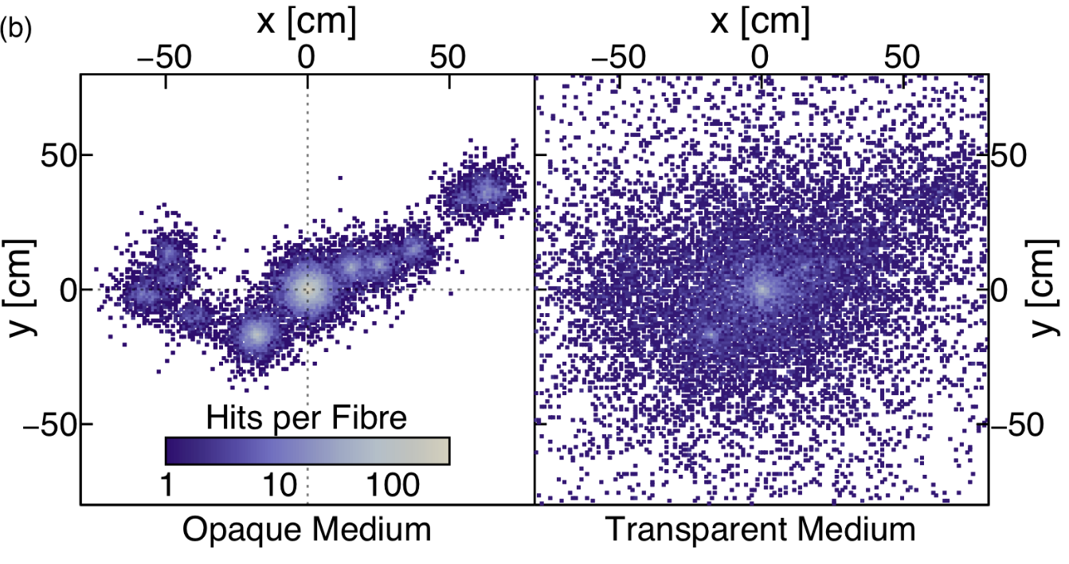
Photodetectors – Opaque Scintillators
LiquidO is a new detection technique making use of opaque scintillators read-out by means of WLS fibers
Opaque detection medium ➔ stochastic light confinement
Imaging + topology and particle ID
Possible application for:
Neutrino physics
Medical imaging
High energy physics
…
Breaking the paradigm of transparency paves the way to a wide range of new scintillator formulations
R8: It is highly recommended to pursue the on-going R&D efforts in the scintillator field, in particular on Li- Elpasolite and opaque scintillators which are very promising.

Slide 16
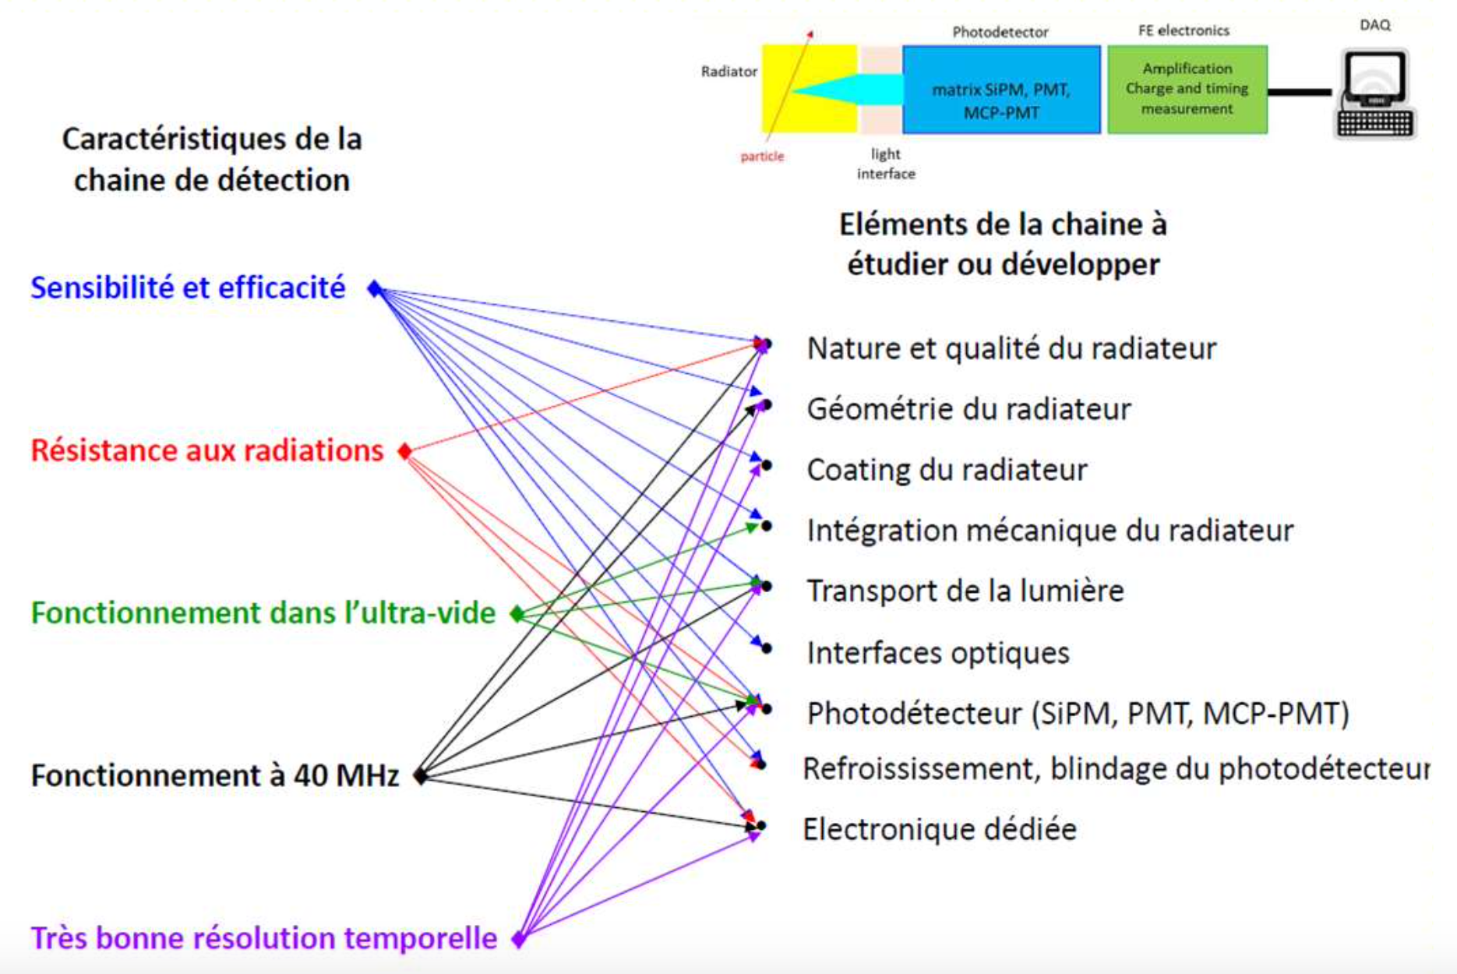
Photodetectors – Cherenkov detectors
Well recognized expertise in IN2P3 labs for the development and prototyping of Cherenkov detectors for use in HEP and TOF-PET. On-going projects:
R&D for F-TOF PID system for Super 𝜏-Charm Factory
PLUME, luminometer for LHCb
R&D to optimize each part of the detection chain: fused silica radiator specifications, SiPM and MCP-PMT, optical coupling, mechanical integration and read-out electronics
R9: The pursue of the on-going R&D efforts in the Cherenkov detection field should be strongly supported.

Slide 17
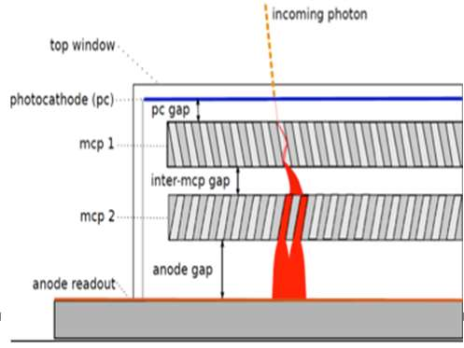
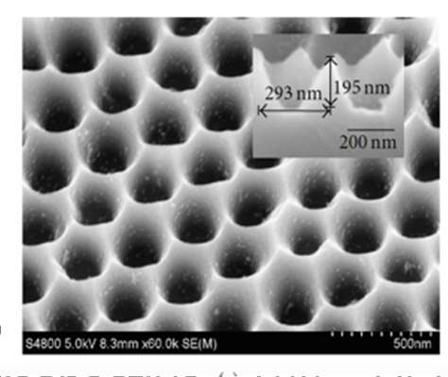
Calorimeters
Next generation collider experiments will need higher granularity (SD#2) to enable the use of particle flow for the energy reconstruction while keeping good intrinsic energy resolution
R&D achieved on SiW compact calorimeters (CALICE, CMS HGCAL, ALICE FOCAL detector) the main challenge is now the integration
R&D on LAr sampling calorimeters to achieve high granularity and for cold ASIC development
R10: Considering the large expertise of IN2P3 teams, starting an R&D on high granularity Liquid Argon calorimeters for future colliders experiments would ensure a good use of the Institute technical skills, providing a very high visibility to IN2P3.
PICMIC is a new detector technology, based on the MCP concept: It will allow the detection of charged particles, 𝛾-rays and n with high time (few ps) and position (<μm) resolution in hostile environments with very high pile-up
R12: IN2P3 should strongly encourage the emergence of innovative and promising developments likely to lead to technological breakthroughs, and therefore support the development of the PICMIC concept.

Slide 18
Timing
Accurate timing information ➽ 10 ps TOF-PET challenge
https://the10ps-challenge.org/
GT10
R11: Precise timing measurements looks to be one of the new features considered for the next generation detectors. It is therefore crucial for IN2P3 to be involved in these developments.

Slide 19
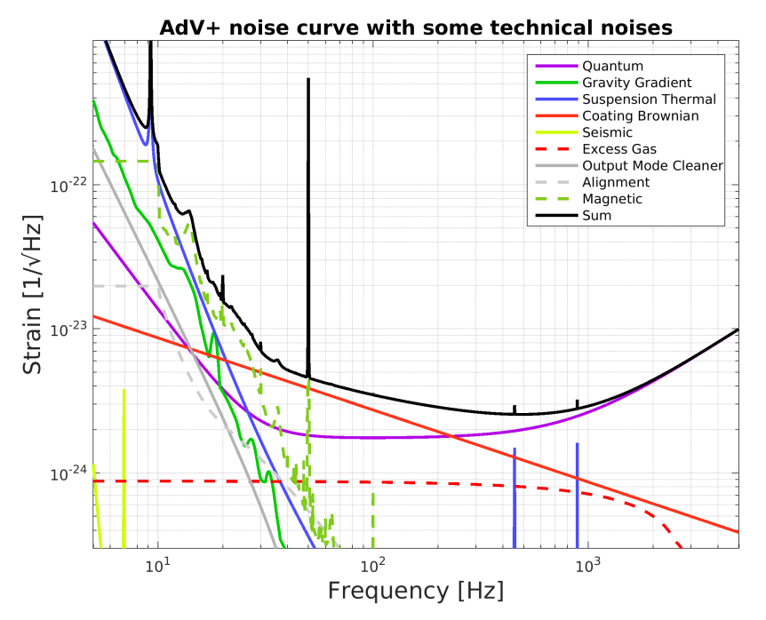
Gravitational wave detectors
The main challenge for the next generation GW detectors is to increase the sensitivity by at least one order of magnitude while enlarging the bandwidth of the detector to lower frequencies (SD#1)
Increase the signal ➽ Lengthen the interferometer arm (10km for the Einstein Telescope)
Reduce the noise
VIRGO, VIRGO post-O5
→ Einstein Telescope
Low freq [<10 Hz]: seismic effects
Mid freq [50-200 Hz]: thermal noise
High freq [>200 Hz]: quantum noise

Slide 20
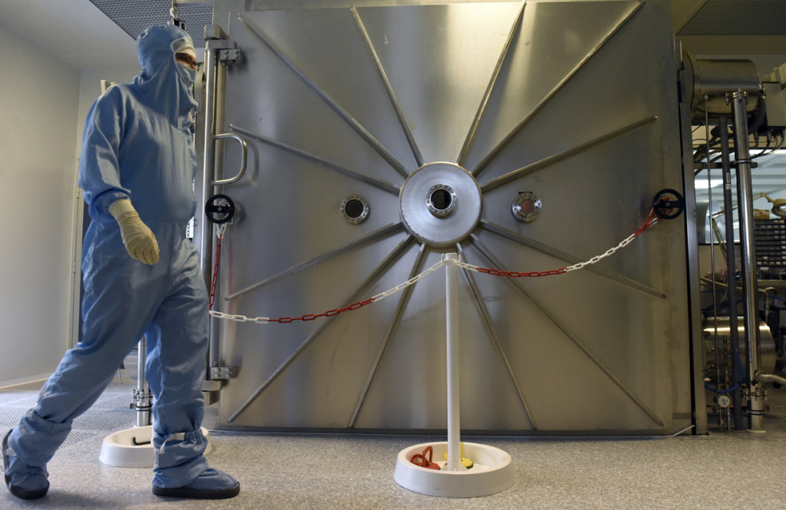
Gravitational wave detectors
Low freq [<10 Hz]: seismic effects ➽ Underground operation, better seismic insulation
Mid freq [50-200 Hz]: thermal noise ➽ Operate of the detector at cryogenic temperature, optimize the mechanical and optical quality of the mirrors (low-loss coating), use of a larger laser beam
R&D on the coating and characterization of low-loss mirrors
‘Tres Grand Coater’ @ LMA for coating very large sizes mirrors (up to 1m in diamater)
R13: It is strategically crucial that the R&D program on low-loss mirrors is strongly supported in the next years so that LMA can keep its world leadership in the domain of high performance large optics

Slide 21
Gravitational wave detectors
Low freq [<10 Hz]: seismic effects ➽ Underground operation, better seismic insulation
Mid freq [50-200 Hz]: thermal noise ➽ Operate of the detector at cryogenic temperature, optimize the mechanical and optical quality of the mirrors (low-loss coating), use of a larger laser beam
High freq [>200 Hz]: quantum noise ➽ Increase the laser power at the input of the interferometer, inject a proper « squeezed vacuum field » into the dark port of the interferometer
R&D to reduce the optical losses in the output mode-cleaner cavity
Study of the radiation pressure noise. Development of a frequency dependent squeezed source able to produce a board-band quantum noise reduction
R&D on high quantum efficiency photodiodes and associated very-low-noise electronic chain and on enhanced calibration techniques
R14: The on-going R&D activities on in-vacuum squeezed sources should be strongly supported.

Slide 22
Transverse technologies
Detector R&D is a highly technological research area that relies on a broad range of technical resources and expertise: it is crucial to guarantee support for detectors developments in terms of human resources, infrastructures and specific know-how
Mechanics and cooling
Electronics and microelectronics
Acquisition systems
R15: The different instrumental and technical teams working on the development of detectors should strongly increase their inter-connection and collaboration, so as to further favor the exchanges in know-how and emergence of innovative technological ideas.

Slide 23
Mechanics and cooling
Metrology and mechanical workshop are essential within the laboratories
Multi-physics Finite Element Analysis (FEA) simulation platforms are essential for design and integration of detectors
3D Additive Fabrication is taking an increasing role in the design and manufacturing process of detectors and accelerator components.
R16: Multi-physics simulation platforms, including CAD tools, are vital to ensure a proper detector design, in particular to overcome the emerging cooling issues. These tools are also more and more complex and it is essential to secure and further develop, in a coordinate way through specific training and enhanced inter-laboratory exchanges, the expertise already existing in IN2P3 teams.
R17: It is essential to define within the next years a proper strategy on how to precisely develop the Additive Fabrication technology in our laboratories.

Slide 24
Electronics and microelectronics
Next generation experiments will require complex ASICs with an increased number of read-out channels >O(10³-10⁴)
ASICs with increased digital electronics
➽ smart data in place of raw data, smart decision algorithm in place of trigger logic
➽ Finer technologies allowing faster transistors and larger integration but more difficult in terms of noise, dynamic range, …
➽ Impossible for a single team to conceive a new ASIC
➽ > 5 years to design, prototype, qualify and produce chips. Strong risk for technology obsolescence during the lifetime of a project
Creation of MI2I @ in2p3
R18: Technology watch on microelectronics should be enhanced. In particular, some IP blocks should be produced with the emerging technologies so as to learn and qualify them and identify a suited technological roadmap for the next 10 years.

Slide 25
Acquisition systems
For the most demanding experiments, in the next 10 years the volume of data will be between 0.2 and 4 TB/s, with event size values between 0.1 and 68 MB and recurrence between 40 MHz to 1 GHz.
Very high luminosity implies:
Higher frequency of individual bunch-crossing ➽ faster electronics
Large detector with finer granularity ➽ higher volume of data
Wireless solution to increase transparency
High radiation dose
CERN roadmap: use of rugged transmission chips and concentrators to collect data from existing transmission chips in a tree structure
Very complex events ➽ more elaborated and flexible algorithms
Trigger-less architecture: real-time event selection in the farms. Implementation of neural networks in the FPGAs to reduce the amount of transmitted data
R19: IN2P3 teams are currently studying the feasibility of implementing neural networks inside FPGAs. This Artificial Intelligence approach is extremely promising and should be strongly pursued.
GT09

Slide 26
Acquisition systems
Ultra-fast links will allow acquisition data flow > 10 to 100 Gbs
In new acquisition systems:
Smarter management of buffer zones throughout the data flow
Not possible to store directly all data coming from electronics
➽ Management of soft trigger
➽ Compression of w/ or w/o data loss
➽ More complex scientific calculation
Computing aspects have to be take into account as an element of the experiments in the same way as electronics
R20: The acquisition framework that meets the online constraints of IN2P3 experiments have a very strong distributed component and the development of the computing clouds could allow the optimization of online scientific computing replacing advantageously the grid approach.
GT09

Slide 27
Conclusions
R1: it is of paramount importance to anticipate the long development cycle and maintain a strong detector R&D activity so as to maintain leading-edge knowledge, push the associated technologies beyond state-of-the-art and meet the challenges of future IN2P3 scientific research.
R15: in order to further enhance the existing strike force of IN2P3 laboratories, the different instrumental and technical teams working on the development of detectors should strongly increase their inter-connection and collaboration, so as to further favor the exchanges in know-how and emergence of innovative technological ideas.
Reinforce and reorganize the existing instrumental IN2P3 expert network
Assure skilled technical support for detectors R&D via internship, PhD students and postdocs as well as adequate financial resources.
Identify and maintain a global technological roadmap suited for future IN2P3 experiments strategic need

Slide 28
Conclusions
Towards a « GDR Détecteurs » ?
Federate teams and create collaborations (inside and outside IN2P3)
Foster researchers/engineers together
Promote young researchers
Identify frontiers detectors and indicate a strategic roadmap
Encourage valorization and diffusions actions
Workshop « Physique et détecteurs à la frontiere », June 22nd-24th 2021
https://indico.in2p3.fr/event/23982/
Agora during the workshop « Journées R&T IN2P3 », October 4th-6th 2021
https://indico.in2p3.fr/event/6256/

