Slide 1

Colloque de restitution de
l'exercice de prospective nationale
GT03 – Physique hadronique
Understanding strong interactions
19 octobre, 2021
Comité de pilotage: Klaus Werner (SUBATECH), Carlos Munoz (IJCLab), Béatrice Ramstein (IJCLab), Frédéric Fleuret (LLR), Laurent Vacavant (IN2P3)

Slide 2
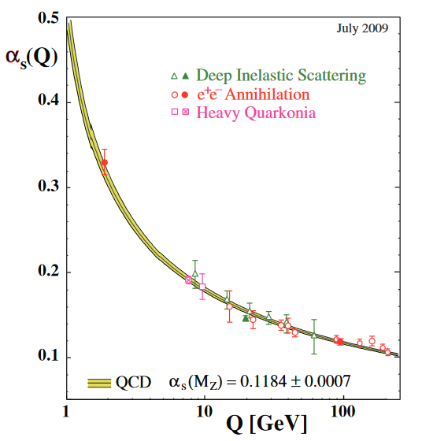
GT03 - Hadronic physics
hadron structure and QGP
95% of the visible mass in the universe is due to QCD !
M_{e}<< m _{u,d quarks} ~ 1/200 m_{proton}
Non-perturbative (strong) QCD
Confinement
Open questions:
• What is the dynamical origin of confinement ?
• How does the hadron spectrum (baryons, mesons, glueballs,…) and hadron properties (mass, spin,…) arise from the quarks and gluons ?
•What are the different hadronic matter phases ?
perturbative QCD
Asymptotic freedom

Slide 3
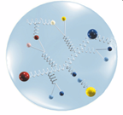
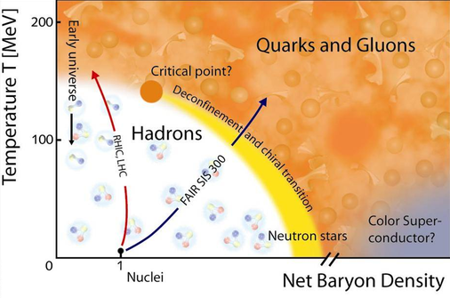
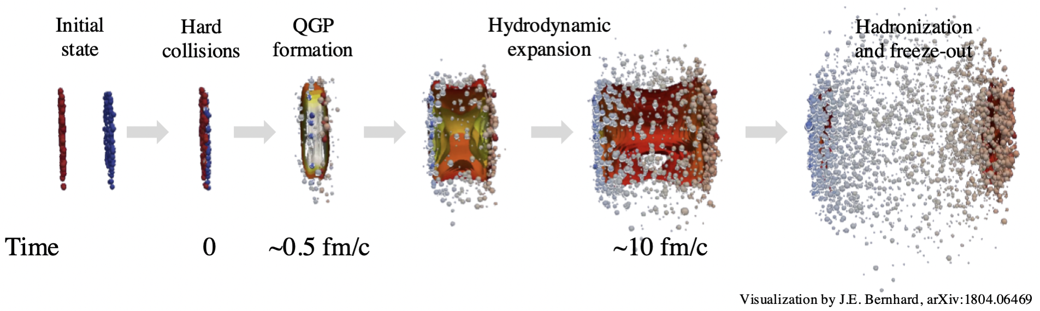
GT03 - Hadronic physics
1. Nucleon Structure (NUST)
Study QCD bound states (hadrons, glueballs,hybrids,...)
IN2P3 studies (GT03): Jlab, EIC
2. Strongly Interacting Matter (SIMP)
Study the phases of strongly interacting matter
IN2P3 studies (GT03): Alice, CMS, LHCb, HADES

Slide 4
GT03 - Science Drivers (SD)
SD1: Understanding the origin of proton mass
  How quantum fluctuations of quark-antiquark pairs, gluons and the dynamics of their interactions eventually generate most of the mass of the nucleon ?
SD2: Mapping the structure of nucleons and nuclei
  quark content: how do the different flavours of quarks distribute in space and momentum inside hadrons?
  Gluon content: how do the nucleon and nuclei look like at high energy, where gluons are dominant ?
  Saturation: how could gluon recombination lead to a saturation of the number of gluons inside nucleons and nuclei, creating a regime of high parton density, but small coupling ?
SD3: Understanding the deconfined state of quarks and gluons
  Nature of QGP: how dense and viscous is the medium ? how does color screening apply ? How fast and how does the system reaches equilibrium? What is the role of saturation for the initial state.
  Collectivity: are collective-like effects observed in small systems of the same nature as in large systems ? what are the conditions of collectivity ?
  Chiral symmetry restoration: can signals be observed and is the restoration of this fundamental symmetry of QCD simultaneous to the deconfinement transition at finite baryon densities ?
SD4: establishing the equation of state of strong interactions
  Phase transition: what are the thermodynamic parameters and the order of the transition ?
  Critical point: where is it located in the phase space diagram ?
  Hadronic matter: what is its microscopic structure (baryon resonances, strangeness,...) and how are hadrons modified in dense and hot hadronic matter ?

Slide 5
GT03 - 14 Contributions received
Title of the contribution | Signatory Lab (number of people signing)
Physique hadronique à Jefferson Lab | IJClab (7), CPhT (2)
The electron-ion Collider | IJClab(14), CPhT(4), Subatech(4), LLR(2), LPSC(2), IPhT(1)
Prospects on QGP characterization and heavy-ion collisions | Subatech(12), IJClab(6), IPhT(4), LLR(3), LPC(3), LPSC(3), IP2I(2), IPHC(2), CERN(1), IFJPAN(1)
French community support for a fixed-target program for the LHC | IJClab(13), CPhT(3), Subatech(3), LLR(2), CERN(1), IP2I(1), LPC(1), LPTHE(1)
Une expérience de nouvelle génération pour la QCD au HL-LHC - ITS3/ANGHIE | IPHC(10), LPSC(3), IPhT(1)
The ALICE FoCal proposal and small-x physics at the LHC | LPSC(7)
Heavy-ion physics with the Compact Muon Solenoid | LLR(3), CERN(1)
Heavy-ion physics at LHCb | LLR(3), IJClab(1)
Unravelling the hadronic collisions structure w/ large-scale system & energy scan | IJClab(6), Subatech(5), IP2I(3), IPHC(2), LPC(1)
Dense baryon-rich matter : the NA60+ experimental project at CERN-SPS | Subatech(9), IP2I(5), LPSC(1), IJClab(1)
Dense baryon-rich matter: The HADES and CBM experiments at GSI and FAIR | Subatech(9), IP2I(5), LPSC(1), IJClab(1)
Dense baryon-rich matter: The experimental program at J-PARC | Subatech(9), IP2I(5), LPSC(1), IJClab(1)
Theory of dense baryon-rich matter: heavy-ion collisions and compact stars | Subatech(9), IP2I(5), LPSC(1), IJClab(1)
Neutron stars, gravitational waves and the QCD equation of state | APC(4), LUTH(1)

Slide 6
GT03 - Séminaire thématique
2-3 mars 2020, Subatech, Nantes
  https://indico.in2p3.fr/evet/20116
  https://webcast.in2p3.fr/container/le-seminaire-thematique-gt03
Agenda :
  Panorama théorique : Samuel Wallon
  Panorama des installations expérimentales : Barbara Erazmus
  Revue théorique - structure des nucléons et noyaux : Cyrille Marquet
  Revue expérimentale - structure des nucléons et noyaux : Raphaël Dupré
  Revue théorique - matière déconfinée à haute température et de la matière riche en baryons : Marlène Nahrgang
  Revue expérimentale - matière riche en baryons : Antonio Uras
  Revue expérimentale - LHC moyen terme : Antonin Maire
  Revue expérimentale - LHC long terme : Sarah Porteboeuf-Houssais

Slide 7
Outline
Nucleon and nUclei STructure
  Jlab
  EIC
Strongly Interacting Matter
  LHC
  FAIR/SPS/JPARC
The role of theory
  Nucleon structure
  QCD matter

Slide 8
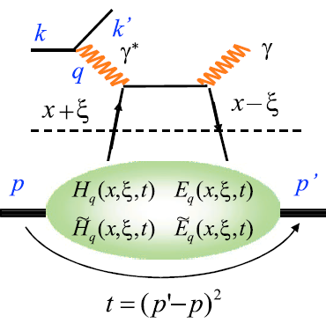
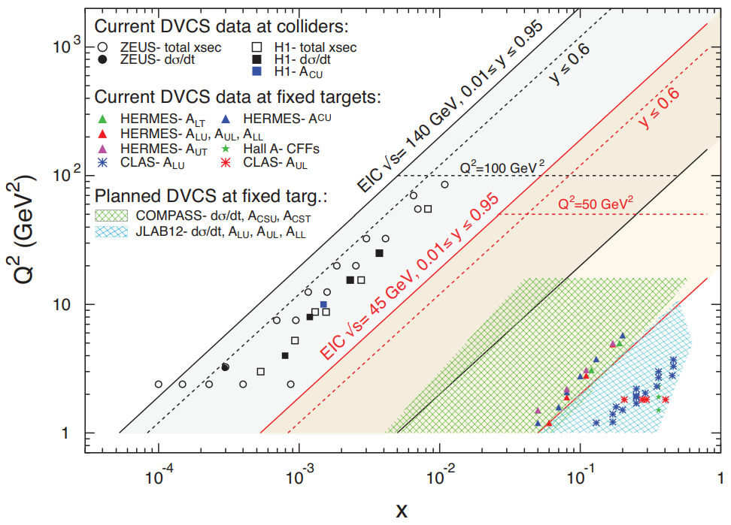
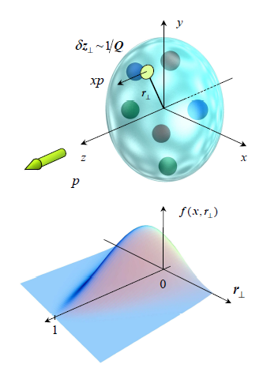
Structure of nucleon and nuclei
Deeply Virtual
Compton Scattering
(DVCS)
e-p/A collisions : electromagnetic probes → cleanest access
High beam energy (>10 GeV) needed to resolve quarks and gluons
High luminosity required : small cross sections (exclusive process)
French groups
          Important theoretical expertise
          Current experimental activities at Jefferson lab (USA)
          Future activities at the electron-ion collider (BNL, USA)
EIC reach: low x, high Q²
JLab: high x,
high luminosity
Study of gluons
Study of valence quarks

Slide 9
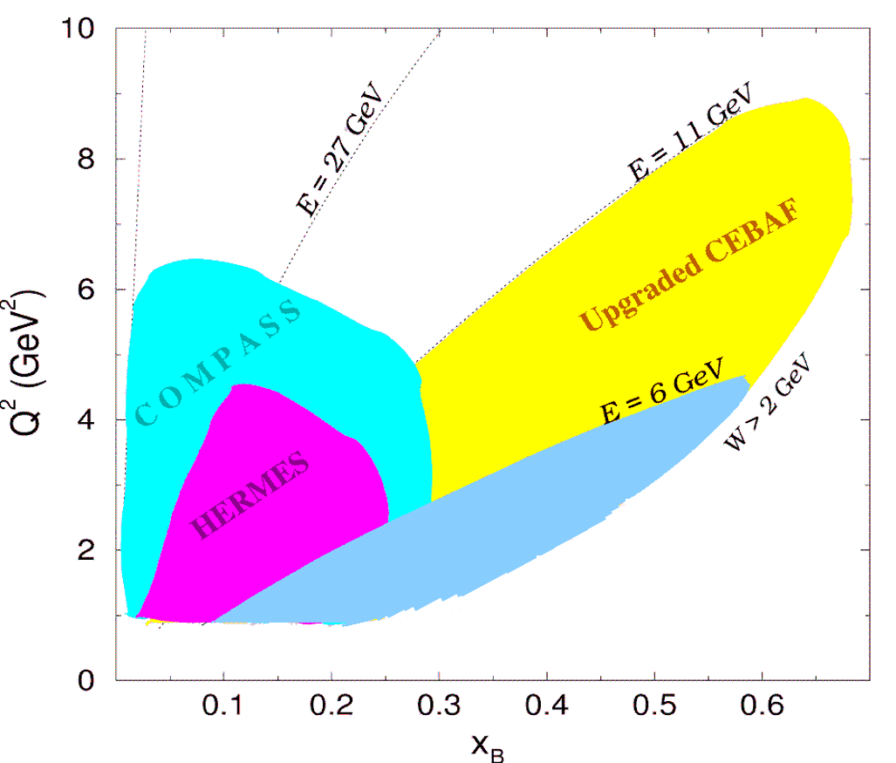
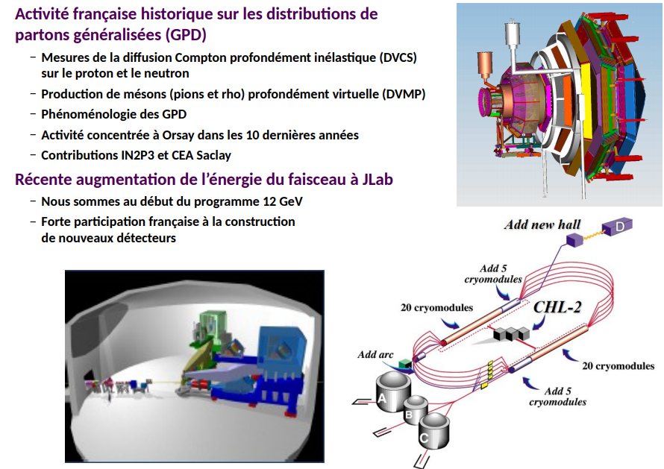

Jefferson lab (Jlab)
Strong involvement of French community, particularly in the field of Generalized Parton Distributions (GPDs):
Measurements of exclusive reactions (DVCS, DVMP…)
Contributions to phenomenology of GPDs
Several important technical contributions over the years
Recent upgrade of the accelerator to a higher beam energy (6 → 11 GeV) & detectors to higher luminosity (x10)
IN2P3 and IRFU leaders of several high-impact experiments in the coming years
Detector contribution ongoing (Hall B, Hall C)
Physics program well established for the next 10-15+ years
Physics goals:
        Precision study of 3D nucleon structure (GPDs, TMDs)
        Hadron spectroscopy
        Nuclear structure (nuclear-medium effects, hadronization…)
        BSM searches : Parity violation, dark matter …
Upgraded JLab
JLab 6 GeV

Slide 10
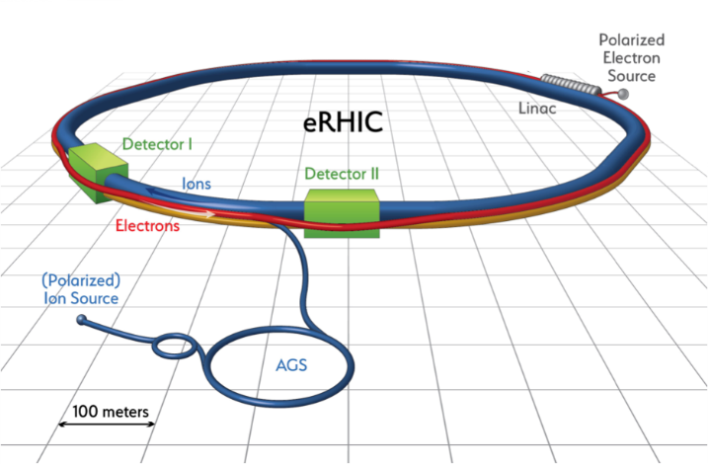

Electron-Ion collider (EIC)
Physics goals : high Energy / small x
Saturation: non-linear regime of QCD
Distributions of positions, momenta, angular momentum of gluons…
Role of gluons in the nuclear medium
Collisions e-p/A:
E_{cdm}=29-140 GeV, Polarized beams : e, p, d/³He
Electron beam: 5-18 GeV
Luminosity L_{ep}~10³³⁻³⁴ cm⁻²s⁻¹ (100-1000 x HERA)
Wide choice of nuclei
Project timeline
CD-0 (December 2019): Mission Need
CD-1 (July 2021): Start of project execution
CD-2 (~Jan’23): R&D completed
CD-3 (~Mar’24): TDR completed; start of construction
CD-4a (~Jul’31): Start of operations
CD-4b (~Jul’33): Projet completion
Call for Collaboration proposals for detectors at the Electron-Ion Collider
  Deadline for submission: December 1, 2021
  Strong French involvement: IN2P3/IRFU
French labs signing
EIC Yellow Report
IJClab (6), Irfu (9), CPhT (2)
BNL-220990-2021-FORE
JLAB-PHY-21-3198
LA-UR-21-20953
March 2021

Slide 11
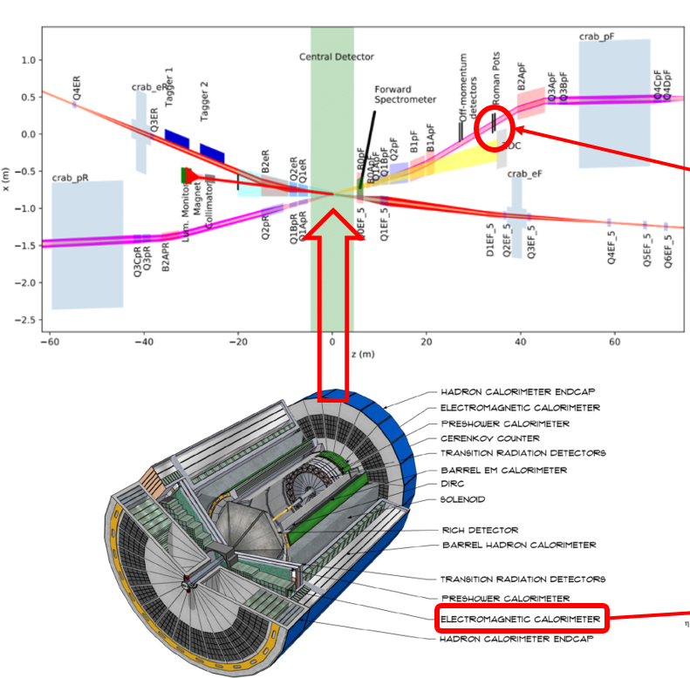
Electron-Ion collider (EIC)
Main physics interests from French experimental groups
3D imaging of nucleons and nuclei
Physics observable
Exclusive reactions (DVCS): very forward and backward detection needed
Possible hardware contributions
Electromagnetic calorimeter
  - Crystals (PbWO₄) and scintillating glass (SciGlass)
  - Readout by SiPMs (or APDs)
  Roman pots (proton/ions) – 30 m from IP
    - AC-LGAD for fast timing and excellent spatial resolution
    - Readout ASIC under development
Roman pots
p’
DVCS
ep → e’p’γ
γ
e'

Slide 12
SIMP - Heavy-ion physics understanding QCD in multi-body systems
QGP = thermalized medium of deconfined partons
QGP as a privileged playground for QCD studies
  Transition from confined to deconfined medium : color screening, jet quenching…
  Collective motion of a medium governed by QCD interactions : flow, …
  Transition from deconfined to confined medium : hadronization, …
QGP and astrophysics/cosmology
  Early universe (high T, low baryonic chemical potential)
  Neutron stars (high baryonic chemical potential)

Slide 13
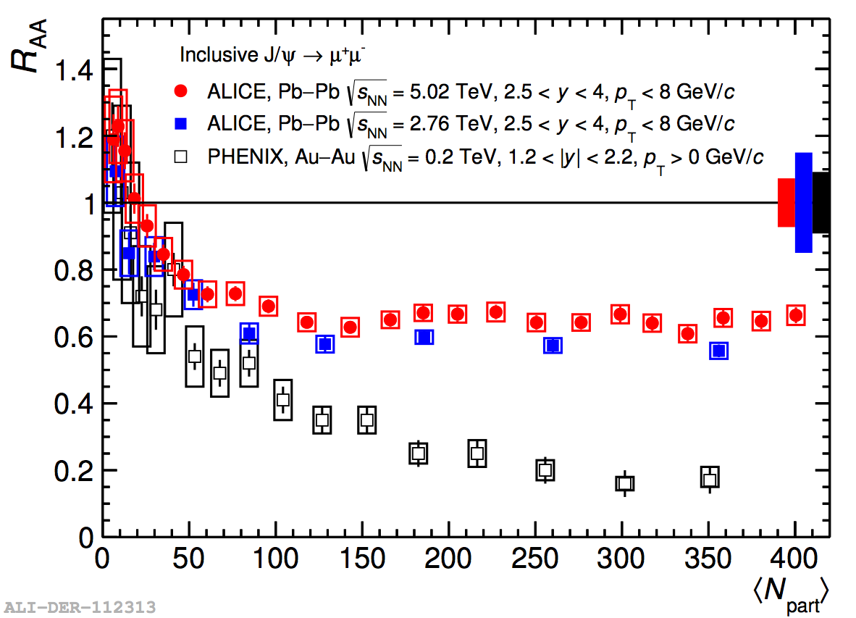

SIMP – heavy ion physics@LHC
pPb
Pbp
pp
PbPb
pPb
Pbp
PbPb
PbPb
PbPb
LHC Run 1 and 2 results confirmed and refined the picture of a nearly-perfect fluid (sQGP) observed in PbPb collisions (first observed at RHIC/BNL):
  Very dense medium (jet quenching)
  Azimuthal and long-range correlations (elliptic, triangular flow, ridge)
  hadron yields following statistical (thermal) models
  Heavy-quark (c,b) energy loss and thermalization, recombination
Peripheral
collisions
Central
collisions
$$R_{AA}=\frac{σ_{AA}}{A²σ_{pp}}$$

Slide 14
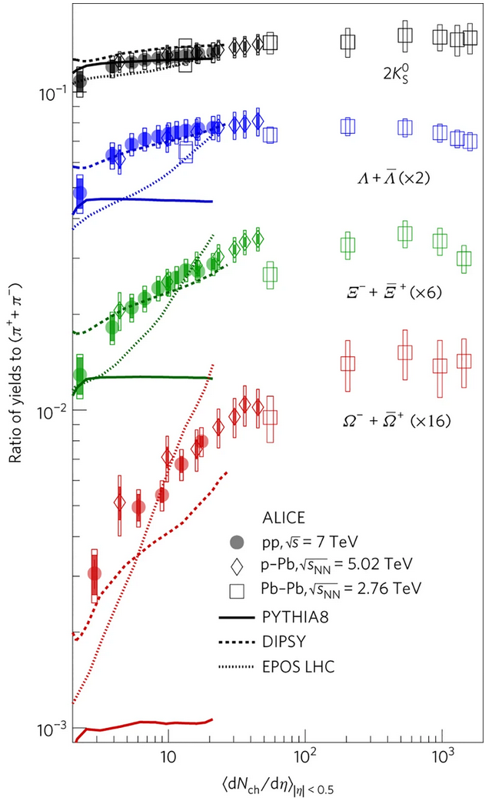
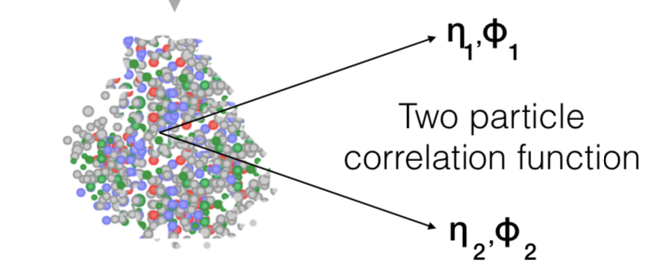
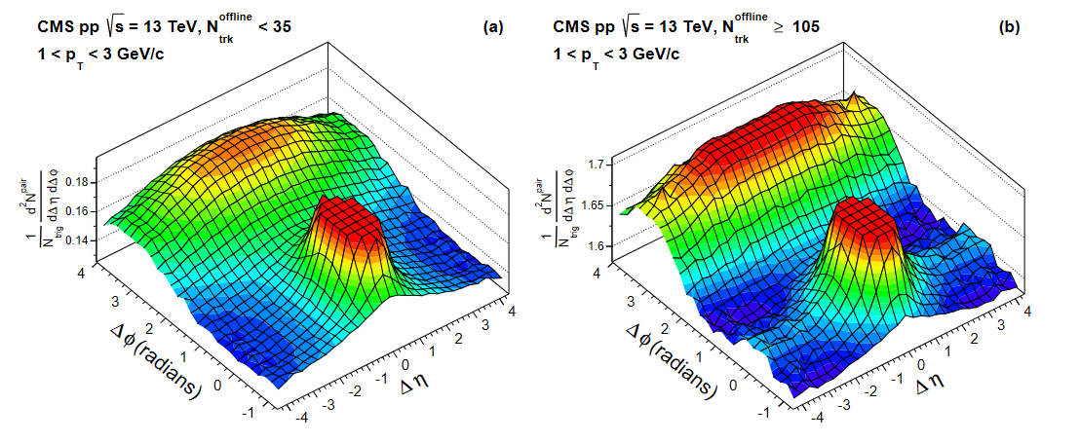
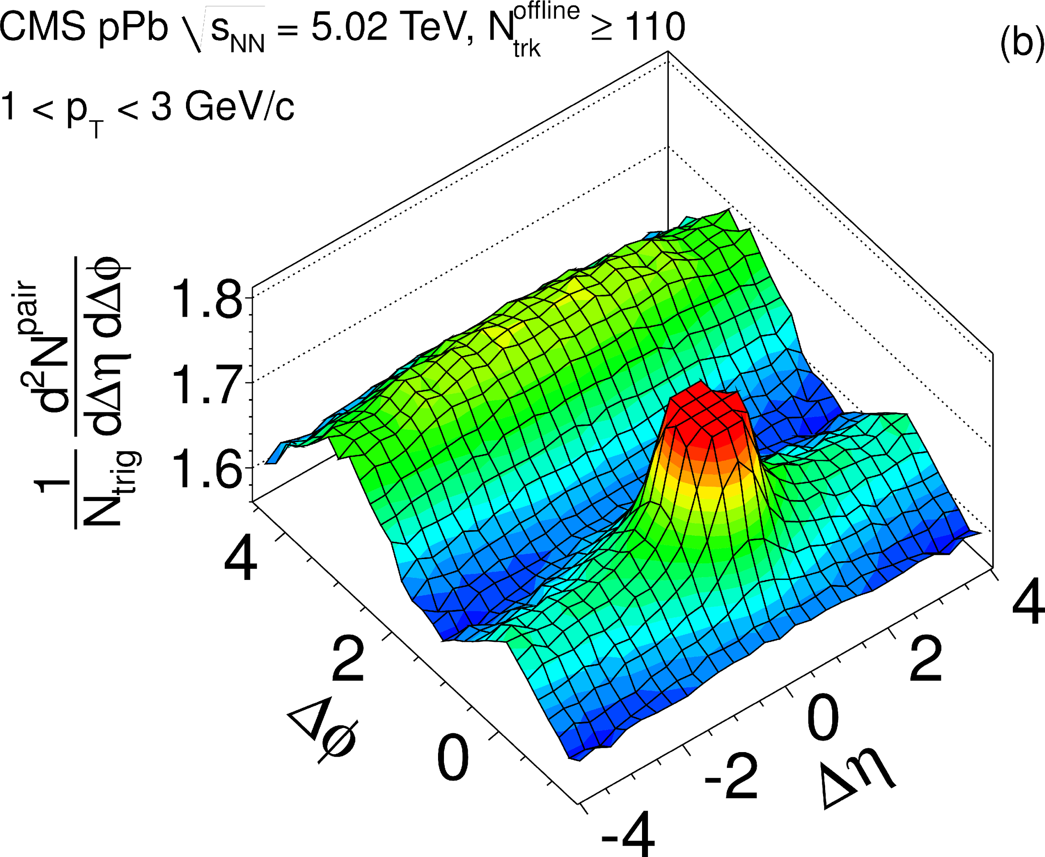
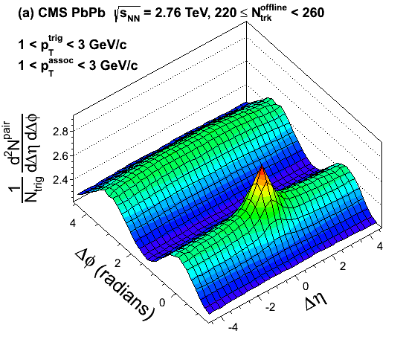
SIMP – heavy ion physics@LHC
p+p
pPb
PbPb
LHC Run 1 and 2 also lead to Striking new results:
  Collective-like effects observed also in high-multiplicity pp and pPb collisions,
  Smooth transition from small (pp) to big (PbPb) systems
    The conditions achieved in AA can be approached in pp
    Understanding the cross-over from free-streaming particles in vacuum to a strongly-interacting system is now a major focus of “heavy-ion” physics
Low
multiplicity
pp
High
multiplicity
pp
High
multiplicity
pPb
High
multiplicity
PbPb
No Ridge
Ridge
Ridge
Ridge
Low
multiplicity
High
multiplicity

Slide 15
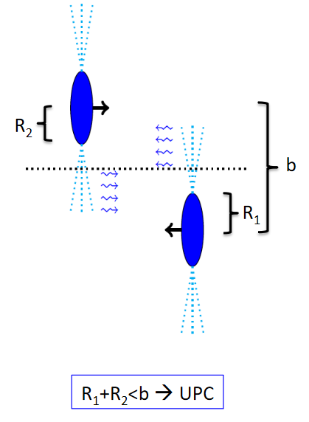
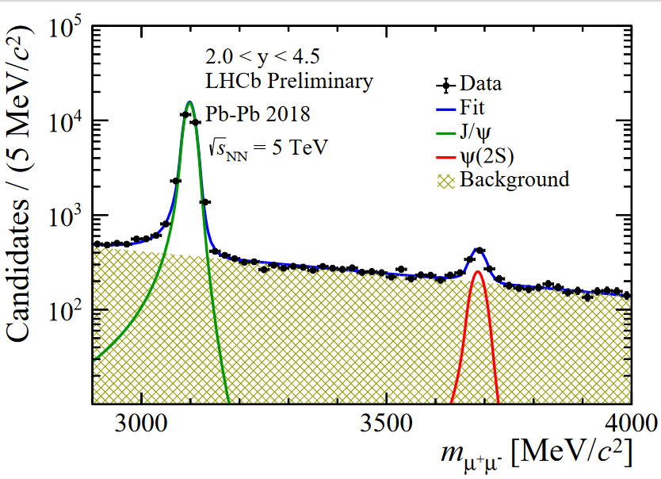
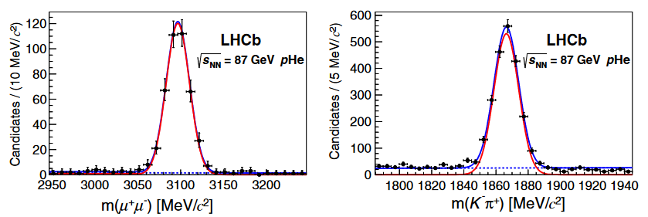
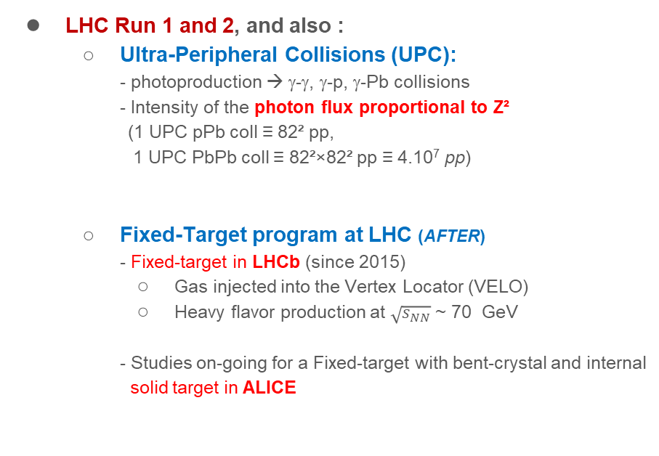
SIMP – heavy ion physics@LHC
LHC Run 1 and 2, and also :
  Ultra-Peripheral Collisions (UPC):
  - photoproduction → γ-γ, γ-p, γ-Pb collisions
  - Intensity of the photon flux proportional to Z²
  (1 UPC pPb coll ≡ 82² pp,
  1 UPC PbPb coll ≡ 82²×82² pp ≡ 4.10⁷ pp)
  Fixed-Target program at LHC (AFTER)
  - Fixed-target in LHCb (since 2015)
    Gas injected into the Vertex Locator (VELO)
    Heavy flavor production at $\sqrt{s_{NN}}$ ~ 70 GeV
  - Studies on-going for a Fixed-target with bent-crystal and internal solid target in ALICE
Phys. Rev. Lett. 122, 132002 (2019)
J/ψ
D⁰

Slide 16
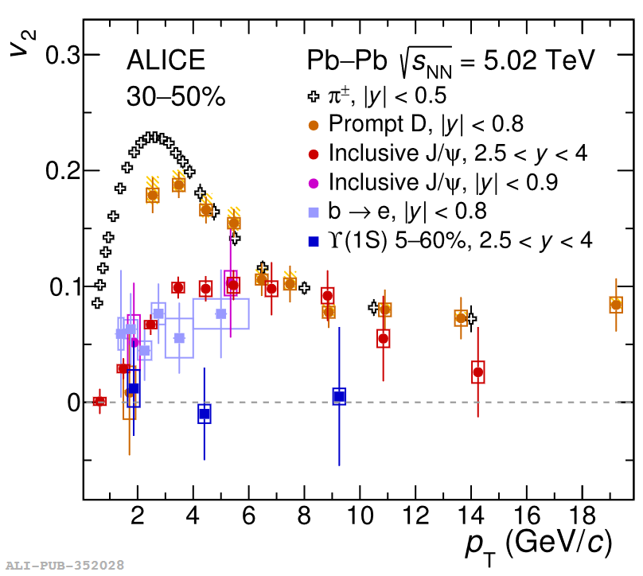
SIMP – heavy ion physics@LHC
LHCb/ALICE
Major upgrades
pp, pPb/Pbp, PbPb
CMS/ATLAS
Major upgrades
pp, pPb/Pbp, PbPb
Next (2022-2030): towards accurate quantitative description
  Build appropriate/accurate models
  Develop tools for model/data comparison and global interpretation
  Explore collective-like effects (multi-parton to fluid dynamics) in pp and pPb
  Focus on pQCD-calibrated probes – heavy-flavor and high p_{T} jets (boson+jets)
LHC Run 3 and Run 4
  More luminosity and improved instrumentation
    ~10x more luminosity than LHC Run 1 and Run 2 (13 nb⁻¹ expected in PbPb)
    experiment upgrades
p_{T}<3 GeV/c
    V2(J/ψ) < v2(D) < v2(π⁺⁻) : consistent w/ hydrodynamics
3 < p_{T} < 6 GeV/c
V2(J/ψ) < v2(D) ~v2(π⁺⁻) :
Heavy quark (D) hadronization via coalescence with flowing light quarks
p_{T} > 6-8 GeV/c
V2(J/ψ) ~v2(D) ~v2(π⁺⁻) : Similar path-length energy loss for heavy and light quarks
no flow for Υ : expected from smaller regeneration contribution

Slide 17
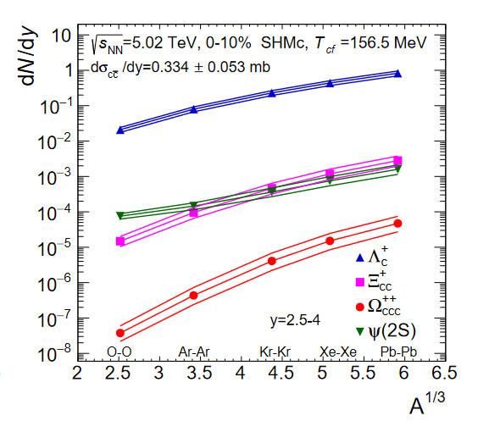
SIMP – heavy ion physics@LHC
LHCb/ALICE
Major upgrades
(Under review by LHCC)
pp, pA, Ap, AA
Next-to-next (2030+): towards thorough quantitative description
Consolidate theoretical models/framework
testing them against other systems than PbPb
LHC Run 5 and Run 6
  - High precision/luminosity with lighter ion systems
  - Testing theoretical models/framework against smaller systems
  - Explore collective-like effects and physics continuum from pp to PbPb
pp → pO → pPb →OO → ArAr → XeXe → PbPb
Multi-charm hierarchy,
Andronic et al.: JHEP07(2021)035

Slide 18
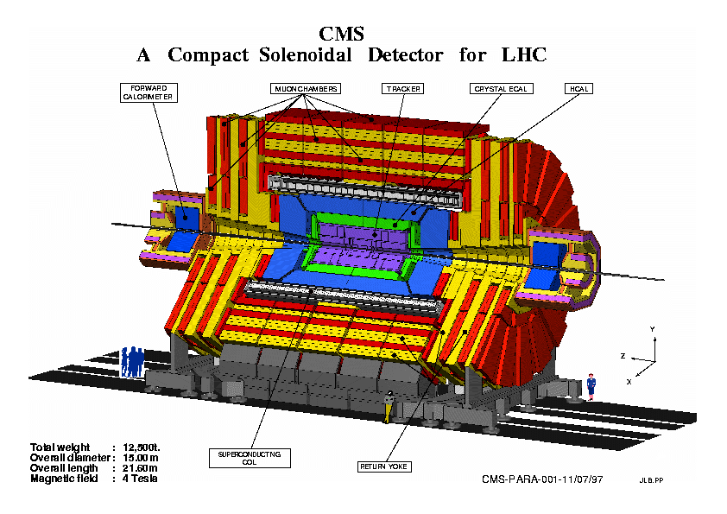
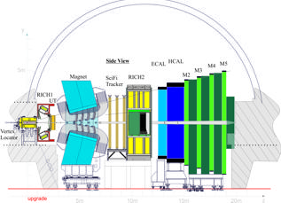
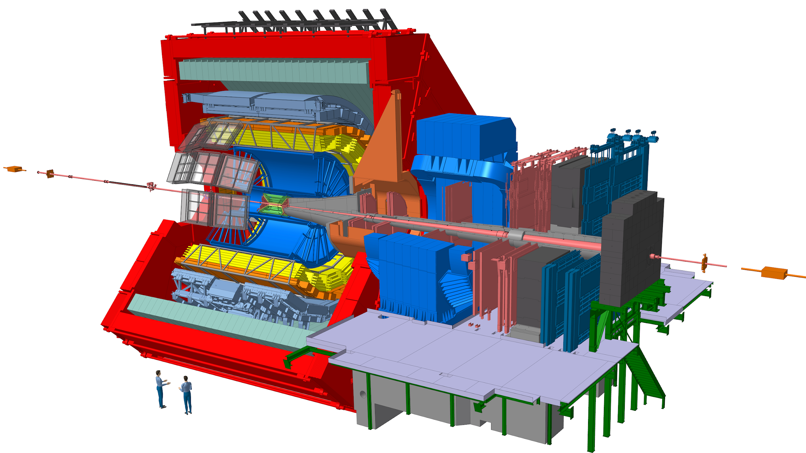
SIMP – heavy ion physics@LHC
Today
LHCb/ALICE
Major upgrades
(Under review by LHCC)
pPb
Pbp
pp
PbPb
pPb
Pbp
PbPb
PbPb
PbPb
LHCb/ALICE
Major upgrades
CMS/ATLAS
Major upgrades
pp, pPb/Pbp, PbPb
pp, pPb/Pbp, PbPb
pp, pA, Ap, AA
All four experiments (ALICE, ATLAS, CMS, LHCb) are involved in QGP physics
French community participates to :
O(45 people) ALICE : IJClab-Orsay, LPC-Clermont, LPSC-Grenoble, IP2I-Lyon, IPhC-Strasbourg, Subatech-Nantes + DPhN/Irfu/CEA (since 2009)
O(5 people) CMS : LLR-Palaiseau (since 2009)
O(5 people) LHCb : IJClab-Orsay, LLR-Palaiseau (since 2015)
ALICE
LHCb

Slide 19
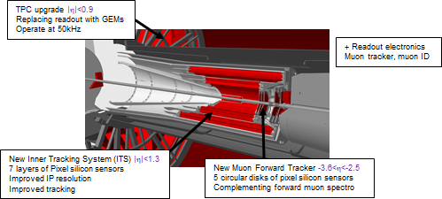
SIMP – heavy ion physics@LHC w/ ALICE
Run 3 (commisionning ongoing) : continuous readout at 50 kHz coll. rate
  Central region: ITS2, TPC-GEM
    Low material budget, PID, improved tracking,
    Lumi x 100
    IPHC, LPSC
  Forward region: Muon Tracking+ID, MFT
    Capability to separate promt/non-prompt muons
    IJClab, IP2I, LPC, Subatech + DPhN/Irfu/CEA
Upgrades for Run 4
  Central region: ITS3 (LoI:CERN-LHCC-2019-018)
    Replace ITS2 first 3 layers with ultra-thin Si CMOS, closer to the beam
    Tracking of short-lived particles. Better precision and efficiency at low p_{T}
  Forward region: FoCal 3.2<η<5.8 (LoI:CERN-LHCC-2020-009)
    FOCal-E: fine grain Si-W sampling calorimeter for 3D photon shower reconstruction
    Gluon saturation, correlations forward/central rapidities
  Fixed-target program with bent-crystal and internal solid target under investigation
ALICE - upgrades

Slide 20
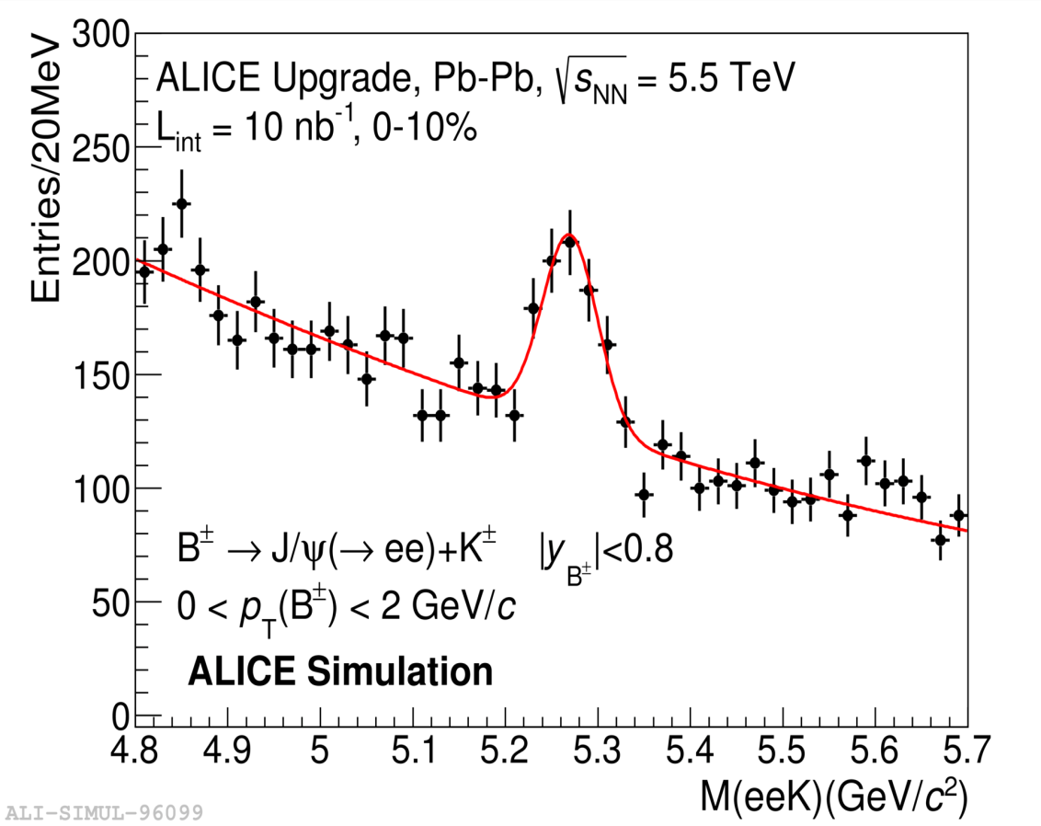
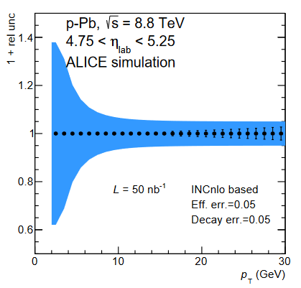
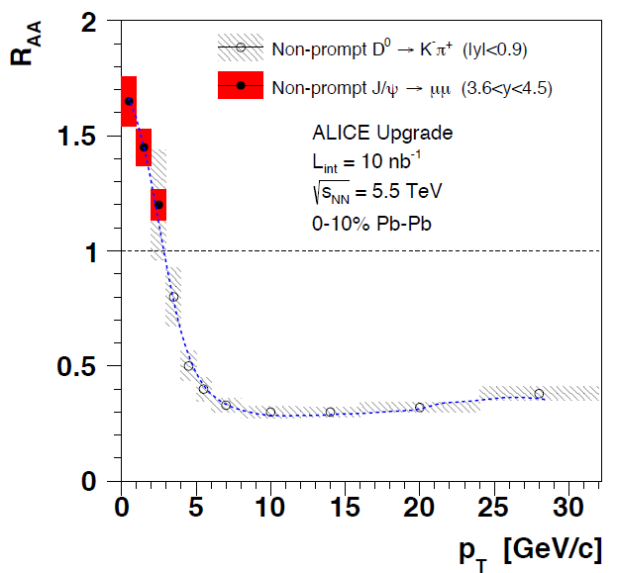
SIMP – heavy ion physics@LHC w/ ALICE
ALICE - upgrades
ALICE - physics program foreseen (Run 3/4)
Extension of the inclusive+differential measurements wrt bulk (u,d,s+c,b)
CERN-LHCC-2013-024
Open heavy flavor
  charm/beauty meson and baryon production at mid-rapidity
Quarkonia
  J/Ψ and Ψ‘ production at mid and forward rapidity
  prompt/non-prompt J/Ψ separation down to lowest p_{T}
Low-mass and low-p_{T} di-leptons
  Vector mesons and thermal photons
Jet quenching and fragmentation
  PID of jet particle content
  Heavy flavour tagging
CERN-LHCC-2015-001

Slide 21
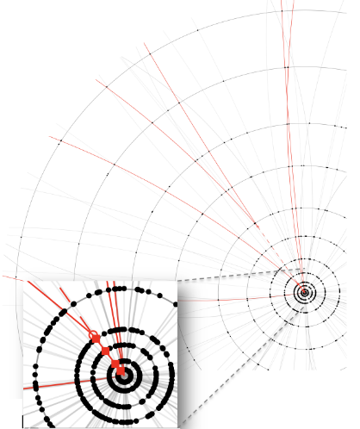
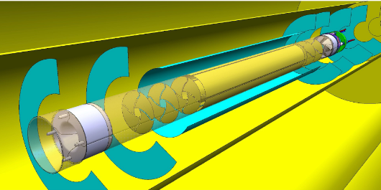
SIMP – heavy ion physics@LHC w/ ALICE
Upgrade for Run 5 (2032+): ALICE 3 (previously ANGHIE)
Physics goal : Enlarge phase-space exploration towards exhaustive description/understanding of the medium
Excellent tracking and vertex resolution down to low p_{T} → excellent HF resolution
Low material budget → low background for EM probes
Large η acceptance → correlations, flow and density dependence
LoI to be submitted to LHCC nov. 2021
ALICE - upgrades
7 cm
147th LHCC Meeting – open session – sep. 2021
(ALICE status Report)
Main characteristics wrt Run 4 :
- more hermetic (y ∈ [-4;+4] + p_{T} ∈ [0.05 ; O(10)] GeV/c)
- extended PID (innerTOF, outerTOF, endcapTOF, RICH, …)
- faster (1 MHz continuous readout)

Slide 22
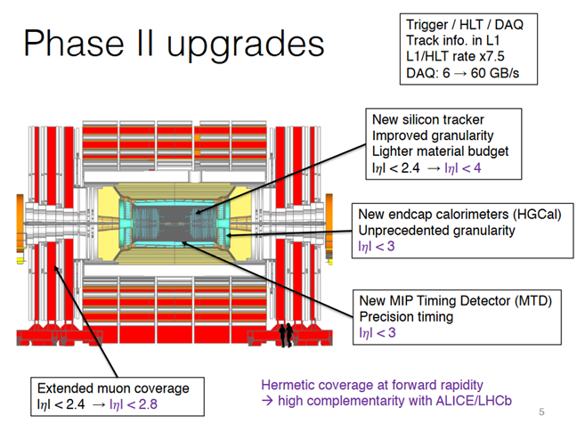
SIMP – heavy ion physics@LHC w/ CMS
CMS - upgrades
Major CMS upgrade for Run 4 (2026+)
  Objective: maintain current performance in pp for an average pileup of ~200 (curr. ~50)
The phase II upgrades enhance the physics potential for heavy ions
  Large acceptance, full particle flow to |η|~3
    Lighter, more granular tracker
    Super-granular endcap calorimeter
    Extended muon coverage
  New PID capabilities with MTD

Slide 23
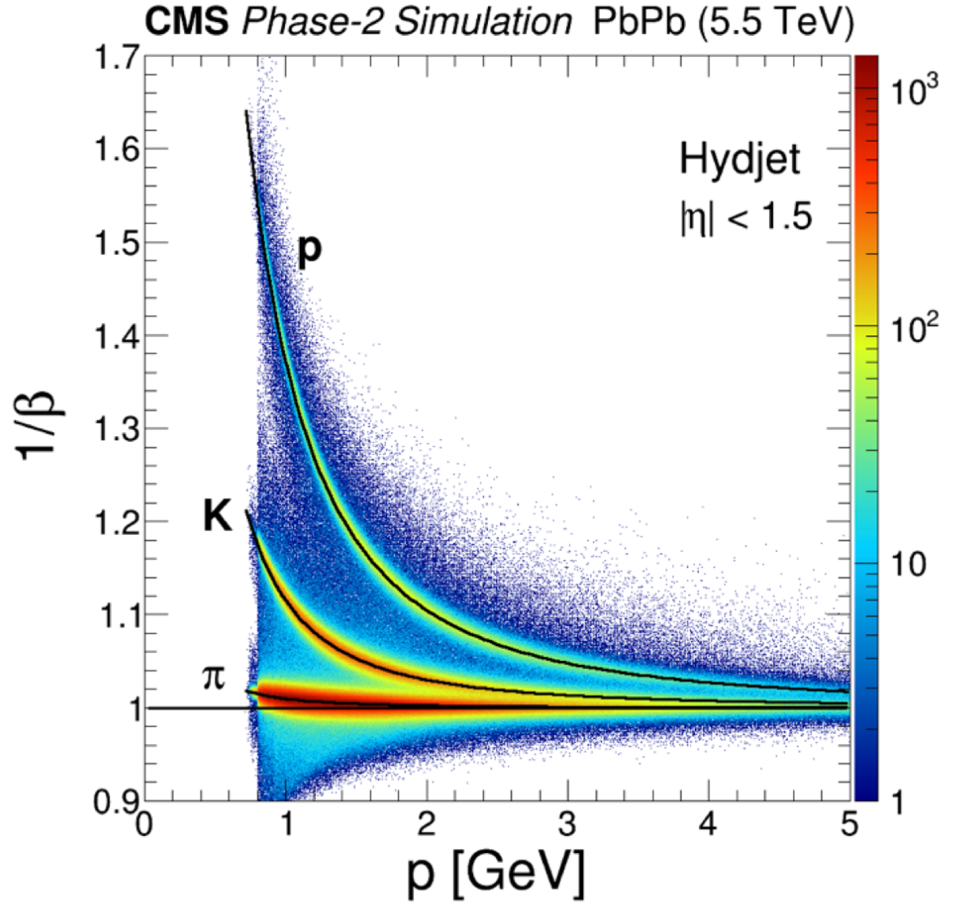
SIMP – heavy ion physics@LHC w/ CMS
CMS - physics program foreseen (Run 4)
Precision measurement of jet quenching
  High statistics boson (Z/γ) + Jet measurements
  capture full energy of recoiling jets (thanks to large acceptance calorimeters)
Bulk particle production
  Long-range correlations (ridge) over 8 units of eta
  Hadrochemistry (π, K, p separation capability thanks to MTD)
Heavy Flavor open mesons/baryons at low p_{T}
(PID thanks to MTD)
  Down to p_{T}~0 GeV/c for D⁰, p_{T}~2 GeV/c for Λ_{c})
Quarkonium states
  Precisely measure upsilon family (including (3S))
|y|<1
1<|y|<2
2<|y|<3

Slide 24
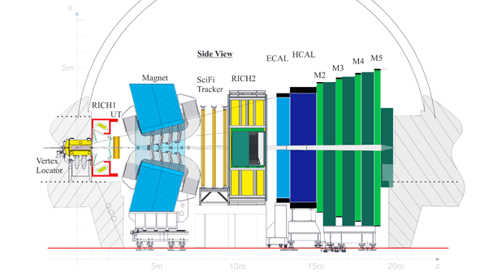
SIMP – heavy ion physics@LHC w/ LHCb
LHCb – upgrades – phase I
Upgrade I for Run 3 and Run 4 (resp.)
  Objective: cope with pileup ~5 – 10 in pp (curr. ~1)
  + new gas target system (SMOG2) → 100x more density
  Enhance the physics potential for heavy ions
    Improve PbPb Centrality reach
    High lumi Fixed-target program
Physics program foreseen
  Coll. mode : Heavy Flavor, hadrochemistry: 2<η<5 down to p_{T}=0
  Full physics program in pp, pPb, Pbp
  Full physics program in PbPb up to 30% centrality
Fixed-target : Heavy Flavor, hadrochemistry: -2.5<y*<0.5 down to p_{T}=0
  √s_{NN}~70 -110 GeV → fill the gap between SPS and RHIC
  Expect no centrality limitation in PbA (A=He, Ne, Ar)
New electronics for muon and calorimeter systems
New tracking system:
- silicon upstream detector
- scintillating fiber tracker (SciFi)
New Pixel VELO
LHCb Upgrade I
New RICH optics and photodetectors

Slide 25
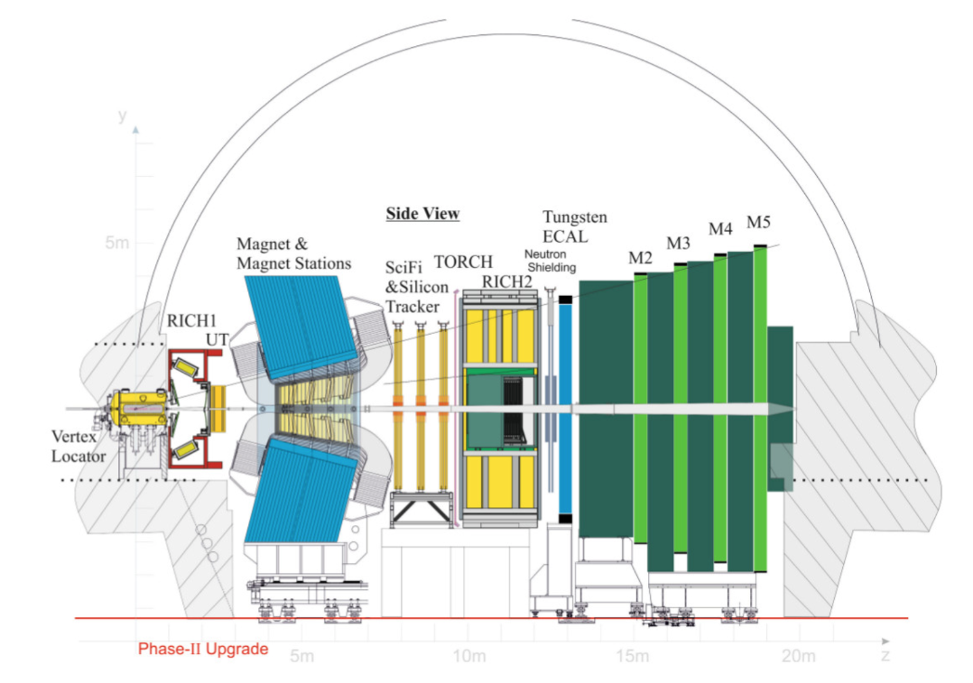
SIMP – heavy ion physics@LHC w/ LHCb
LHCb – upgrades – phase II
Upgrade II for Run 5 (2032+)
  Objective : Improve tracking and calorimetry performances to cope with pileup ~40 in pp and with full PbPb centrality
    + new DAQ
    + New vertex detector
    + New Upstream Tracker and Mighty Tracker
    + New TOF
    + New ECAL
    Framework TDR draft submitted to LHCC (sep. 2021)
Further enhance heavy-ion physics potential
  Heavy-Flavor, hadrochemistry
  Both in collider and Fixed-Target programs
    No limitation on centrality reach
0 m
10 m
20 m

Slide 26
SIMP – heavy ion physics@LHC
LHC run 5+ (phase II) – 2032+
Current status
Exp. | participating/interested perm. Phys. | Status | Main specs
ALICE3 | IN2P3 O(10) | LOI to be submitted to LHCC (11/2021) | low p_{T}, |η|<4, PID, calorimetry, muons
CMS | IN2P3 (2) | TDRs(2017 – 2021) TGIR HL-LHC | Intermediate p_{T}, |η|<4, PID, calorimetry, muons
LHCb | IN2P3 (9) + Irfu/CEA (7) | Framework TDR draft submitted to LHCC (09/2021) | Low p_{T}, 2.5<η<5, PID, calorimetry, muons, fixed-target
+ O(10) people undeclared

Slide 27
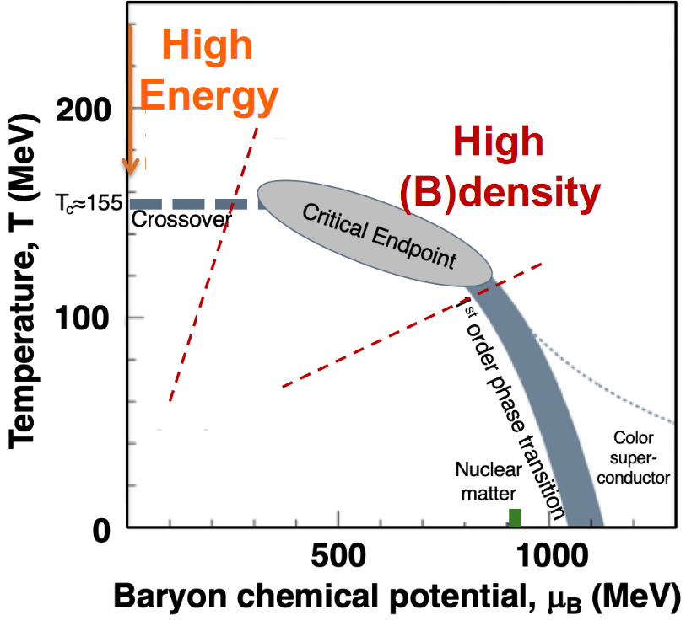
SIMP – heavy ion physics@FAIR/SPS/JPARC
High Energy : LHC, RHIC
Quantify properties of QGP fluid
How is collectivity developed ?
Collectivity in small systems
High (Baryon) density : FAIR/SPS/JPARC
Onset of deconfinement: where do partonic degrees of freedom start to dominate ?
Is the phase transition of 1st order ?
Critical endpoint ?
Microscopic structure of dense hadronic phase, as existing in the core of compact stars (strangeness, condensates, deconfined states…)

Slide 28
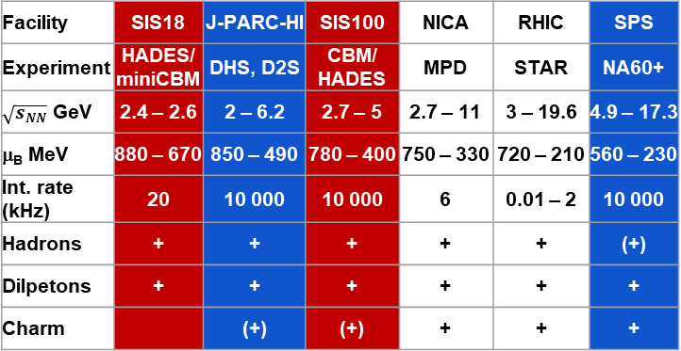
SIMP – heavy ion physics@FAIR/SPS/JPARC
FAIR/GSI
√s_{NN}=2.4 - 5 GeV
HADES and CBM: charged hadrons, ɣ, e⁺e⁻ CBM: 𝝁⁺𝝁⁻
HADES : bwd acceptance, limited to 200 kHz
Continuation of IJCLab activities HADES/SIS18
CBM : fwd acceptance, up to 10 MHz
IPHC : production of CMOS sensors for MVD of CBM
possible extension at higher energies in further future
SIS100 : First beams in 2025
J-PARC-HI
√s_{NN}=2.- 6.2 GeV
Detection of charged hadrons +neutrons, ɣ, e⁺e⁻, μ⁺μ⁻
Project status: LOI for J-PARC-HI, july 25, 2016,
Start of experiments probably not before 2029
NA60+
√s_{NN}=4.9-17.3 GeV
𝝁⁺𝝁⁻ + unidentified hadrons (vertex tracker) and real ɣ
Highlights: thermal dileptons, ρ spectral function,
Project status: EOI submitted to SPSC May 3rd 2019 (CERN-SPSC-2019-017), LOI in preparation
Starting
2025
running
project
project
Facility | SIS18 | J-PARC-HI | SIS100 | NICA | RHIC | SPS
Experiment | HADES/ miniCBM | DHS, D2S | CBM/ HADES | MPD | STAR | NA60+
$\sqrt{s_{NN}}$ GeV | 2.4 – 2.6 | 2 – 6.2 | 2.7 – 5 | 2.7 – 11 | 3 – 19.6 | 4.9 – 17.3
μ_{B} MeV | 880 – 670 | 850 – 490 | 780 – 400 | 750 – 330 | 720 – 210 | 560 – 230
Int. rate (kHz) | 20 | 10 000 | 10 000 | 6 | 0.01 – 2 | 10 000
Hadrons | + | + | + | + | + | (+)
Dilpetons | + | + | + | + | + | +
Charm |  | (+) | (+) | + | + | +
Nuclear Physics A 982 (2019) 163–169

Slide 29
The role of Theory
Nucleon structure studies: ~15 theorists involved in France
Factorization frameworks for TMDs and GPDs (CPhT, IJClab, Irfu)
Modelling 2+3d Wigner distributions (CPhT)
n-pdfs, role of cold nuclear matter effects (LLR,LPSC, CPHT, IPhT, Subatech, IJCLab)
QCD matter studies at zero and finite baryon number: ~20 theorists involved in France
Equation of State, properties of QCD matter (IP2I, Subatech, APC)
description of the different collision phases: Initial state (Subatech), Thermalization (IPHT), hadronization (Subatech)
Probes of QGP: jet quenching, open and hidden heavy flavour (Subatech, IJClab, IPhT)
Understanding the origin of collectivity in small systems (Subatech)
Fluctuations (related to phase transitions) (Subatech)

Slide 30
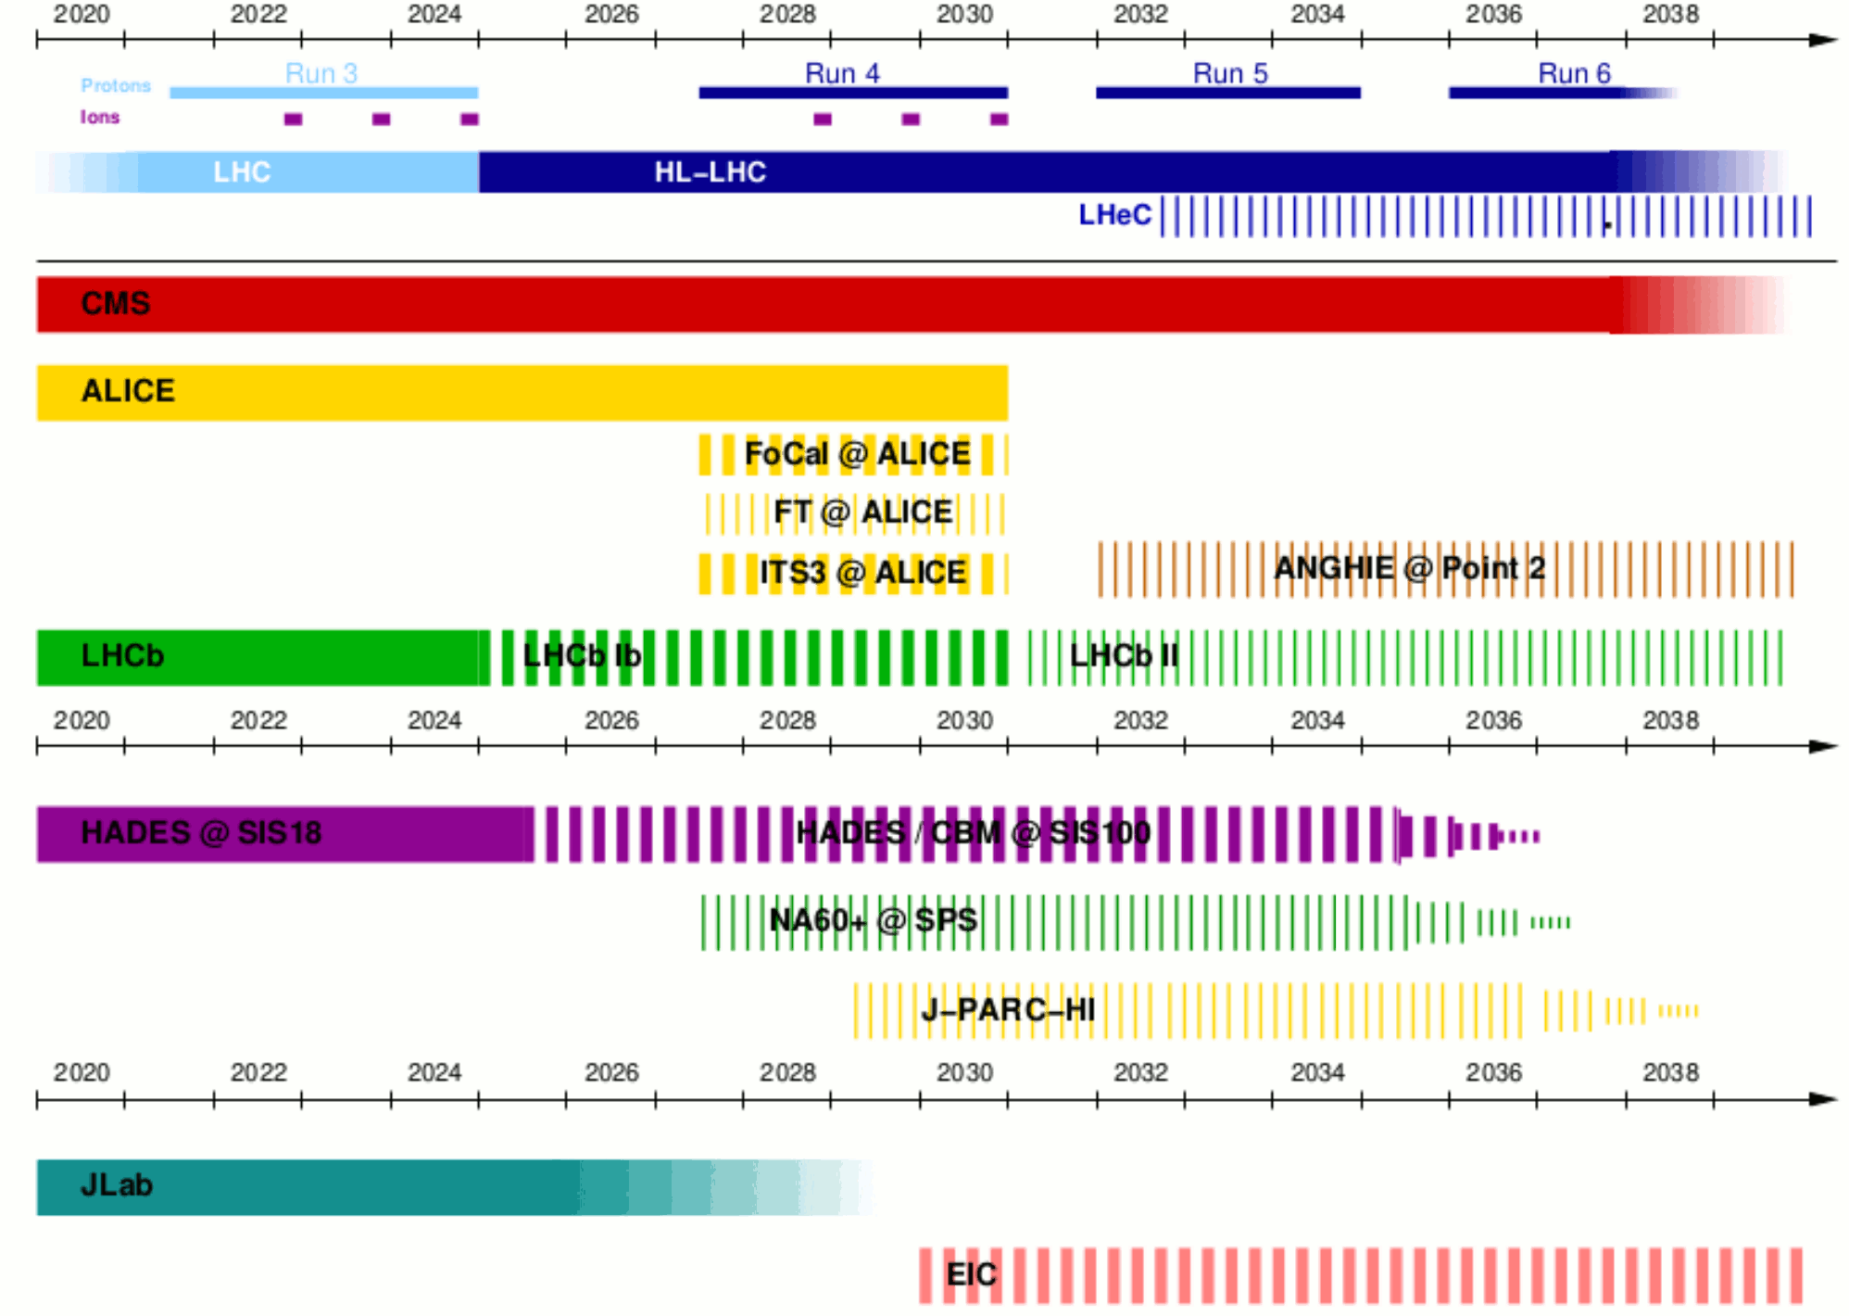
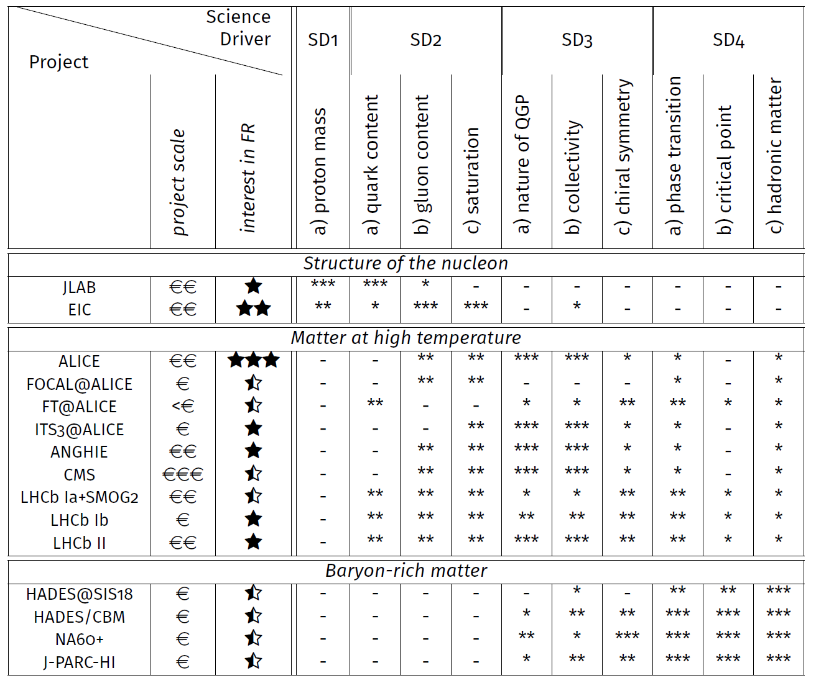
GT03 – Experimental projects
(ALICE 3)
(ALICE 3)

Slide 31
Recommendations - NUST
1. Support the theory groups to maintain the french leadership over the next decade on the outstanding problems of hadrons and nuclear structure in terms of TMDs and GPDs, as well as cold nuclear effects of interest at the EIC and in p+A collisions at the LHC. Phenomenological studies in close connection with the French experimental program in the field should be encouraged.
2. Capitalize on the investments on the Jefferson Lab experimental program and take full advantage of the recent CEBAF energy upgrade to complete a three-dimensional exploration of the structure of nucleon and nuclei in the valence quark region. The program, centered around the determination of the GPDs, is well-defined until 2025-2030, with the experiments relying on the CND, NPS and ALERT detectors.
3. Consolidate the french community interested in a participation to the Electron-Ion Collider project which is emerging as a flagship project for hadronic physics, for at least two decades starting around 2030. A stronger involvement in early studies and design phase, gathering the many and experimental and theoretical expertise, should be supported as the framework for shaping the French scientific project. Contribution to the detector construction should be focussed and commensurate with the size of the interested community.

Slide 32
Recommendations - SIMP
1. Fully exploit the physics potential of LHC Run 3 with the upgraded ALICE, CMS and LHCb (+SMOG2) experiments to pursue the study of matter at high temperature. The three experiments exhibit very rich and interesting complementarities, which should be promoted by combining their measurements.
2. Strengthen efforts involving theorists and experimentalists towards a global interpretation of data, taking advantage of the forthcoming various and precise data from all experiments at different energies and correlating them. A forum like the GDR QCD should be fully exploited to this end. Moreover, the establishment of a centralized platform, providing various model predictions in a complete manner, as already done in particle and cosmic ray physics, would be highly valuable.
3. Organize the strategic choices to be made for QGP studies after LHC Run 3. Given the size of the French community, and the beginning of the EIC program in the US, strategic orientations should be based on long term perspectives, well-identified French collaborations and comprehensive studies of the ALICE, CMS and LHCb upgrade-related physics gain. For instance, a comprehensive comparison between the physics gain of the already upgraded CMS experiment (including low-field configuration) and the ANGHIE project should be performed. Key-decision points for the strategic choices should be planned on timescales compatible with LHC pre-Run 4 and pre-Run 5 installations.
4. Support the scientific production at GSI/FAIR in the baryon-rich sector, and develop prospective activities along new connections to astrophysics, in light of the world-wide development of new projects and the recent detection of gravitational waves. In addition to the participation to the HADES/CBM project at SIS100, interests for NA60+/CERN and J-PARC-HI have been expressed, which demonstrate, together with the developing theoretical activity in France in the field, that a new dynamic is growing in this sector. The objective in the next years should be to gather a critical mass of physicists and to elaborate a common project, taking into account investments already made. A research program should be developed in close connection with the astrophysics community interested in the equation of state of the dense hadronic matter.
5. Strongly support theoretical activities on QGP which are closely related to the experimental programs in France, in particular covering open and hidden heavy flavor, effective theories of the QCD phases, the hydrodynamic evolution of quark matter, and their implementation in Monte Carlo event generators.

Slide 33
Colloque de restitution de
l'exercice de prospective nationale
GT03 – Physique hadronique
Understanding strong interactions
19 octobre, 2021
Comité de pilotage: Klaus Werner (SUBATECH), Carlos Munoz (IJCLab), Béatrice Ramstein (IJCLab), Frédéric Fleuret (LLR), Laurent Vacavant (IN2P3)

