Slide 1
The DLR Software Engineering Guidelines An approach to support sustainable software development in research
Carina Haupt
Institute for Softwaretechnology German Aerospace Center (DLR)

Slide 2
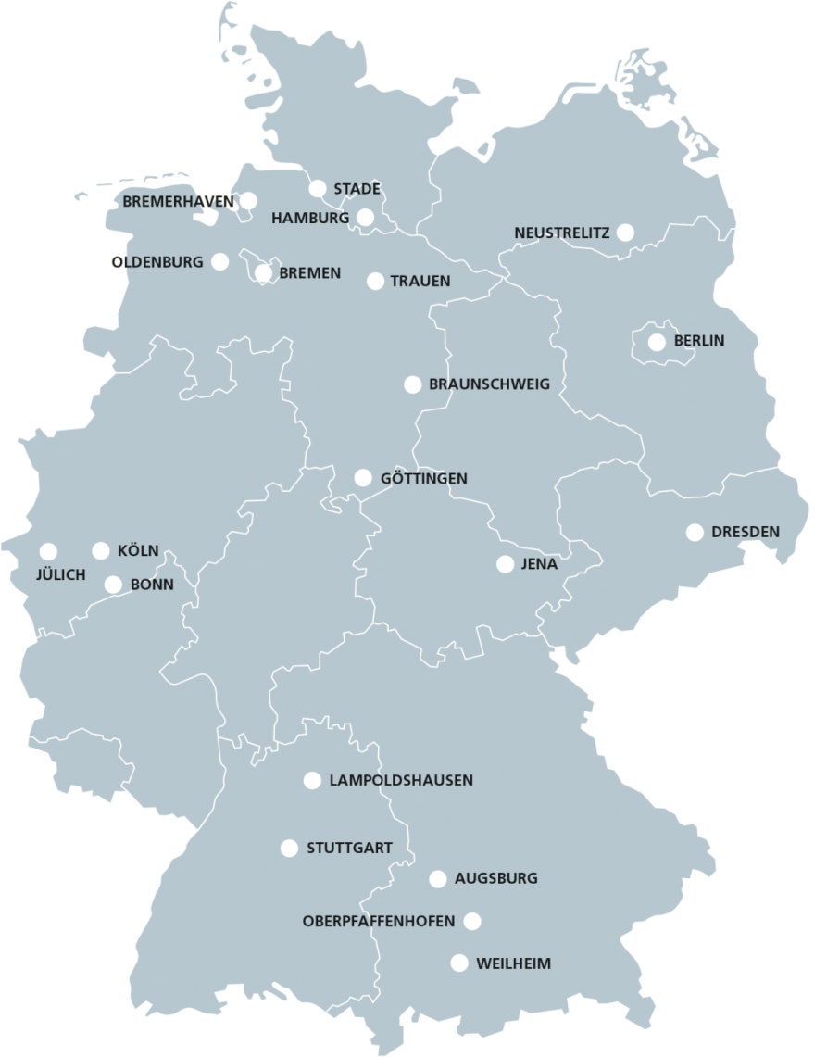
DLR Some Facts around Software Development
Some numbers…
More than 1500 employees develop software
Characteristics
„Developer“ often do not have any training in software development
Huge amount of software projects
Variety of used software technologies
How to support scientists to develop sustainable software?
Notes:
Teams often 20 people, but not at a time. At once one MA + students.

Slide 3
Aspects of modern software development
Distributed development processes via git, subversion,…
Community software (github, bitbucket,…)
Issue tracking systems
Open source licensing (BSD, MIT, (L)GPL,…)
Software architecture
Build systems (CMake, Autotools,…)
Meta build systems (Spack, EasyBuild, Conda)
Test frameworks (GoogleTest, PyTest, jUnit,…)
Continuous integration testing (Jenkins, gitlab-ci,…)
Integrated development environments (IDEs, e.g. Eclipse, QtCreator, MS Visual Studio)
.etc.
Do I need all that???

Slide 4
The DLR Software Engineering Guidelines Topics
https://rse.dlr.de
Guidelines support research software developers to self-assess their software concerning good development practices.
Guideline document & Checklists
Joint development with focus on good practices, tools, and essential documentation
77 recommendations give advice in different fields of software engineering:
Requirements Management
Software Architecture
Design & Implementation
Change Management
Software Testing
Release Management
Automation & Dependencies
https://zenodo.org/record/1344612 (EN)
https://zenodo.org/record/1344608 (DE)

Slide 5
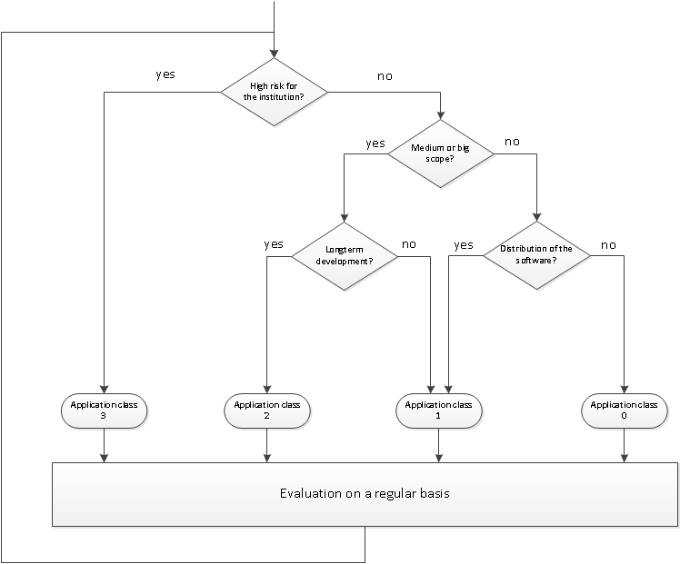
The DLR Software Engineering Guidelines Tailoring Checklists
An application class provides an initial starting point. Recommendations can be added and removed to fit the context.
Application class 1
„small“, but other use it
Application class 2
„medium – large“, other use it, long-term support
Application class 3
„products“, critical for success of department or institute
Application class 0
Personal „use“ (intentionally left blank)
Classification may change over time!
Notes:
An application class provides an initial starting point. Recommendations can be added and removed to fit the context.

Slide 6
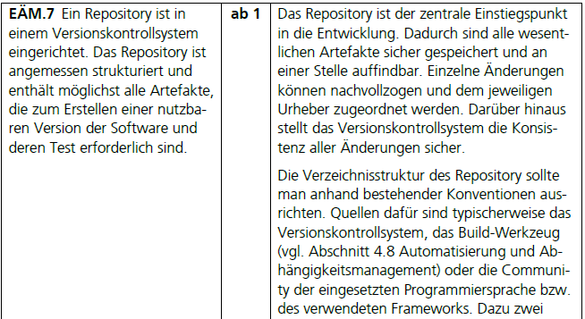
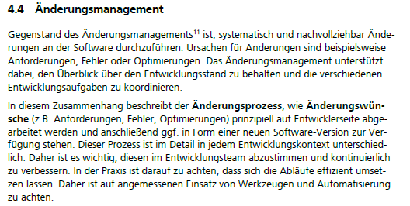
The DLR Software Engineering Guidelines Using Checklists
Check List
Concrete Guideline
Topic Overview

Slide 7
The DLR Software Engineering Guidelines An Example
The software fits well into the application class 1.
Python script for calculation of characteristics of a set of sample values
Software is a small tool and used by other internally.
Summary of the generic recommendations:
Manage your code using a version control system
Apply a basic coding style, strive for a modular design, avoid code duplication and over-engineering
Automate creation of an executable, usable version
Provide essential documentation: software purpose, user and developer information, constraints and central concepts, known problems and ideas
Internal release: test your software and assign a proper release number
Public release: check the open source guidelines
Recommendations have to be mapped into the concrete development context.

Slide 8
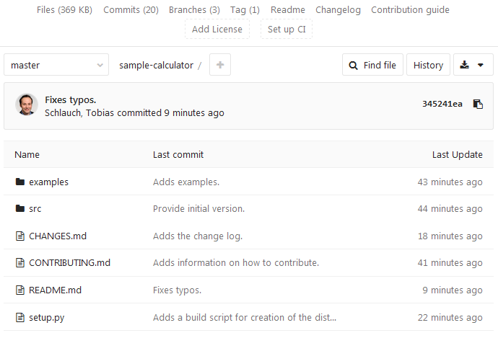
The DLR Software Engineering Guidelines Possible Implementation
Git repository which contains code, examples, build script, and documentation
Releases correspond to tags
Release package download
Examples provide reference input values and results
Code is broken into small functions
Coding style recommendations applied
Build script for packaging and installing
Release numbers follow semantic versioning approach
CHANGES.md explains user-understandably major changes

Slide 9
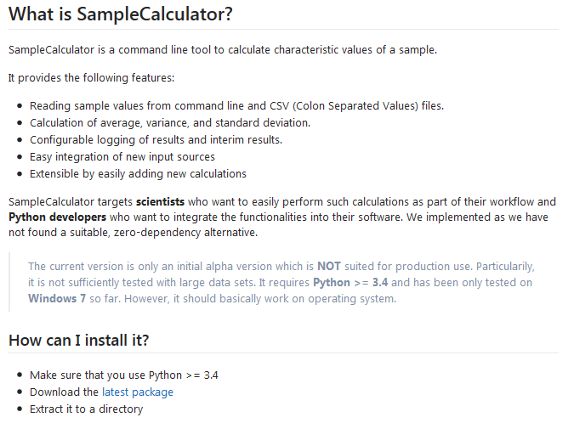
The DLR Software Engineering Guidelines Possible Implementation (cont.)
README.md: main documentation
CONTRIBUTING.md: contributor information
Explanation of the software purpose (what?, for whom?, why?)
Overview of the main features
Important usage constraints and conditions
Basic installation and usage information
Future plans and ideas

Slide 10
The DLR Software Engineering Guidelines Summary
Checklists are project sensitive
Generic recommendations → Solution Suggestions
Covering the Basics
Reevaluate regularly

Slide 11
DLR Our approach
Software Engineering Initiative of DLR
Guidelines
Trainings
Knowledge Provision
Collaboration
Experience Exchange
Notes:
Backbone: Software Engineering Network

Slide 12
We are not the only ones… eScienceCenter (NL)
Similar to Application Class 1
Split up by use case
Paper Publishing
Users
Contributors
Quelle: eScienceCenter https://guide.esciencecenter.nl/best_practices/checklist.html

Slide 13
There is a whole movement…
RSE UK (http://rse.ac.uk/)
de-RSE (http://www.de-rse.org/)
Helmholtz Task Group „Wissenschaftliche Software“ (https://os.helmholtz.de)

Slide 14
Questions?
carina.haupt@dlr.de
@caha42

