Slide 1
Mechanical R&D @ CPPM
Eric Vigeolas FC-CPPM meeting June the 23rd 2020

Slide 2
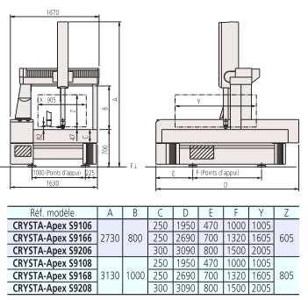
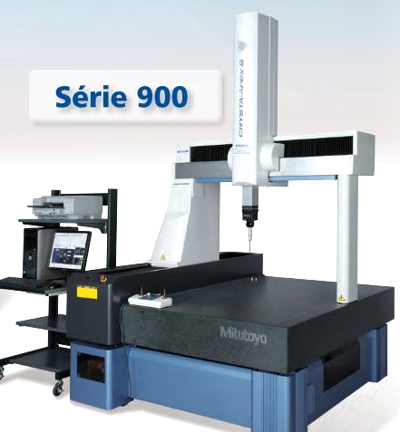
20 years of expertise @ CPPM
Cppm was involved in Aleph, Delphi, Pixel, IBL and now ITK pixel construction and installation
Skill developed in materials and assembly geometrical and thermal properties
Contact and Non contact Metrology (Crysta Apex 9166 Mitutoyo MMT, SP25 scanning system, Laser Scanning system, QVP camera probing..) complete measurement capability @ CPPM
Skill developed in semi automated electronic assembly (Glue deposition, module handling and precise placement)

Slide 3
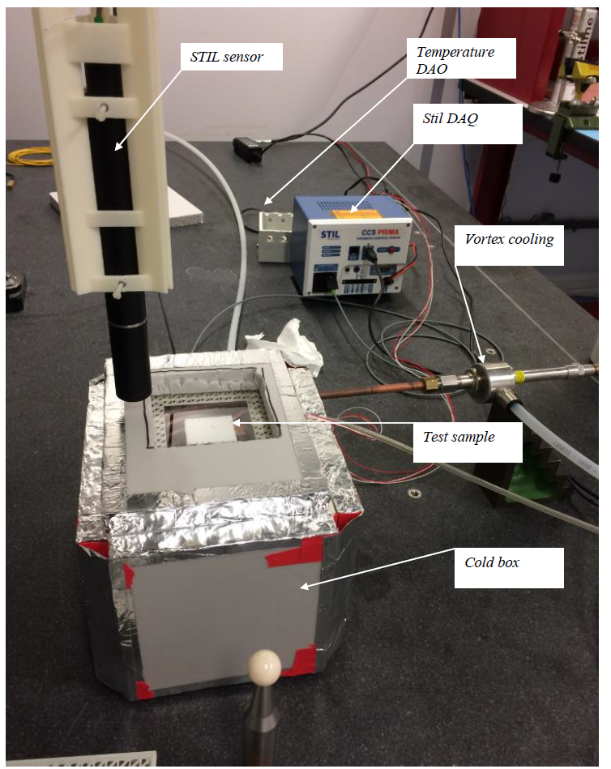
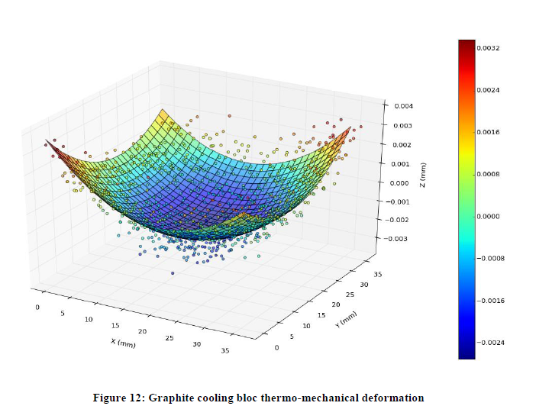
Developments Made @ CPPM
2 years ago, we developed the adaptation of STIL optical sensors on the Mitutoyo MMT. This development offer us the capability to measure by scanning large variety of materials
This has permit us to develop our capacity to measure pieces under different temperature conditions and extract the thermal deformations
CPPM is the only site in the collaboration where thermal deformations are measures
This laser scanning is now largely used by Madmax to probe the crystals

Slide 4
First source of development
Keep our Metrological capability and improv it
Develop our capability to perform such metrology under various thermal condition even cryogenic
Keep developing the STIL scanning system, automation improvement

Slide 5
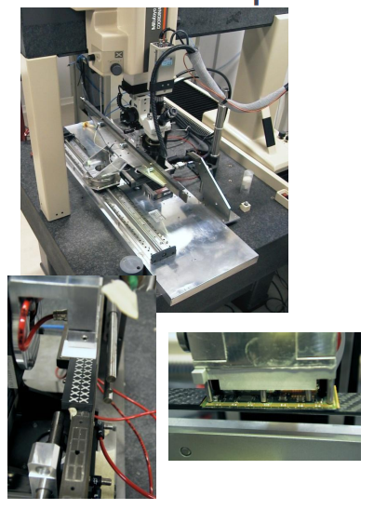
Electronic assembly
Since Atlas Pixel detector we developed automated process to deposit modules on support structure → better accuracy, high repeatability, process safety, complex motions
Detectors, especially tracked will integer more and more modules (1400 module on the actual Atlas Pixel detector, 11000 Modules on the future ITK PIXEL dectector
Placement accuracy is in the order of ±0.05 mm 3σ

Slide 6
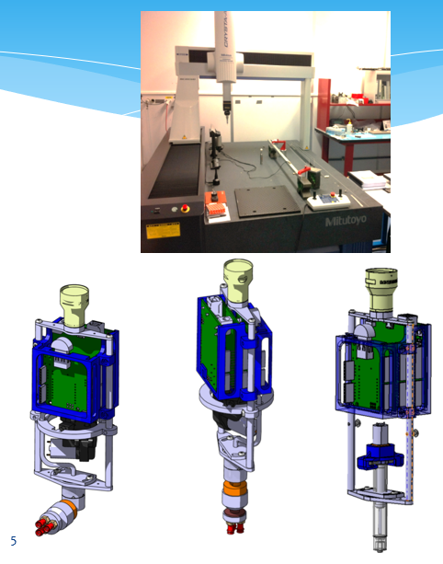
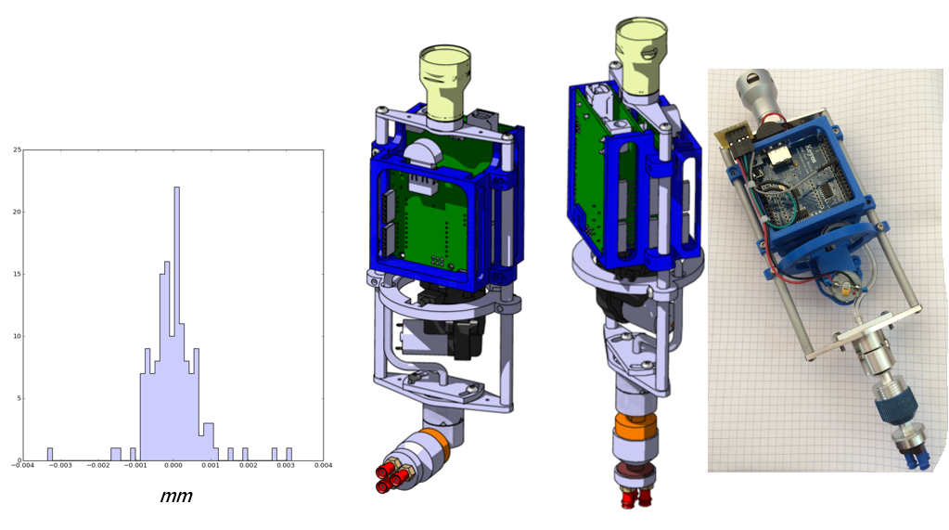
Electronic assembly
One development which was started few years ago and which will be developed consists to transform a full automated MTT to a glue deposition device and a automated module assembly device
Demonstrator has been already developed, final tool need to be designed , tested and qualified

Slide 7
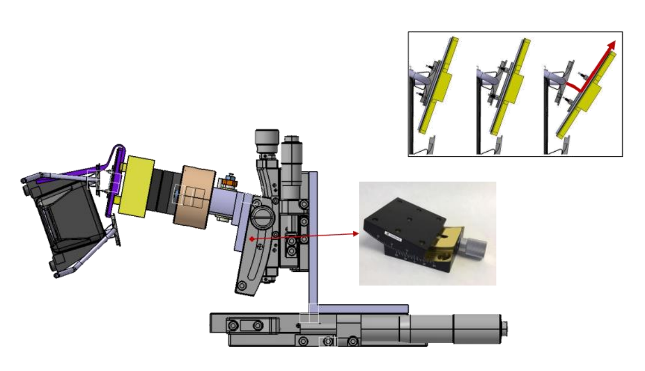
Complex motions
Here is an example of what was necessary to repair a module on Pixel detector
Pixel replacement
Usually 4 to 5 DOF systems needs to be designed to satisfy the complex assembly we are performing

Slide 8
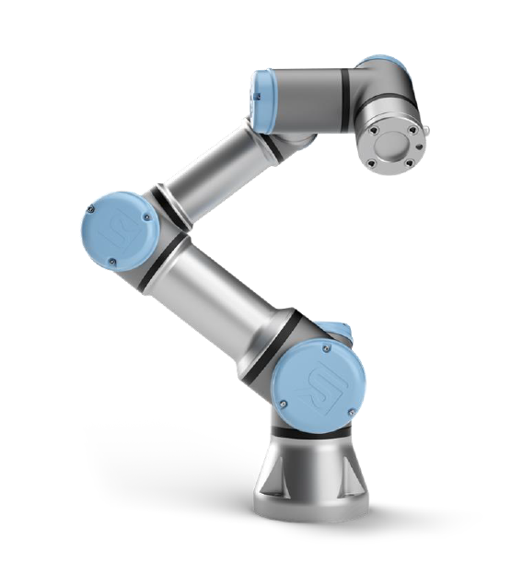
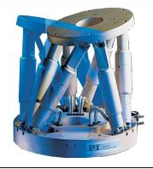
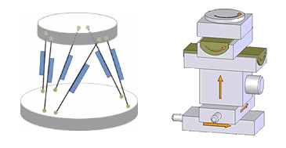
Second source of development
High precision 6DOF systems development for multi purpose acticities (glue deposition, module loading and integration, automated connections, metrology/scanning)

Slide 9
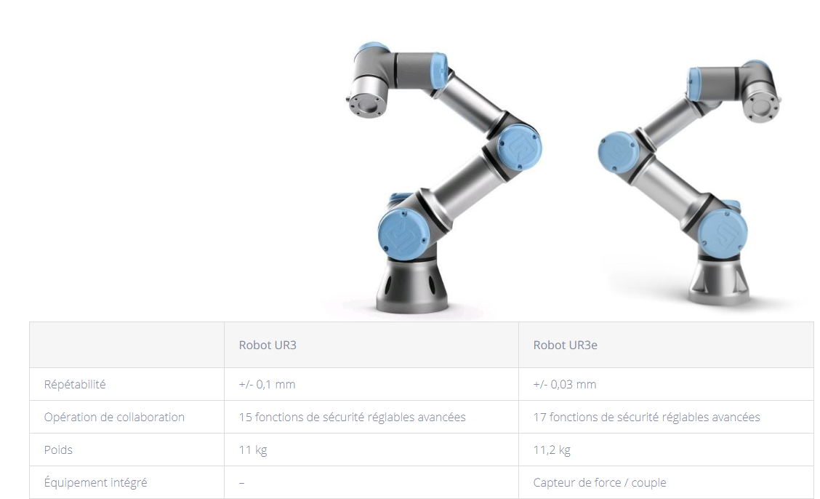
Universal robot
Robotization is the growing in all industries
This offer the 6DOF we are looking for with a high precision and repeatability capacity
Our goal is to develop capacity to deposit glues, thermal past, modules or even services with such robotic arm
Arm can be operated under a MMT and therefor improvement of the accuracy and Robot/MMT collaboration developed
Arm could be equipped with scanning syst to perform complex parts geometrical control

Slide 10
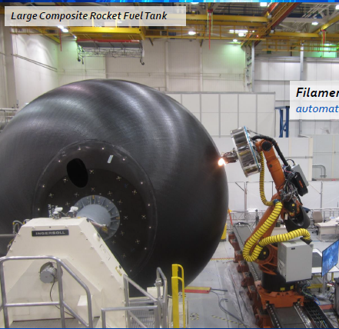
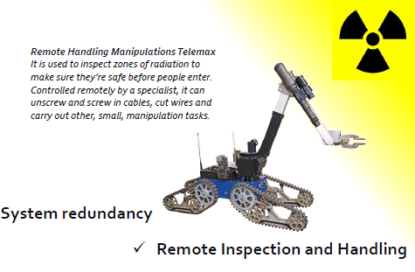
Robot arm for the future
Large number of fabrication processes will be done with 6DOF robotic arm → 3D printing is on of the potential development to study
Remote handling is one of the field we would like to cover → remote services connection disconnection, remote pipe welding, services routing and management
Developing systems under high radiative env.
This development will have high potential application in industries

Slide 11
Summary
Robotic Arm
Manufacturing process
Additive manufacturing
Assembly process
All activities developed around detector qualification, manufacturing and assembly are sharing common space to develop new technics and improve our capabilities
Robotic arm behave like the metrology device it can be a starting point on multiple interesting development
We are currently looking to finance our first arm → 16Keuro → first to evaluate capability to perform complex assembly steps on ITK and develop improvements
Complex assembly
Metrology
New metrology
High accuracy
Material characterization
Thermal properties

