Slide 1
SNOWMASS USA
-- Why is this important
-- What is happening
-- what FCC is doing
-- accelerators
-- Physics
-- case studies
-- I could use some help!
Alain Blondel 2020-05-07

Slide 2
SNOWMASS (this year virtual) is the strategy exercize of the USA
Unlike the European Strategy it is Bottom-up.
Why is this important?
The USA (DOE esp.) have sent a strong message of commitment to the FCC *→
-- It is important that this is repeated in the US exercize
-- and it would be very bad if it isnt
-- while the ESPP support for the FCC is not out yet,
the ILC and muon collider are making their moves….
It is (at least was) a place where real work gets done
-- the TLEP paper was a ‘contribution to snowmass’.

Slide 3
Important US input to ESPP:
-- *committment* expressed for CERN and FCC if supported by ESPP
-- strong *interest* for an ILC hosted in Japan.

Slide 4
What is happening
many meetings (I have to admit I am not managing to follow everything)
we were not particularly informed because info is circulated internal US
(APS members)
Kick off was given on Saturday 18 Apr 2020 (note they use proper date system!)
https://indico.fnal.gov/event/23601/
I repeat in the following some slides from YKK

Slide 5
Young-kee Kim

Slide 6
Young-kee Kim

Slide 8
We intend to submit early next week a 2-page summary of the FCC
physics capabilities stressing the various domains of interests,
references and contact persons as well as a list of challenges
see: https://docs.google.com/spreadsheets/d/
1ja0UQC-20NHzYq3FktolpYuNfLM-oGffA0D4PrVJh9E/edit#gid=0

Slide 9
FCC physics : overall contact M. Klute (MIT)
+ Alain Patrick Michelangelo
P. Azzi, M. Selvaggi
S. Monteil, M. Dam
M. Mc Cullough
Zimmermann, Benedikt
M. Dam, F. Bedeschi
???
10^12 Z is a large number!
Young-kee Kim

Slide 10
useful sites
Mother site: https://snowmass21.org/
Join Slack workspace and Snowmass email list!
For joining the snowmass email list:
Send an e-mail message to listservATfnalDOTgov,
Leave the subject line blank, and
Type “SUBSCRIBE SNOWMASS FIRSTNAME LASTNAME” (without the quotation marks) in the body of your message.
If you need help, email rhbob[AT]fnal.gov. Please make the subject line “snowmass slack” or “snowmass email”. When we get your email we will add you to Slack. Or for just Slack, send an email to rhbob[AT]fnal.gov. See also Contact, Help, Terms of Use, Privacy Policy
Calendar of all the meetings
https://indico.fnal.gov/category/1098/calendar
in particular
EF01 The first kick-off meeting of the Higgs property group is scheduled for 13 May
https://indico.fnal.gov/event/24382/
EF kick-off
https://indico.fnal.gov/event/24264/

Slide 11
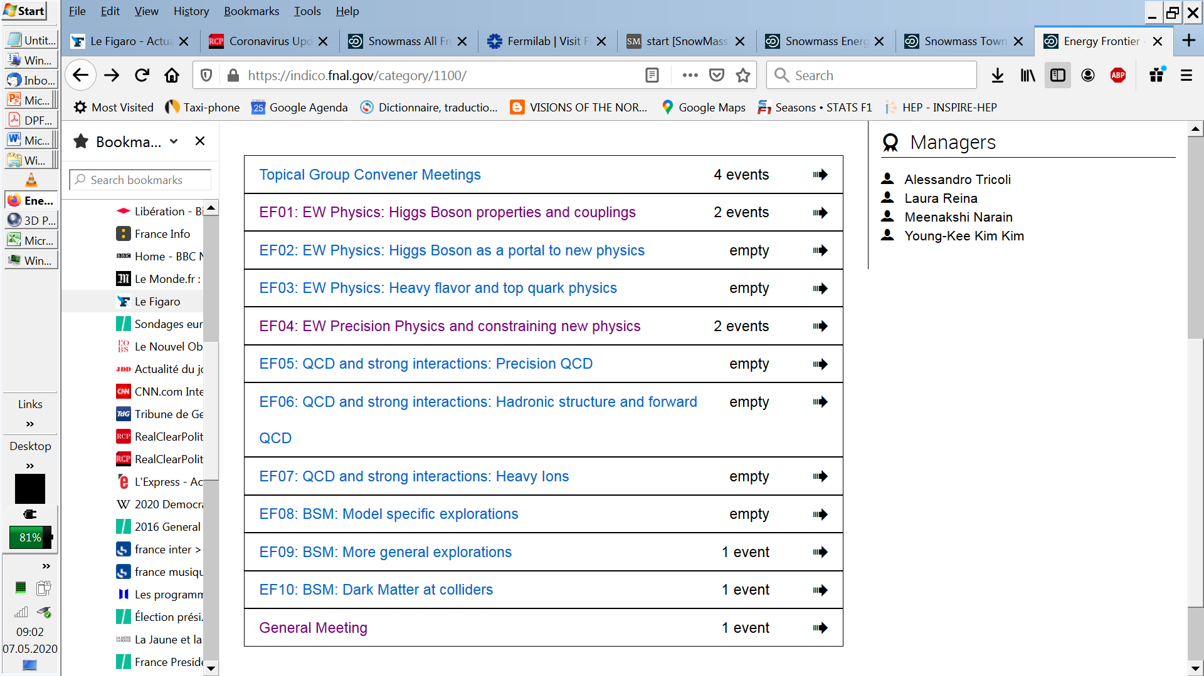
ENERGY FRONTIER MEETINGS : 10 tracks!

Slide 12
I could use some help!
There are many things to do in addition to snowmasss in particular creation
of FCC-UK, Deutschland etc.. and relations to ECFA
By construction we are very short of contacts in the US.
-- if some of you could help with the networking that would be great
-- We cannot follow all the meetings, esp. for the Energy Frontier.
-- it would be good to have a few who could take on some of the
EF frontier meetings series (there are 11 of them)
-- Software:
-- FCC full sim is not ready. Yet a number of things (b-tagging etc… really need it)
-- start studies with the DLEPHES FASTSIM that Clement+Gerri can tutor
-- we have made the dedicated request to CERN-EP for people to help with
the adaption to key4hep of full simulation and reconstruction
-- computing is a real issue anybody in France?

