Slide 1
OMEGA SiPM readout ASICs
SiPM workshop Bari 2-4 oct 2019
C. de La Taille
Professor of microelectronics at Ecole Polytechnique
Director of OMEGA national design center for IN2P3

Slide 2
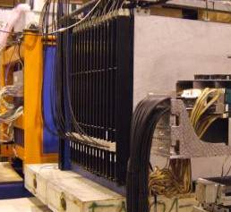

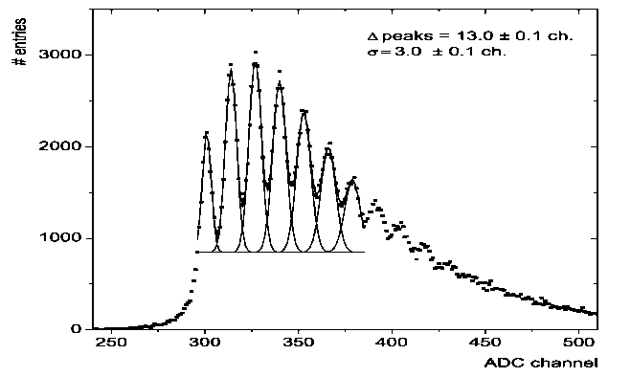
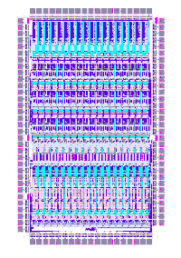
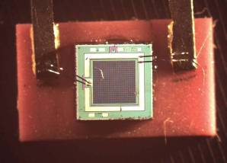
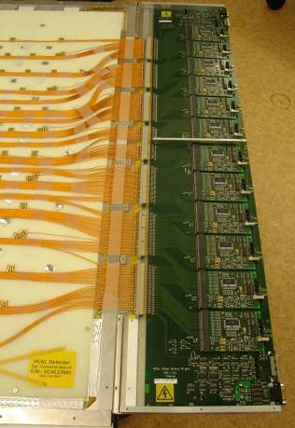
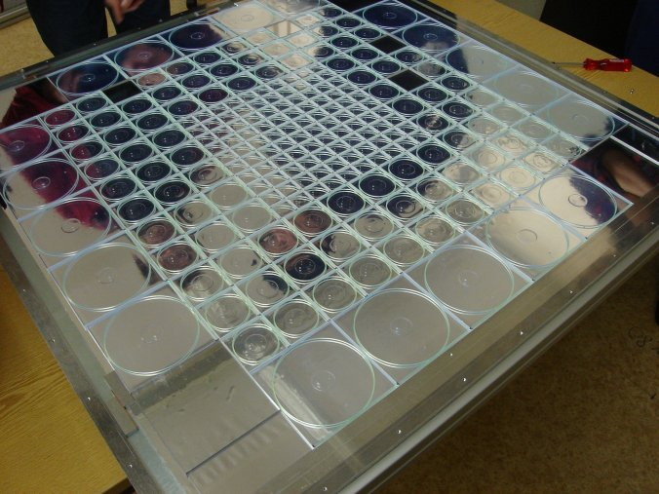
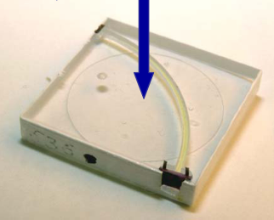
A bit of history : CALICE AHCAL physics prototype (2004)
Hadronic calorimeter prototype for the ILC : 1 cubic metre, 38 layers, 2cm steel plates
8000 tiles with SiPMs fabricated by MePHY group
First ASIC to read SiPMs : FLC_SiPM 18ch
FLC_SiPM
ASIC
Mephy SiPM
Mechanics and front end boards: DESY
SiPM : Mephy Pulsar Moscow
Front end ASICs: LAL

Slide 3
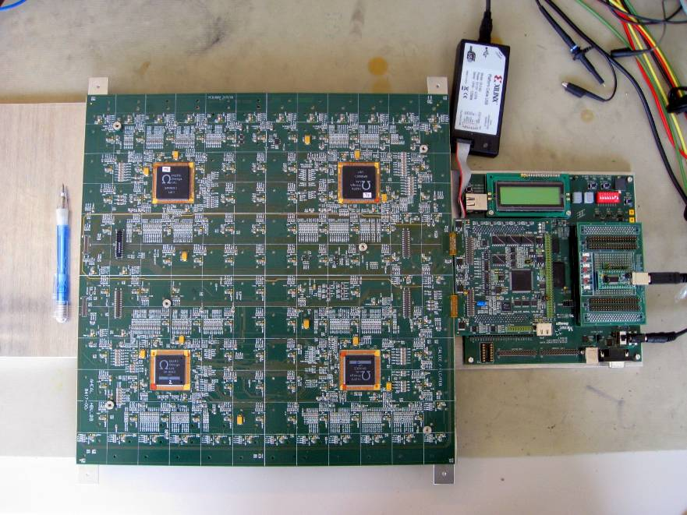


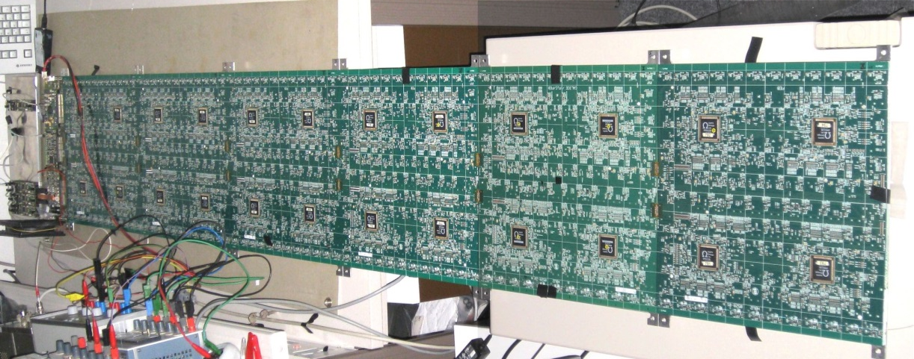
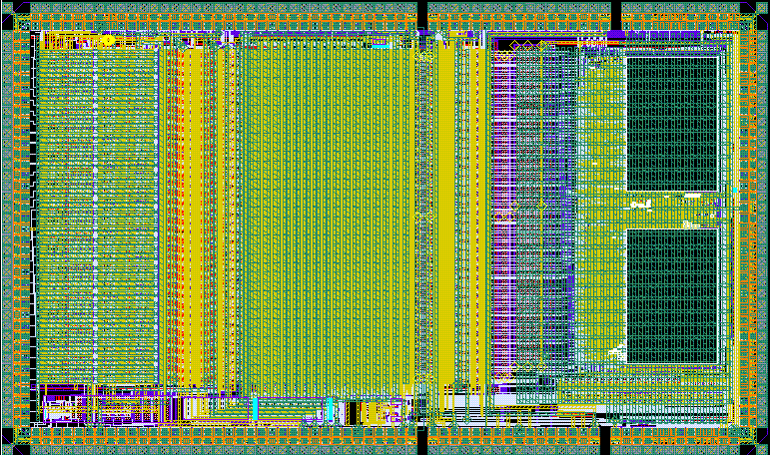
Evolved into SPIROC for ILC calorimetry
SPIROC : Silicon Photomultiplier Integrated Readout Chip
  Developed to read out the analog hadronic calorimeter for CALICE (ILC)
  DESY collaboration (EUDET project)
  Chip embedded in detector : low power !
36 channels autotrigger 15bit readout
  Energy measurement : 15 bits in 2 gains
  Autotrigger down to ½ p.e.
  Time measurement to ~1ns
  Power dissipation : 25µW/ch (1% power pulsed)
(0.36m)² Tiles + SiPM + SPIROC (144ch)

Slide 4
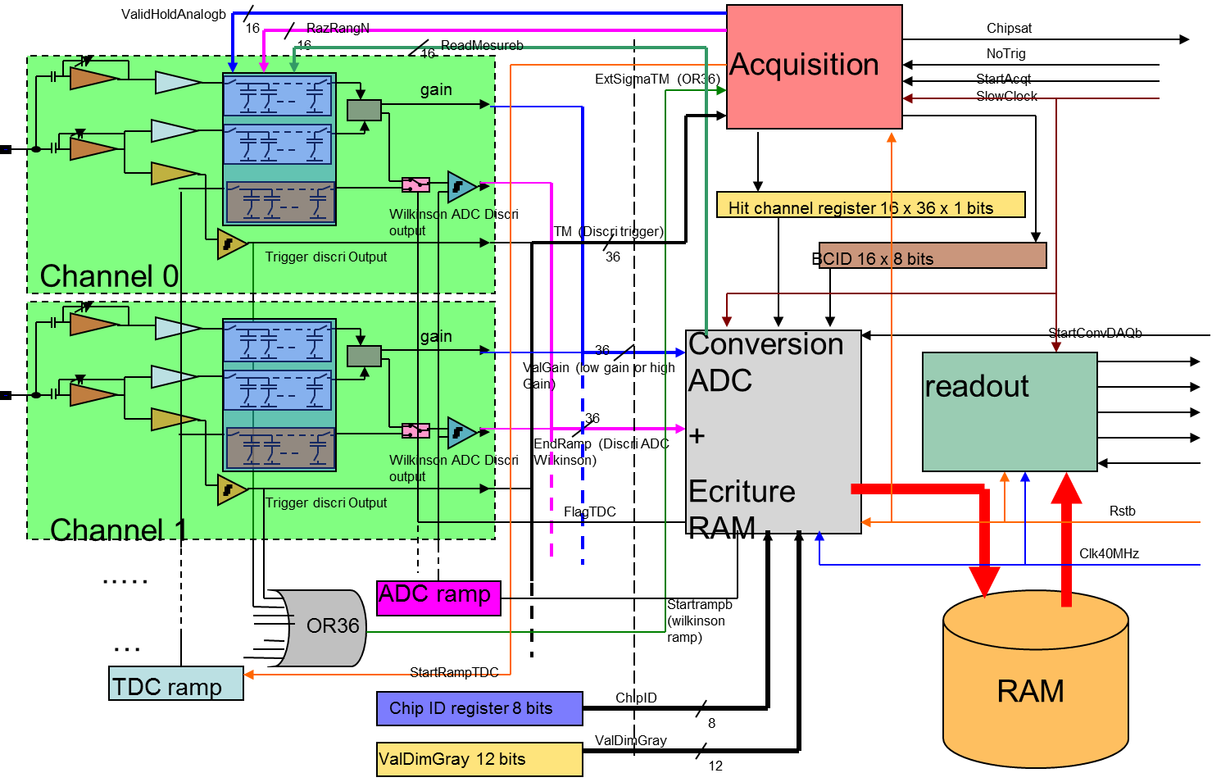
SPIROC architecture
Dual-gain voltage amplifier
  Variable gain for HG and LG
8-bit input DAC
25-50 ns shaping
Auto-trigger
16 bit analog memory
2x12 bit Wilkinson ADC
12 bit TDC
0.5% Power pulsing
  5 mW -> 25 µW
ASIC

Slide 5
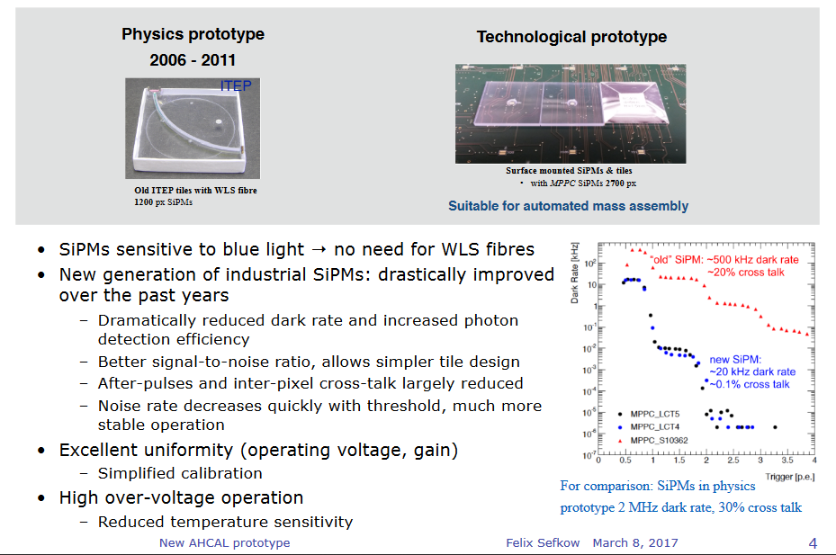
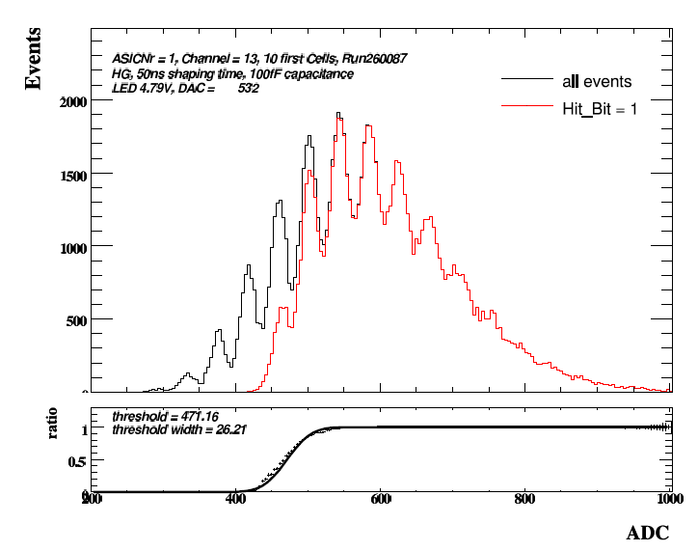

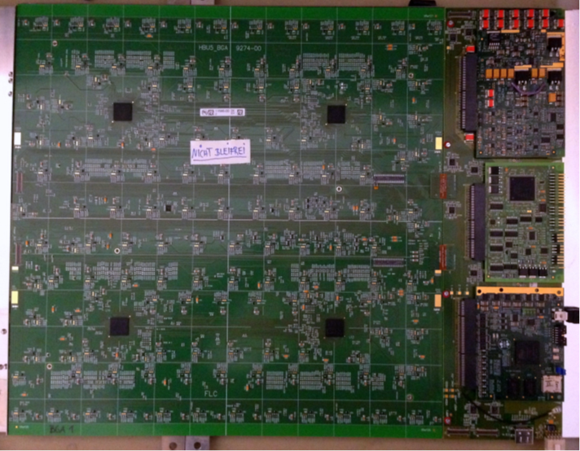
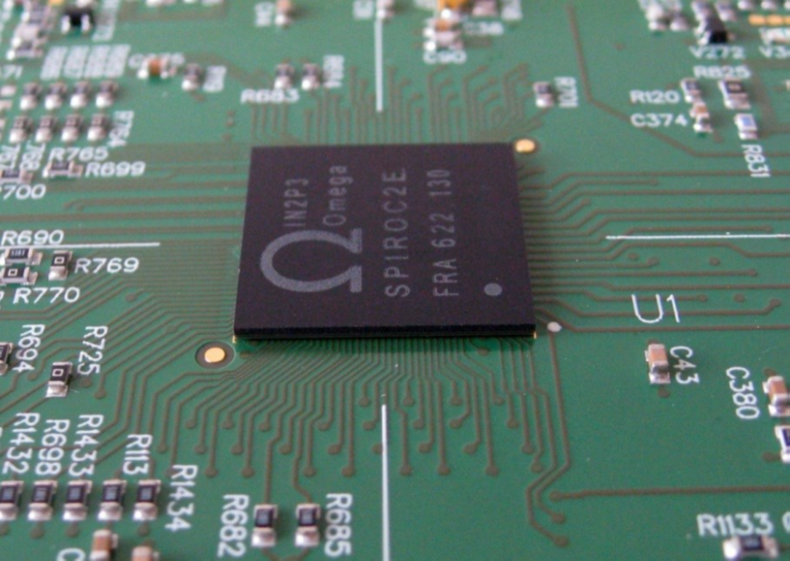
SPIROC performance
Progress in SiPM and tiles [F. Sefkow CLIC workshop]
SiPM SPECTRUM with Autotrigger
5
5

Slide 6
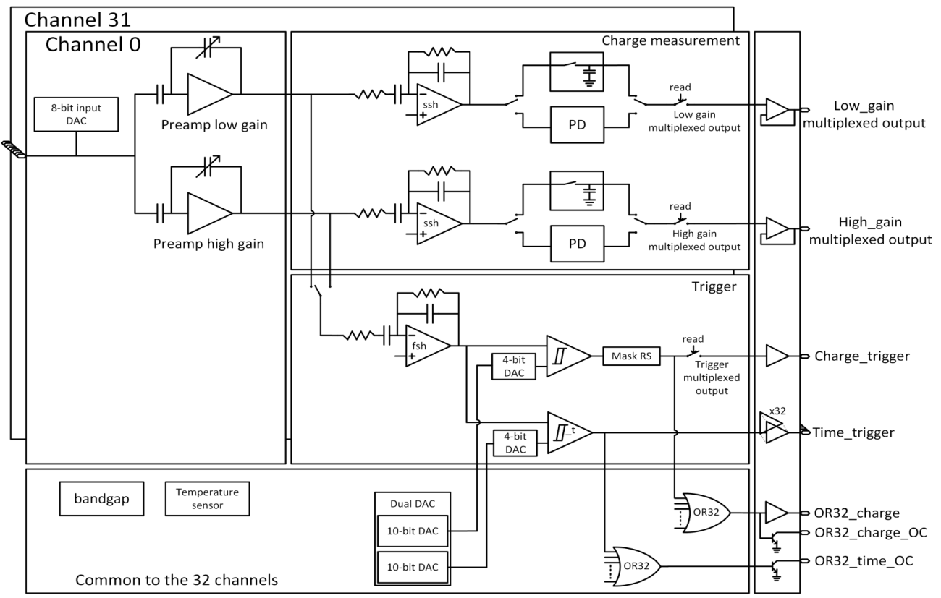


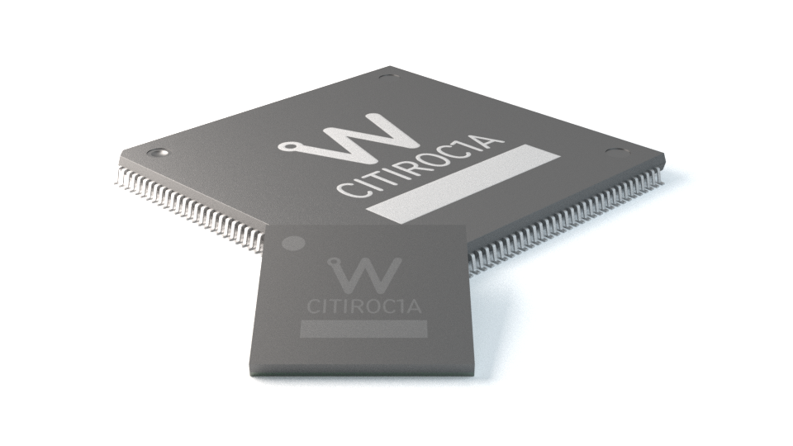
Variant : CITIROC for CTA ASTRI collaboration
Scientific instrumentation SiPM read-out chip
Detector Read-Out | SiPM, SiPM array
Number of Channels | 32
Signal Polarity | Positive
Sensitivity | Trigger on 1/3 of photo-electron
Timing Resolution | 100 ps RMS on single photo-electron
Dynamic Range | 0-400 pC i.e. 2500 photo-electrons @ 10⁶ SIPM gain
Packaging & Dimension | LQFP 160 – TFBGA353

Slide 7
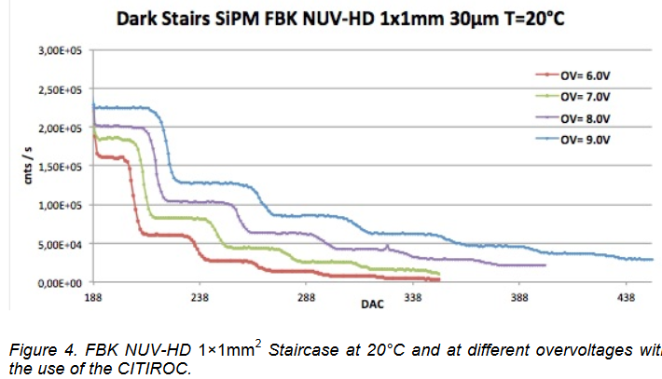
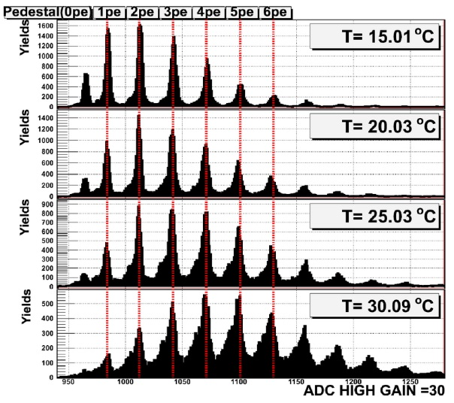
CITIROC performance [ASTRI]
Extensive tests at INAF Palermo
Peak sensing allows to capture signals even out of phase

Slide 8




CITIROC: Peak detector
Linearity
High Gain 0-60 pe
Low Gain 0-2000 pe
PD
© O. Cataneo INAF Palermo
SCA

Slide 9
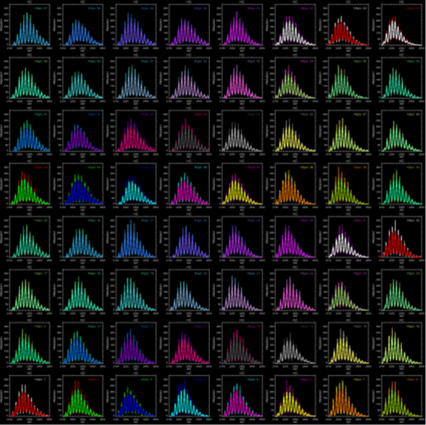
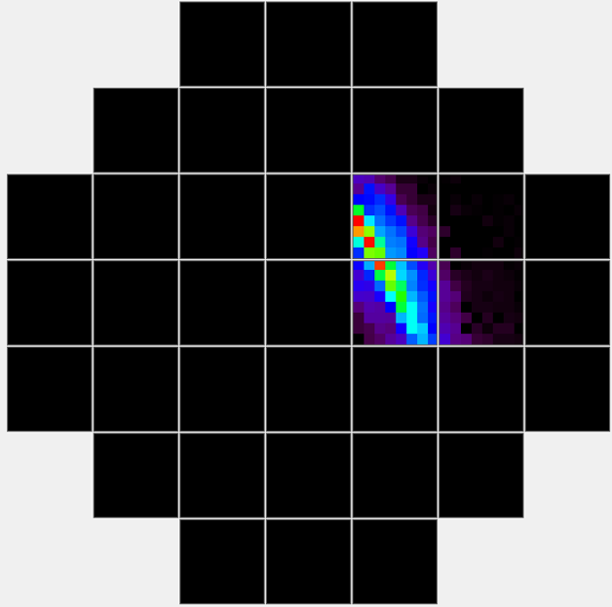
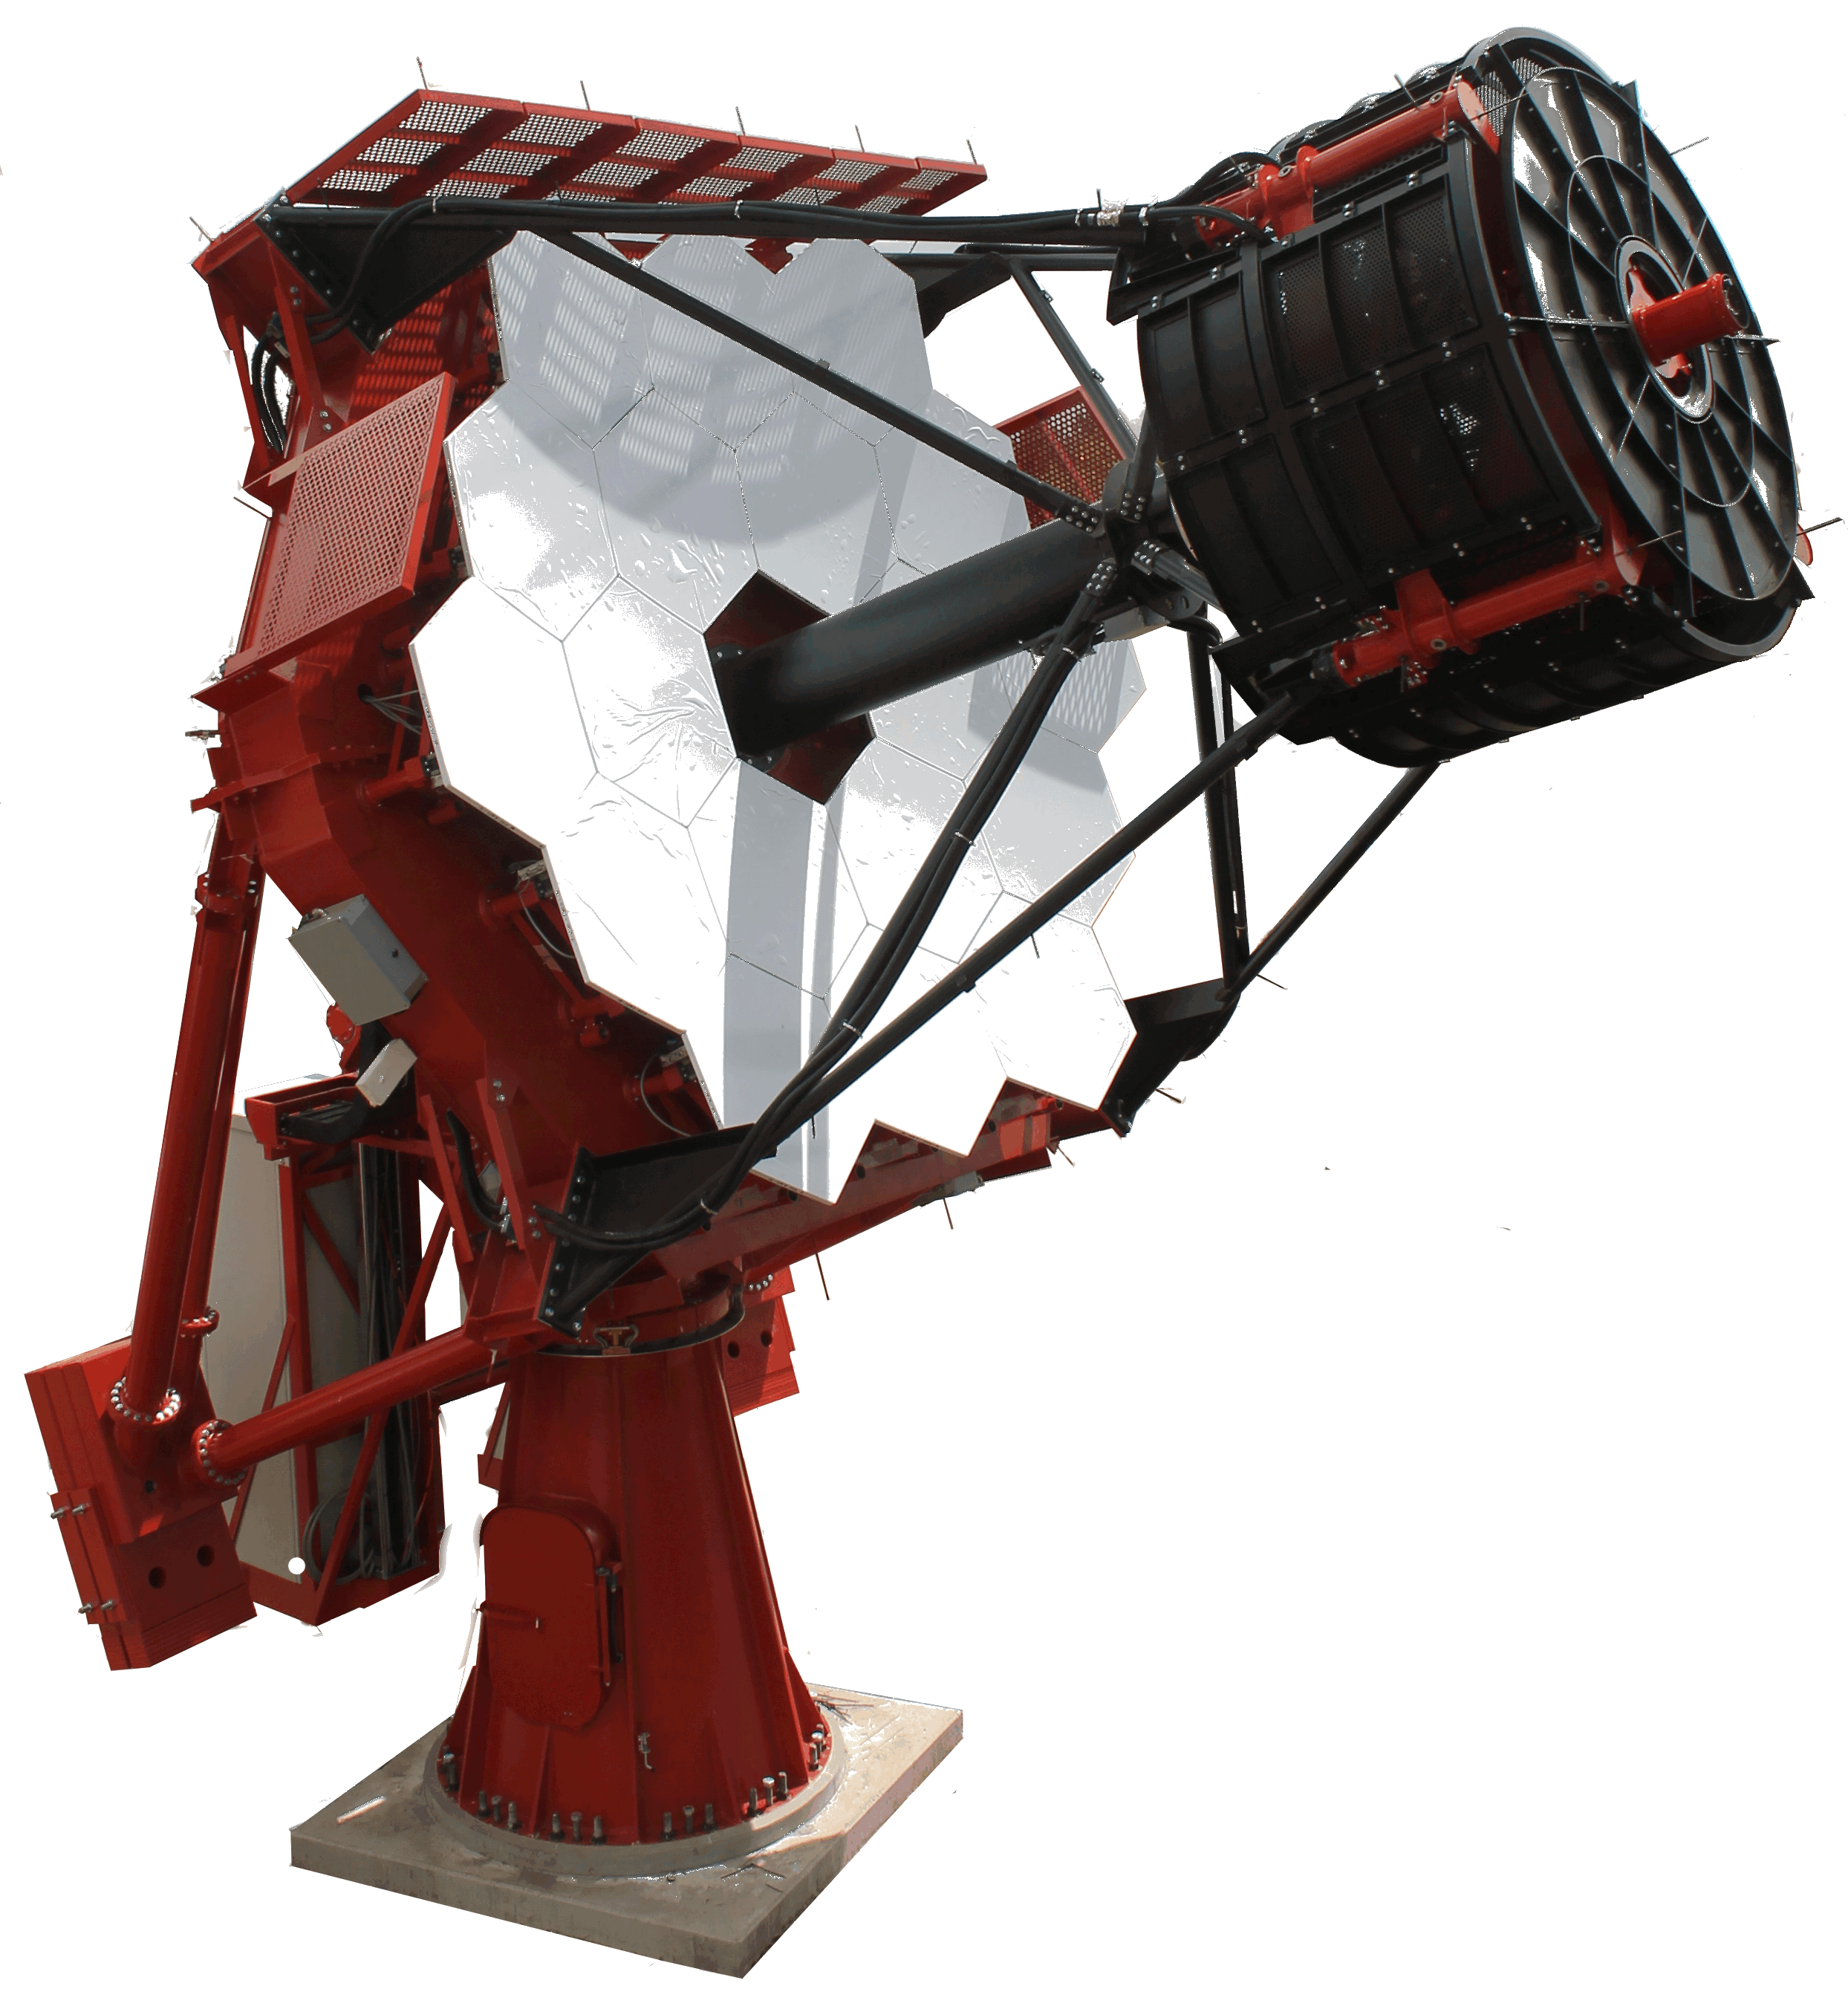
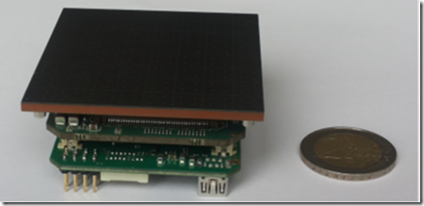
Calibration – one PDM – 64 channels
Courtesy Osvaldo Catalano, IASF Palermo / ASTRI collaboration / CTA

Slide 10
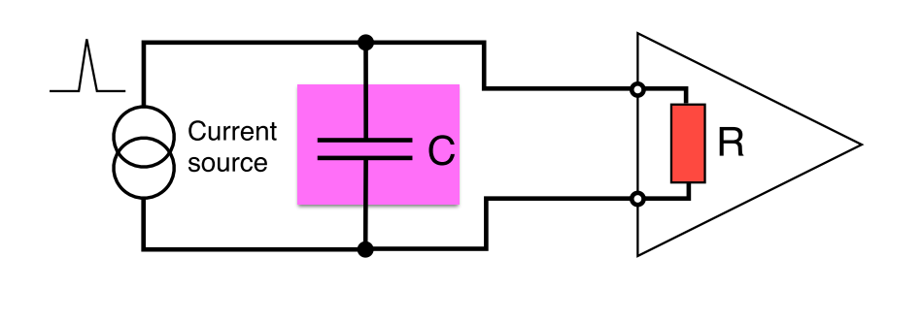
Timing optimization : getting the speed
Jitter due to electronics noise:
also presented as j = tr / (S/N)
dV/dt prop to BW, N prop to √ BW => jitter prop to 1/√BW
« the faster the amplifier the better the jitter ? »
« High speed preamps need to be low impedance (50 Ω or less) »
NB : tr = t_{10-90%} = 2.2 tau.
f_{-3dB} = 1/2πtau = 0. 35 / t₁₀₋₉₀
f_{-3dB} = 1 GHz <-> t_{10-90%} = 300 ps
1 ps = 300 µm in vaccum

Slide 11
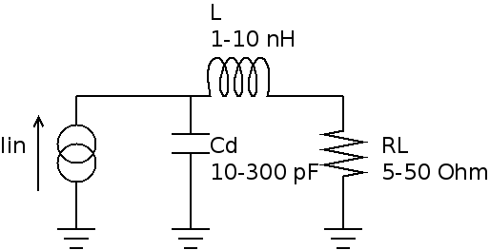
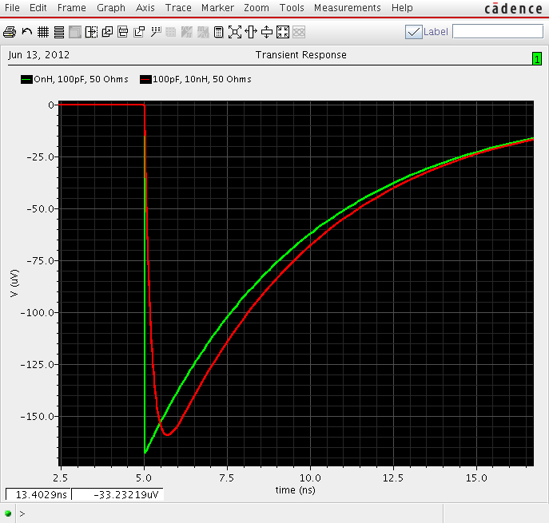
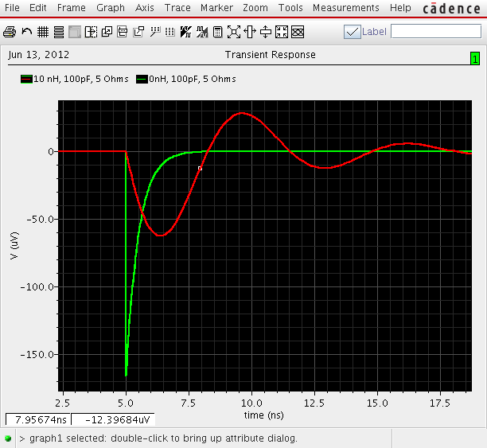
Preamp input impedance : examples of pulse shapes
SiPM pulse : Q=160 fC, Cd=100 pF, L=0-10 nH, R_{PA}=5-50 Ω
Sensitivity to parasitic inductance : 1 mm = 1 nH
Choice of R_{PA} : decay time, stability
Small R_{PA} not necessarily the fastest
Convolve with current shape… (here delta)
L/R
RC
C=100 pF
L=10 nH
R=50 Ω
C=100 pF
L=10 nH
R=5 Ω
Q/Cd

Slide 12
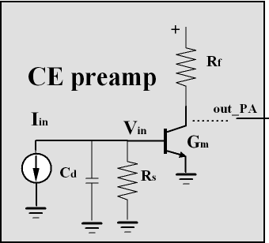
Jitter optimization
Jitter is given by [details in backup] :
Optimum value: t_{10-90_PA}= t_{d} (current duration)
Gives ps/fC as scales with 1/Qin en~1 nV/
SiPMs should be particularly good because Qin is large and td is small, but Cd is not so small…
With SiPM G = 1E6 C_{d} = 300 pF e_{n} = 1 nV/√Hz t_{d} = 100 ps expect : σ = 3 ns/Q(fC)
  1 pe = 160 fC => σ = 20 ps/#pe (~60 ps measured)
Cd: detector capacitance
t _{10_10_PA} : rise time of the PA
t_{d}= drift time of the detector
e _{n} preamp noise density
Dominated by sensor
Electronics only gives the spectral density of the input transistor e_{n}

Slide 13
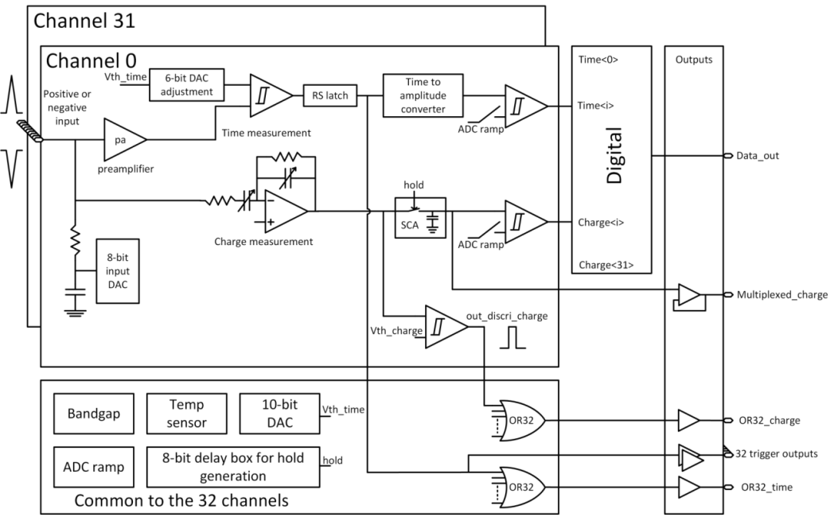
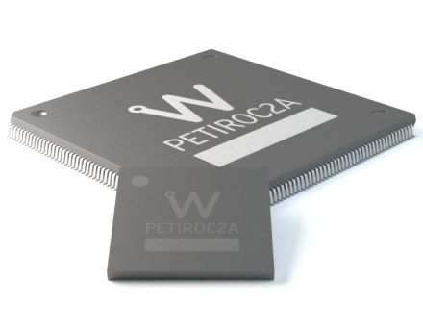
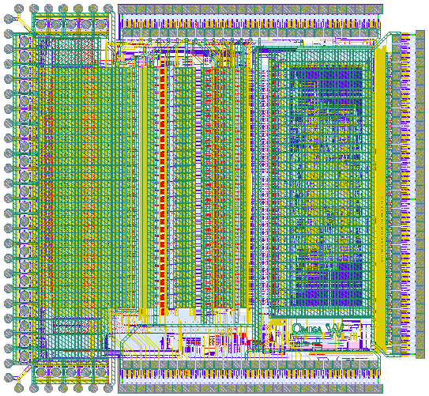
PETIROC2A
SiPM read-out for time-of-flight PET
Detector Read-Out | SiPM, SiPM array
Number of Channels | 32
Signal Polarity | Positive or Negative
Sensitivity | Trigger on first photo-electron
Timing Resolution | ~ 35 ps FWHM in analogue mode (2pe injected) - ~ 100 ps FWHM with internal TDC
Dynamic Range | 3000 photo-electrons (10⁶ SIPM gain), Integral Non Linearity: 1% up to 2500 ph-e
Packaging & Dimension | TQFP160 – TFBGA353

Slide 14
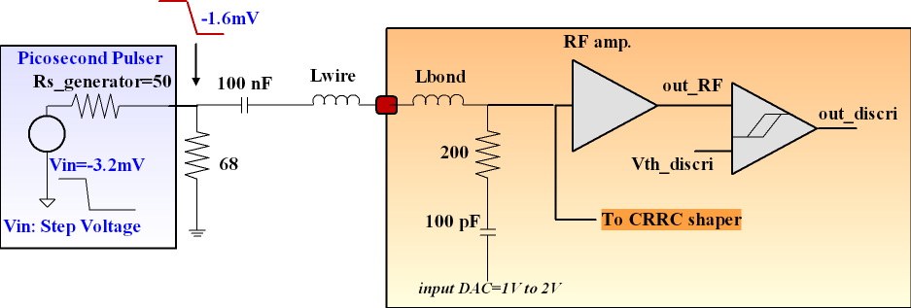
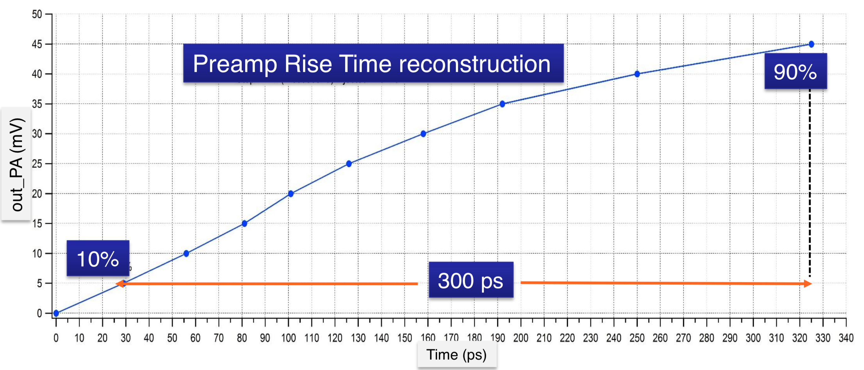
Petiroc2A bandwidth measurement
Preamp + discriminator bandwidth
reconstruction of pulse by discriminator
tr 10%-90% = 300 ps,
BW = 0.35 / tr ~ 0.9 GHz
can also use BW = 0.1 / (t_{50%} - t_{10%})

Slide 15
Petiroc 2A Operation Modes
Photon Counting
Analogue Read-out
Digital Read-out
No system clock in the chip
Fast preamplifier
& fast discriminator
Programmable threshold
32 trigger outputs
Photon counting on each channel on trigger rising edge
Time-Over-Threshold possible
120 MHz max rate
No system clock in the chip
Asynchronous
32 triggers outputs
analogue multiplexed output
Trigger OR, two thresholds
External TDC and ADC required
Count rate 500 kCPS
All conversion inside Petiroc
One wire serial data out
Two trigger level
No zero suppression
Backend controlled by DAQ
Count rate 40kCPS

Slide 16
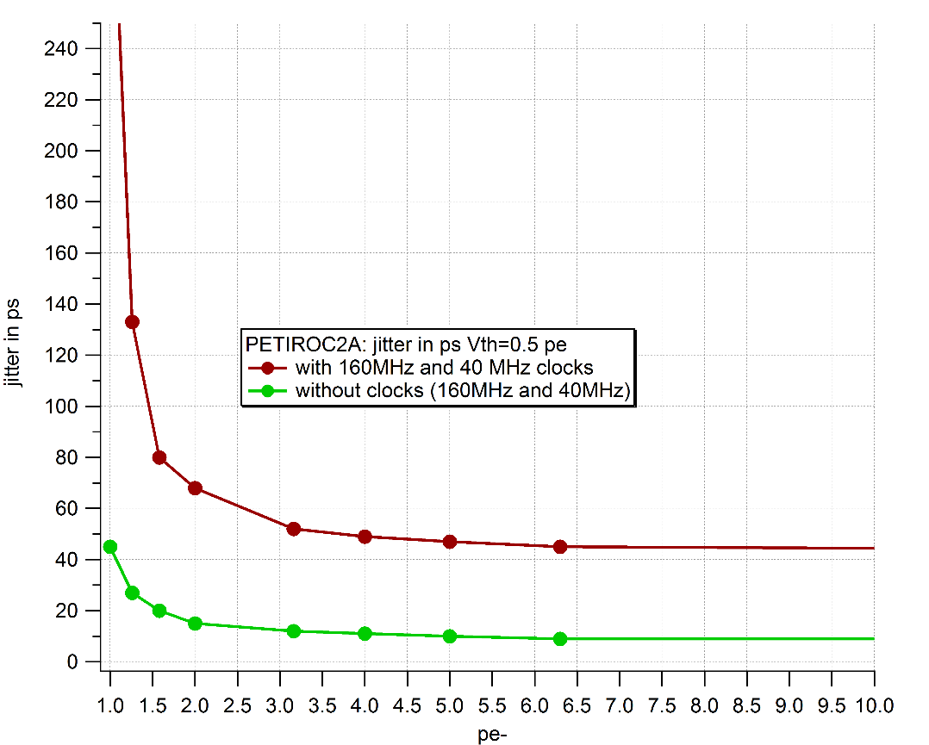
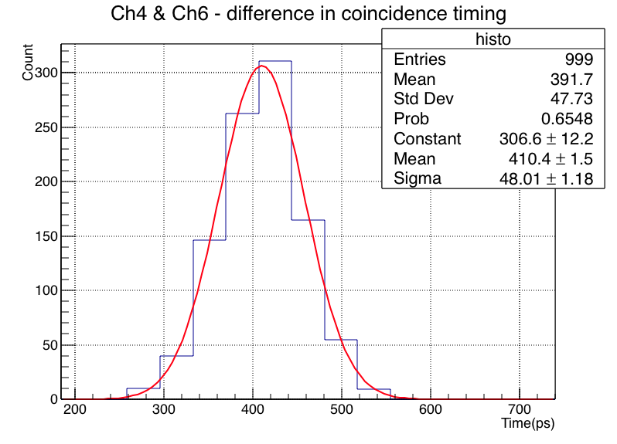
Petiroc2A characterization results - Time
Jitter vs threshold & pulse injection,
Clock couplings: through substrate
Jitter < 40 ps σ for input pulse > 1mV
Coincidence measurement with internal TDC
Synchronous pulse injection – Ideal case scenario
Constant term : ~48 ps σ
Trigger output jitter
100pe
48 ps σ
Jitter (ps σ)
CTR measurement by TDC
40 ps
10 ps
Vin (mV)

Slide 17
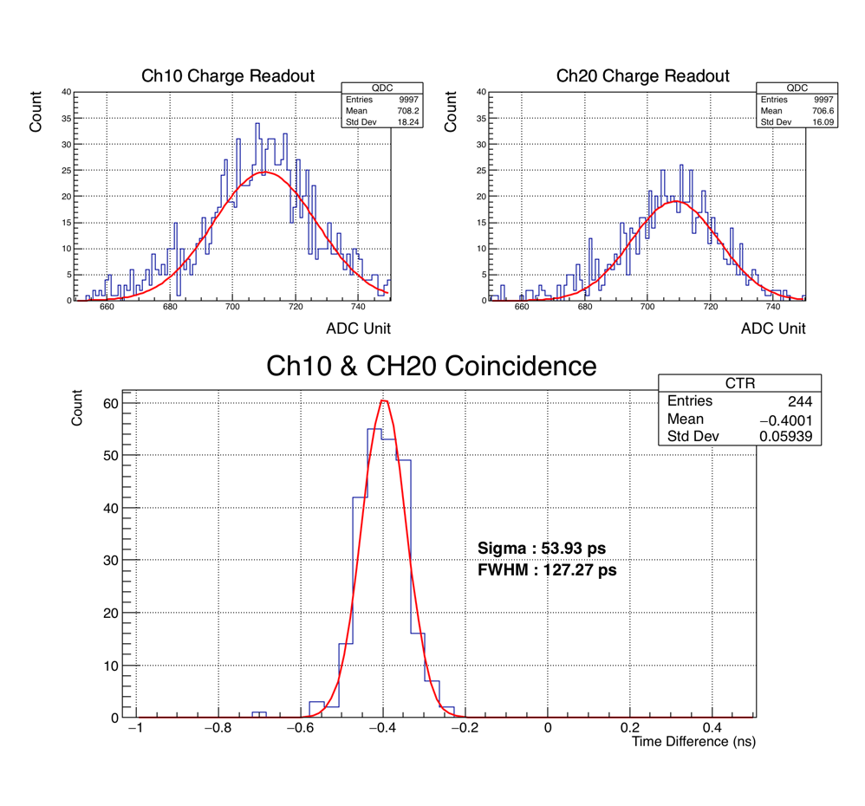
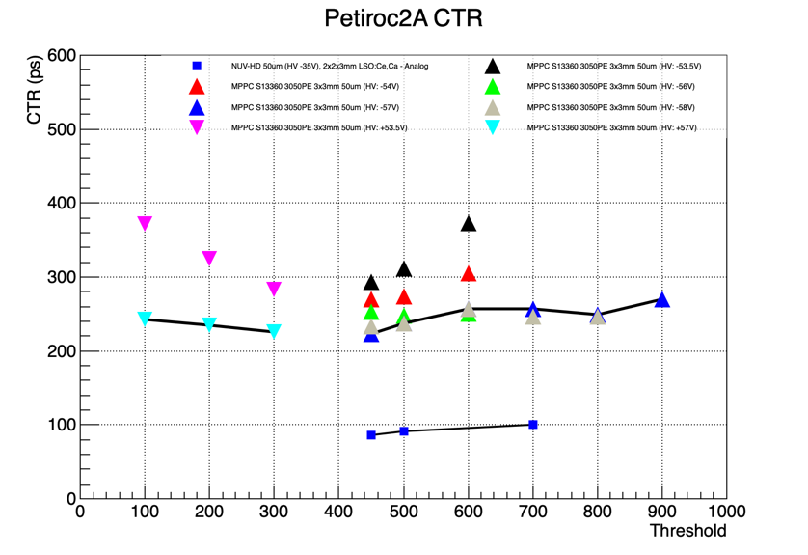
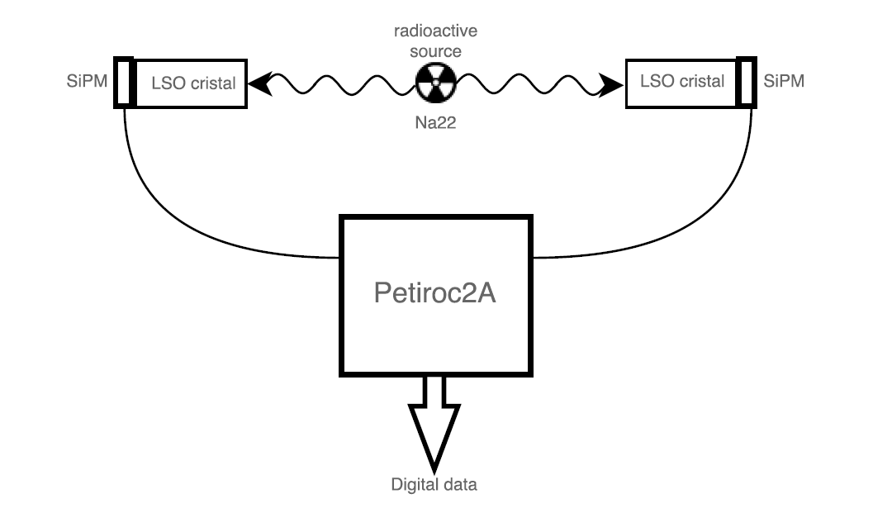
CTR measurement : Petiroc2A TDC (internal)
+HV
-HV
3x3x20mm³ LSO
222 ps
2x2x3mm³ LSO
127 ps
NUV-HD & 2x2x3m³ LSO:Ce,Ca : 127.3 ps FWHM
Source : Na22
Scintillator : 2x2x3mm³ / 3x3x20mm³ LSO:Ce codoped Ca
SiPM : FBK NUV-HD 4x4 mm² 40um
Hamamatsu MPPC S13360 3050PE 3x3 mm² 50um
HV : Various values
Thanks to S. Gundaker and E. Auffray for their help in the measurements

Slide 18
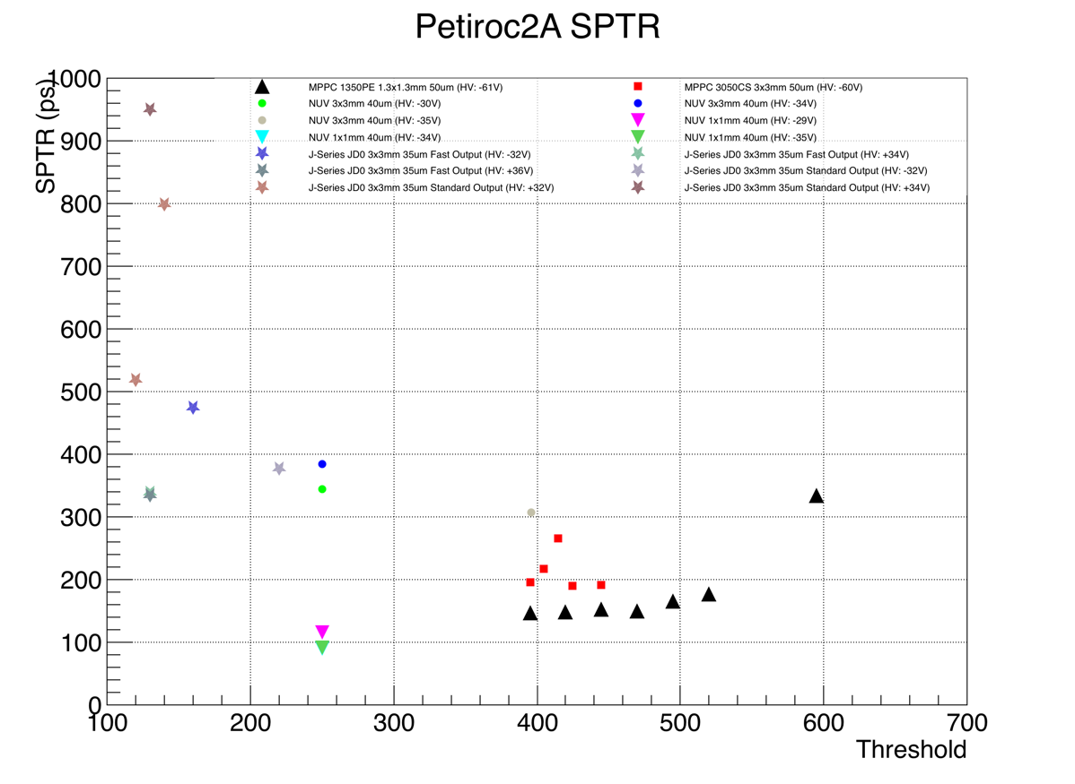
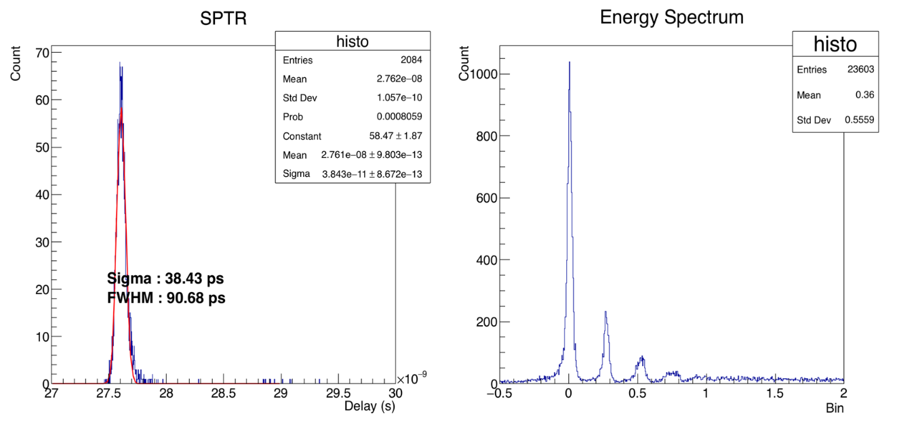
SPTR measurement : Petiroc2A trigger outputs
SPTR : 90 ps FWHM (40 ps rms)
3x3mm² JDO
3x3mm² MPPC
FBK NUV 1x1 mm² : 90.7 ps FWHM
1.3x1.3mm² MPPC
90 ps
1x1mm² NUV
Source : Laser
SiPM : Various model (FBK, Hamamatsu, Sensl)
HV : Various value

Slide 19
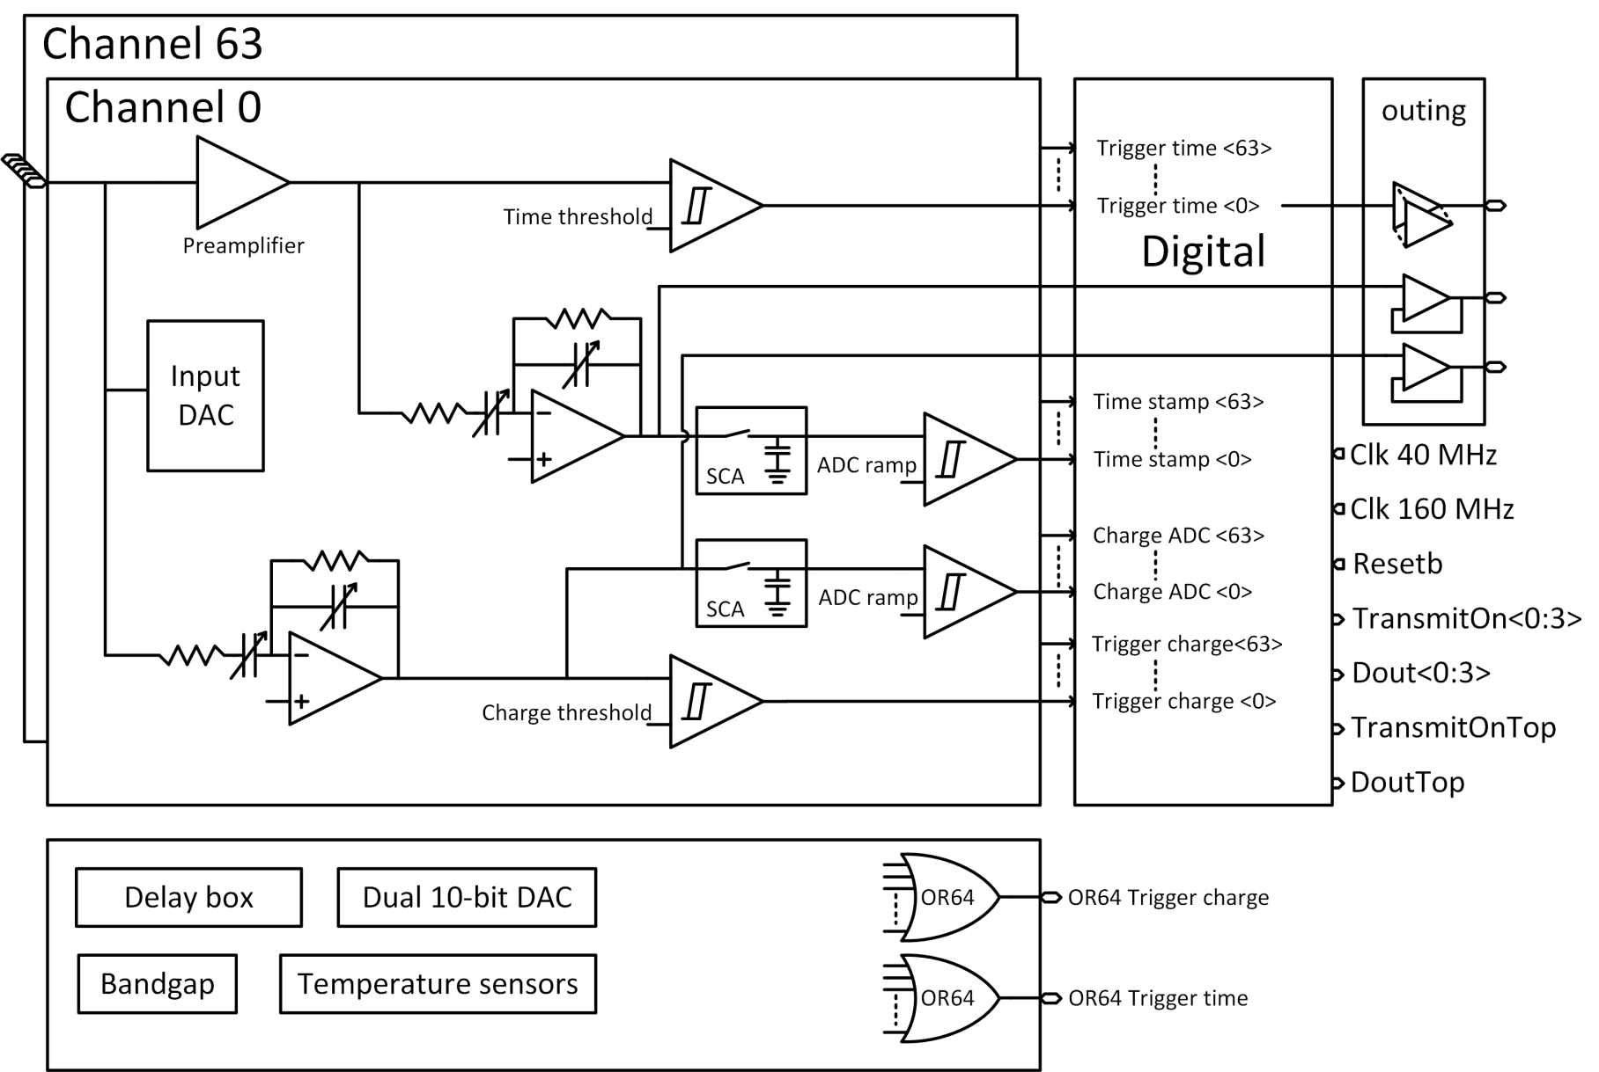
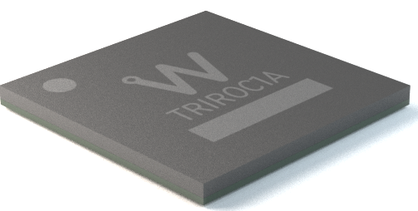
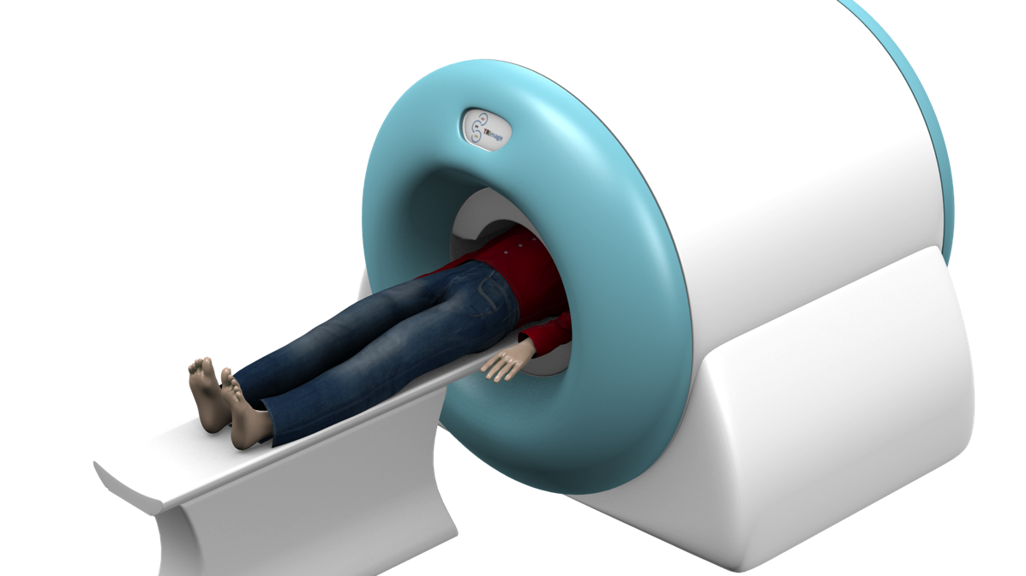

TRIROC
All-in-one SiPM read-out for multimodal PET inserts
Detector Read-Out | SiPM, SiPM array
Number of Channels | 64
Signal Polarity | Positive or Negative
Sensitivity | Trigger on first photo-electron
Timing Resolution | ~20 ps trigger jitter, ~430ps FWHM (internal TDC)
Dynamic Range | 3000 photo-electrons (10⁶ SIPM gain), Integral Non Linearity: 1% up to 2000 ph-e
Packaging & Dimension | BGA (12x12mm, 393 balls)

Slide 20
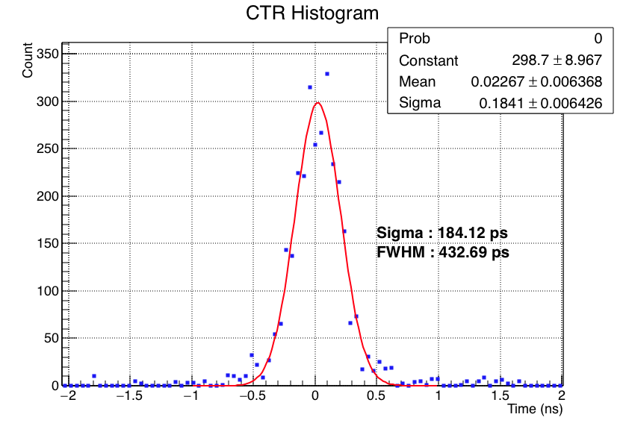
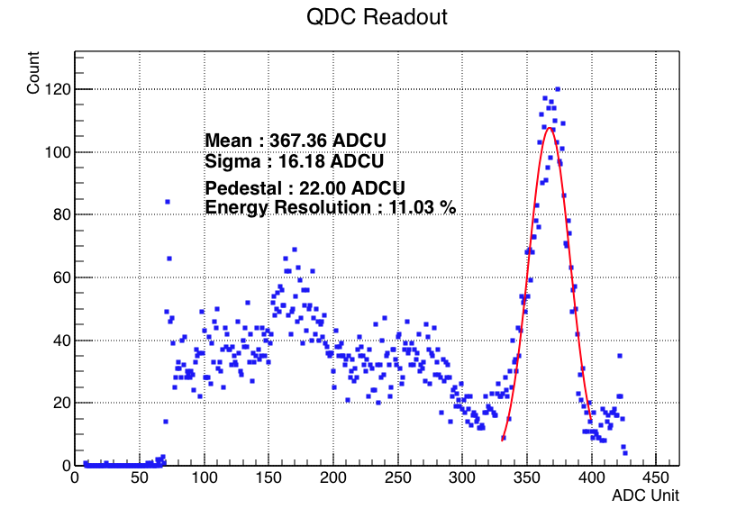
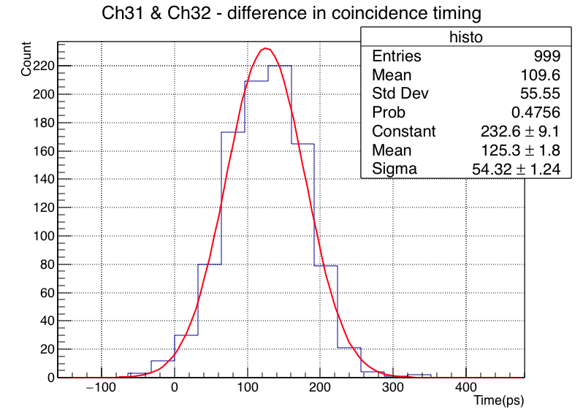
Timing resolution : test pulse and full system CTR
Two channels of Triroc are fired by fast test pulse
TDC output is compared
Sync measurement correspond to perfect calibration
Async measurement correspond to no calibration

Slide 21
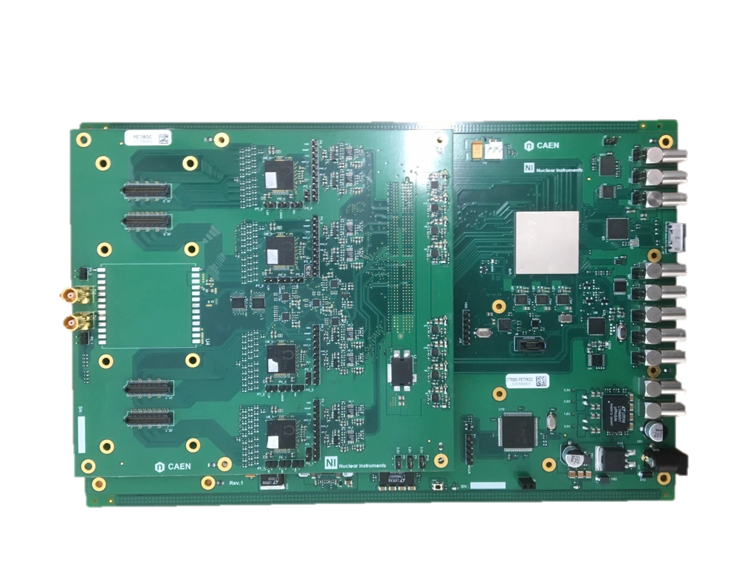
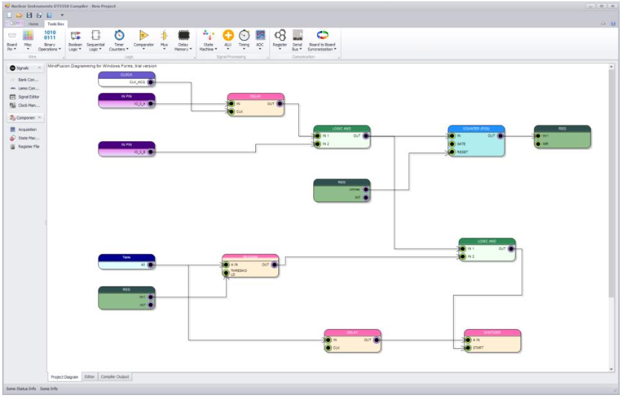
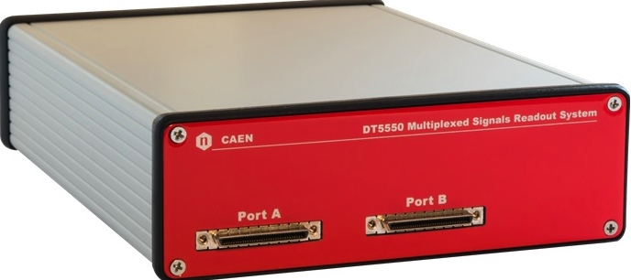


DT 5550W from CAEN
Transfer to industry
128-channel – 4 Petiroc 2A Hi performance evaluation system
Easy firmware design
Released summer 2017

Slide 22
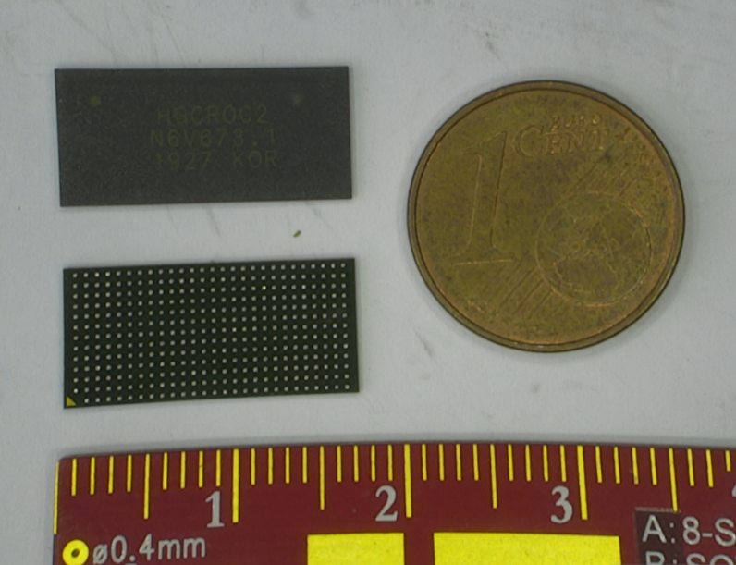



coming up : H2GCROC & LIROC
Omega strongly involved in LHC ATLAS & CMS upgrades
H2GCROC : Hadronic High Granularity Calorimeter Read Out Chip
  78 channels with current conveyor « à la KLAUS [U. Heidelberg] »
  ADC + TDC
  Collaboration : AGH, CEA, CERN, Imperial, OMEGA
LIROC : ATTRACT project for space based LIDAR
  64 high speed amplifiers/discriminators « à la petiroc »
  1 GHz bandwidth
  2 ns double pulse resolution
  SEU hardened
  Flip chip on BGA 0.8 mm pitch
CMOS 130 nm process rad hard up to 300 MRad

Slide 23
conclusion
Several SiPM chips developed at OMEGA for HEP
SPIROC tested extensively on ILC R&D by DESy et al.
  Also equips Wakashi detector on T2K
Variants developed and transfered from HEP to WEEROC / CAEN
  EASIROC equips E40 experiment in Japan
  CITIROC equips ASTRI CTA SST, T2K…
PETIROC and TRIROC developed for PET applications
  1 GHz bandwidth for 10-100 ps timing accuracy
Thousands of chips fabricated in SiGe 350 nm
Next generation : HGCROC, LIROC, SPACIROC….

Slide 24
backup

Slide 25



Petiroc 2A energy resolution
Scintillator : 3x3x20mm LSO:Ce codoped Ca (TBC)
SiPM : Hamamatsu MPPC S13360 3050PE 3x3 mm 50um
Isotope | Photopeak | energy (MeV)
Na22 | 1 | 0,511
Na22 | 2 | 1,274
Co60 | 1 | 1,173
Co60 | 2 | 1,332
Cs137 | 1 | 0,662
Co57 | 1 | 0,122
Na22 spectrum
before correction
Na22 spectrum
after correction

Slide 26


Petiroc 2A – CTR measurement, analog mode
Petiroc2A Threshold | Digital Part | CTR (FWHM)
450 | OFF | 85.48 ps
500 |  | 91.91 ps
700 |  | 100.57 ps
450 | ON | 125.07 ps
500 |  | 104.07 ps
Source : Na22
Scintillator : 2x2x3mm LSO:Ce codoped Ca
SiPM : Advansid/FBK NUV-HD 40um
HV : 35V
FWHM : 85ps
State of the art timing in TOF-PET detectors with LuAG, GAGG and L(Y)SO scintillators of various sizes coupled to FBK-SiPMs
S. Gundacker & Al, CERN
JINST - 10.1088/1748-0221/11/08/P08008

Slide 27


Petiroc 2A – CTR measurement : digital mode
Source : Na22
Scintillator : 3x3x20mm LSO:Ce codoped Ca
SiPM : MPPC S13360 3050PE 3x3 mm 50um
HV : 54V
FWHM : 380ps
Source : Na22
Scintillator : 2x2x3mm LSO:Ce codoped Ca
SiPM : Advansid/FBK NUV-HD 40um
HV : 35V
FWHM : 220ps
Full system Coincidence Timing Resolution including all errors : from Crystal to data processing in Computer

Slide 28



Detector impedance and input voltage
1 GHz, Cd=few tens of pF, input signal width <1ns
Cd>1 pF, Zs@1GHz dominated by Cd
Rise time: tr= td when td<< R_{S} C_{d} and tr= R_{S} C_{d} when td>> R_{S} C_{d}
At HF : difficult to beat the capacitance => signal integrated on Cd
1 GHz
1pF
10 pF
50Ω
100pF

Slide 29



High speed amplifiers
Response to very short pulse
Broadband
  Zin=Rs (50 Ohm)
  Vin = Q/Cin
  $VOUT$= $−\text{G}\text{m}\text{R}\text{F}$ $\frac{QIN}{C_{d}}$
Transimpedance
  Zin ~ Zf/G ~ 1/gm
  $VOUT=\frac{\frac{1}{G_{m}}\text{ − }\text{R}\text{F}}{1 + jω\frac{C_{d}}{G_{m}}}$ $IIN ≈{−G}_{m}\text{R}\text{F}\frac{QIN}{C_{d}}$
Same response at High Frequency
For highest speed : go to broadband. Faster, less stability issues

Slide 30

High speed amplifiers
Jitter is given by [details in backup] :
Optimum value: t_{10-90_PA}= t_{d} (current duration)
Gives ps/fC as scales with 1/Qin
Electronics noise e_{n} given by the input transistor transconductance g_{m}:
Cd: detector capacitance
t _{10_10_PA} : rise time of the PA
t_{d}= drift time of the detector
e _{n} preamp noise density
Dominated by sensor
Electronics only gives the spectral density of the input transistor e_{n}

