Slide 1








ALTIROC, a 25 ps time resolution ASIC for ATLAS HGTD
N.Seguin-Moreau*¹, S. Conforti¹, C. de La Taille¹, P. Dinaucourt¹, G. Martin-Chassard¹, A. Dragone², B. Markovic² , L. Ruckman² , A. G. Schwartzman², D. Su², C. Agapopoulou³, N. Makovec³, S. Sacerdoti³, L. Serin³, D. Gong⁴, J. Ye⁴, W. Zhou⁴
TWEPP 2019
3
4
1
2

Slide 2
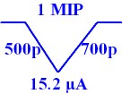
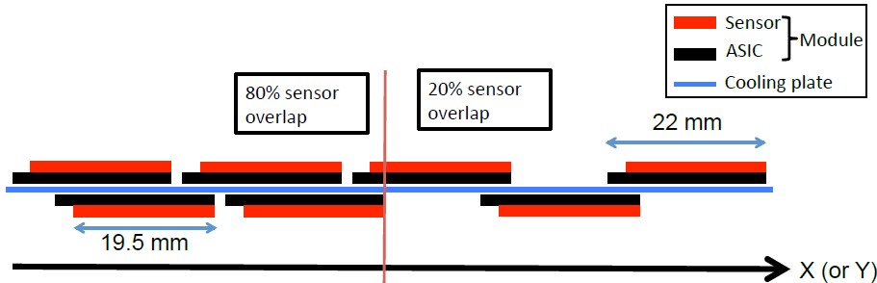
ATLAS High Granular Timing Detector in HL-LHC
In the forward region, between the Inner Tracker and the End Cap of EM Calorimeter
• 2.4 < η < 4.0 ( 120 mm < R < 640 mm), ΔZ = 75 mm (+50 mm moderator)
• TID up to 9.5 MGy (SF 2.25) at R = 120 mm after 4000 fb-1 (10¹⁶ n/cm² SF =1.5) => Ring 3.1< η < 4.0 replaced half the HL-LHC lifetime = 32 % of modules.
• σt ~ 30 ps/track at start, 50 ps/track at the end, dominated by electronic jitter and < 10% occupancy
- Si (Low Gain Avalanche Diodes) sensors
- 1.3 x 1.3 mm² granularity
- 2 hits/track η< 3.2 ; 3 hits/track η> 3.2
• Use as counting detector at 40 MHz for luminosity measurements
MIP signal (10 fC) with LGAD sensor
thickness = 50 µm and G = 20
2 disks, 2 layers/disk
equipped on both sides with
Low Gain Avalanche Diodes (LGAD)
Sensor overlap: 20% for r>320 mm and 80% for r<320 mm

Slide 3
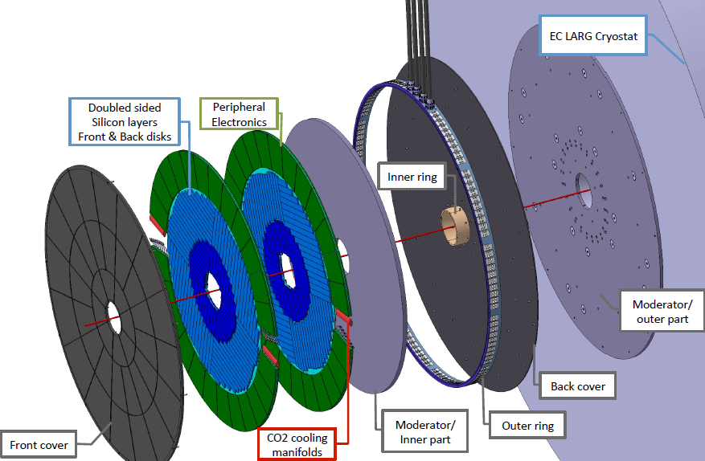
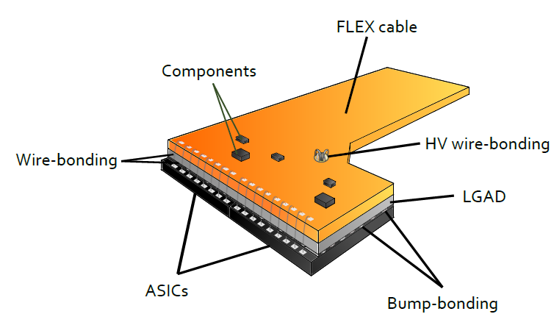
HGTD module
See Marisol Robles’ poster (144) :
« Test results of a flexible printed circuit for the ATLAS HGTD »
Module = LGAD sensor (450 PADs of 1.3 x1.3 mm2) + 2 ASICs (225 channels/ASIC) bump bonded to sensor + Flex to peripheral electronic boards (LpGBT, DC-DC, flex connectors)
  - 2 ASICs =2 x 2 cm x 2 cm (15x30 channels) with 1.3 x 1.3 mm² pads granularity
Flex: wire bonded to sensor (bias voltage) and to ASICs (signals and power)

Slide 4
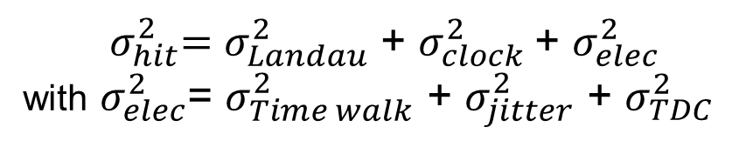
Requirements for the ASIC
HGTD key requirement: Time resolution per track, combining multiple hits, is 30 ps at the start of lifetime
to 50 ps after 4000 fb-1 => Time resolution /hit must be < 40 ps at start and 85 ps (70 ps) at the end of lifetime
for the inner radius (outer radius)
Main contributors:
${ σ}_{hit}^{2}=σ_{Landau}^{2}$ + $σ_{clock}^{2}$+ $σ_{elec}^{2}$
with $σ_{elec}^{2}$= $σ_{Time walk}^{2}$ + $σ_{jitter}^{2}$ + $σ_{TDC}^{2}$
Maximum jitter (σ_{elec}) | 25 ps at 10 fC at the start of the HL-LHC and 70 to 85 ps after 4000 fb-1 for 2.5 fC
TDC contribution | < 10 ps
Time walk contribution | < 10 ps
TDC conversion time | < 25 ns
PAD size | 1.3 x 1.3 mm² x 50 µm => Cdet = 4 pF
ASIC size and channels /ASIC | 2x2 cm2 225 channels/ASIC
Single PAD noise (ENC) | < 1500 e- or 0.25 fC
Minimum threshold | 1 fC
Dynamic range | 2.5 fC to 100 fC
TID Tolerance | Inner region (R<320 mm): 4.7 MGy (Modules replaced after 2000 fb⁻¹) Worst case at R=320mm: 5.1 MGy
Voltage and Power dissipation per ASIC | 1.2V and 300 mW cm⁻² => 1.2 W/ASIC (225 ch) or 4.4 mW/channel and 200 mW for the common part
ASIC designed in CMOS 130 nm

Slide 5

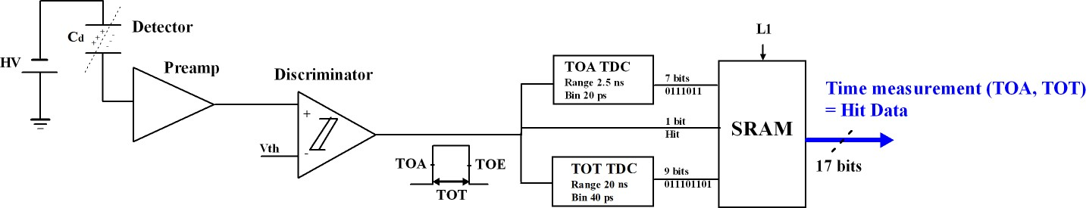


ALTIROC1 single channel FE readout
ALTIROC1 FE integrates:
A preamplifier followed by a discriminator: Time walk correction made with a Time over Threshold (TOT) architecture
Two TDC (Time to Digital Converter) to provide digital Hit data =Time of Arrival (TOA) + Time Over Threshold (TOT) measurement
  TOA TDC: range of 2.5 ns and a bin of 20 ps (7 bits)
  TOT TDC: range of 20 ns and a bin of 40 ps (9 bits)
One Local memory (SRAM): to store the 17 bits of the time measurement (Hit data) until L0/L1 trigger (~ 1 MHz) => trigger latency = 35 µs
Altiroc1 integrates a standalone phase shifter designed by SMU

Slide 6
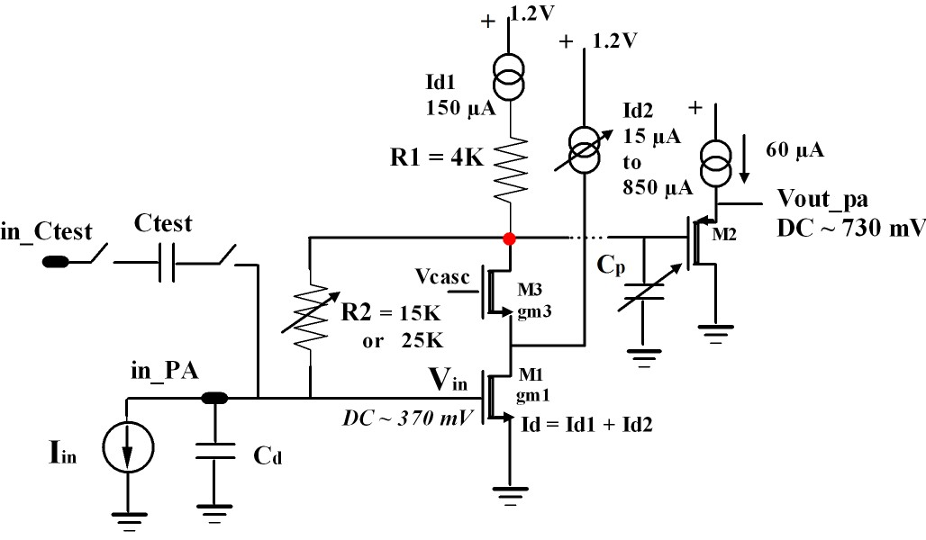
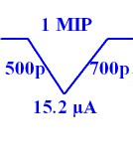
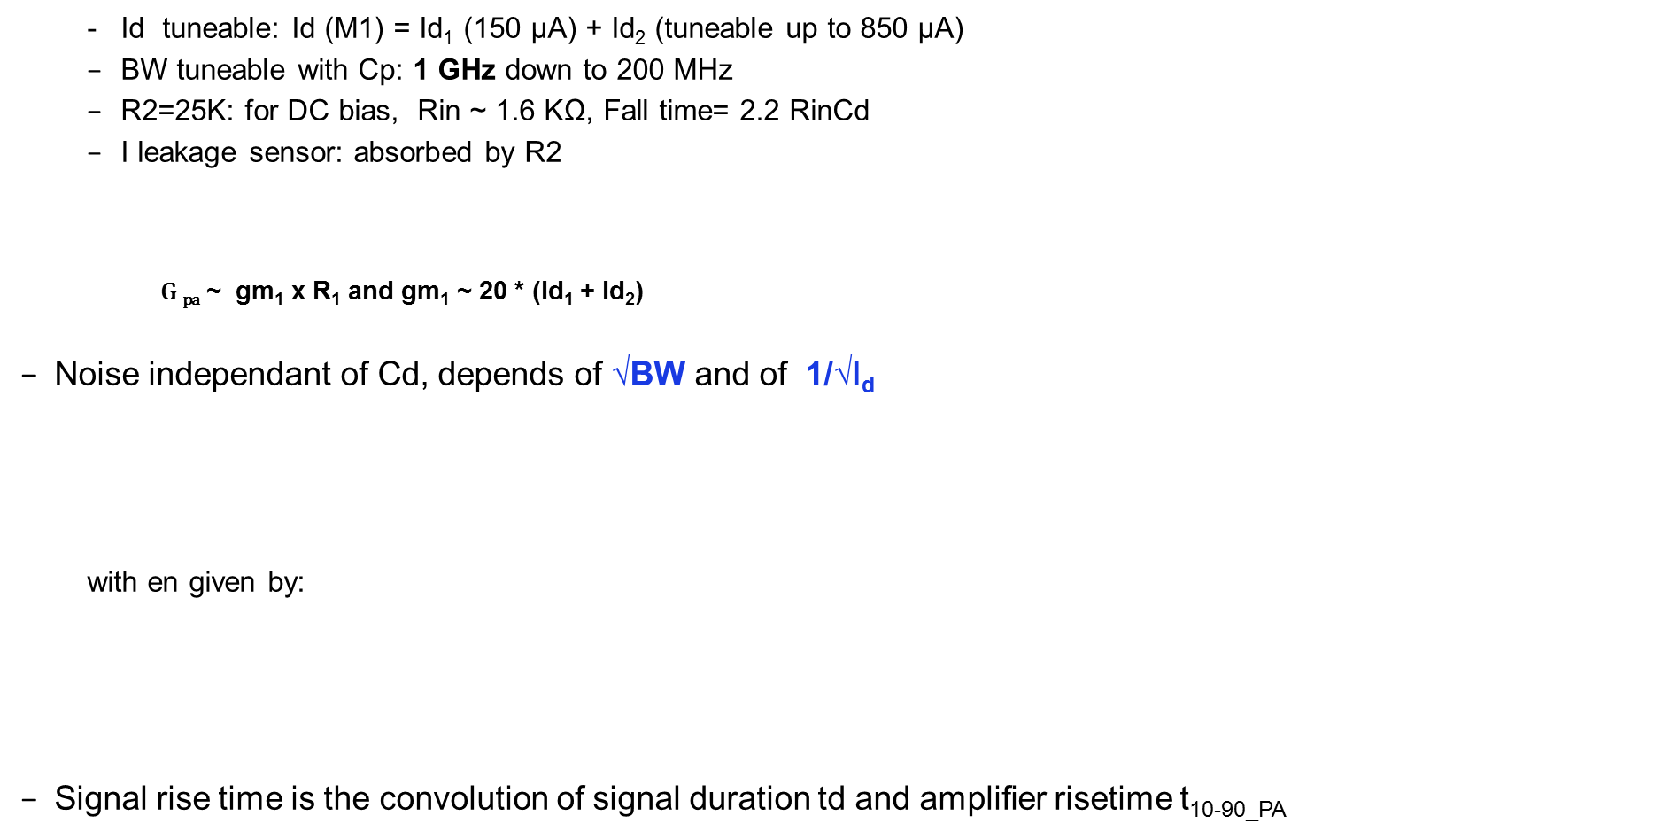

ALTIROC Preamp: Voltage configuration (Baseline)
  Id tuneable: Id (M1) = Id₁ (150 µA) + Id₂ (tuneable up to 850 µA)
  BW tuneable with Cp: 1 GHz down to 200 MHz
  R2=25K: for DC bias, Rin ~ 1.6 KΩ, Fall time= 2.2 RinCd
  I leakage sensor: absorbed by R2
    $\text{G} \text{pa}$ ~ gm₁ x R₁ and gm₁ ~ 20 * (Id₁ + Id₂)
Noise independant of Cd, depends of √BW and of 1/√I_{d}
  with en given by:
Signal rise time is the convolution of signal duration td and amplifier risetime t_{10-90_PA}
V step from internal pulser
70 ps
$Vout_pa=\text{G} \text{pa} \text{Vin}\text{=}\text{G} \text{pa}\frac{\text{Q}\text{IN} }{C_{d}}$ ~ α I_{d} $\frac{\text{Q}\text{IN} }{C_{d}}$

Slide 7
TOA TDC Architecture (Simplified): Vernier Delay Line
TDC Power consumption 0,4 mA *1.2V = 0,5 mW @ 10% occupancy
TOA TDC
Resolution: 20 ps
Range: 2.5 ns
7 bits
Simplified Block Diagram:
@ Bojan Markovic, SLAC
Time-to-Digital Converter (TDC)
2.5ns Measurement Window
2.5ns
120ps
120ps
120ps
120ps
120ps
STOP signal propagates
in the Fast Delay Line
(Delay of one cell = 120 ps)
1
F1
2
F2
3
F3
4
F4
128
F128
Event
Detection
STOP
Q1
Q2
Q3
Q4
Q128
Clock
STOP
1
2
3
4
128
START signal propagates
in the Slow Delay Line
(Delay of one cell = 140 ps)
START
S1
S2
S3
S4
S128
START
140ps
140ps
140ps
140ps
140ps
0
Q1
Q1
Q2
Q2
Q3
Q3
Q4
Q128
Q128
ToA
Bin1
Bin2
Bin3
Bin4
Bin128
Differential shunt capacitor voltage-controlled delay cells
The START pulse comes first and initializes the TDC operation.
The STOP pulse follows the START with a delay that represents the time interval to be digitalized.
At each tap of the Delay Line the STOP signal catches up to the START signal by the deference of the propagation delays of cells in Slow and Fast branches of the delay line: i.e. 140ps – 120ps = 20ps that represents the LSB of time measurement.
The number of cells necessary for STOP signal to surpass the START signal represents the result of TDC conversion
Cycling configuration used in order to reduce the total number of Delay Cells.
TDC range is equal to 128*20ps = 2.56ns

Slide 8
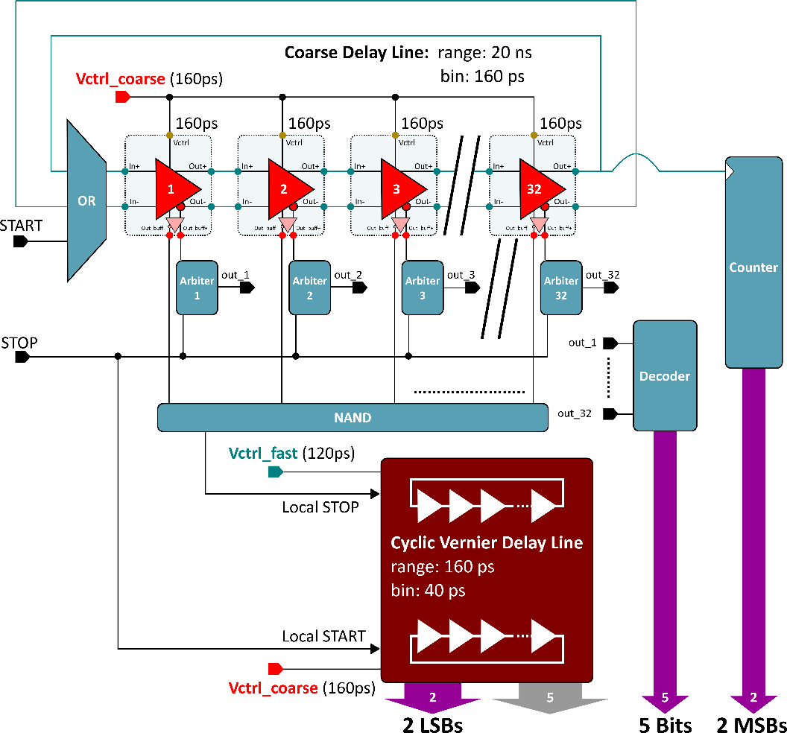
TDC for TOT measurement
TDC Power consumption 0,4 mA *1.2V = 0.5 mW @ 10% ocupancy
TOT TDC
Resolution: 40ps
Range: 20 ns
9 bits
TOT: coarse delay line (160 ps) + TOA TDC
@ Bojan Markovic, SLAC

Slide 9
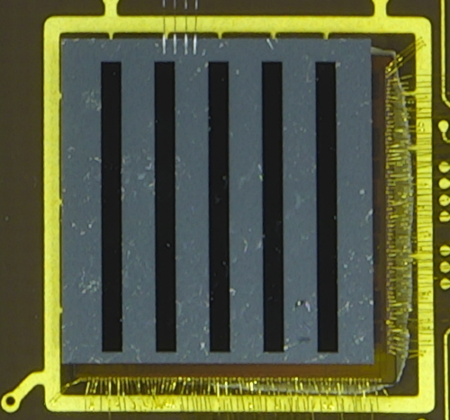
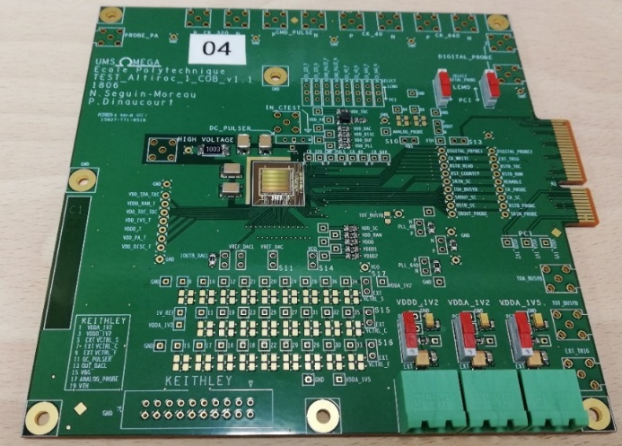
PROTOTYPES DONE SO FAR (all CMOS 130 nm)
Altiroc0
ALTIROC0: contains only PA + discriminator – for 2x2 1x1 mm2 sensors
  Altiroc0_V1 (Dec 2016): 4 channels for 2 pF (1x1 mm2 sensor) and 4 channels for 20 pF (3x3 mm2 sensors), Voltage PA (=VPA) for all channels
  Altiroc0_V2 (December 2017): 4 channels with faster VPA preamp and and 4 channels with TZ preamp. All for Cd ~ 2pF
  Testbench and testbeam measurements
ALTIROC1_V1 : 5x5 complete readout channels (PA, discri, TDC, SRAM) to readout 1.3 x 1.3 mm2 LGAD pixels , 15 channels with VPA, 10 with Transimpedance amplifier (TZ)
  Testbench measurements (debug) since beg. of Dec. 2018
  Irradiation tests
ALTIROC1_V2: submitted March 2019 (CMS eng run ) but thinned/diced dies received beg of July => first tests begun mid July 2019
  Minor modifications between V1 and V2: 1.2V MOSCAPs used to filter DLL Vctrl voltages changed to 2.5 MOSCAPs to get rid of the leakage current on these nodes
  Testbeam 19-25 August @DESY
  => measurements shown with Altiroc1_V2 are quite preliminary
2 mm
2 mm
~ 7,7 mm
Wire bonding and bump bonding done by IFAE, CNM and IHEP
Altiroc1 tesboard

Slide 10
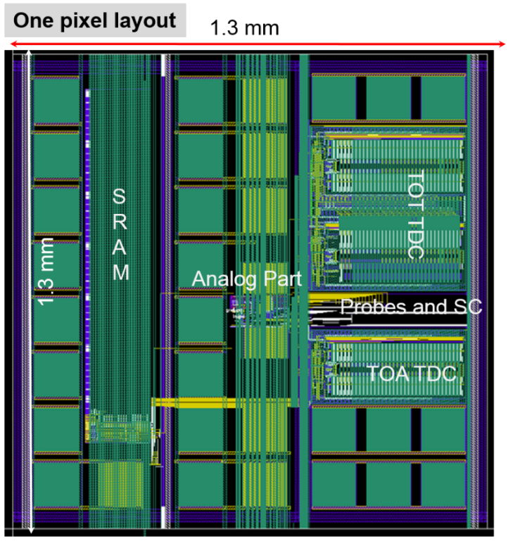
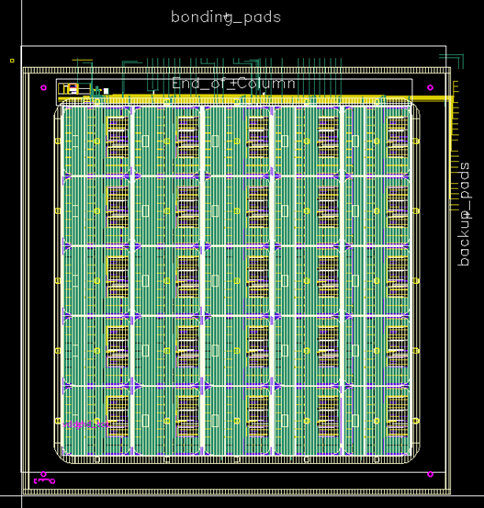
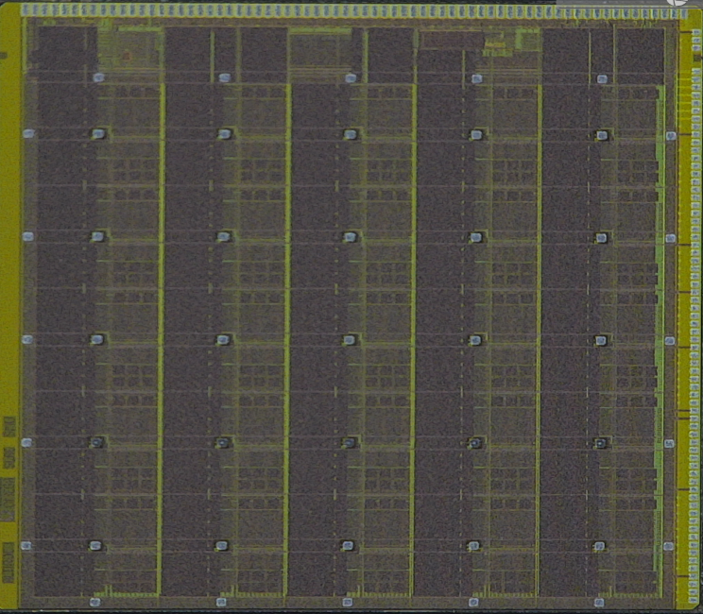
ALTIROC1
Altiroc1 layout
ZOOM of one pixel
~ 8 mm
Submission :
V1 13 June 2018, V2 March 2019
VPA
VPA
VPA
TZ
TZ
VPA
VPA
VPA
TZ
TZ
VPA: Voltage preamp
TZ: Transimpedance preamp
Measurements shown in this presentation only with VPA
VPA
VPA
VPA
TZ
TZ
VPA
VPA
VPA
TZ
TZ
VPA
VPA
VPA
TZ
TZ

Slide 11
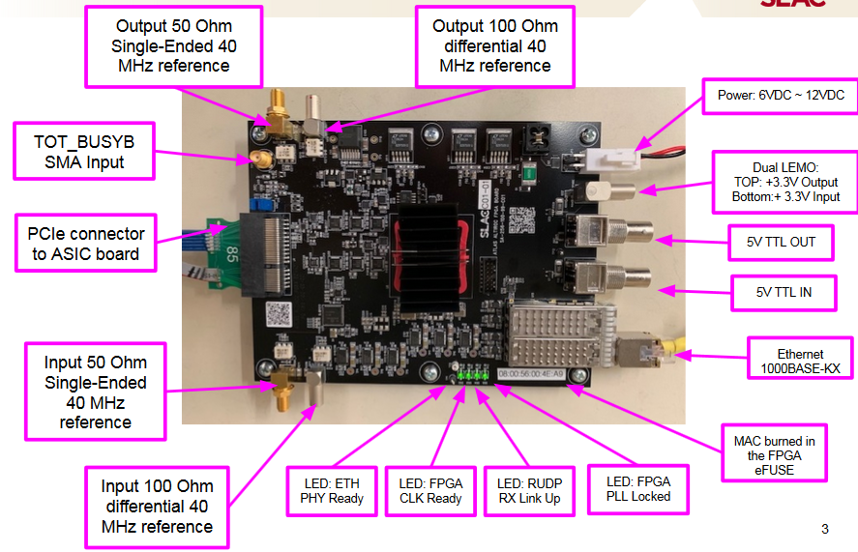
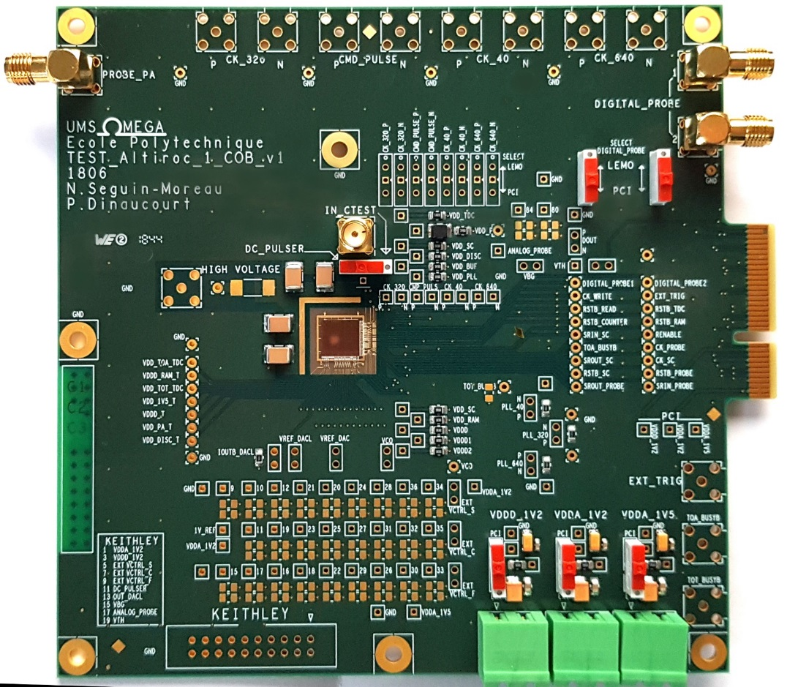
SETUP for ALTIROC1 measurements
Altiroc1 die
Wire bonding @

Slide 12
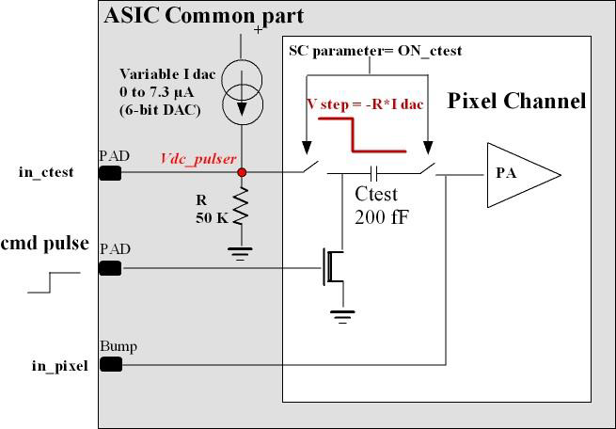

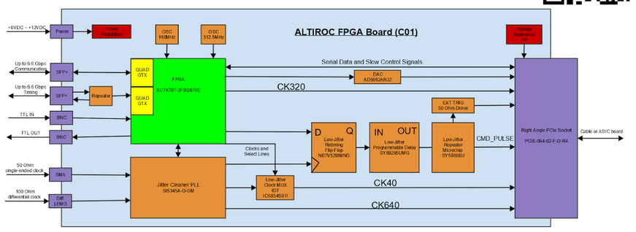
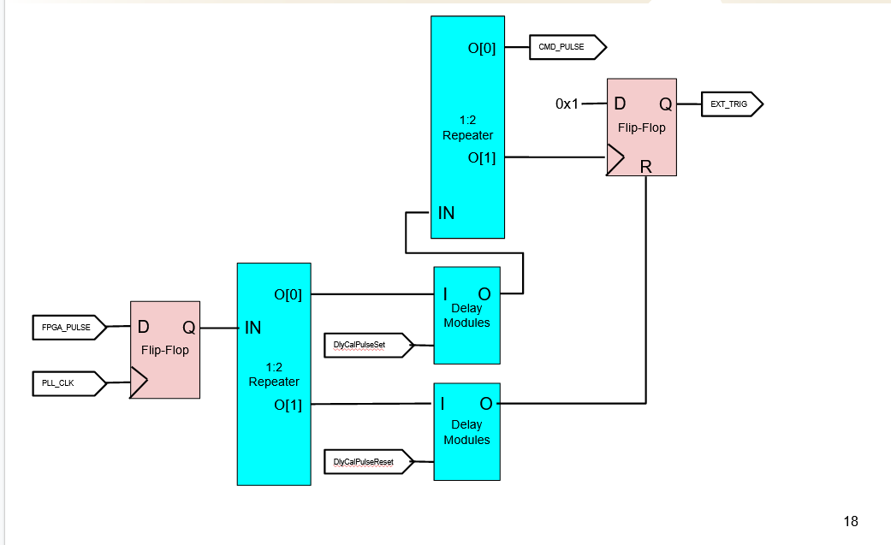
ALTIROC1 TOA measurement setup
Injection of charge (0 fC up to 50 fC) using the ASIC internal pulser controlled by cmd_pulse input
cmd_pulse signal generated by the FPGA, synchronous to 40 MHz clock
External trigger pulse to characterize the TOT TDC alone (as well as TOA TDC)
ALTIROC FPGA Board (C01):
Cmd_pulse
Ext_trig
Using SY89295UMG as a programmable delay, the cmd_pulse can be delayed by software with steps ~10 ps in ~10 ns range

Slide 13
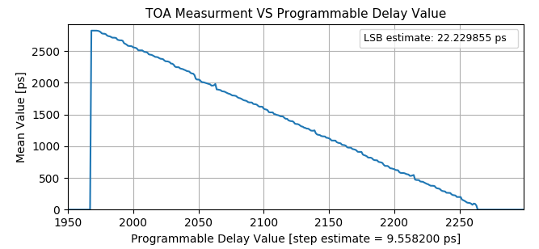
ALTIROC1_V2: TOA Measurements using PA+Discri
2.5ns
40 MHz clock
2.5ns
cmd_pulse
cmd_pulse
Altiroc1_V2
LSB= 22 ps
Range = 2.7 ns
In Altiroc1_V1, LSB was 28 ps and range 1.8 ns (due to Ileakage in MOS filtering Cap used in the DLL): corrected in Altiroc1_V2 by replacing 1.2V MOS transitors capacitors by 2.5V MOS transistors

Slide 14
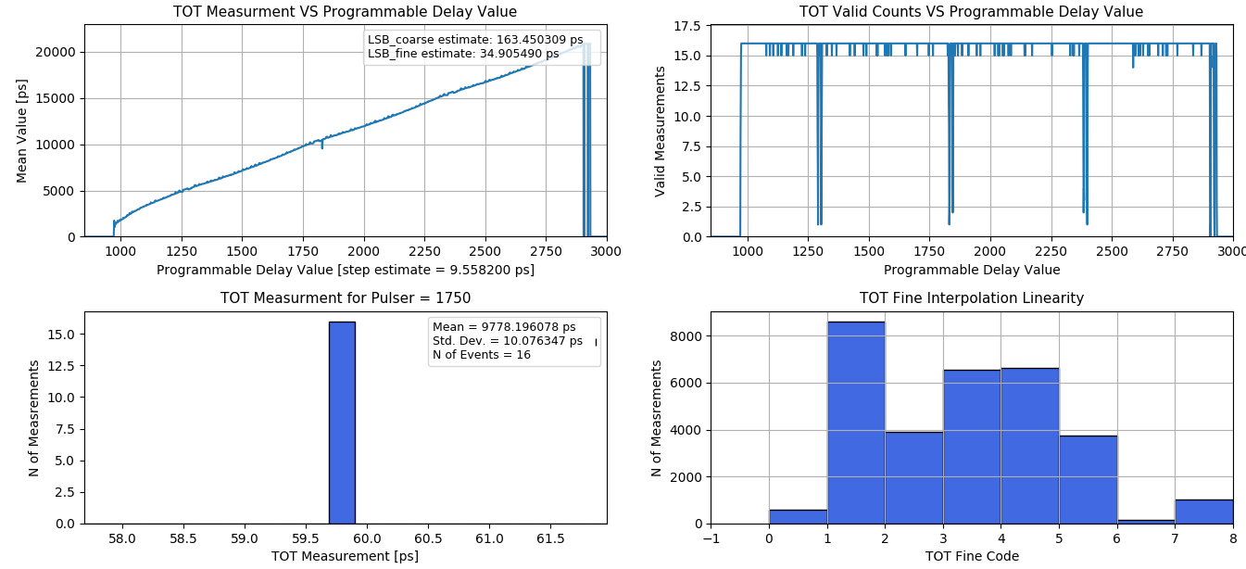
ALTIROC1_V2: TOT measurement using external trigger
ALTIROC1_V2
LSBc= 163 ps
LSBf= 35 ps
Range = 20 ns
TOT TDC of Altiroc1_V1: range was only 5 ns. Due to a larger than expected initial pulse-width (higher parasitics)
of signals circulating within the cyclic delay lines => corrected in Altiroc1_V2 with a better control the initial pulse width
Jitter = 10 ps

Slide 15
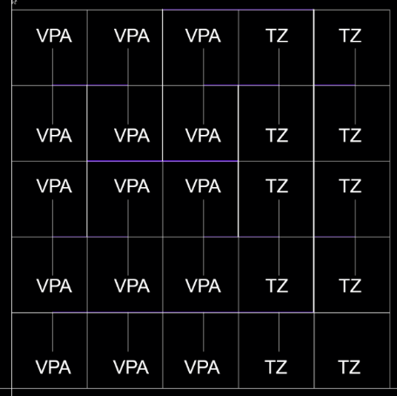
Jitter and LSB uniformity of ALTIROC1_V2 meas. , wo sensor
Measurements done
on the 15 VPA channels only
Qinj=10 fC, Cd =0
Individual tunings of the pixel TDC not done
VPA: Voltage preamp
TZ: Transimpedance preamp
LSB
JITTER

Slide 16
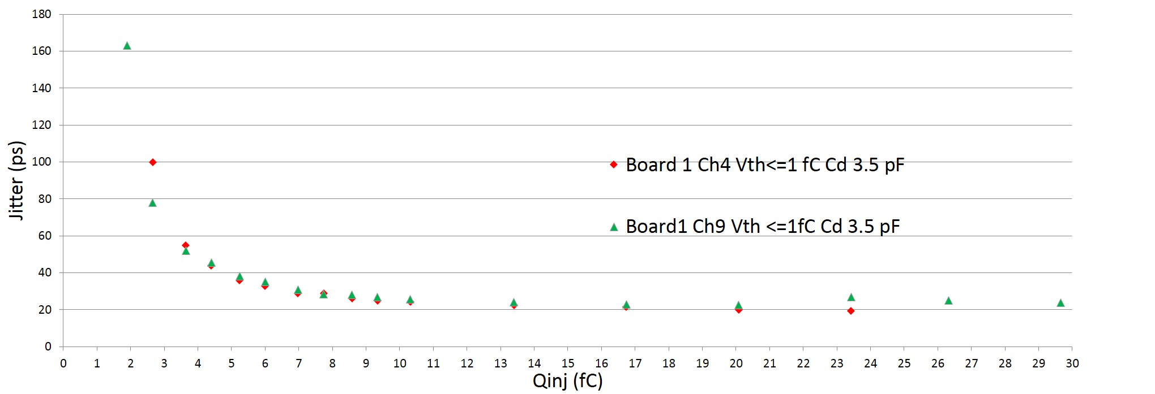
ALTIROC1_V1: Jitter vs Qinj measurement (Cd=3.5 pF)
Measurements done with the internal TOA TDC
Floor (~ 13 ps) from clock, command pulse and TDC bin not substracted
5fC, σ = 36 ps (33 ps afetr floor substraction)
10fC, σ = 23 ps (19 ps after floor substraction)

Slide 17
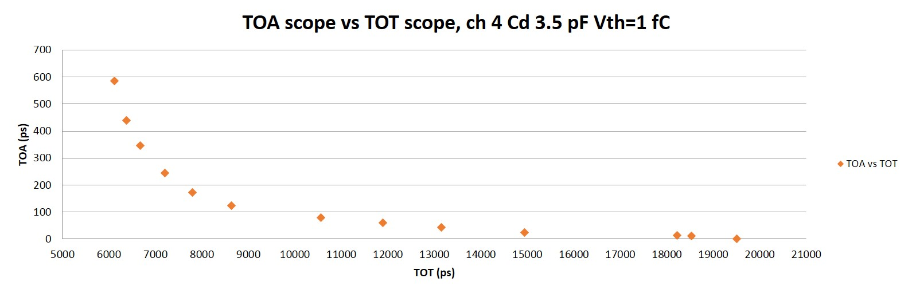
TOA vs TOT of ALTIROC1_V1 measurement
Measurements done with scope as TOT TDC didn’t work properly in Altiroc1_V1

Slide 18
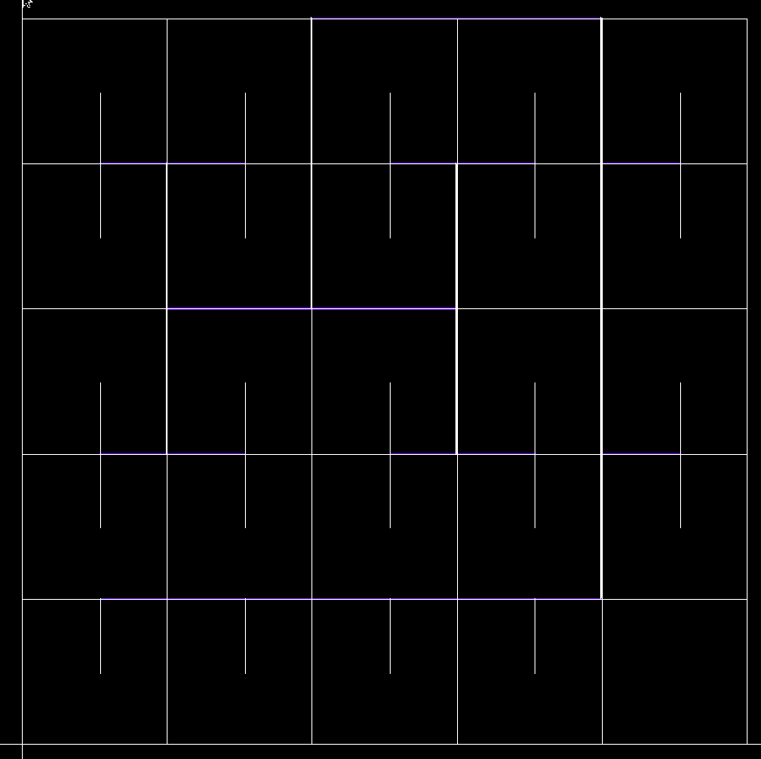
CK tree measurement
Clock tree (pulser command, clocks): good distribution for 4x4 channels
VPA
VPA
VPA
VPA
TZ
TZ
Ch 0
Ch 5
Ch 10
Ch 15
Ch 20
ck0
ck1
ck2
ck3
ck4
VPA
VPA
RMS = 18 ps ± 4ps
VPA
TZ
TZ
Ch 1
Ch 6
Ch 11
Ch 16
Ch 21
Ch8: to be checked on another ASIC
VPA
TZ
VPA
VPA
VPA
TZ
VPA
VPA
VPA
TZ
TZ
VPA
VPA
VPA
TZ
TZ
Ch 2
Ch 7
Ch 12
Ch 17
Ch 22
ck5
ck6
ck7
ck8
VPA
VPA
VPA
TZ
TZ
ck9
Ch 3
Ch 8
Ch 13
Ch 18
Ch 23
VPA
VPA
TZ
TZ
VPA
VPA
ck11
ck11
ck10
ck10
VPA
VPA
VPA
TZ
TZ
Ch 4
Ch 9
Ch 14
Ch 19
Ch 24
VPA
VPA
TZ
TZ
VPA
VPA
VPA: Voltage preamp
TZ: Transimpedance preamp
VPA
VPA
VPA
TZ
TZ

Slide 19
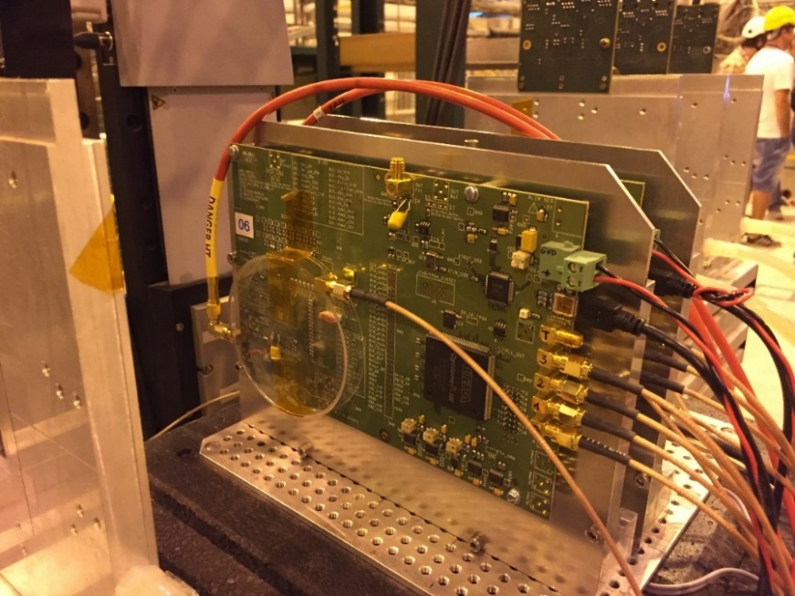
TEST BEAM measurements with Altiroc0_V2 (Oct. 2018)
Time resolution of a 2x2 x1x1 mm2 LGAD array bump bonded on an Altiroc0 ASIC as a function of the discri threshold (DAC Units) before (black points) and after TW correction (red points)
VPA
VPA
VPA
VPA
VPA
VPA
VPA
Time reference given by SiPM
with a time resolution = 40 ps ,
which has been substracted
30 % improvement after TW correction
Jitter around 35 ps
VPA
VPA

Slide 20
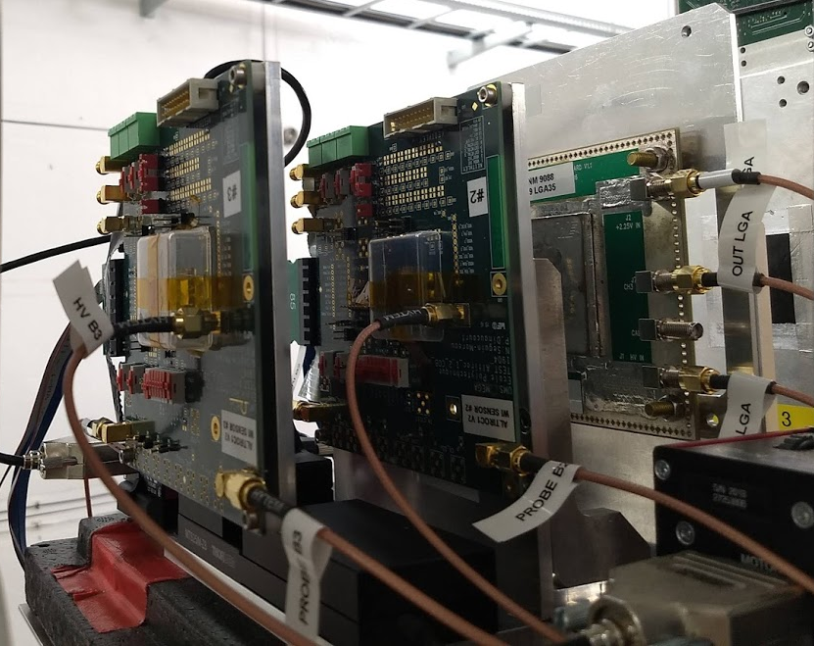
TEST BEAM measurements with Altiroc1_V2 (19-25 Aug. 2019)
LSB =20 ps

Slide 21
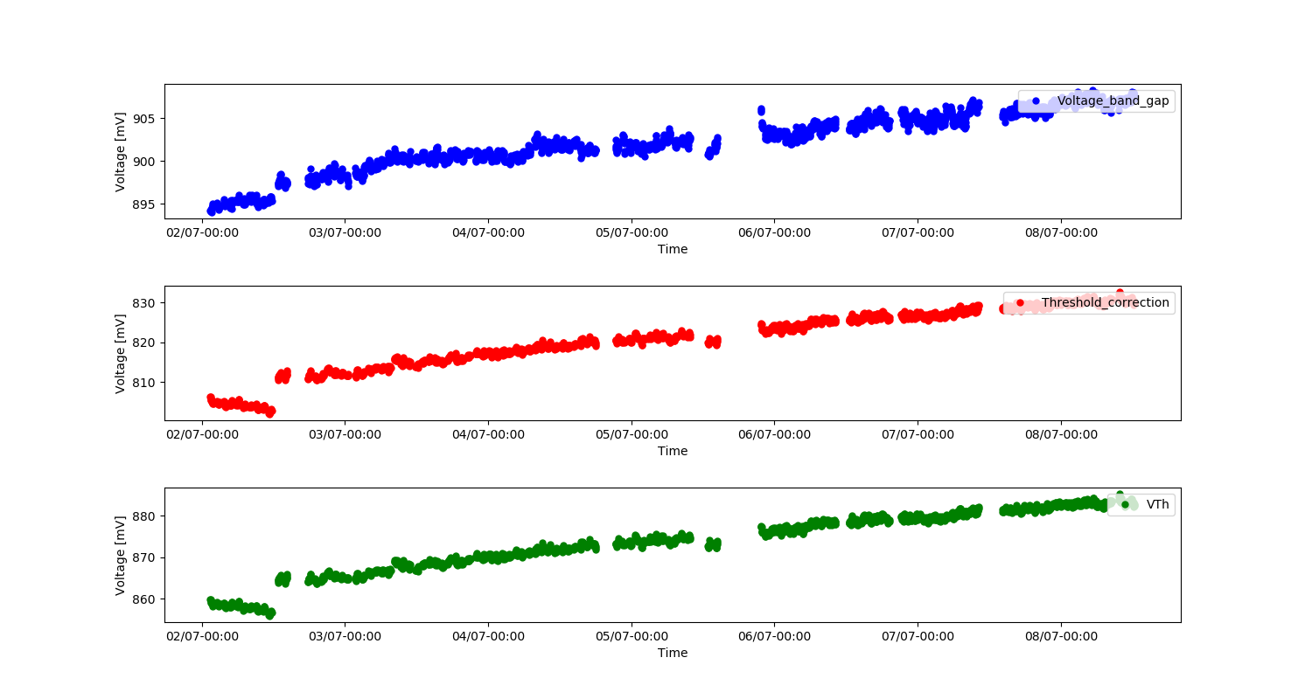

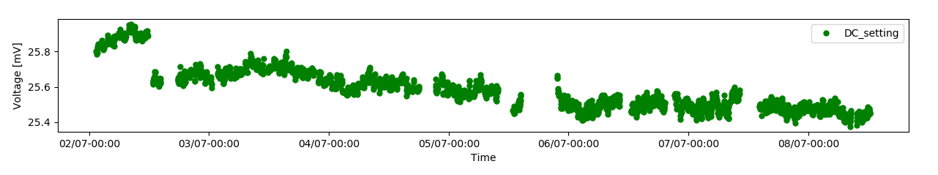
Irradiations tests with Altiroc1_V1 (June 28- July 8, 2019)
CERN facility, TID up to 340 Mrad
VPA
VPA
20 mV
V bandgap
VPA
DC internal pulser
0.3 mV
VPA
VPA
20 mV
7 bit DAC (Threshold correction)
VPA
VPA
20 mV
VPA
10 bit DAC (Threshold setting)
Slope bef and after irrad: - 0,4 mV/DACU
VPA
20 Mrad
340 Mrad

Slide 22
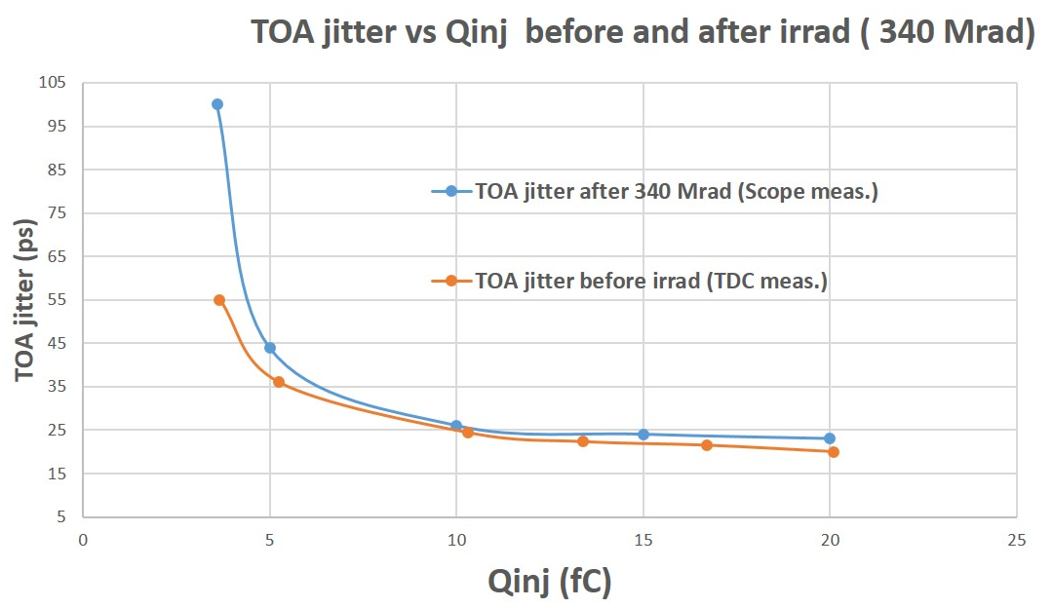
Irradiation tests with Altiroc1_V1 (June 28 – July 4, 2019)
TOA jitter could be measured up to 23 Mrad but then water pb on the setup … => TDC didn’t work anymore
=> Measurements (after 340 Mrad) of the jitter vs Qinj performed on scope (using discri output) and compared to measurements performed with the TDC done on the very same channel before irrad: 45 ps jitter @ Qinj=5 fC after TID to be compared with 35 ps obtained before irrad.
VPA
VPA
VPA
VPA
VPA
VPA
VPA
Test of PLL (designed by OMEGA) used in the phase shifter after irrad. Ref clock = 40 MHz. After 340 Mrad, PLL can still lock up to 50 MHz
VPA
VPA

Slide 23
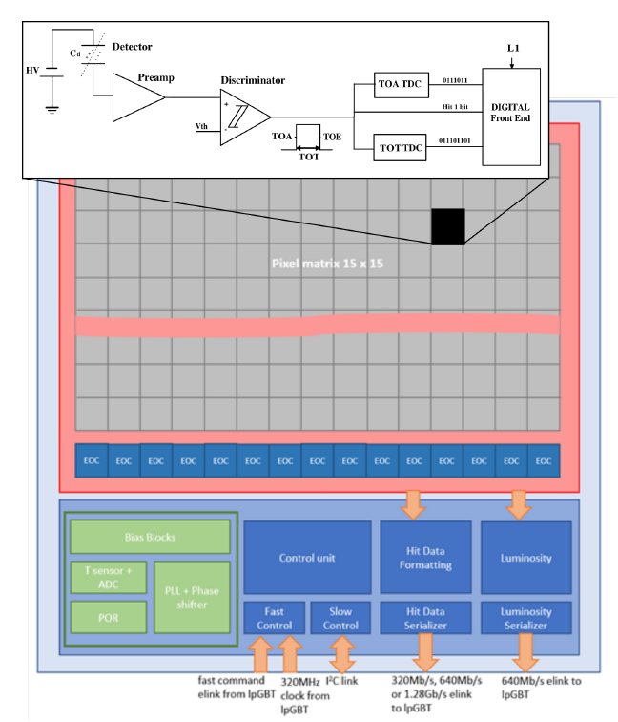


Summary and next steps
See Raimon Casanova’s poster (152):
« ALTIROC2, a readout ASIC for the HGTD in ATLAS »
  ALTIROC0 and ALTIROC1 prototypes crucial to measure the analog performance, which is rather good (25 ps @ 10 fC) but still a lot of measurements to be done in particular with the sensor (testbench and testbeam)
  Still points to be understood:
    Leakage currents in the DLL and the internal pulser
  Next steps: ALTIROC2 with 225 channels (1.3 x 1.3 mm2 LGAD pixels) to be submitted in Jan. 2020
    Digital part quite complicated (IFAE, IHEP and LPC Clermont)
    Analog part performance vs 2x2 cm2 ASIC
    Plan to combine « Digital On Top » for matrix part (with an exclusion area for 1/3 of the pixel = PA + Discri + TDC) and « Analog On Top » design for off pixel electronics and the floorplan (distribution of the power supplies)

Slide 24
BACKUP

Slide 25
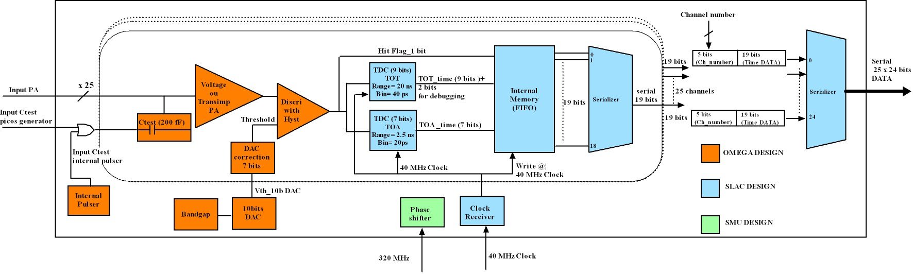
ALTIROC1 prototype (June 2018 submission)
ALTIROC1 = Second ALTIROC ASIC prototype with 25 complete FE channels to readout 5 x 5 sensor cells of 1.3 mm x 1.3 mm (6.5 mm x 6.5 mm) + Phase shifter
3 Labs involved: OMEGA (analog Part, floorplan), SLAC (Digital part: TDC and FIFO), SMU (Phase shifter)
ASIC size: 7,5 x 7 mm² taking into account the pads on the right side of the ASIC (7.5 mm) and also pads (for bias, probes ...) on the top side for debug (top pads only for this prototype version)

Slide 26
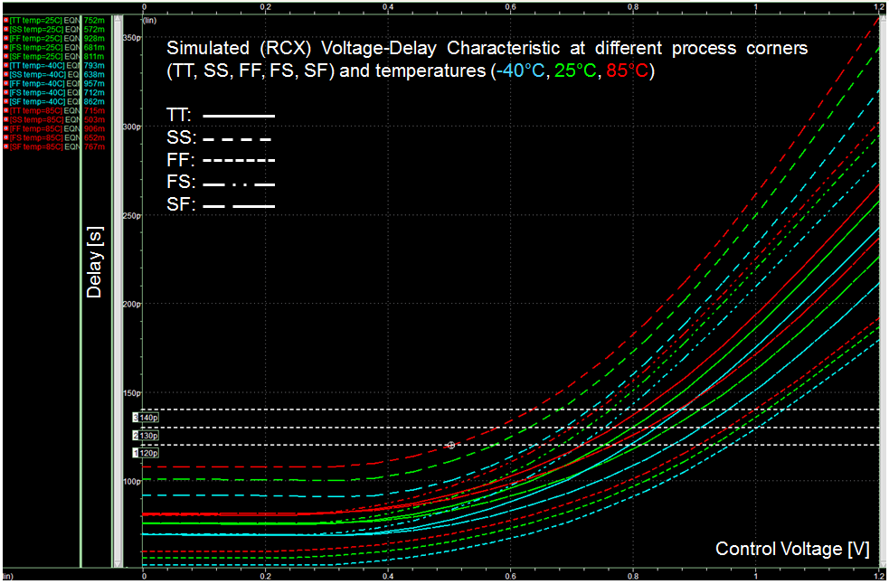
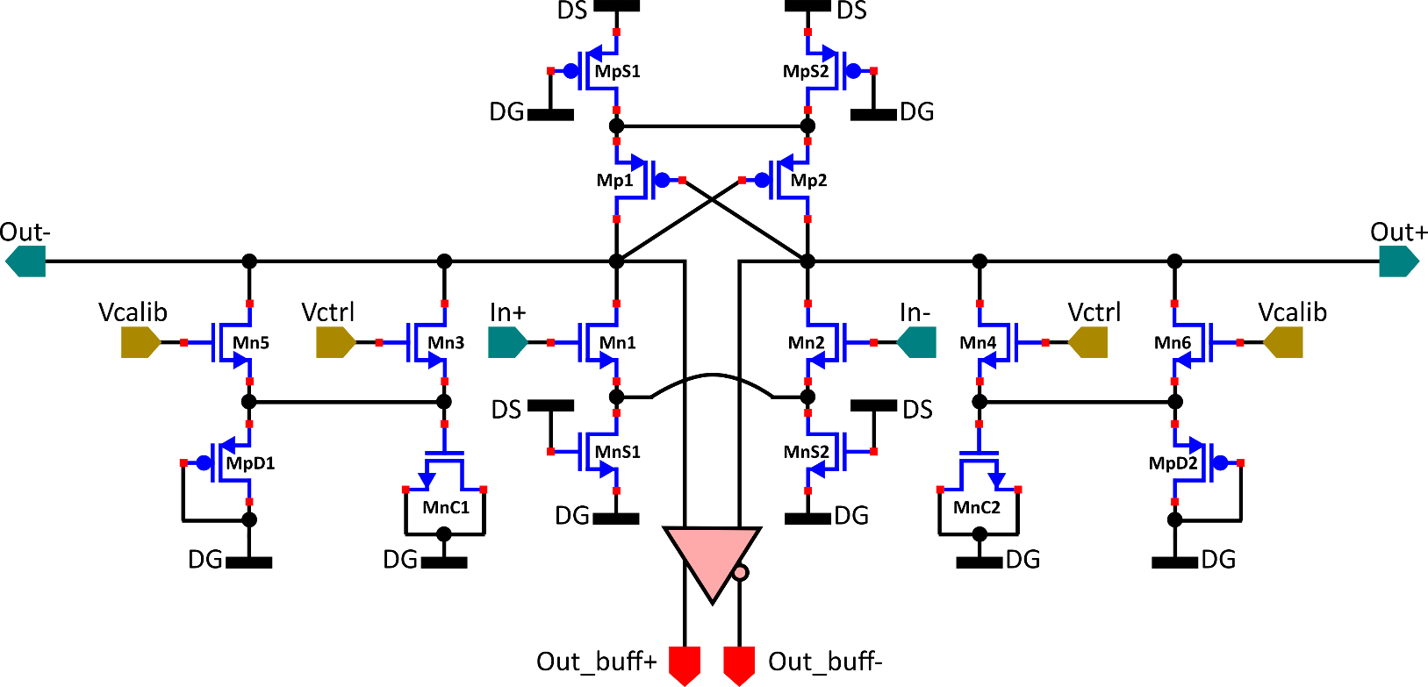
Voltage-Controlled Delay Cell
@ Bojan Markovic, SLAC
Differential Shunt-Capacitor Delay Cell:
  Differential architecture: reduced jitter and improved supply noise rejection.
  Additional source transistors for supply noise rejection.
  Compared to Current-Starved approach, the Shunt-Capacitor approach guarantees a more contained and linear Voltage-Delay characteristic with benefit of reducing jitter due to control voltage noise and ripple.
  The MOS diodes in parallel to MOS capacitors prevent leakage currents from altering the capacitor voltage, thus improving delay accuracy.
  Additional delay-control transistors for trimming/calibration purposes.
  Separate buffered outputs for time measurement operations.

Slide 27
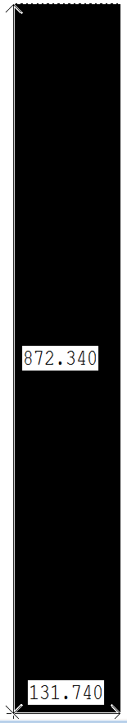
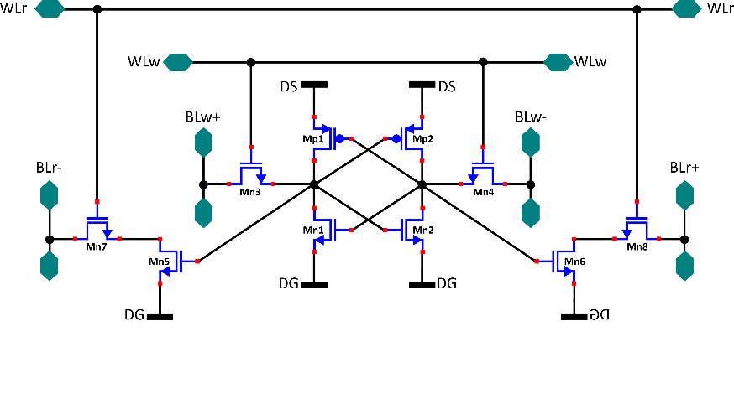

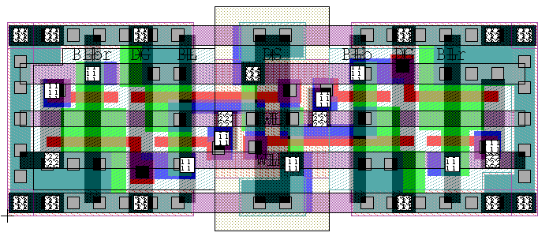
Local FIFO 19x400 (SRAM)
Layout:
SRAM Cell (10T configuration):
SRAM word length: 19bits
  1 HIT bit
  7 TOA bits
  9 TOT bits
  2 extra debugging bits:
    TOA overflow bit
    1 extra Vernier TDC bit for TOT measurement
SRAM depth: 400 (10µs data)
Standard 6T cell Configuration
Additional buffers in order to allow for simultaneous Read/Write operation within the same clock period.
+
+
+
+
Dimensions:
6.57um x 2.18um = 14.3226um^2

Slide 28
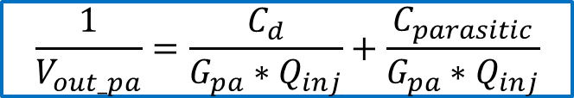
ALTIROC1: jitter and out_pa amplitude vs Cd Vth = 1 fC
Jitter increases with Cd as expected
Amplitude goes as 1/Cd as expected
$$\frac{1}{V_{out_pa}}=\frac{C_{d}}{G_{pa}∗Q_{inj}}+\frac{C_{parasitic}}{G_{pa}∗Q_{inj}}$$

Slide 29
ALTIROC1: TOA jitter vs Qinj (VPA), Cd=3.5 pF Vth = 1 fC and 2 fC
Jitter decreases with Qinj and is better for larger Vth as expected

Slide 30
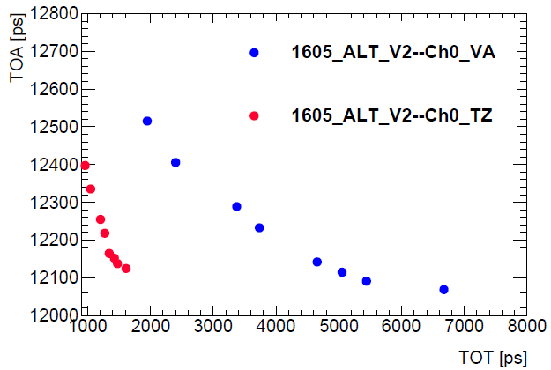
VPA jitter vs TZ jitter (Altiroc0_V2)

Slide 31
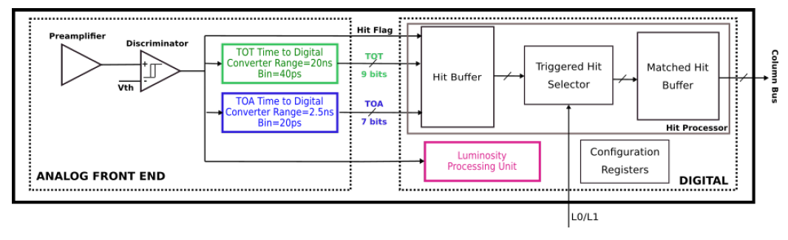
Single-channel readout in ALTIROC2

Slide 32
POWER CONSUMPTION
Power consumption requirement: MAX= 300 mW/cm2 => 1.2W/ASIC (2X2 cm2)
200 mW for the common digital part
=> Max 1W /225 = 4,4 mW / channel
PA + Discri + 2 TDC of one channel = (570 +60) µA + 350 µA + 2* 0,4 mA = 1,8 mA or 2,2 mW (= vdda)
2.2 mW (= vddd) for all the digital part of the channel (Hit buffer, ck trees, lumi block etc)

Slide 33
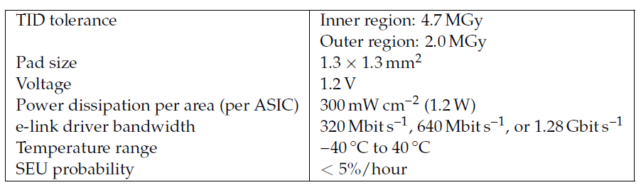
Requirements
9.5 MGy
2.7 MGy
=> Cd ~ 4 pF
=> ~ 4 mW/channel
@ Cd= 4 pF

Slide 34
Connections between ASIC and DAQ
Peripheral boards: flex connectors, DC DC converters for LV and HV voltages. LpGBT for data transmission and optical modules. 3 sets of optical links. Down links for slow control (in red) connected to the FELIX boards in USA15 and up links for the offline data. The uplinks for the lumi data go to dedicated back-end boards

