Slide 1





CHEF 2019
Performance study of HGCROC-v2
G. Bombardi, J. Borg, F. Bouyjou, E. Delagnes, F. Dulucq, M. El Berni, M. Firlej, T. Fiutowski, F. Guilloux, M. Idzik, C. de La Taille, A. Marchioro, J. Moron, L. Raux, K. Swientek, D. Thienpont, T. Vergine

Slide 2
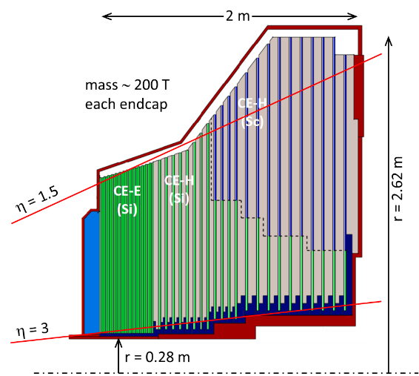
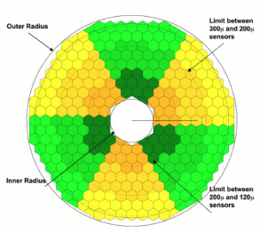
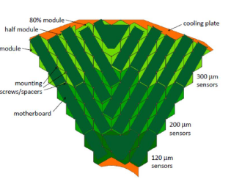
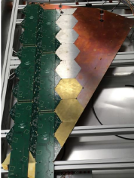
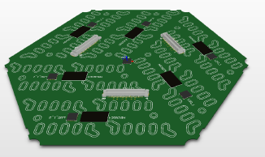
HGCAL: CMS EndCap Calorimeters for the LHC Phase-II upgrade
New Endcap Calorimeters
Rad. Tolerant
High Granularity: increased transverse and longitudinal segmentation, needed to mitigate pileup effects to select events with a hard scatter process at L1-Trigger and to identify the associated vertex and particles
Precise timing capability: further mitigation of pileup effects

Slide 3
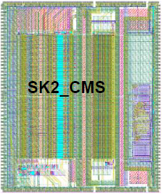


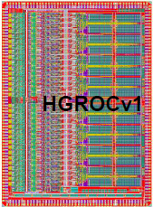
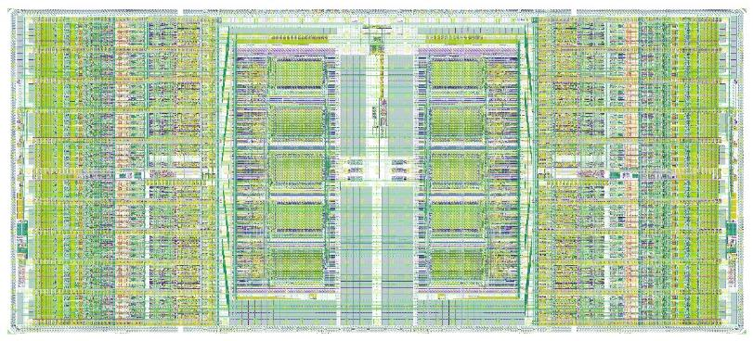
Development history
Jan 16: SKIROC2_CMS [TWEPP 2016]
  SiGe 350 nm 7x9 mm²
  Dedicated to test beam and analog architecture (TOT)
May 16: 1st test vehicle TV1
  CMOS 130 nm 2x1 mm²
  Dedicated to preamplifier studies
Dec 16: 2nd test vehicle TV2 [TWEPP 2017]
  CMOS 130 nm 4x2 mm²
  Dedicated to technical proposal analog channel study
July 17: HGCROCv1 [TWEPP 2018]
  CMOS 130 nm 5x7 mm²
  All analog and mixed blocks; large part of digital blocks
Feb 19: HGCROCv2 (this talk)
  CMOS 130 nm 15x6 mm²
  Silicon and SiPM versions (for both 2 and 2A)
  Final size, packaging and I/Os
HGCROCv2

Slide 4
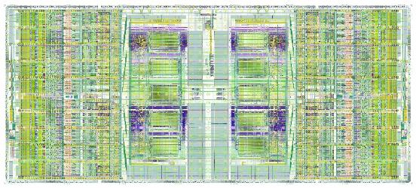

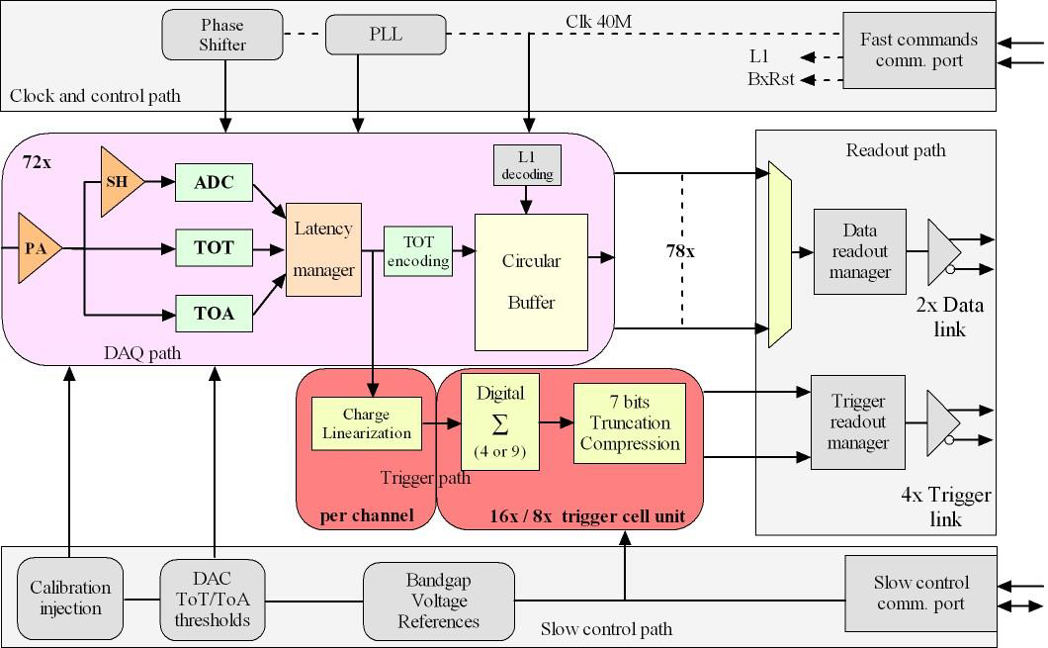
HGCROCv2 overview
Overall chip divided in two symmetrical parts
1 half is made of:
  39 channels: 18 ch, CM0, Calib, CM1, 18 ch (78 channels in total)
  Bandgap, voltage reference close to the edge
  Bias, ADC reference, Master TDC in the middle
  Main digital block and 3 differential outputs (2x Trigger, 1x Data)
Measurements
Charge
  ADC (AGH): peak measurement, 10 bits @ 40 MHz, dynamic range defined by preamplifier gain
  TDC (IRFU): TOT (Time over Threshold), 12 bits (LSB = 50ps)
  ADC: 0.2 fC resolution. TOT: 2.5 fC resolution
Time
  TDC (IRFU): TOA (Time of Arrival), 10 bits (LSB = 25ps)
Two data flows
DAQ path
  512 depth DRAM (CERN), circular buffer
  Store the ADC, TOT and TOA data
  2 DAQ 1.28 Gbps links
Trigger path
  Sum of 4 (9) channels, linearization, compression over 7 bits
  4 Trigger 1.28 Gbps links
Control
Fast commands
  320 MHz clock and 320 MHz commands
  A 40 MHz extracted, 5 implemented fast commands
I2C protocol for slow control
Ancillary blocks
Bandgap (CERN)
10-bits DAC for reference setting
11-bits Calibration DAC for characterization and calibration
PLL (IRFU)
Adjustable phase for mixed domain

Slide 5
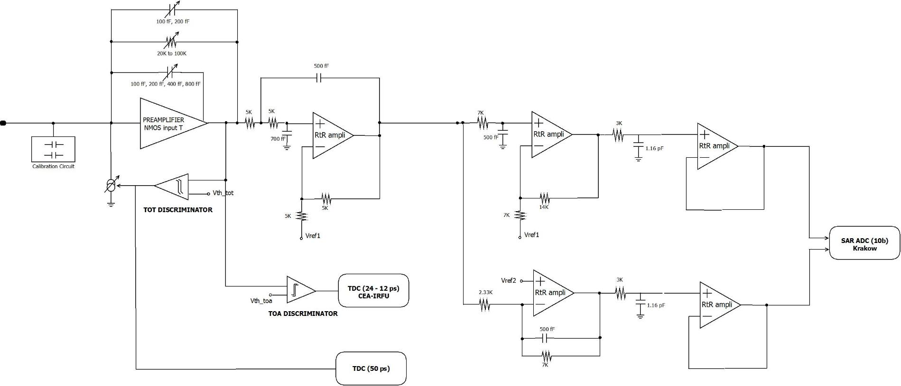
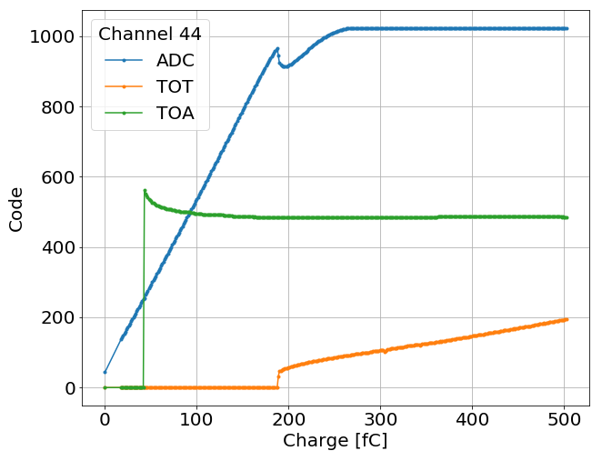
Analog Channel Overview + montrer schema pour SiPM
New calibration pulser, 0.5pF and 8 pF calibration cap.
Preamp : adjustable gains for 80, 160 and 320 fC ranges
Tunable TOT over 5 bits
Compensation for the leakage current, 10 µA max. (not shown in the figure)
Sallen Key shaper RC4, tp<25 ns, tunable (~20%) with 2 bits, BX+1/BX<0.2
Temperature stabilization to < 0.5 mV/K
10 bit ADC from Krakow AGH
TOT and TOA TDCs from CEA-IRFU
Total analog power (static, without ADC and TDCs): 5.5 mW (typ)

Slide 6
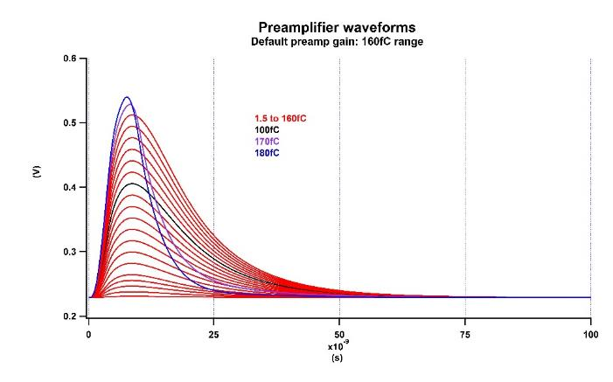
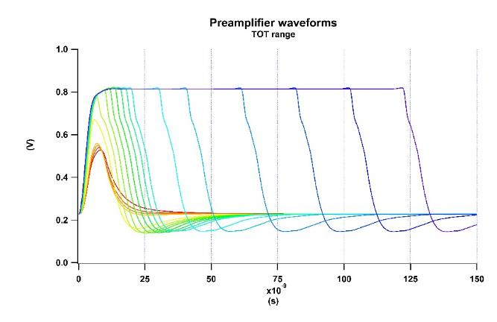
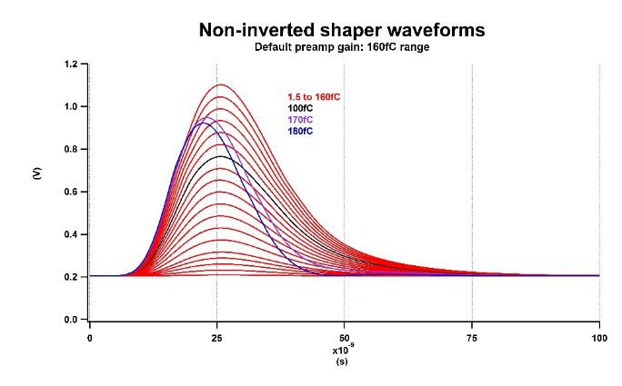
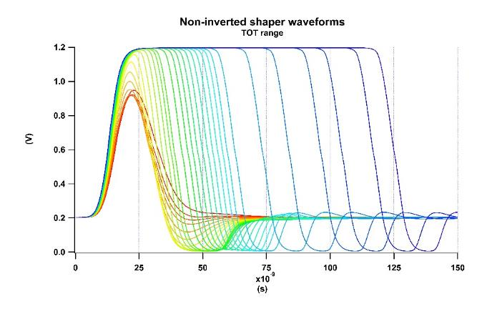
Analog waveforms (Simulations)
Charge measurements
  From ADC in the linear range of the preamplifier, at the shaper outputs
  From TOT when preamplifier saturates, at the preamplifier output
Time
  At the preamplifier outputs

Slide 7
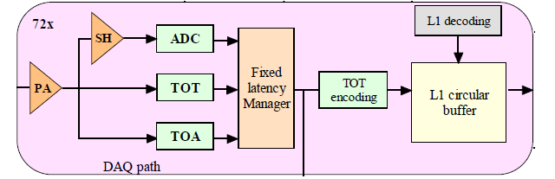
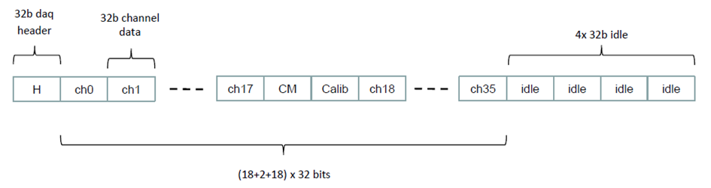

DAQ path
ADC, TOA and TOT stored in L1 circular buffer
Only L1-triggered data are read-out
  2 DAQ links, CLPS @ 1.28 Gbps
When no L1 request, Idle packet is send out
The DAQ data frame provides the BX counter and Write address

Slide 8
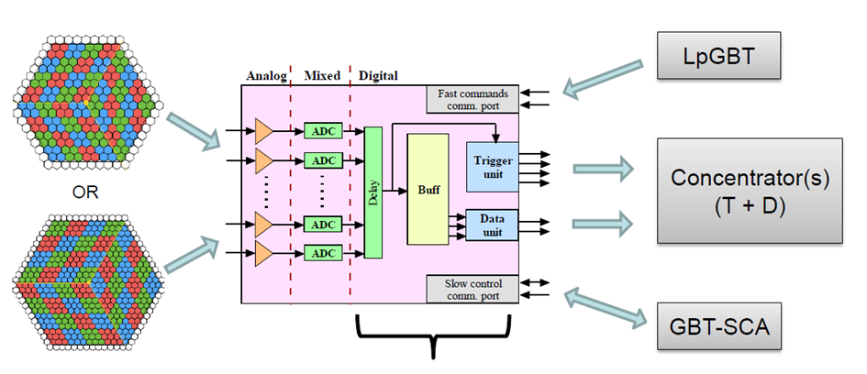
Trigger path
The chip provides compressed data of the charge to the L1 trigger processing
  Charge linearization over ADC / TOT range
  Sum of 4 (or 9) channels (depending on the sensor)
  Charge compression to fit the bandwidth (4b Exponent + 3b Mantissa)
  4 E-link transmitters, CLPS @ 1.28 Gbps
HGCROC2 integrates 72 channels to readout
192 channels sensor with a 64-ch configuration
432 channels sensor with a 72-ch configuration

Slide 9
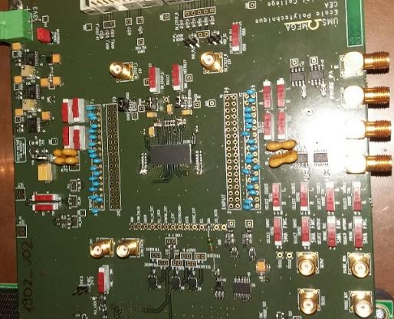
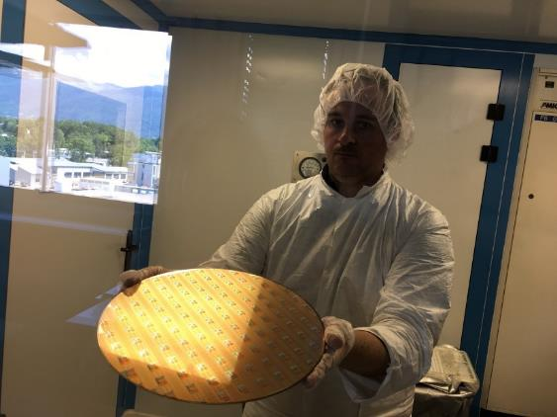
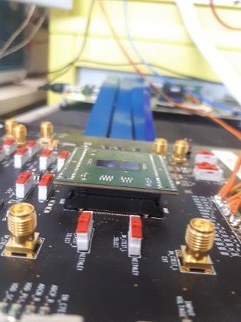
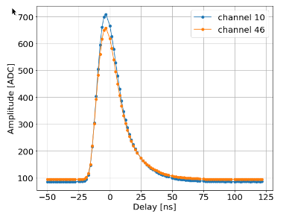
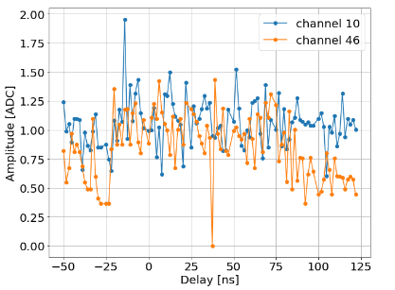
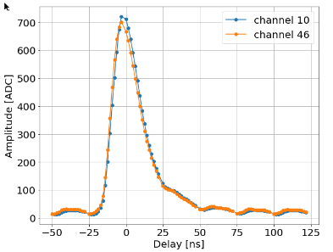
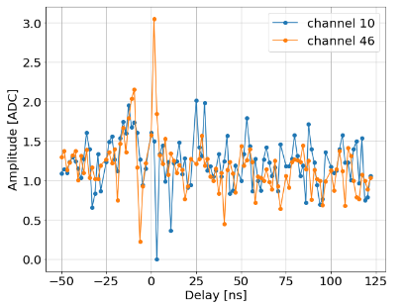
Two Characterization boards
125 fC
Gain = ~0,18 fC/ADCu
125 fC
Gain = ~0,18 fC/ADCu
FlipChip
No digital coupling on preamp inputs
w/o sensor capacitance, noise = ~1 ADC (0.2 fC)
BGA
Digital coupling on preamp inputs (20 ADC; 4 fC)
w/o sensor capacitance, noise = ~1.25 ADC (0.25 fC)

Slide 10
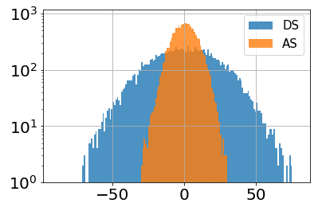
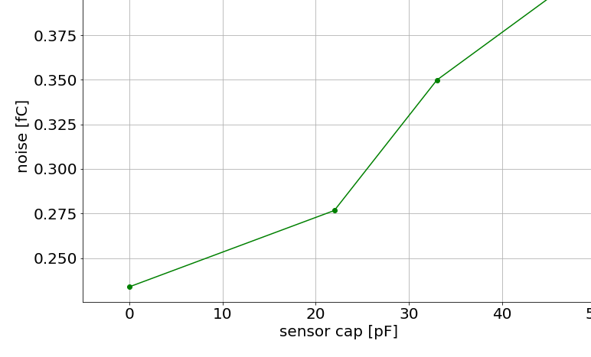
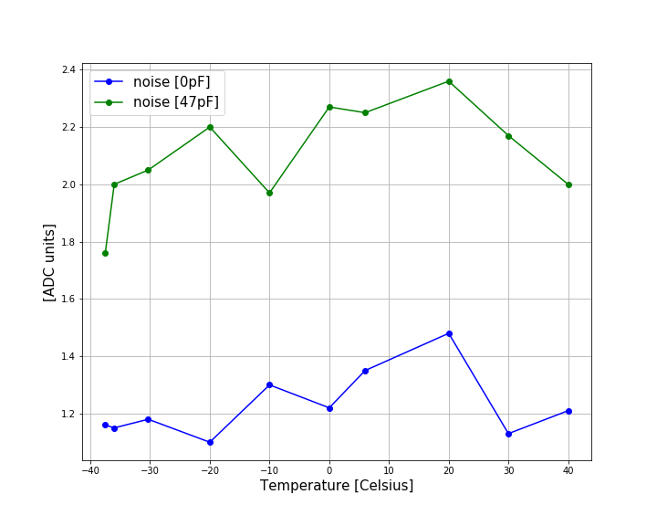
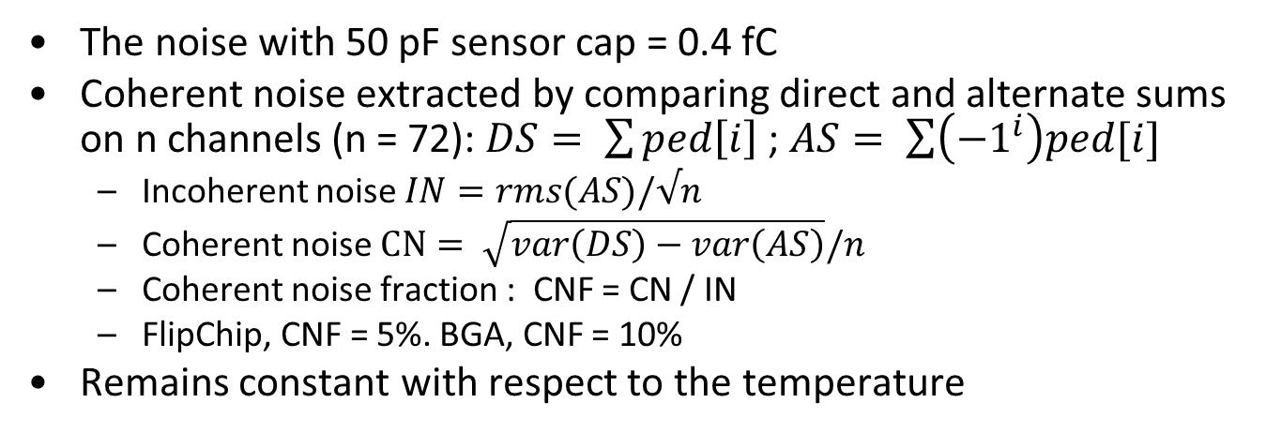
Noise
The noise with 50 pF sensor cap = 0.4 fC
Coherent noise extracted by comparing direct and alternate sums on n channels (n = 72): $DS= \sum{ped\left[i\right]}$ ; $AS= \sum{\left({−1}^{i}\right)ped[i]}$
  Incoherent noise $IN=rms(AS)/√n$
  Coherent noise $CN= \sqrt{var\left(DS\right)−var\left(AS\right)}/n$
  Coherent noise fraction : CNF = CN / IN
  FlipChip, CNF = 5%. BGA, CNF = 10%
Remains constant with respect to the temperature
FlipChip board

Slide 11
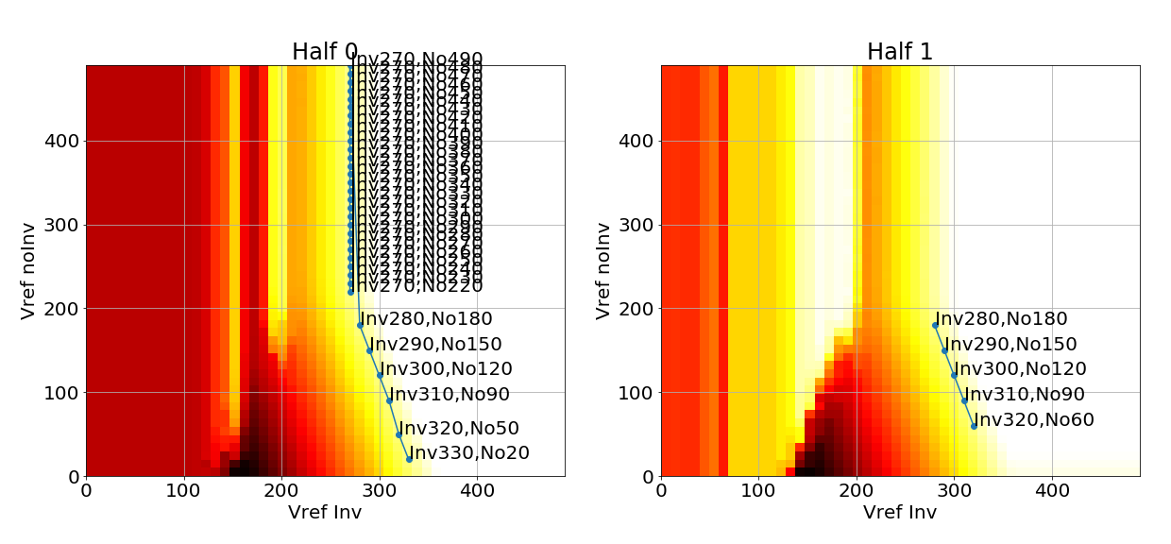
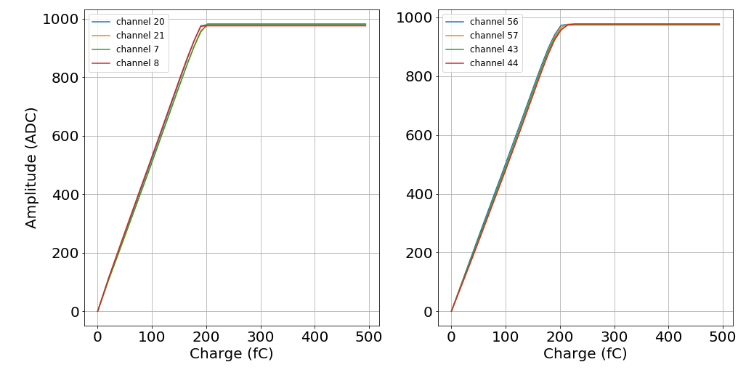
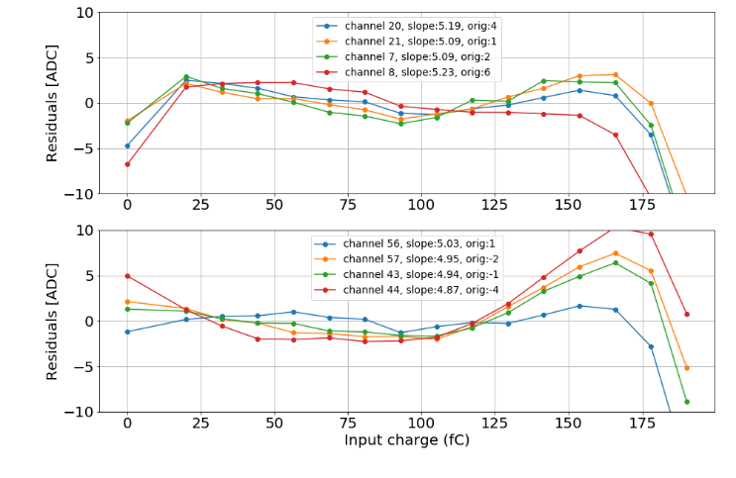
Charge ADC range: linearity, residuals
Two 10b-DAC to globally set the pedestal to a wanted level
5b-DAC to reduce dispersion per channel
Good linearity in-between +/- 1%,

Slide 12
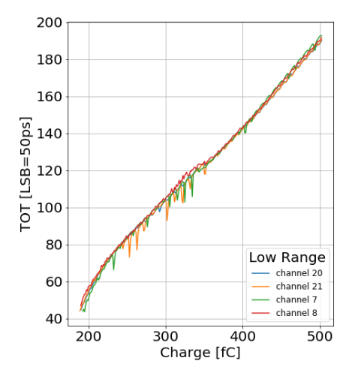
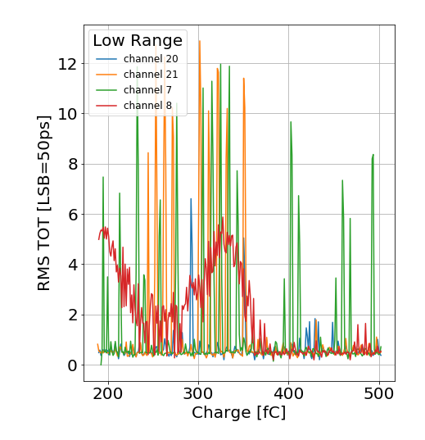
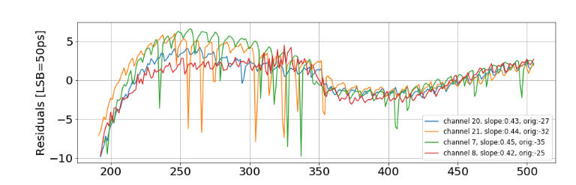
TOT: linearity, noise, residuals [Low Range]
Charge measurement from TOT when preamplifier saturates [LSB = 2.5 fC]
Need fine characterization/calibration of the non-linear part of the TOT
  ~ +/- 250 ps INL
Jitter spikes
  Need channel TDC calibration, not done yet
Digital coupling, TDCs DNL

Slide 13
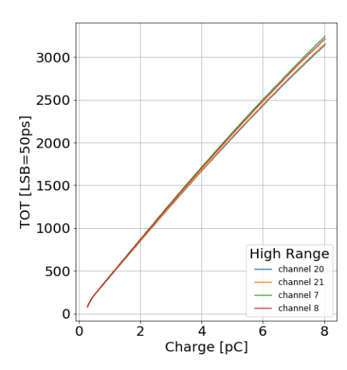
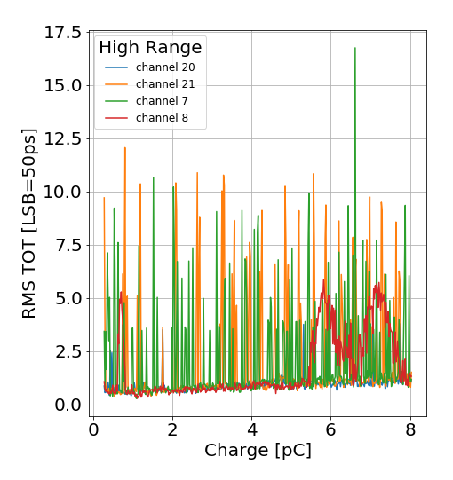
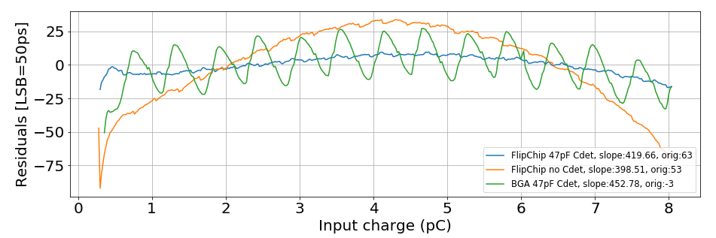
TOT: linearity, noise, residuals [High Range]
Charge measurement from TOT when preamplifier saturates
Linearity
  +/- 1% INL
  Better with sensor capacity (as expected)
But TOT directly sensitive to digital coupling on preamplifier output
  Visible with the BGA
  Need to improve the BGA lead frame
Jitter spikes
FlipChip
FlipChip
FlipChip vs. BGA

Slide 14
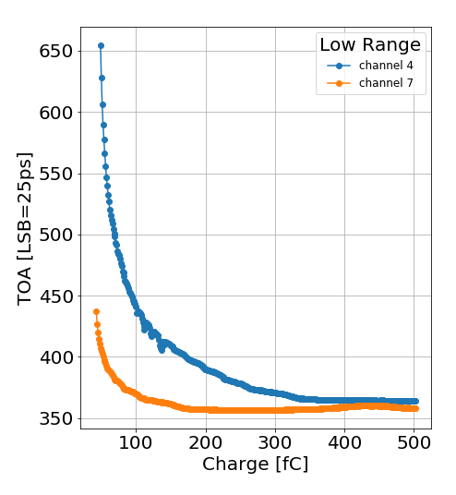
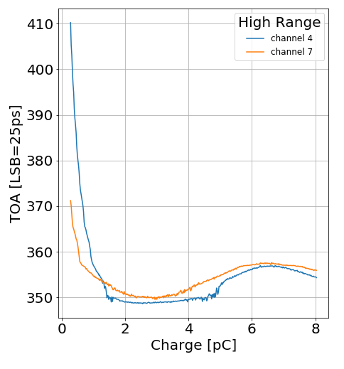
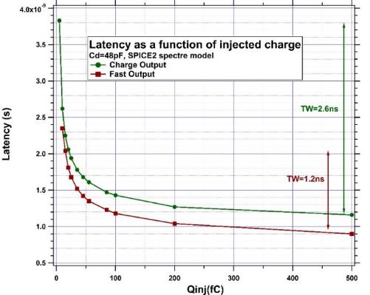
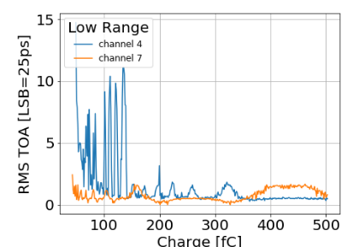
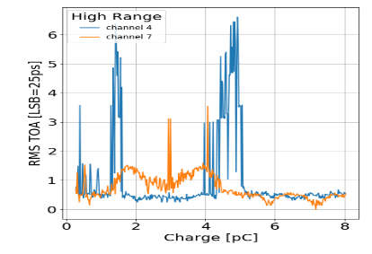
TOA: linearity, noise
Time measurement
2.5 ns Time Walk
Jitter spikes
Simulation

Slide 15
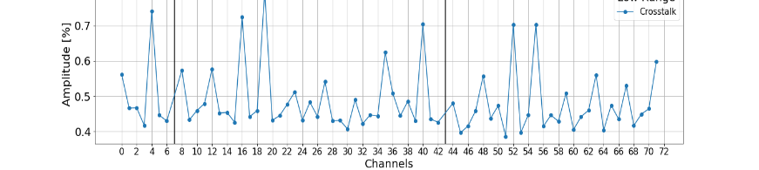
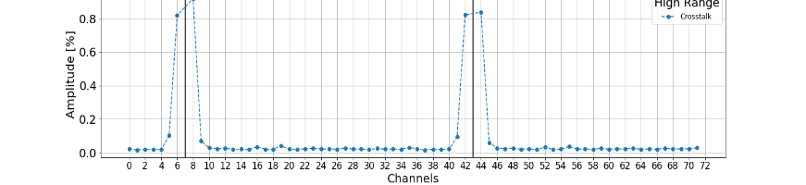
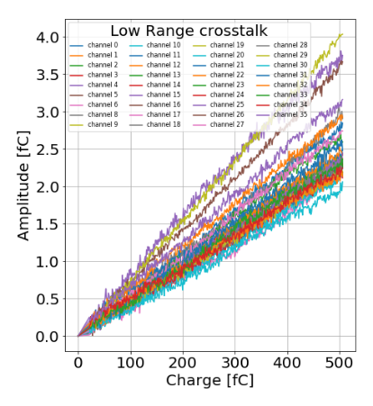
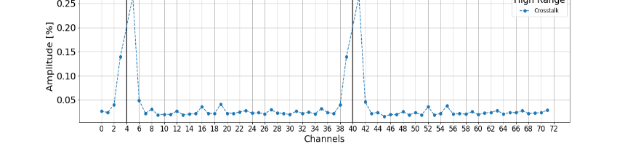
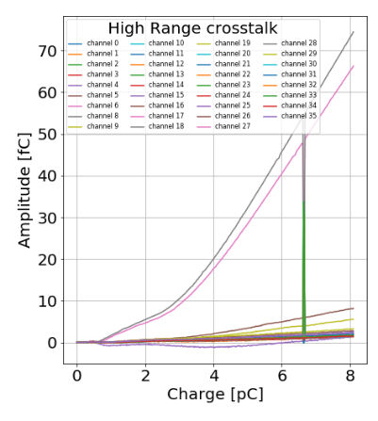
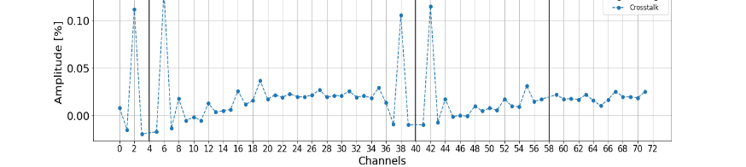

Crosstalk
FlipChip low range
Odd channel
Crosstalk different for FlipChip and BGA
Always < 1%
FlipChip high range
Odd channel
FlipChip high range
Even channel
BGA high range
Even channel
BGA high range
Odd channel

Slide 16



Bandgap and temperature measurements
Bandgap value moves over 2mV between -40°C and +40°C, but lower shift around -20°C
  ~ 6-8 mV increasing after 300 Mrad
Pedestals
  1 ADC/°C in room temperature
  ~ 0.4 ADC/°C around -30°C

Slide 17







TID and SEU tests
Used one thinned chip (70 µm) for TID irradiation
Irradiation to 310 Mrad
  Speed 1.5 Mrad/h, then 3 Mrad/h, counting 25% attenuation
Cooled the chip slightly
The chip still works after irradiation
SEE
First time in the facility (Louvain). Gained experience.
I2C acted as expected: cross section seems to increase with LET and auto-correction makes mismatches go away
Bit shifting in the DAQ link
Detailed analysis required for DRAM, ADC and TDC

Slide 18



TID tests: ADCs
Before irradiation
115 Mrad
From 90 Mrad, ADC1 begins to misbehave, some bits are not converted anymore (LSB)
From 115 Mrad, ADC2 begins to misbehave, the issue seems to come from the adjusted phase since we can see a 40MHz effect
➔ But annealing at room temperature works

Slide 19


TID tests: after annealing
During the annealing, the chip was powered at room temperature
After 310 Mrad (in 5 days)
After 2 days annealing
ADC2
ADC1
ADC2
ADC1
ADC2 has been modified to better resist to the TID

Slide 20




Issues
Non-zero Calibration DAC value
  Due to leakage current (~0.1 µA)
  Not sensitive to temperature or to radiations
  Not seen simulation and extracted views
  Not due to the pad
  Need to be understood, although workarounds possible
High current in vdd_adc_R (70 mA)
  Due to short circuit on vrefn_adc to ground, measured but not seen in schematic
  Probably not useful to have a vrefn_adc different from ground
Calibdac[0]
0.1 % INL

Slide 21
HGCROC-v3: next iteration
Analog blocks
  1 ns phase adjustment for test pulse
  12 bits calibration DAC
  New TDC calibration scheme
Digital blocks
  New 32 depth DRAM for buffering post-L1 data
  Hamming encoding of stored data
  CRC
  Full triplication of FSMs, control logic
Final set of Fast commands

Slide 22
Summary
The summary slide must be improved. What have we learnt so far ? What is the time scale for V3, etc.. Be a bit positive: this is probably one of the most complex ASICs developped for calorimetry, we have made a big step, even if not perfect yet.
« Many, many measurements to be done, with many configurations »
  Si/SiPM, 2/2A, L/R, die/BGA, cold/warm, HG/MG/LG, ADC/TOT/TOA, irrad/non irrad…
Measurements now advancing well on Si 2/2A @CERN, LLR and OMEGA
  Mostly pedestal, noise and ADC linearity.
  Now also with Cd = 47 pF
  TOA/TOT measurements
  Warm and cold (-30°C)
  TID and SEU irradiations encouraging
  Not much difference so far left/right, 2/2A
  Trigger branch to be measured
Measurements starting on SiPM version @DESY and Omega
And in parallel, works well advanced for the next (final) iteration

Slide 23
Backup slides

Slide 24
Preamplifier adjustable gain

Slide 25

ENC vs. Cdet

Slide 26

Calibration 11bits-DAC
Linearity 0,1%
But offset

Slide 27

PLL performances

Slide 28


TOA: linearity, noise [High Range]

