Slide 1
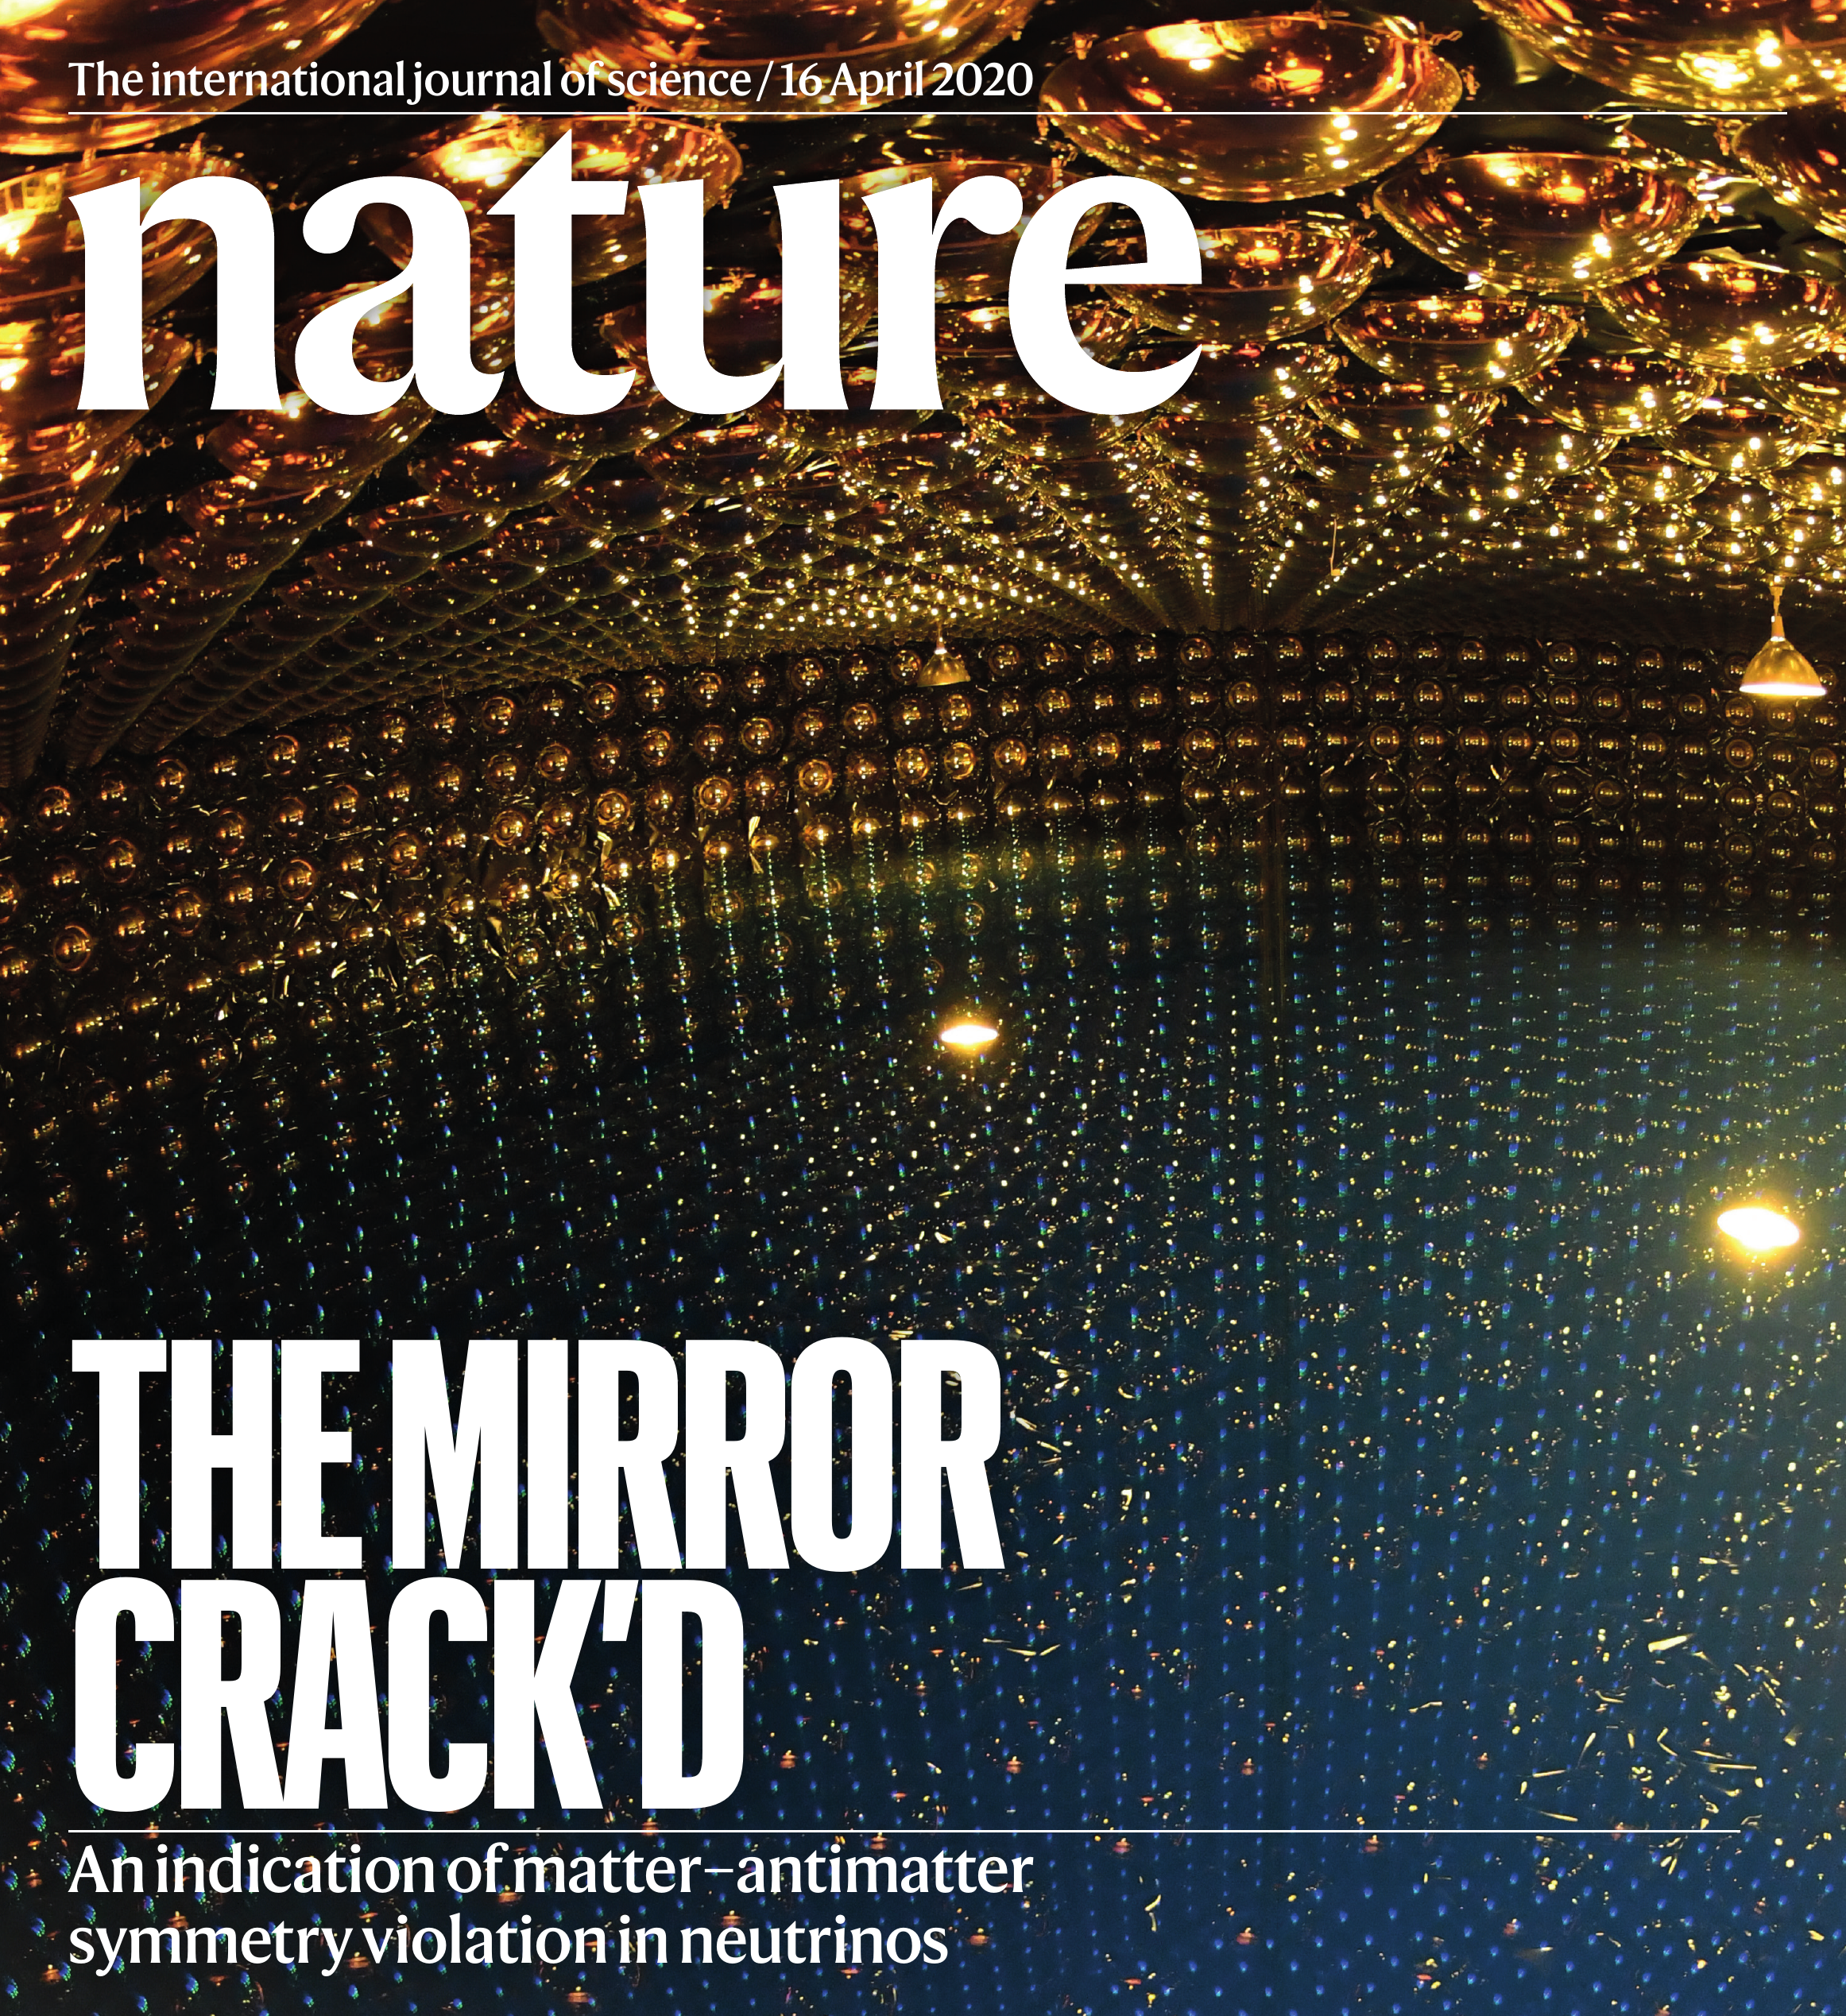
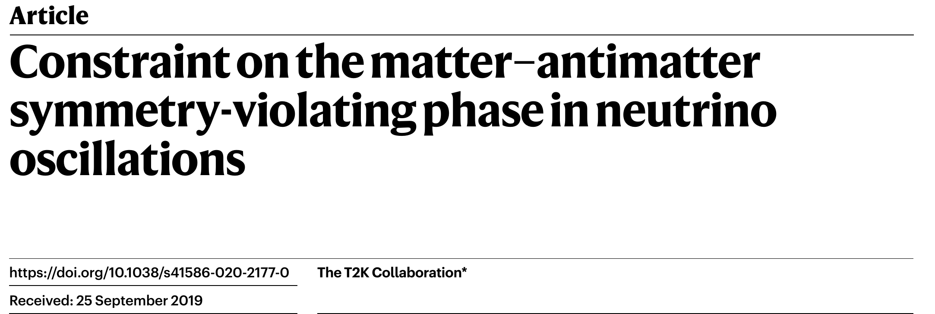
Neutrino: T2K
T2K article recently published in Nature:
https://www.nature.com/articles/s41586-020-2177-0
It can also be found here (for free):
https://rdcu.be/b3Aq6
Nature also posted some supporting content:
News and views:
https://www.nature.com/articles/d41586-020-01000-9
And an editorial:
https://www.nature.com/articles/d41586-020-01022-3

Slide 2
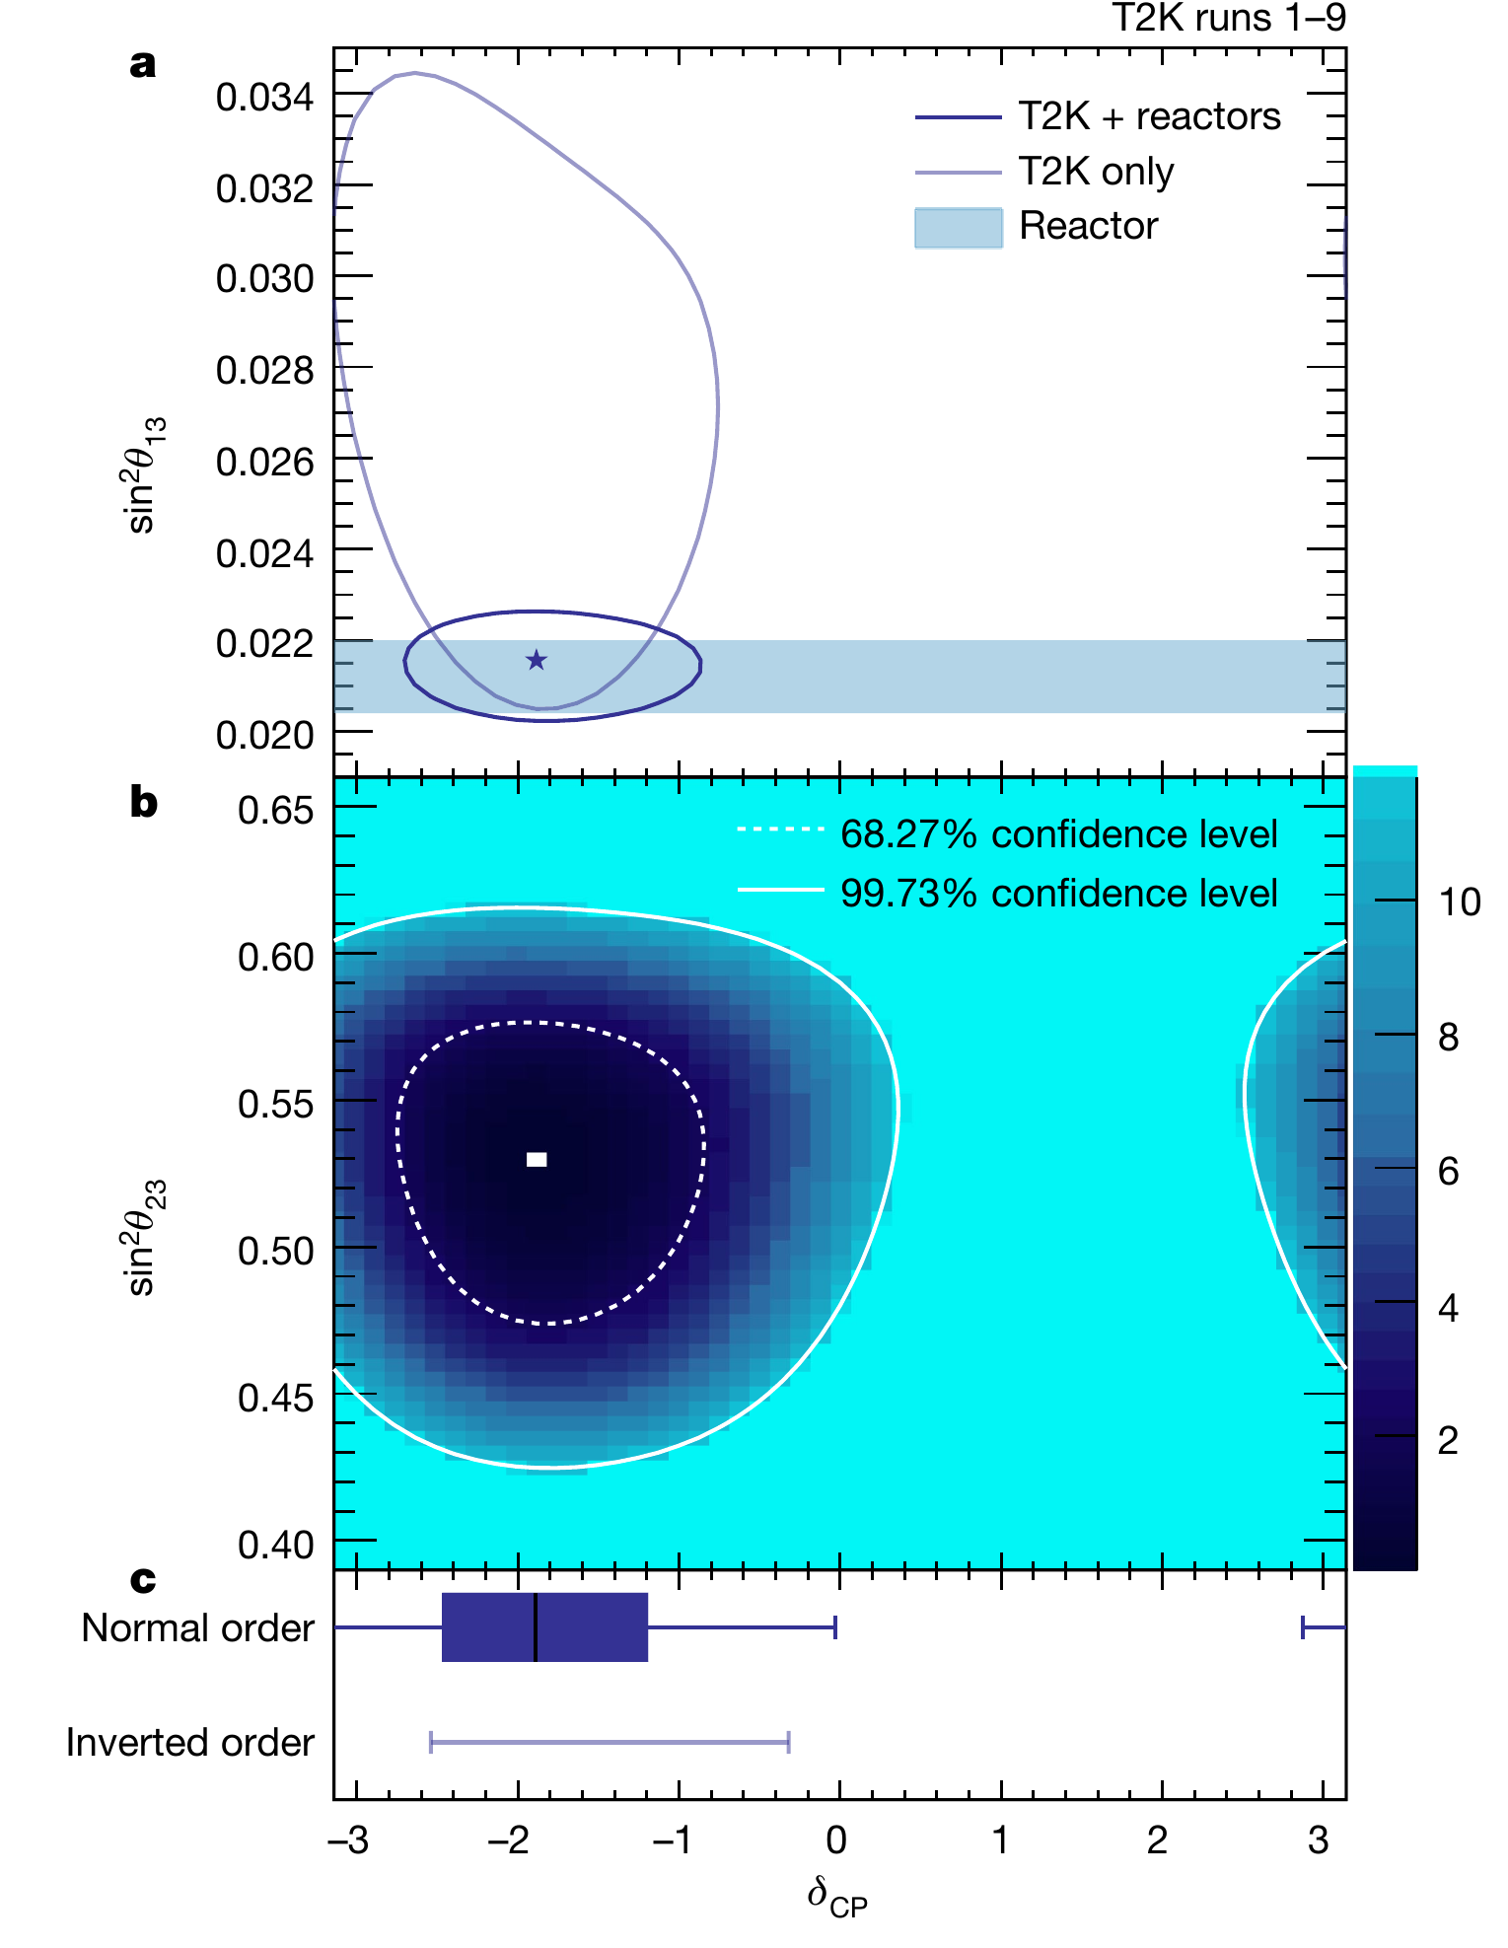
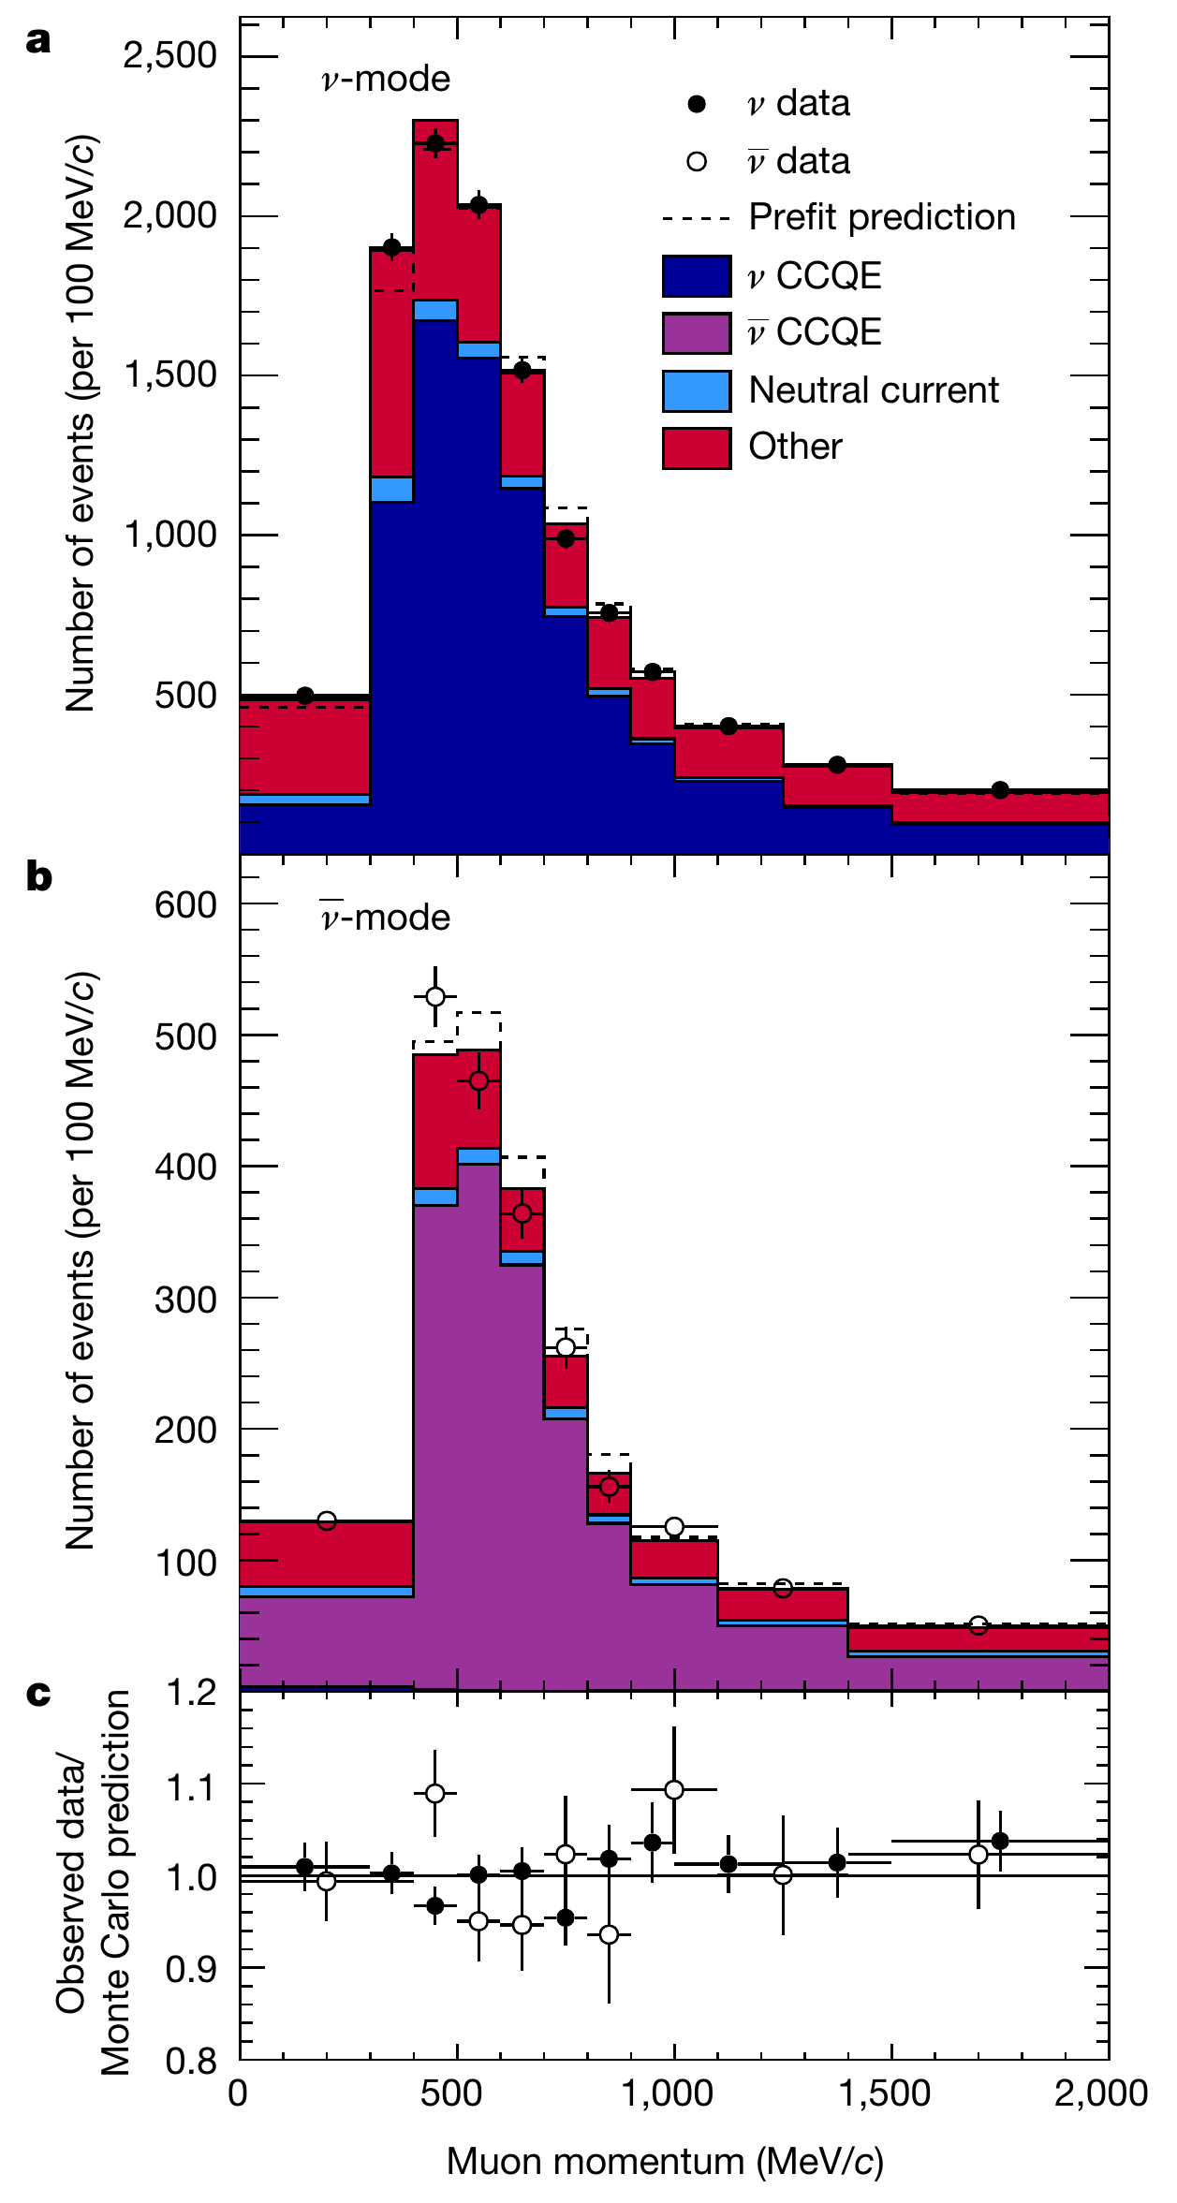
Neutrino: T2K
Important constraints on flux x xsec from
Near Detector (ND280) data and NA61/SHINE
hadron production measurements

Slide 3
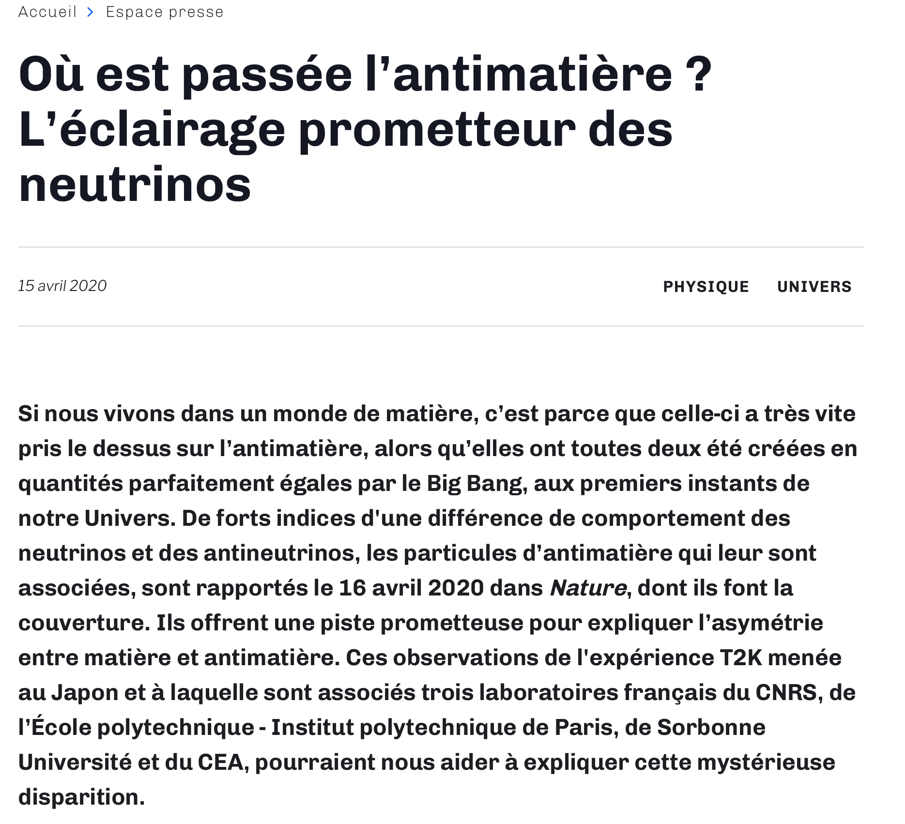
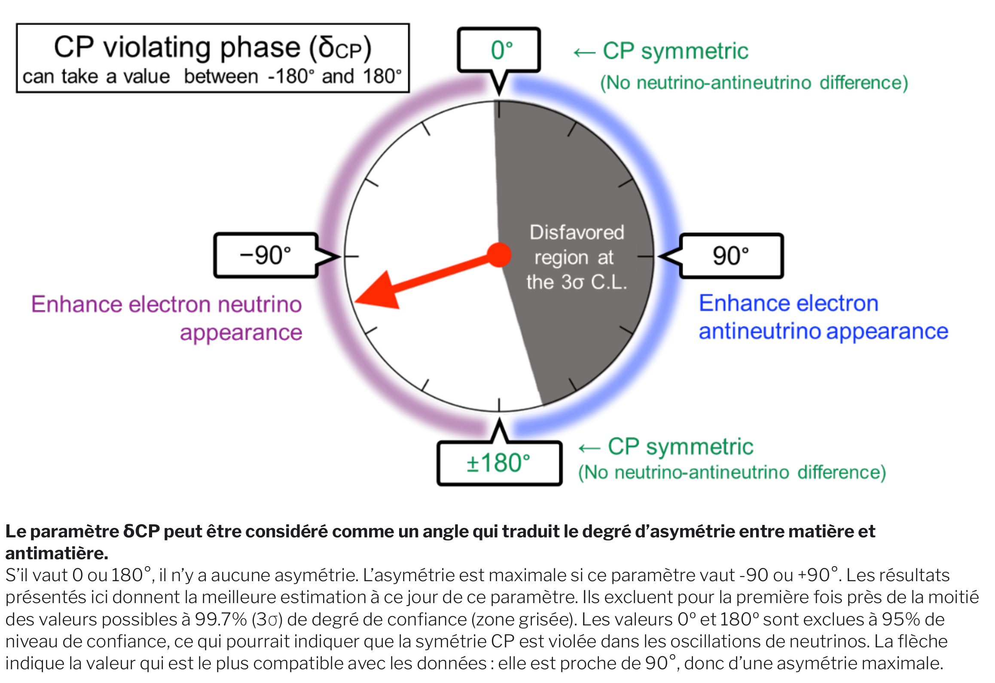
Neutrino: T2K
https://www.cnrs.fr/fr/ou-est-passee-lantimatiere-leclairage-prometteur-des-neutrinos

Slide 4
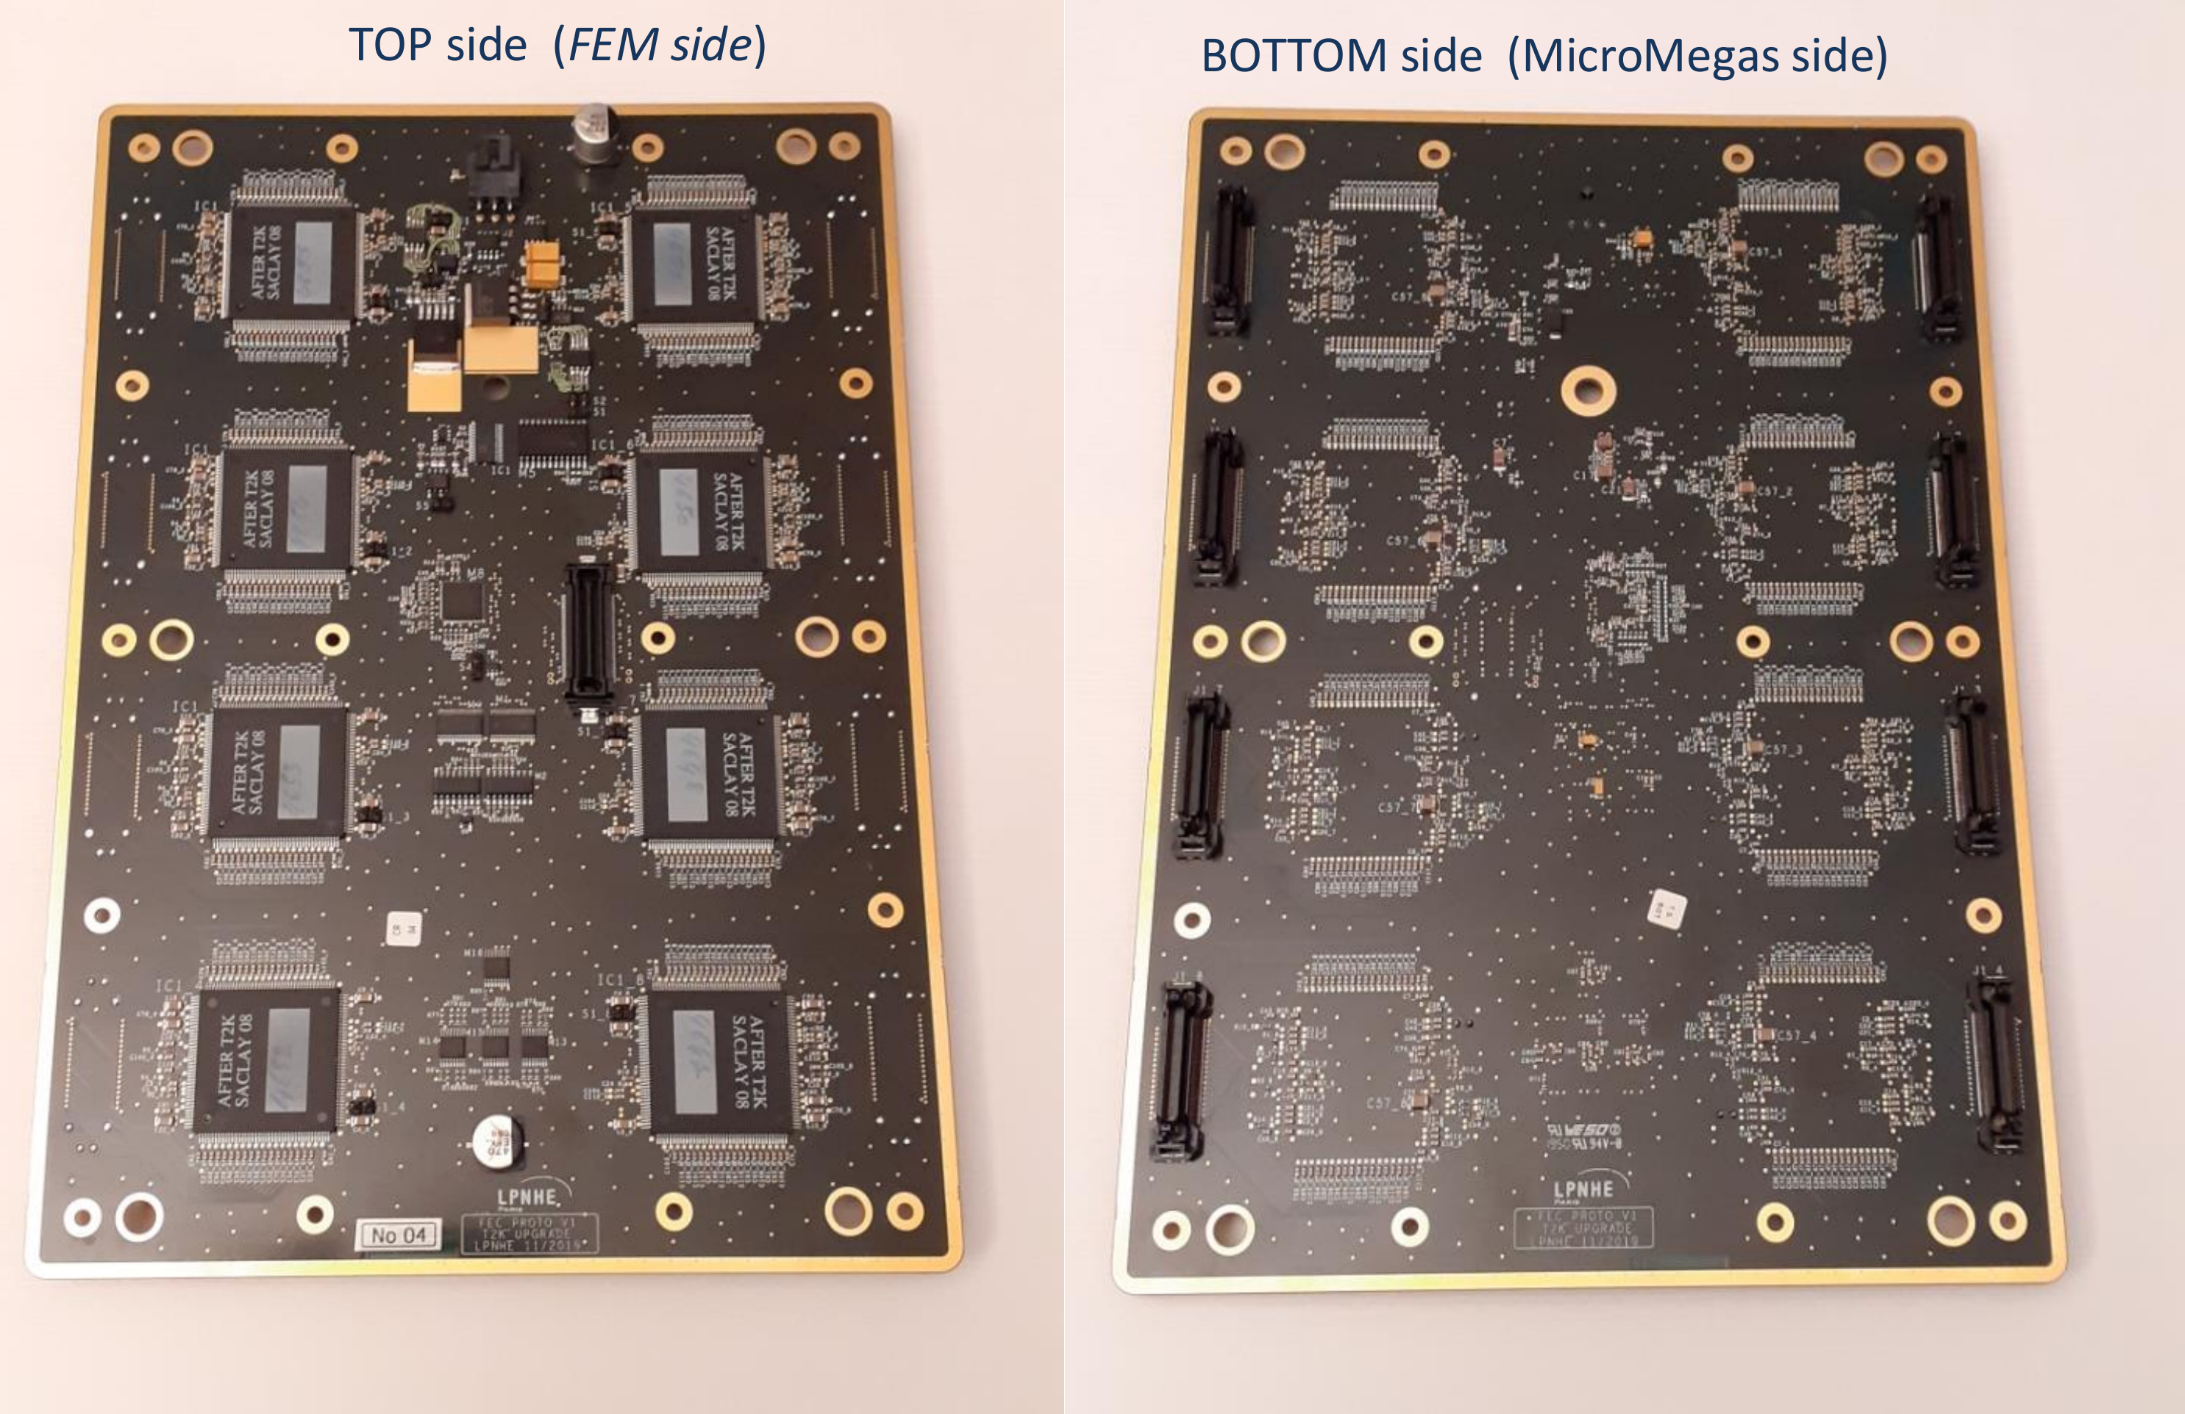
Neutrino: ND280-upgrade
One of the front-end readout boards (FEC) for the new TPCs is being developed at LPNHE.
Prototypes ready and successfully tested.

Slide 5
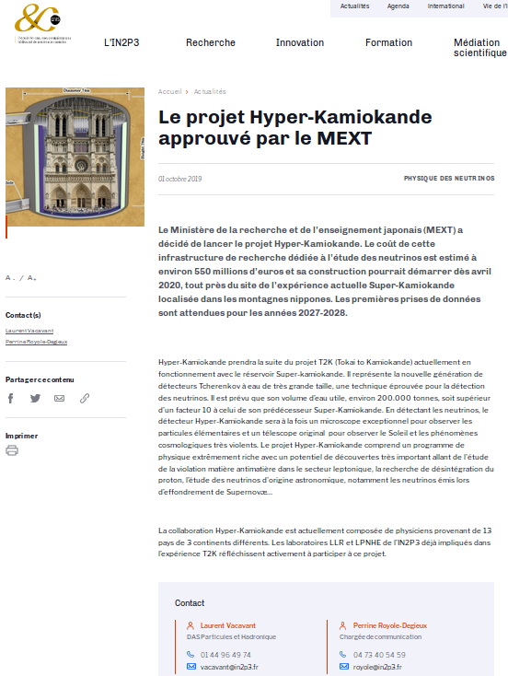
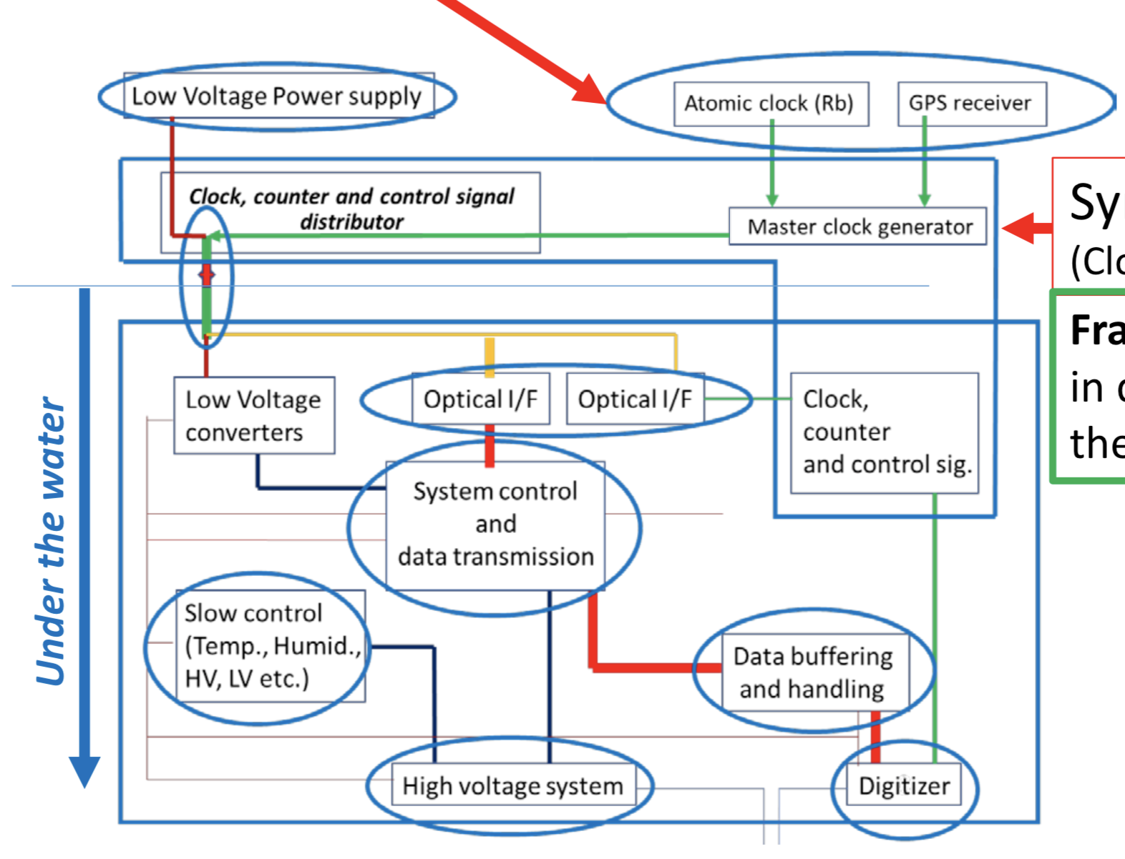
Neutrino: towards HK
After the positive evaluation by the
LPNHE Scientific Council
an R&D work on clock distribution and
time synchronization started at LPNHE

