Slide 1
Development of Electronics and its Synchronization System for the Hyper-Kamiokande
Japanese PI Yoshinari Hayato
(Kamioka Obs., ICRR, The Univ. of Tokyo)
hayato@suketto.icrr.u-tokyo.ac.jp
French PI stefano russo
(LPNHE/IN2P3)
srusso@lpnhe.in2p3.fr

Slide 2
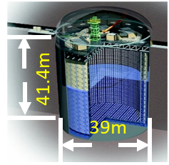
Neutrino research and Hyper-Kamiokande
Secrets of neutrino are gradually revealed since the discovery of non-zero neutrino mass
in 1996 at Super-Kamiokande.
However,
we still don’t know which neutrino is heaviest.
(Mass hierarchy problem)
Also, we don’t know whether neutrino and
anti-neutrino oscillations are same or different,
i.e. CP is conserved or violated.
Current analyses are statistically limited!
Super-Kamiokande can detect a tens
of atmospheric, solar and
accelerator neutrinos from J-PARC
(@ 500kW neutrino mode).
Upgrade the J-PARC accelerator
and build gigantic detector,
Hyper-Kamiokande.
Hyper-Kamiokande
71ｍ
Super-K
68ｍ

Slide 3
Hyper-K Electronics and Synchronization System
Interaction position of particles in the detector
Reconstructed using timing.
Accurate timing measurement is essential.
Total number of PMTs are up to 55,000.
# of front-end electronics boards is > 2,000.
All the front-end boards must be synchronized.
Need accurate synchronization system,
better than 100ps.
Hyper-K is expected to be operated for >20 yrs.
Long term stability and durability are essential.

Slide 4
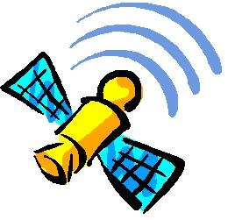
Time distribution architecture
1 Gbps Eth*
DAQ
1 Gbps Eth*
clock distribution edge
Time dist. element
…
Time dist. element
FE
…
FE
FE
…
FE
…
…
…
…
24
24
24
24
8*
* These numbers depend on the bandwidth
8*
Each time distribution element is synchronized to the local base and accorded to UTC.
Clock is sent to FEs embedded into data stream. Each FE reconstructs it and use as reference.
R&D focus to define the best way to distribute the clock.
Two scheme under evaluation: CERN White Rabbit and custom solution. Both based on FPGA serialiser-deserialiser.

Slide 5
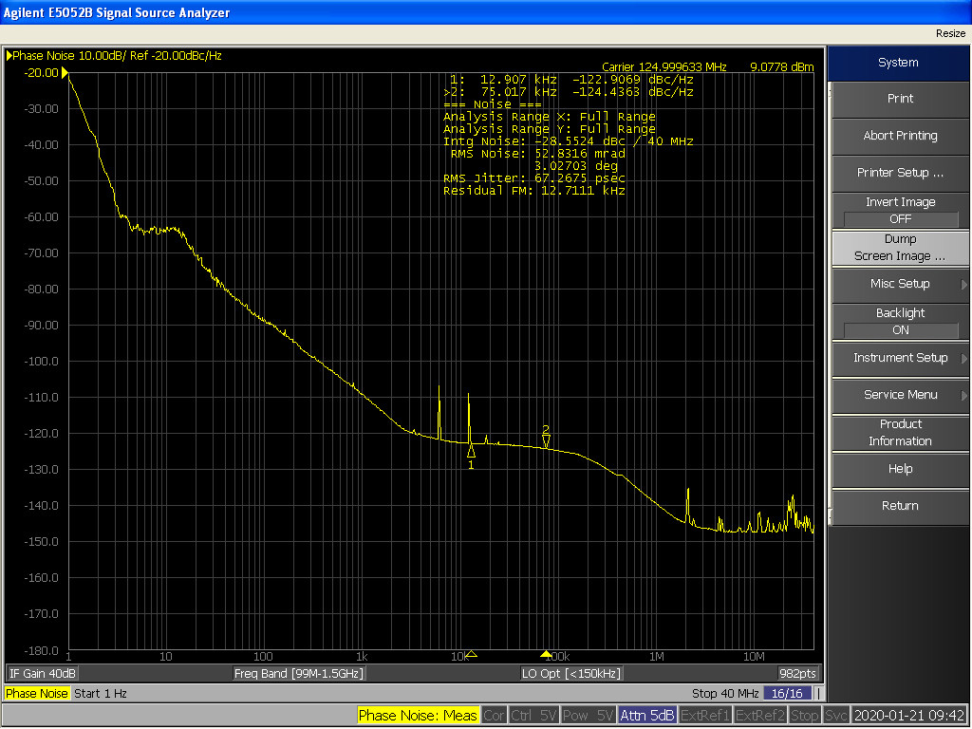
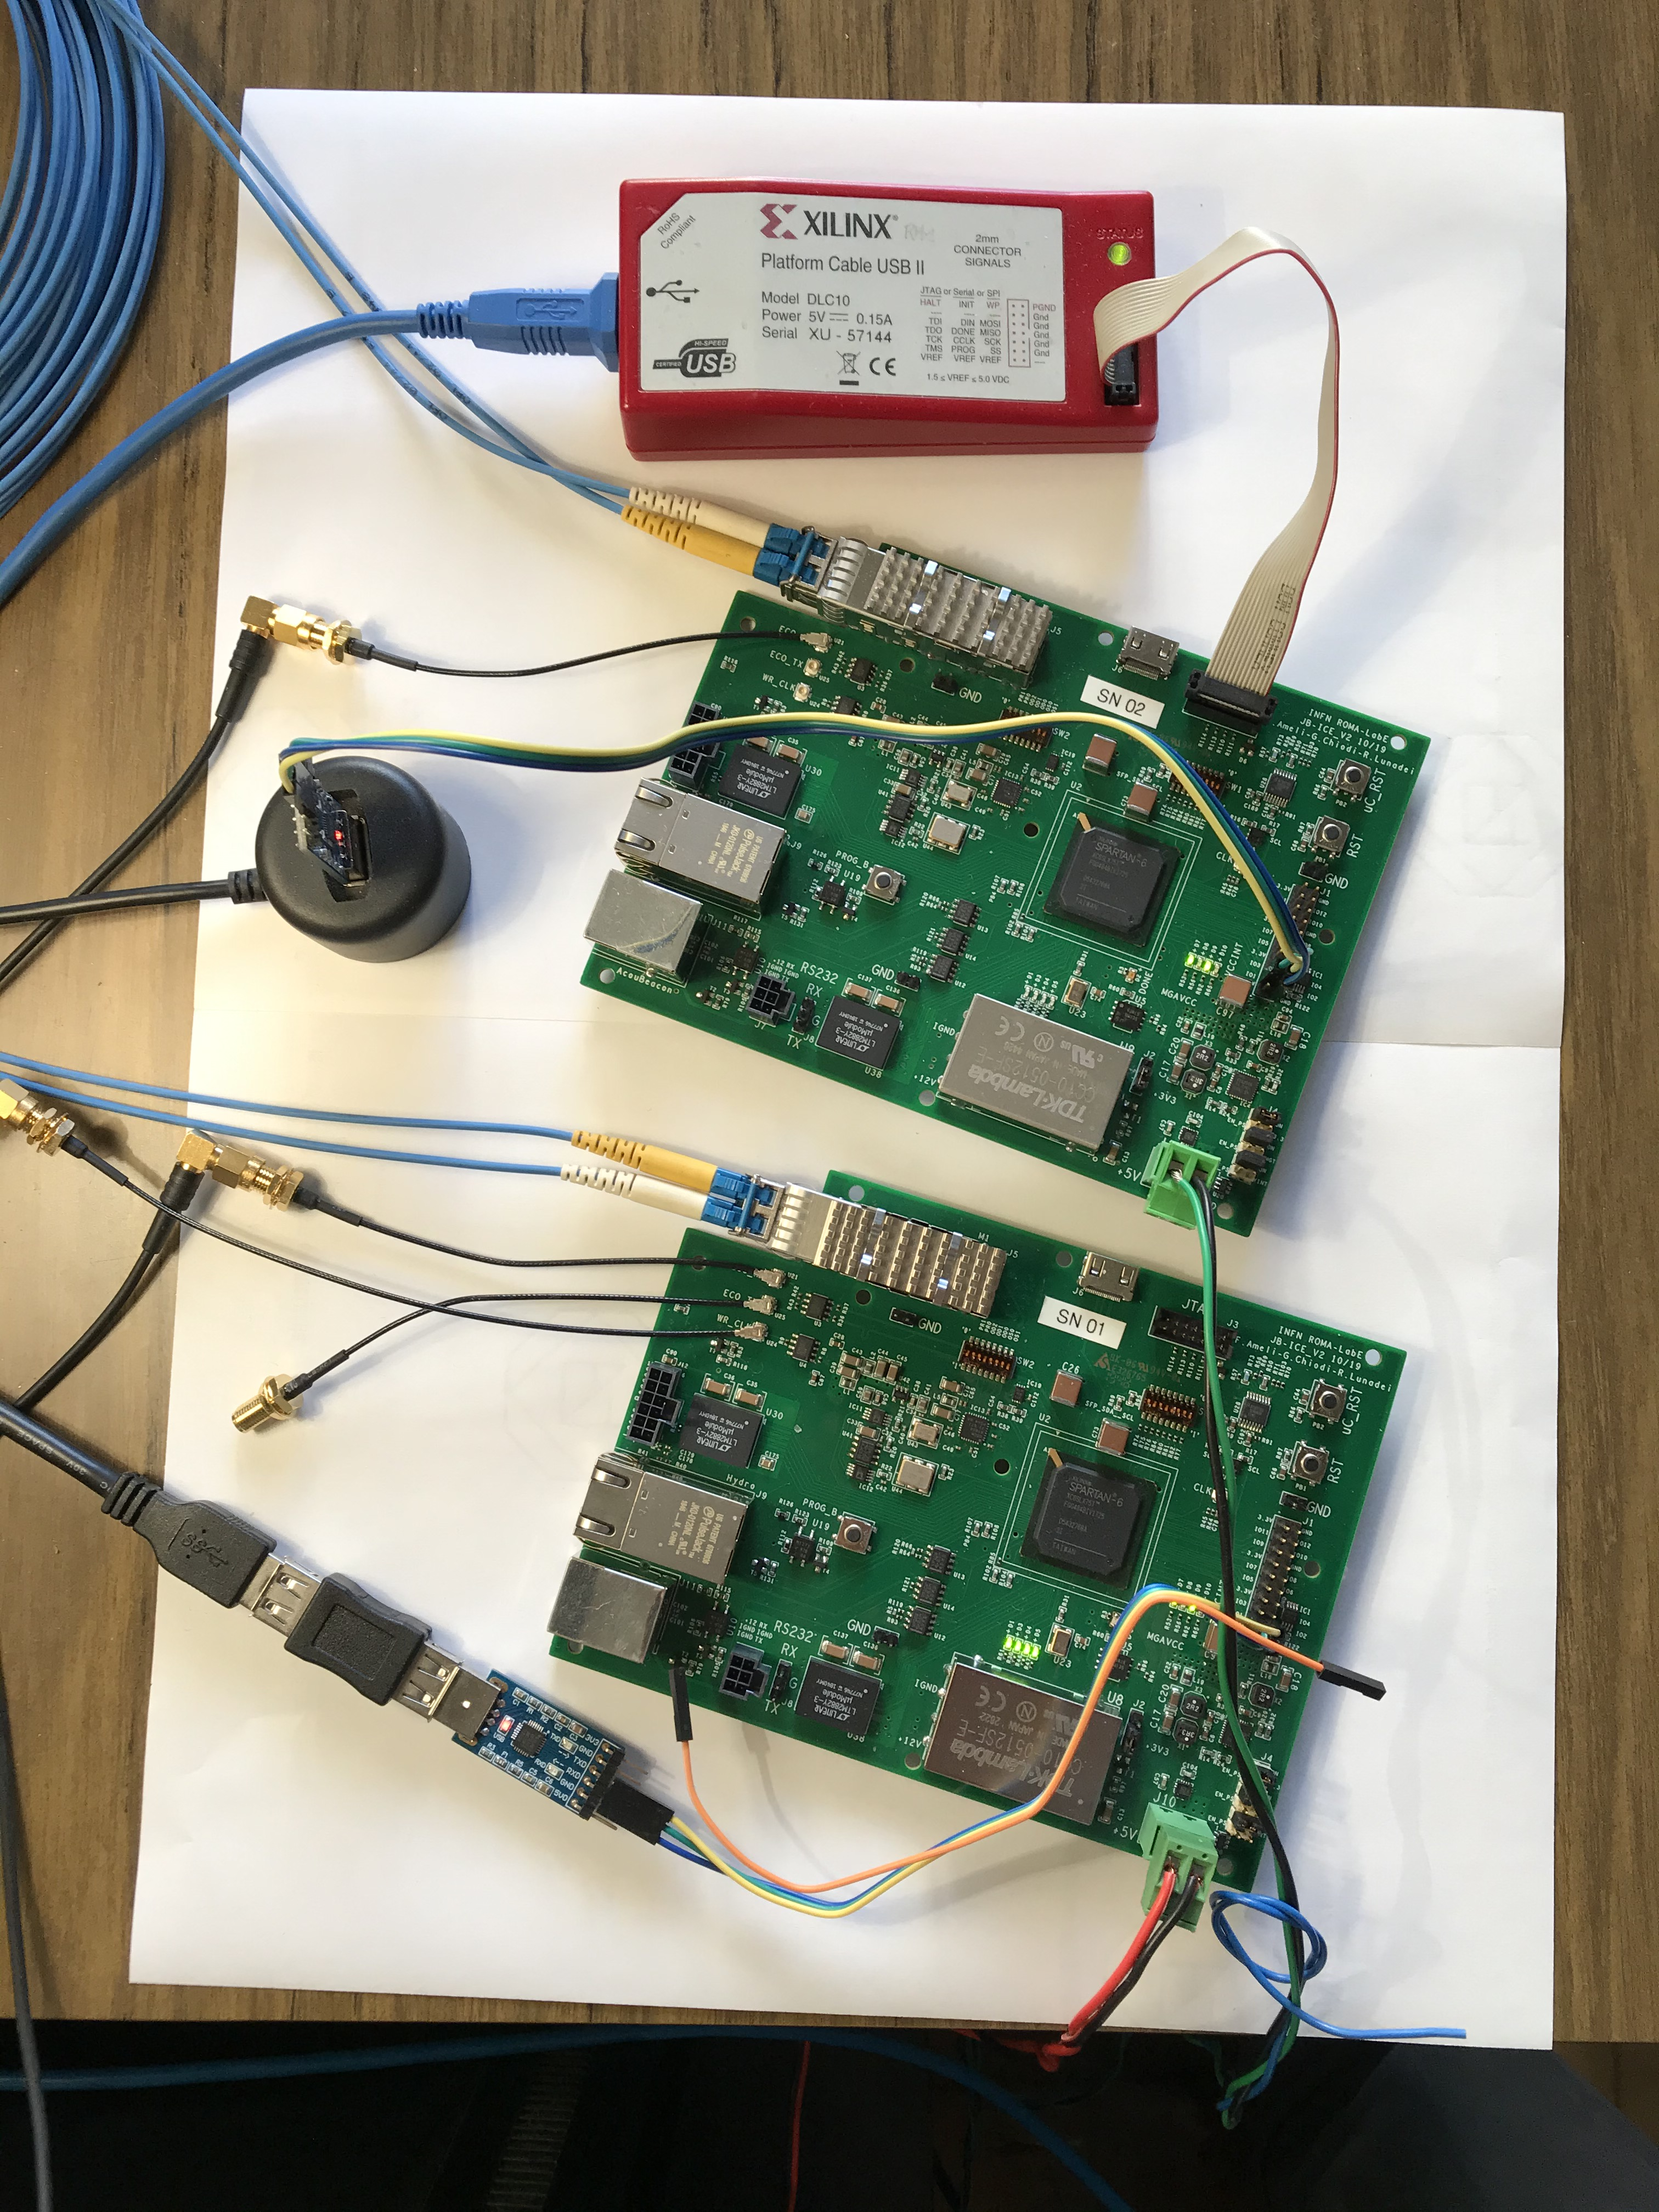
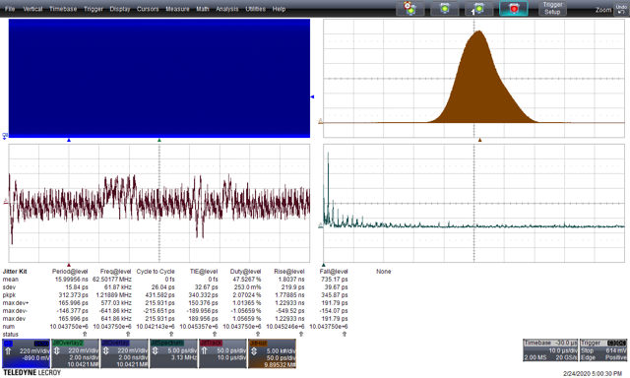
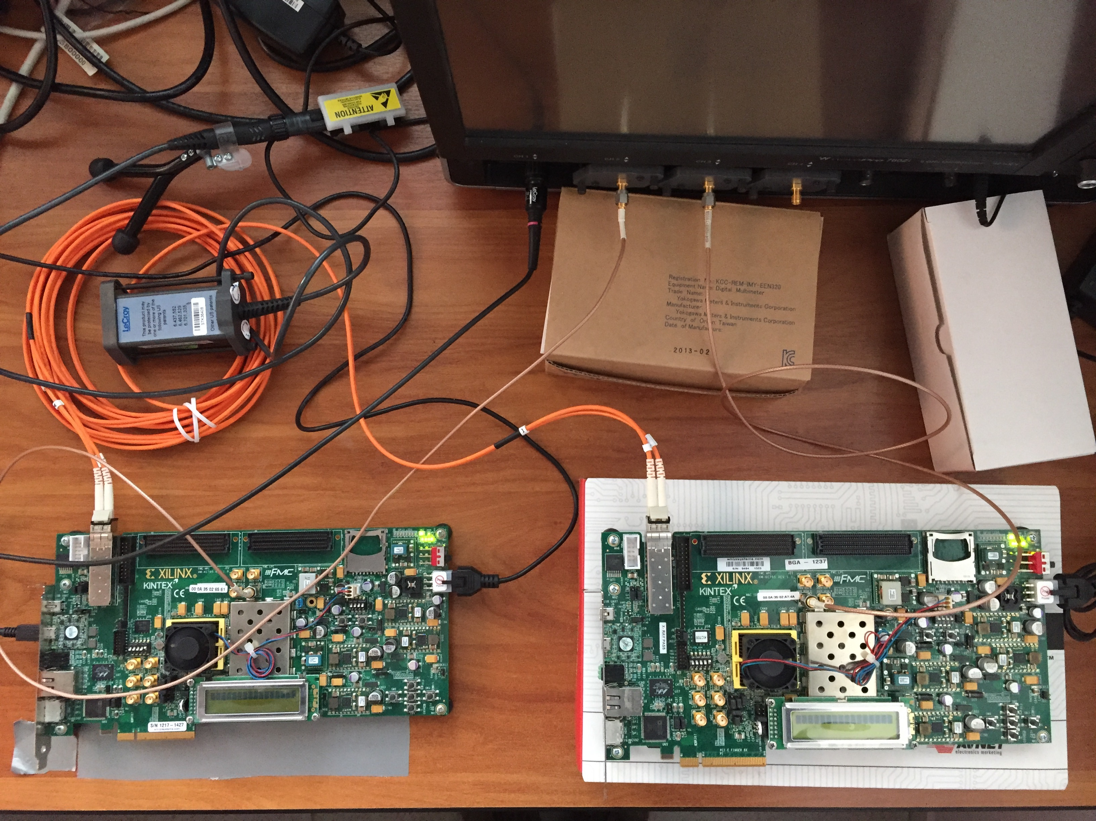
R&D program
R&D already started. Preliminary jitter tests performed on evaluation boards
Next steps are:
  Perform time distribution tests on FE electronics at an earlier stage.
  Test the UTC synchronization scheme is situ on the real orography.
  Test the prototypes on the existing similar detectors like Super-Kamiokande

Slide 6
Founding requests
Founding request from France
Description | €/unit | Nb of units | Total (€) | Request to
Visit to Japan | 100/day | 30 days | 3000 | IN2P3
Travel | 1000 | 2 travels | 2000 | IN2P3
Visit to Japan | 100/day | 5 days | 500 | CEA/IRFU
Travel | 1000 | 1 travels | 1000 | CEA/IRFU
Total |  |  | 6500
Additional founds from France
Provided by | Type | €
JENNIFER2-RISE IN2P3 | Travel | 5000
JENNIFER2-RISE IN2P3 | Travel | 1500
Total |  | 6500
Founding request from KEK
Description | k¥/Unit | Nb of units | Total (k¥) | Request to
Visit to France | 20/day | 20 days | 400 | KEK
Travel | 150 | 3 travels | 450 | KEK
Total |  |  | 850
Additional founds from KEK
Provided by | Type | k¥
JSPS | Travel | 450
Total |  | 450

Slide 7
backup slides

Slide 8
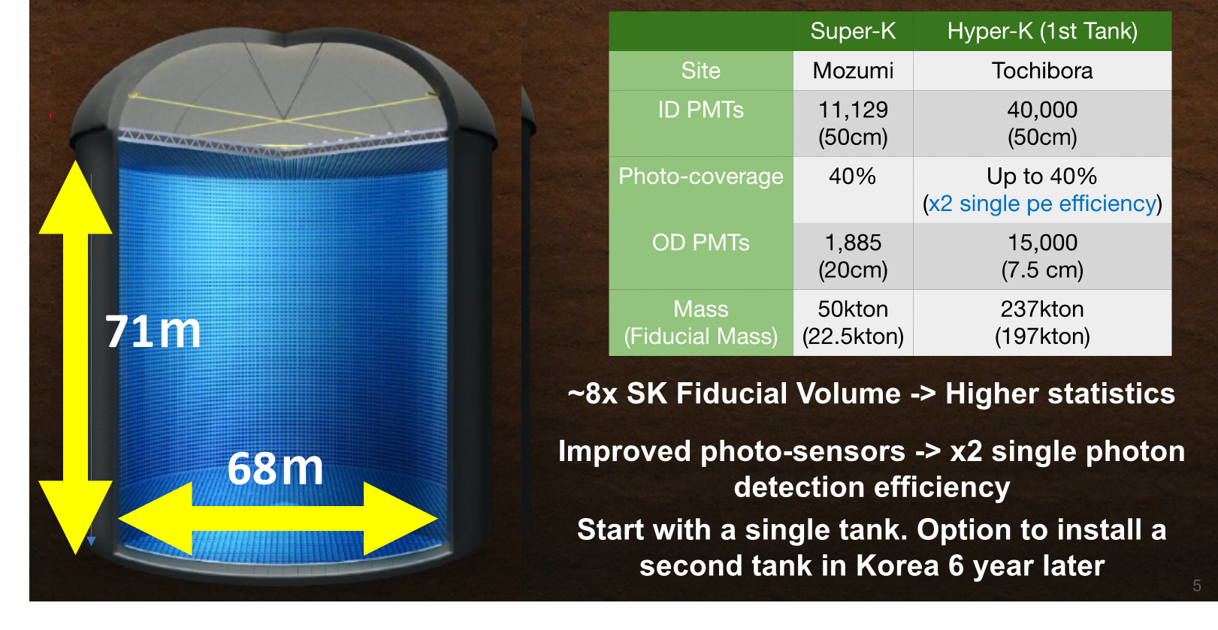
Hyper-Kamiokande detector
Start operation in 2027

Slide 9
Wide variety of Hyper-Kamiokande physics program
Atmospheric neutrino
Neutrino mass hierarchy
Solar neutrinos
Interior of the sun
Accelerator neutrinos
CP violation
Supernova neutrinos
Evolution of the universe
Proton decay
Grand Unification

Slide 10

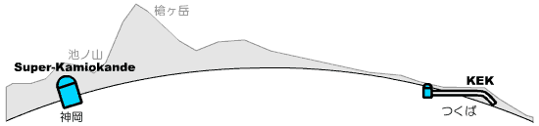
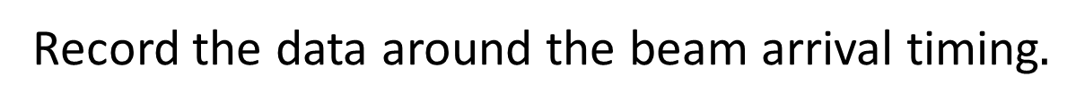
Detection of accelerator neutrinos
Accelerator produces neutrino every ~1 sec.
Record the neutrino production time with GPS.
Send information via L2VPN.
Record the data around the beam arrival timing$.$
GPS systems in both sites need to
provide “correct” time.
Distance = 295km
Neutrino arrives at SK in ~1ms.
J-PARC
Kamioka
L2VPN (SINET)
Tokai

Slide 11

Local time reference and UTC
A very small jitter (1 ps), small drift local time base is generated by an atomic clock system.
The local time base is accorded to UTC by means of Global Navigation Satellite System (GNSS) network.
The UTC reference is used to select particles events from the accelerator and to corelate astrophysical events with other telescopes
The system architecture depends on the site orography
GNSS receiver
Time distribution
Atomic
clock

