Slide 1

EGI et les infrastructures de recherches ESFRI
Bob Jones (CERN)
EGEE project Director
e-Infrastructures for e-Science: 7th Concertation Meeting

Slide 2

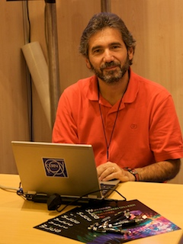
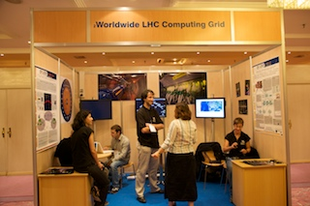
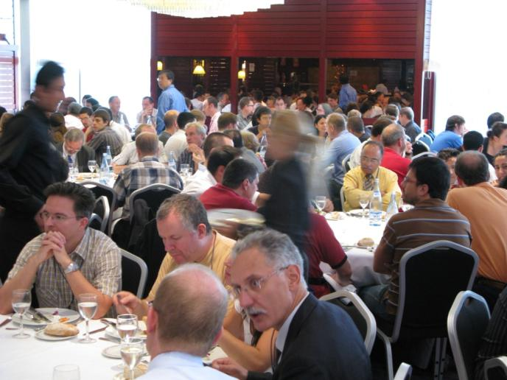
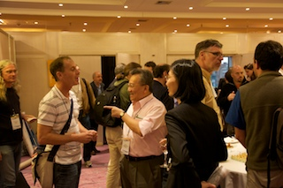
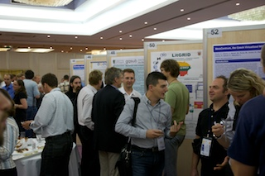
EGEE09 - EGEE’s annual conference theme - realising a sustainable European grid
631 registrants
  from 43 countries
  18 % women
22 demos
  20 films!!
57 posters
108 sessions
http://egee09.eu-egee.org/

Slide 3

























Collaborating Projects @ EGEE09
Notes:
http://collaborating.eu-egee.org/index.php?id=530

Slide 4







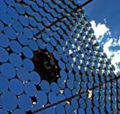

ESFRI @ EGEE’09
Cherenkov Telescope Array

Slide 5

The ESFRI Roadmap is an ongoing process
First edition 2006 and updated in 2008 with 44 projects
Preparatory phase funding for most with second round soon
About 10 will fly by 2010
European X-FEL first to go real – civil construction started in 2009 and International convention agreed 2 days ago.

Slide 6
Current View
Distinct Infrastructures / Distinct User Experiences
Raw Data
Data Analysis
Analysed Data
Publication Data
Publications
Facility 1
Raw Data
Data Analysis
Analysed Data
Publication Data
Publications
Facility 2
Raw Data
Data Analysis
Analysed Data
Publication Data
Publications
Facility 3

Slide 7
Future View
Common Infrastructure / Common User Experience
Raw Data Catalogue
Data Analysis
Analysed Data Catalogue
Publication Data Catalogue
Publications Catalogue
Raw Data
Data Analysis
Analysed Data
Publication Data
Publications
Facility 1
Raw Data
Data Analysis
Analysed Data
Publication Data
Publications
Facility 2
Raw Data
Data Analysis
Analysed Data
Publication Data
Publications
Facility 3
Capacity
Storage
Standards/
Converters
Data
Repositories
Publications
Repositories

Slide 8
ESFRI and EGI
The creation of National Grid Infrastructures and their overall coordination can provide an ICT context for the research infrastructures
  An operational framework for centres involved in ESFRI projects
In the EGI context, Specialised Support Centres (SSCs) are the means of interaction with user communities
  The EGI SSCs are established and governed by the user communities
  The SSCs support the research communities use of the infrastructure
  SSCs must become independent, sustainable communities

Slide 9
ESFRI related EC funding calls
Total 260Meuros – deadline 3 December 2009
1.2.2 Construction of New Infrastructures (or major upgrades) - Preparatory phase
  INFRA-2010-2.2.1: EISCAT_3D
  INFRA-2010-2.2.2: EPOS
  INFRA-2010-2.2.3:SIAEOS
  INFRA-2010-2.2.4:ECCSEL
  INFRA-2010-2.2.5: EMBRC
  INFRA-2010-2.2.6: EU-OPENSCREEN INFRA-2010-2.2.7: EuroBioImaging
  INFRA-2010-2.2.8: High Security BLS4 Laboratory
  INFRA-2010-2.2.9: EMFL
  INFRA-2010-2.2.10: CTA
  INFRA-2010-2.2.11: European strategy for particle physics (CERN Council)
As well as support for existing infrastructures and their integration in the field of Social Sciences and Humanities, Life Sciences, Environmental Sciences, Energy, Engineering, Mathematics, Computer-related Sciences, Data
Is there scope for some strategic links on e-infrastructure issues
between proposals to these calls and the SSC related proposals?

Slide 10
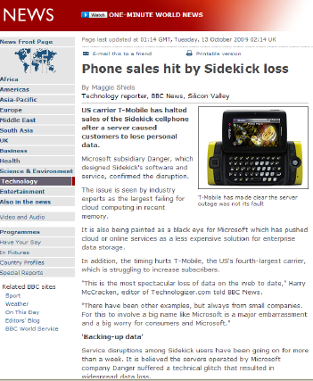
Grids, clouds, supercomputers, etc.
Grids
Collaborative environment
Distributed resources (political/sociological)
Commodity hardware (also supercomputers)
(HEP) data management
Complex interfaces (bug not feature)
Supercomputers
Expensive
Low latency interconnects
Applications peer reviewed
Parallel/coupled applications
Traditional interfaces (login)
Also SC grids (DEISA, Teragrid)
Many different problems:
Amenable to different solutions
No right answer
Clouds
Proprietary (implementation)
Economies of scale in management
Commodity hardware
Virtualisation for service provision and encapsulating application environment
Details of physical resources hidden
Simple interfaces (too simple?)
Volunteer computing
Simple mechanism to access millions CPUs
Difficult if (much) data involved
Control of environment ➔ check
Community building – people involved in Science
Potential for huge amounts of real work
Consider ALL as a combined e-Infrastructure ecosystem
  Aim for interoperability and combine the resources into a consistent whole

Slide 11
European E-Infrastructure Forum
Forum for the discussion of principles and practices to create synergies for distributed Infrastructures
Goal: seamless interoperation of leading e-Infrastructures serving the European Research Area
Focus: needs of the user communities that require services which can only be achieved by collaborating Infrastructures
Initial membership:
  EGEE & EGI
  DEISA & PRACE
  Terena & GEANT
Offers a way of interacting as a whole with user communities of a multi-national nature that are interested in making use of the Infrastructures

Slide 12
Proposed next steps (1)
Identify clear contact points between the ESFRI projects and e-Infrastructures
  E-Infrastructure projects have been talking to individuals (users or partners)
    Can we make contacts more official and identify contact points in specific areas:
      Security
      Data management
      Network
      Etc.
  These will be useful for establishing links between different ESFRI projects, between ESFRI projects and e-Infrastructures etc.

Slide 13
Proposed next steps (2)
Use these contacts to build matrix for technical requirements & organisational aspects
requirement | CLARIN | DARIAH/ CESSDA | EISCAT3D | EPOS | LIFEWATCH | ELIXIR | XFEL | CTA | FAIR | SKA
Single sign-on
Persistent storage
Global Scope
Workflows
Virtual Organisations
Standards
DRAFT

Slide 14
Proposed next steps (3)
Once the matrix has been built it can be used to focus:
  Collaboration between ESFRI projects
  Collaboration between ESFRI projects and e-Infrastructures
  Provide input to roadmaps for e-Infrastructures of the future
  Provide input to national funding agencies and European Commission on their future funding programmes

Slide 15
What has happened since EGEE09?
Refining template and gathering the list of contacts from the ESFRI and e-infrastructure projects
NEERI09 Meeting in Helsinki on 1-3 October
  organised for CLARIN and other humanities ESFRI projects (CESSDA, DARIAH)
  with e-infrastructures (EGEE/EGI, DEISA/PRACE, GEANT)
  and EC (DG for Research, European Commission and DG INFSO ) in Helsinki
  http://www.csc.fi/english/pages/neeri09/programme/index_html
Similar meeting being planned for Jan’10 in Cambridge hosted by EBI for life science ESFRI projects
National meetings to formulate/coordinate ESFRI involvement/support
European E-infrastructure Forum has entered into contact with eIRG

Slide 16

http://egee-uf5.eu-egee.org/

