Slide 1
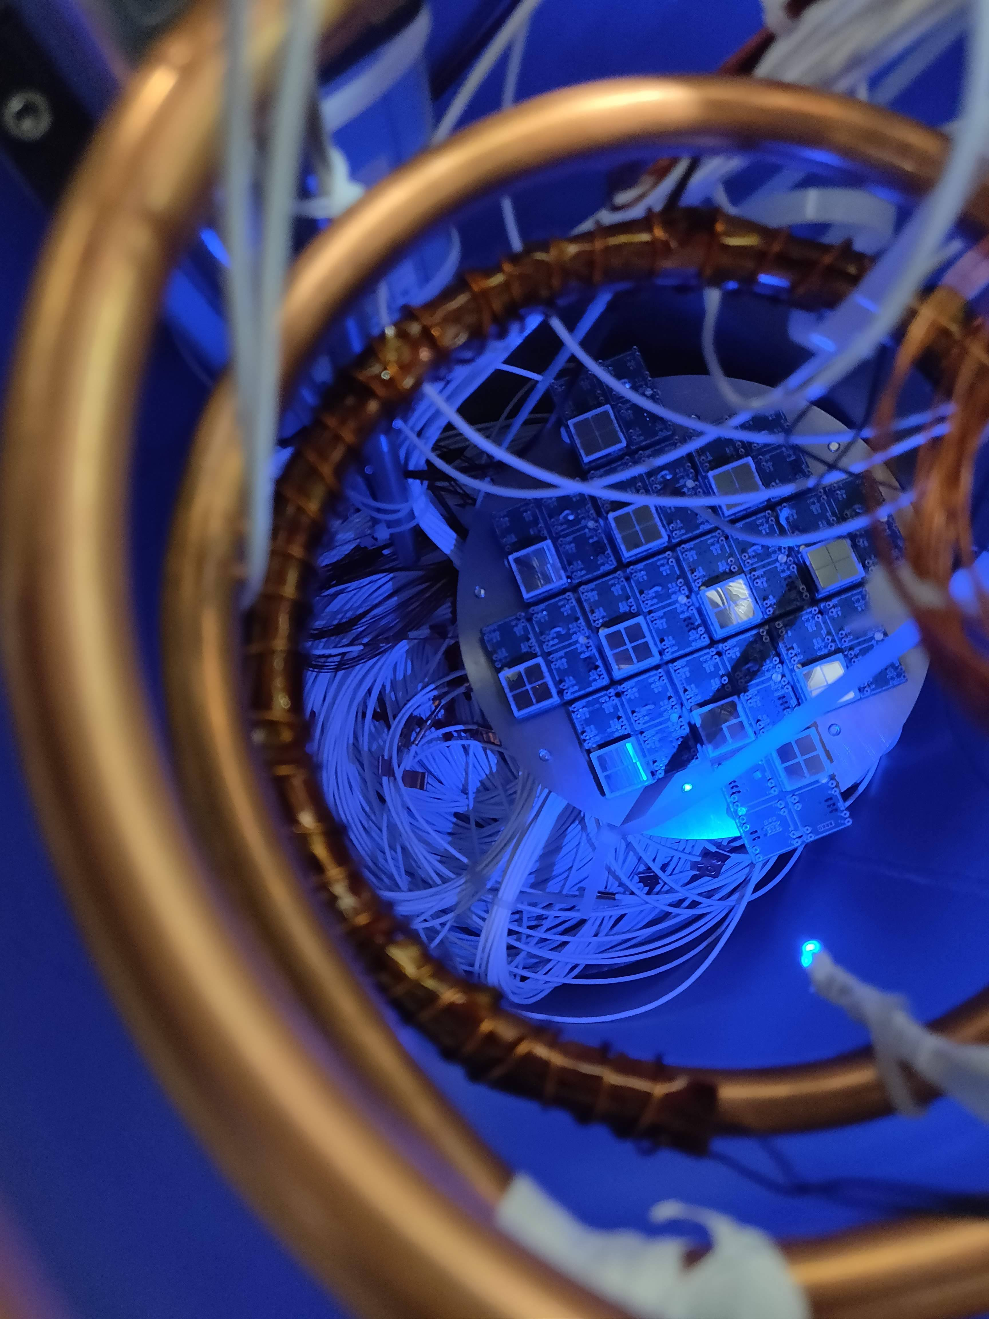
SiPM readout of Xenoscope
XeSAT 2022
University of Coimbra
Ricardo Peres
24/05/2022

Slide 2
Xenoscope - a full-scale vertical DARWIN demonstrator
52.5 cm Purity Monitor
1 m TPC
2.6 m TPC
52.5 cm single phase PM
Signal from Xe flash-lamp shining on a photocathode
Direct charge readout from electrodes
1 m dual-phase time projection chamber
Electron signal from the photocathode
Proportional scintillation light readout with a SiPM tiled array
Final drift length goal.
Electron signal from photocathode and possibly internal and external sources
See Prof. Baudis’ talk from earlier today

Slide 3
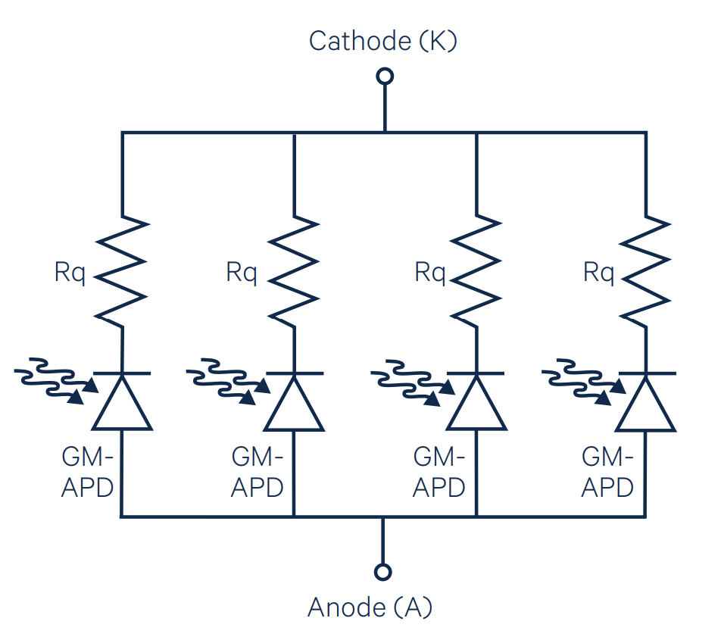
Light detection with SiPMs
Avalanche Photo Diodes (APDs) with a doped PN junction in a silicon wafer
Each APD is set in Geiger-mode and proportionality achieved by the number of triggered cells
In recent years VUV sensitive SiPMs were made accessible in large form factors
from “Introduction to silicon photomultipliers (SiPMs)”, First Sensor

Slide 4
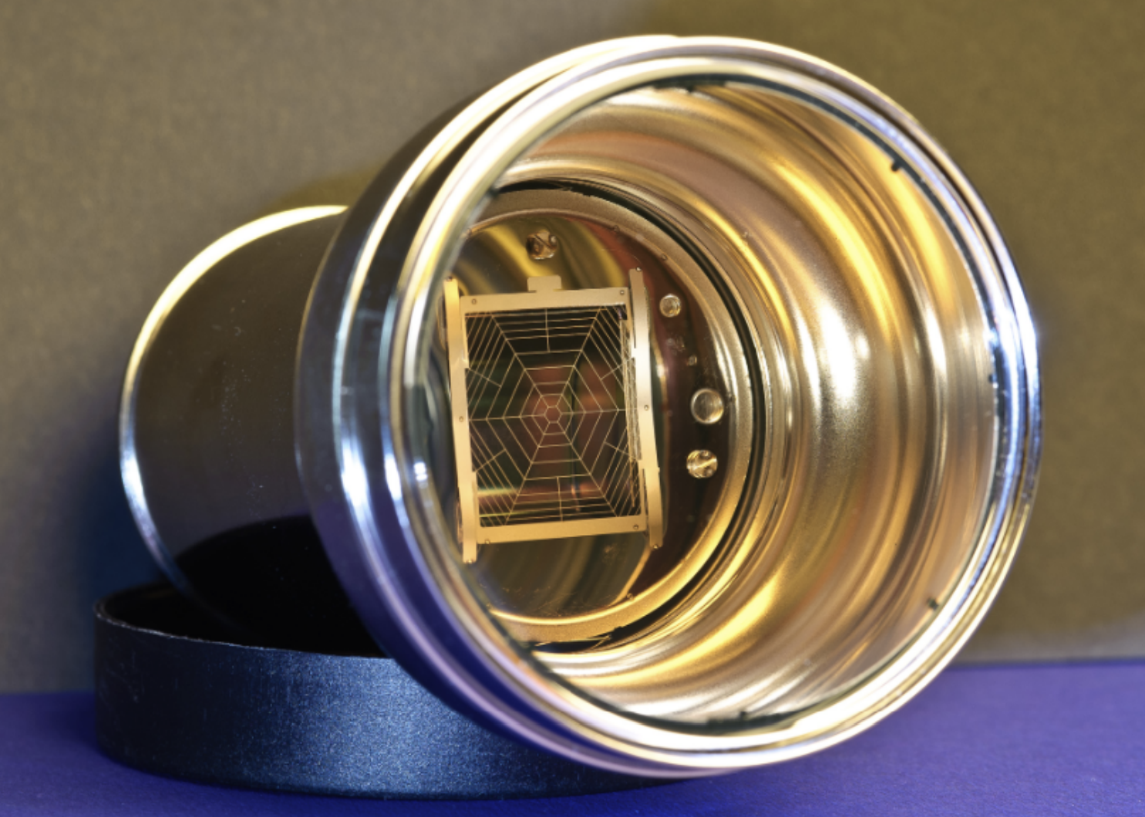
Light detection with SiPMs
Are SiPMs the photosensors of the next generation LXe DM experiment?
 | PMTs | SiPMs
Bias voltage | 1-2 kV | ~50 V
QE @175 nm | ~35% | ~30%
SPE | 30% | 4-6%
DCR | 0.01 Hz/mm² | O(1) Hz/mm²
Radioactivity | Higher per area | Lower per area (excluding readout)
Notes:
PMTs: 0.00646 mBq/mm2

Slide 5
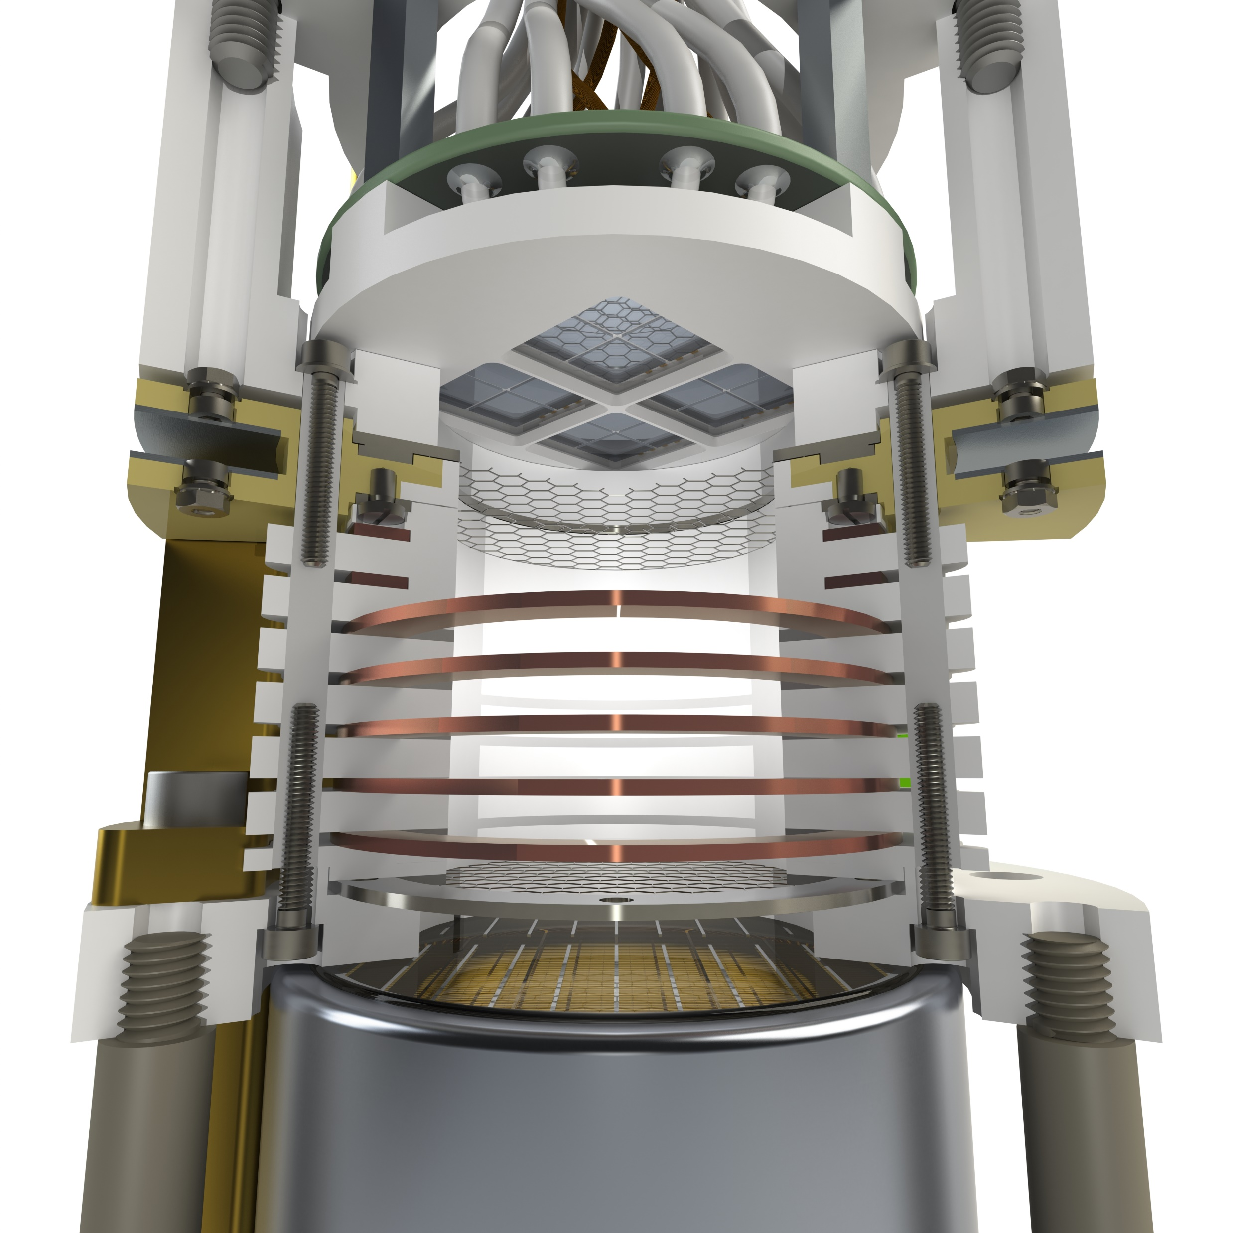
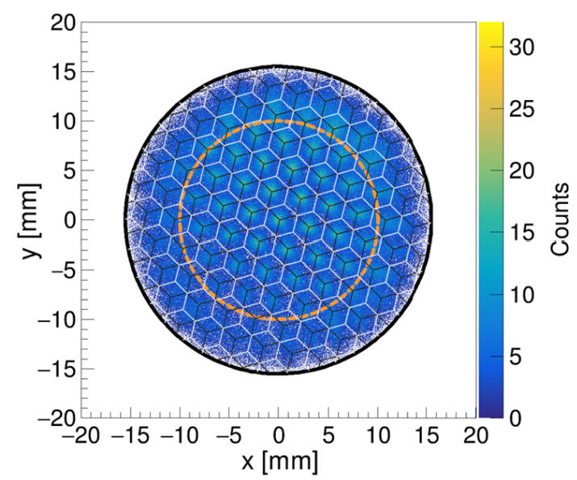
SiPMs in a dual-phase LXe TPC – Xurich II
LXe dual-phase TPC with 31 mm x 31 mm (diameter x height)
Operated with a 2” PMT on the bottom, 16 VUV MPPCs on the top.
Position reconstruction (center-of-gravity) with ~1.5 mm resolution
Detector calibrated with ^{83m}Kr and ³⁷Ar
(https://doi.org/10.1140/epjc/s10052-020-8031-6)
New measurement of W-value in Lxe
(https://doi.org/10.1140/epjc/s10052-021-09834-x)
See K. Thieme’s talk (Thu. 14h)

Slide 6
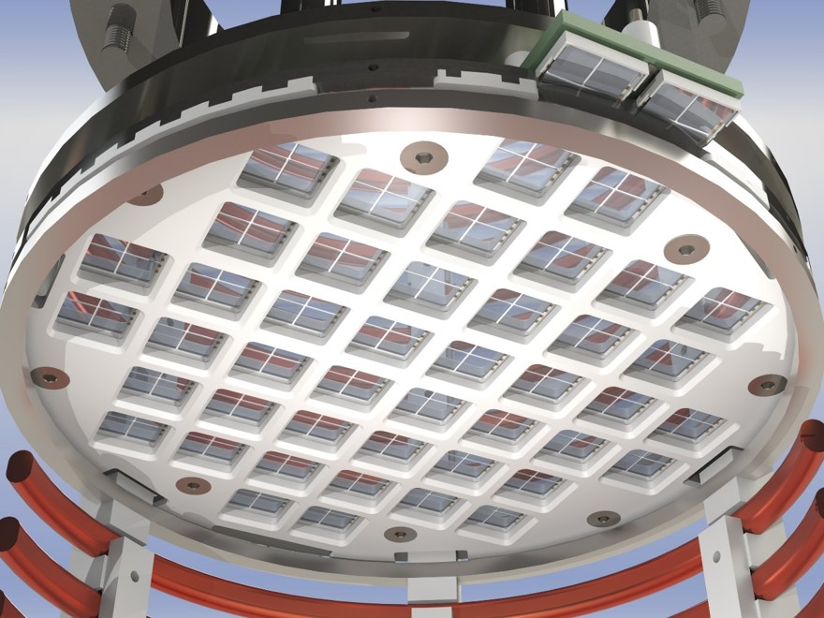
The Top Array of Xenoscope
Dimensions:
Back plate: ø160 mm
TPC/active area: ø150 mm
Testing SiPMs on a large-scale dual-phase LXe TPC
Detect proportional scintillation light signal from drifted electrons:
Xe lamp on photocathode
Muons with coincidence trigger
Total of 48 12x12 mm² VUV4 MMPCs from Hamamatsu
192 6x6 mm² SiPMs
~2.76 x 10⁶APD cells

Slide 7
The Top Array of Xenoscope
Dimensions:
Back plate: ø160 mm
TPC/active area: ø150 mm
Testing SiPMs on a large-scale dual-phase LXe TPC
Detect proportional scintillation light signal from drifted electrons:
Xe lamp on photocathode
Muons with coincidence trigger
Total of 48 12x12 mm² VUV4 MMPCs from Hamamatsu
192 6x6 mm² SiPMs
~ 2.76 x 10⁶APD cells

Slide 8
Hamamatsu VUV4 12x12 mm² MPPC
Latest generation of VUV SiPMs from Hamamatsu
50-μm pitch cells
Tiled array with 4 12x12 mm² MPPCs
Summed readout (parallel) with a x20 pre-amplifier
Known gain of each sensor allows gain-matching within tiles

Slide 9
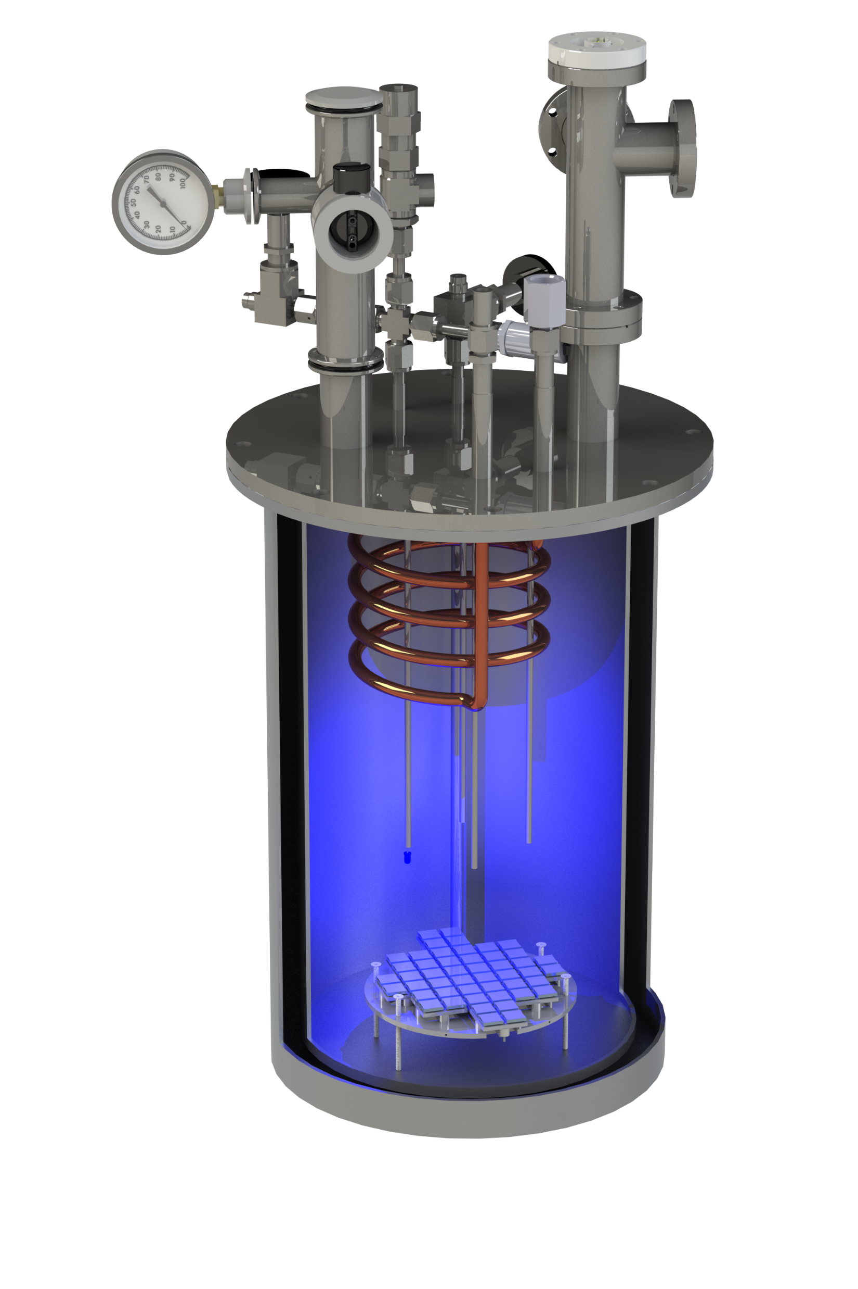
Liquid Argon Setup - LArS
LN₂ boil-off cooling
Cryostat filled with GN₂ or GHe.
Pressure: 1.9 bar
Tests between 170 K and 200 K
Temperature stability: < 0.5 K
Temperature sensor soldered to one PCB
Electrical and instrumentation feedthrough
Gas inlet
Pressure relief valve
Gas outlet
LN₂ coil
Cryostat
SiPM array
On-board PT100

Slide 10
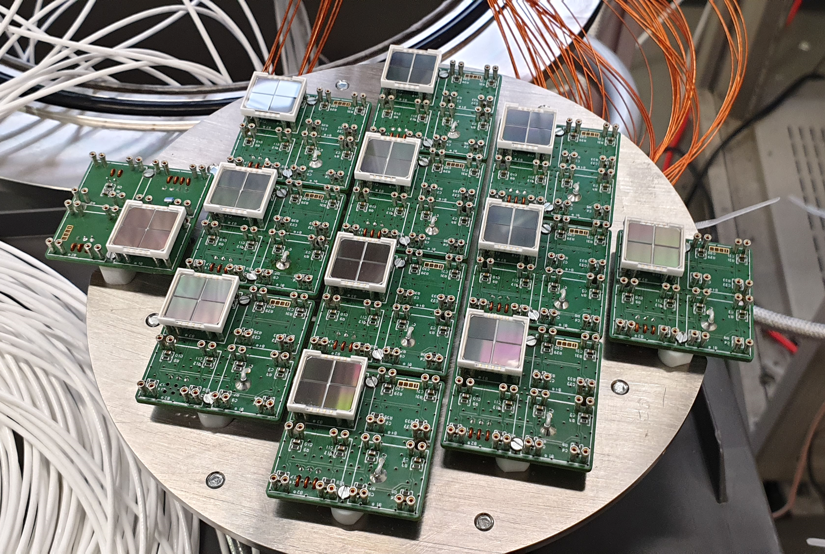
Liquid Argon Setup - LArS

Slide 11
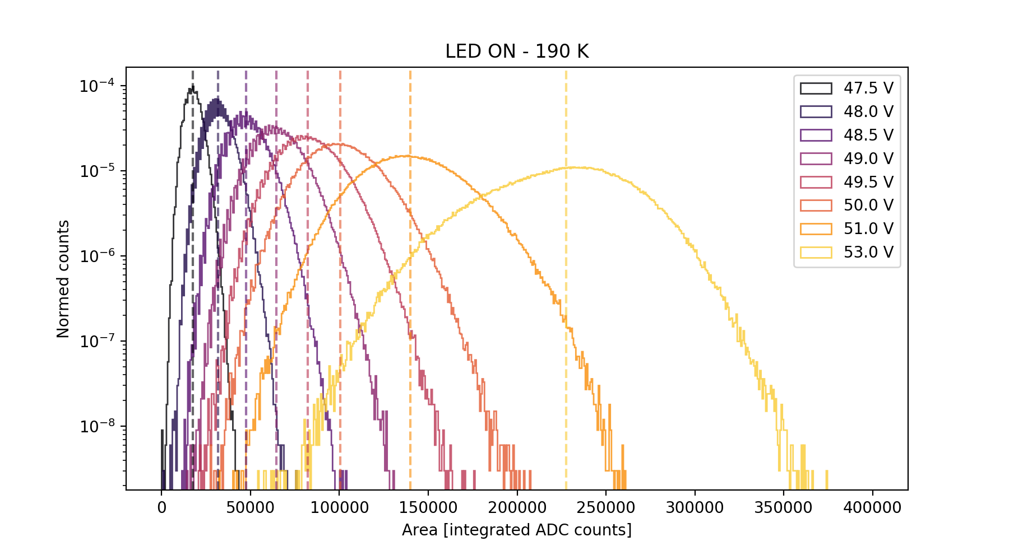
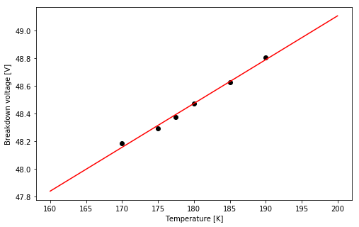
SiPM characterization – breakdown voltage
Measurements at different temperatures in GN₂
In-situ LED at constant luminosity
Measured: 48.2-49.0 V

Slide 12
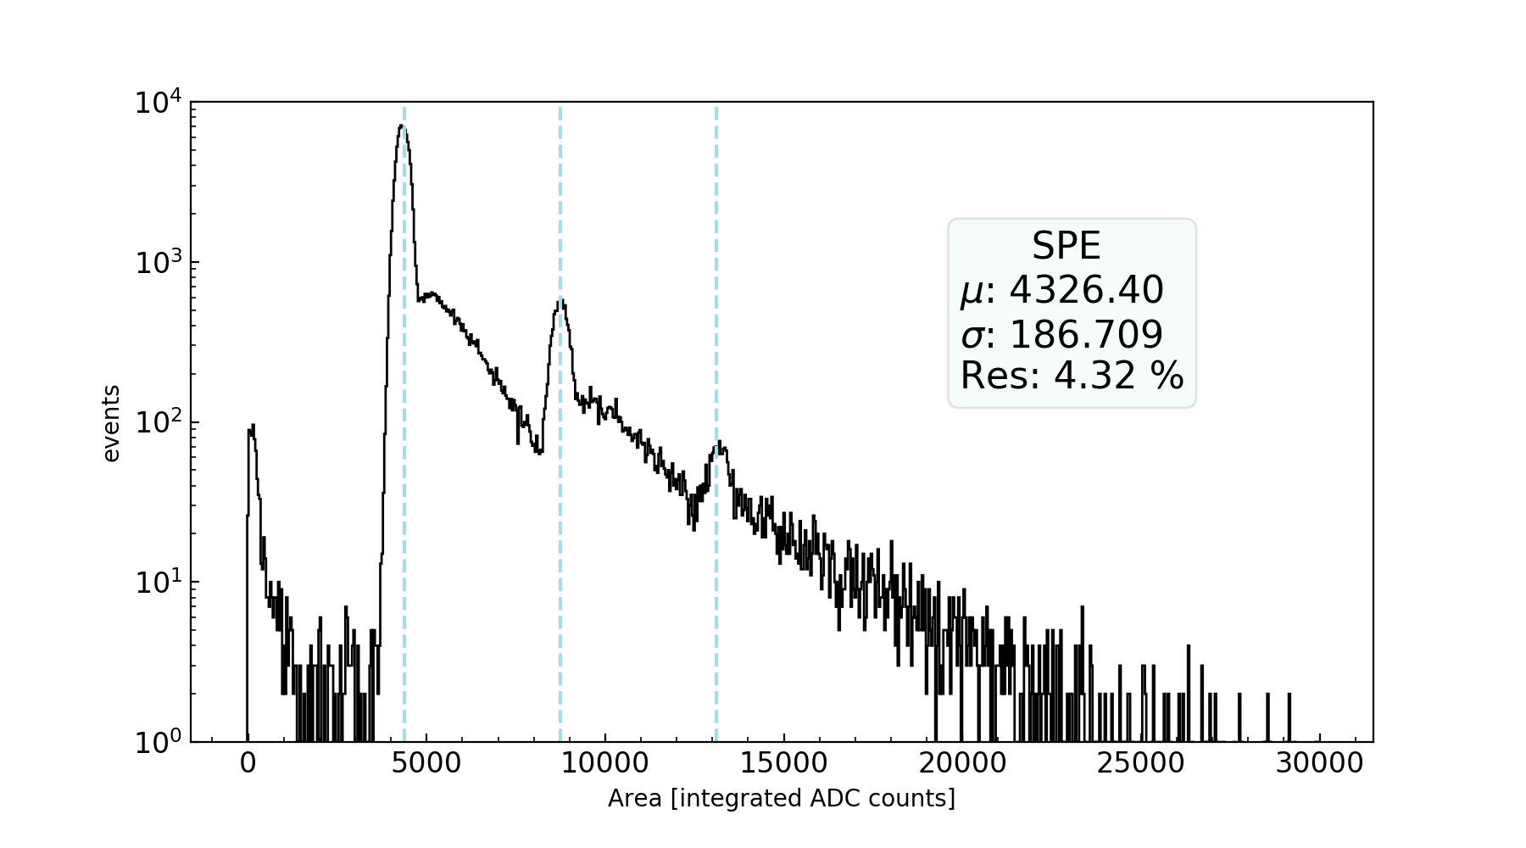
SiPM characterization – gain and SPEres
Measurements at different temperatures in GN₂
Fit of 1 pe peak in dark count dataset
Presence of “shoulders” in photoelectron peaks (as seen in G. Gallina et al. (nEXO collaboration), Nucl.Instrum.Meth.A 940, 2019)
Measured gain: O(10⁶)
Measured SPE resolution: 4% at ~4x10⁶ gain

Slide 13
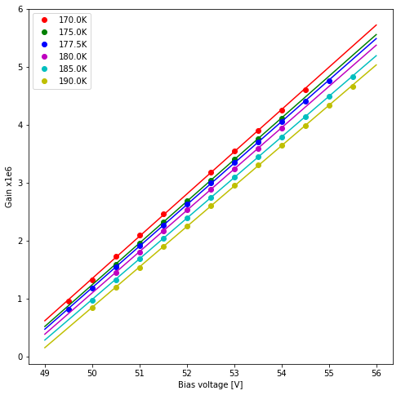
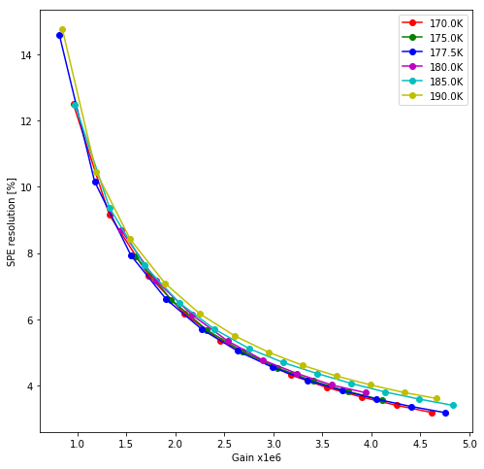
SiPM characterization – gain and SPEres
Measurements at different temperatures in GN₂
Fit of 1 pe peak in dark count dataset
Presence of “shoulders” in photoelectron peaks (as seen in G. Gallina et al. (nEXO collaboration), Nucl.Instrum.Meth.A 940, 2019)
Measured gain: O(10⁶)
Measured SPE resolution: 4% at ~4x10⁶ gain

Slide 14
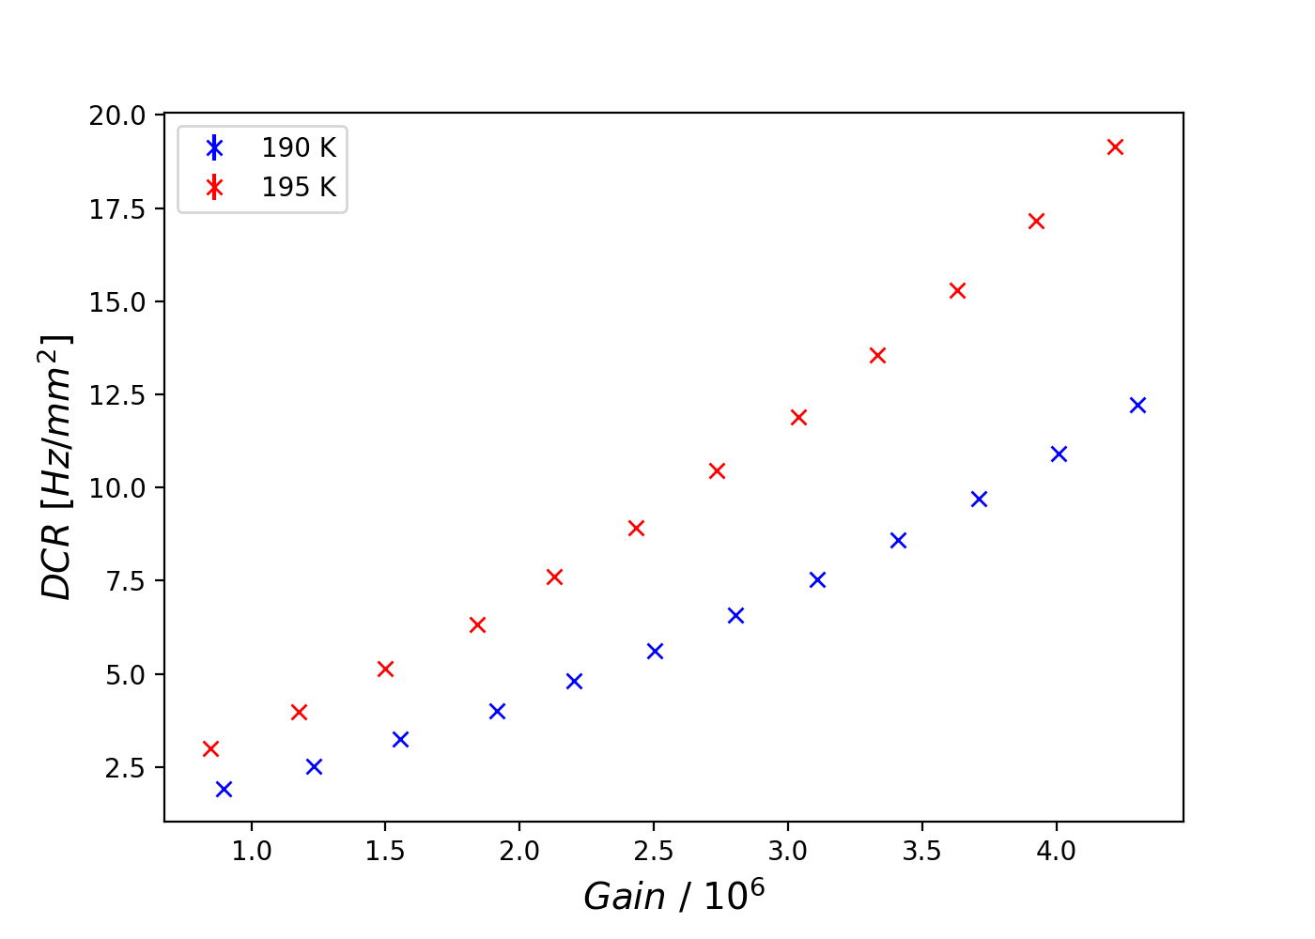
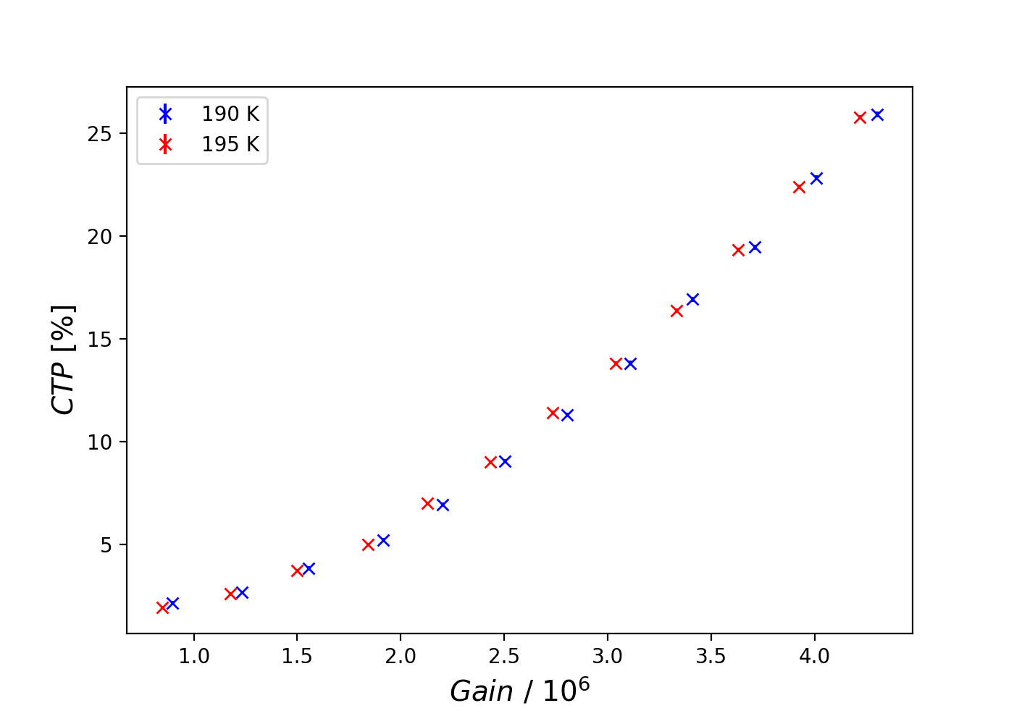
SiPM characterization - DCR
Measured DCR: O(1) Hz/mm² at GXe temperature up to 2x10⁶ gain
Low cross talk probability: 2-5 % up to 2x10⁶ gain

Slide 15
Electron diffusion simulation
The overall effect is a combination of two independent random-walks with distinct diffusion constants, D_{L} and D_{T.}
In the parallel direction, usually z, the field gives an extra component $v_{d}t$.
The variance of the gaussian distributions is given by the diffusion constants such that:
$$σ^{2}=2D_{T/L}t$$

Slide 16
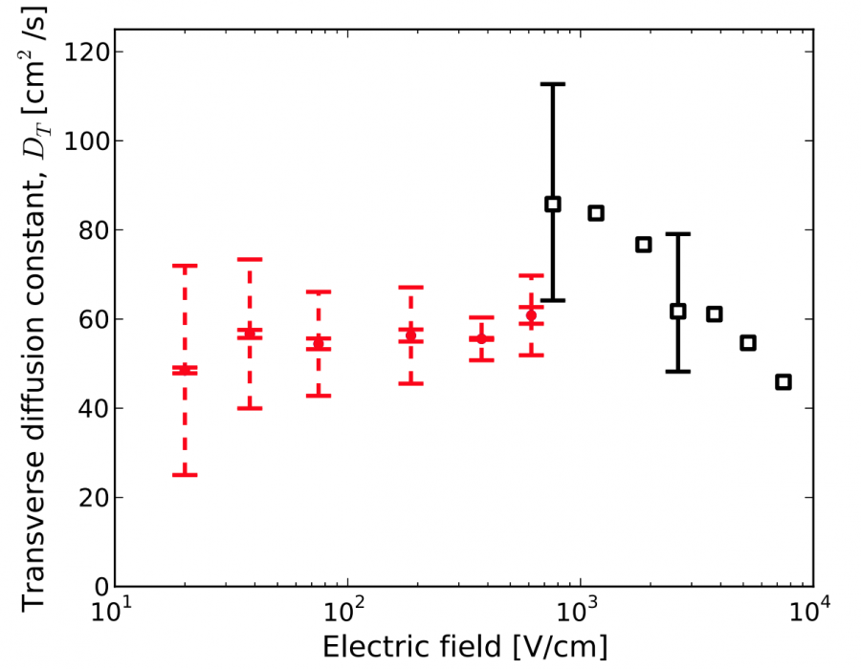
Transverse diffusion measurements
Few and contradicting results in current literature.
Requires fine position reconstruction
Improved fit by deep characterization of the detector response
Accentuated in longer drift times
from J. B. Albert et al. (EXO-200 Collaboration), Phys. Rev. C 95, 2017

Slide 17
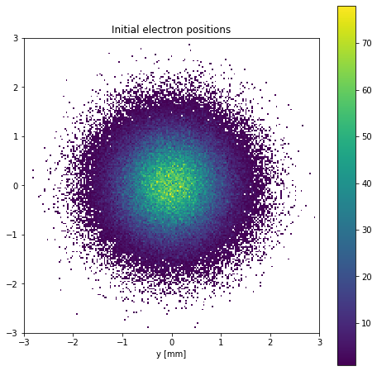
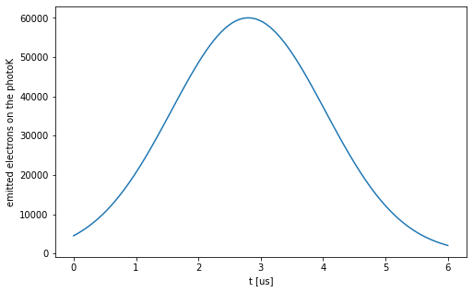
Xe lamp pulse (work of Y. Biondi)
Gaussian pulse with FWHM=2,9 us
Numerical aperture: 0.22
Distance from Photocathode: 2mm
Gaussian distribution of produced electrons*

Slide 18
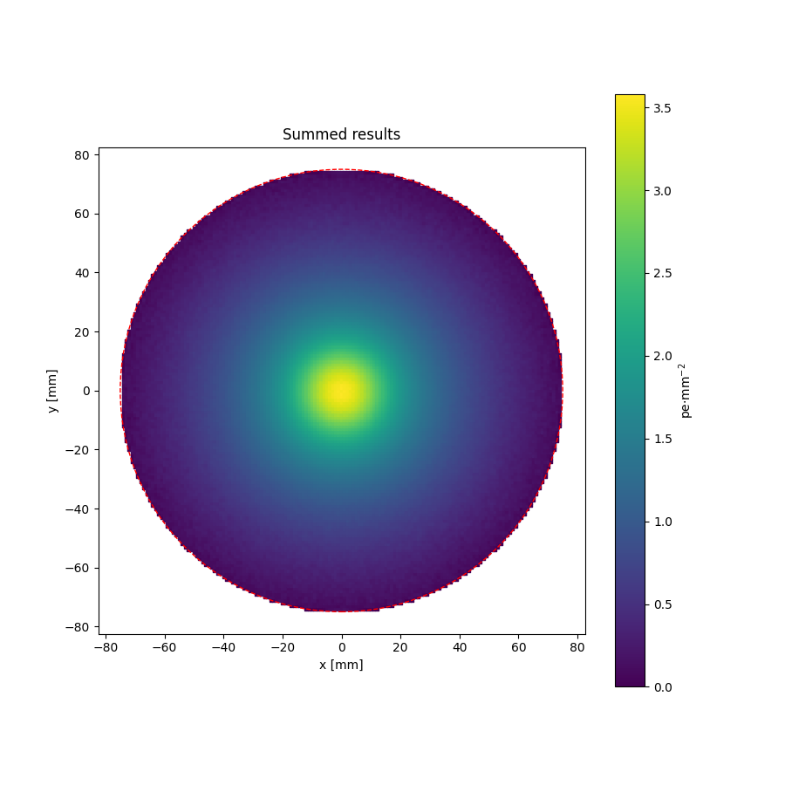
Drift, diffusion and electron extraction
Drift and diffuse the electron cloud over through the TPC volume.
90% within a 15 mm radius
Adjusted for electron lifetime and extraction efficiency.
Binned toy-MC light patterns on the top array area.
Final light distribution as the sum of each electron light pattern

Slide 19
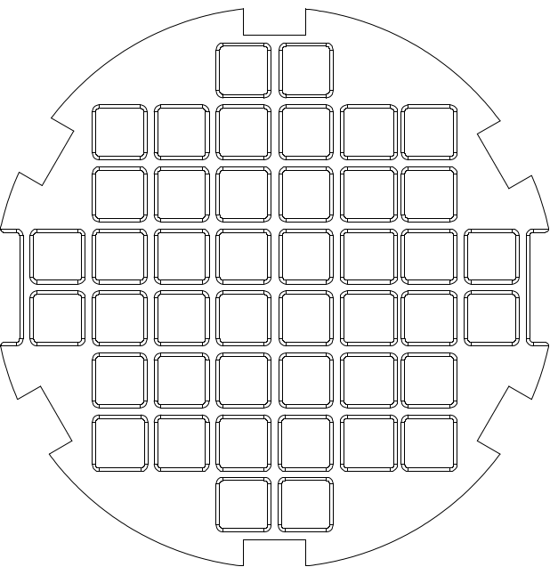
Signal on the Top Array
Actual top array is finitely tilled:
12 tiles of 4 12x12 SiPMs
Direct measurement of diffusion
Simulated response of SiPM array can be used as a template for diffusion constant fit
Inform next design choices and physics reach

Slide 20
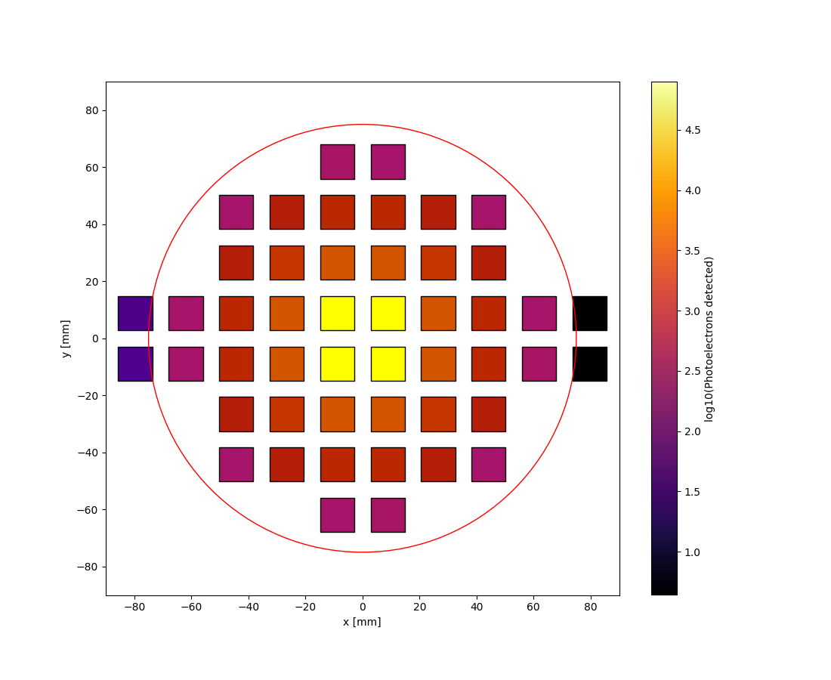
Signal on the Top Array
Actual top array is finitely tilled:
12 tiles of 4 12x12 SiPMs
Direct measurement of diffusion
Simulated response of SiPM array can be used as a template for diffusion constant fit
Inform next design choices and physics reach

Slide 21
Outlook
Xenoscope will feature an array of VUV SiPMs in its next run (starting this summer/autumn!)
All the sensors are being characterized to detect outliers and allow gain-matching
Breakdown voltage, gain, SPE resolution, DCR and CTP
At LXe and expected GXe temperature (170 K to 200 K)
Equipped with light readout, Xenoscope will be able to measure the electron longitudinal and transversal diffusion constants in LXe

Slide 22
Thank you!

Slide 23
Backup Slides

Slide 24
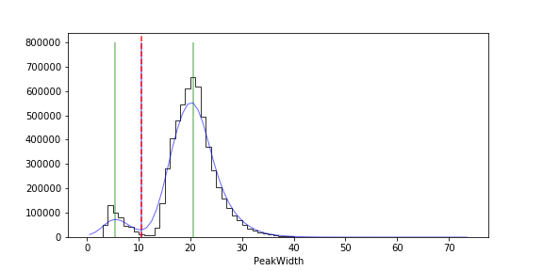
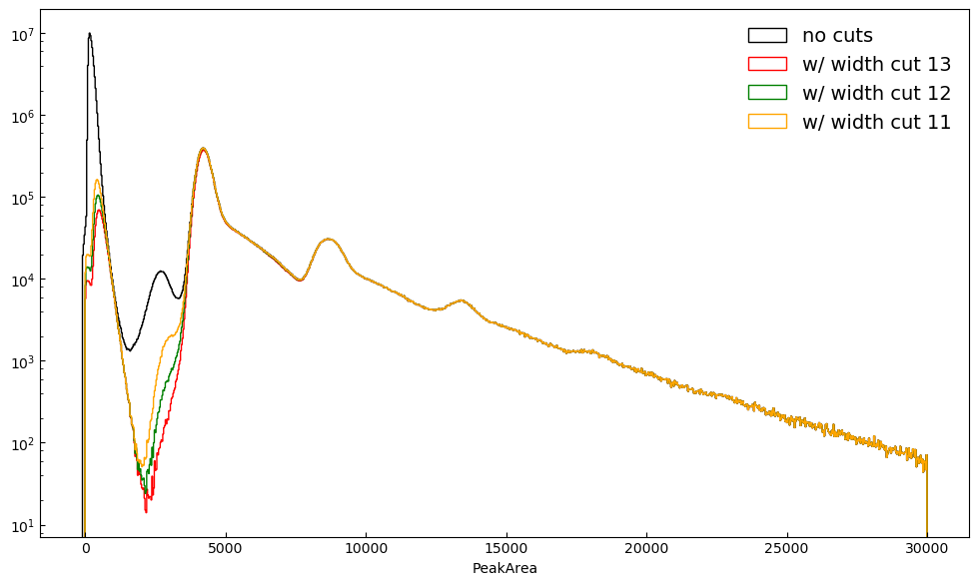
Event selection

Slide 25
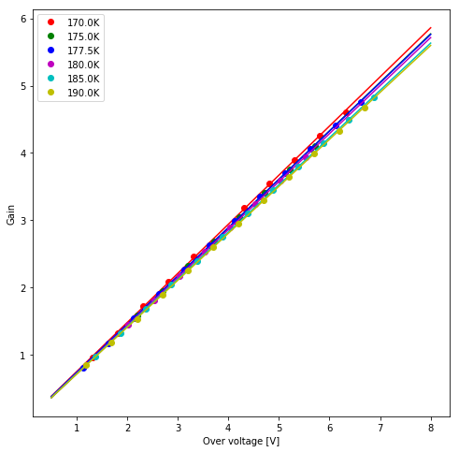
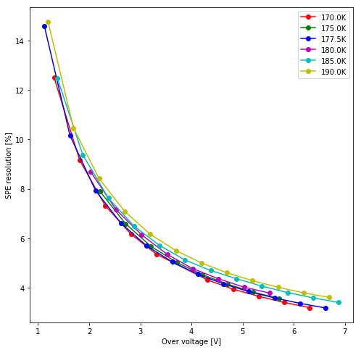
Gain and SPE – alternative plots

Slide 26
DCR vs threshold

Slide 27
Lots of PEs

Slide 28
Simulating a light signal from a diffused electron cloud
Xe lamp produces a pulse of light
Focusing effect on the hexagonal grids
Drift of electrons with longitudinal and transverse diffusion
Extraction of electrons
Some were captured by impurities
Light shining on the photocathode produces an (extended) electron cloud
Proportional scintillation in Gxe (no reflectors)
DAQ and signal processing
Detection on the SiPMs

Slide 29
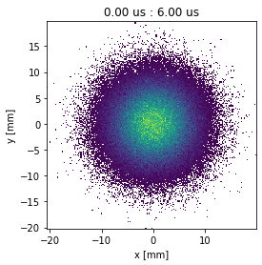
Drift and diffuse
Propagate the electrons given a certain time step.
Gaussian random-walk + drift velocity
Stop when electrons reach the length of the TPC

Slide 30
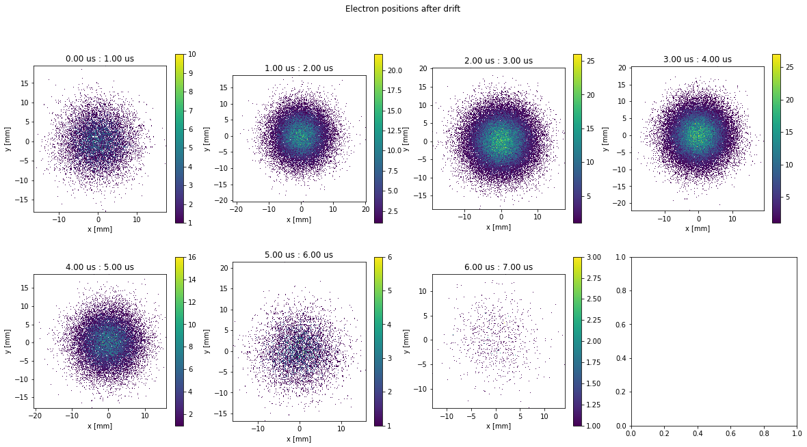
Drift and diffuse
Longitudinal diffusion will be ignored for now

Slide 31
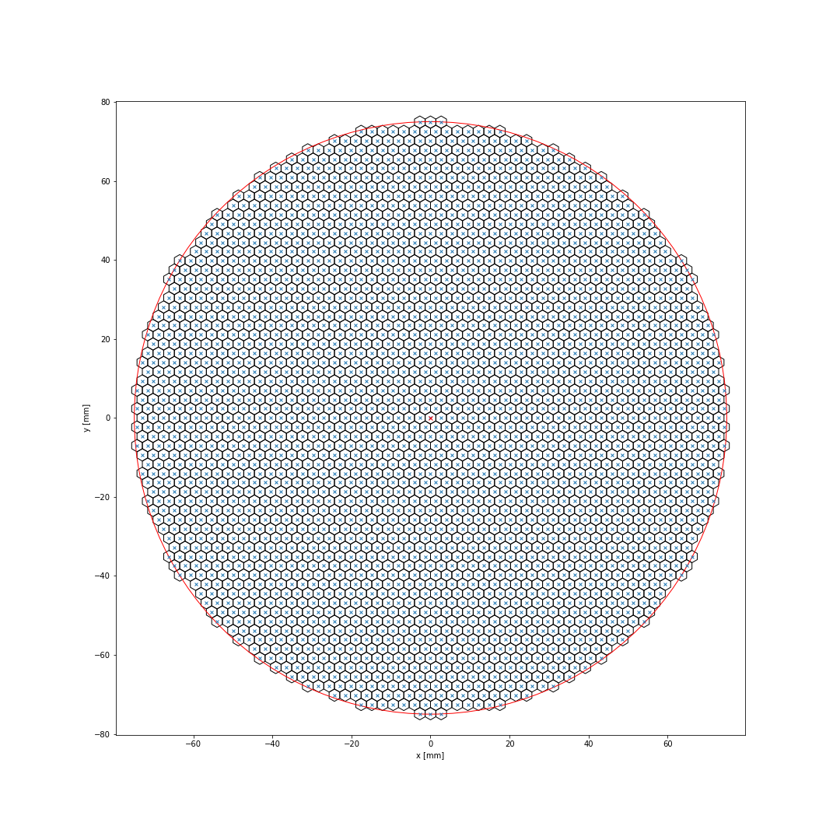
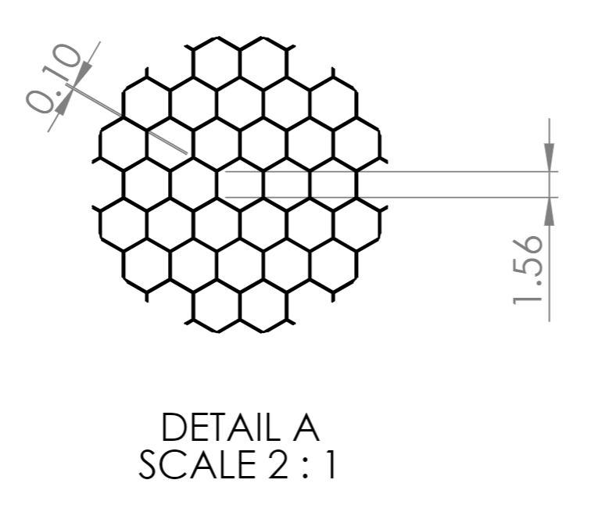
Focusing effect on hex mesh
If you need hexagonal meshes take a look at hexalattice.
Radius: 150 mm
Hex side: 1.56 mm
Hex center radius: 2.70 mm

Slide 32
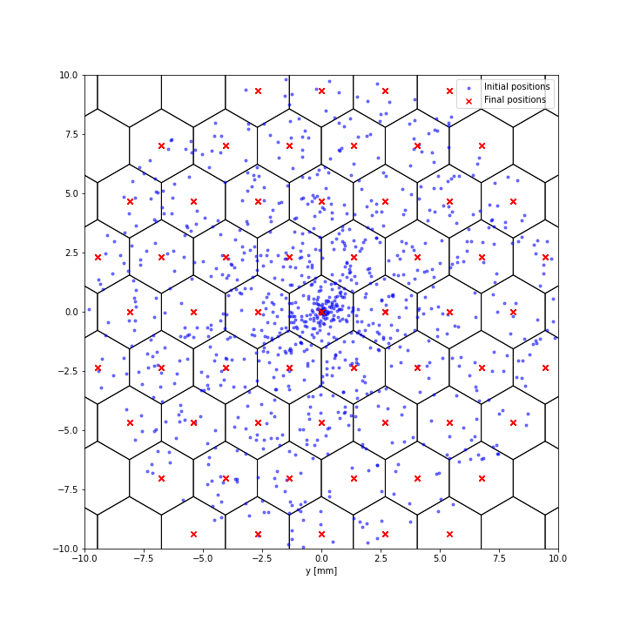
Focusing effect on hex mesh
Focusing effect simplified: all the electrons converge to their closest hex center.
Count how many electrons are in each.
Apply extraction efficiency (99%)
Apply e-lifetime (2000 us)

Slide 33
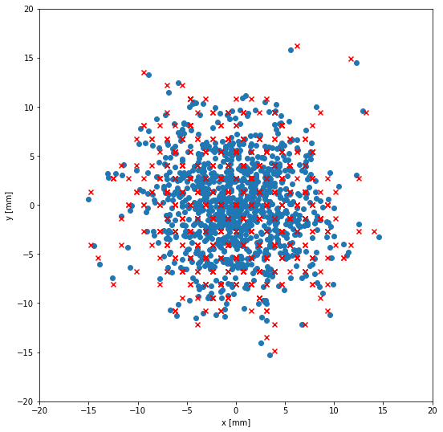
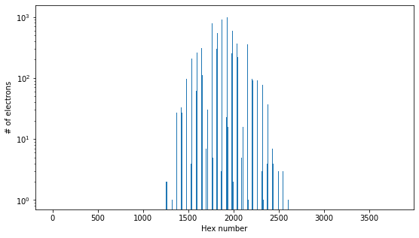
Focusing effect on hex mesh

Slide 34
From electrons to detected photoelectrons
What to take into account:
Proportional scintillation: (“over”)simplified by using a single-electron gain (28.57 pe/e- from Xurich II)
LCE maps, or what’s the chance that a photon from a certain hex center hits a certain (x,y) on the top array?
LCE maps:
Toy-MC in half a sphere (1e6-1e8)
Select hits on the Top Array
Discretize into bins (2dhist), normalize and define interpolative function (spline)
Repeat for each hex center
The number of photon/pe for a given area is then
$${\left\{\begin{aligned}x^{′}=x_{0}+\left(z^{′}−z_{0}\right)\cos{φ}\tan{θ} \\ y^{′}=y_{0}+\left(z^{′}−z_{0}\right)\sin{φ}\tan{θ}\end{aligned}\right.}^{}$$
$$\sum^{n_{hex}}{\int{LCE_{i}\left(x,y\right)dxdy }}$$

Slide 35
From electrons to detected photoelectrons

Slide 36
From electrons to detected photoelectrons
All 3808 hex centers’ LCEs were computed (~30 min)
Say a number between 0 and 3807 : )

Slide 37
Add all the patterns
Add all the patterns from all the (non-empty) hex centers
Recheck normalization
Get your final pattern
No grid survives on this size and gas gap?

Slide 38
Read on the actual Top Array
12 tiles
12*4 = 48 12x12mm2 VUV4 MPPCs
12*4*4 = 192 6x6mm2 VUV4 MPPCs
What kind of patterns do we expect from such an ensemble?
Should any adjustments still be done?

Slide 39
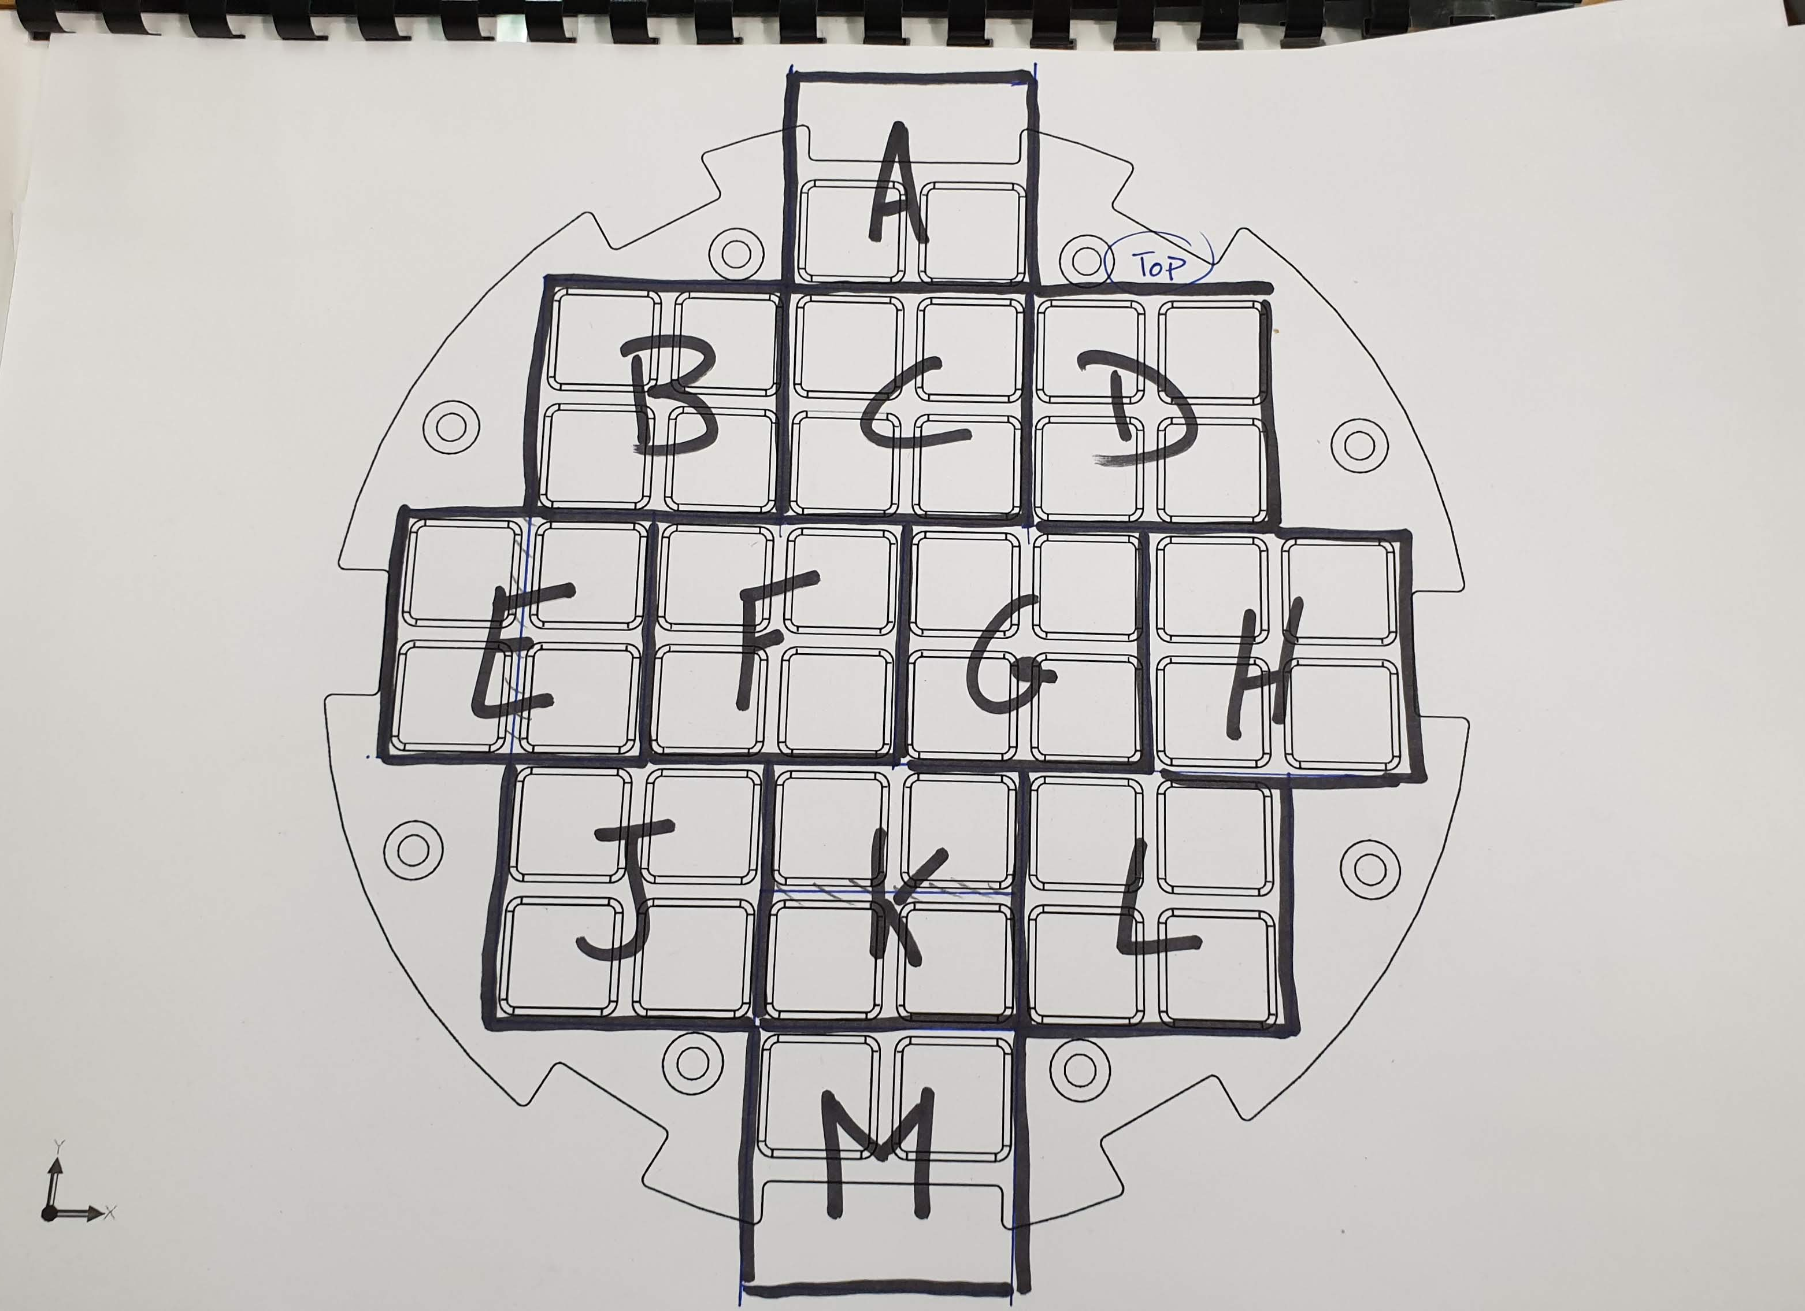
Read on the actual Top Array
Take the summed pattern and integrate

Slide 40
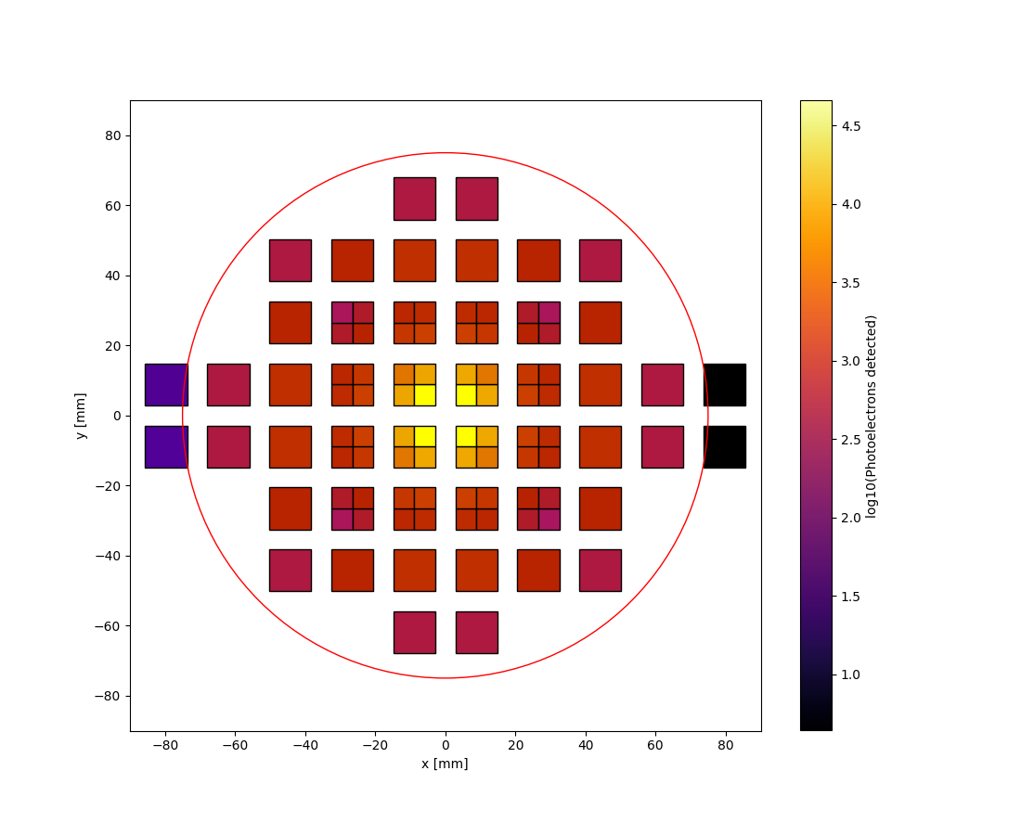
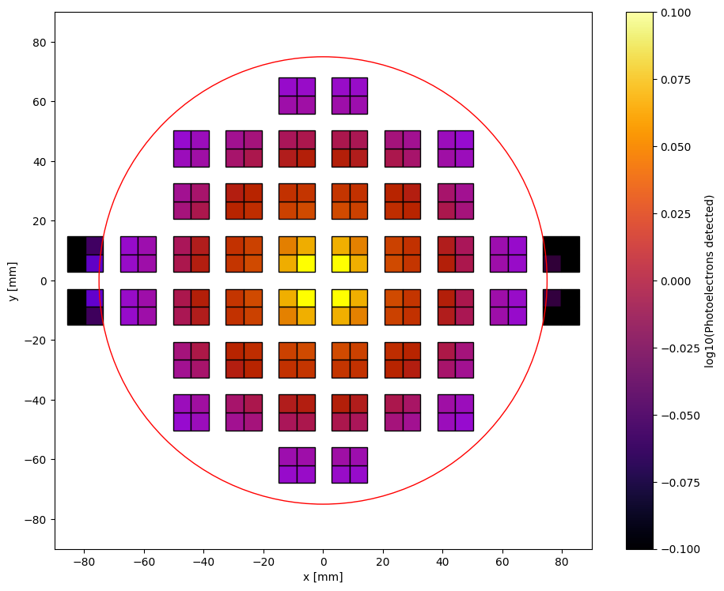
Alternative configurations

