Slide 1
Time and band-resolved scintillation in time projection chambers based on gaseous xenon
S. Leardini, E. Sánchez García, P. Amedo, A. Saa-Hernández, D. González-Díaz, R. Santorelli, D. J. Fernández, D. González
25-12-2022

Slide 2
Why to still address this in 2022?
Because, still, a significant part of the information below must be obtained by simulation!
Ionization electron in electroluminescence gap
2.4MeV electron
2nd continuum
?
?
?
C. D. R. Azevedo, DGD, S. F. Biagi et al NIM A, 877(2018)157

Slide 3
Common wisdom
Less-common wisdoms
‘3rd’ excimer continuum
assigned to Xe_{n}^{+*} and Xe_{n}⁺⁺ (n=2,3)
IR excimer continuum
1250nm
assigned to Xe*(2p5)
for xenon above ~1 bar:
𝝉_{triplet} = 100ns (about 90% of signal)
EL
𝝉_{singlet} = 4.5ns (about 10% of signal)
nBr
𝝀 = 172nm
EL threshold

Slide 4
Ok, whatever wisdom, is this known/understood or not?
problem is that most experiments conform to two basic types:
Hammer approach
Ballerina approach
Release a lot of energy into the medium
and do spectroscopy (no yield estimate)
Release particles one by one to estimate accurately the yields (and abandon spectroscopy)
if we add to the mix the possible presence of impurities, it becomes very difficult to interpret the information found in literature, when it comes to study sub-10% effects.

Slide 5
How impactul are these ‘subdominant’ emissions?
S1 (argon, 1.5bar)
S1 (xenon, 1bar)
not-resolved
not-resolved
VUV (128nm)
VUV (172nm)
UV (~200nm)
UV (~300nm)
R. Santorelli, E. Sánchez-García et al.,
Eur. Phys. J. C (2021) 81:622
S. Leardini, E. Sánchez-García et al.,
Eur. Phys. J. C (2022) 82:425 (this work)
at around atmospheric pressure, the 3rd continuum completely dominates the fast component!

Slide 6
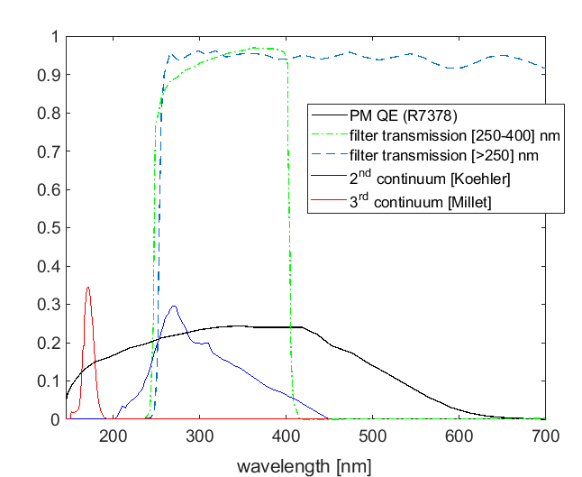
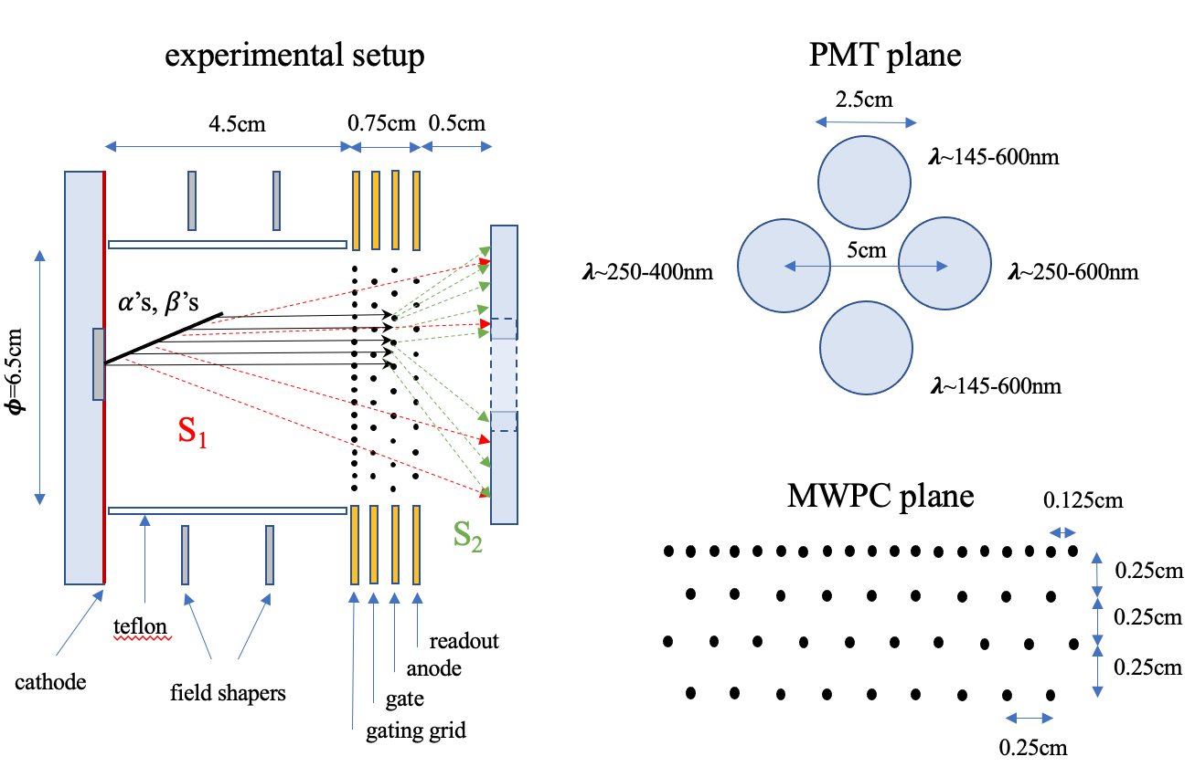
Experimental setup (I)

Slide 7
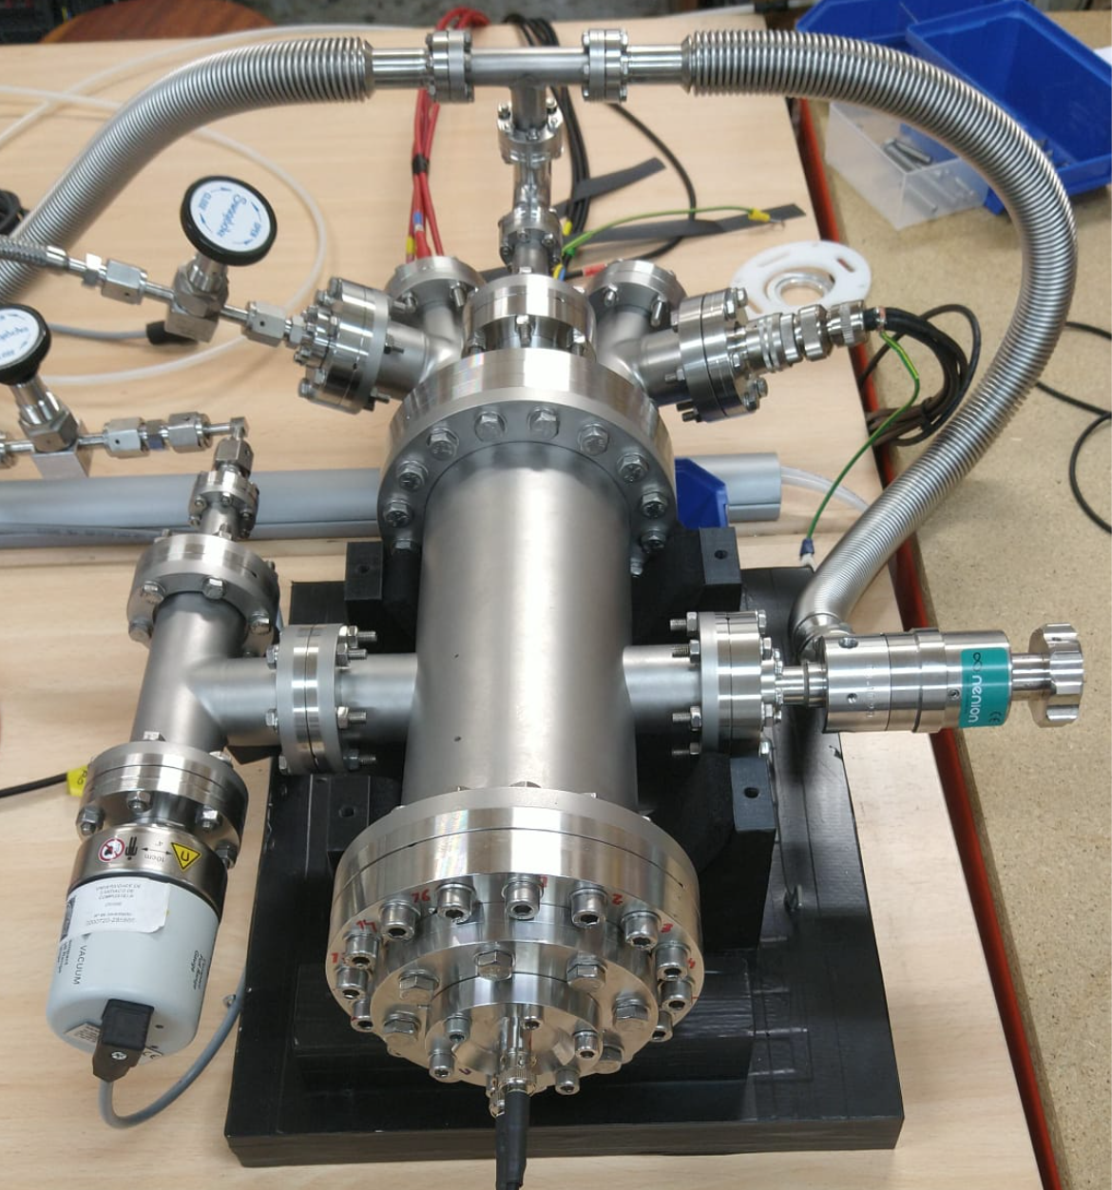
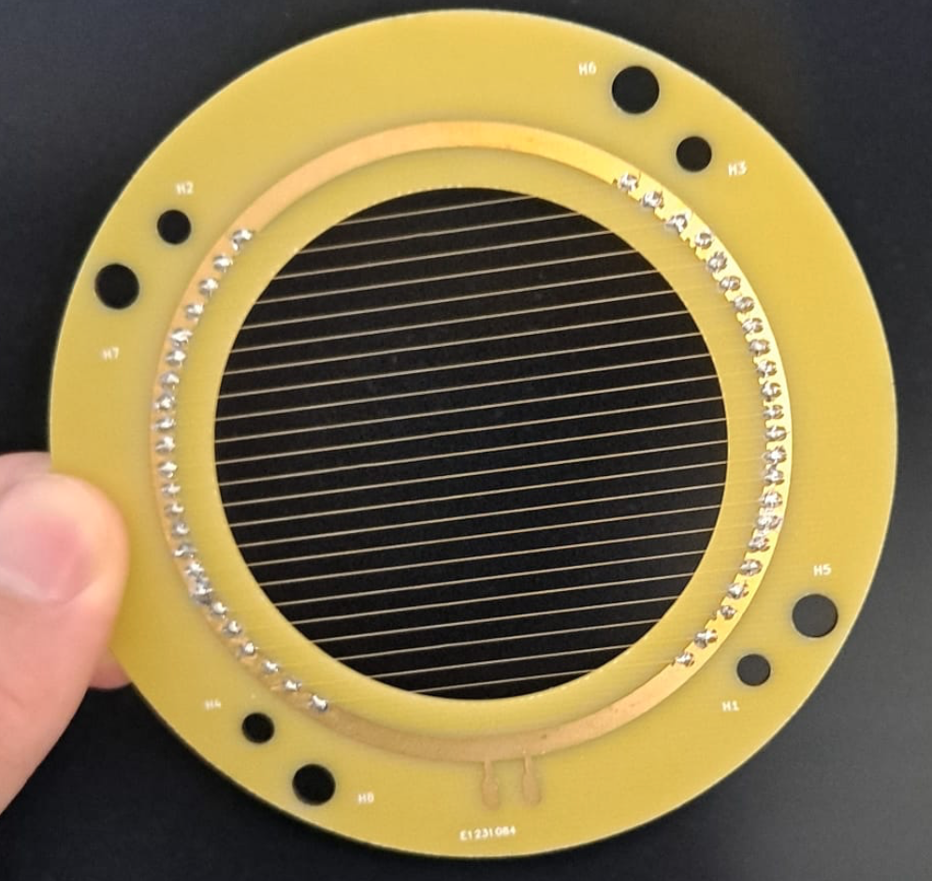
Experimental setup (II)
vessel
PM frames
setup
multi-wire readout

Slide 8
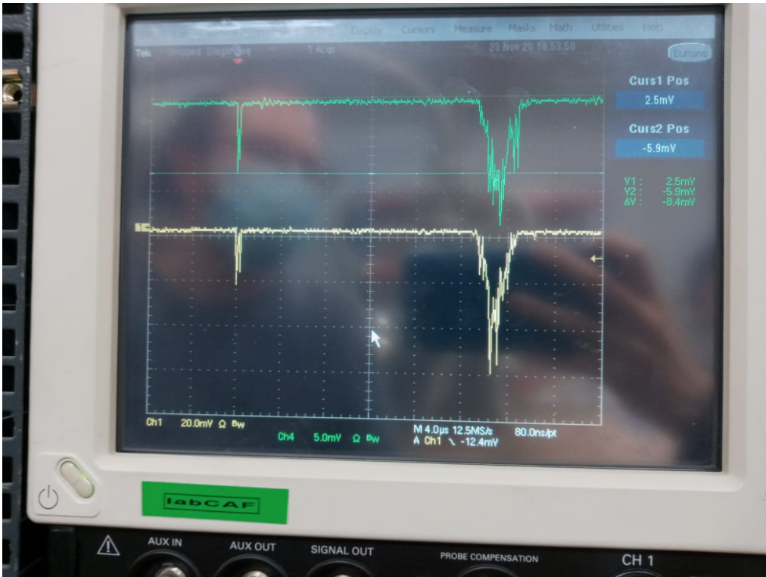
Purity situation
System pumped and He-tested.
Gas circulated through cold getter.
Xe recovered and vapor-phase purged before every new run.
Comparison of drift velocities with PyBoltz simulations showed ~ 300 ppm contamination of N₂ (no hot getter).
Time constant of Xe triplet: 85-98 ns – compatible with the estimated N₂ contamination.

Slide 9
Single-photon calibration
LED runs
time spectra [145-600]nm
5-10% variations run-to-run
(in the absence of charge recombination)

Slide 10
Results: electric field dependence
𝜶’s
𝜷’s
2nd continuum band
(no recombination signal for 𝜷’s)
3rd continuum band
(no dependence with E-field!)

Slide 11
Results: pressure dependence
𝝉_{f} = 4.5ns
𝝉_{f} = 8.3-8.5ns

Slide 12
Geometrical corrections
𝜶’s
𝜷’s
(expanded)
~10% uncertainty
consider a reflectivity range, according to literature:

Slide 13
Results: W_{sc}-values (2nd continuum band)
this work
previous results
slightly above previous values (not band-resolved), as expected

Slide 14
Results: secondary scintillation (2nd continuum band)
avalanche
region
We do not reproduce previously observed deviations from Y/P vs E/P scaling
EL region
E. D. C. Freitas et al., Phys. Lett. B,
684, 205, 2010

Slide 15
Results: secondary scintillation (visible/UV bands)
UV
UV+vis
VUV+UV+vis
Energy peak reconstructed clearly in all bands
scintillation levels and spectral content compatible with neutral bremsstrahlung emission
(no other emissions expected in the range 250-600nm)

Slide 16
Conclusions
We observed and characterized scintillation compatible with the previously reported 3rd continuum emission (same time constant and spectral band).
At around 1bar, it represents the biggest contribution to the fast component of the scintillation signal, dropping by a factor x2 at 10bar.
Despite involving highly ionized states, third continuum is highly independent from electric field.
No recombination signal observed for ~0.5MeV electrons at 10bar.
W_{sc} slightly higher than previously reported, compatible with errors. Higher tension for 0-field W_{sc}-values.
Y/P vs E/P scalings reproduced in the range 3-10bar (contrary to previous observations).
Evidence for broad-band emission in the secondary scintillation signal, compatible with neutral bremstrahlung.

