Slide 1
Experimental aspects of top-quark physics
at FCCee
Detector constraints from top-quark physics
Jeremy Andrea (IPHC, Strasbourg)
1

Slide 2
Introduction
The top-quark program at FCCee is vast (see previous talks) and the runs at $t\overline{t}$ threshold (and beyond), might lead to specific detector requirements.
The expected precisions of measurements and sensitivities to new physics have been studied in several ILC, CLIC and FCCee publications and notes.
Some examples of these studies are presented here, to illustrate the physics needs in terms of detector precisions and performances.
Outline:
FCCee schedule for top quark physics,
Beam-induced backgrounds,
Discussions on experimental systematics, with some examples,
Discussions on future studies.
Not in this talk : precise quantification of the impacts of detector designs on top quark measurements !
Thanks to : Patrizia Azzi, Auguste Besson, Alain Blondel, Patrick Janot, Roman Poeschl, Juergen Reuter, Frank Simon
For sharing their experiences, thoughts and for the many references !

Slide 3
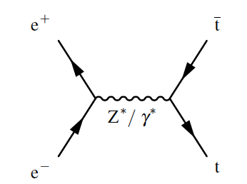
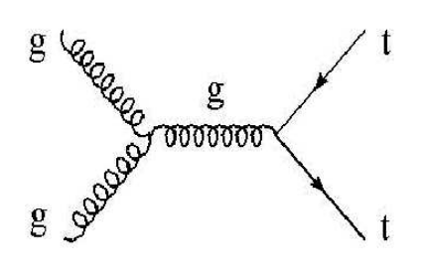
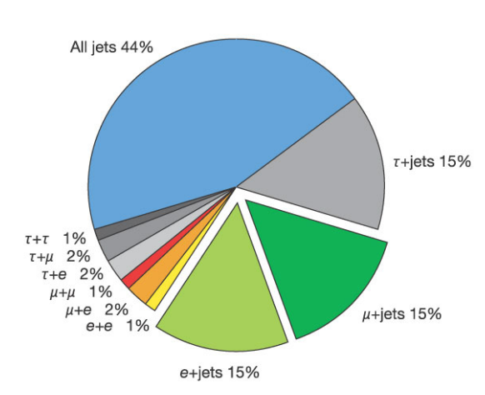
$t\overline{t}$ events properties : reminder
Heaviest particle known so far.
Decays before hadronises => top quark can be reconstructed precisely from decay products.
Decays almost entirely into a $W$ boson and a $b$-quark (although it is interesting to measure ratio to $\left|V_{tb}\right|+\left|V_{td}\right|+|V_{ts}|$).
LO e+e-
LO pp
At the LHC :
dileptonic channels are very precise => lower background and large lumi compensate the lower Br,
Full hadronic very challenging because large QCD- multijet background,
Semi-leptonic channel shows a good compromise.
At FCCee, the situation is totally different ! Moderate backgrounds for all channels, mainly from WW,
➔ Easier to exploit all channels.
$t\overline{t}$ decays contained all objects ! Very relevant for determining detector requirements.

Slide 4
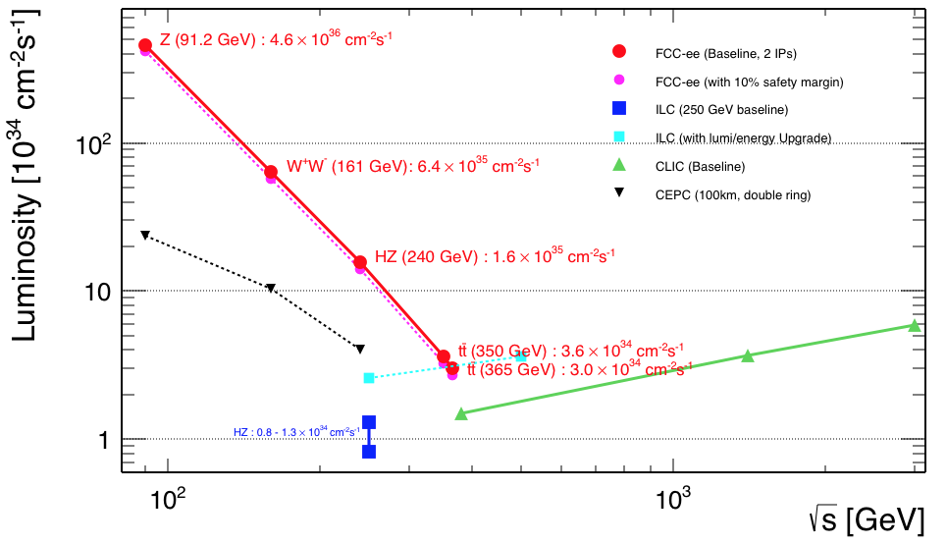
$t\overline{t}$ program at FCCee
FCCee schedule : run at different collision energies.
Top quark physics program in two steps :
Scan energies from ~340 to ~350 GeV, 0.2 ${ab}^{−1}$ in total,
Large statistic run at 365 GeV, 1.5 ${ab}^{−1}$.
Cross section at 365 GeV ~1000 fb => ~2 Mevts in total.
1-2 order of magnitude lower during the scan.
Important to identify dominating systematics ➔ improve detector design, analysis and run plan.
We want stat. dominated measurements !
Z(4 ys)
WW
(1y)
ZH(3y)
LS
(1y)
tt(4 ys)
72${ ab}^{−1}$
10 ${ab}^{−1}$
5 ${ab}^{−1}$
0.2+1.5 ${ab}^{−1}$
Theoretical uncertainties not discussed here (see talk from G.Durieux), but key element !

Slide 5
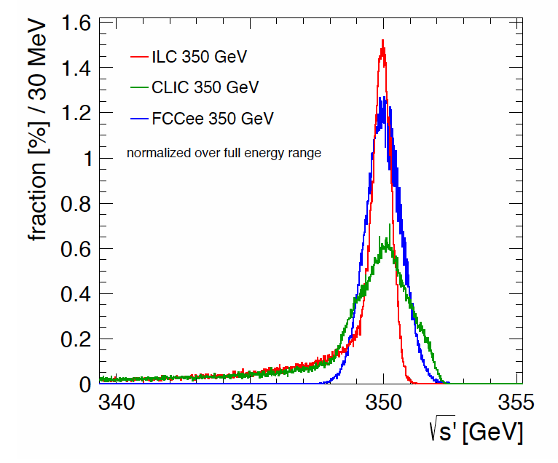
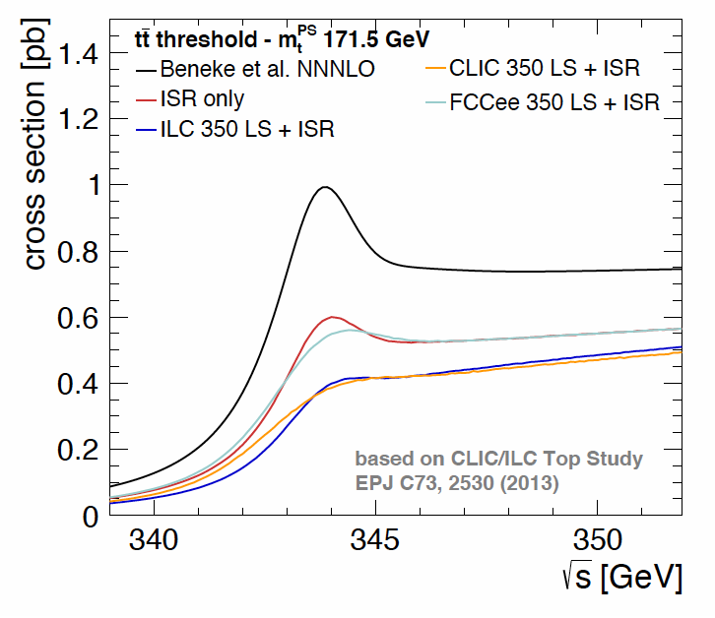
Beam characteristics and impact on $t\overline{t}$ at FCCee
F.Simon, PoS (ICHEP 2016) 872
Due to the energies involved and beam optimisation, there is some beam energy spread at $t\overline{t}$ thresholds.
Beam energy spread, systematics ?
beam energy (spread) measured with dimuon-events at top energies to very precise values,
high muon resolution required, known better than ~10%.
Can be adjusted with machine optimisation.
At FCCee : narrow and no tails toward lower energies
Beamstrahlung effects on beam profile small, energy loss recovered by RF.
Impacts of energy spread :
lower effective cross sections (fraction of the lumi below the threshold),
broader ”turn-on” ,
interplay between statistics and energy shape,
FCCee in a favourable position.
ISR
BES
BS
Has to be accounted in the simulation/interpretation !

Slide 6
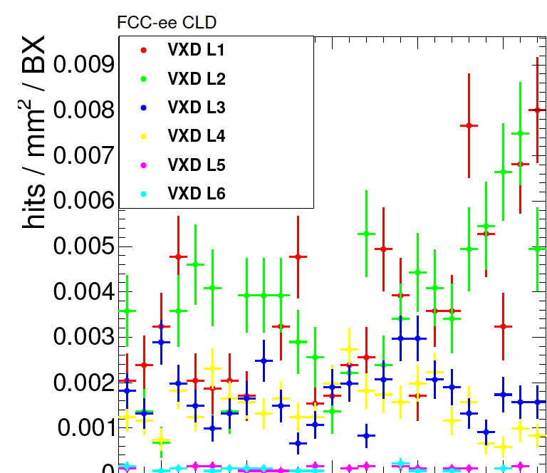
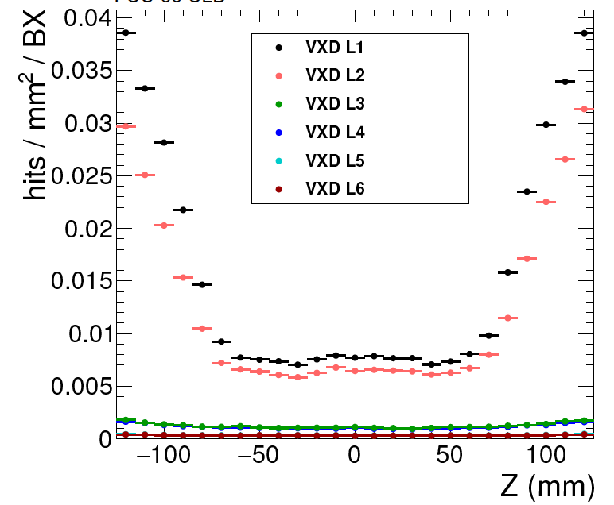
Beam backgrounds at $t\overline{t}$ threshold
Beam Backgrounds :
$γγ→hadrons$ found to be negligible,
Synchrotron Radiation (SR) from last bending magnet,
Incoherent Pair Creation (IPC, $e^{+}e^{−}$ pair via interaction with beamstrahlung).
Effects estimated from full simulation, impact on the CLD vertex detector shown.
SR largely reduced by shielding : #hits/BX reduced by 2 order of magnitude to achieved 700 hits/BX (<40 extra MeV per bunch crossing),
IPC contribution significant (especially in first layers), but moderate => acceptance choices.
(Naïve) interrogations on detector requirements (mainly for inner most layers of Vertex detector) :
What is the minimum granularity required in the innermost layers of the vertex detector ?
What is the radiation tolerance ?
What is the readout rate ?
CDR FCCee
SR
IP
First CLD layer acceptance

Slide 7
Do we need a trigger at $t\overline{t}$ threshold ?
Trigger (at least software) might be foreseen for the Z run.
Effects of trigger selection on analysis (my LHC bias) :
Could cause lower signal efficiencies ?
Systematics on the trigger efficiency ?
At FCCee : mainly to reject beam-backgrounds, we want to keep all physic backgrounds (physics, alignment, calibrations and efficiencies measurements etc…).
Rate of bunch crossing at $t\overline{t}$ (back of the envelop) : ~3000 ns of bunch spacing => ~300kHz, that is ~3 times the actual CMS/ATLAS L1 trigger rate, but half of the HL rates.
Can/should we avoid L1 and/or HLT triggers ?
(Naïve) questions to answer :
What is the rate of beam backgrounds ?
What is a typical size of an event ?
What is the needed readout speed and disk throughput ?
At minima : low trigger requirements to detect a collision (a la LEP). Trigger systematics should be small !

Slide 8
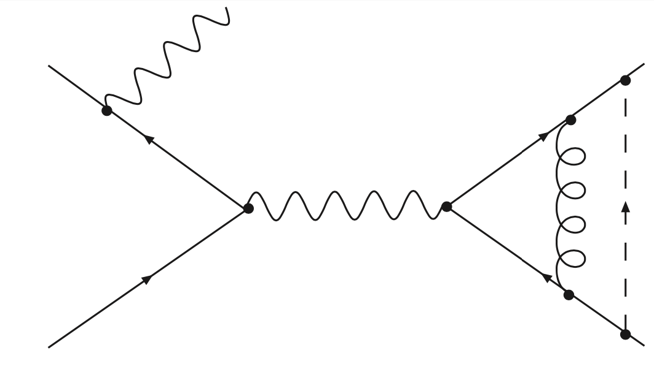
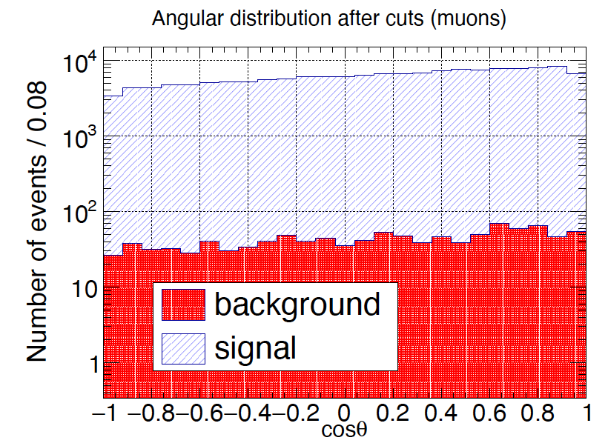
Precision of $t\overline{t}$ cross section measurements
Inclusive and differential => probe of $t\overline{t}Z$ and $t\overline{t}γ$ couplings (EFT related) at LO. Sensitive on $t\overline{t}g$ and $t\overline{t}H$ (EFT) couplings at NLO !
Dominant backgrounds (lepton+jets):
WW(dominant)/ZZ => b-tagging !
WWZ, ZH => more difficult to reject, but much lower cross section (/20).
Events selection :
one (relatively loose) isolated leptons with $p_{T}$>10 GeV, 80-90% efficiency,
no jet reconstruction in the LHC-sense : event reconstruction with expected number of jets as inputs (VTL algo),
cut on the “compatibility” of the jet multiplicity hypothesis,
b-tagging requirements,
jets and lepton association to top, with a kinfit (W and top mass).
Overall efficiency ~60-70% can be achieved (JHEP 11 (2019) 003), very high purity (>99%).
Target systematics ~few % (even below ?)
physics background should not be a problem,
highest possible selection efficiency : flavour tagging (!) but lepton sel/jet reco not negligible => impact also acceptance and modelling uncertainties !
Excellent control of selection efficiencies (from data).
$$α_{s},t\overline{t}g$$
$$t$$
$$e^{+}$$
$$Z/γ^{∗}$$
$$g$$
$$H$$
$$e^{−}$$
$α,t\overline{t}Z$, $t\overline{t}γ$
$$\overline{t}$$
$$y_{t},t\overline{t}H$$
Foppiani, Pajero, Janot

Slide 9
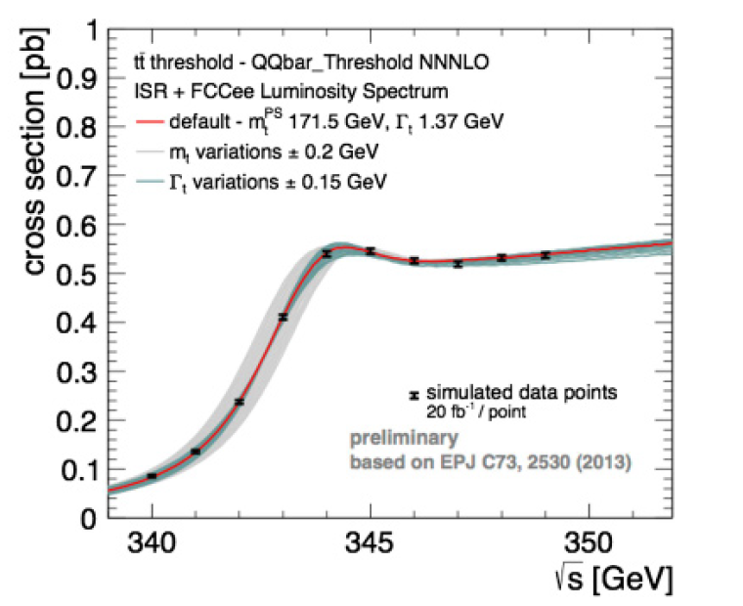
Top mass measurement
Top mass measurement from cross sections => resolving top mass “ambiguities” : MC mass vs mass in various renorm. scheme. Also important to keep the universe safe against vacuum instability !
Typical mass difference in the various renorm. schemes ~200 MeV.
Mass extracted from various cross section measurements while scanning $\sqrt{s}$ , and then compared to theoretical predictions.
Cross section measurement precision : 1-2% to reach <200 MeV.
CDR FCCee
$$α_{s}$$
$$y_{t}$$
$$m_{t}$$
$$Γ_{t}$$
Expected precisions (CLIC analysis revisited for FCCee):
Stat uncertainty at ~15 MeV,
Beam energy, reconstruction efficiency and background contamination ~50 MeV ,
And luminosity ... ~10 MeV,
Total uncertainty below 100 MeV, previous measurements of $α_{s}$ => reduction to < 50 MeV could be achievable!
Experimental uncertainties (close to be) dominated by statistics is possible at the FCCee !
Still significant impact of theory uncertainties : requires a significant effort from theory community.

Slide 10
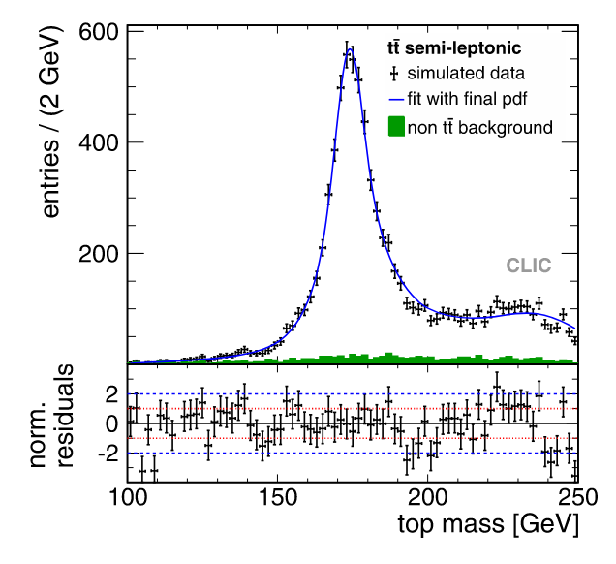
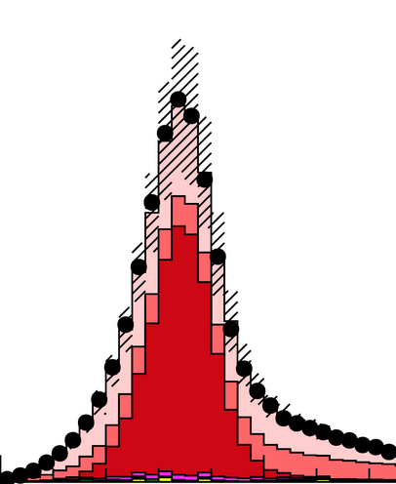
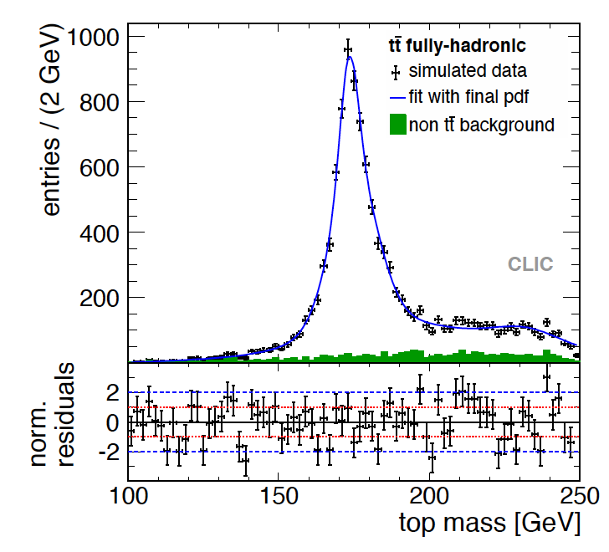
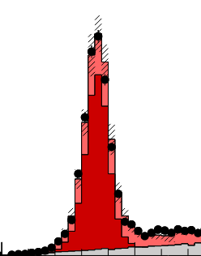
Direct measurement of top mass from decay products (above threshold)
CLIC, EPJC 73 (2013) 2530
Direct mass measurement from top quark decay products (in a nutshell):
reconstruct and identify decay products,
reconstruct top quarks candidates using a kin fit (determine jets-lepton associations),
fit the reconstructed top mass with templates issued from MC generation. Simultaneous fit with JES reduces systematics,
requires “calibration” : input $m_{t}^{MC}≠m_{t}^{reco}$.
Comparisons with CMS top reconstruction at 13 TeV, 35.9 ${fb}^{−1}$.
Estimations of the uncertainties (CLIC@380 GeV) :
stat: 30-40 MeV for 1${ab}^{−1}$,
moderate impact of JES : 2% variation of light and b jets = 200 and 350 MeV,
JES related uncertainties can be greatly reduced by including the perfect knowledge of the initial stat into the events reconstruction,
=>statistically dominated measurement?
Direct top mass measurement can be competitive with the threshold scan measurement.
Other “non” standard measurements can help (dilepton, $J/ψ$, endpoints, extra jet/$γ$) => combinations?
CMS-17-007
CMS-17-008

Slide 11
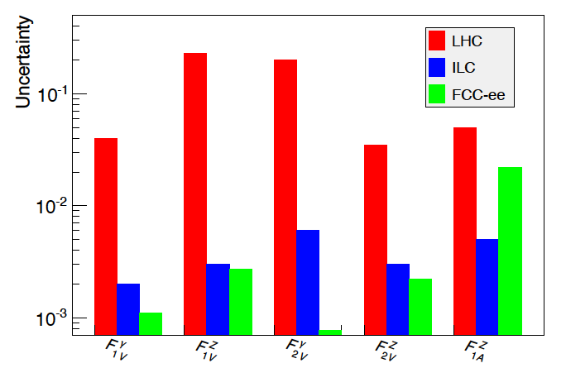
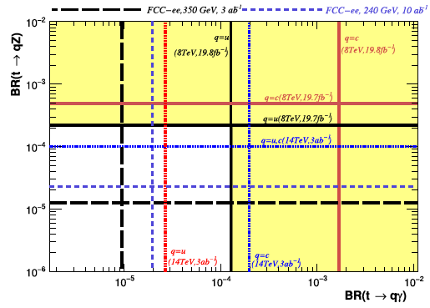
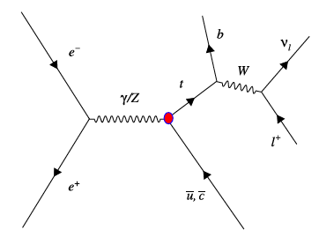
Top quark couplings to bosons
Sensitivity on (anomalous) $t\overline{t}$ EWK couplings.
Based on lepton energy and polar angle :
very low expected experimental uncertainties,
dominated by stat. uncertainties (and theory).
Lower integrated lumi and larger boost at higher energies => better precision at 365 GeV than higher energies.
JHEP(2015)182
Top-quark FCNC couplings to $γ, Z, H$ usually probed in top quarks decays in $t\overline{t}$ (probably to be updated).
Interesting channels at lepton colliders : single top production possible for $tγ$ and $tZ$-FCNC.
Very promising channels : higher cross section, limited by statistics and background contamination (Wjj), $t\overline{t}$ channels still useful to disentangle $tγ$ from $tZ$.
Large impact of b and c-tagging.
PLB 775(2017) 25-31

Slide 12
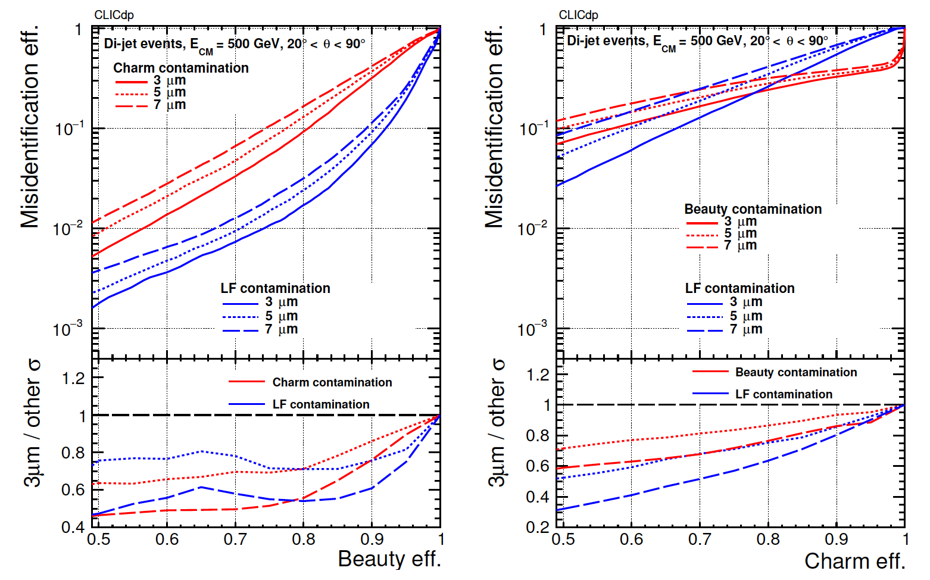
Detector impact on flavour tagging
Flavour (b/c)-tagging is a key element for top quark physics.
$ε_{t\overline{t}}∝ε_{b}^{2},$
Top-FCNC , $t→cH(b\overline{b})$, ${ε_{tHc}∝ε}_{b}^{2}ε_{c}$.
B-tagging and c-tagging performances for various single point resolutions.
From 7$μ$ to 3$μ$:
$ε_{b}:\sim 8\%$(abs.) improvement at $ε_{l}≈1\%$,
$ε_{c}:\sim 18\%$(abs) improvement at $ε_{l}≈10\%.$
➔ increase of ~10% abs (20% rel) of $ε_{t\overline{t}}$ (for Medium P…) and ~15% abs (75% rel) of $ε_{tHc}$.
Flavour tagging systematics ⬄ data driven estimations of efficiencies.
CLICdp-Note-2018-005

Slide 13
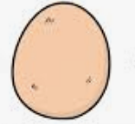
General (naïve) comments on detector design “optimisation”
Needs (resolutions, efficiencies etc…) for top quark physics are probably very similar to the Higgs physics, at first order.
We need to verify this assumption at $t\overline{t}$ threshold (different beam conditions and backgrounds)!
Some of this work already done for CLD/IDEA : do we want to join effort there, or create our own design? A lot to learn from ILC/CLIC here as well !
High involvement required !
Physics
performance
Tools needed for Physics performance studies :
FastSim => interesting to test sensitivity on detector performance, but rapidly limited,
FullSim => ultimately needed, but takes time, need (flexible) reconstruction,
Intermediate approach with some modelling ? Partial fullsim (not entire detector) to feed fastsim?
Developments need to proceed in parallel.
Enough work on all topics to keep us busy for years.
Detector
Design
Reconstruction
Algorithm

Slide 14
Conclusion
The FCCee top quark physics program is rich and useful !
FCCee will deliver a luminosity up to 2${ab}^{−1}$, the expected very low systematics could lead to statistically dominated measurements.
Expected precisions are just outstanding !!
To achieve this ambitious scientific program, outstanding detectors have to be designed :
deal with beam background efficiently,
highest possible acceptance/efficiency to maximise statistical precision and lower signal modelling uncertainties,
ultra-performant flavour tagging => high resolution of innermost tracker layers required,
systematics related to control efficiency/resolutions/energy scale (also from data) .
To better study the interplay between detector performances/designs and top quark physics, at lot still has to be done => lot of fun ahead 🤪!

Slide 15
Backup

Slide 16
Discussions on backgrounds
List of the main background and cross sections.
Beam backgrounds (large angle) M.Dam link

Slide 17
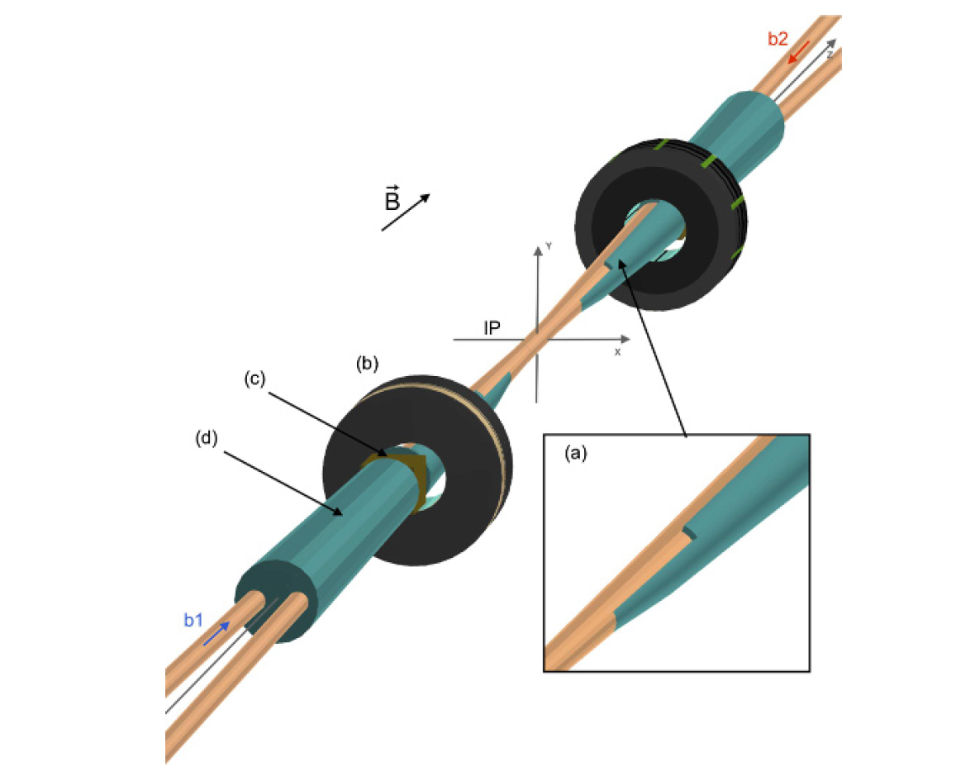
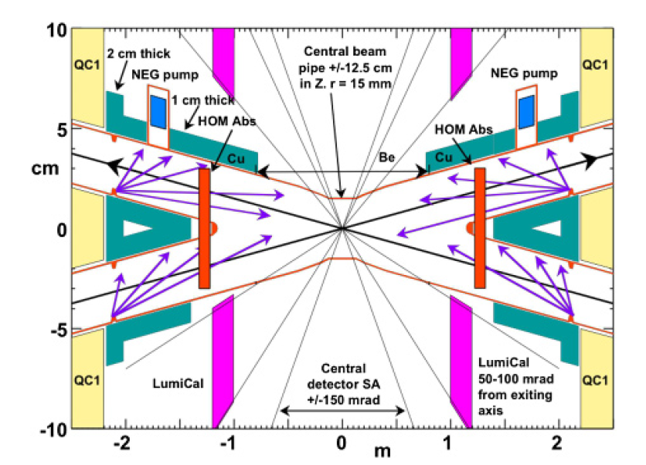
Interacting points

Slide 18
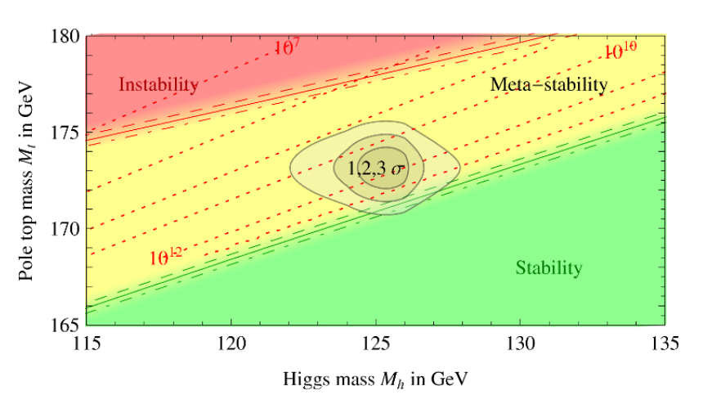
Top mass : target
Objectives of top mass measurement :
Test of the SM, yukawa couplings and top mass,
Confront pole mass to the “MC” mass (differences of a coupe f hundreds MeV),
Study of the stability of the vacuum, differentiations between stable and meta-stable universe.
JHEP08 98 (2012)

Slide 19
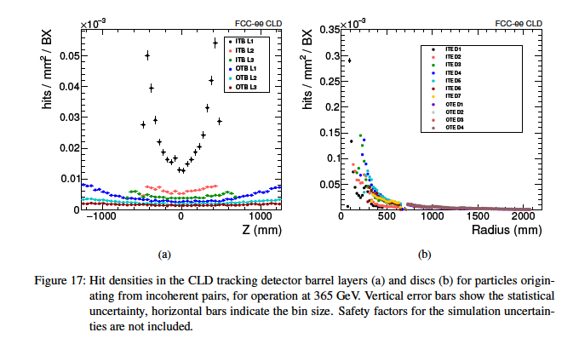
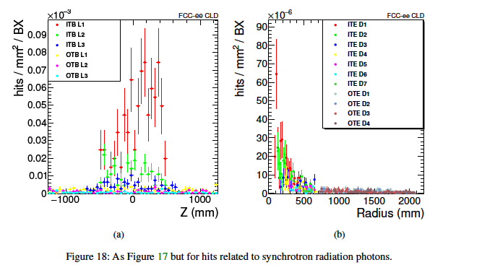
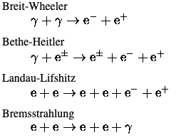
Beam background

Slide 20
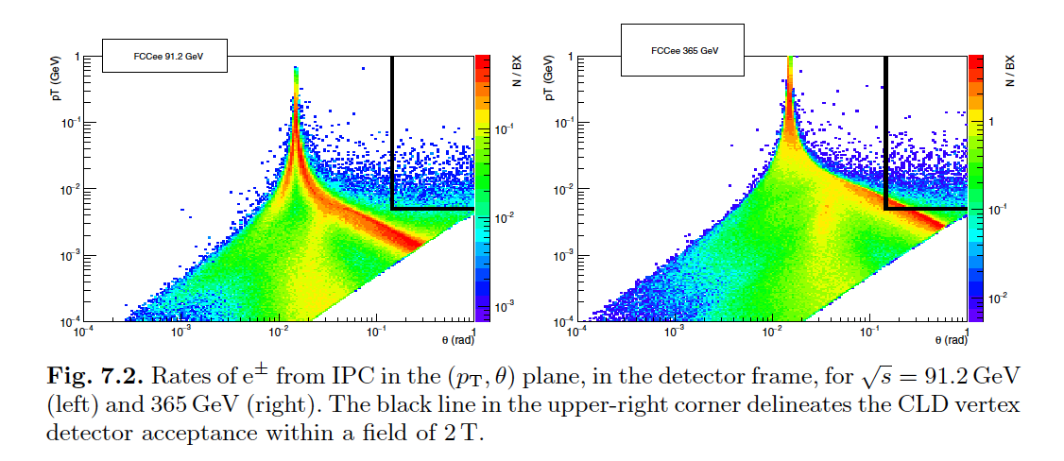
Rates of electron pair backgruonds

Slide 21
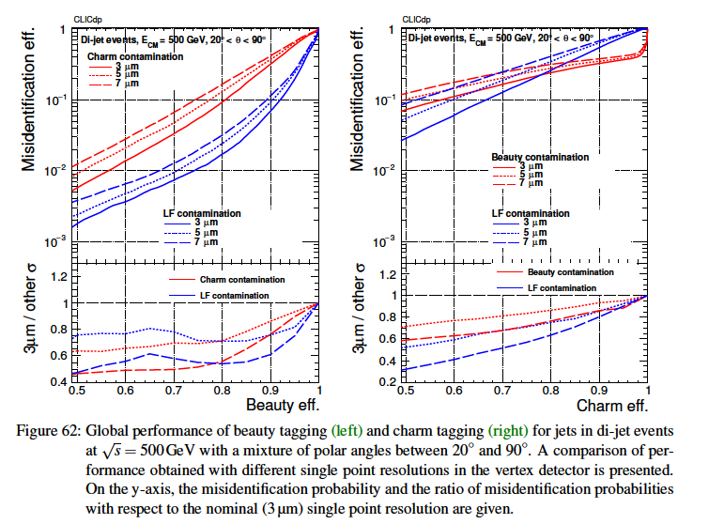

Slide 22
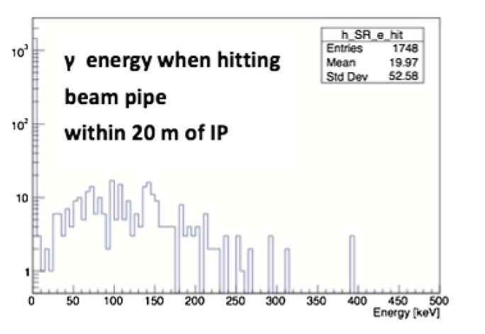

Slide 23
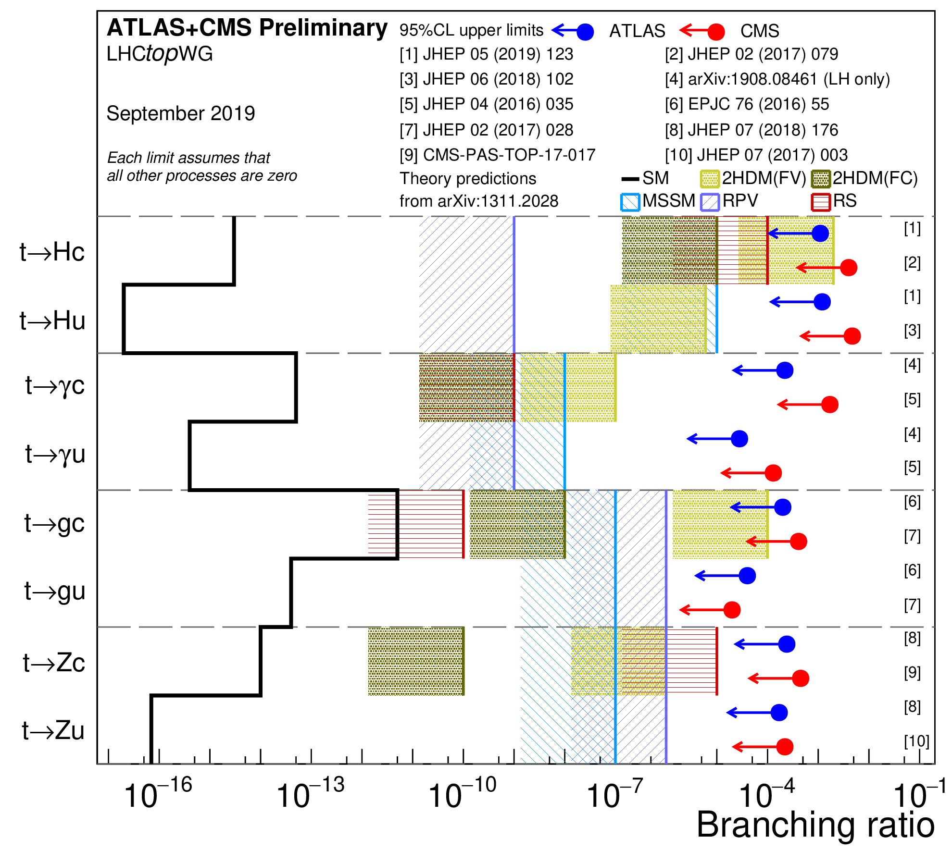
Status top FCNC at LHC

