Slide 1
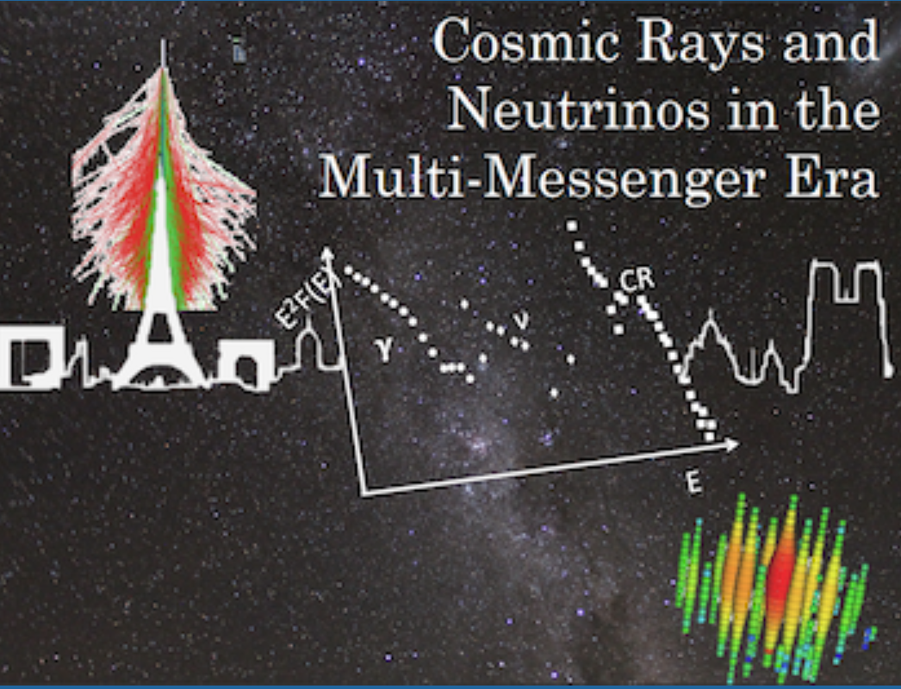
WELCOME !
Dmitri Semikoz
APC, Paris

Slide 2
Cosmic rays and neutrinos in multi-messenger era
Dec 7-11, 2020

Slide 3
Workshop schedule
All talks and discussions will be recorded and can be found on indico web-page of Workshop
To the speakers: don't forget to upload your talk on indico before the beginning of the session. In case of issues, send the slides to cosmicraysandneutrinosinparis@gmail.com
Don't miss the poster sessions (two on Monday and two on Friday). We ask the presenters to be near their posters for at least two sessions. The poster rooms can also be visited at any time during the conference.
Don't miss on Tuesday the Art&Science talk presented by Donald Fortescue, PhD in Art and professor at the Californian College for the Arts in San Francisco

Slide 4
During session
Please do not forget to mute your microphone and turn off your camera when you are not speaking
Remember to raise your hand during question time.

