Slide 1
JRA4-WP22
3D structure of the nucleon in momentum space (TMD-neXt)
Alessandro Bacchetta

Slide 2
Plan :
1 Work performed from the beginning of the project to the end of the period covered by the report and main results achieved so far
2 List of the Deliverables and Milestones achieved
3 Progress beyond the state of the art, expected results until the end of the project and potential impact

Slide 3
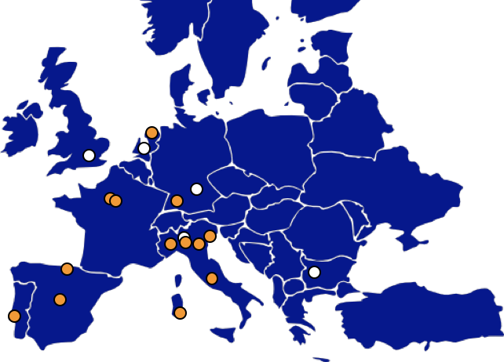
JRA4-WP22
3D structure of the nucleon in momentum space (TMD-neXt)
INFN
  Frascati
  Cagliari
  Ferrara
  Pavia
  Torino
  Trieste
CEA/IRFU Saclay
CNRS/CPHT Palaiseau
University of the Basque Country, Bilbao
LIP, Lisbon
Universidad Complutense, Madrid
Rijksuniversiteit Groningen
University of Montenegro
3D structure of the nucleon in momentum space (TMD-neXt) Alessandro Bacchetta

Slide 4
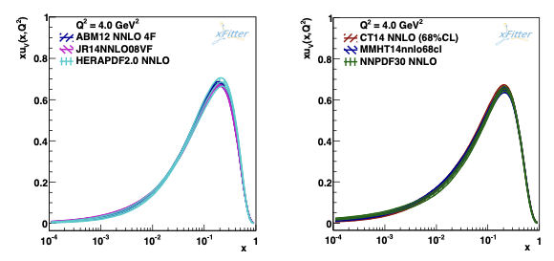
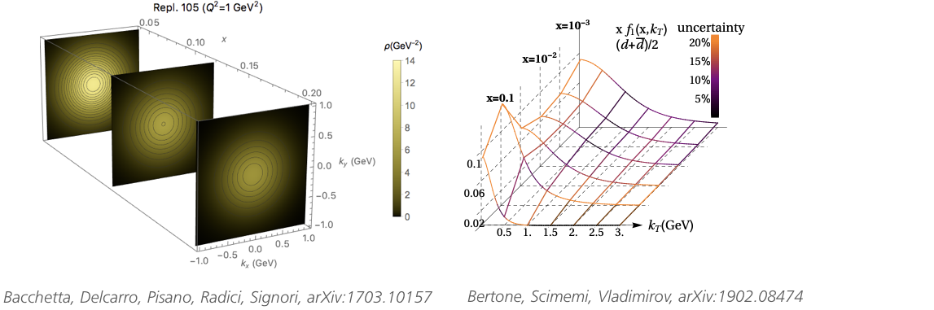
standard PDFs
JRA4
From standard PDFs to
Transverse-Momentum-Dependent PDFs
TMD PDFs
3D structure of the nucleon in momentum space (TMD-neXt) Alessandro Bacchetta

Slide 5
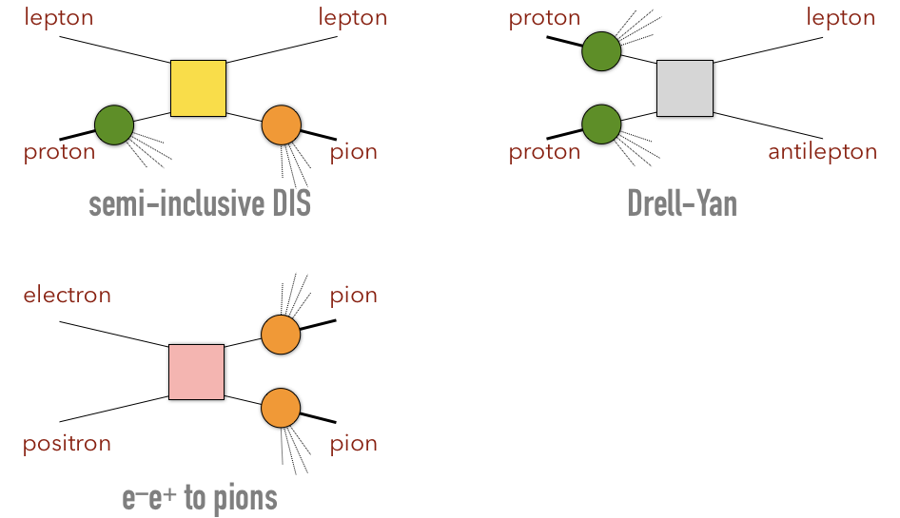




Where do you access TMDs?
3D structure of the nucleon in momentum space (TMD-neXt) Alessandro Bacchetta

Slide 6
Overall situation
Progress taking place in each task
Complex WP, with theory and several experiments together
Already more than a dozen publications, mainly theory/phenomenology
Not much money used so far
3D structure of the nucleon in momentum space (TMD-neXt) Alessandro Bacchetta

Slide 7
Costs
Personnel: two researchers have been hired (at INFN Trieste and U. Montenegro). The goal is to hire 4-5 more researchers for two years, using matching funds. Most of the hiring should take place next year.
Other costs: participation to a few conferences and workshops, but only about 3500€ have been spent, also due to Covid
3D structure of the nucleon in momentum space (TMD-neXt) Alessandro Bacchetta

Slide 8
WP Tasks
Task 1. Analysis of Drell-Yan data.
Task 2. Analysis of semi-inclusive DIS data
Task 3. Analysis of electron-positron data
Task 4. Quark TMD extractions
Task 5. Gluon TMD studies
3D structure of the nucleon in momentum space (TMD-neXt) Alessandro Bacchetta

Slide 9
WP Gantt diagram

Slide 10
Task 1
Analysis of Drell-Yan (DY) data
The analysis of COMPASS (2018 data taking) and CMS (2016 data taking) are in an advanced stage.
Publications expected in 2021.
3D structure of the nucleon in momentum space (TMD-neXt) Alessandro Bacchetta

Slide 11
Task 2
Analysis of semi-inclusive DIS data
The analysis of COMPASS (2016 data taking) is in an advanced stage.
3D structure of the nucleon in momentum space (TMD-neXt) Alessandro Bacchetta

Slide 12
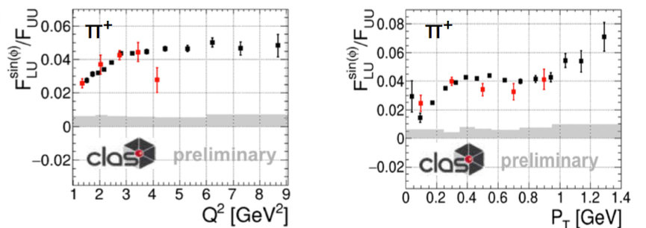
Task 2
Analysis of semi-inclusive DIS data
CLAS: the original plan was to do measurements with polarized target. However, it is not clear when data taking will happen (see also discussion of milestones).
Nevertheless, data with polarized beam have been analyzed and publications are expected in 2021.
3D structure of the nucleon in momentum space (TMD-neXt) Alessandro Bacchetta

Slide 13
Task 3
Analysis of e⁺e⁻ annihilation
Azimuthal asymmetries at BELLE have been published (arXiv:1909.01857).
Analysis of hadron multiplicities in progress.
3D structure of the nucleon in momentum space (TMD-neXt) Alessandro Bacchetta

Slide 14
Task 4
Quark TMD extractions
Extraction of unpolarized TMD PDFs and FFs from Drell-Yan-like and SIDIS processes (arXiv:1912.06532).
A theoretical study of the PT-dependent cross sections in e⁺e⁻ single hadron production was presented (arXiv:2007.13674).
Extraction of the quark polarizing fragmentation function for a Λ hyperon (arXiv:2003.01128).
Phenomenological study of the quark Boer-Mulders TMD (arXiv:2004.02117).
3D structure of the nucleon in momentum space (TMD-neXt) Alessandro Bacchetta

Slide 15
Task 5
Gluon TMD studies
Theoretical studies of gluon TMDs in quarkonia production were published (arXiv:1909.05769, arXiv:2004.06740).
Access to gluon TMDs through unpolarized observables and transverse single-spin asymmetries for quarkonium production in hadronic collisions was studied (arXiv:1909.05769, arXiv:1910.09640)
Studies were conducted on quarkonia production in SIDIS (arXiv:2004.06740, arXiv:2007.05547, arXiv:2008.07531). A model for gluon TMD was developed, which can be used for estimates of observables (arXiv: 2005.02288).
3D structure of the nucleon in momentum space (TMD-neXt) Alessandro Bacchetta

Slide 16
Deliverables
 | Deliverable name | Date
D22.1 | TMD data from DY, SIDIS, e+e- | 24, 36, 48
D22.2 | Parametrizations of TMD PDFs and FFs | 48
D22.3 | Estimates of quarkonium production in electron-proton collisions | 48
No deliverable was foreseen in the first periodic report, however something has already been achieved.
Azimuthal asymmetries in e+e- were published.
Parametrizations of TMD PDFs and FFs have been obtained and will also be made available to public through VA2- 3D partons.
One article with estimates of quarkonium production in SIDIS published.
3D structure of the nucleon in momentum space (TMD-neXt) Alessandro Bacchetta

Slide 17
Milestones
MS42 was supposed to be
achieved by August 2020
Advancement: the longitudinal NH₃/ND₃ target is under construction, the transverse HD-ice arget is ready for the performance validation with the JLab UITF test beam.
Expected delivery date: the (transverse) target is ready and should be tested in the next months, with some delay compared to plans due to Covid-19. However, it is not clear when it will be installed in the beamline to take data. This depends on JLab scheduling.
3D structure of the nucleon in momentum space (TMD-neXt) Alessandro Bacchetta

Slide 18
Expected results and impact
The amount of TMD data will be significantly increased.
At least two sets of unpolarized TMD PDFs and FFs will be completed and made available to public, not only through publications, but also throuh VA2 - 3D partons.
We expect also to obtain other extractions of polarized TMDs, with less data and accuracy compared to the unpoarlized ones.
Results are already being used for studies related to Electron Ion Collider.
Impact expected also in comparison with LHC measurements and search for new physics.

