Slide 1
LEM/Anodes and CRP Improvement Plan
Edoardo Mazzucato CEA/Irfu

Slide 2
LEM Improvement Plan
Three issues being addressed:
LEM active area. In ProtoDUNE-DP, LEM active area reduced to 86% in order to mitigate spark rates in the boundary regions of the PCB. Would like to achieve > 95% for DUNE.
LEM HV stability. Aim is to keep spark rates as low as possible for very long term operation in DUNE and avoid ageing effects. Spark rates < 1/h per CRP at gains ∼ 20 in Cold Box tests at CERN in 2018.
Rim defects. LEM carbonization issues found during Cold Box tests point to method used by ELTOS (Italy) for the micro-etching process of rims around amplification holes.

Slide 3
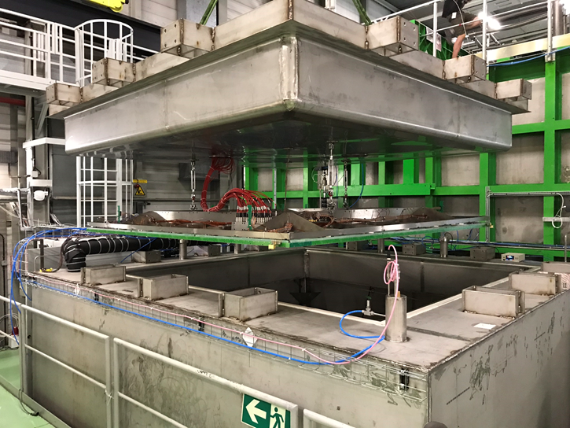
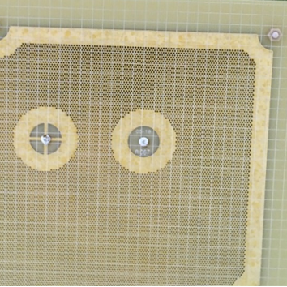
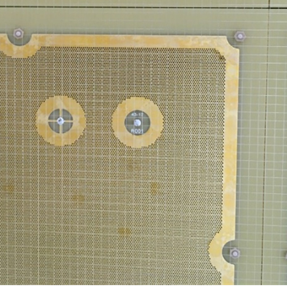
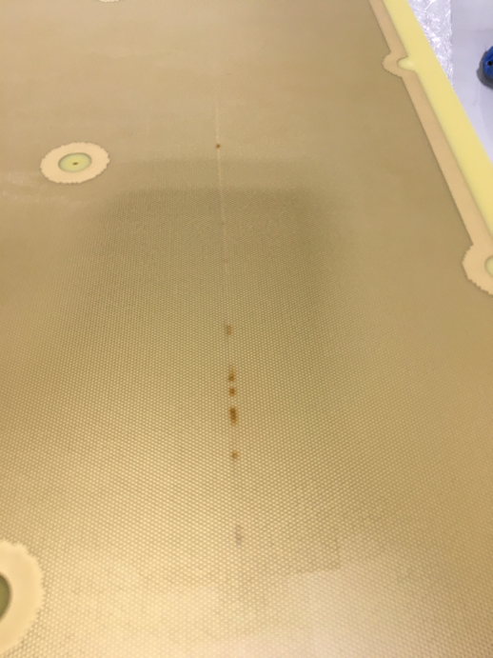
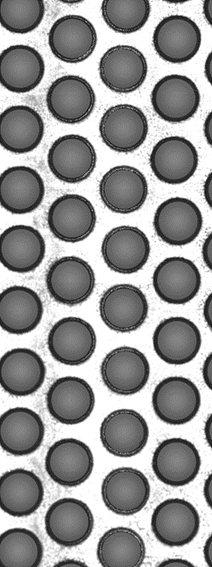
Reminder : carbonization issues during CB tests in 2018
In total, 5/72 LEMs affected
by such problems
CRP tests in Cold Box at CERN
Issues point to standard micro-etching process used by ELTOS to make rims.
LEM 16
LEM 28
Carbonization spots
Decentered rims with
copper residues

Slide 4
Standard micro-etching process by ELTOS
In a chemical bath
105 µm
Cu
Cu
65 µm
⇒
1 mm
FR4
FR4
1 mm
105 µm
Cu
Cu
65 µm
40 µm rims
φ = 500 µm
amplification hole

Slide 5
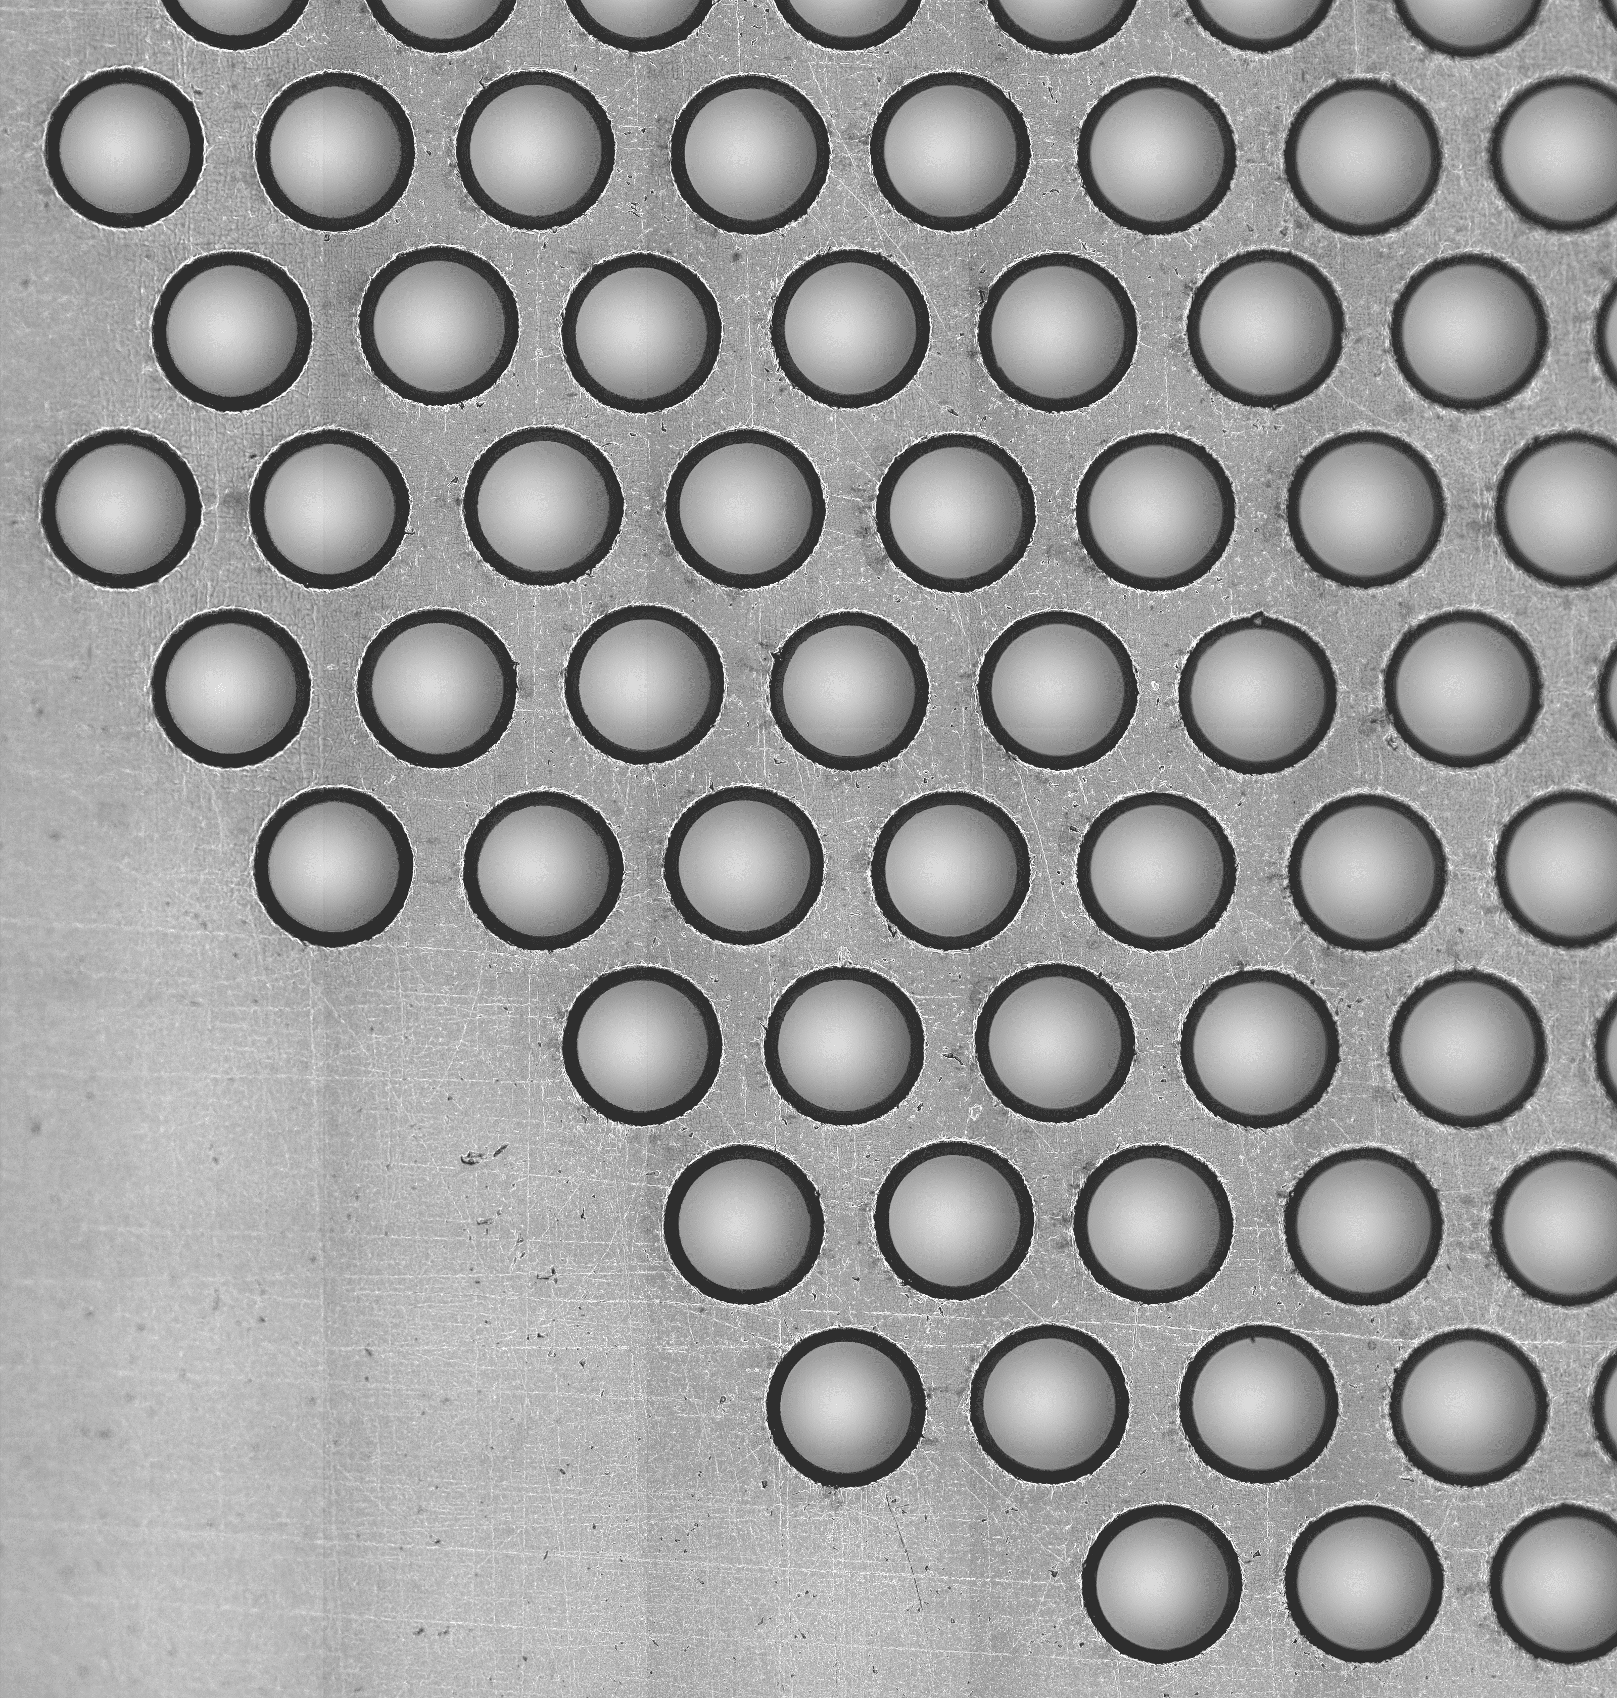
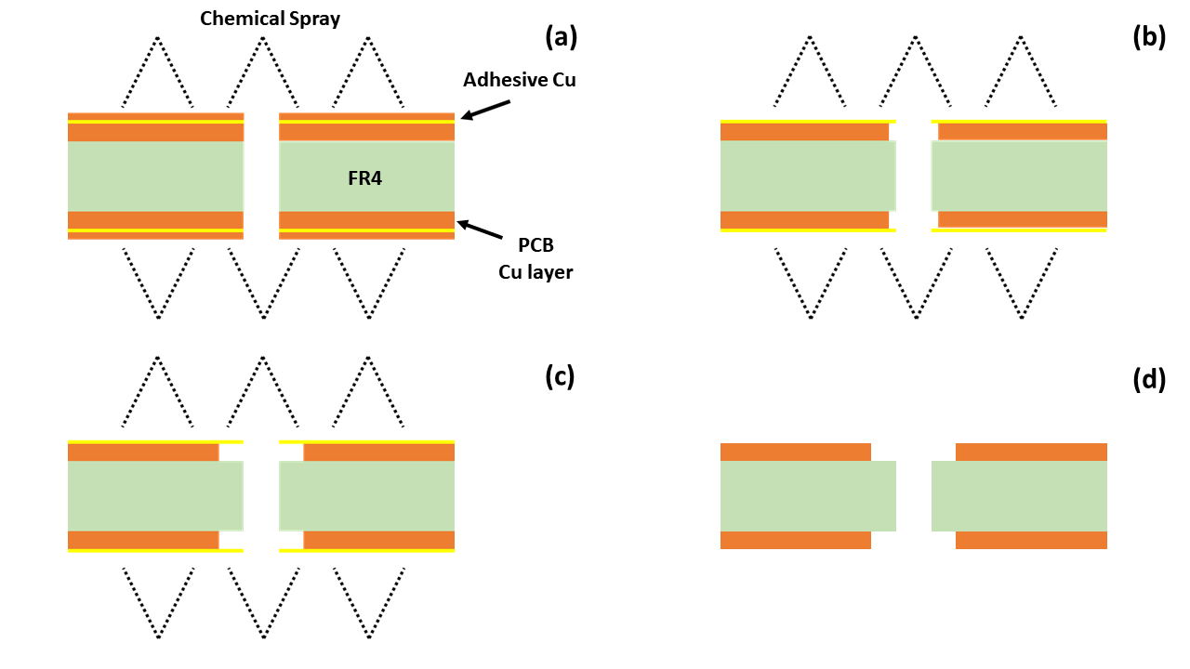
Improved micro-etching process for rims
Developed at CERN by EP-DT-EF.
LEM copper surfaces protected with thin (15 µm) adhesive copper foils before drilling.
Micro-etching only around holes, visible through transparent glue.
50×50 cm² LEM manufactured at CERN
Copper
removed
Improved
rim quality
Glue
Glue
removed
Technology transferable to PCB industry

Slide 7
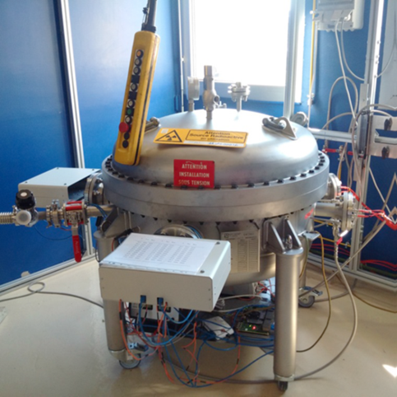
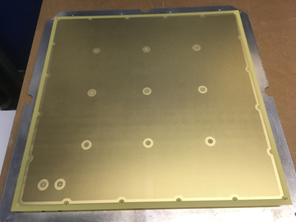
LEM with improved rims
Prototype built by CERN with same design as the one for ProtoDUNE-DP
HP chamber at CEA/Irfu
Tests with ²⁴¹Am source in Ar
@ 3.3 bar (same gas density
as in ProtoDUNE-DP)

Slide 8
LEM with insulation
LEM prototypes being
constructed at CERN
Improve HV stability by insulating areas where E-field is high (edges, corners, boundary regions).
Add 64 µm coverlay (Pyralux PC) on dead areas.
Use improved rim micro-etching process.
Prototypes built at CERN by EP-DT-EF.
Technology transferable to industry.
If successful, increase active area.
64 µm coverlay

Slide 9
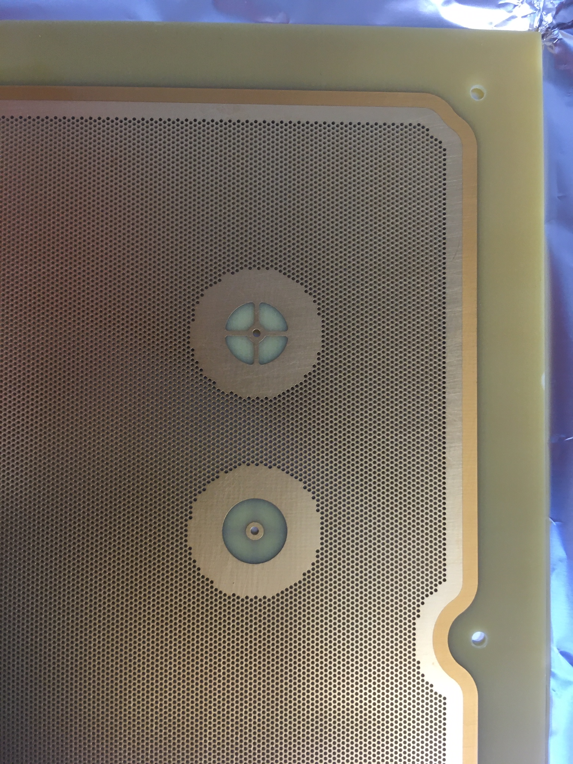
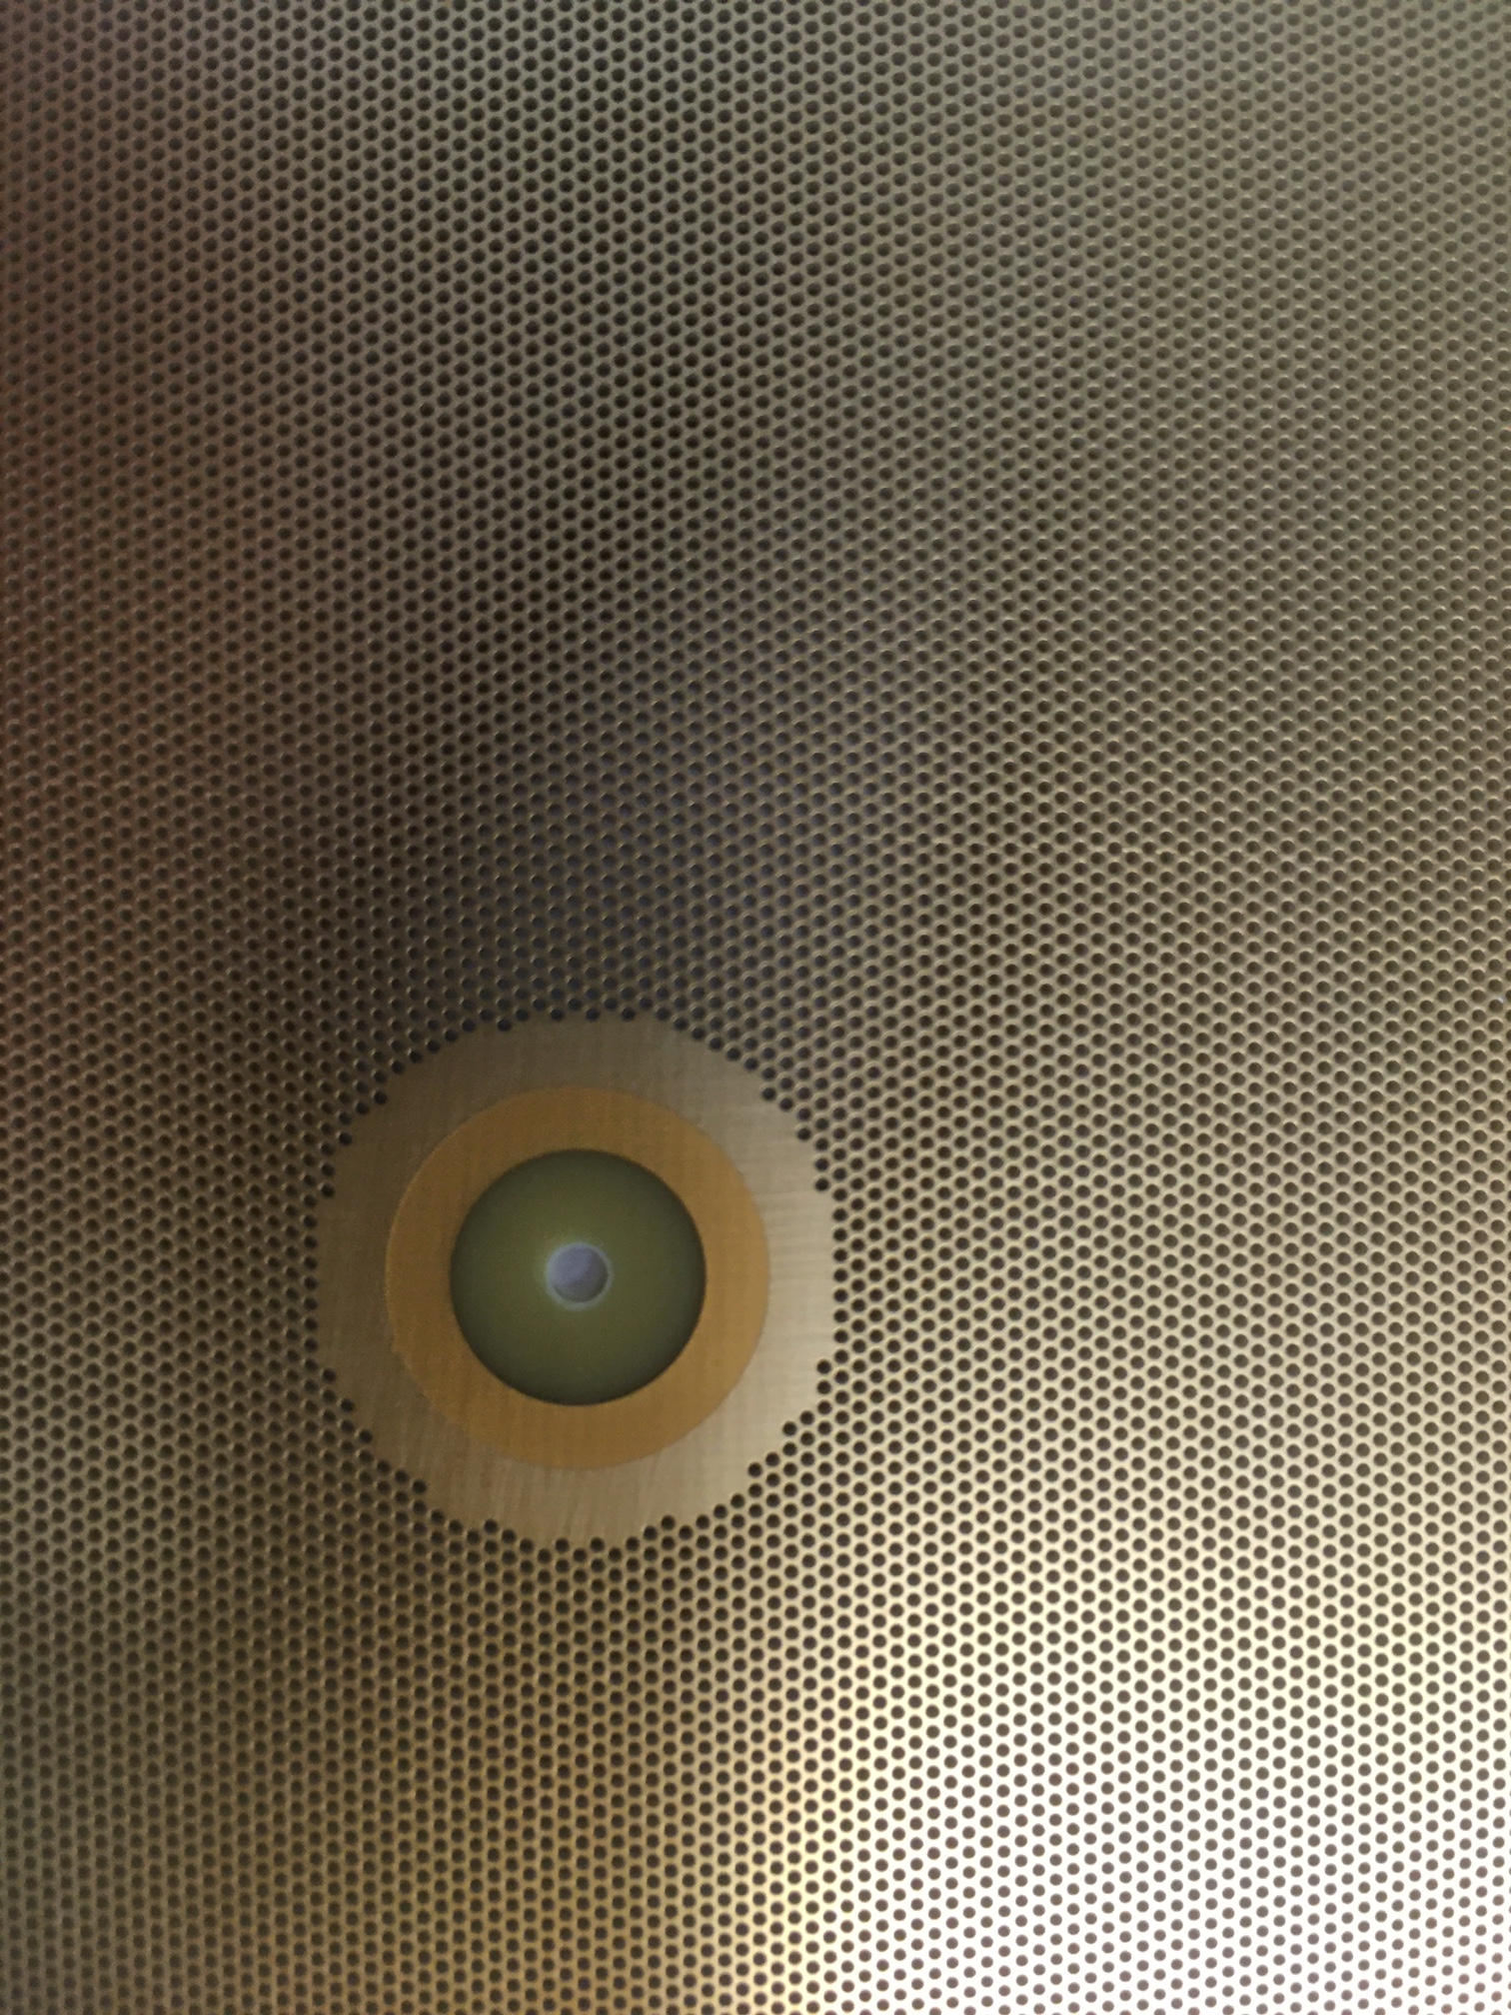
LEM with insulation
First prototype with insulation and improved rims arrived at CEA/Irfu on Nov. 25th 2019
64 µm Pyralux PC
50×50 cm²

Slide 10
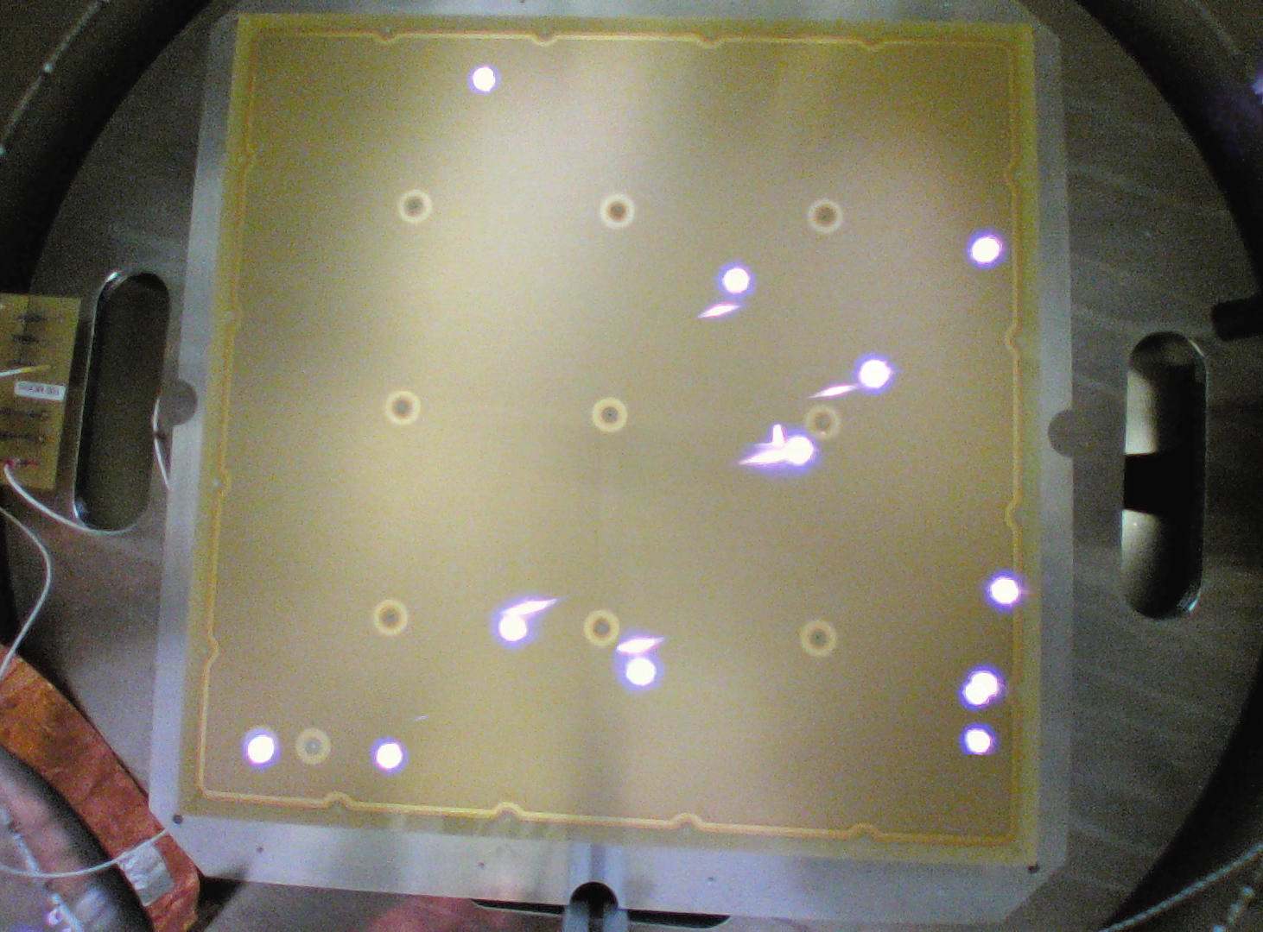
First tests in pure Ar @ 3.3 bar
3.4 kV
Sparks observed in
the active region only
Tests in progress at CEA/Irfu.
Spark rates and amplification gain measurements up to max. HV to be performed soon.

Slide 12
Next …
Solder Mask

Slide 13
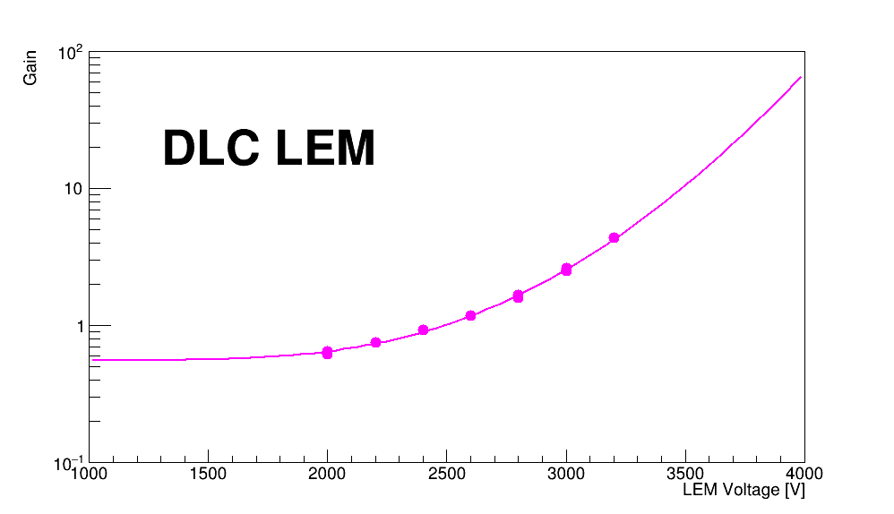
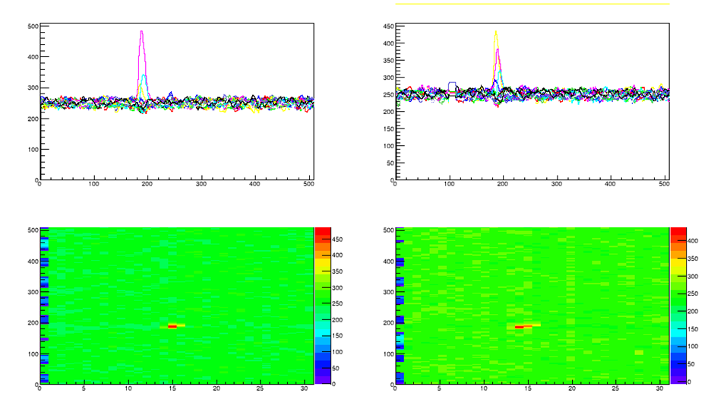
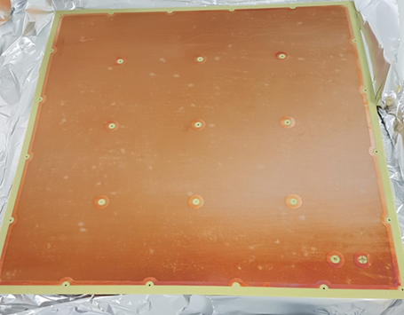
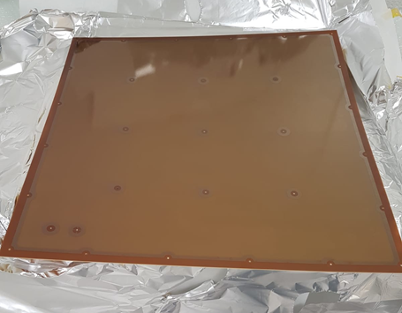
Resistive LEM
Tests @ CEA/Irfu
Quenching of discharges with resistive 50×50 cm² LEM :
Made at CERN EP-DT-EF :
- copper side facing readout anode
- DLC on 50 µm APICAL polyimide film (250 MΩ/)
- same geometry as CFR-35 (ProtoDUNE-DP)
- no rims, no gold plating on copper face.
Tests in progress at CEA/Irfu.
R&D will continue in collaboration with CERN.
Signal from 5.5 MeV alpha
Time bin
Time bin
Copper face
DLC face
Channel no
Channel no

Slide 14
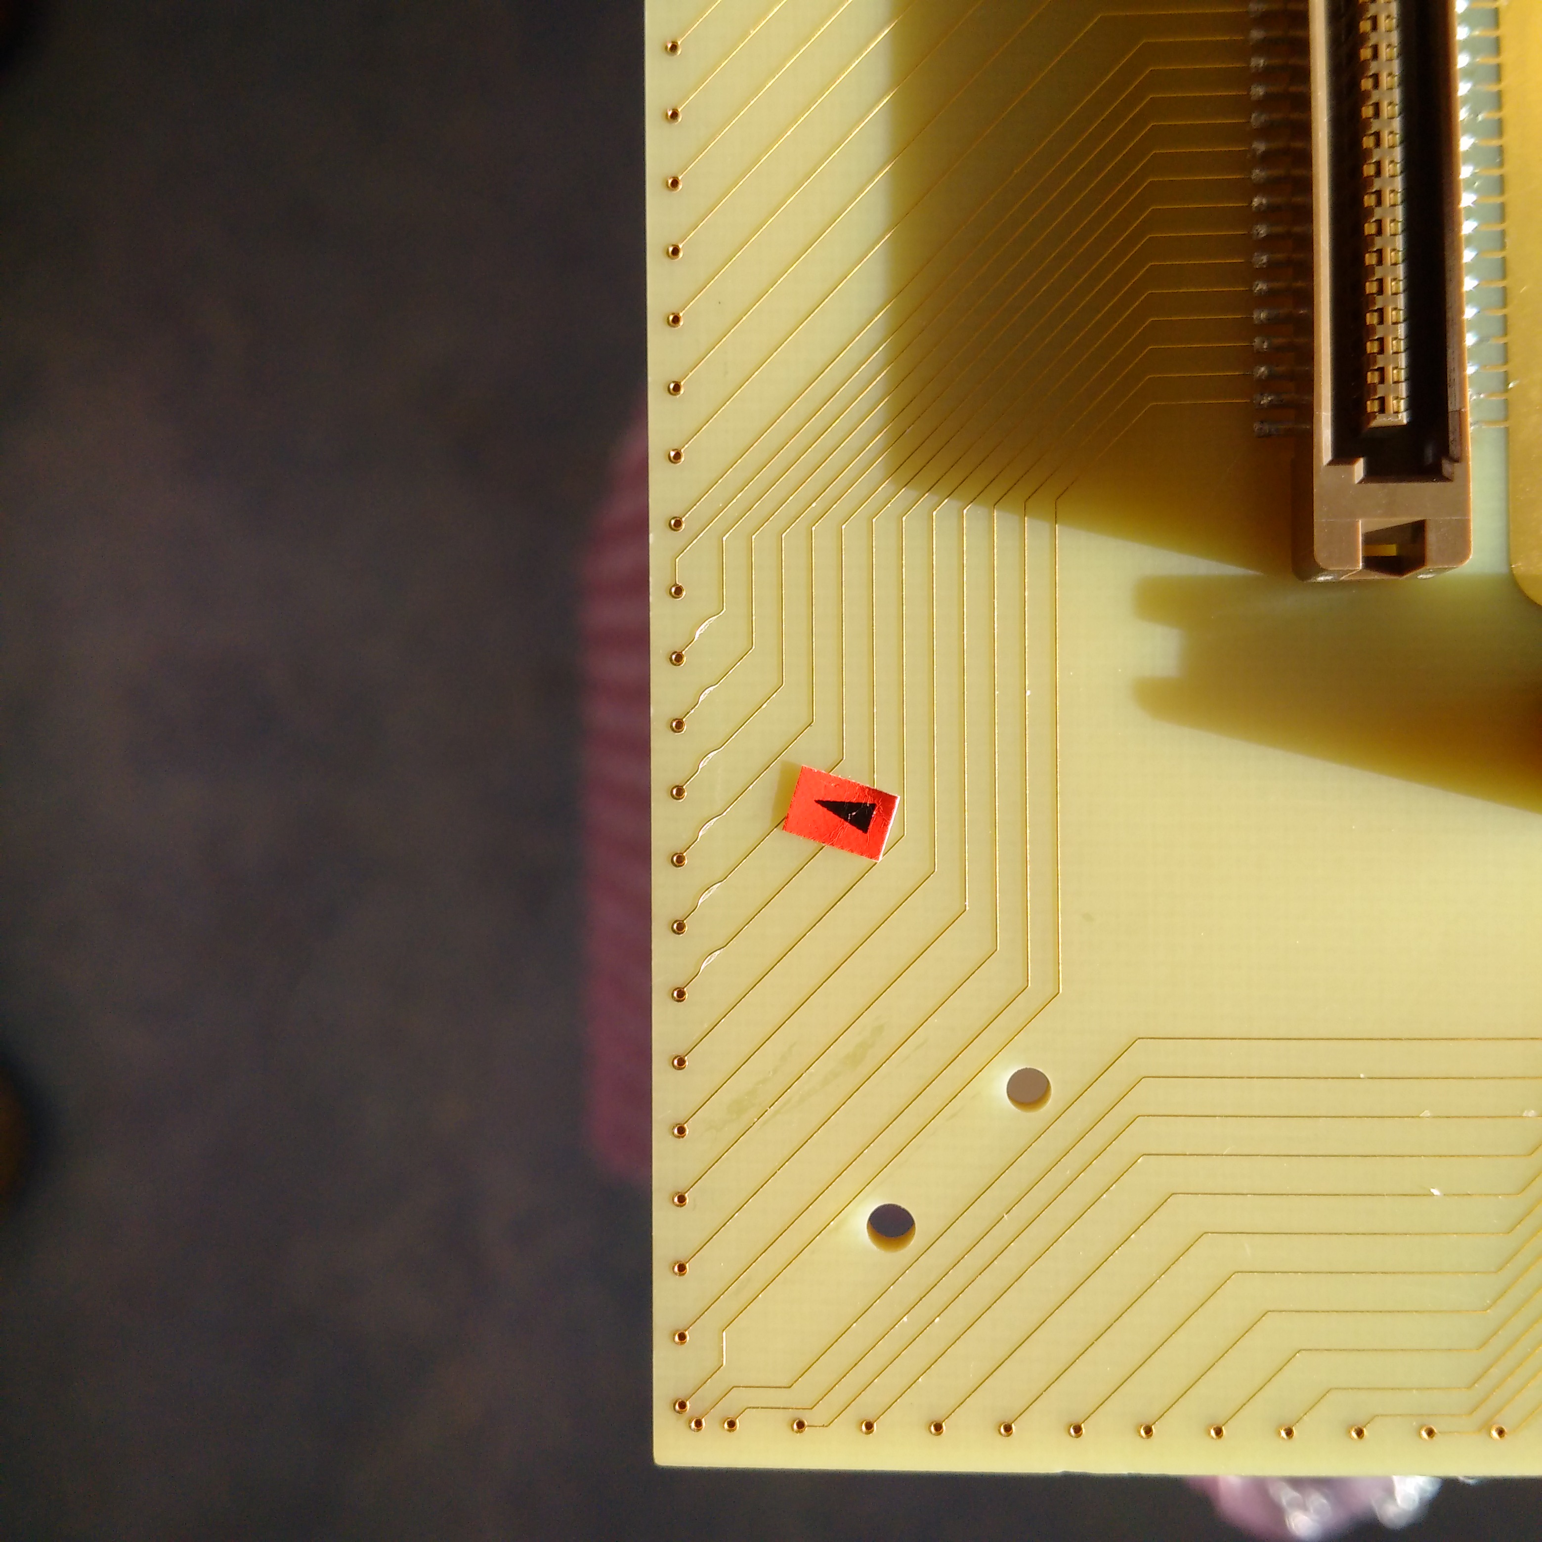
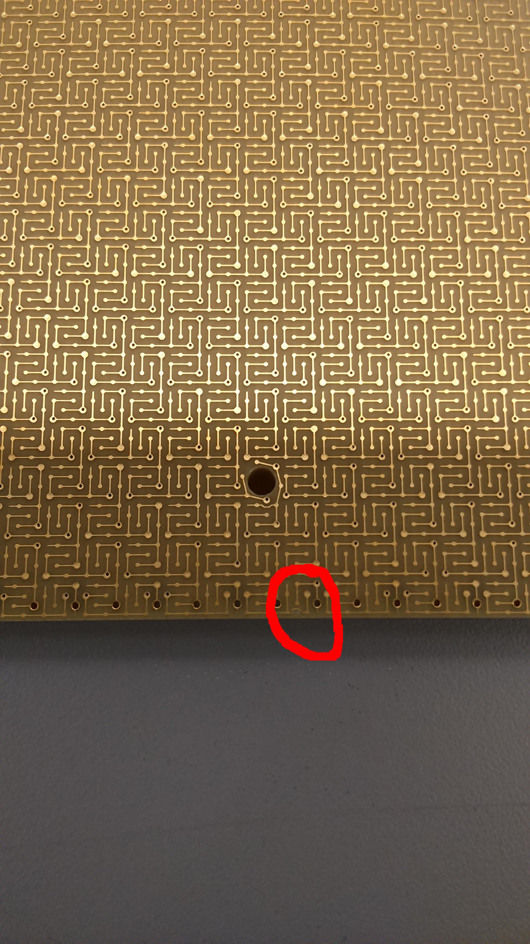
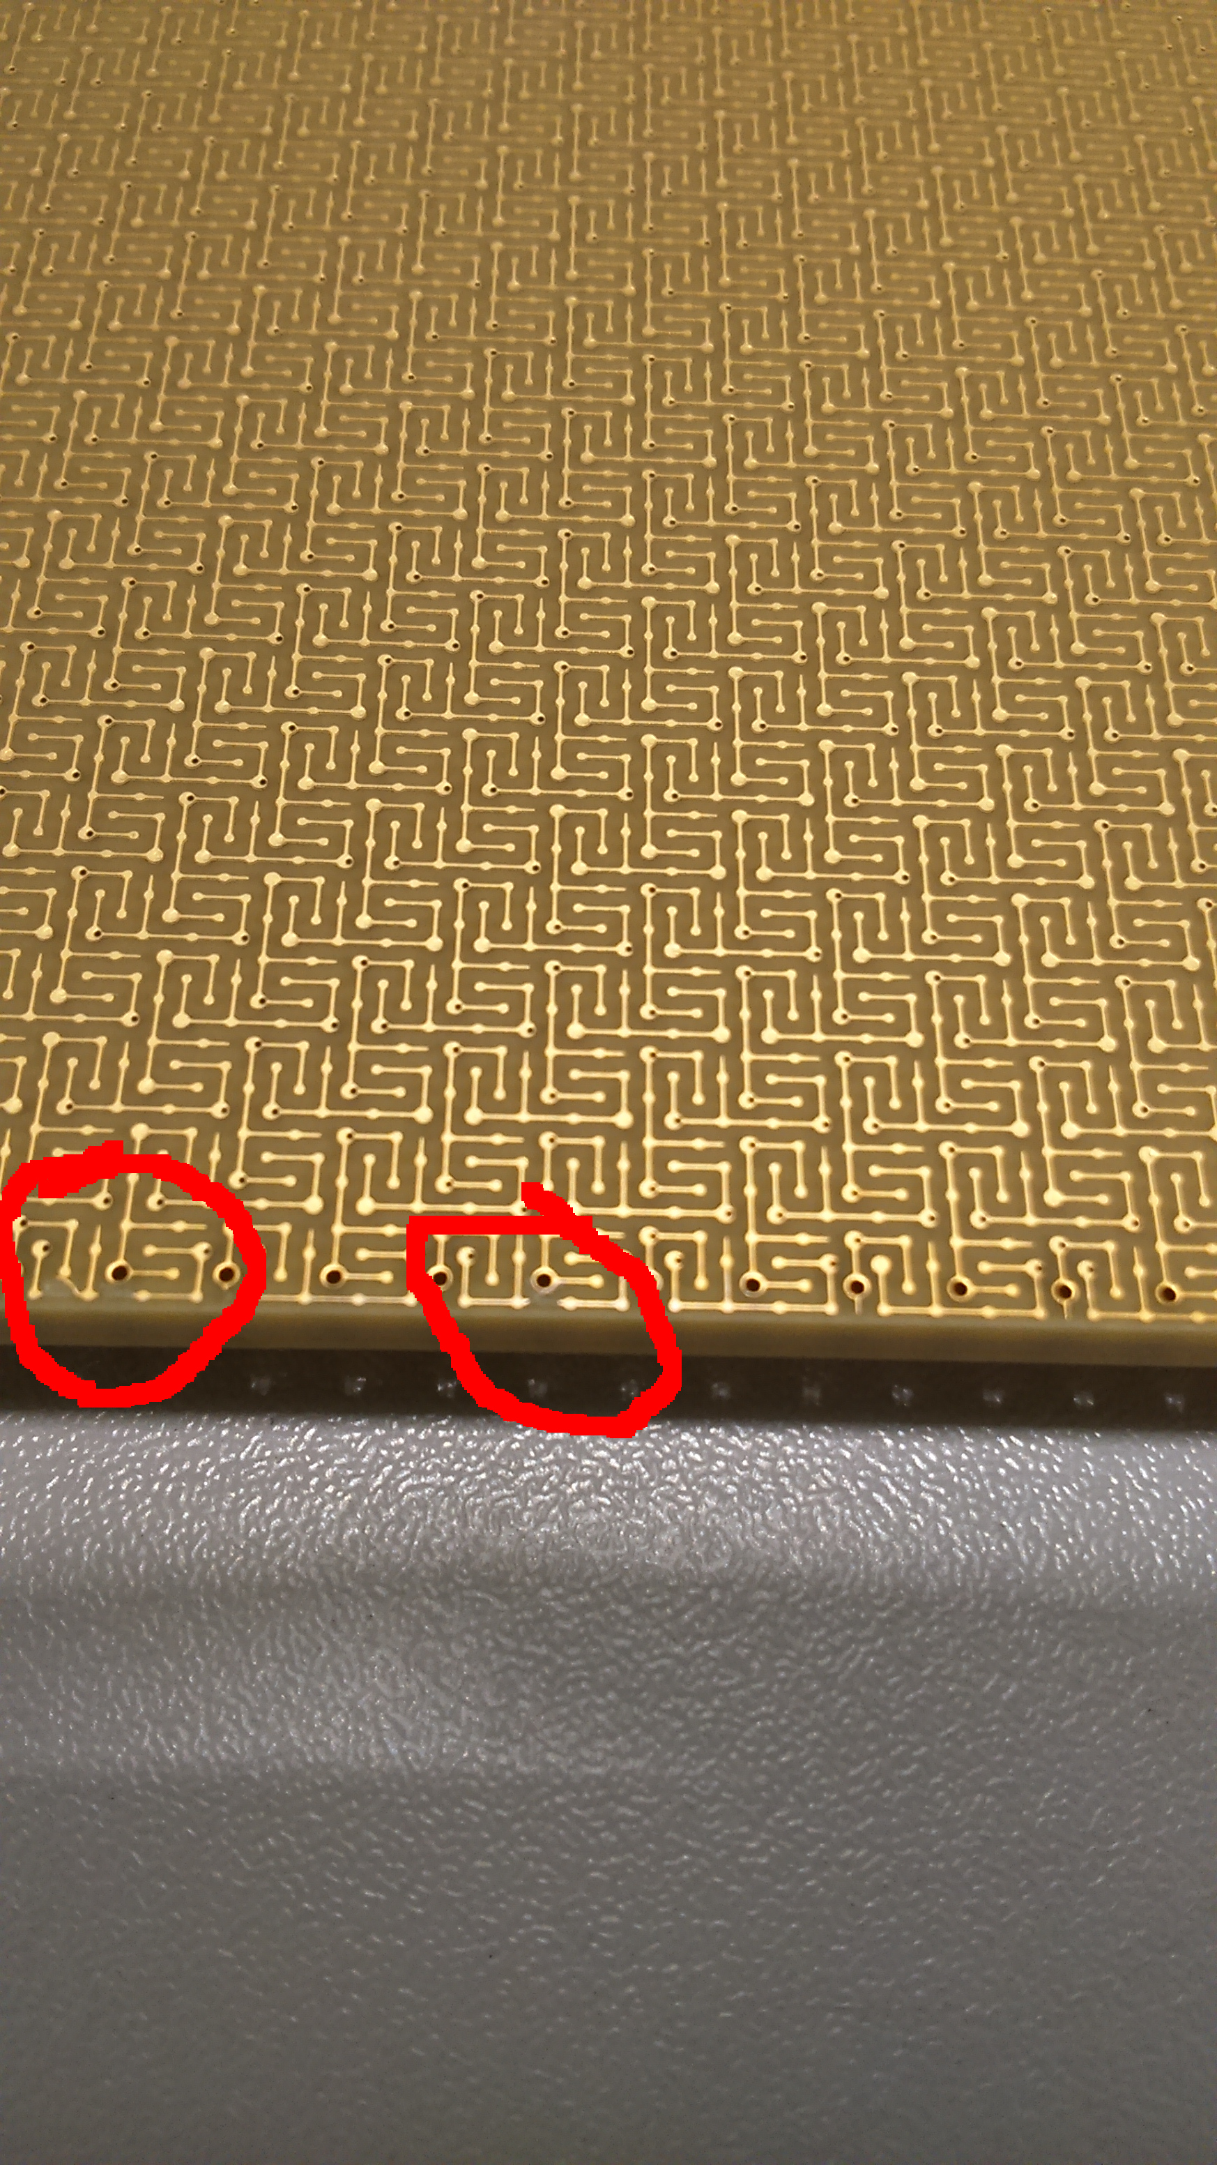
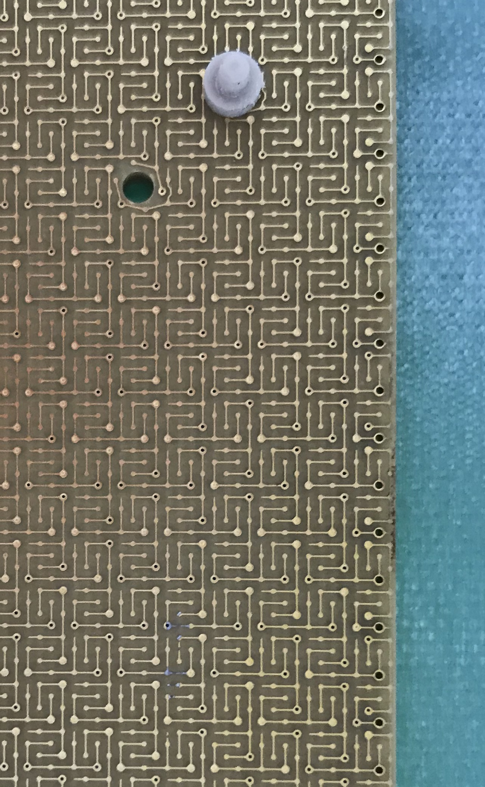
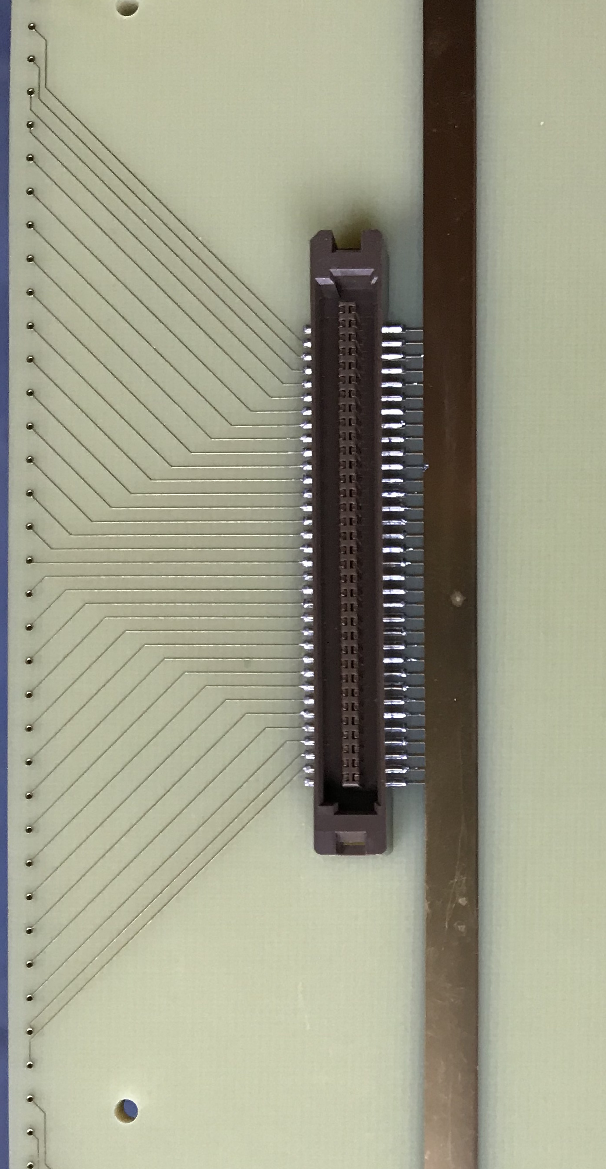
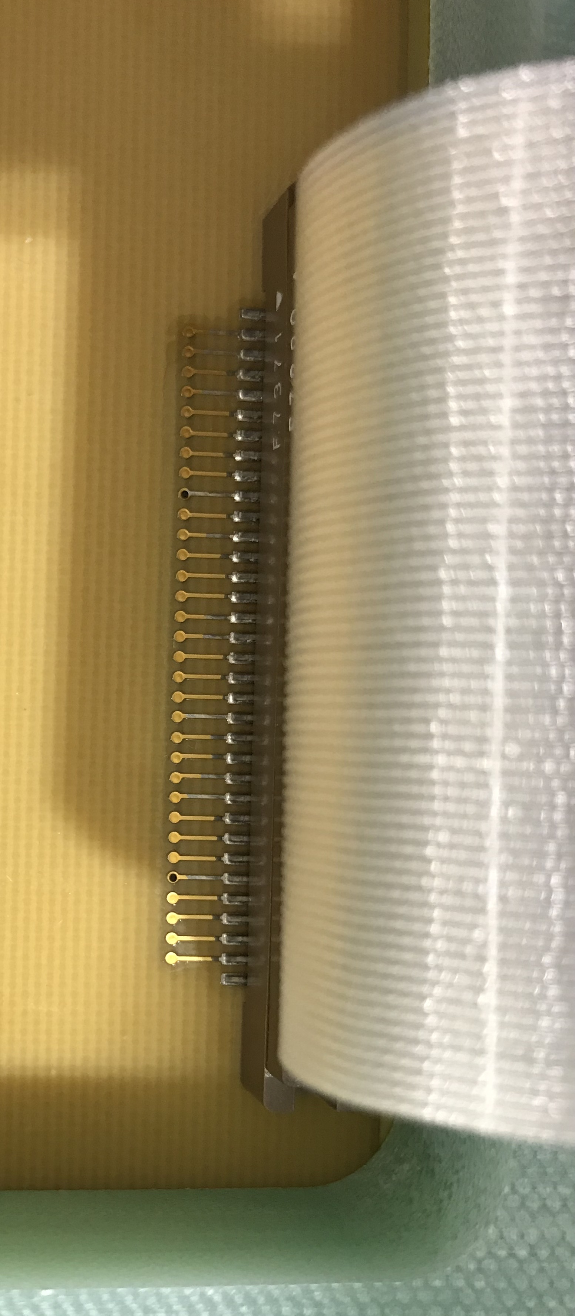
Anode
No change needed in the anode concept.
Facilitate manufacturing process with minor changes to fix observed defects (about 10% of anodes for ProtoDUNE-DP had their outer strips damaged ⇒ increase clearance).
In discussion with ELTOS (Italy) and ELVIA (France) to improve QC/QA.
Damaged
outer strip
Damaged
outer strips
Repaired
strips
Damaged strips
Non-plated
vias
Fragile strips

Slide 15
ANODE Guard Ring

Slide 16
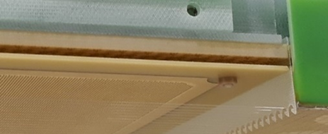
CRP
LAPP in Annecy is working on the following improvements:
Stiffening of the Invar structure :
- to guarantee a ± 1 mm planarity in cold
- to make structure less sensitive to inhomogeneous distribution of mass
like cables, instrumentation.
Implementation of a guard ring around the CRP to avoid grid sparks to reach the anodes and thus potentially damage the FE electronics.
Development of resistive combs for the Grid to collect ions remaining on the LAr surface (ion feedback). Needs more input from ProtoDUNE-DP
Consider the possibility to increase LEM-Grid distance from 10 to 12 mm.
Comb

Slide 17
Possible schedule for a 2-CRP production (to replace the current 2 dummy CRPs)
2020:
- LEM prototyping and tests at CEA/Irfu, tests in CB at CERN.
- LEM & anode final design.
- CRP prototyping and tests: guard ring, resistive combs.
- CRP final design.
2021:
- Early 2021: start production of 1st CRP.
- Mid-2021: tests in CB at CERN and start production of 2nd CRP.
2022:
- Test of 2nd CRP in CB at CERN.
- Integration in cryostat.

