Slide 1
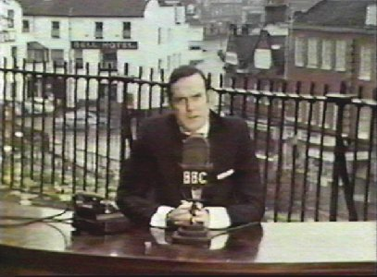
and now for something completely different...

Slide 2

Axion like particles
and
the transparency of the Universe
Malcolm Fairbairn
Based on work with Sergei Troitsky and Timur Rashba

Slide 3
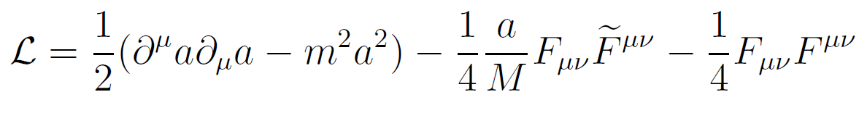
Axions
Originally motivated as a solution to the strong CP problem
Spin zero pseudo-scalar with induced coupling to the photon

Slide 4
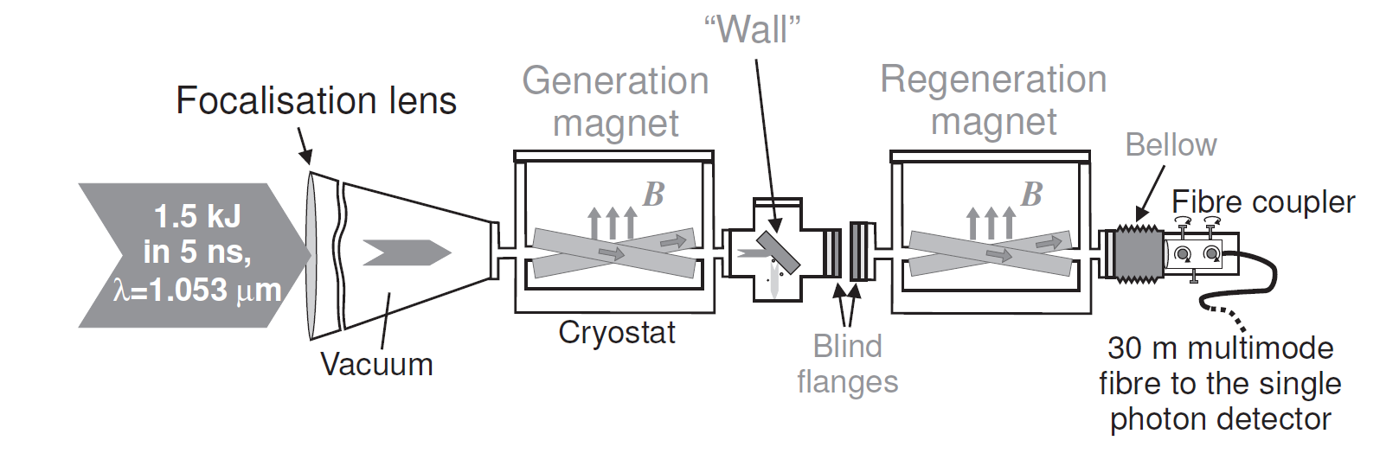
Shining light through walls
B=12.3T, L =365mm
Robilliard et al, arXiv: 0707.1296

Slide 5
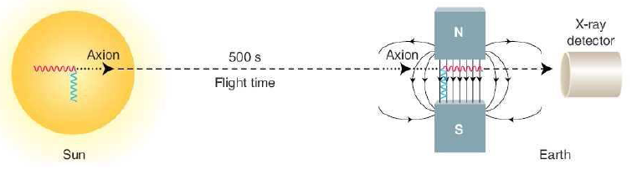
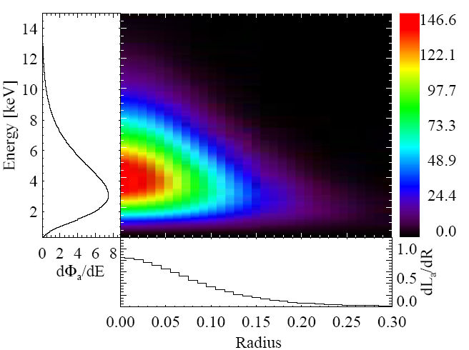
Search for Solar axions
look for axions produced in the sun and turn them back into photons down here

Slide 6
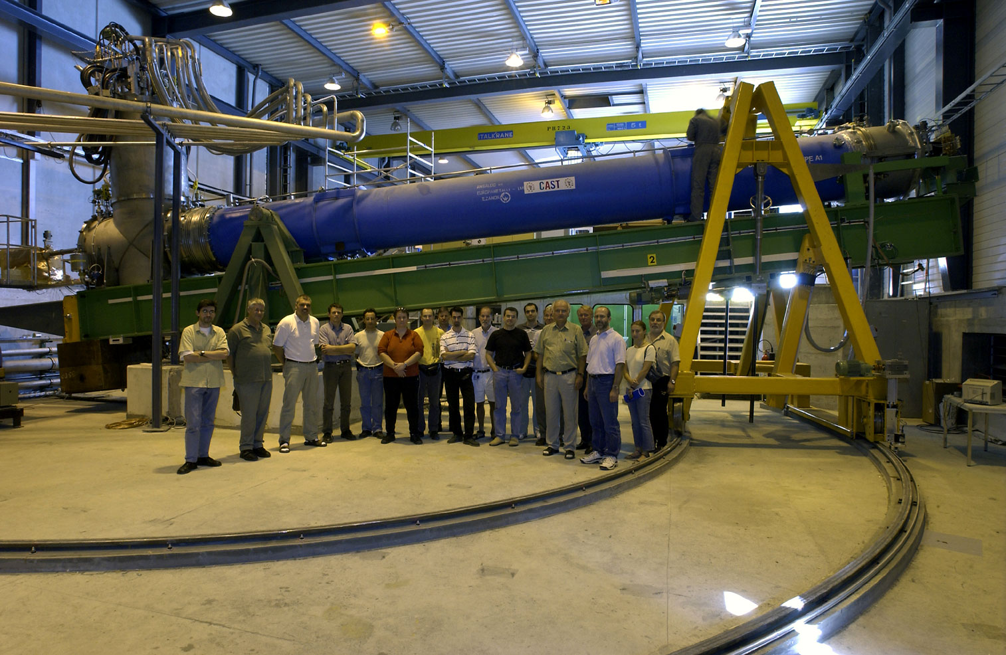
CAST cern-axion-solar-telescope

Slide 7
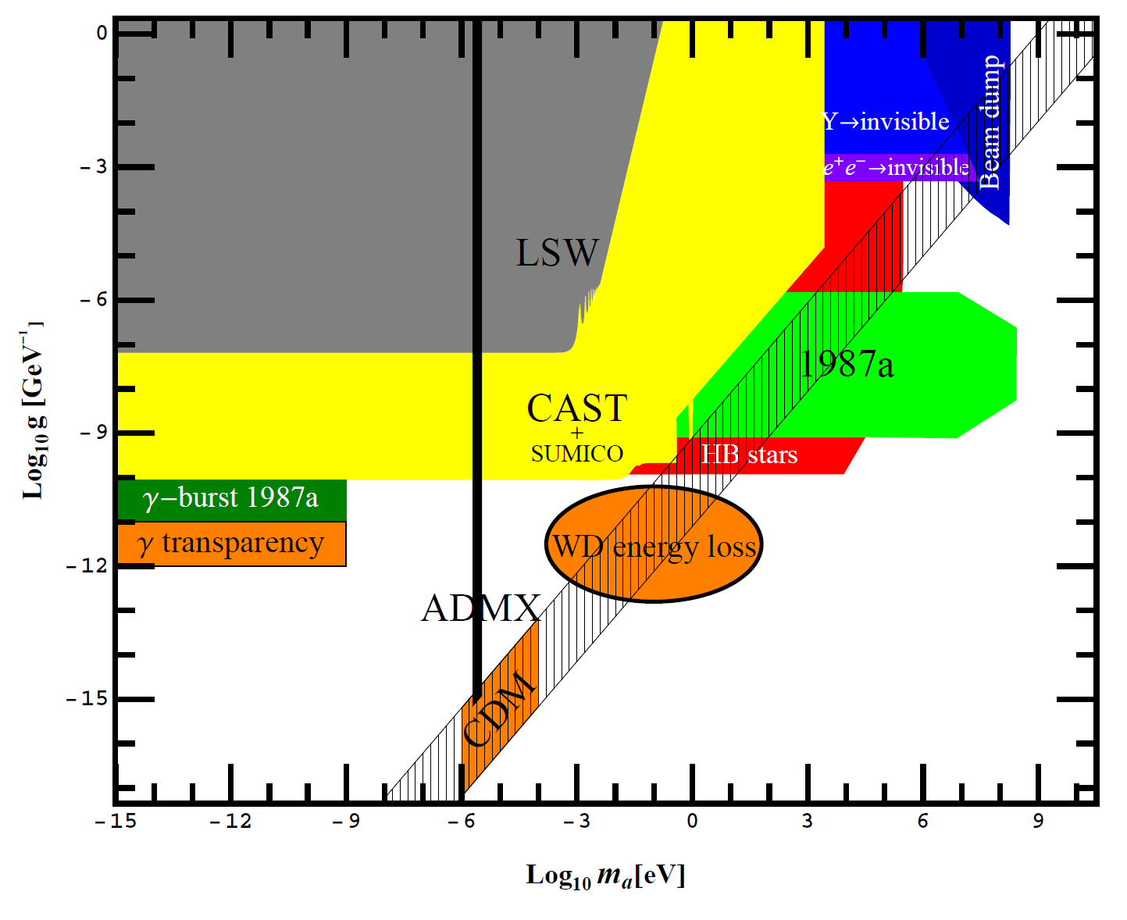
Light shining through walls
Wait for next talk by Klaus Ehret for exact limit!
Jaeckel and Ringwald
arXiv:1002.0329

Slide 8

Opaque things we can try sending axions through:-
Walls.... Stars.... The earth....

Slide 9
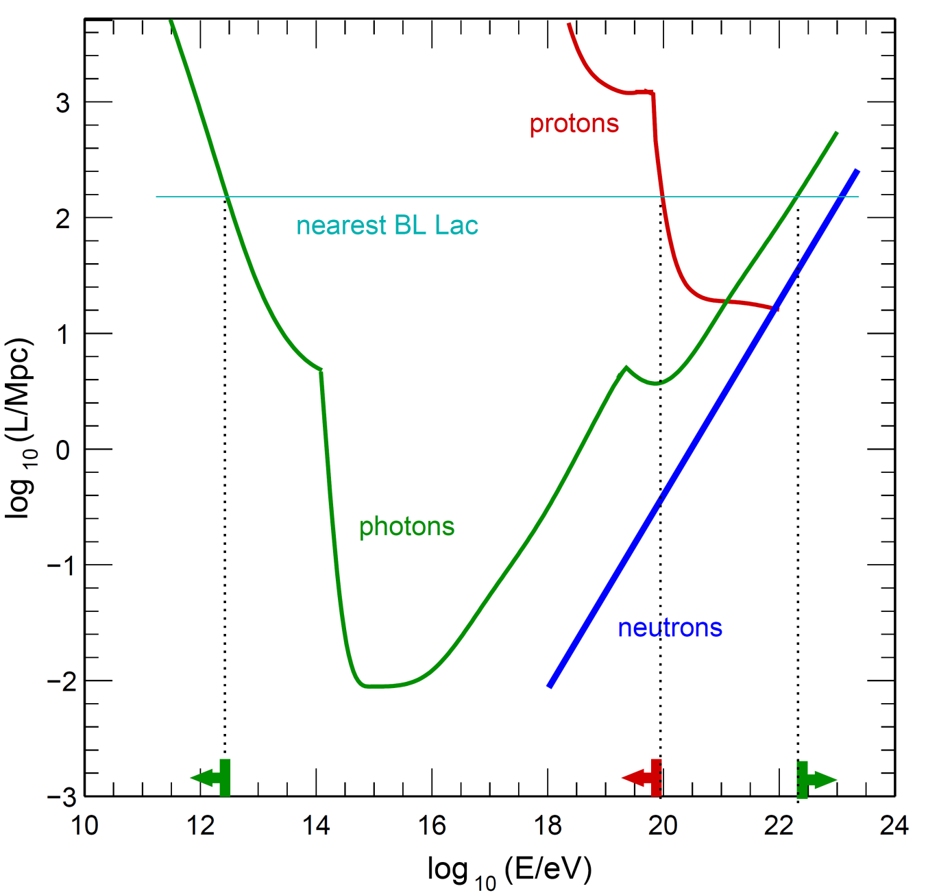
Universe also opaque...

Slide 10
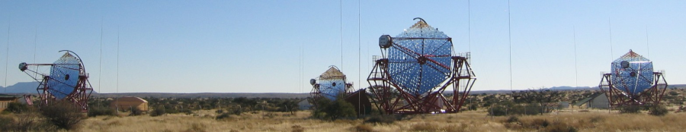
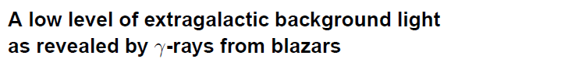
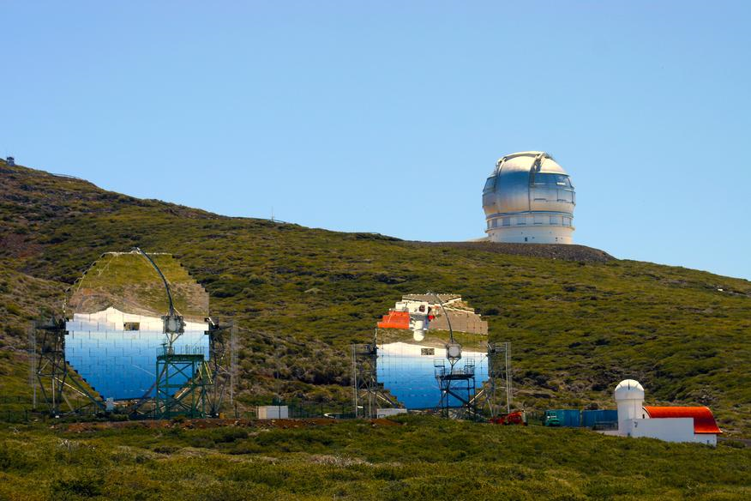
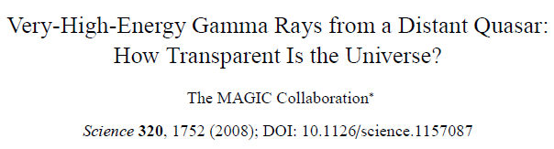
HESS
Nature 440:1018 (2006)
MAGIC
Quasar 3C279
Z=0.536

Slide 11
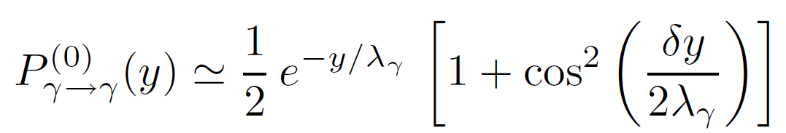
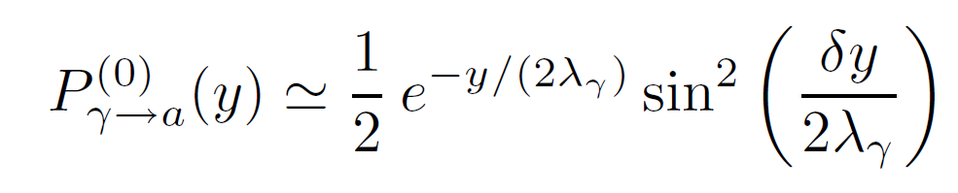
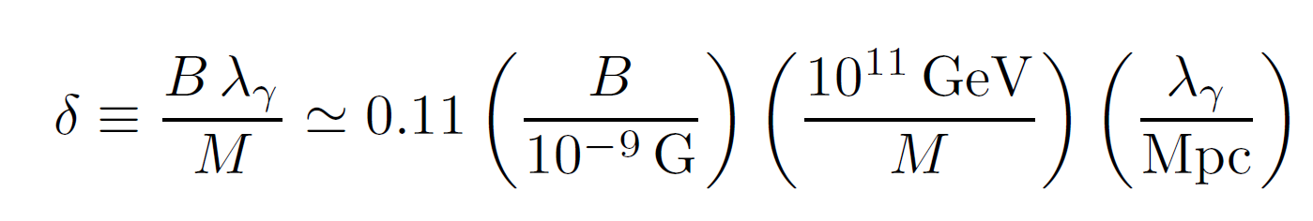
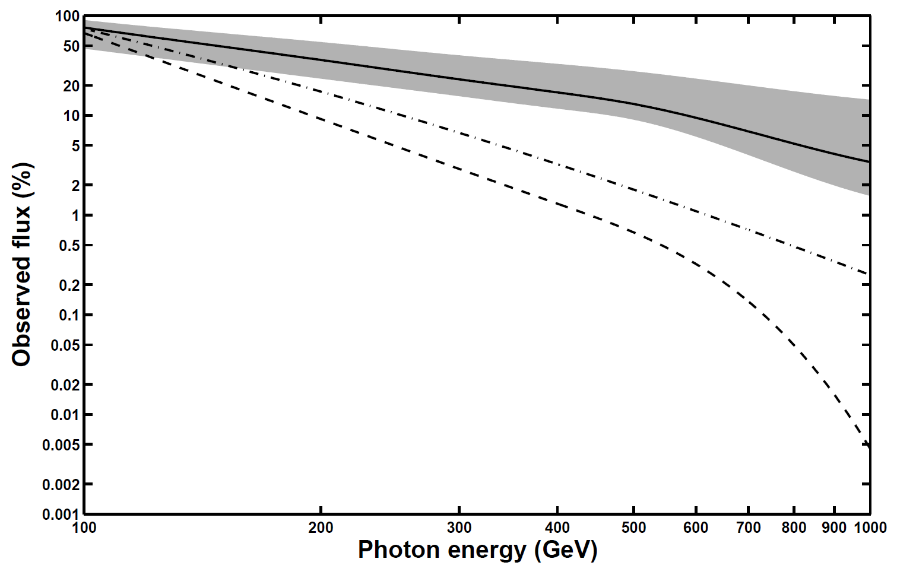
Possible axion explanation : Roncadelli 07074312
With regeneration
Distance to TeV source 3c279
Without regeneration

Slide 12
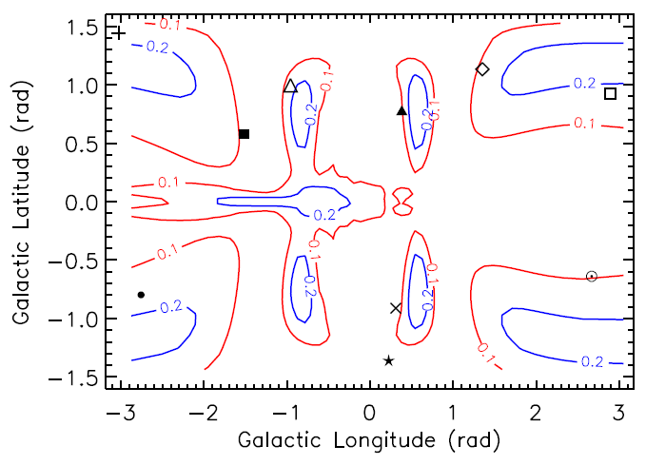
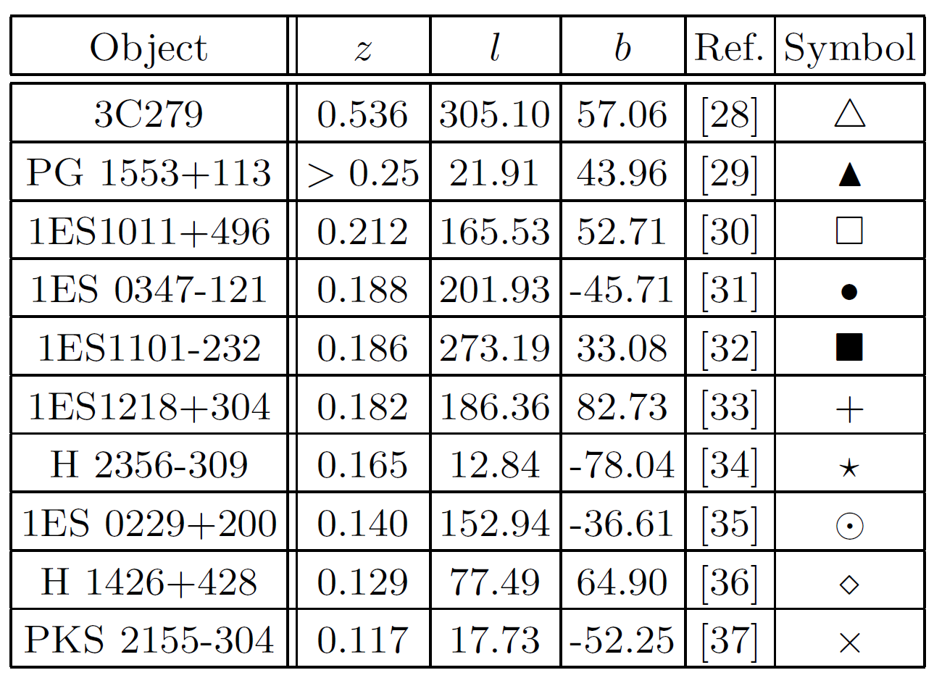
Reconversion in Galactic field
Simet, Hooper and Serpico, 0712.2825
See also Hochmuth and Sigl, 0708.1144

Slide 13
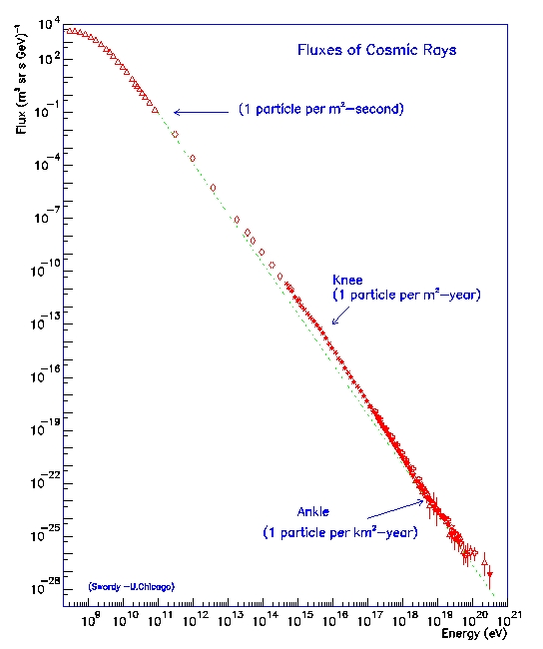
Cosmic rays exist with much higher energies

Slide 14
High energy protons must come from nearby
GZK cut-off

Slide 15
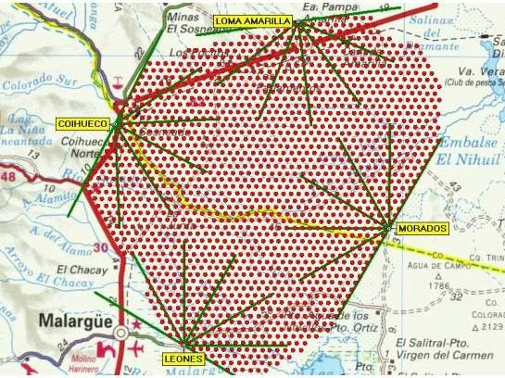
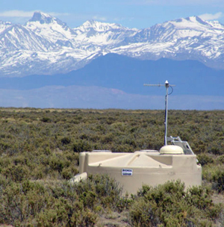
Pierre Auger Observatory, Argentina

Slide 16
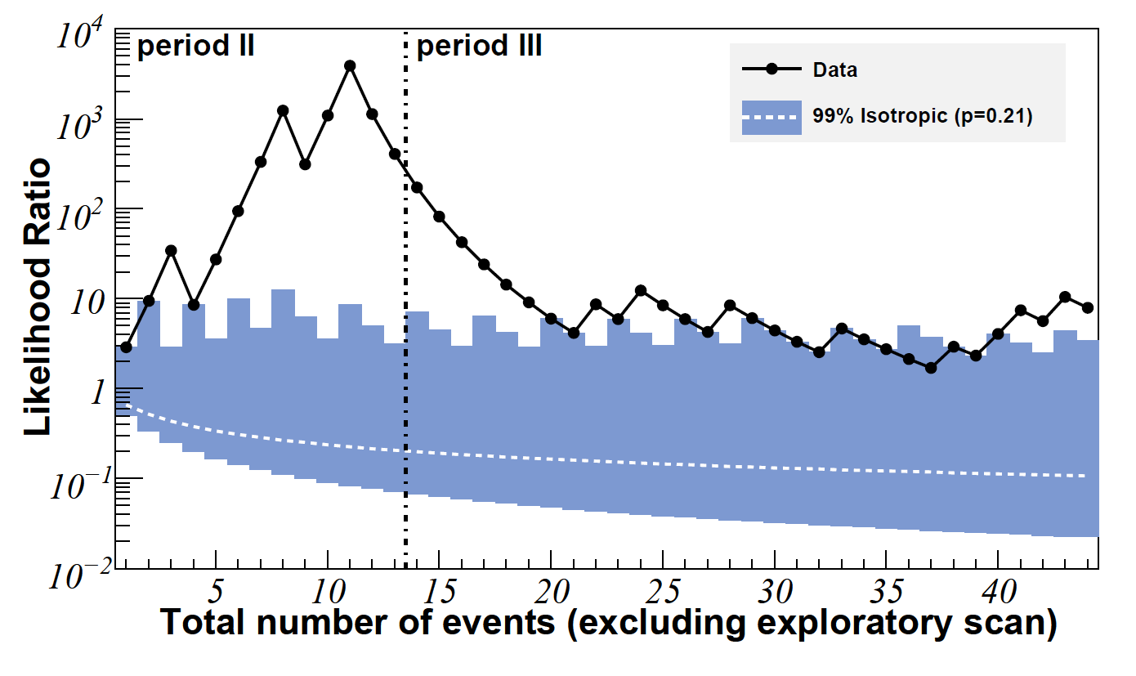
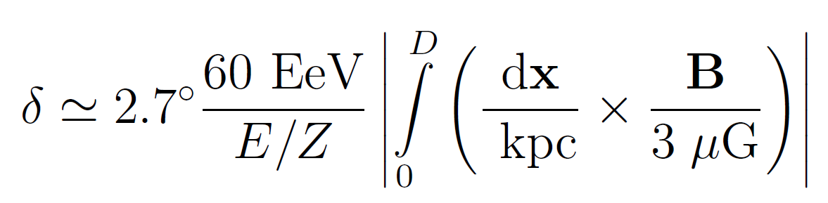
PA arrival coincidences with close objects
Z < 0.02
Hague 0906.2347

Slide 17
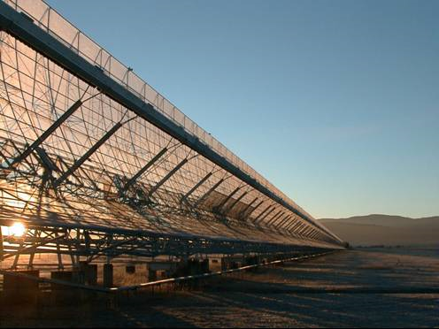
Highest energy Auger Source also consistent with bright radio galaxy in Molonglo catalogue at redshift z=1.275. Galaxy is also a gamma ray source AND has high faraday rotation.
Albuquerque and Chou arXiv:1001.0972

Slide 18
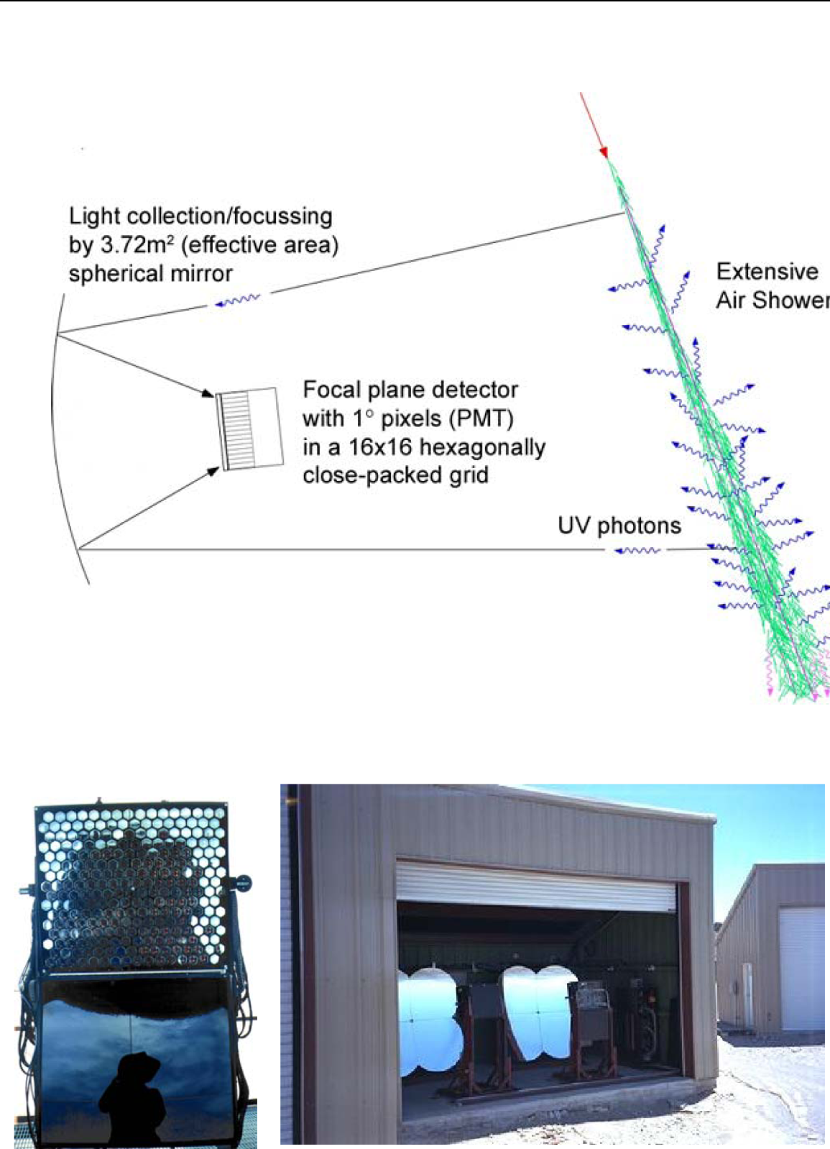

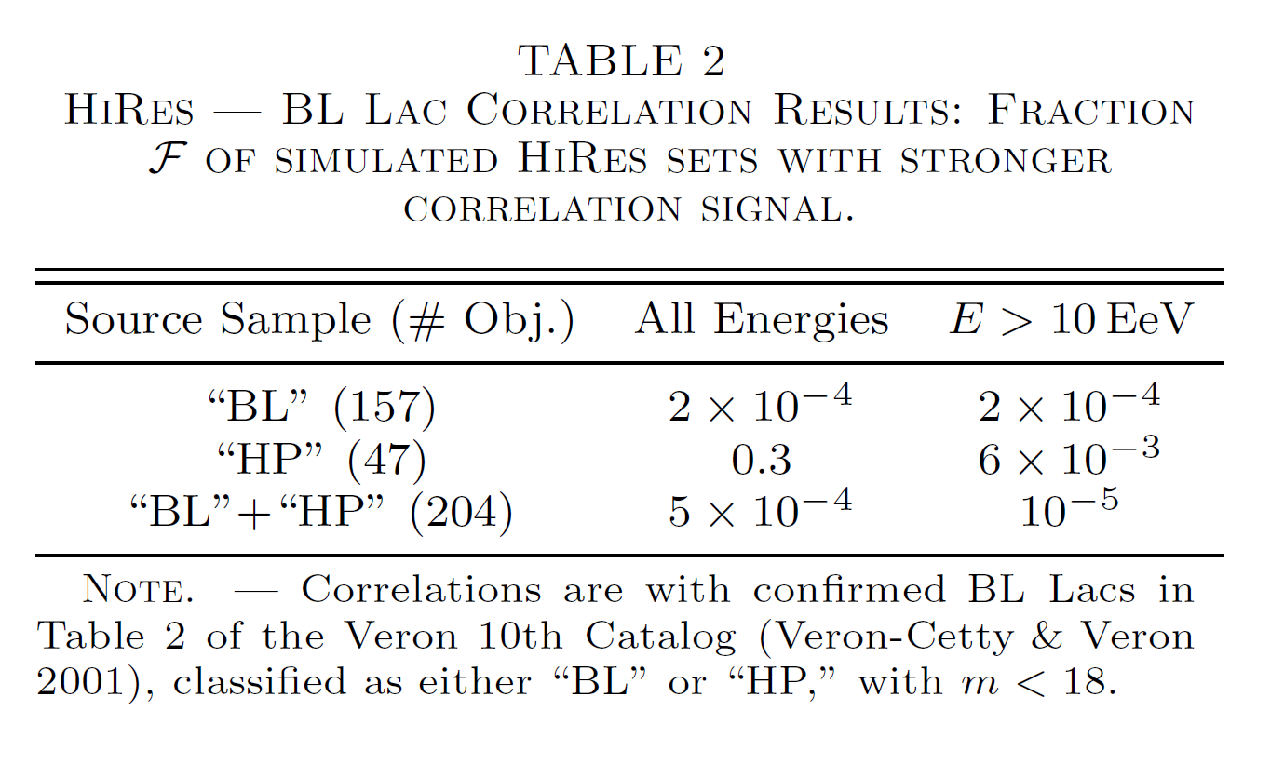
Lets see if ALPs can serve as
high energy cosmic rays
astro-ph/0507120
Possible correlation with much more distant objects

Slide 19
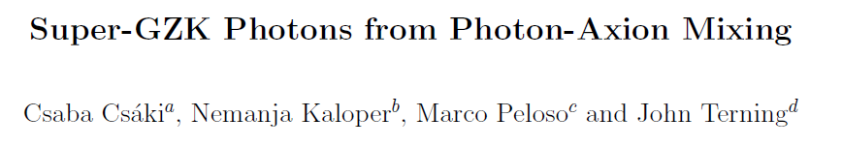
Old idea...
hep-ph/0302030

Slide 20
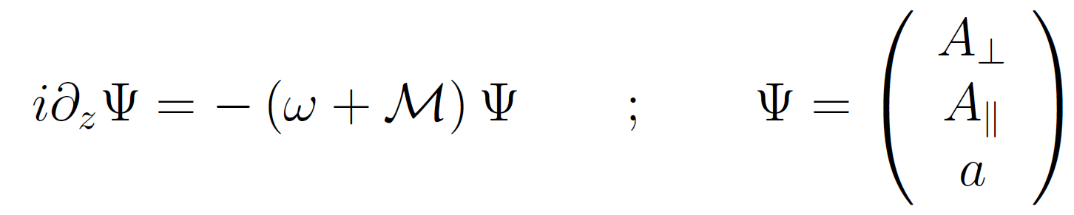
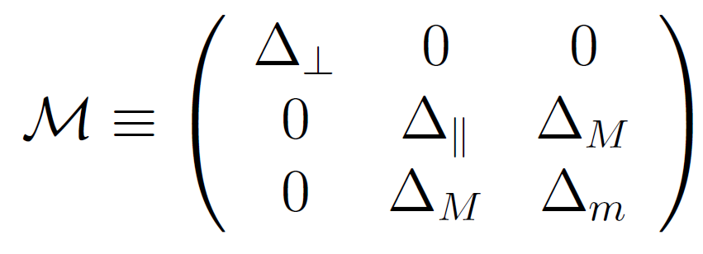
Linearised wave equation
See, e.g. Raffelt and Stodolsky 1987

Slide 21
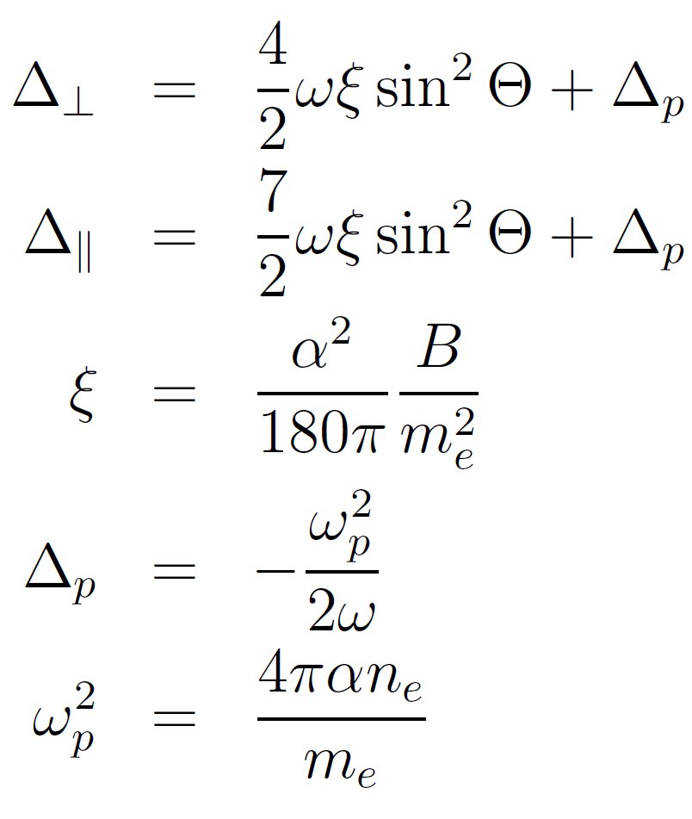
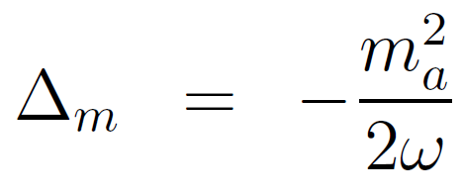
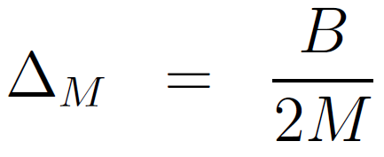
Mixing Matrix
2

Slide 22
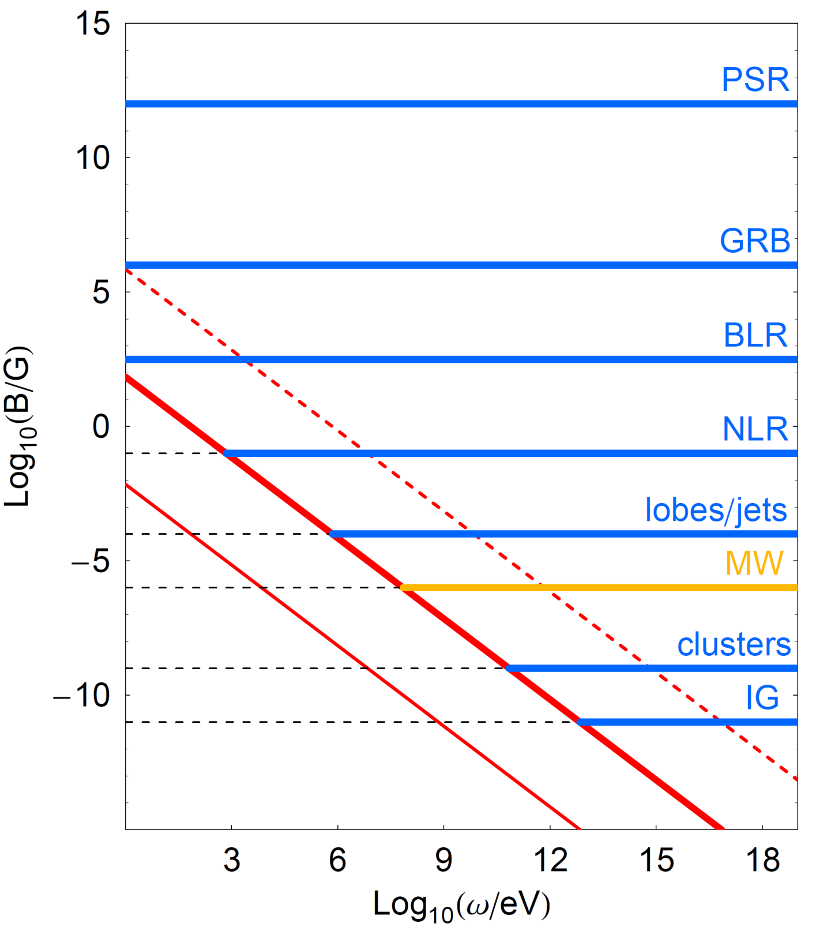



Maximal
Mixing 1

Slide 23

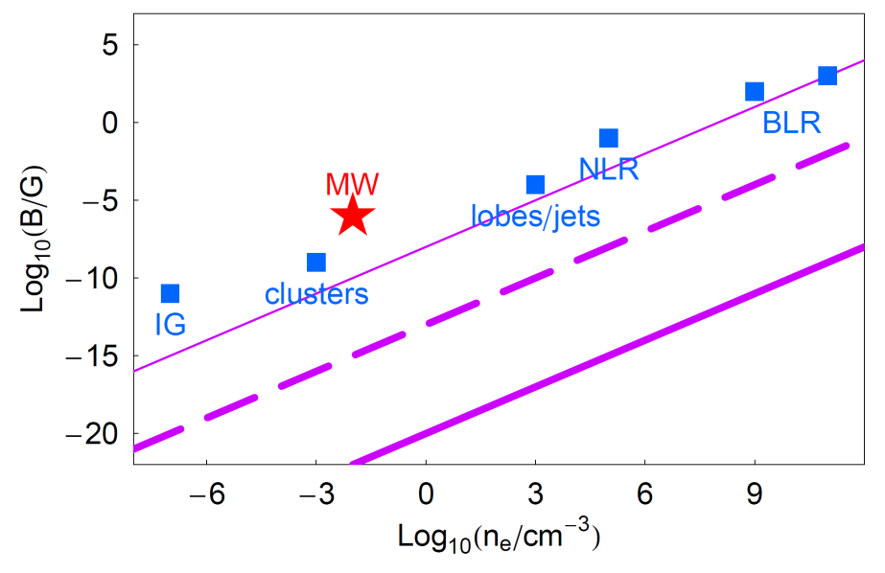


Maximal Mixing 2

Slide 24
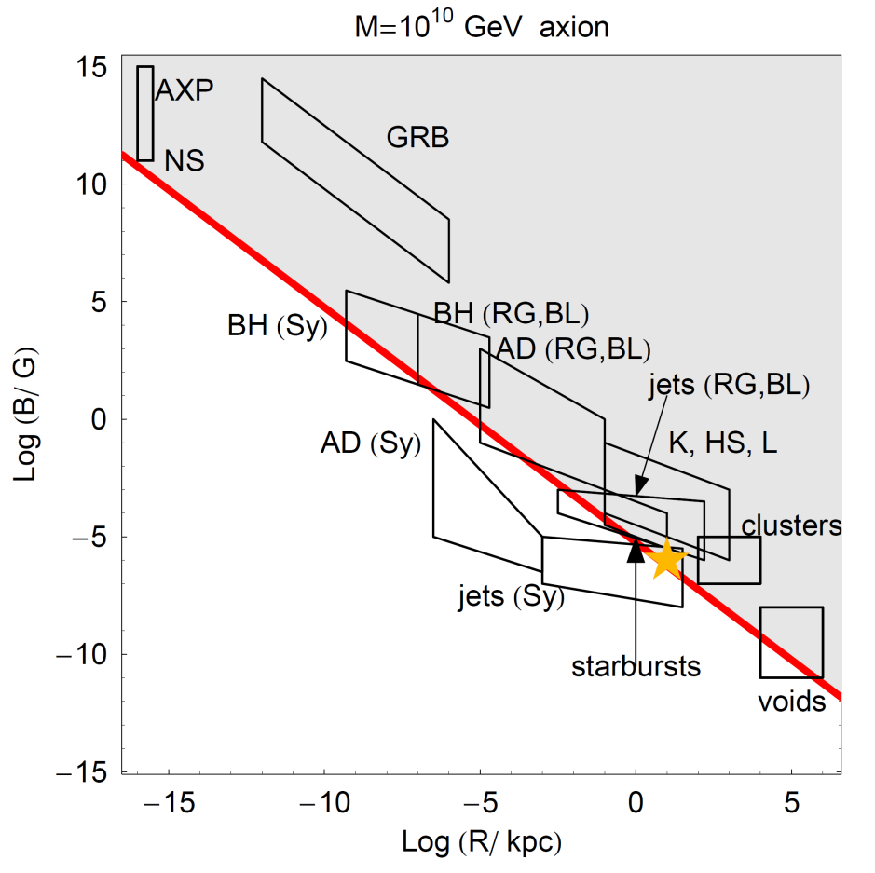
Mixing Length in Source
(Maximal mixing assumed)

Slide 25
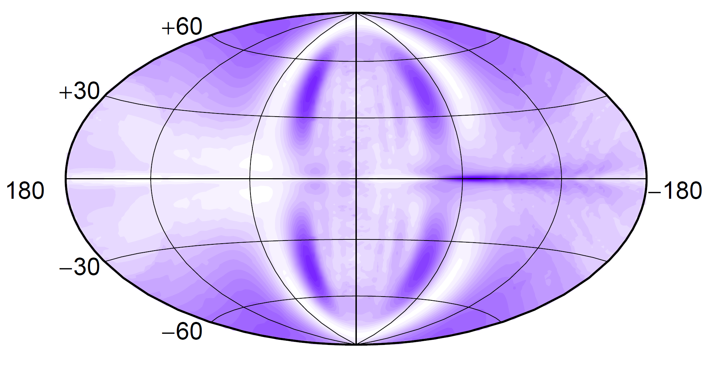
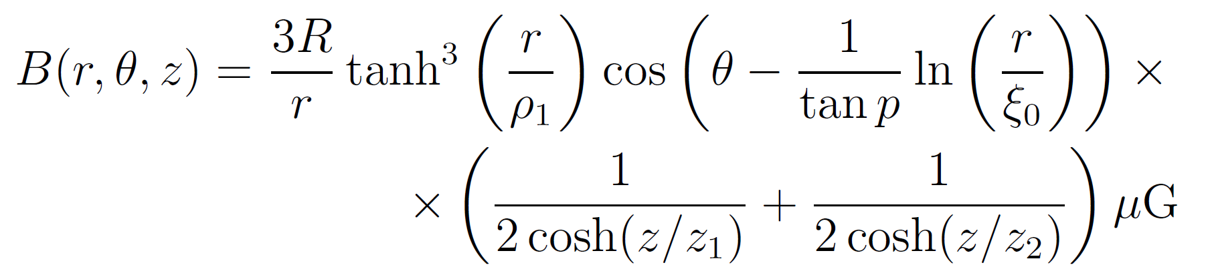
Harari, Mollerach and Roulet (HMR) model

Slide 26
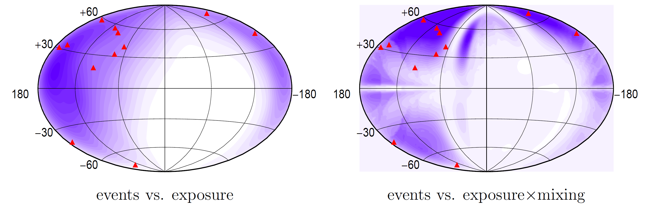
Testing for correlation
2.4% chance of occuring randomly – not very small.

Slide 27
Mixing Matrix
2

Slide 28
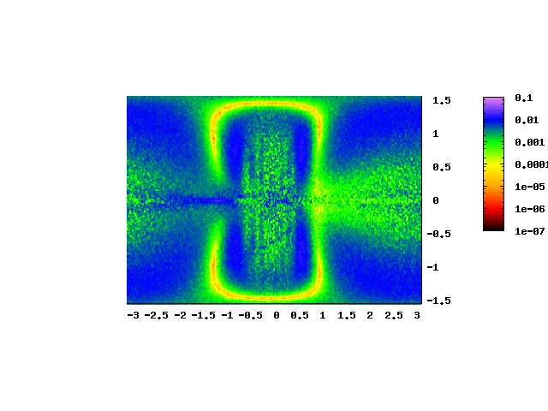
ω = 10³ GeV

Slide 29

ω = 10⁴ GeV

Slide 30

ω = 10⁵ GeV

Slide 31
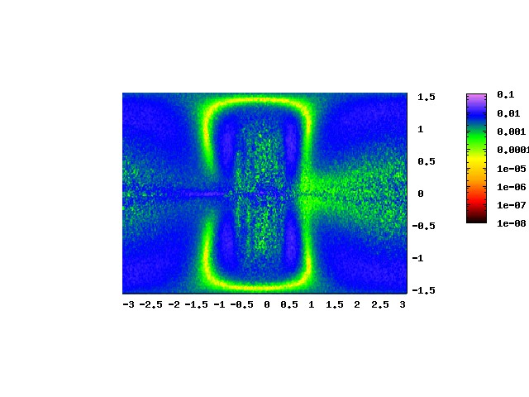
ω = 10⁶ GeV

Slide 32
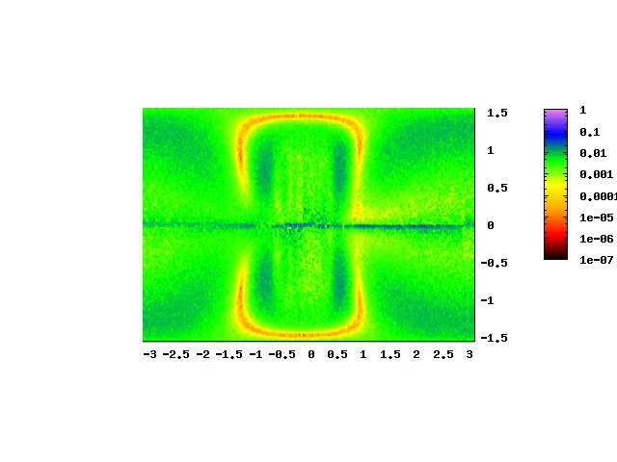
ω = 10⁷ GeV

Slide 33
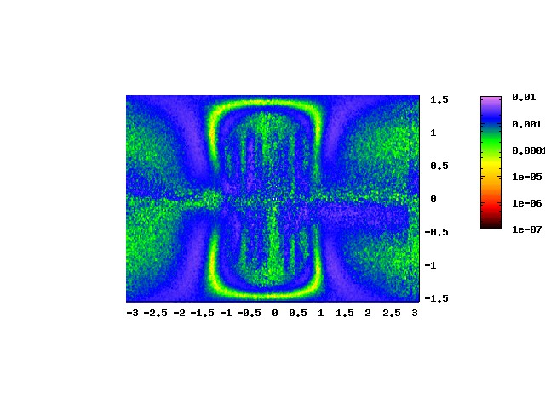
ω = 10⁸ GeV

Slide 34
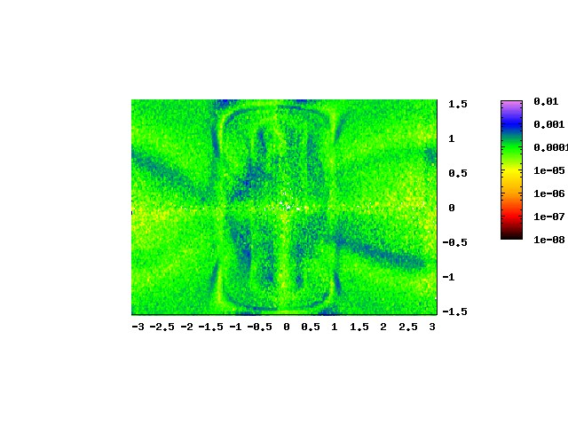
ω = 10⁹ GeV

Slide 35
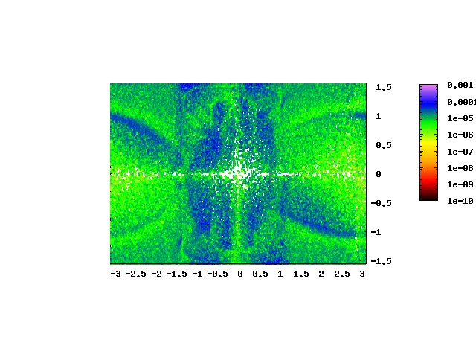
ω = 10¹⁰ GeV

Slide 36
Conclusions
Current gamma ray observations starting to create problems for some background radiation models
ALP particles can in principle solve this problem, and also explain arrival of cosmics from large distance although the probability of conversion quite suppressed at high energies
If correlation between cosmic ray arrival direction and BL-Lacs turns out to be true, may be related...

Slide 37
ADDITIONAL SLIDES

Slide 38
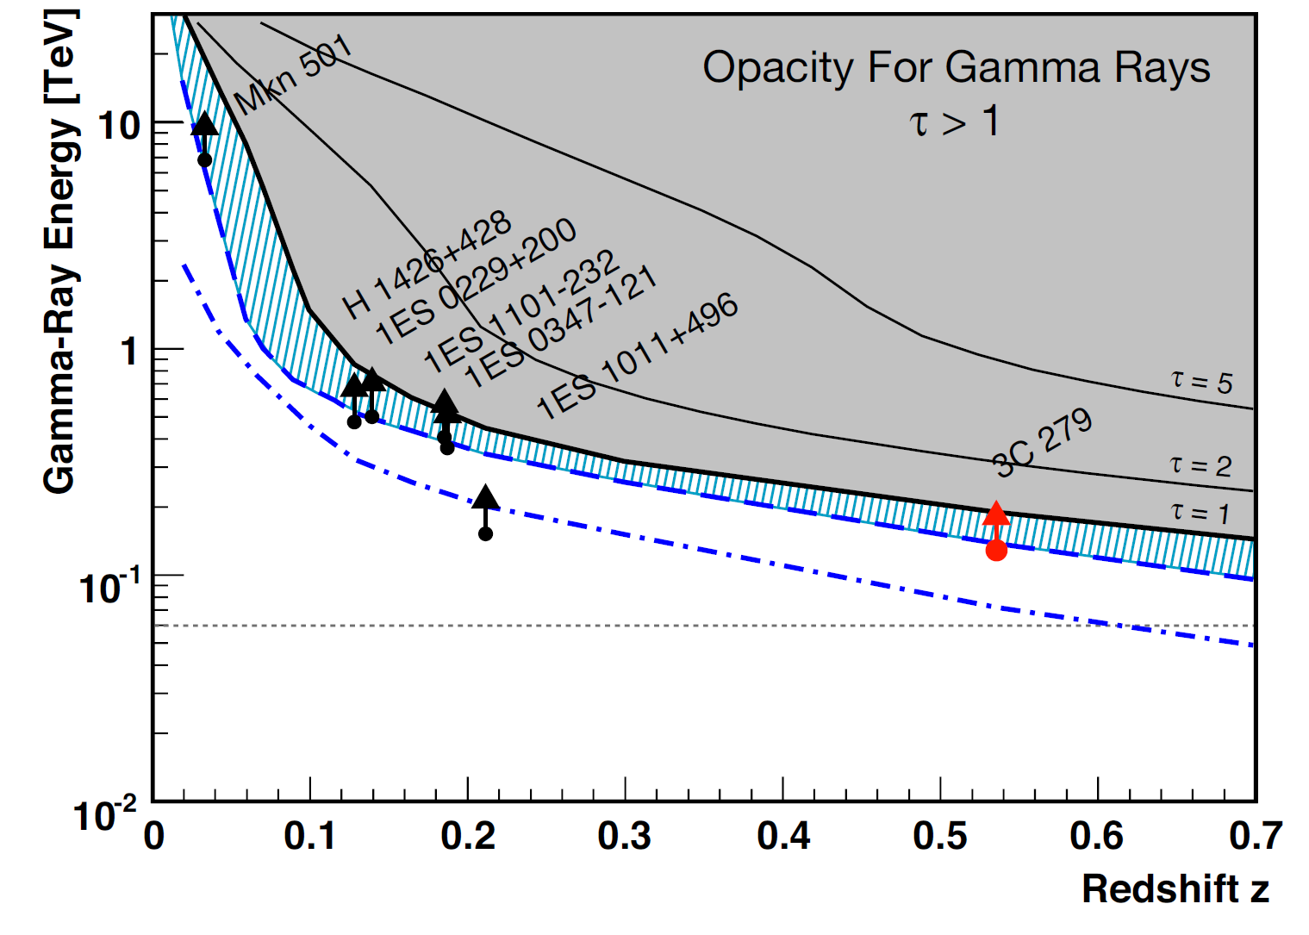
Gamma Ray Horizon
MAGIC COLLABORATION arXiv:0807.2822

Slide 39
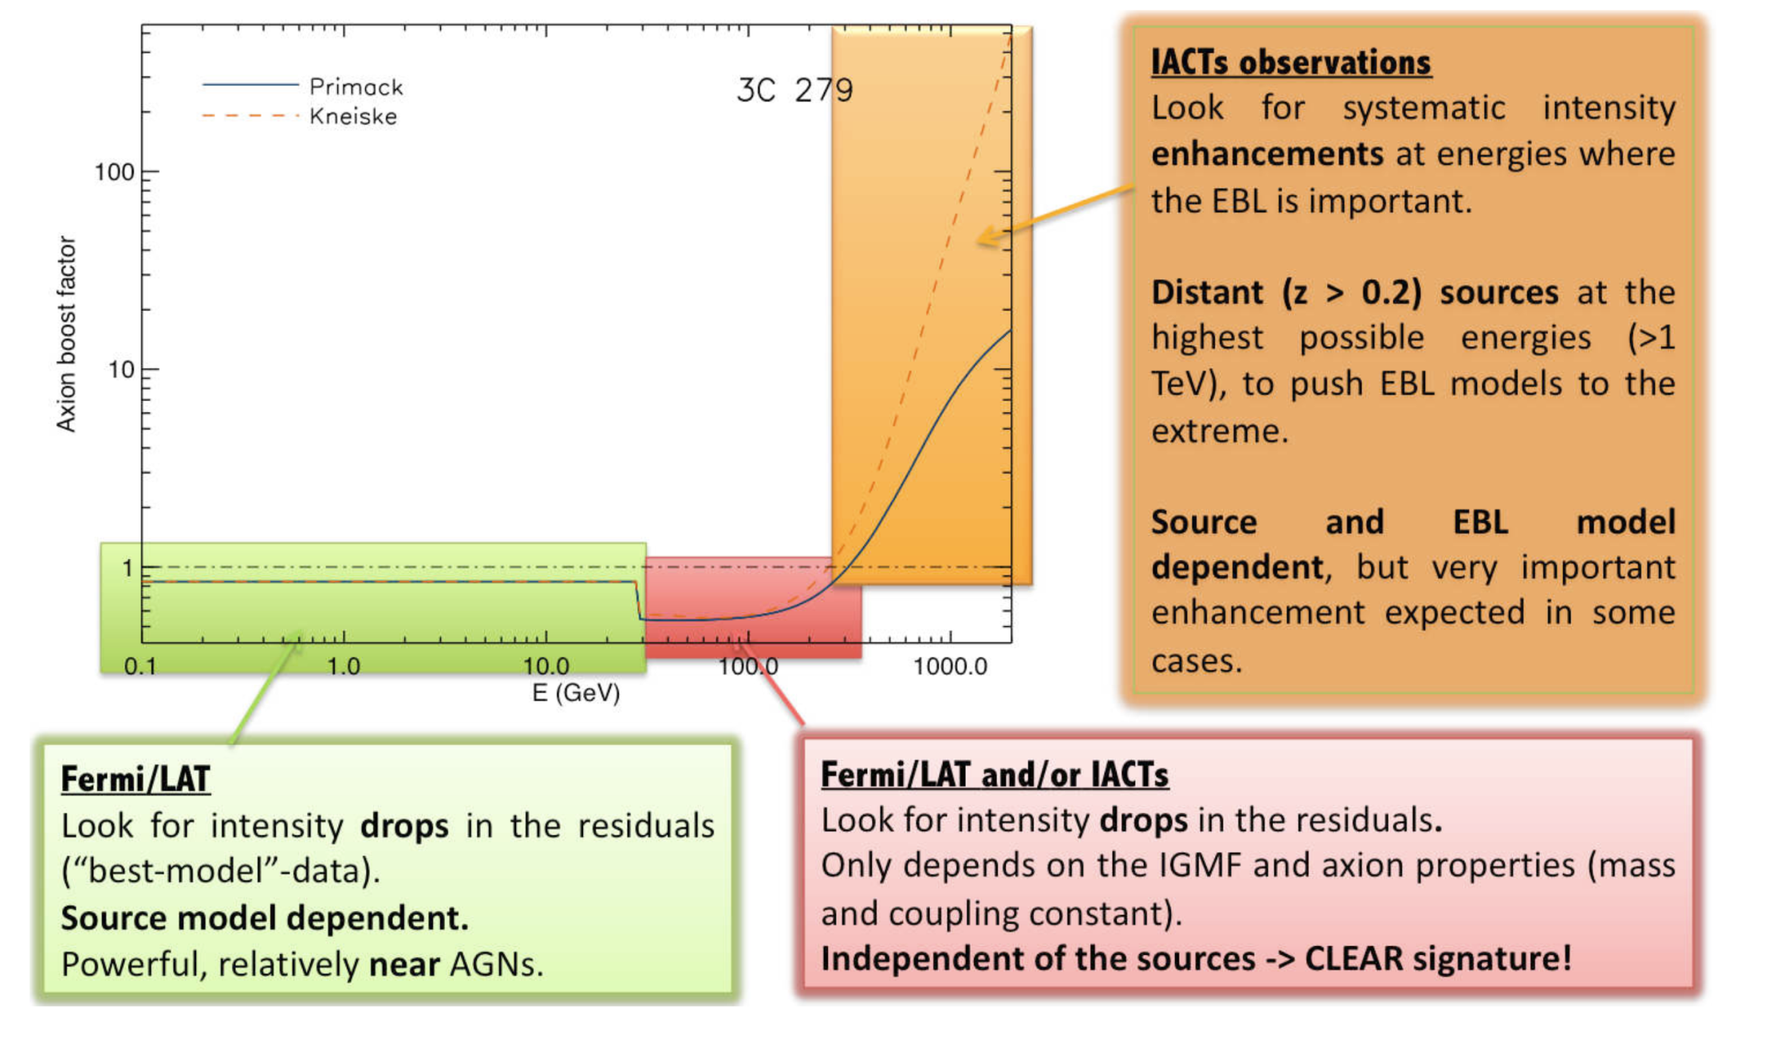
Relative enhancements and observation strategies
Sanchez-Conde et al arXiv:1001.1892

Slide 40
HMR model,
Harari et al

Slide 41
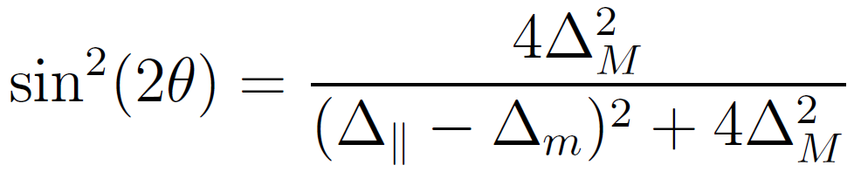
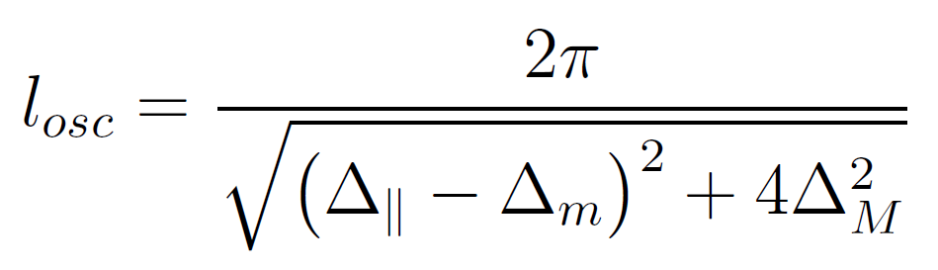
Mixing in constant background
Mixing angle (strength)
When these terms
dominate you have
maximal mixing
Oscillation length

