Slide 1

Allpix² : Un logiciel générique de simulation Monte-Carlo des détecteur pixels semi-conducteurs
Mathieu Benoit
10 Juin 2021

Slide 2
Outline
Introduction to the Allpix² Framework
Simulation flow
Description of modules
  Energy deposition
  Charge Transport
  Transfer
  Digitization
  IO and analysis
Examples
Ressources

Slide 3
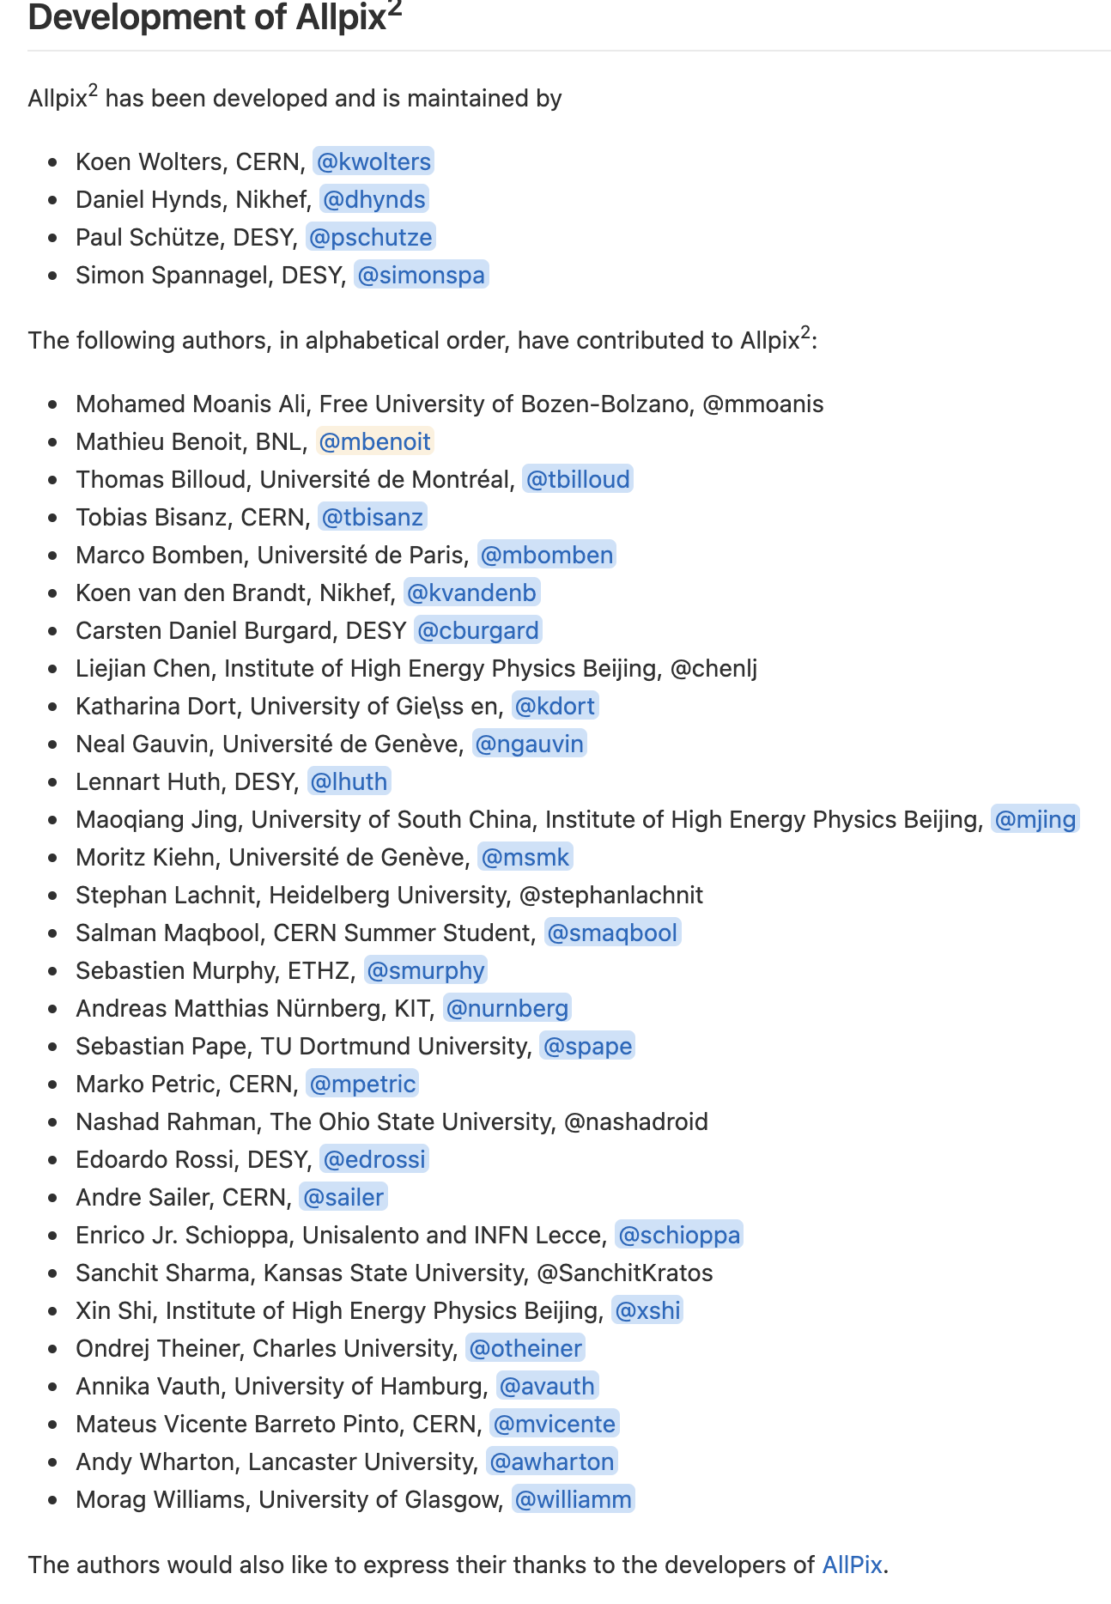
The Allpix² team

Slide 4
The Allpix² Framework
A Modular, Generic Simulation Framework for pixel Detectors
The framework aims at facilitating the different steps of the simulation of semiconductor detectors
  Energy deposition in the detector material (GEANT4 etc.)
  Charge Transport in the semiconductor
  Transfer, Digitization and Analysis
The developpers aim at implementing the best practices in semiconductor detector simulation in a generic way to provide to the community verified and standardardized methods and a developement environment for further improvement to simulation methods
  Framework infrastructure
  Documentation, examples and code demonstration

Slide 5
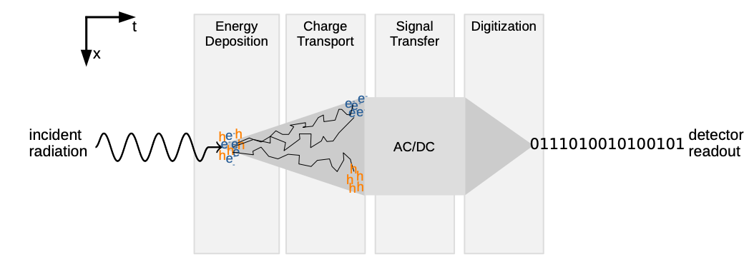
The simulation flow

Slide 6
The Allpix² Framework
The allpix Framework offer a modular way to build a simulation flow and provide the infrastructure (core) to easily transfer information between modules, configure them and log their actions

Slide 7
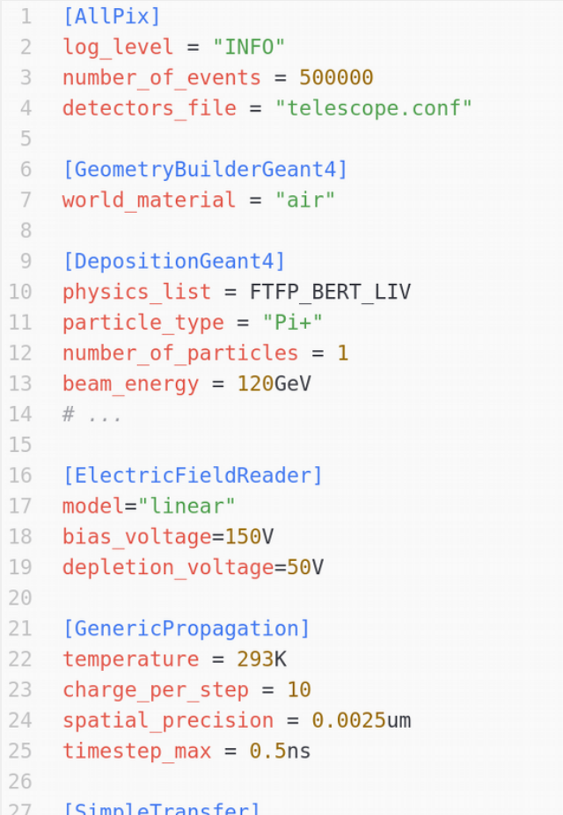
Framework Configuration
Framework configured by one file
  All desired modules listed in order of execution
  Key-value pairs in TOML-style (extended)
  Human readable
  Little overhead (e.g. compared to XML)
Support for physical units
  Never ask what units are used – type them out!
  Automatic conversion to internal units
  No need for manual conversions in C++

Slide 8
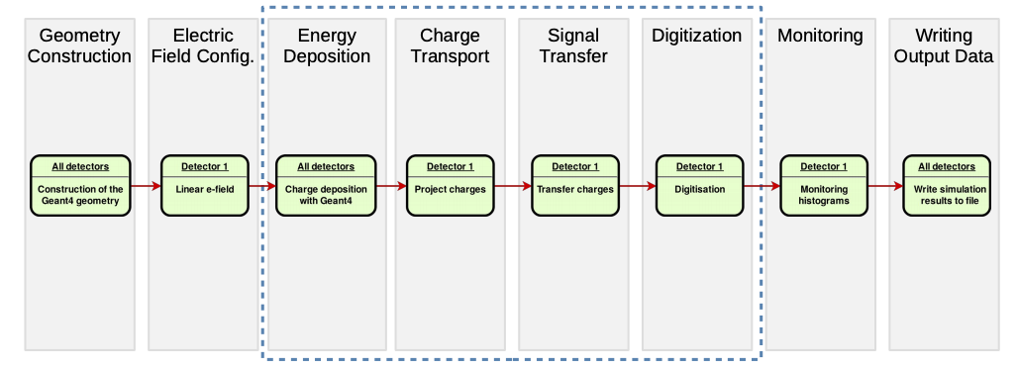
Simulation Flow in Allpix² (simple)

Slide 9
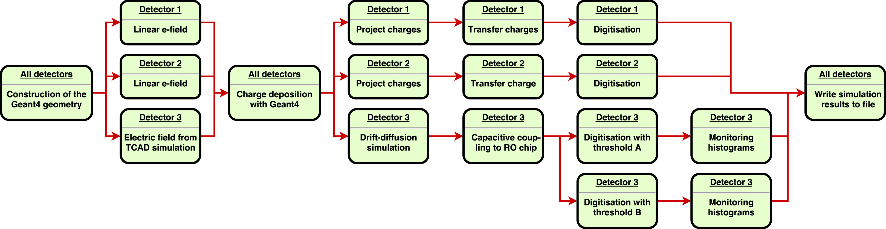
Simulation Flow in Allpix² (Complex)

Slide 10
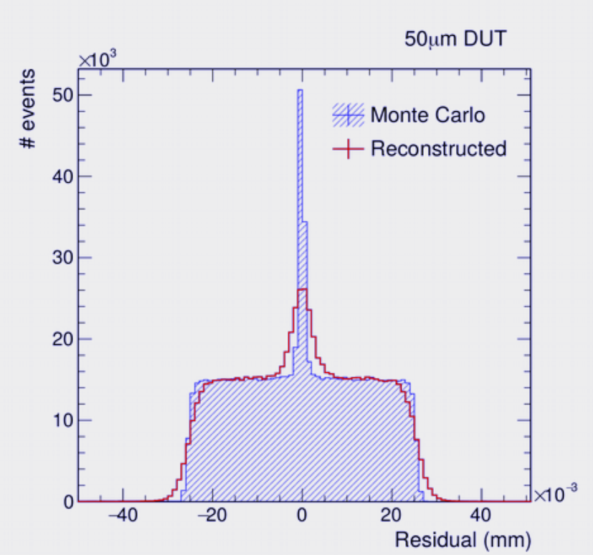
Messages & Object History
Data exchanged between modules by means of messages
  Message holds specific data type and has an origin (detector name, stream name…)
  Modules bind to specific message (or message type) via central messenger
Object history
  For each object the full provenance is recorded using TRef objects
    PixelHit ← PixelCharge ← PropagatedCharge(s) ← DepositedCharge(s) ← MCParticle(s) ← MCTrack
  Allows direct relation of each pixel hit from front-end to initial particle(s)
  Relation between MCParticles enables sorting between primaries (entered sensor from outside) and secondaries (produced within sensor)
  Answers questions like “where in the detector did the charge carriers of this hit originate from?”

Slide 11
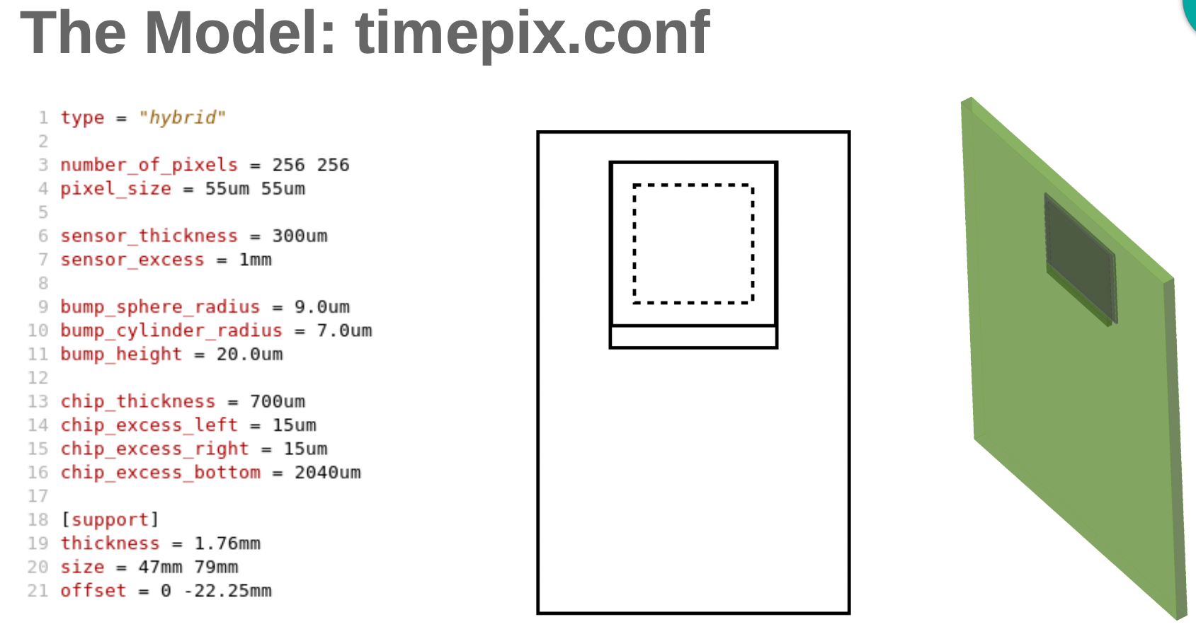
Defining the geometry

Slide 12
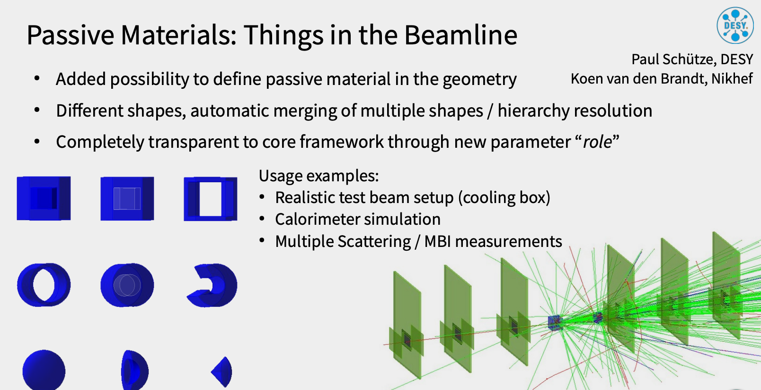
Defining the geometry

Slide 13
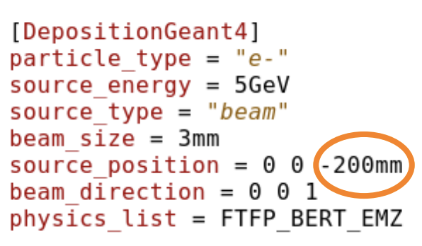
Defining particle sources and energy deposition model
DepositionGeant4
Interface to Geant4
Definition of particles and tracking through the setup
Energy deposition in sensitive material
Pick …
  the type of particles (or radioactive sources)
  the particle energy
  the origin and direction of the beam
  the shape and size of the beam
  a suitable physics list

Slide 14
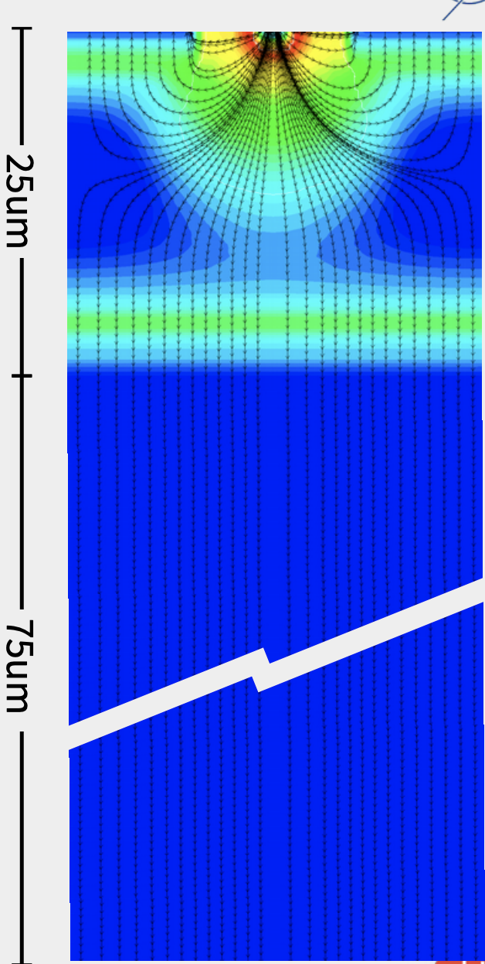
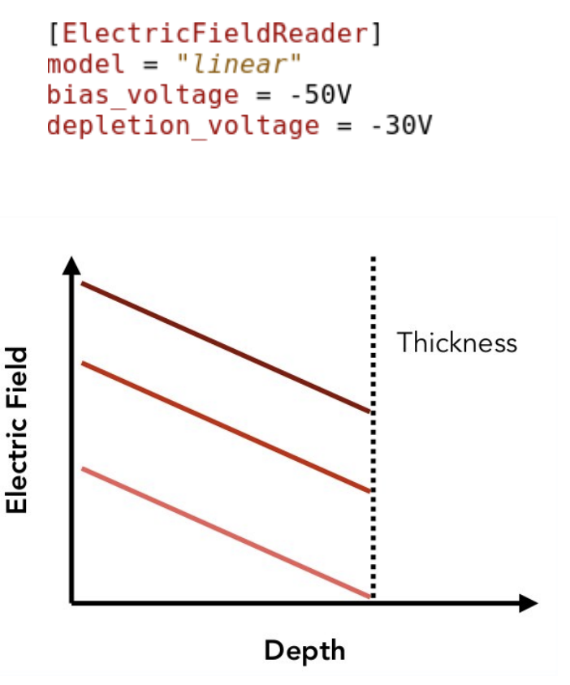
Defining the electric field
Modules are provided to model detector with common analytical models for simple simulation
Tools for converting more complex electric field distribution from TCAD (Sentaurus) are provided to import more complex electric field distribution in the Framework

Slide 15
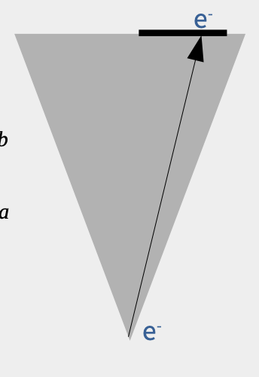
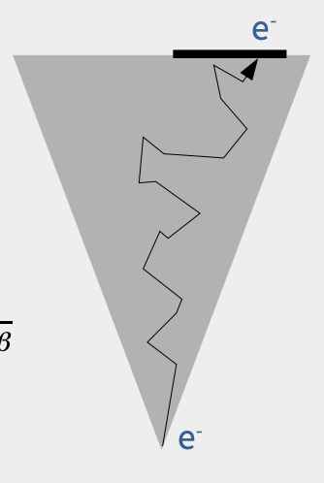
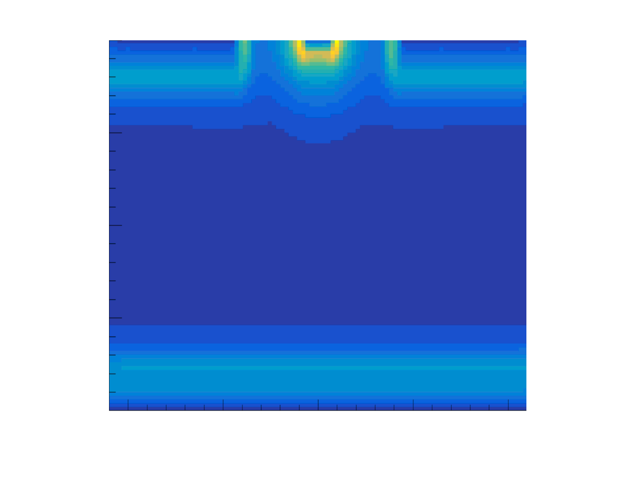
Propagating deposited charge
The framework provide multiple methods to transport the charge in the defined electric field, from simple to complex
Projection Propagation
  Simple approximation of transport, good for linear electric field and thick sensors, transport to surface then smear charge to account for diffusion
Integration of charge motion
  Full numerical integration of charge or fragments trajectory via a RKF45 method, in the electric field, taking into account :
    Mobility
    Magnetic and electric field

Slide 16
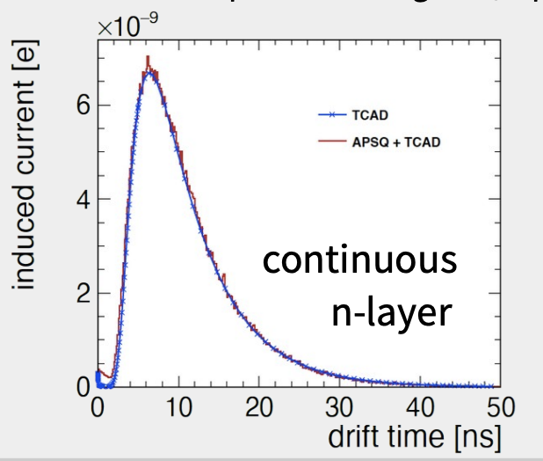
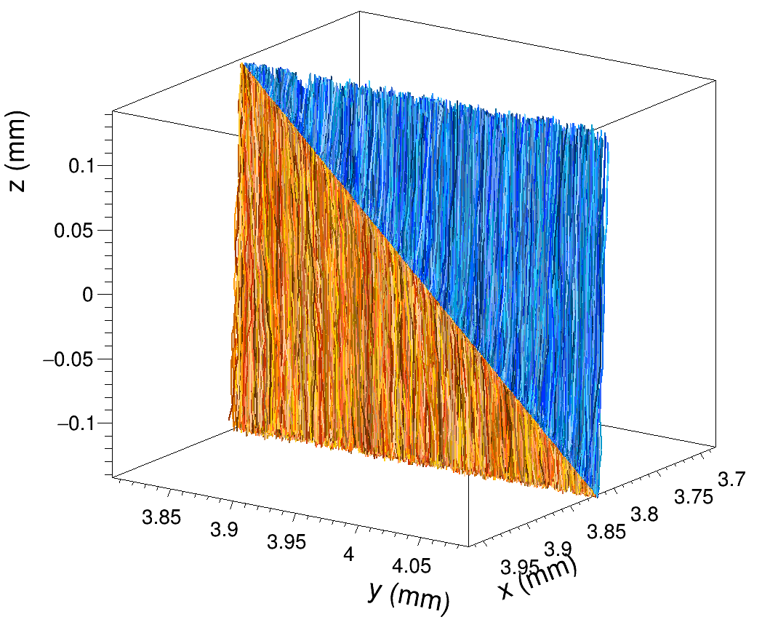
Transfer charge to signal
The framework provide multiple transfer method from simple to complex to transform the information from charge trajectory to registered signal in the electrode
Simple Transfer
  Assign charge to closest electrode at the end of trajectory
Simple Ramo
  Assign charge to each electrode following start and end point and Ramo Potential model or Ramo potential provided via TCAD
Full Ramo
  Calculate induced pulse from charge trajectory for each electrode using provided Ramo potential

Slide 17
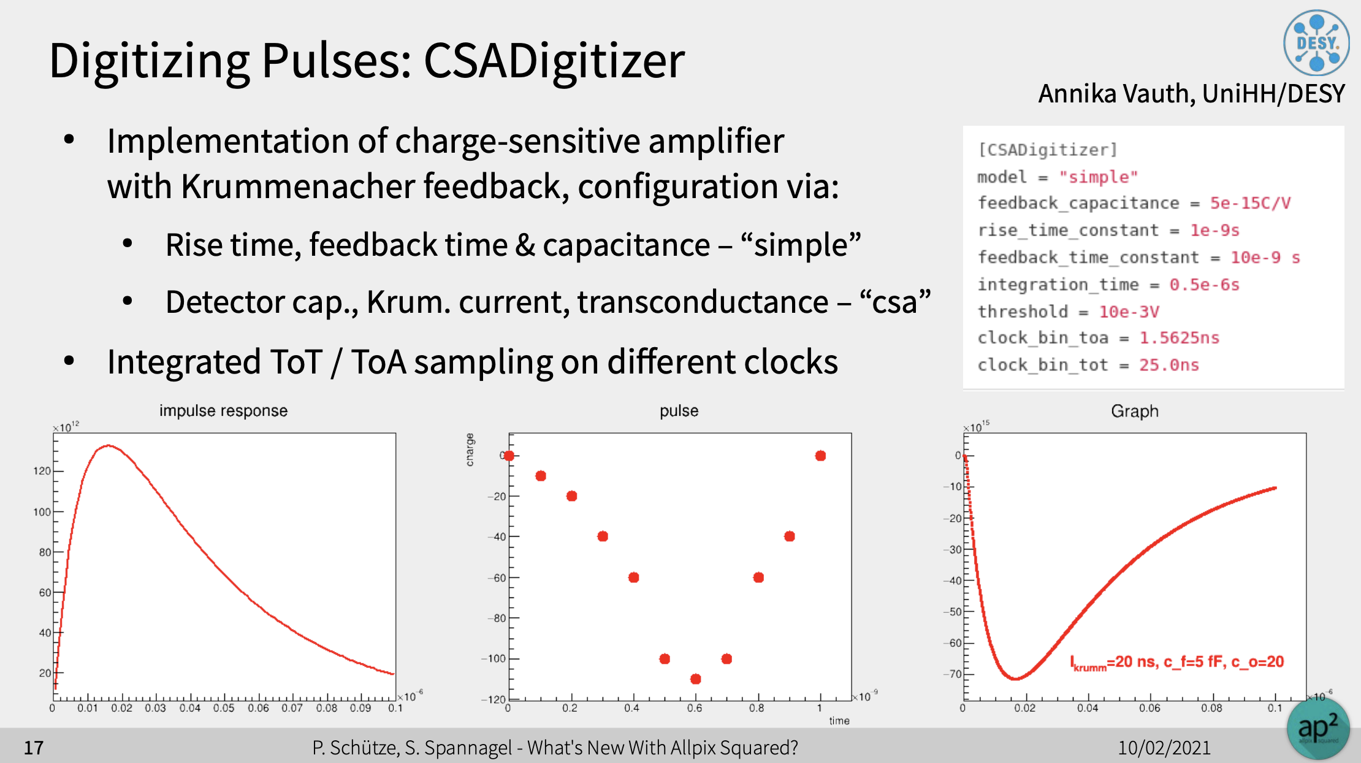
Digitization

Slide 18
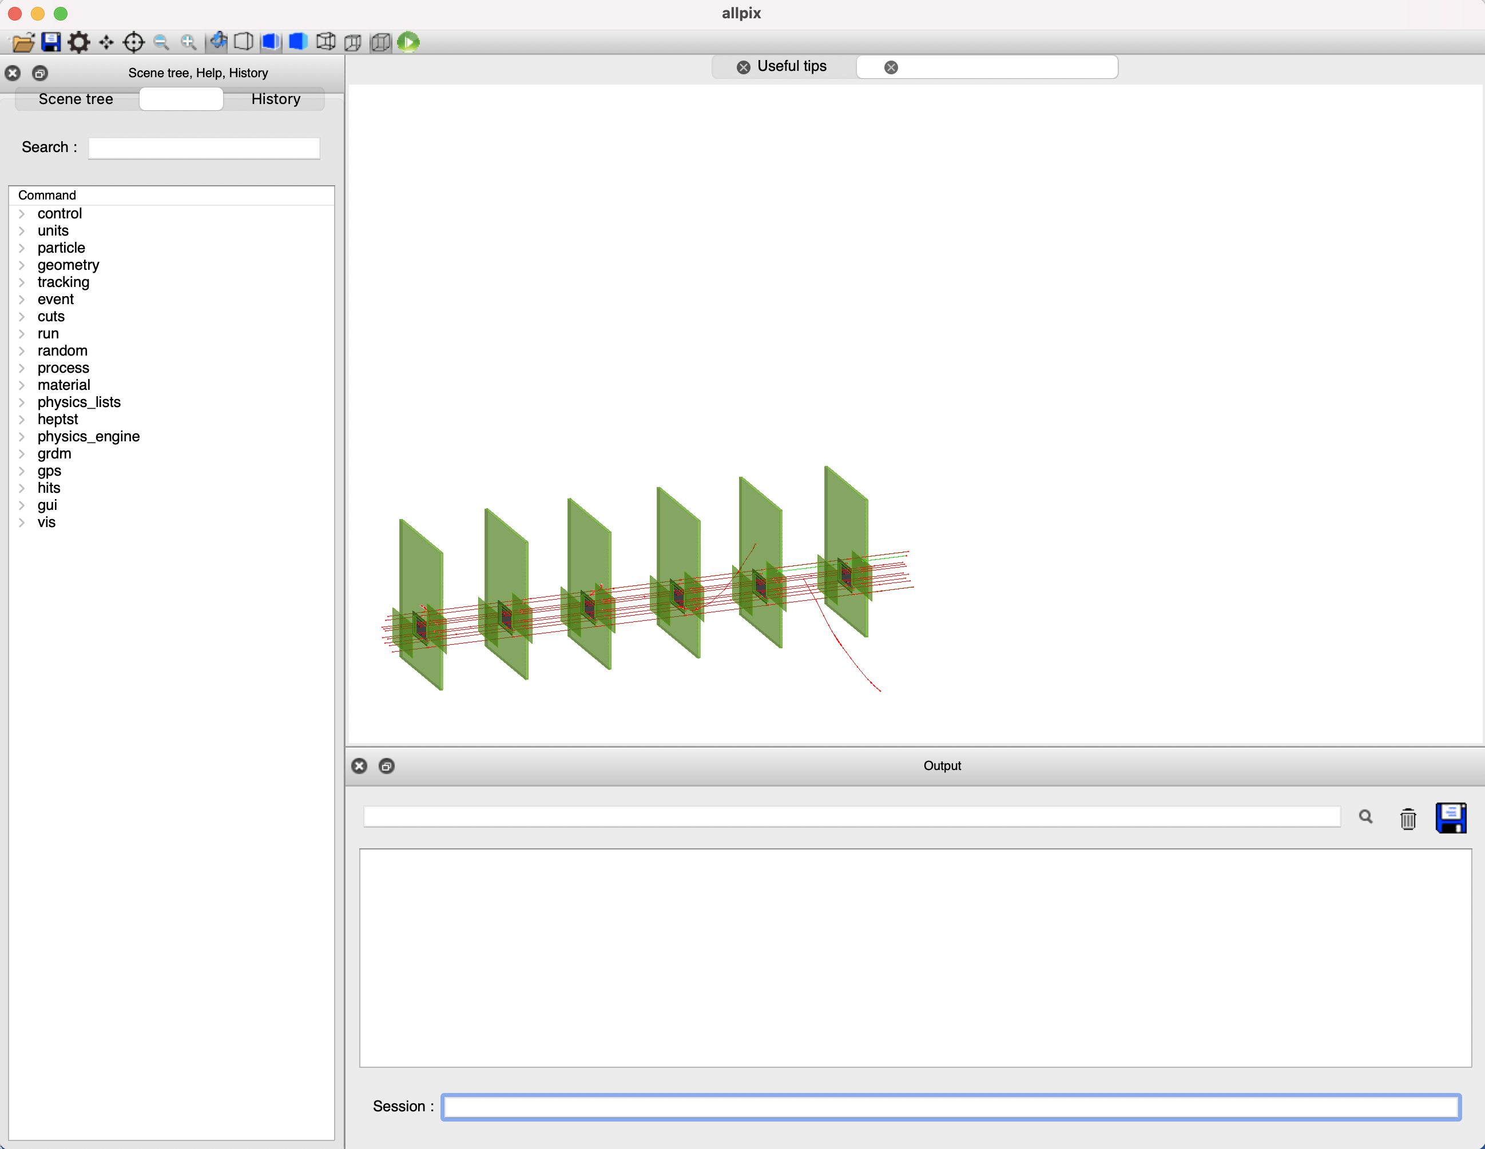
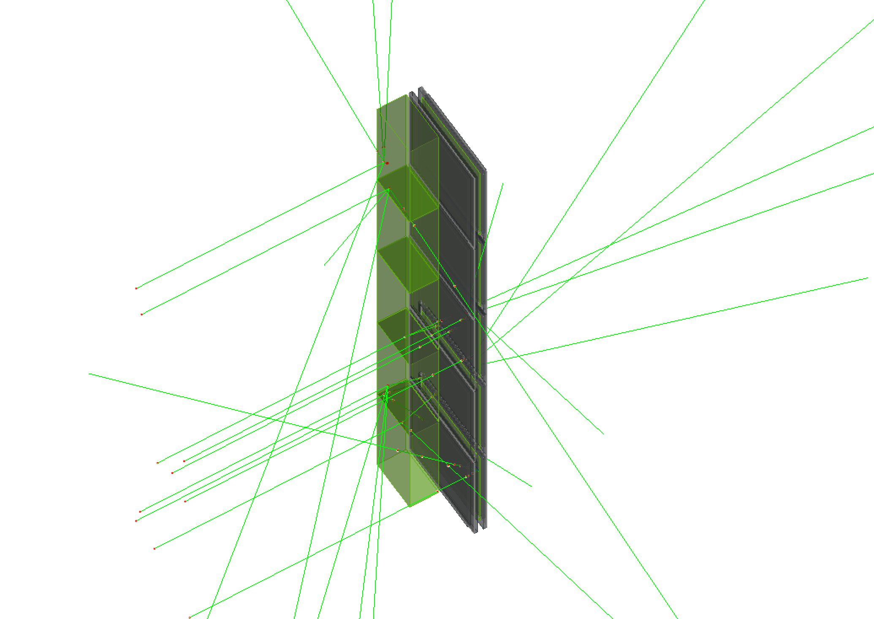
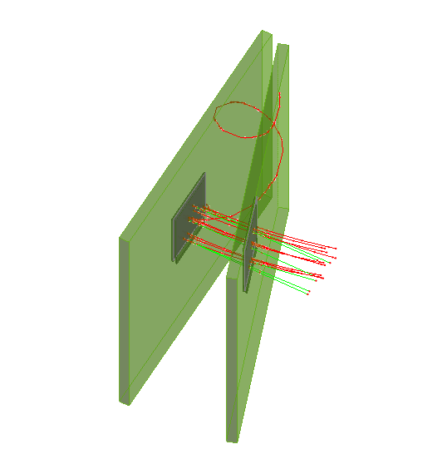
Visualization
The framework comes with an easy to use visualization Module using the GEANT4 capabilities to illustrate the simulation
Particle trajectories, charge, secondaries production
Volumes, passive and active
Hit pixels, energy deposition

Slide 19
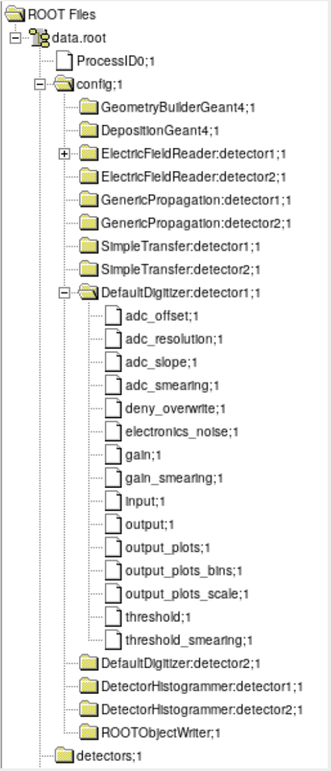
Output of results
Different output writers available
  Eutelescope, RCE, Corryvekran and more
  Can be use for reconstruction with Telescope software
Native format: ROOT files with all objects
  Also contains detectors & sim. parameters
  Full framework configuration can be reconstructed from single data file
ROOTObject reader replays data from file
  Simulate deposition & propagation once
  Read data from file and quickly repeat final digitization step with different parameters
Each module reports a set of plots and histogram for rapid analysis of results

Slide 20
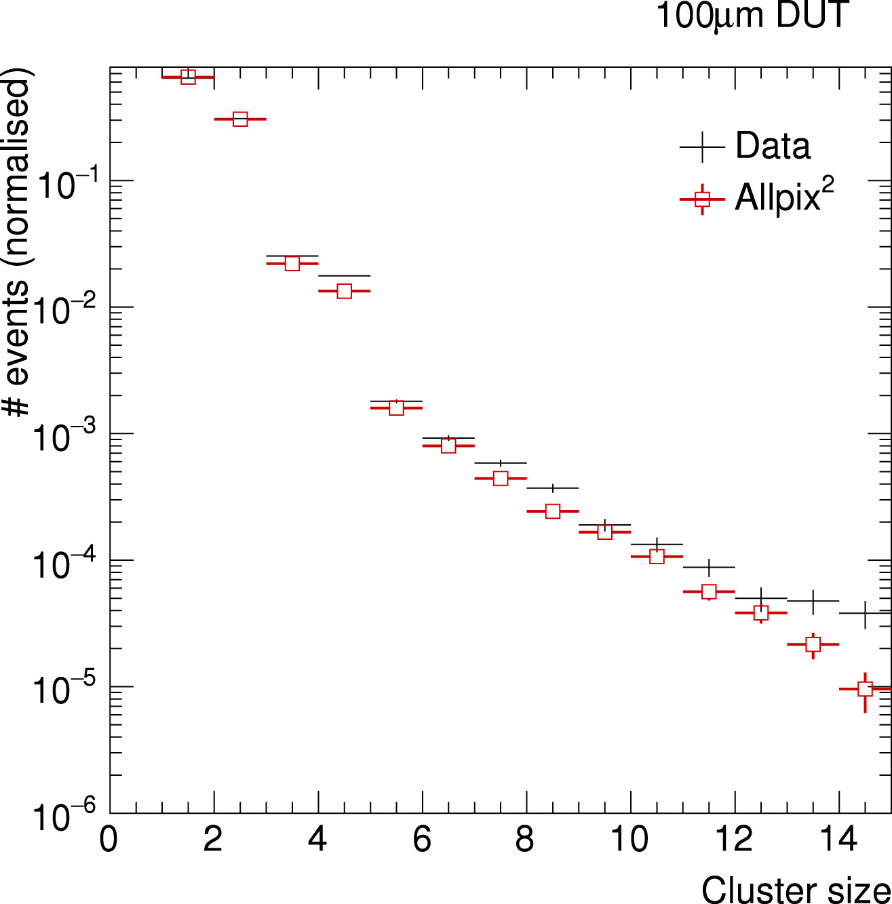
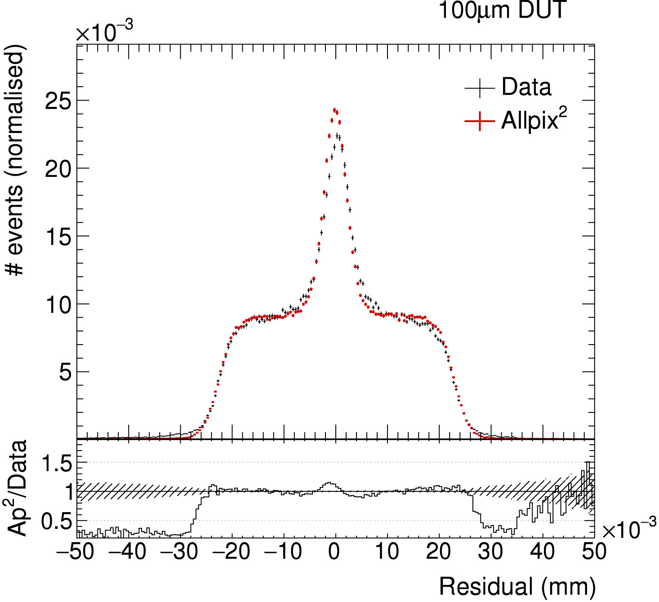
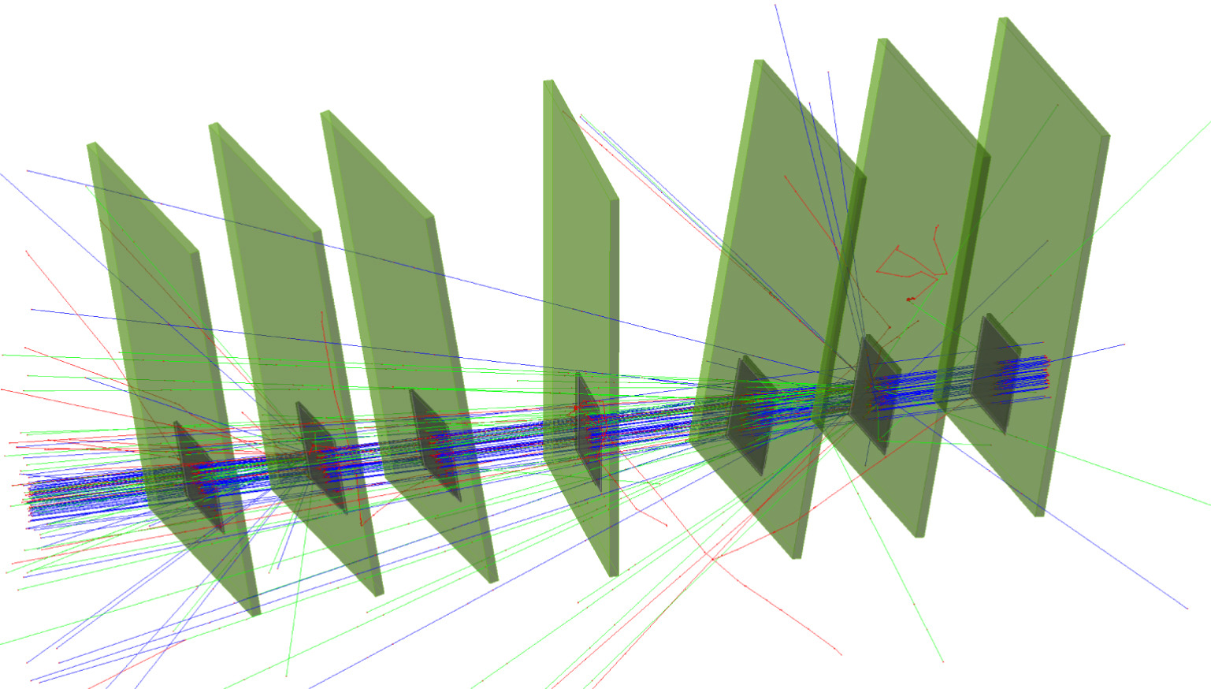
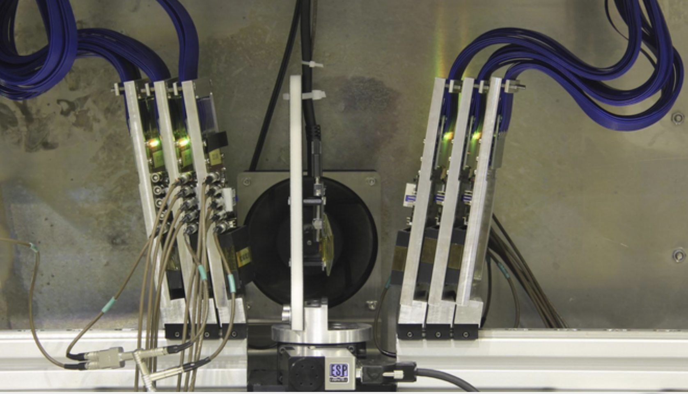
Example Application
NIMA 901 (2018) 164 – 172 doi:10.1016/j.nima.2018.06.020
Simulation of a beam telescope setup: CLICdp Timepix3 telescope @ SPS H6
  Telescope: 6x Timepix3 w/ 300 µm sensors
  DUT: 1x Timepix3 w/ 50 µm sensor
Validation of reconstruction
Different algorithms used:
  Telescope: projection
  DUT: successive integration
Linear electric field approximation
Very good agreement between data and simulation observed (total charge: Geant4; cluster size: both; residual shape: Allpix² )

Slide 21
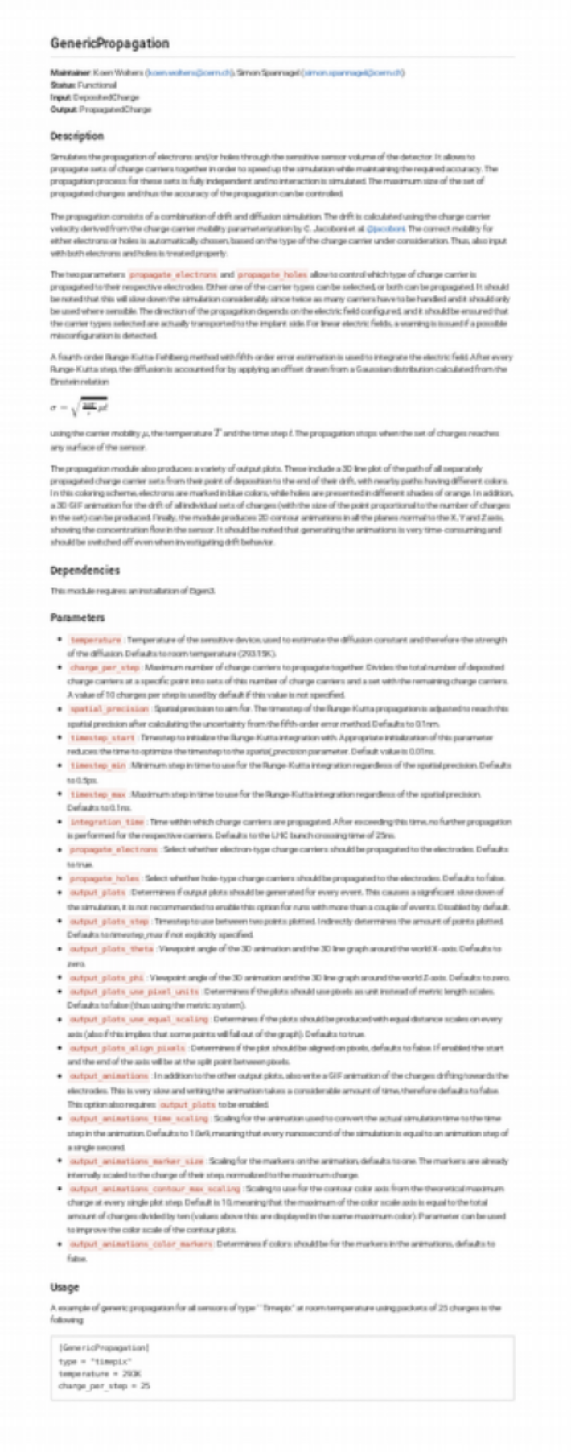
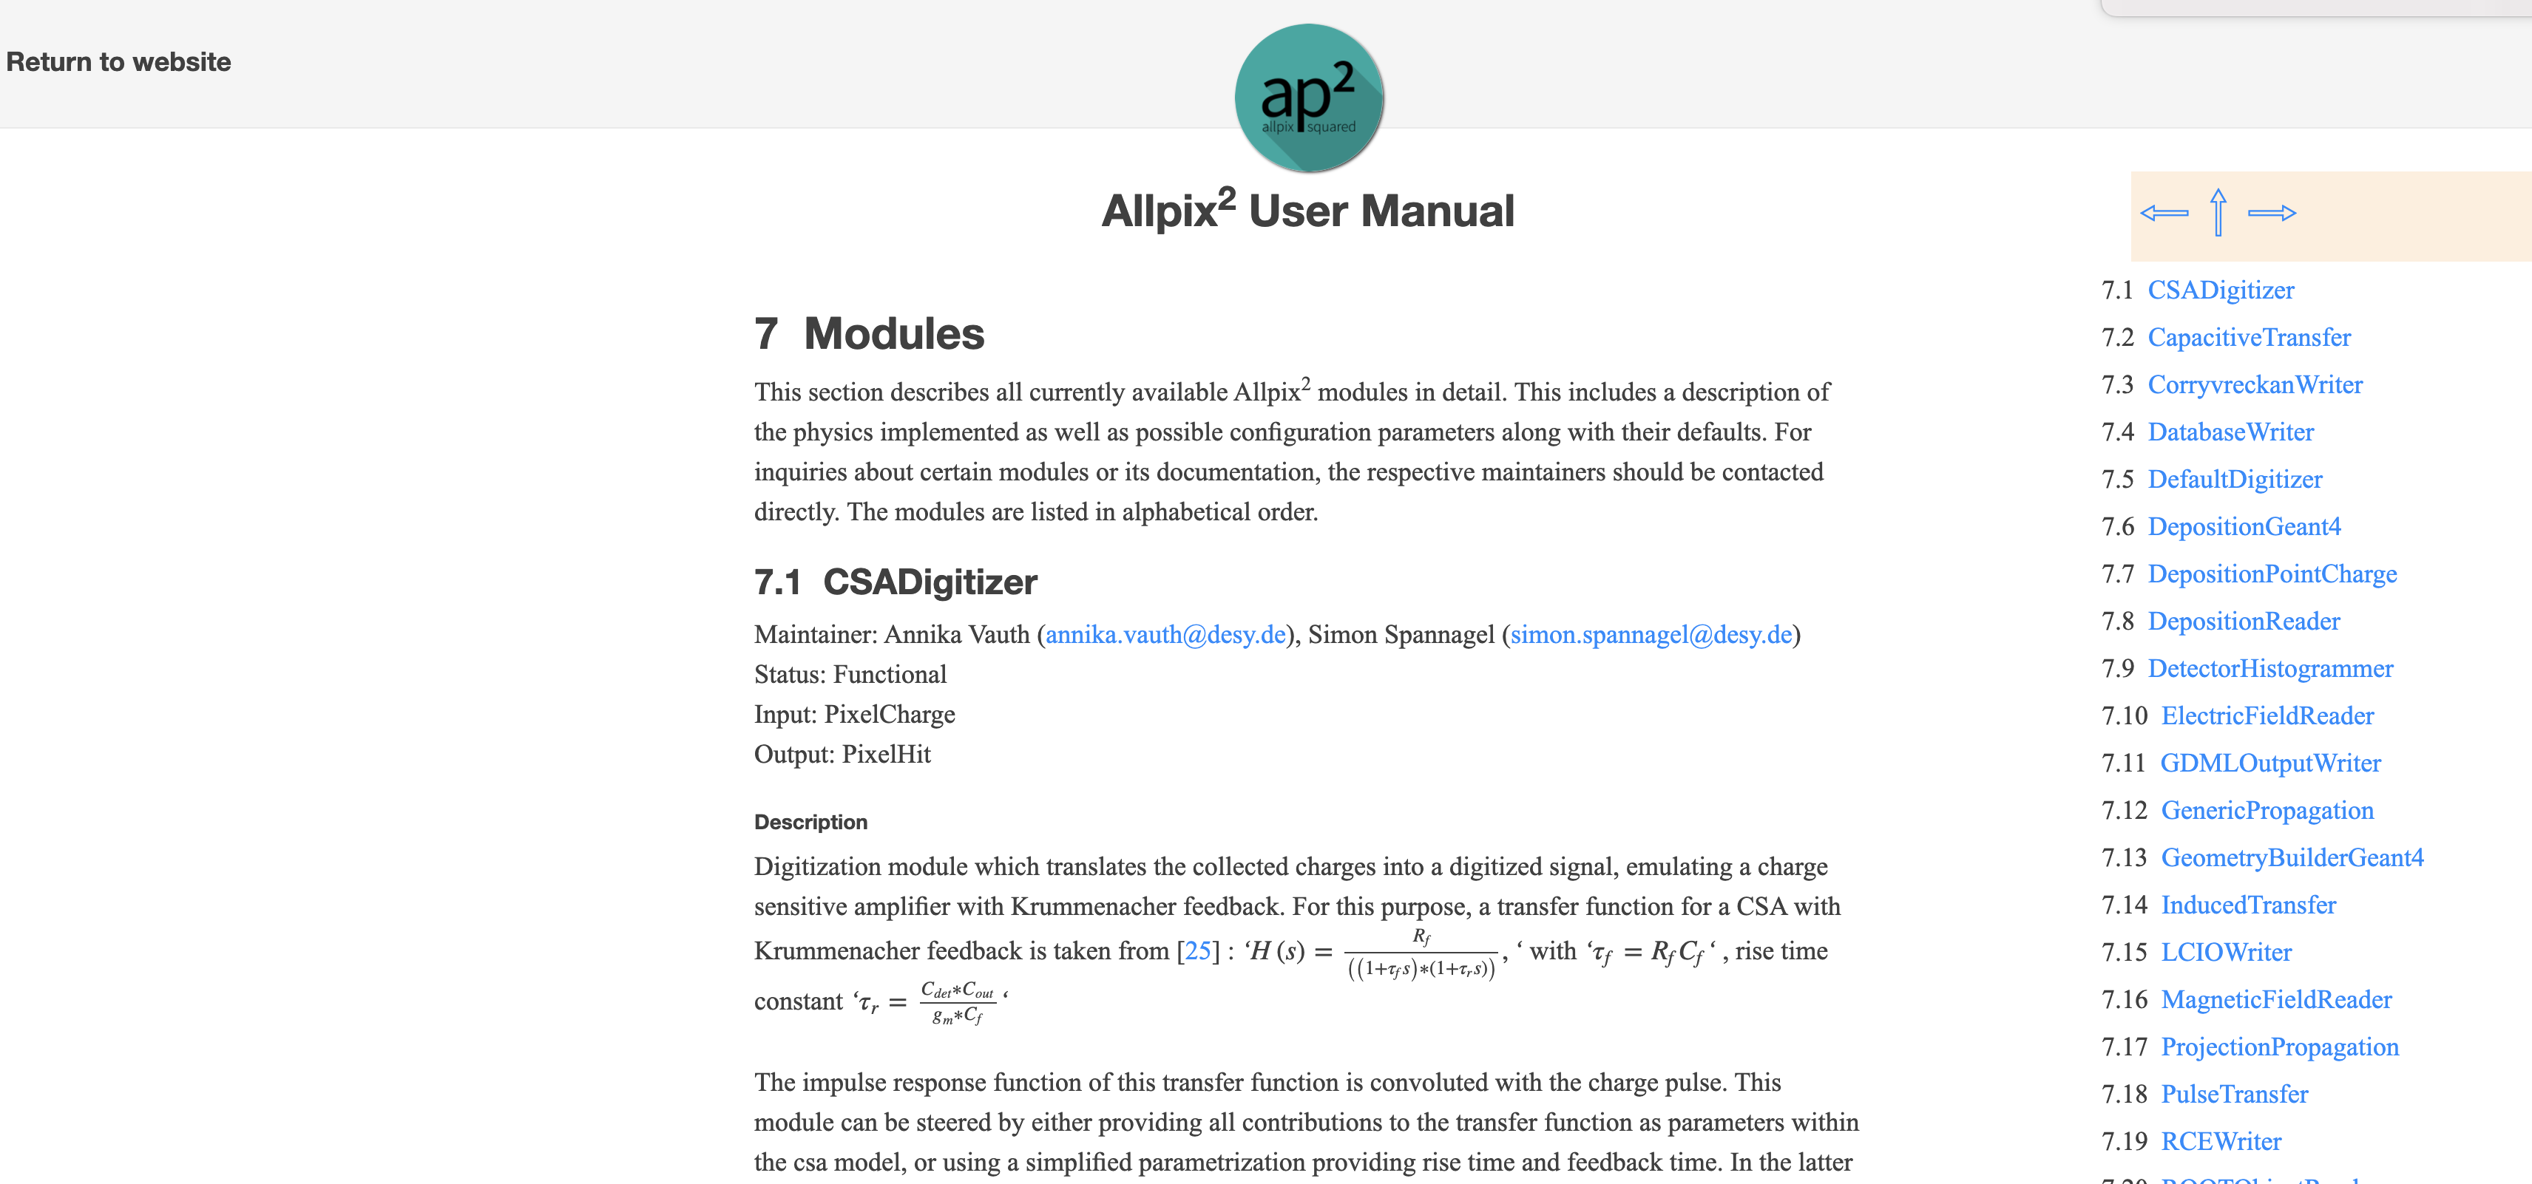
Documentation, coding guidelines, peer review
Focus from the very beginning on well-documented framework
  Source code documentation for every class, method
    Doxygen markup for code reference
    Deployed to the website for tags
  Extensive User Manual in LaTeX
    Automatically compiled by CI
    Module documentation as Markdown
      Document module parameters, algorithms
      Included in manual via Pandoc
Peer review of code for inclusion help maintains code readability and preserve the usability

Slide 22
Conclusion
The Allpix² Framework, a generic tool for simulation of semiconductor detectors combine the power of GEANT4 with state of the art algorithms for the simulation of transport, transfer and digitization
  Easy to use , no coding required in most case
  Validated widly by the community
  In constant evolution, each version gets better !
  Well documented, including examples
  We hope to have convinced you to have a look at the framework !

Slide 23
All the good links !!!
Website https://cern.ch/allpix-squared
Repository https://gitlab.cern.ch/allpix-squared/allpix-squared
Docker https://gitlab.cern.ch/allpix-squared/allpixsquared/container_registry User
Forum: https://cern.ch/allpix-squared-forum/
Mailing Lists:
  allpix-squared-users https://e-groups.cern.ch/e-groups/Egroup.do?egroupId=10262858
  allpix-squared-developers https://e-groups.cern.ch/e-groups/Egroup.do?egroupId=10273730
User Manual:
https://cern.ch/allpix-squared/usermanual/allpix-manual.pdf

Slide 24
Tutorials
For multiple hands-on tutorials and in-depth presentation on allpix
https://project-allpix-squared.web.cern.ch/project-allpix-squared/page/publications/
Users who published so far :
https://www.scopus.com/results/citedbyresults.uri?sort=plf-f&cite=2-s2.0-85048755761&src=s&imp=t&sid=e2843363bb8a407e98425a734fed7a9e&sot=cite&sdt=a&sl=0&origin=inward&editSaveSearch=&txGid=7bb166821b2dc64286a13edfe8973e2b

