Slide 1
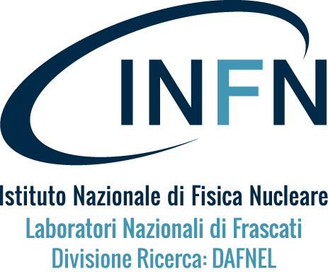
Synergies between dynamic vacuum issues in accelerators and GW instrumentations.
Luisa Spallino¹, Marco Angelucci¹, Andrea Chincarini², Riccardo Musenich², Stefania Farinon², and Roberto Cimino¹
¹ LNF-INFN Frascati, Italy. ² INFN Genova, Italy.

Slide 2
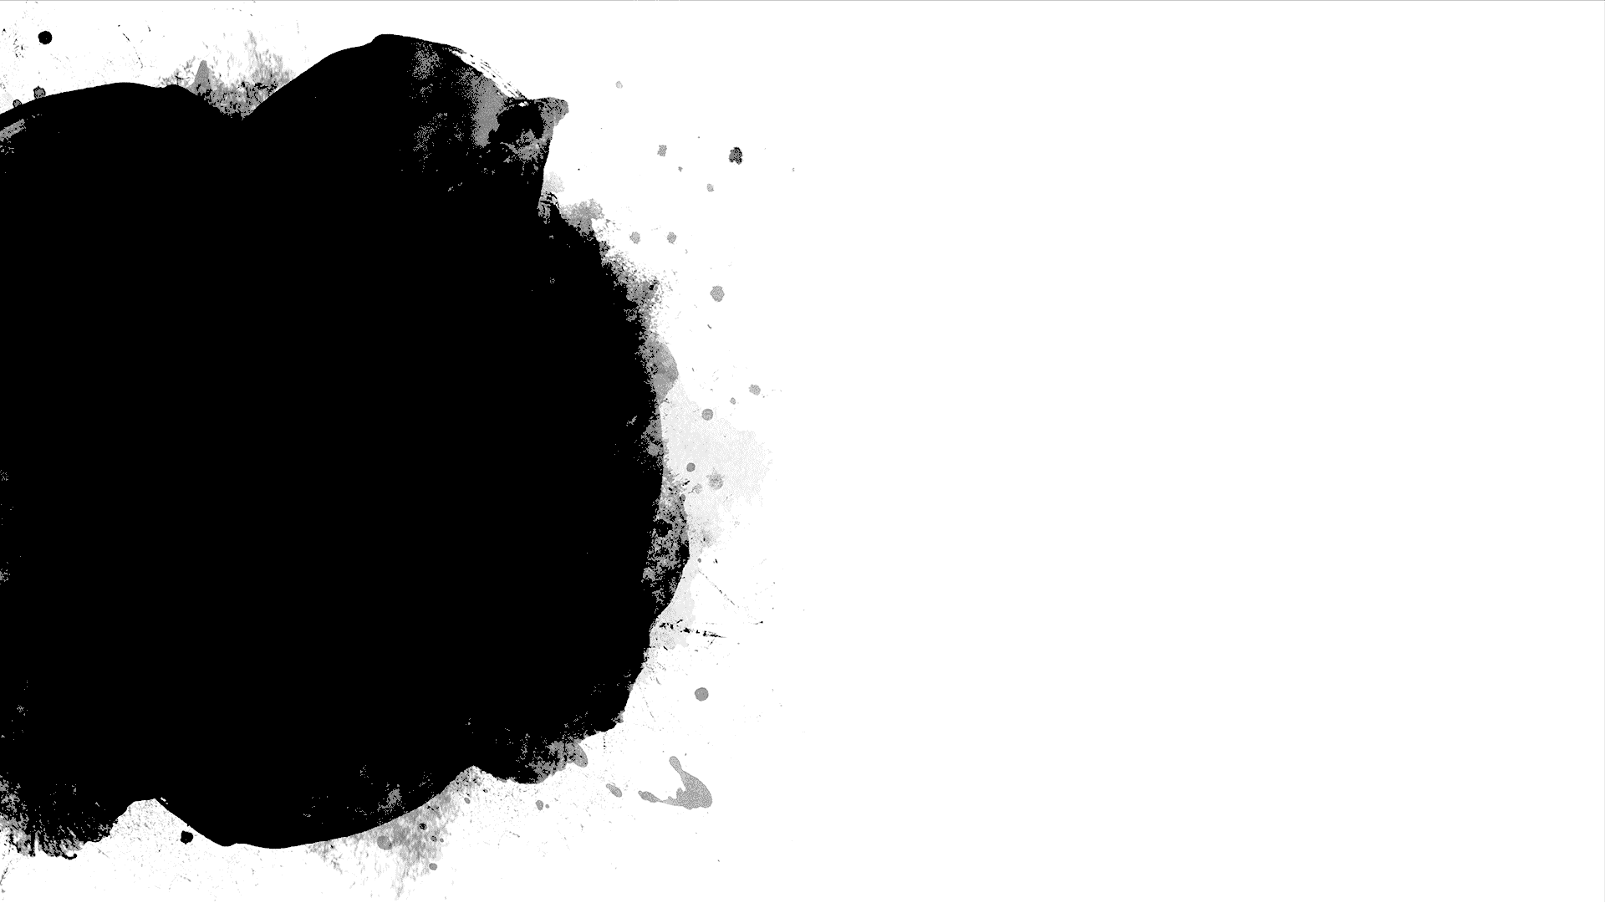
Motivation:
There are clear synergies in vacuum, cryogenics plants and installation between ultimate accelerators and Gravitational Waves Observatories.
Are recent R&D for (cryogenic) dynamic vacuum of interest too?
Can a “Material and Surface Science laboratory” and the competences developed in recent years to tackle unconventional “dynamic” vacuum be of some use for the running of existing GW interferometers and for the proposed ones?

Slide 3
(Personal) Motivation:
“... The only common items between LHC vacuum and The Einstein Telescope are..... the pumps!!” V.B.
“... Vacuum in accelerators has nothing to do with the one needed for the the Einstein Telescope. There, being absent the particle beams, only static vacuum issues are of interest, while, in ultimate accelerators, dynamic vacuum phenomena are dominating and attracting the most recent R&D. ” N.F.

Slide 4
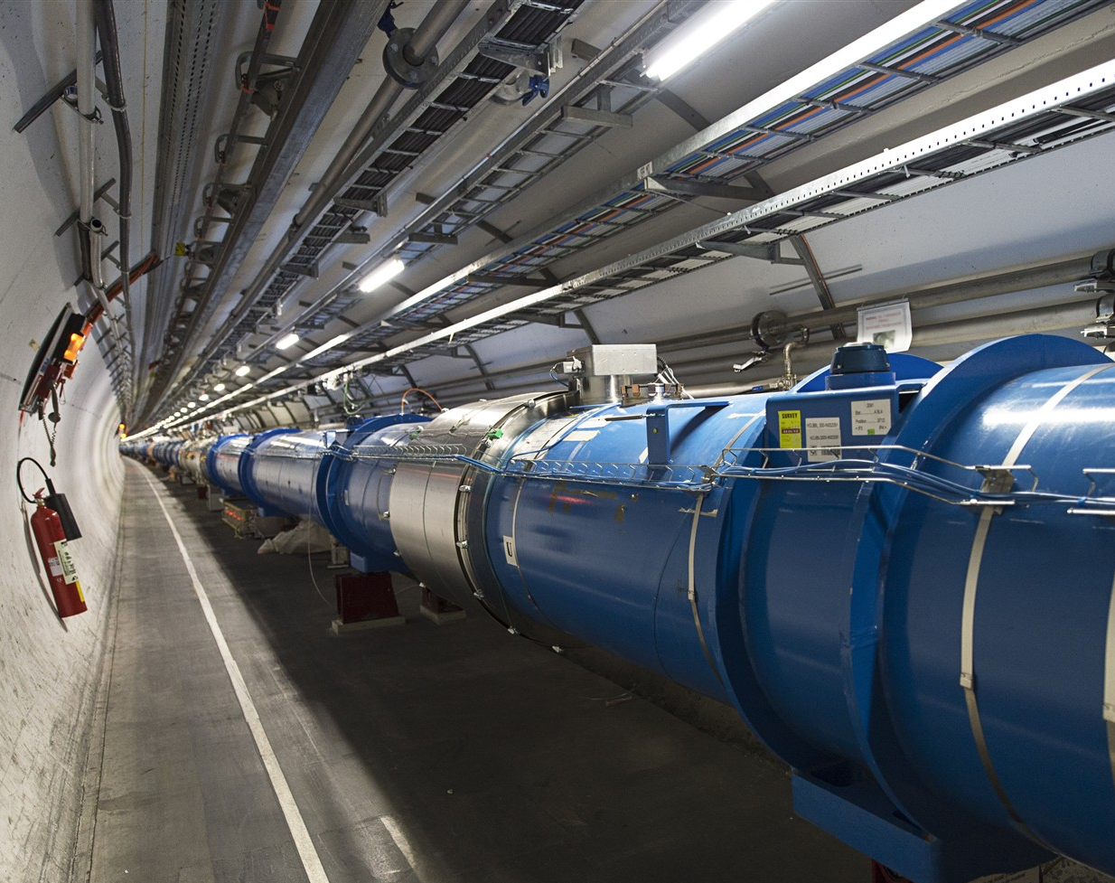
Common Standard vacuum issues
Installations and running of huge vacuum and cryogenic systems.
Joints, flanges, valves etc. R&D.
Pumps and diagnostic (gauges, mass spectrometers and related R&D)
Vacuum calculations.
R&D on new materials, material’s coatings (NEGs?) and/or surface treatments to reduce surface degassing to limit vacuum pumps and contain vacuum costs!

Slide 5
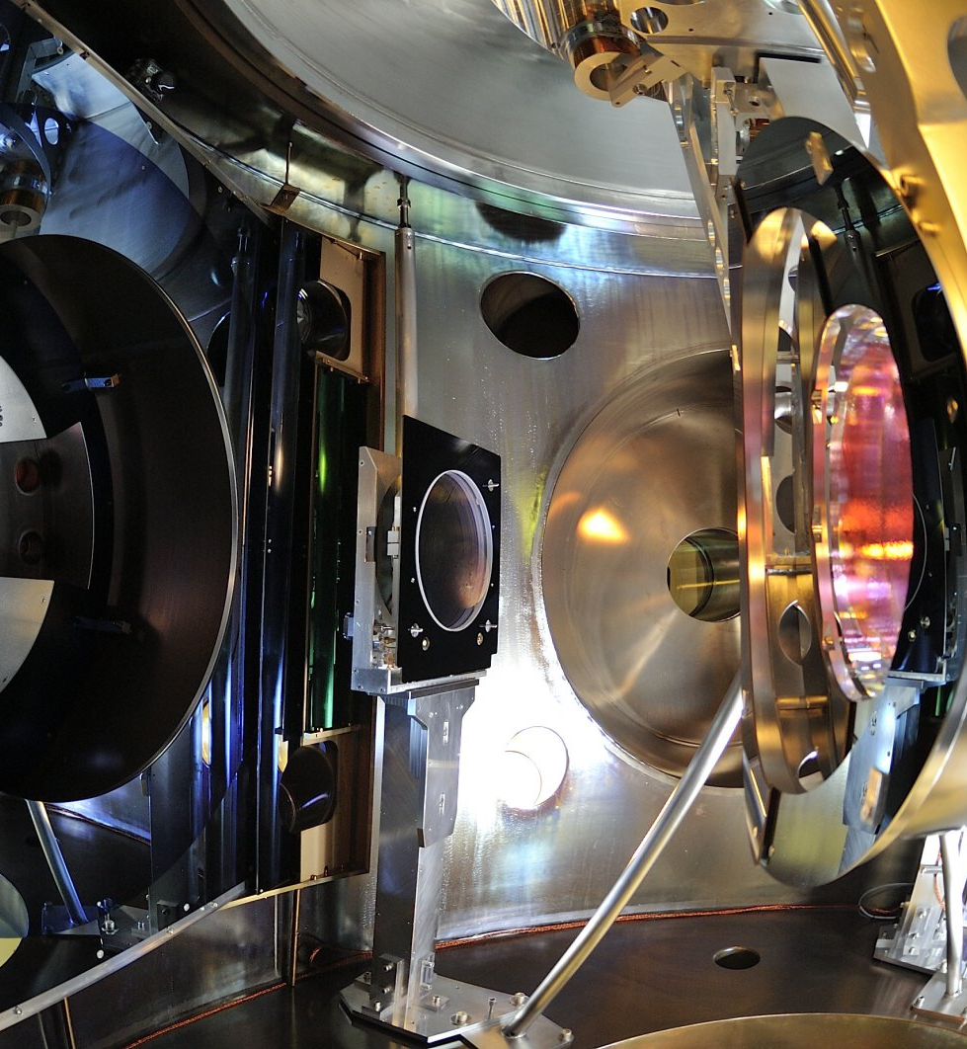
Unconventional GWO issues:
1. Electrostatic charge of mirrors
  Both VIRGO and LIGO optics undergo to inhomogeneous electrostatic charging of variable (or unknown) sign that may induce unwanted noise.
  → procedures are undertaken for neutralization with positive/neg ions. (time consuming and risky)
2. Cryosorption on cold optics (frost):
  KAGRA GWO suffers from gas cryosorbed on the mirror surface inducing detrimental effects on the optics.
  → Warming up should be avoided (time consuming)
Anything to do with accelerator Dynamic Vacuum?

Slide 6
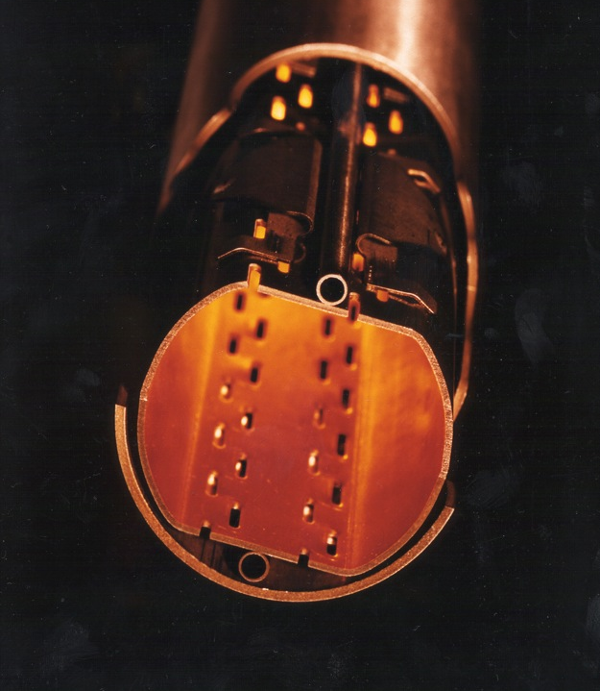
Unconventional issues: dynamic Vacuum
1. The beam interacts with the rest gas in the vacuum chamber causing:
  reduced beam lifetime - and/or emittance.
2. The vacuum system plays an important role for beam stability:
  Its material(s) conductivity, shape, coating and transitions determine machine impedance.
3. The vacuum chamber also affects beam stability and lifetime otherwise
  Its inner wall surface properties, in particular electron induced desorption and electron yields, are critical
  → High desorption yields can lead to pressure runaway.
  → High electron yields can lead to electron cloud formation

Slide 7
e⁻ cloud formation
See for instance: R. Cimino and T. Demma “Electron cloud in Accelerators” Int. J. Mod. Phys. A 29 (2014) 1430023.
Electrons from Ion pumps and gauges
Generation of electrons inside the vacuum chamber
(primary, or seed, electrons)
Electrons from cosmic rays etc...
Residual gas ionization
Photoelectrons from synchrotron radiation
Desorption from the losses on the wall
Acceleration of primary electrons in the beam field
Secondary electron production when hitting the wall
(F.Zimmermann)
Primary e⁻
θ
E
secondaries
elastically reflected
After bunch passage
SEY Study the number of electrons emitted by the surface when hit by an electron of given energy.
R. Cimino et al PRL 2004

Slide 8
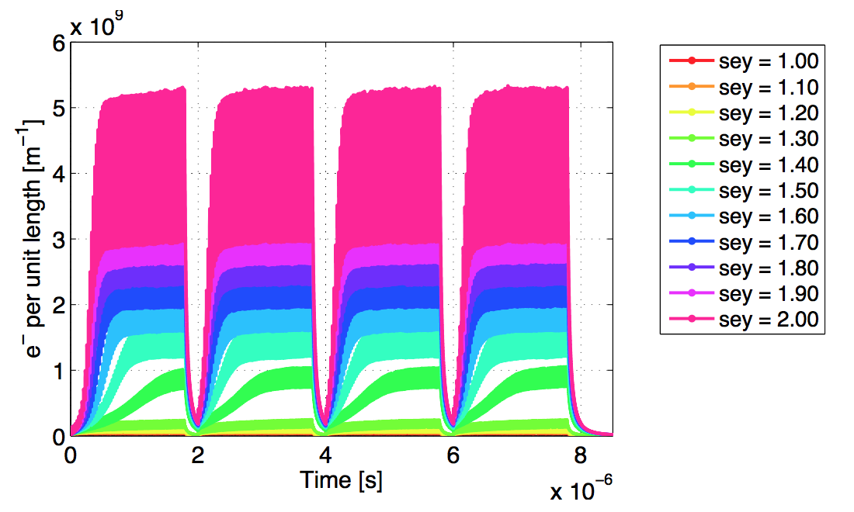
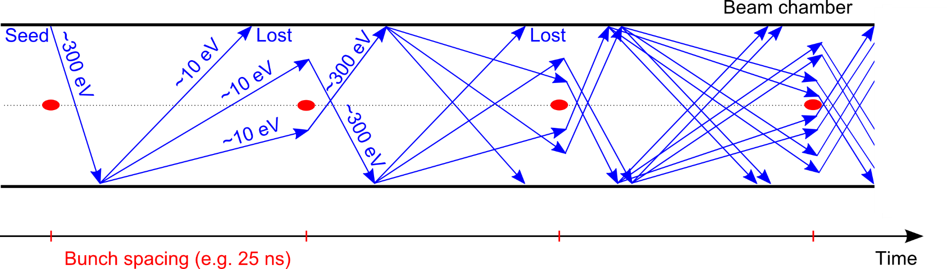
e⁻ cloud formation
See for instance: R. Cimino and T. Demma “Electron cloud in Accelerators” Int. J. Mod. Phys. A 29 (2014) 1430023.
Generation of electrons inside the vacuum chamber
(primary, or seed, electrons)
Acceleration of primary electrons in the beam field
Secondary electron production when hitting the wall
Avalanche electron multiplication
Tx to G. Rumolo
Tx to F. Ruggiero
The presence of an e⁻cloud inside an accelerator has consequences on the machine (pressure rise, outgassing, heat load, etc.) and on the beam Needs to be mitigated!

Slide 9
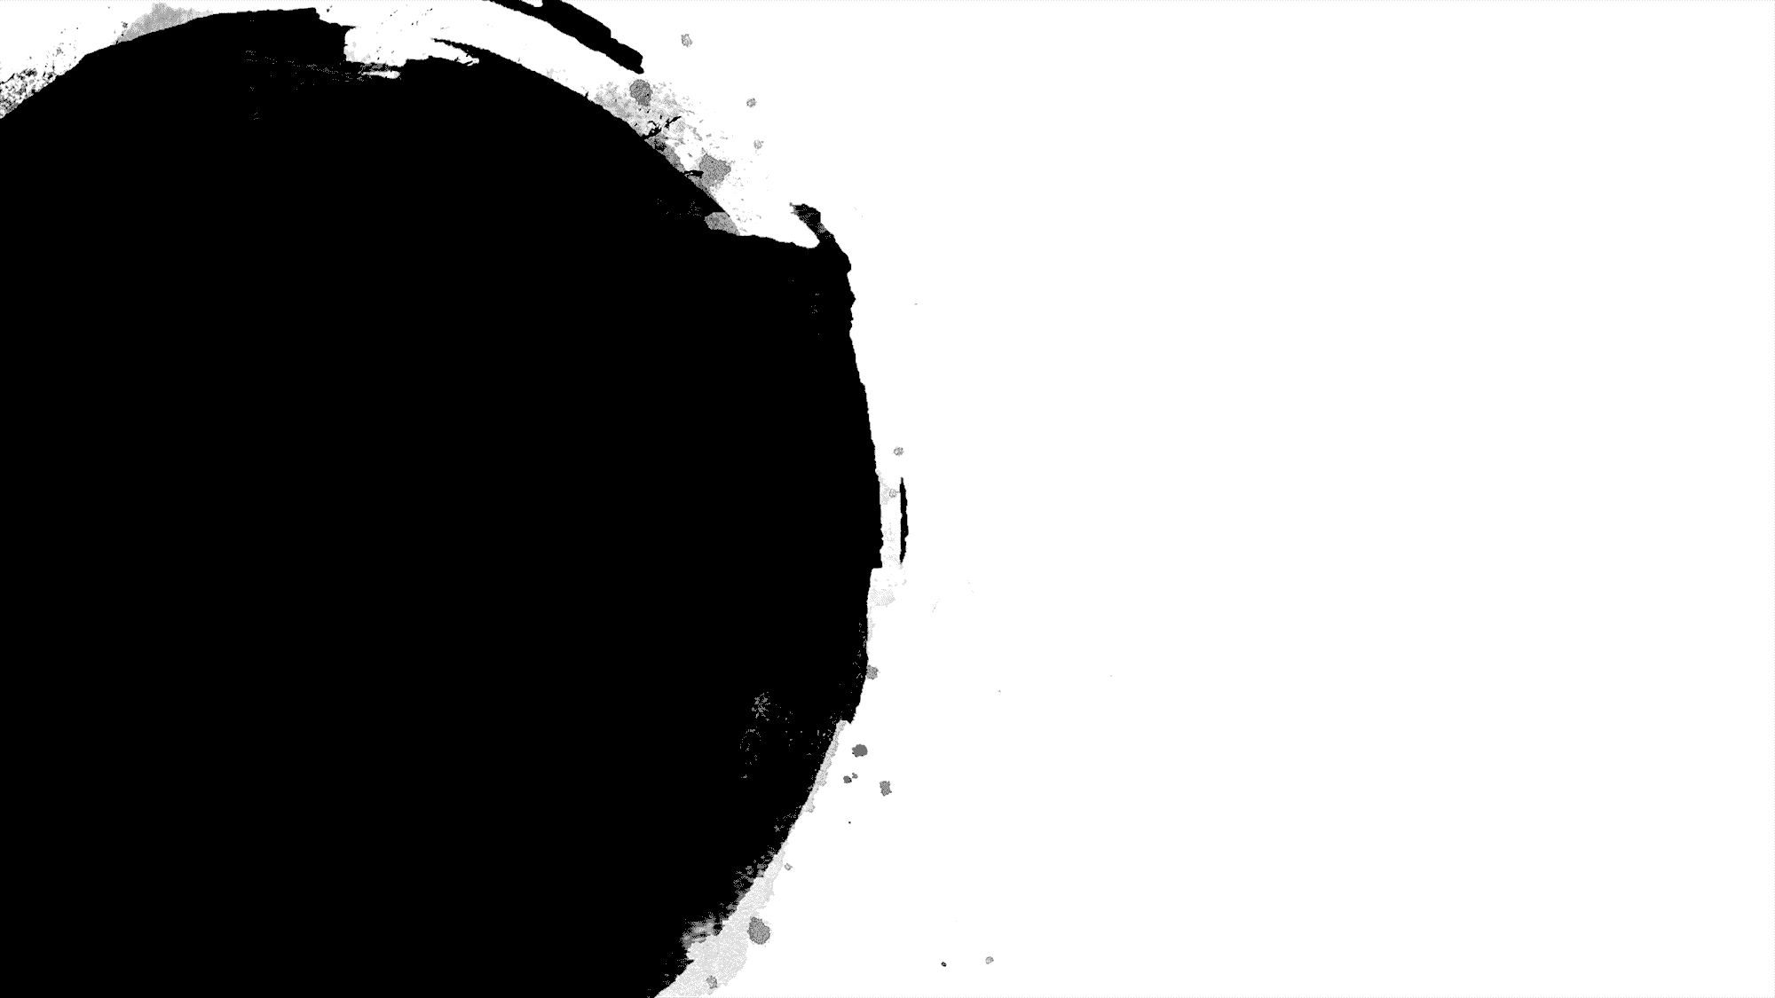
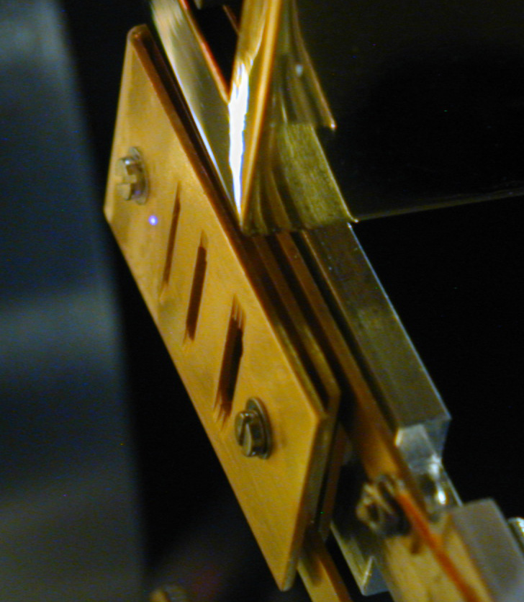
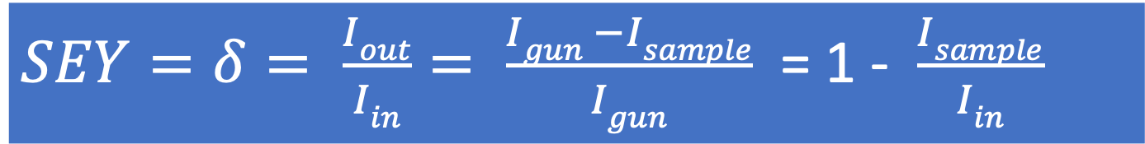
$SEY=δ= \frac{Iout}{Iin}= \frac{Igun −Isample}{Igun}$ = 1 - $\frac{Isample}{Iin}$
SEY depends on the electron impinging energy
Material and surface conditions:
R.Cimino et al PRL 2004
On a dielectric, the charge left on the surface depends on the energy of the impinging electrons

Slide 10
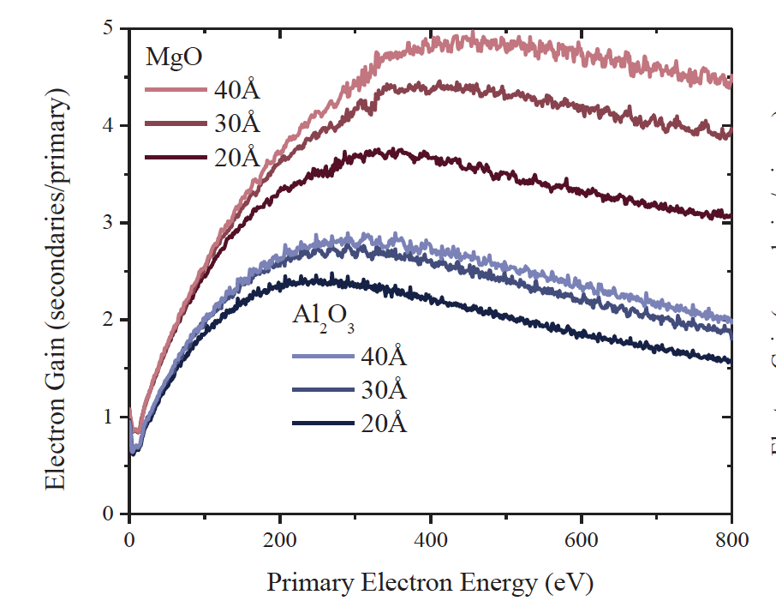
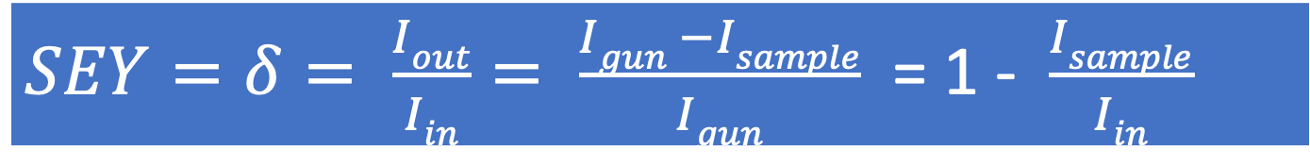
For non conductive surfaces (Ar ice on Cu; MgO,Al₂O₃):
$SEY=δ= \frac{Iout}{Iin}= \frac{Igun −Isample}{Igun}$ = 1 - $\frac{Isample}{Iin}$
SEY of 83 ML Ar on Cu
Jokela et al. TIPP 2011
1
SEY < 1
1
This can very well explain the mirrors electrostatic charge, its inhomogeneity and sign uncertainty.

Slide 11
SEY not only can explain the charging phenomenon but suggests how to cure it!
Using electrons of a given (low) energy just above or below SEY=1 to neutralize a dielectric.
Ongoing:
Measure detailed SEY from realistic samples representative of the various surfaces composing the mirrors.
Study the effect of electrons (very low doses and energy) on the mirror surface. (Much less penetrating than UV photons and much less disruptive than Ions)
Study the effect of electrons impinging on a charged surface.

Slide 12
Design a testbench, where, with an e⁻gun, we can deliver to a mock-up mirror a given positive or negative charge.
We can than charge the mirror locally (by focusing / defocusing the gun) and set a “smart” system to measure the effect of such charging on the mirrors.
Having a Feed back seems very useful in this approach. We can define and validate the approach to estimate charging.
We can induce and neutralize this charge!
If validated, electrons can be delivered to actual mirrors without breaking UHV, efficiently reducing down-time.

Slide 13
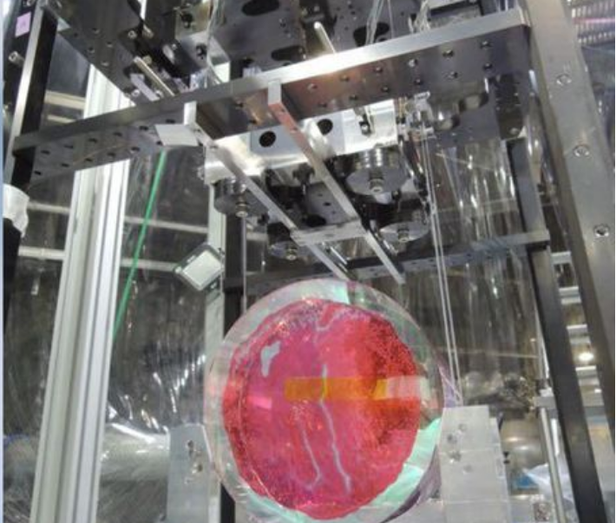
On Cryogenic mirrors this method can be used not only to neutralize them, but also to “clean” them.
In fact, at LT a cryosorbed gas layer grows on mirrors influencing reflectivity and adding unwanted thermal noise.
Jessica Steinlechner and Iain W. Martin PRR 1, 013008 (2019)
Need to be mitigated.

Slide 14
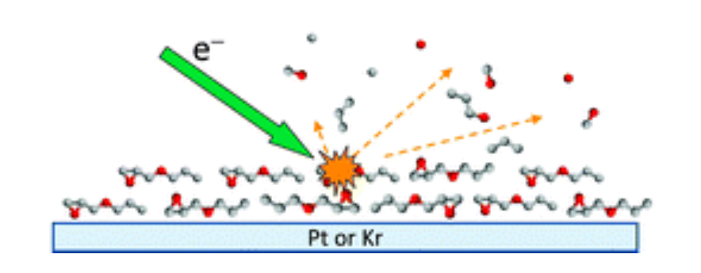
Electrons are efficiently inducing desorption from cryogenically adsorbed gas!
Much more efficient than Photons (factor 100 – 1000)
Much less penetrating.
R. Dupuy et al. J. Appl. Phys. 128, 175304 (2020)
Mirror

Slide 15
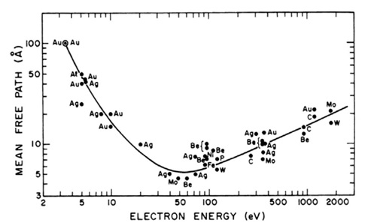
Electrons may see only the cryogenic overlayer (few μm are needed to be detrimental) and not the mirror surface!

Slide 16
Some “back of the envelope” estimates.....
If P_{eff} ∼ 1 10⁻¹⁰ (H₂O,CO,CO₂, etc) mbar;
sticking coefficient = 1
1 monolayer (∼ 10¹⁵ mol/cm² ∼ 0.3 nm) will be cryosorbed in 10.000 s. (∼ 2.5nm/day ∼ 10 times less than in KAGRA)
If we assume a mean ESD η= 0.1 mol./electron (as for H₂O) @ 100eV. (R. Dupuy et al. J. Appl. Phys. 128, 175304, 2020)
To remove 1 ML we need an el. current of:
~ 1 mAmps/cm² in one second (10⁴ faster)
~ 100 μAmps/cm² in 10 seconds (10³ faster)
~ 10 μAmps/cm² in 100 second (10² faster)
.....
and deposit, in total, less than 100 mW/ML/cm²
All in UHV, with marginal heating up of the mirrors and (possibly) reduced downtime.
Deserves further investigation!

Slide 17
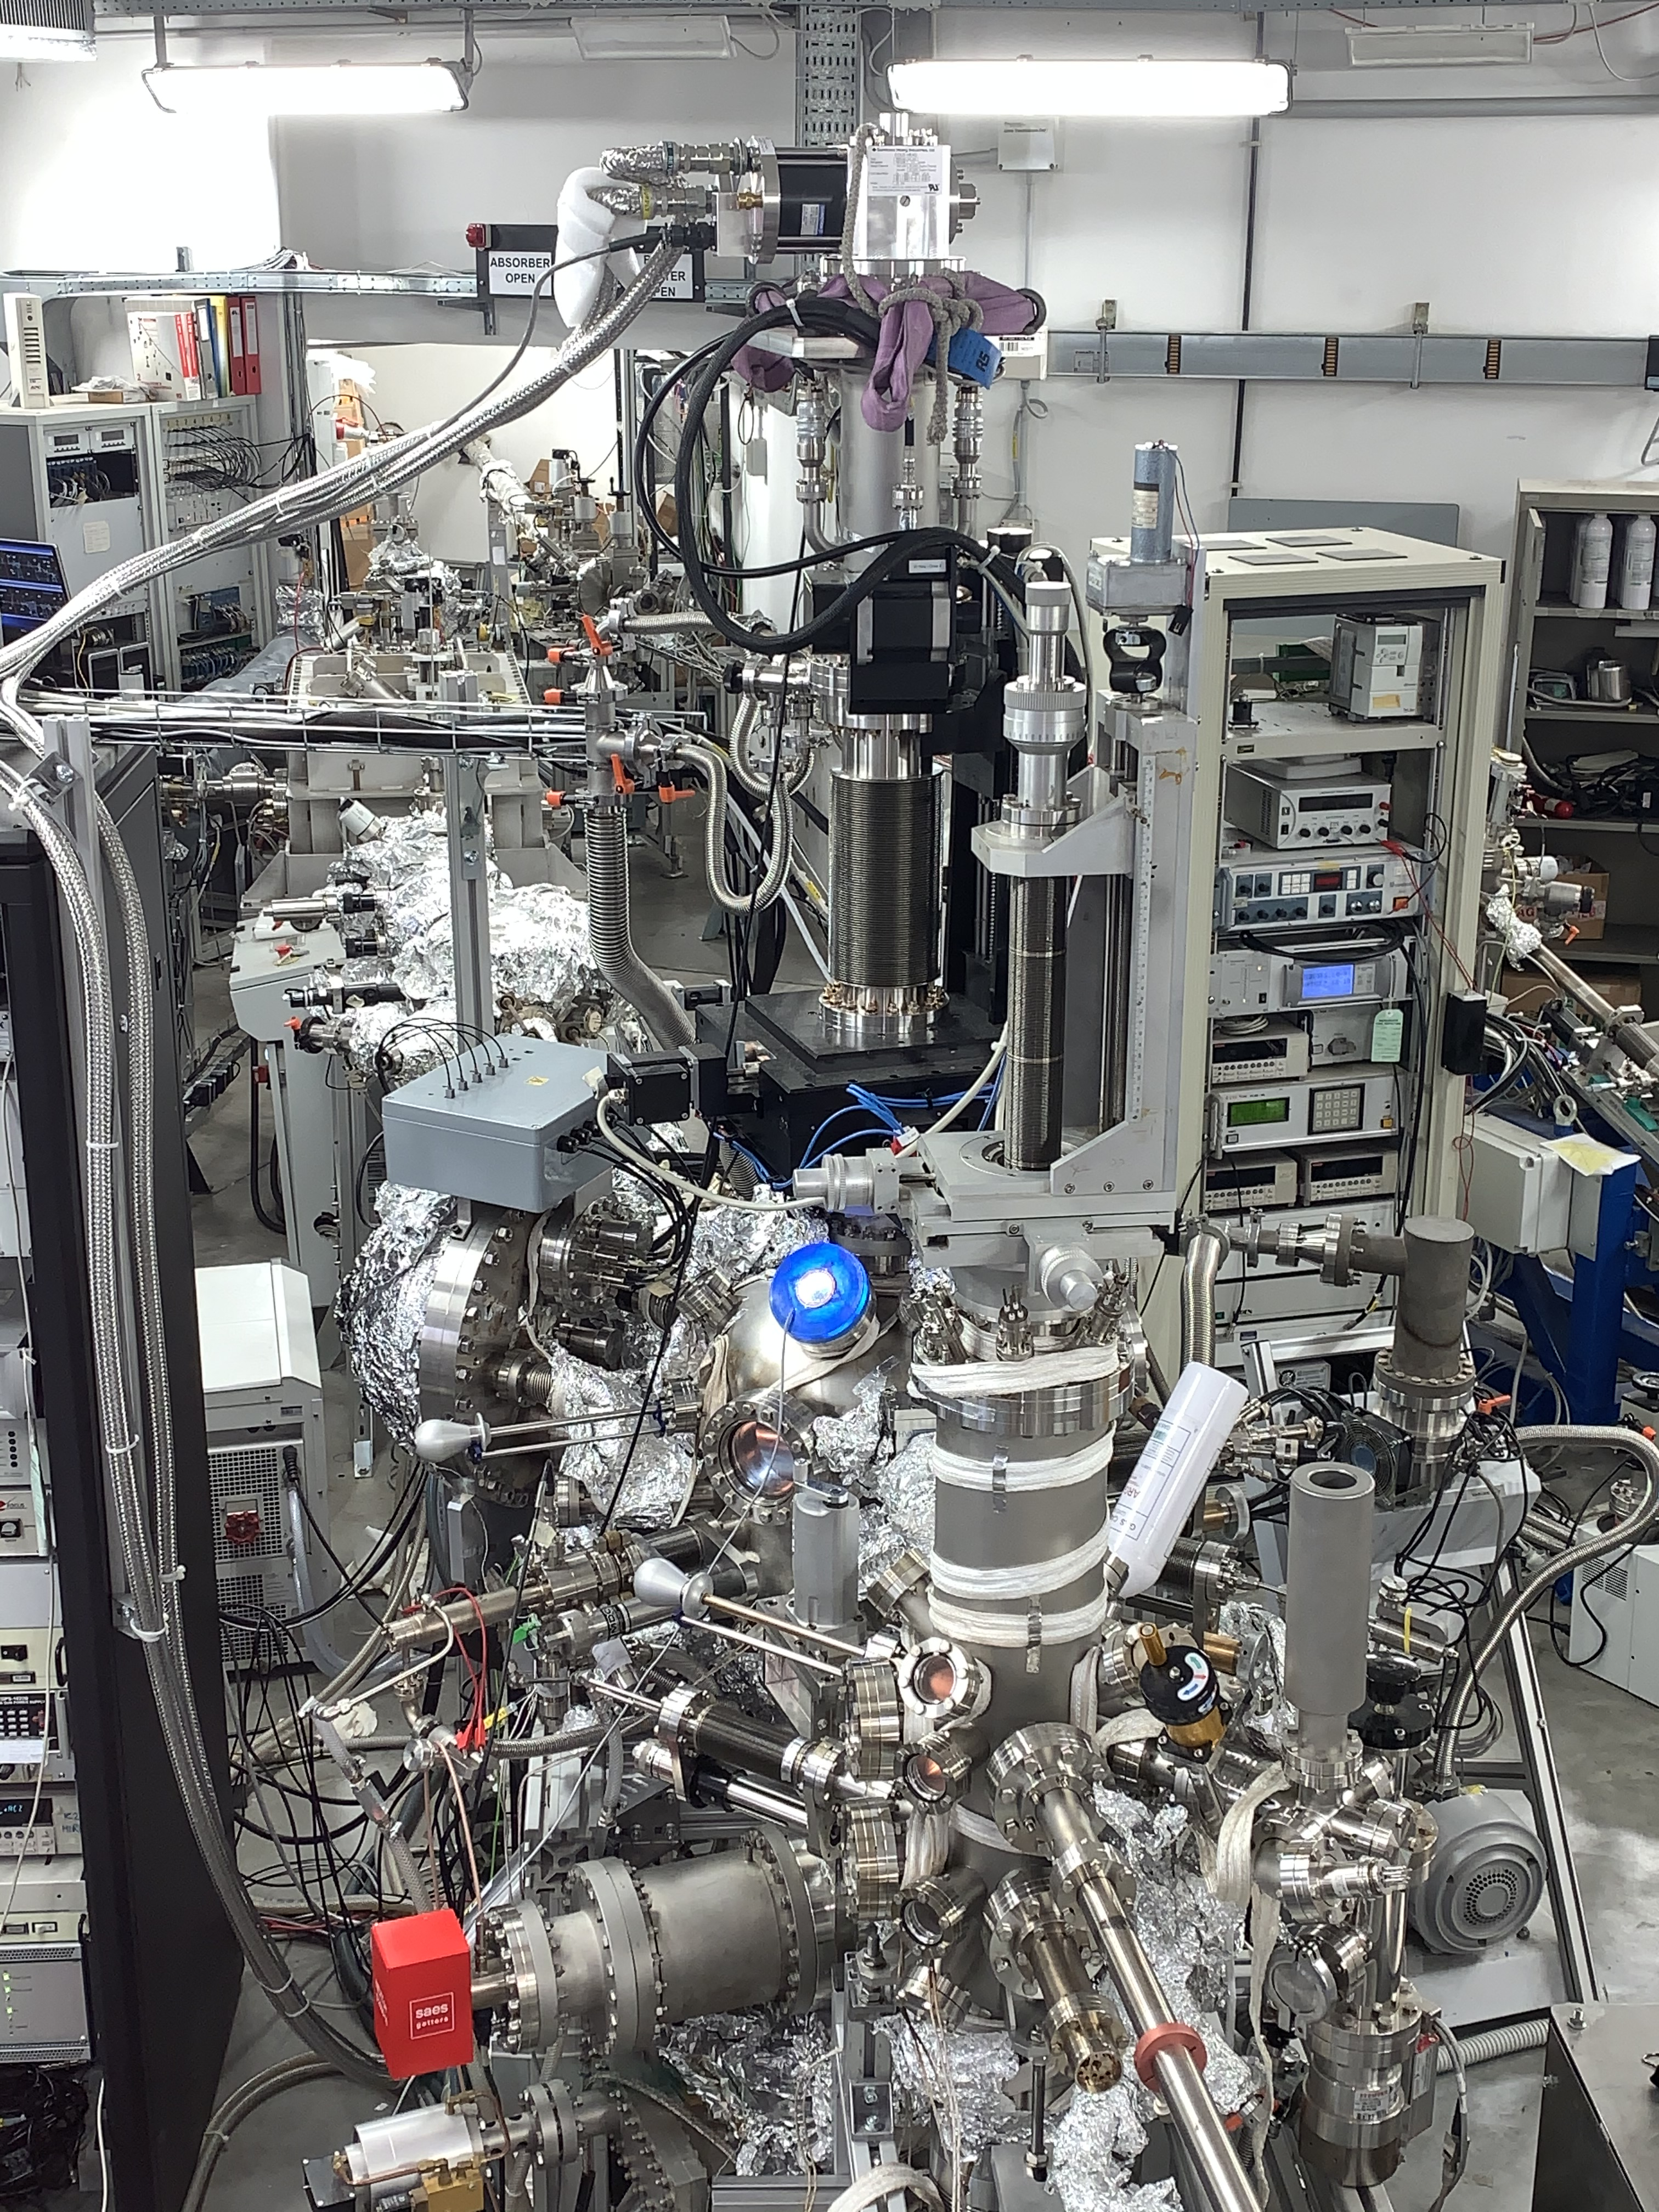
LNF-INFN MaSSlab “Material and Surface Science laboratory”
Two “state of the art” UHV set-ups equipped with cryogenic manipulators for hosting small samples (10x10mm²) at <20 K, electron guns, XPS, SEY, QMS and other spectroscopies to perform (with minor upgrades):
Proof of principle SEY and surface characterization of mirrors materials at RT and LT before and after cryosorption of gases.
03/12/2020

Slide 18
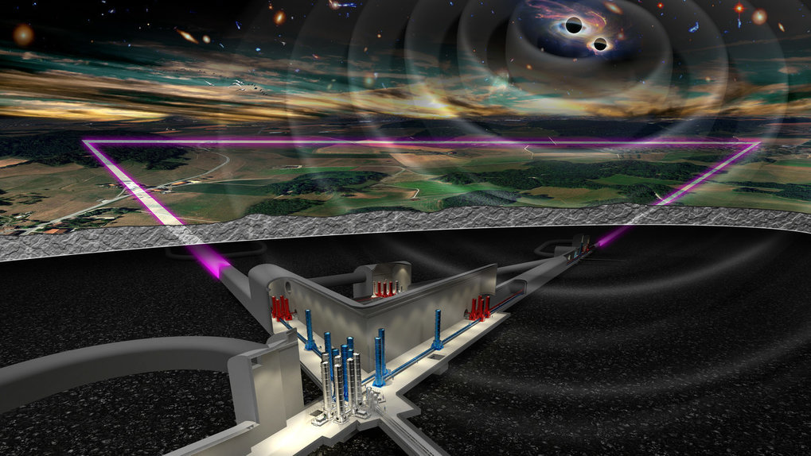
Conclusion
There are many conventional vacuum issues in common between GWO and Accelerators.
There are also some “unconventional” vacuum studies were both communities can learn from each other.
A lot of R&D is ahead and have to be tackled as soon as possible to be included in the final design.

