Slide 1
ARCHIMEDES measurements at Sos Enattos
Einstein Telescope 11° Symposium
Wednesday, December 2nd 2020
L. Errico – università degli studi di napoli ‘Federico II’
on behalf of archimedes collaboration
lerrico@na.infn.it

Slide 2
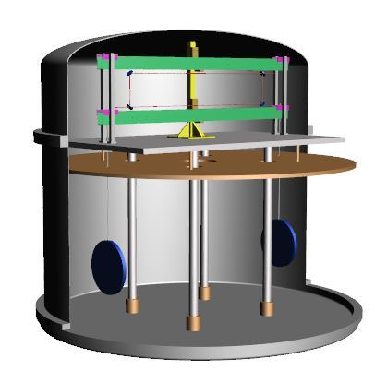
ARCHIMEDES: weighing the quantum vacuum
Vacuum energy from QED is somehow physical (evidenced by the Casimir effect).
The problem is that in QED the vacuum state has infinite energy.
Acceptable in Particle Physics
Not acceptable in General Relativity (The cosmological constant problem [Weinberg, 1989])
Does quantum vacuum «feel» gravity?
ARCHIMEDES experiment (INFN) will clarify if
the weight of material bodies
is influenced by the vacuum energy stored inside.
A sample of YBCO will be weighted while the internal vacuum energy is modulated via Casimir effect.
This measurement requires a very sensitive beam balance.

Slide 3
ARCHIMEDES for ET
Direct tilt measurement from 2 Hz to 20 Hz (region of interest for ET)
Contribution to Newtonian Noise Cancellation
Quality check of the site with a fundamental physics experiment

Slide 4
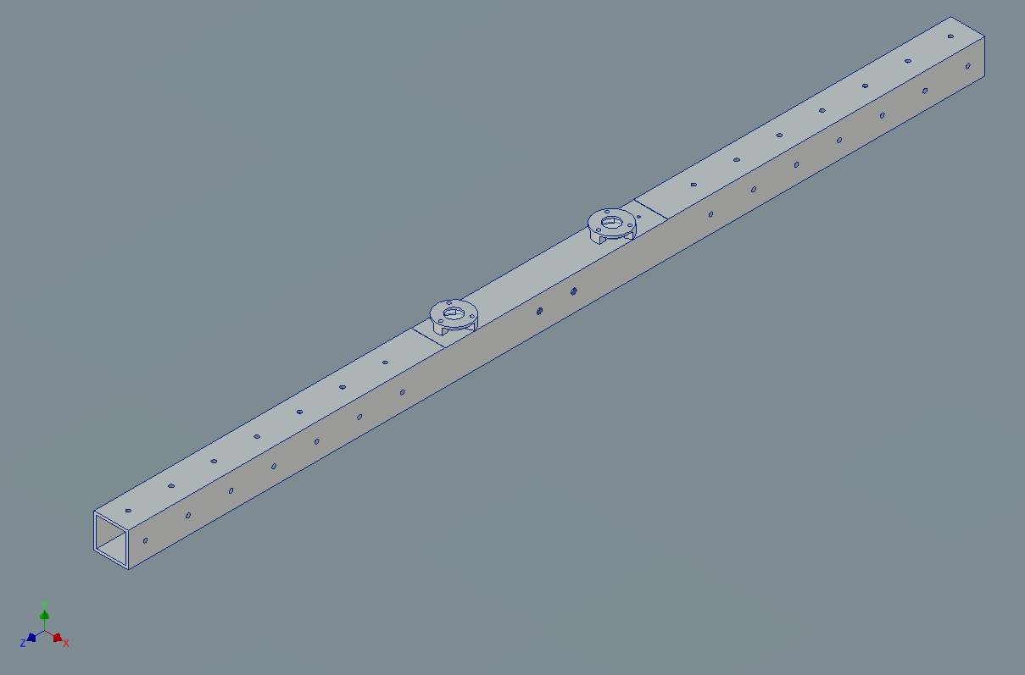
Tiltmeter (Archimedes prototype): Mechanics
50 cm long arm with low momentum of inertia

Slide 5
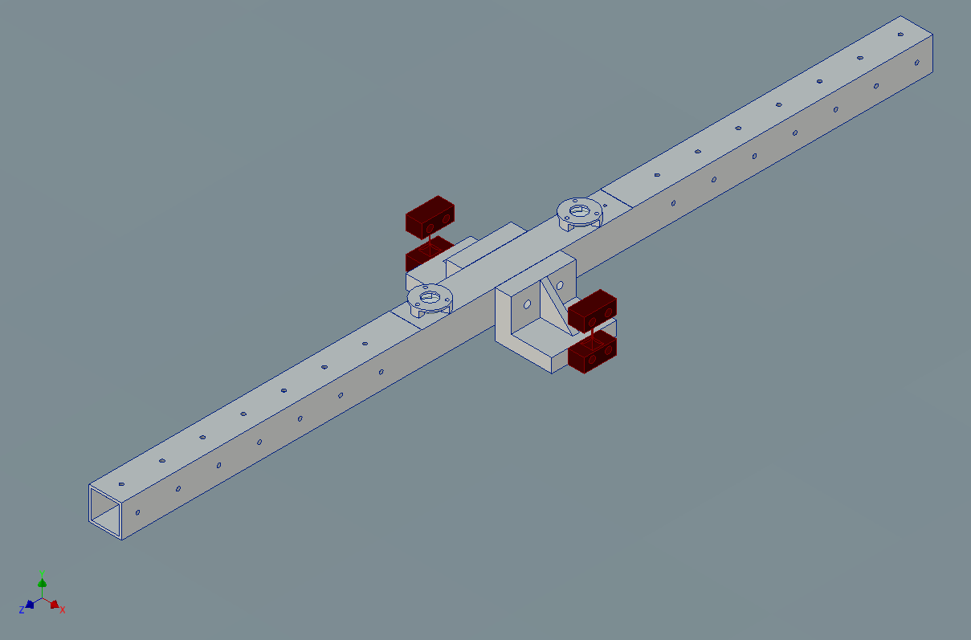
Tiltmeter (Archimedes prototype): Mechanics
50 cm long arm with low momentum of inertia
Suspended through thin flexible joints (Cu-Be, 100 μm x 500 μm), very similar in design to LIGO tiltmeters (Venkateswara et al., 2014)

Slide 6
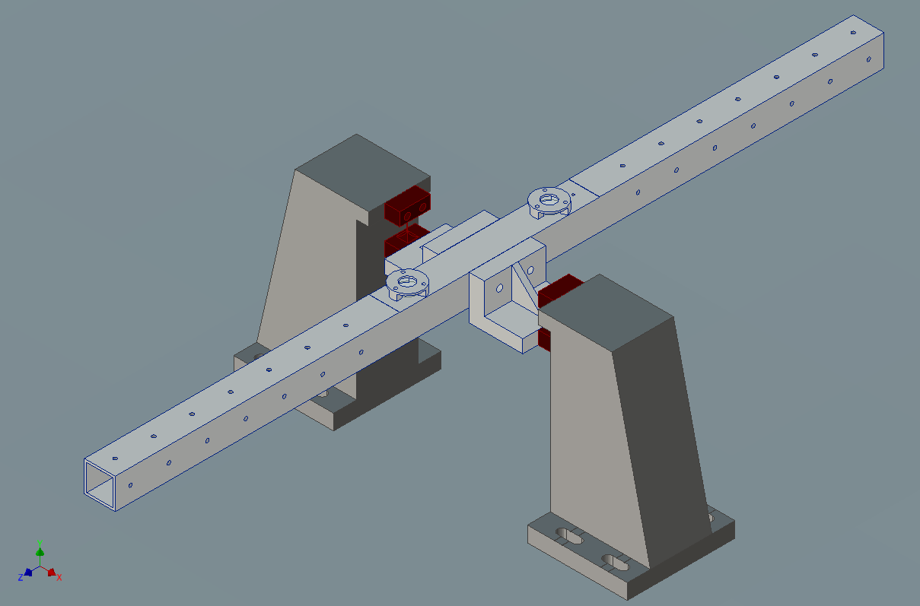
Tiltmeter (Archimedes prototype): Mechanics
50 cm long arm with low momentum of inertia
Suspended through thin flexible joints (Cu-Be, 100 μm x 500 μm), very similar in design to LIGO tiltmeters (Venkateswara et al., 2014)
The balance center of mass is positioned as close as possible to the bending point ($≈10 μm$)
Depending on the center of mass positioning, its resonance frequency is around 20-30 mHz

Slide 7
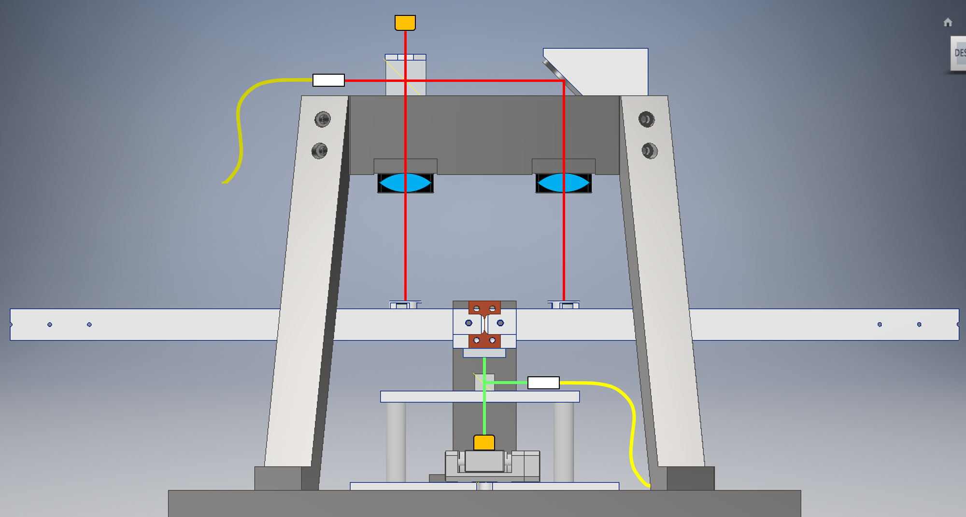
Tiltmeter (Archimedes prototype): Optical Read-Out
Tilts w.r.t. the ground are read finely with a Michelson interferometer
Optical lever only as
coarse positioning sensor

Slide 8
Optical Read-Out: prisms and lenses
Prisms are used to equalize the lenght of the optical paths ($ΔL≈2mm$). In this way frequency noise is highly suppressed.
Also amplitude noise is reduced by measuring a pick-off on the input beam and performing a signal normalization.

Slide 9
Optical Read-Out: prisms and lenses
Lenses are used to maintain good alignment and contrast against static tilt.
The interferometer is aligned while the balance arm is horizontal
An arm tilt $α$ would misalign the interferometer, but contrast changes at second order thanks to the lenses
Alignment can be restored by moving vertically the input laser beam by $δy=L_{f}α$ ($L_{f}$ lens focal length), without moving any optics on the suspended arm

Slide 10
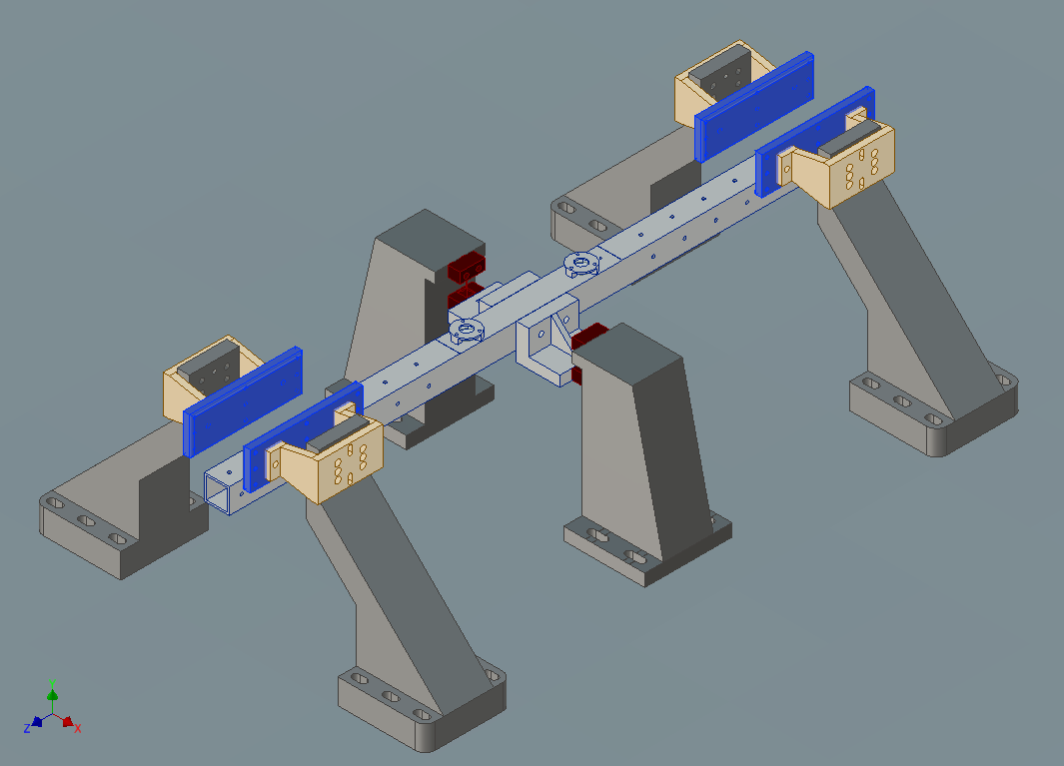
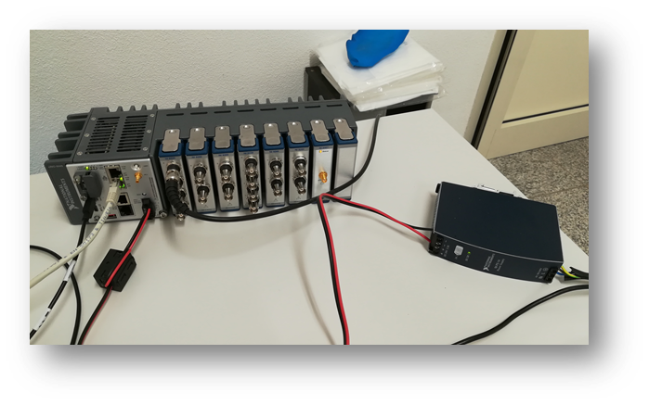
Tiltmeter (Archimedes prototype): Acquisition & Control
env. noise
Electrostatic actuators
$$x$$
$$y$$
+
Tiltmeter
DAC
ADC
Digital
Filter
-
ref.
control signal
error signal
NI-cRIO

Slide 11
Tiltmeter in Virgo site
At North End building, from April to mid July 2019 (during O3a)
Tilt measurement in the NN frequency band
No pick-off (higher amplitude noise)
No equal arms (higher frequency noise)
Virgo vs LIGO in the 10-20 Hz range:
in the extreme range (10-13 Hz and 18-20 Hz) the floor is comparable
in the middle range (between 13 and 18 Hz) the noise is higher.
Seismic noise level in Virgo is comparable with the LIGO site
$≈8×{10}^{−11} rad/√Hz$ @ 5Hz

Slide 12
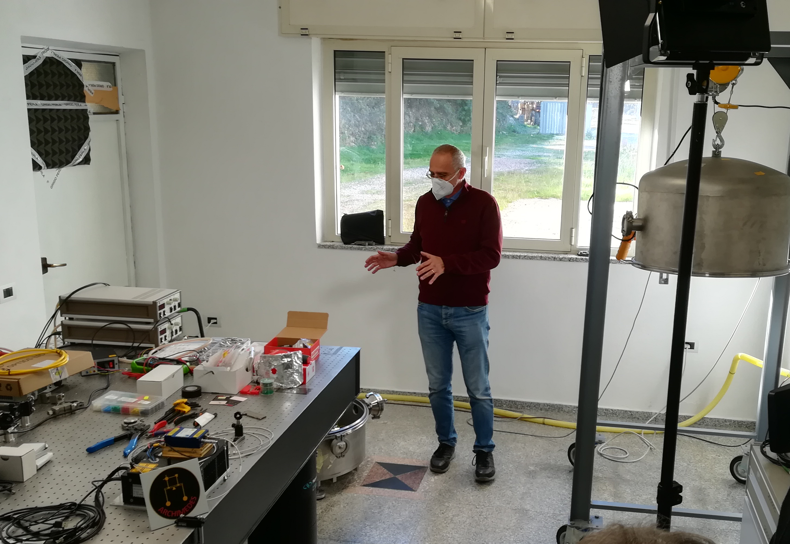
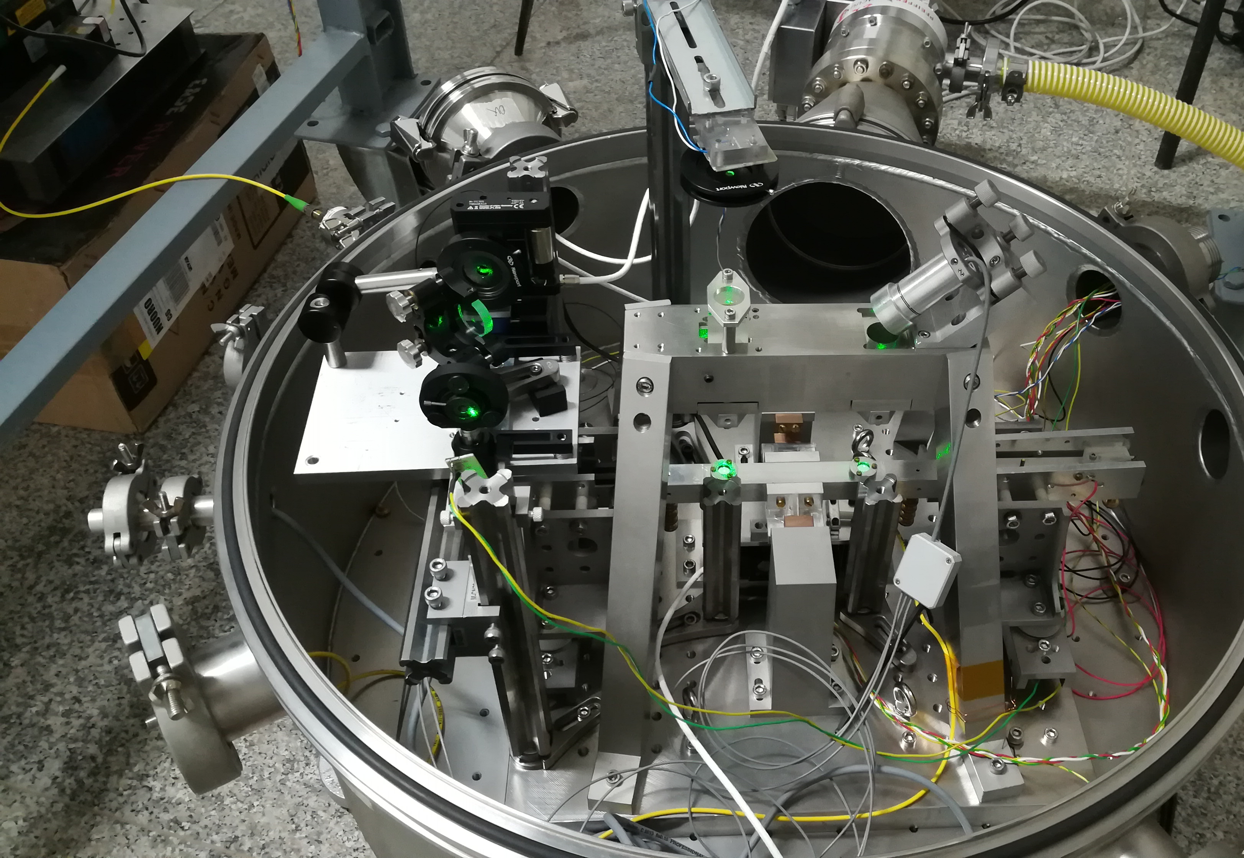
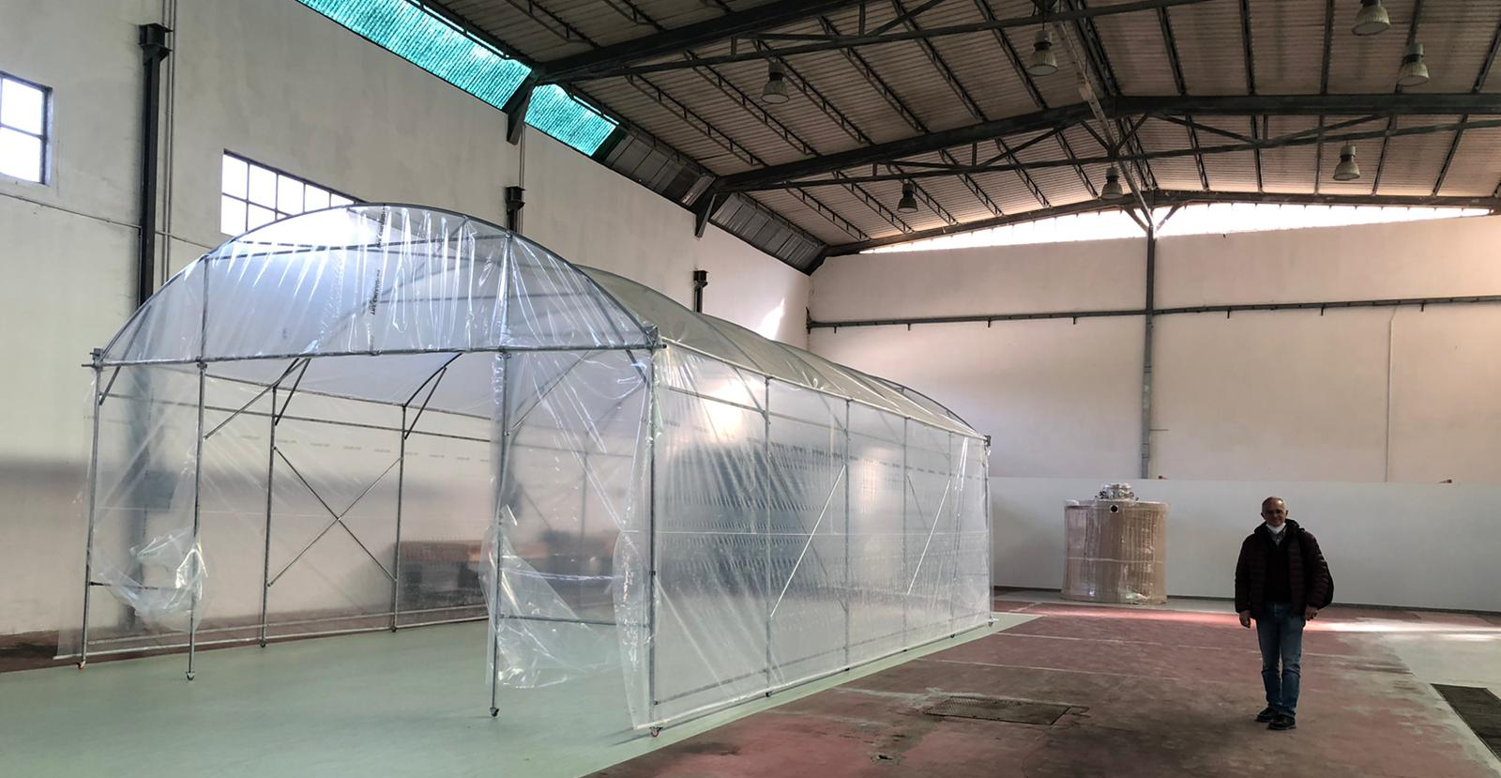
Tiltmeter in Sos Enattos: Sar-Grav is operational!

Slide 13
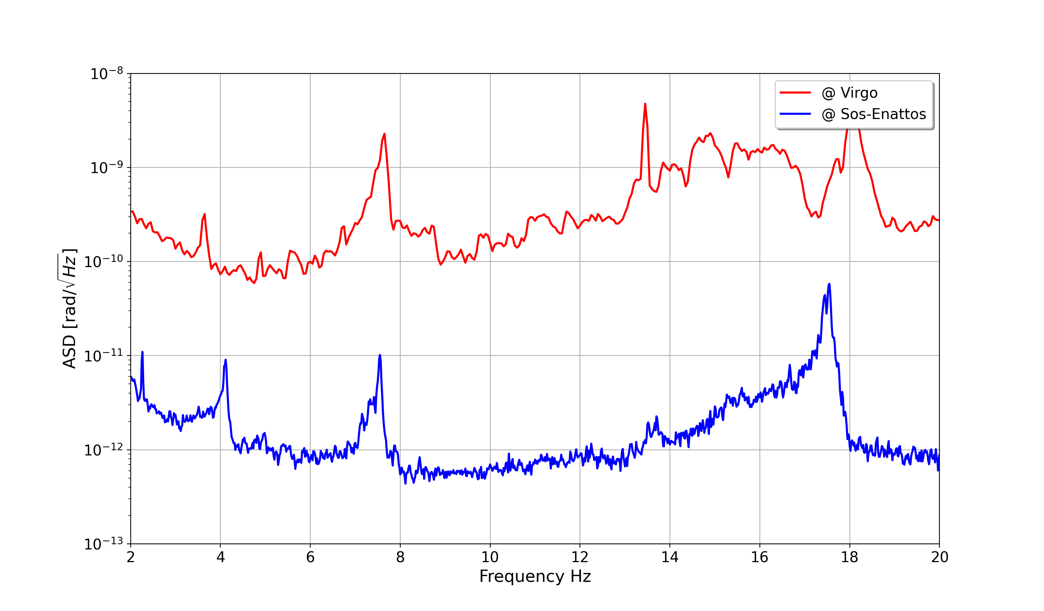
Tiltmeter in Sos Enattos
$$6×{10}^{−13}rad/\sqrt{Hz}$$

Slide 14
Conclusions
Best sensitivity in the world for a tiltmeter in the region 2 Hz – 20 Hz
At our knowledge Sos Enattos has shown the lowest tilt noise ever measured
Encouraging results for the Archimedes experiment, which now will start to study the sensitivity in the region 1 mHz – 100 mHz

Slide 15
Future developments
Commissioning on diffused light
Longer measurement campaigns for site characterization
Coherence studies with seismometers
Measurements at lower frequencies (also by using a heavier suspended arm)

