Slide 1
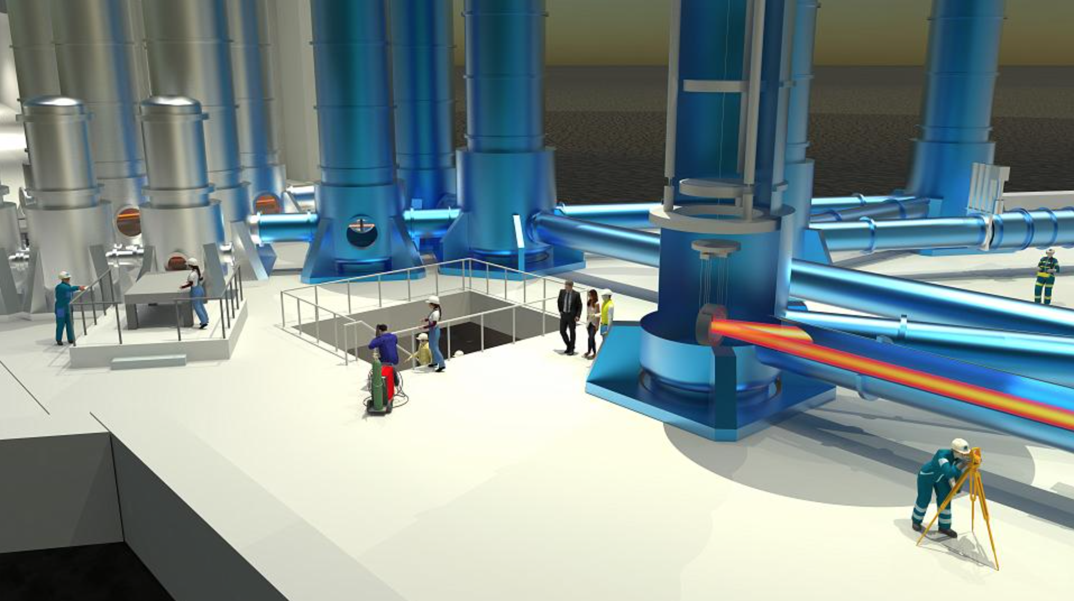
ET Suspensions
A.Bertolini (NIKHEF) and F.Fidecaro (UniPisa and INFN)
on behalf of ET-ISB

Slide 2
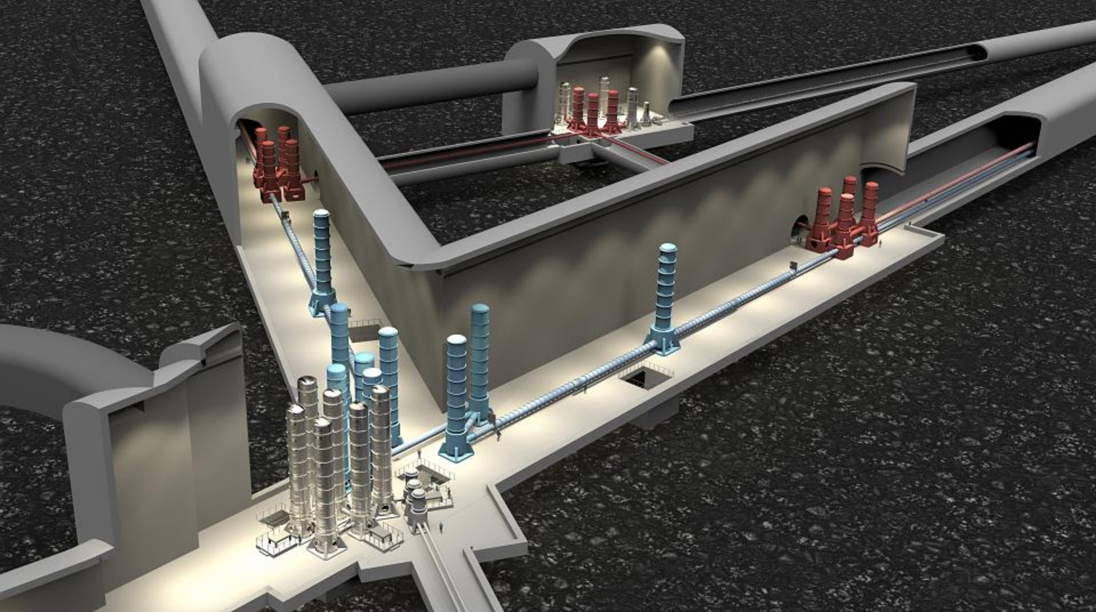
Some numbers
About 200 in-vacuum vibration isolation systems are needed for core and recycling optics, input mode cleaners, optical benches, mirrors of filter cavities…which means:
>5000 blade springs
>1000 suspension wires
>1000 inertial sensors
>5000 displacement sensors
>5000 actuators

Slide 3
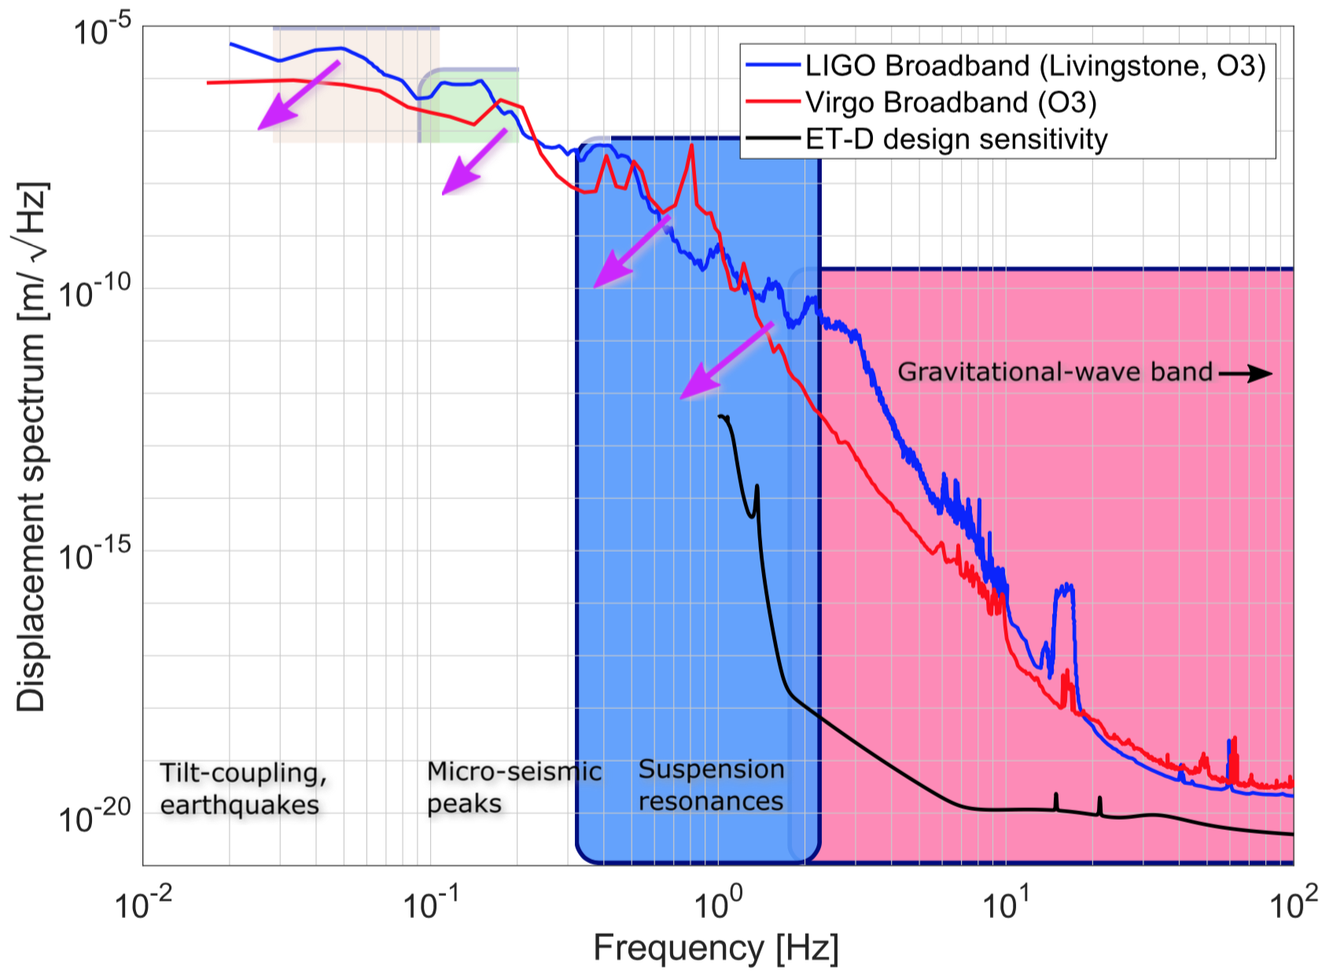
Seismic isolation of test masses
ET requirements
The extension of the detection bandwidth of the Einstein Telescope to the low-frequency region starting from 3 Hz requires improved seismic attenuation chains compared to 2G detectors.
The experience matured on operating Advanced detectors strongly suggests that in-band sensitivity improvements pass also thru the reduction of optics RMS motion.
RMS motion, dominated by the µ-seismic peaks, is the driver of scattered light noise, impacts dynamic range of linear and angular alignment loops, etc.
Local and global control strategies must be implemented to mitigate its effects.
Credit: C. Mow-Lowry

Slide 4
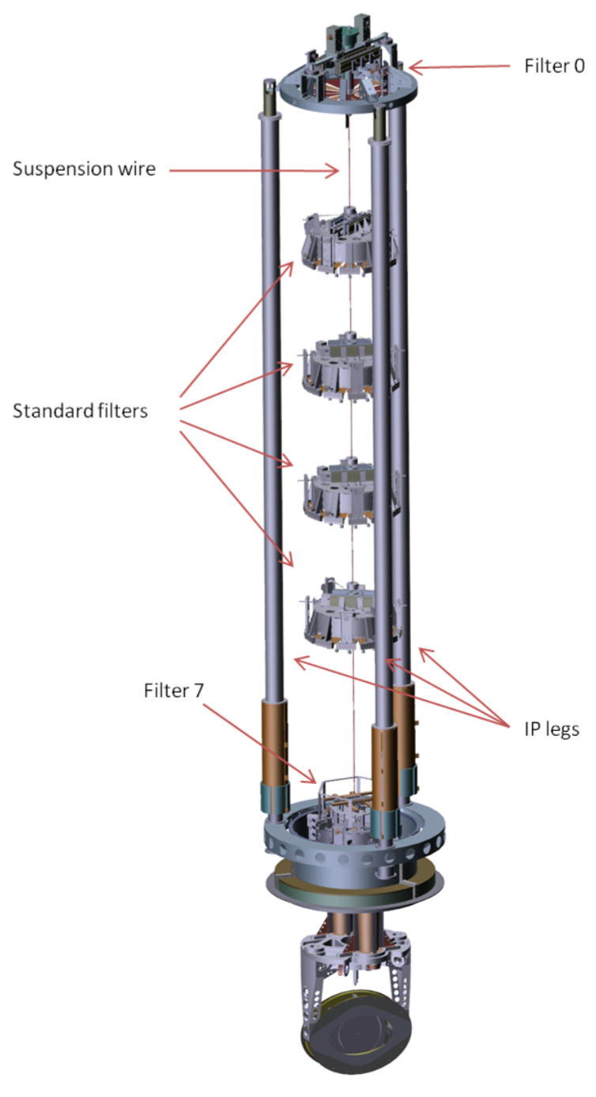
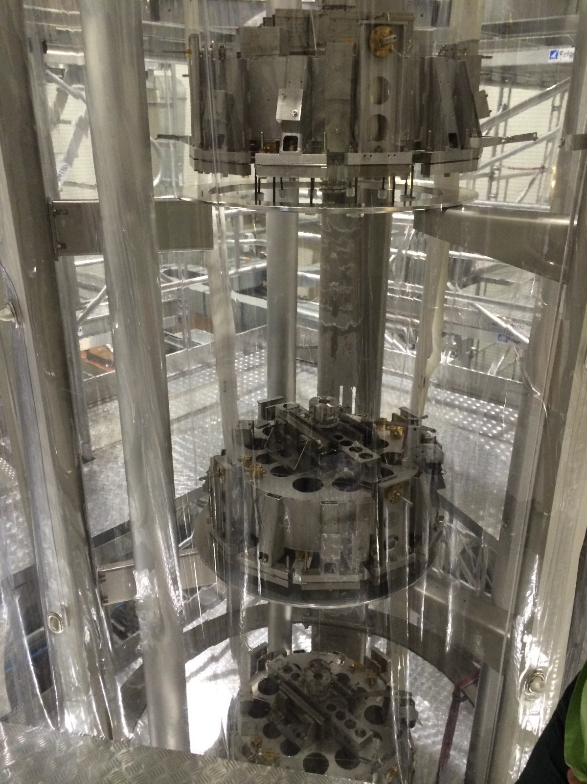
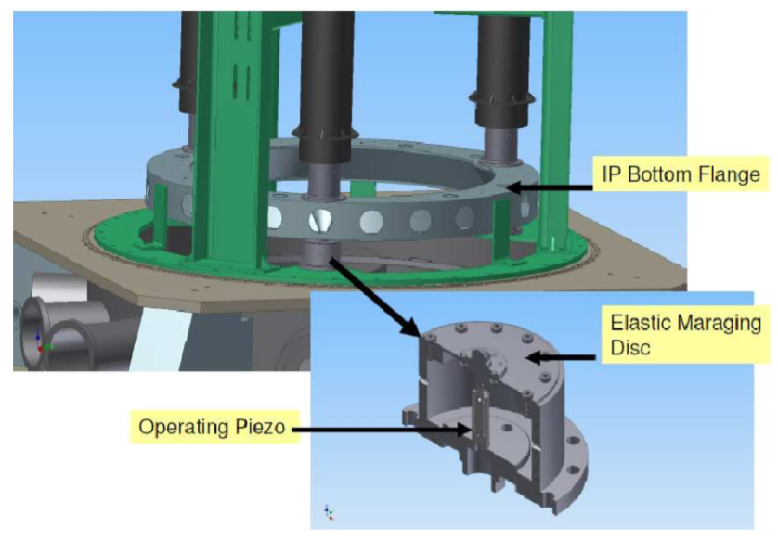
Seismic isolation of test masses
Building on Virgo Super-attenuator experience
Seismic isolation platform
-ultralow natural frequency inverted pendulum for horizontal pre-isolation + long period vertical filtering stage (Filter-0)
-instrumented with seismic sensors for active damping of translational modes of the suspension chain
-provides large dynamic range actuation and seismic attenuation from a few tens of mHz to 10Hz
Suspension chain
-cascade of passive pendulum stages and low natural frequency
vertical spring systems (filters)
-provides in-band bulk seismic attenuation
inverted pendulum legs
base ring with piezo
actuators for tilt control
Payload
mirror and its
static and dynamic
positioning stage

Slide 5
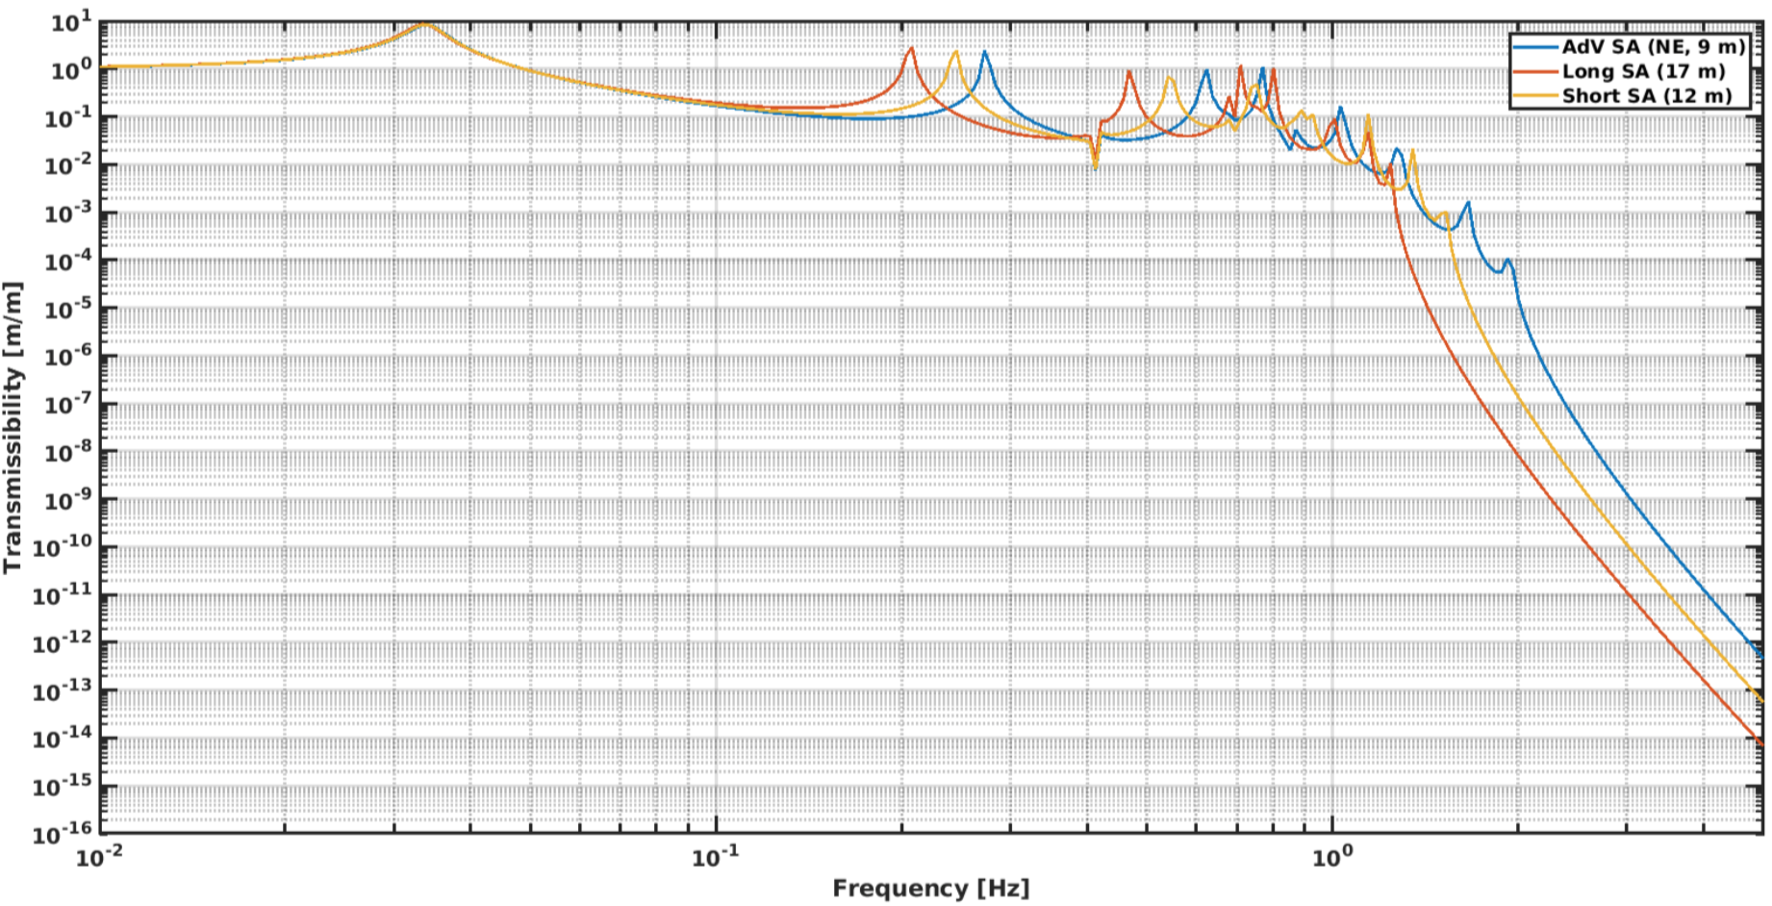
Seismic isolation of test masses
Building on Virgo Super-attenuator experience
F.Acernese et al.
Astropart.Phys.,33,
182-189 (2010)
AdV SA shown to be compliant to ET-HF
in-band requirements
17-m long SA with equally spaced filter stages found to be suitable for ET-LF
ET-CDR (2011)
Credit: V. Boschi

Slide 6
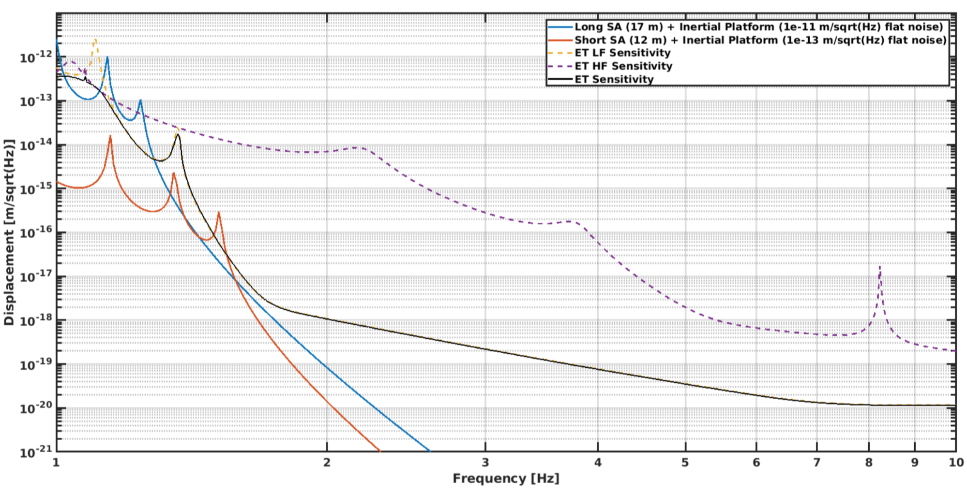
R&D on seismic isolation
Augmenting Super-attenuator performance with active isolation
Credit: V. Boschi
Models show that, evolving the current tilt control base ring into a six degrees of freedom active isolation stage would allow:
improving residual RMS motion figures;
shortening the height of the towers without losing performance, with a positive impact on the infrastructure.
Availability of suitable inertial sensors is crucial: tiltmeters insensitive to linear acceleration are the Holy Grail.

Slide 7
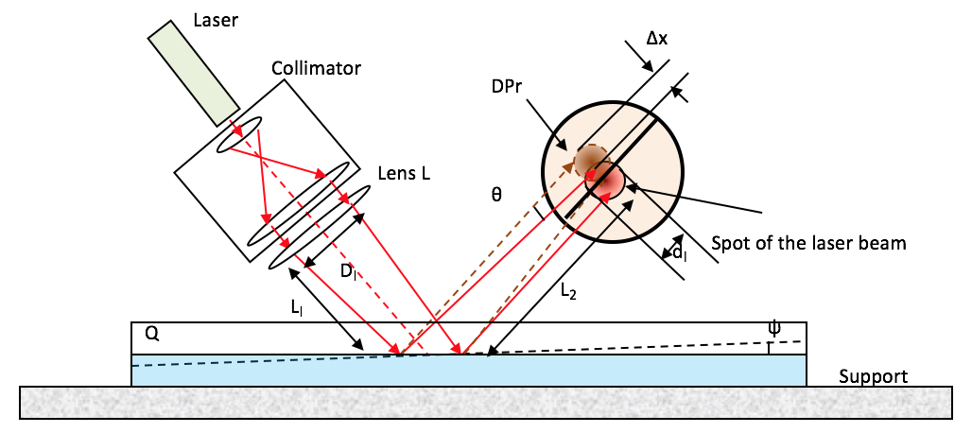
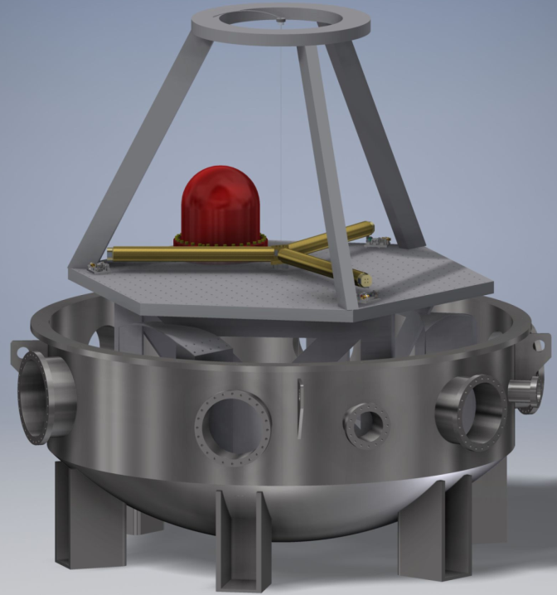
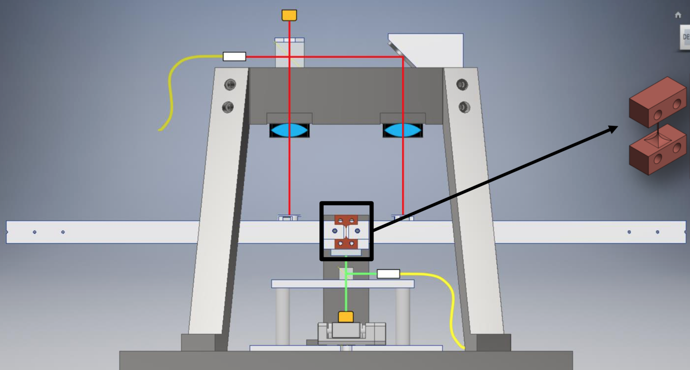
R&D on seismic isolation
Advanced seismic sensors now under development
Novel single and multi-axis seismometers with optical readout
Laser inclinometer, Credit: B. Di Girolamo, CERN
6-D interferometric readout inertial sensor
Credit: Conor Mow-Lowry, VU Amsterdam
Low frequency seismometers
Credit: Christophe Collette, U. Liege
Ultralow frequency tiltmeter
Credit: ARCHIMEDES and VIRGO Coll.

Slide 8
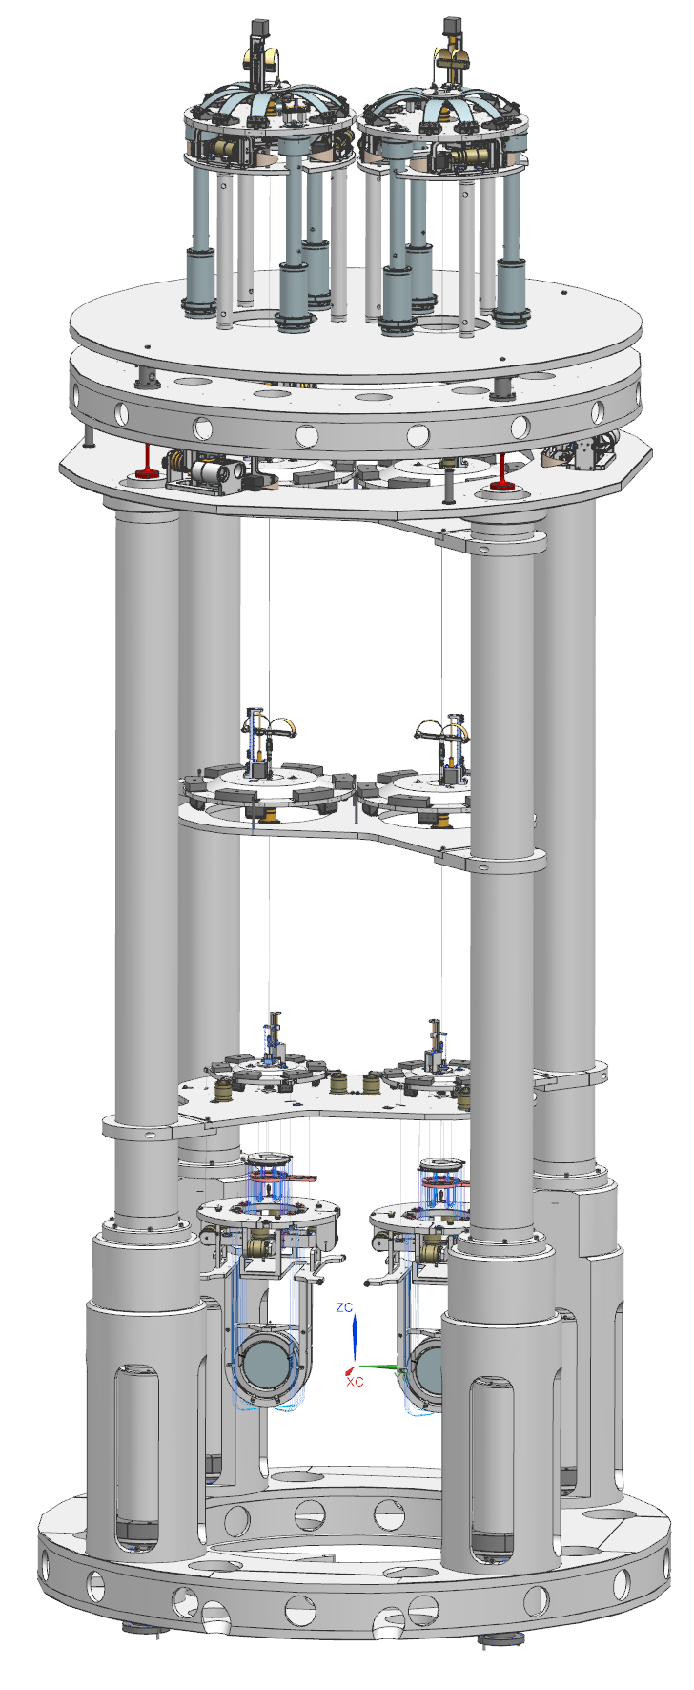
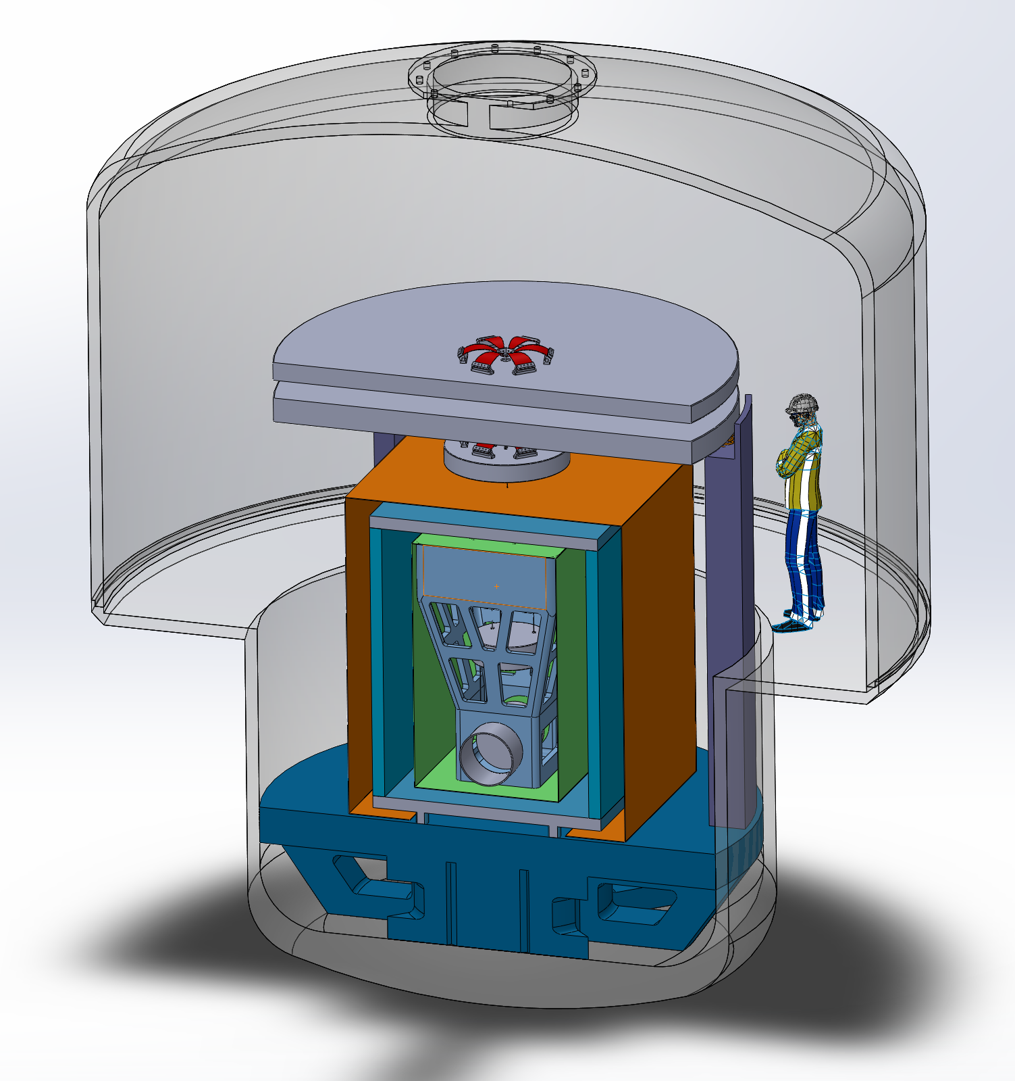
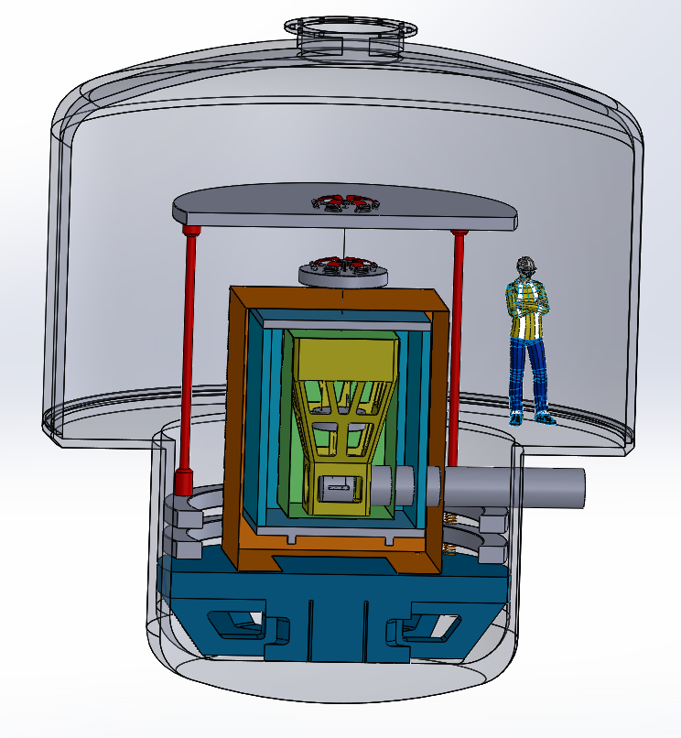
R&D on seismic isolation
Examples of testing and prototyping infrastructures
inverted
pendulum
two-stages six degrees of freedom active isolation platform
Option A
Option B
R&D on seismic isolation platforms combining active and passive isolation strategies
Double inverted pendulum pre-isolation will be used for the arm cavities of the ETpathfinder
https://www.etest-emr.eu/
https://www.etpathfinder.eu

Slide 9
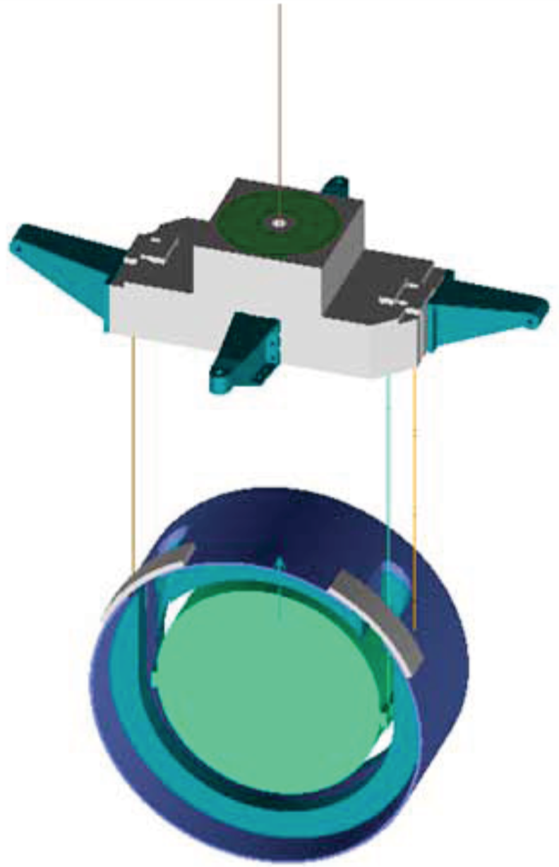
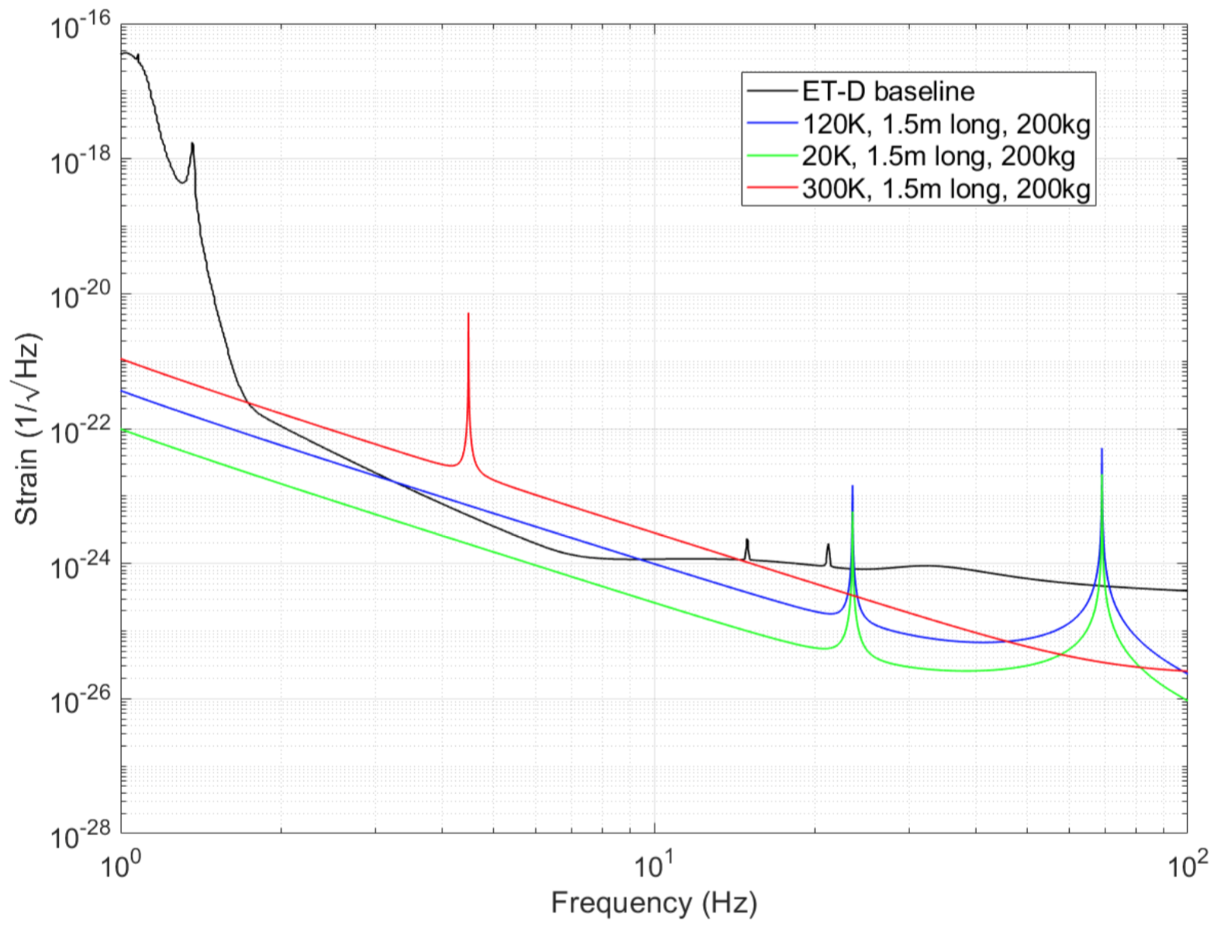
Payload
ET baseline design follows Virgo scheme
ET suspension thermal noise: current estimate
marionette for large dynamic range angular and longitudinal mirror control
reaction mass for mirror actuation
mirror
parameter | ET-HF | ET-LF
mirror material | fused silica | single crystal silicon
suspension material | fused silica | single crystal silicon
temperature [K] | 300 | 20
mirror mass [kg] | 200 | 200
suspension length [m] | 1.5 | 1.5
fiber diameter @mid section [mm] | 0.6 | 4.4
Improvement in last suspension stage Brownian displacement noise compared to 2G detectors:
6-fold for ET-HF, 50-fold for ET-LF thanks to larger mirror mass, low temperature (ET-LF) etc.
Credit: G. Hammond

Slide 10
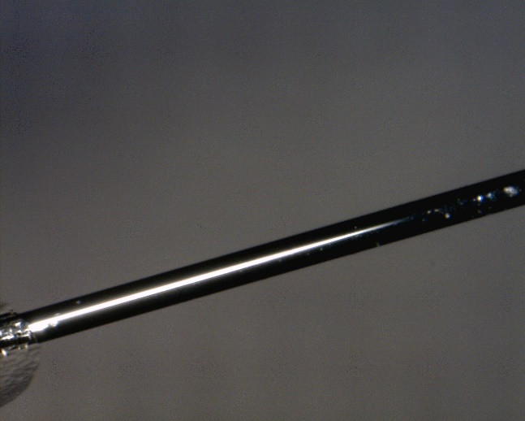
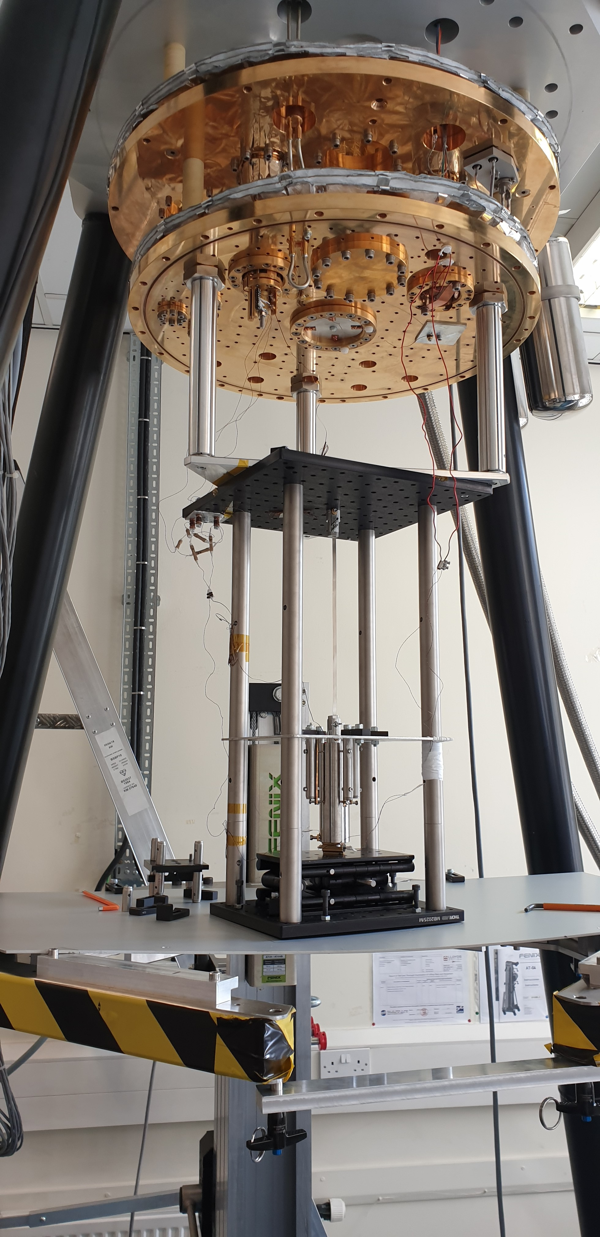
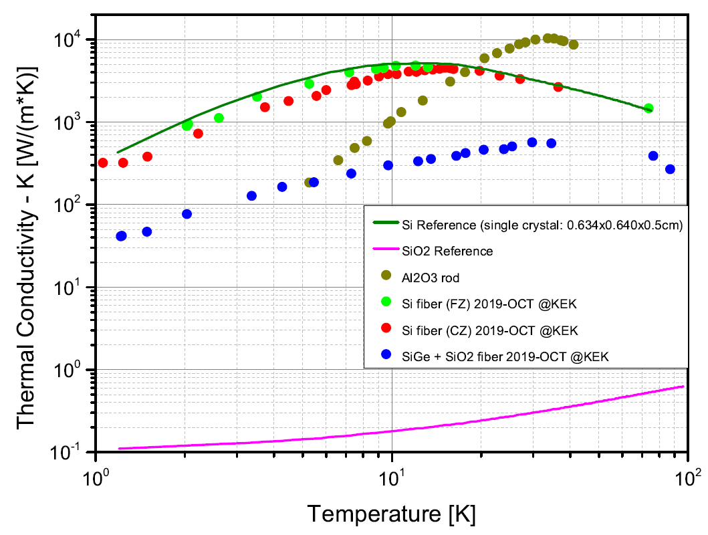
Challenging R&D in ET test masses suspensions
Monocrystalline silicon suspensions for ET-LF test masses
Requirements
ultralow mechanical losses
high thermal conductivity below 20K
robustness/reliability
Still a long path
low breaking stress (<200 MPa) is severely constraining the mechanical design; improving surface quality is crucial.
different manufacturing methods are under investigation: micro-pulling, etching from from large crystals or wafers, laser heated pedestal growth, glass-clad silicon etc.
fabrication methods allowing tapered ends at the fiber attachment points would be a major breakthrough: high suppression of clamping losses, easier assembly etc.
1-mm
R&D on Si suspensions
Credit: Flavio Travasso (Perugia Un.), KAGRA Coll.
Prototype Si ribbon suspension
Credit: IGR Glasgow

Slide 11
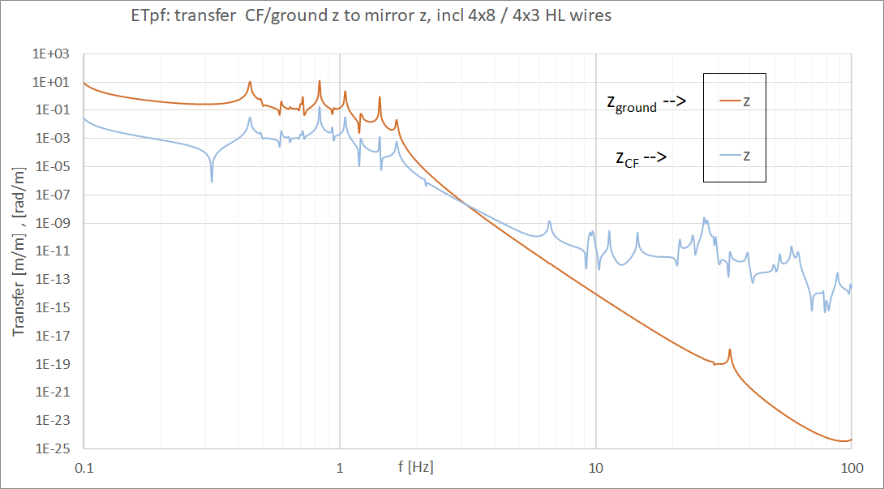
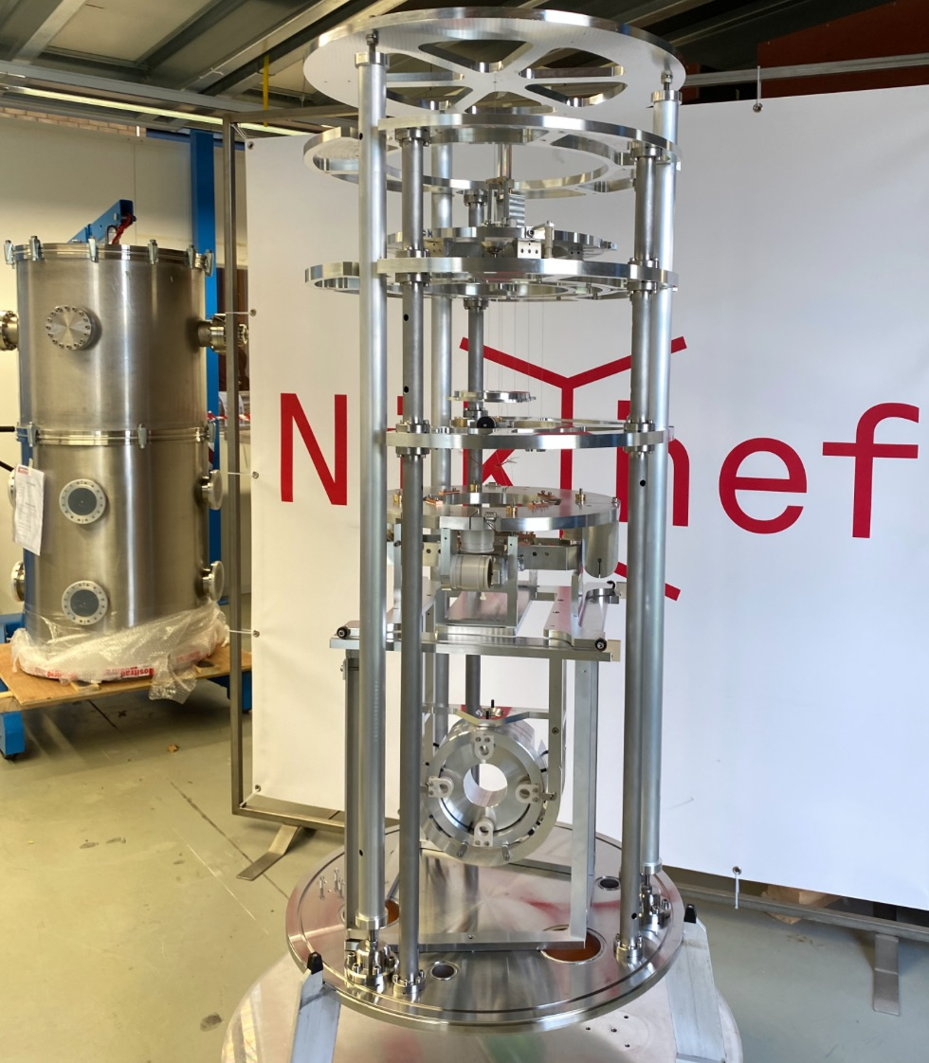
Challenging R&D in ET test masses suspensions
Vibrations transmission from cryogenic plant in ET-LF
ET design can fully benefit from experience and solution devised by KAGRA: current ET baseline foresees a vibration isolated heat link.
however, requirements at low frequency are much more stringent and, besides developing quiet cryocoolers, understanding (modeling and model validation) of heat link dynamics is an important input for the design.
FEM modeled cold finger to mirror horizontal TF
A room temperature test setup with a full scale payload has been realized to validate the model and to inform the final design
Credit: E. Hennes

Slide 12
ET-ISB Suspensions division
Organization
Co-chairs: Francesco Fidecaro, Alessandro Bertolini |  | Focus | Interfaces
WP1 | Seismic isolation platform | mechanical design and design of controls using advanced seismic sensors | suspension chains, inter-platform global controls
WP2 | Suspension chain | design of standard filtering stages, interface stage between chain and payload and local controls for active damping of chain modes | seismic isolation platform
WP3 | Payload design | payload thermal noise engineered design for both ET-HF and ET-LF, design of mechanical interface with the cryocooler, design of mechanical interface with the last suspension stage, mirror and marionette local controls | suspension chain, test mass suspension stage, cryogenics
WP4 | Test mass suspension | engineering design of fused silica (ET-HF) and crystalline silicon (ET-LF) suspension elements. Bonding technique selections. Manufacturing method selection. Fabrication. | Payload design
WP5 | Auxiliary optics suspensions | mechanical design of suspensions for IMC, optical benches, filter cavities mirrors, etc.

Slide 13
Summary
Now moving towards the TDR: we must treasure the experience gained in 2G detectors and KAGRA to inform the ET suspensions design.
Input from R&D activities needed on (non exhaustive list)
design of seismic isolation platforms: boosting the performance of Virgo pre-isolators with active vibration isolation would improve RMS figures and allow shortening the length of the suspension chains.
manufacturing and design of monocrystalline silicon suspension elements for ET-LF. Huge amount of work in front of us. Need to put resources and expand sample testing capability. A coordinated effort of all labs, e.g. like for coatings, is desirable.

