Slide 1
Alkaline Etching of silicon
Igor Ozerov / PLANETE /
Aix-Marseille Univ, CNRS, CINAM 13009 Marseille France
28/01/2020 meeting at CPPM

Slide 2
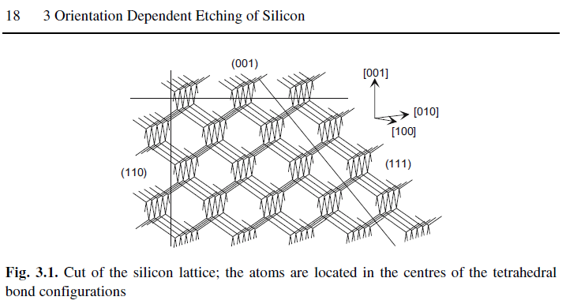
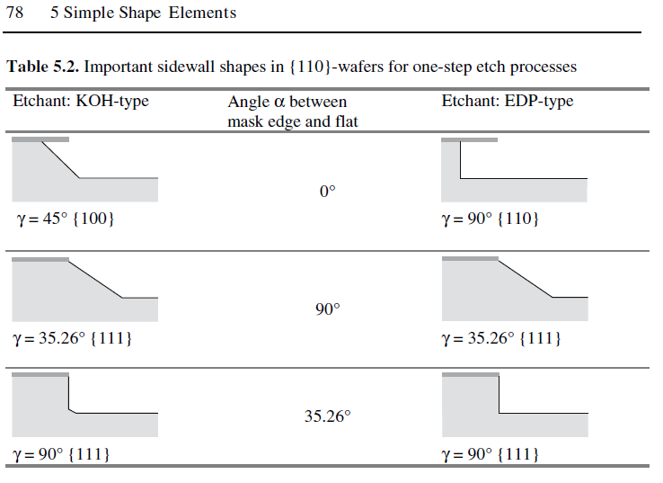
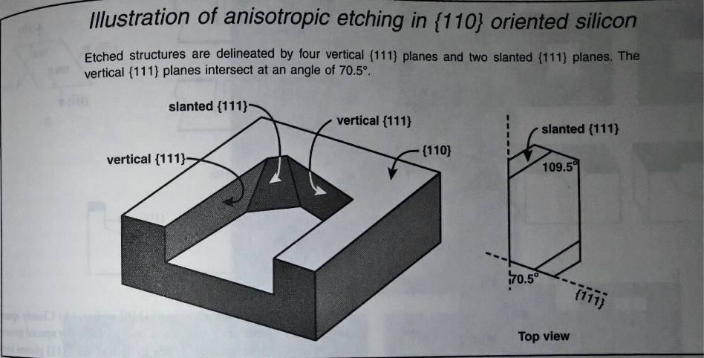
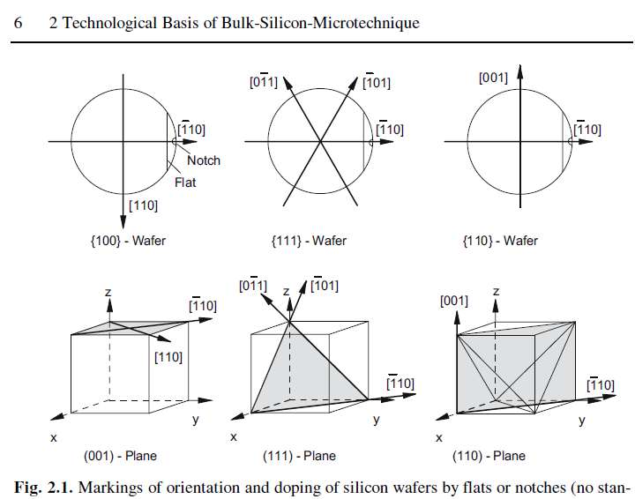
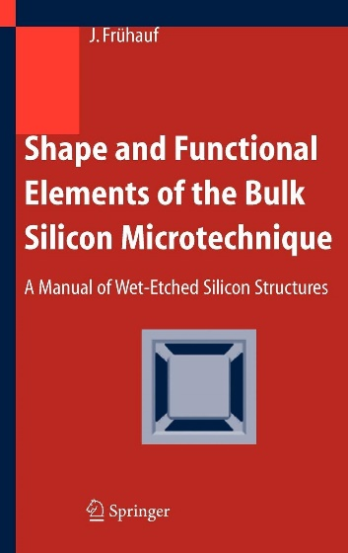
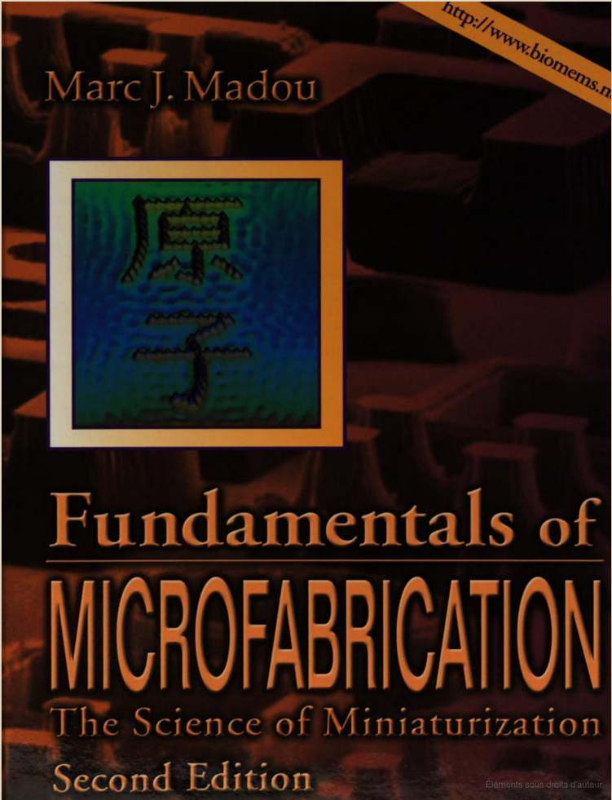
Principles of anisotropic wet etching of Silicon
Parallel vertical walls with high aspect ratio for {110} wafers !

Slide 3
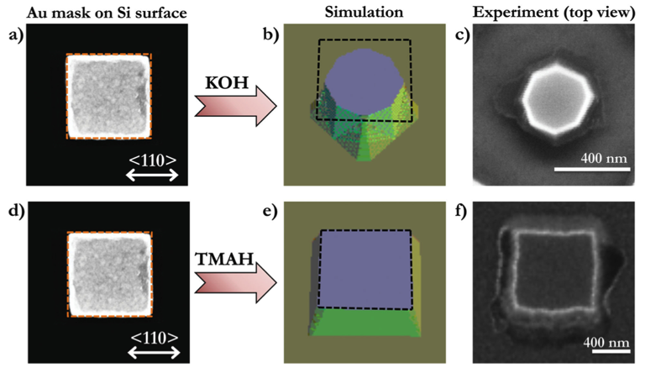
Alcaline Wet Etching of Silicon at CINaM
KOH or TMAH ?
KOH {110}>{100}>{111}
TMAH {100}>{110}>{111}
Selective chemical etching, Cr/Au mask
J. Proust, F. Bedu, S. Chenot, I. Soumahoro, I. Ozerov, B. Gallas, R. Abdeddaim, and N. Bonod, Advanced Optical Materials, vol. 3, pp. 1280-1286, 2015.

Slide 4
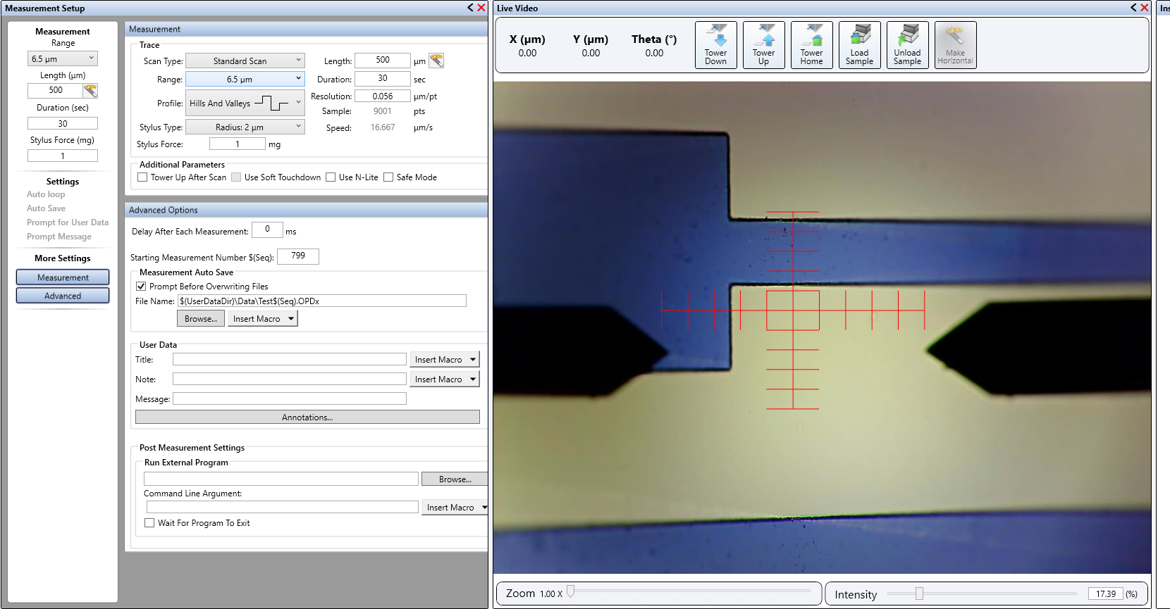
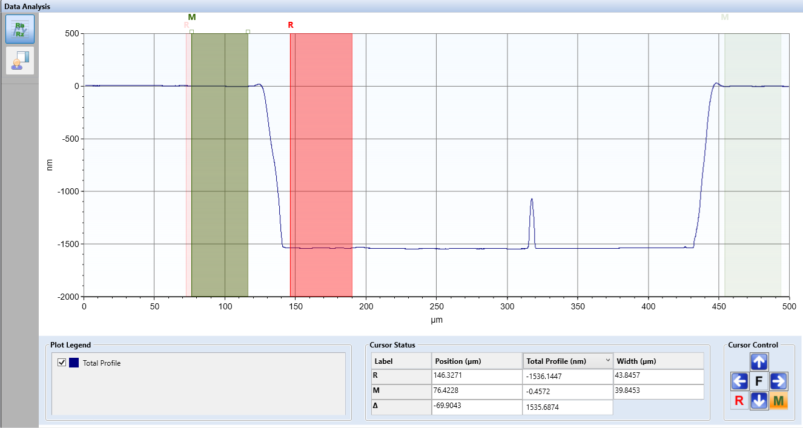
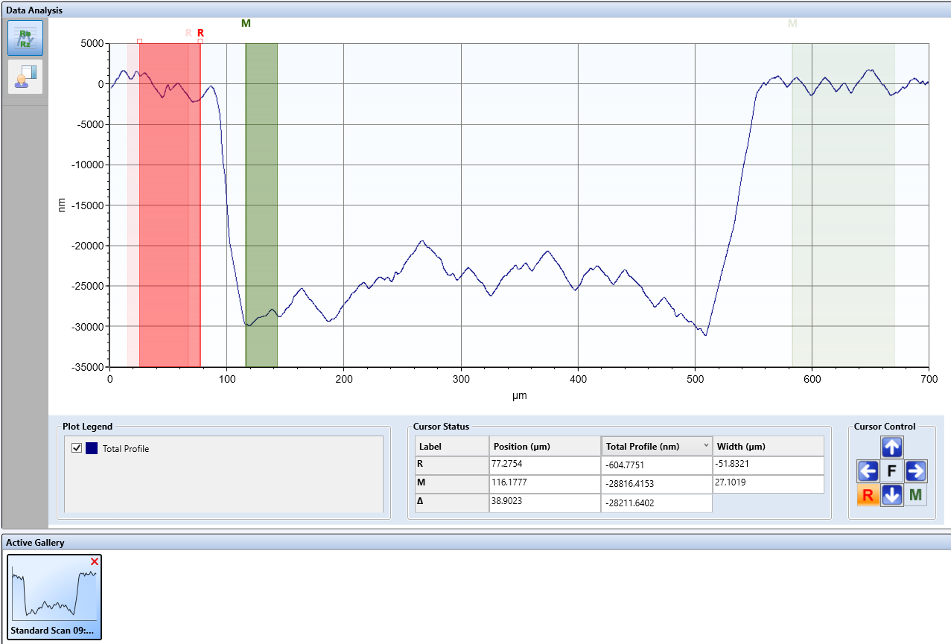
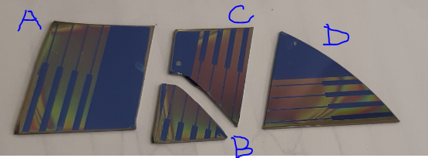
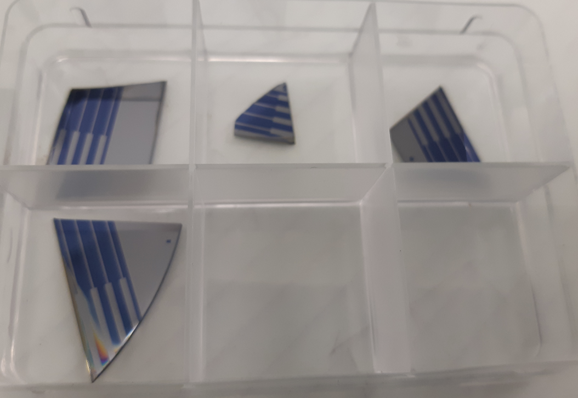
Preliminary results on Si (110) nov.-dec. 2019
Technological steps:
Plasma cleaning of Si(110)/ SiO₂
UV lithography (channel definition)
Reactive Ion Etching of SiO₂ (channel opening)
Wet etching of Si in KOH solution
(Removal of the remaining SiO₂ mask)
After lithography : Channel width 300 µm, photoresist thickness 1.5µm
Sample B: etching in KOH solution for 1 hour
Contact mechanical profilometer measurements: Channel depth ~27-30 µm
After lithography
After RIE

Slide 5
Preliminary conclusions
Proof of concept – Ok.
Need to get Si (110) wafers thicker SiO2 layer mask for deeper etching.
Roughness of the obtained surface (along the channel direction)

