Slide 1
Data versus simulation
Yannis, Corinne, Sabine, Thodoros, et al,
October 2019

Slide 2
Input to the simulation
Tumulus Description
From Grigoris et al measurements to GEANT4
Inner Material Dirt with density 2.2 g/cm3, nothing else
Nb of detectors 3x2. Detector size (m) 2x0.07m 0.8m, 0.8m
Detector Rotations 10 deg in θ (polar) and 188 deg in φ
Detector digitization by Corrine

Slide 3
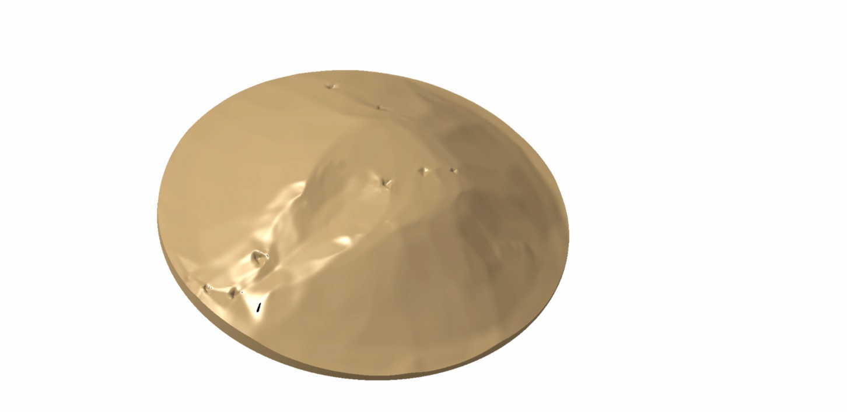
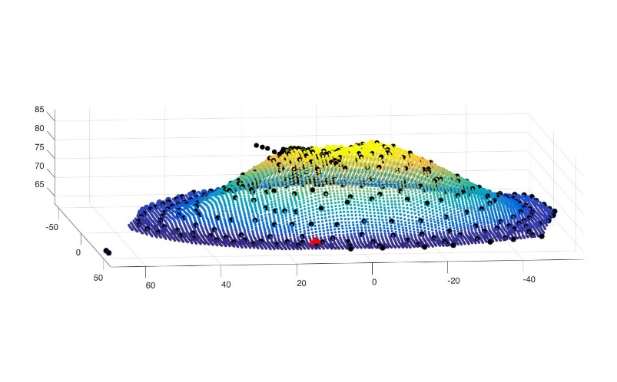
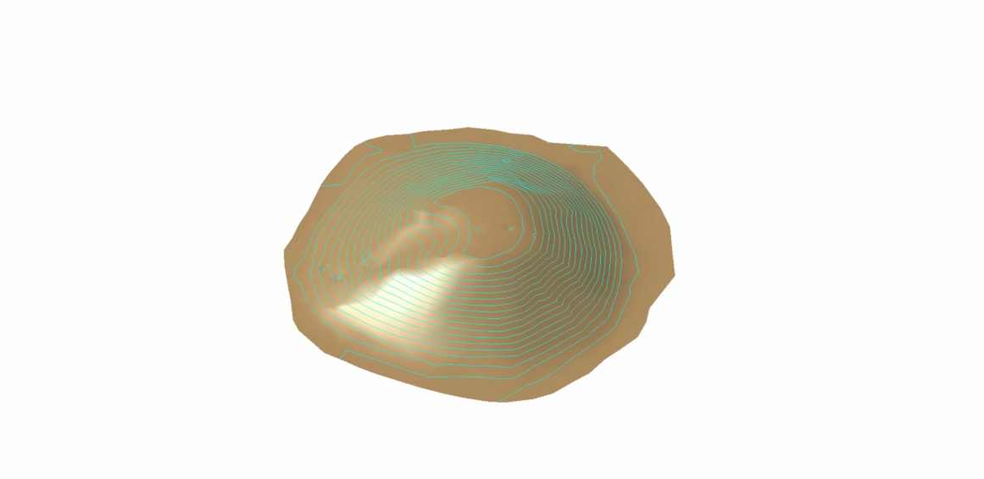
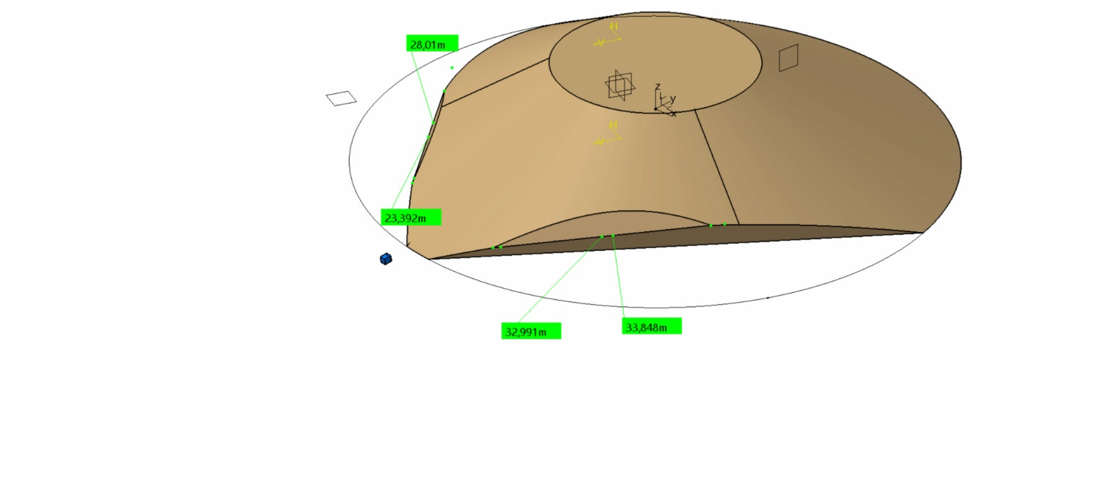
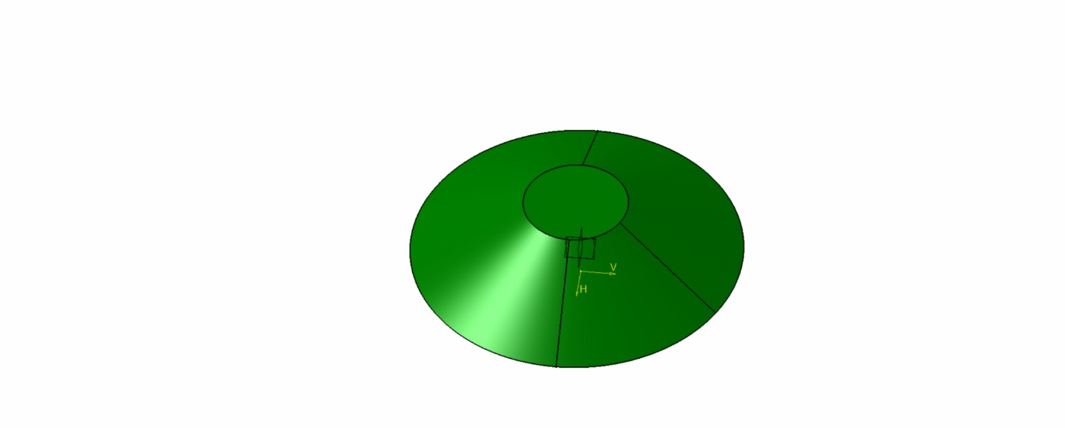
Tumulus in CATIA
Input data file
The tumulus seen by the detector
GEANT4 approximation

Slide 4
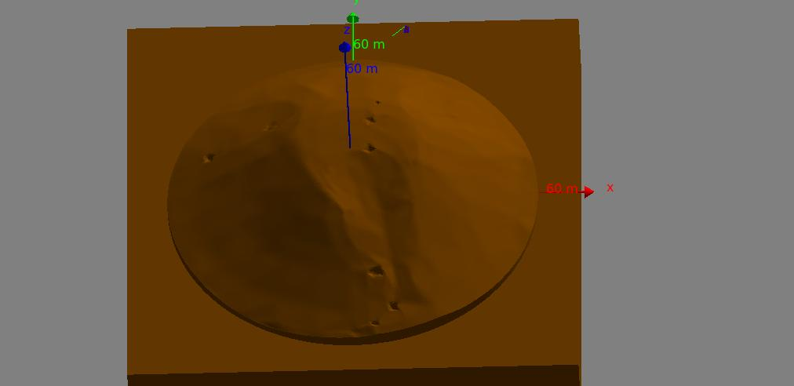
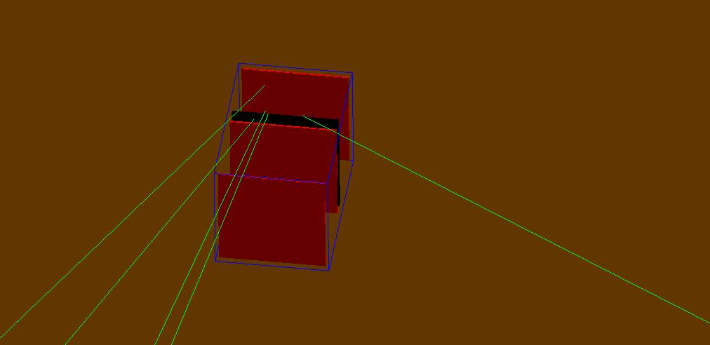

Slide 5
Reconstruction
Data
Events are filtered by Thodoros to validate hits (ADC >200 )
Use channel id, get coordinates in the detector system, fit a straight line in 2 directions and measure θ and φ in the detector system ! Reject bad tracks (see Corrine’s talk)
~5M events
Simulation
Use channel id after Corrine’s digitization, fit a straight line in 2 directions and measure θ and φ in the detector system !

Slide 6
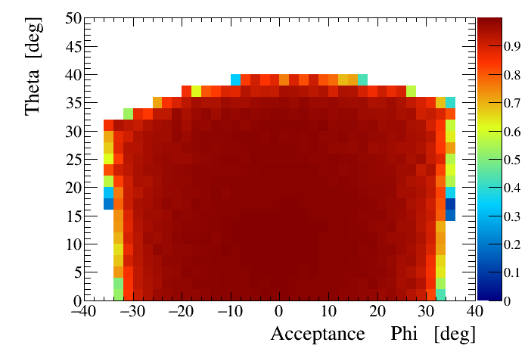

Slide 7
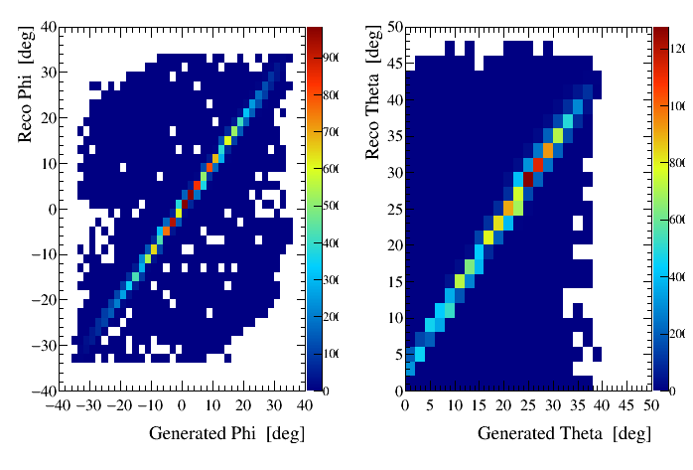
Reconstructed
True
Simulation

Slide 8
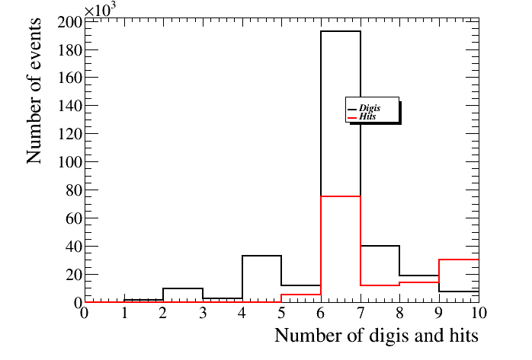
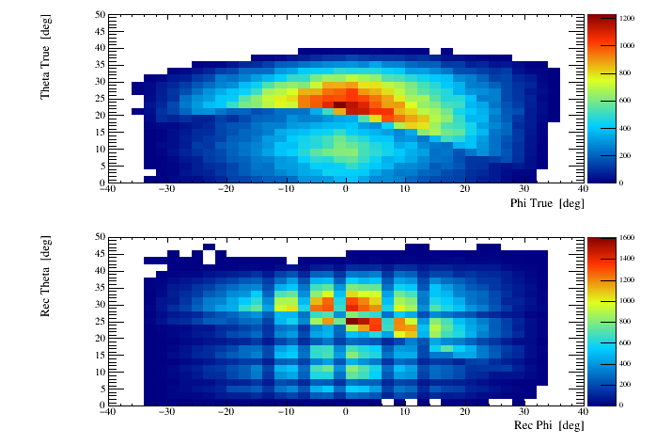

Slide 9
Data versus simulation
Cosmic muons angular distribution models
Simulation is done with both polar and azimuthal angles distributions uniform
Using a given law f(θ,φ) we compute for every bin θ,φ a weight = ratio of
f(θ,φ) / uniform
The θ,φ distribution from simulated muon events, after reconstruction is multiplied by the weights to obtain a new θ,φ distribution . In this way we can change the model without regenerating all muons with Geant4
Normalising data and simulation
The normalization between data and simulation is computed using the total number of events above the tumulus

Slide 10
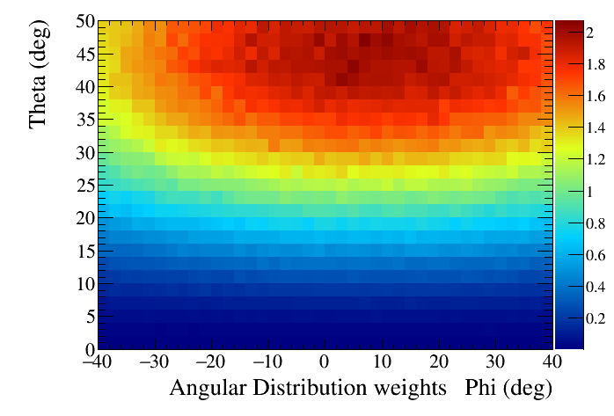
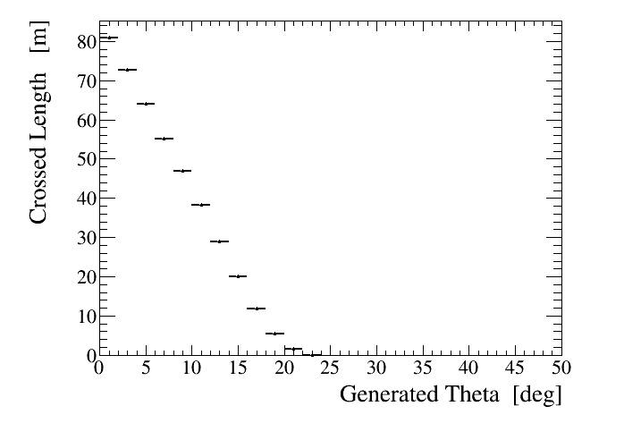

Slide 11
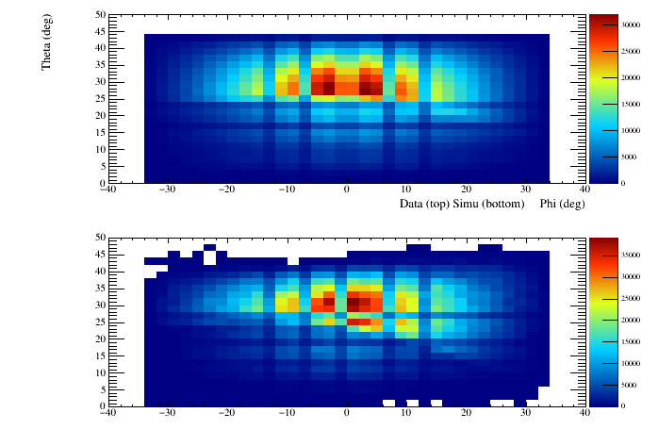

Slide 12
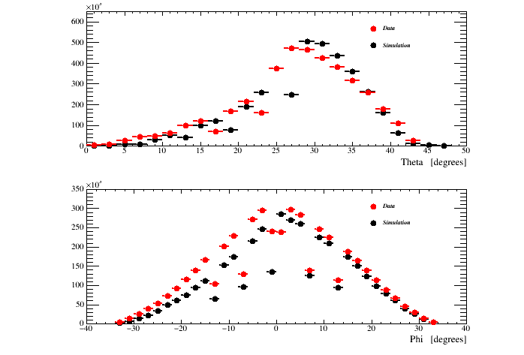
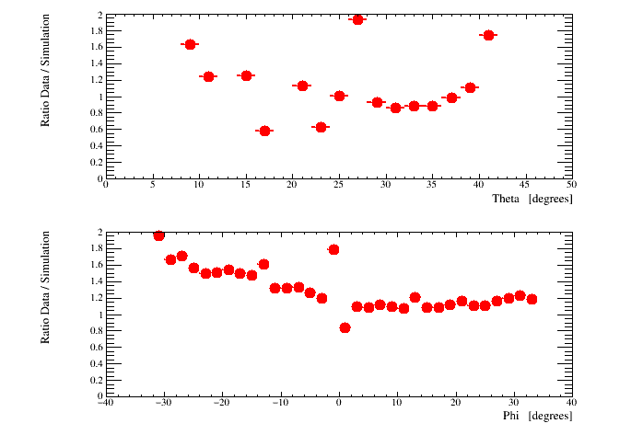
Ratio data / simulation integrating over 1 dimension

Slide 13
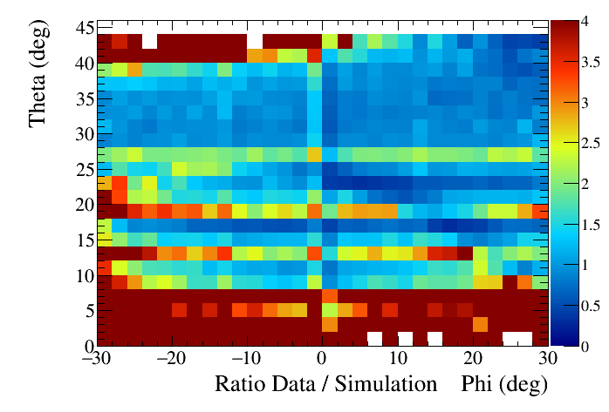
We make the ratio of Data / (Normalized weighted simulation events)
When ratio = 4 means it means > 4 !!!!

Slide 14
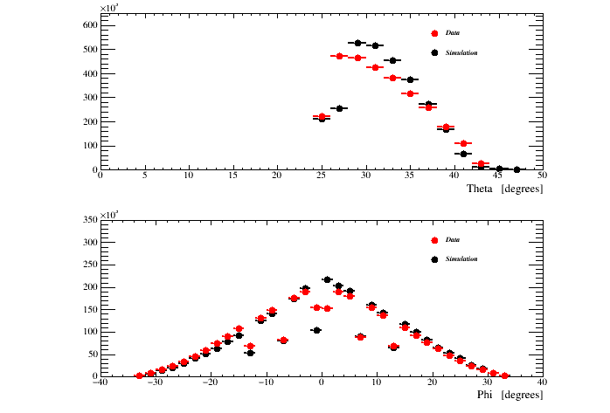

Slide 15
Conclusions and projects
We need a reliable muon angular distribution in open sky
Use backward tracks
Very close to a final data / simulation comparison
Think the future

