Slide 1
ITk Pixel Services &
Mechanics Meeting
-
Services Specifications
Updates
Su Dong, Tobias Flick, Matthias Hamer, Jason Nielsen, Michele Weber
February 2nd, 2020

Slide 2
plot is for 4000 / fb
Item | R [cm] | Z [cm] | TID [Mrad]
OB Services | 15.6 | 103.1 | 162

Slide 3
a safety factor of 1.5 for TID is recommended: link
this safety factor is supposed to cover uncertainties in the simulation
there have been some discussions on adding a second safety factor
this should account for an increase in the total integrated luminosity (numbers I have heard range from 1.0 to 1.5 for this safety factor)
would add up to a combined SF of 2.25 for the TID

Slide 4
Power Dissipation Limits : acceptable power dissipation on services is defined as 10% of the delivered FE power in the standard power scenario
this resistance budget has been used to estimate the dissipation on the detector services in a high power scenario

Slide 5
we propose a change to the services specifications:
The overall power budget for the Type-0 and Type-1 services, including PP0, the Module Flexes and any connectors between any of these elements, up to PP1, is 20% of the delivered FE power in the ‘standard power’ scenario that was defined in September 2018. The power budget for the Type-1 services shall be 10% of the delivered FE power in that scenario, and 10% for the Type-0 + PP0 + Module Flex in that scenario.

Slide 6
Updated HV testing and rating requirements (TBC)
several discussions on required HV ratings and testings:
HV defined as anything > 50 V
asked for clarification from ATLAS electronics coordination
Cables and PCBs:
rating: 100% of the max operating voltage
manufacturer should test 100% of all cables at 2x the max operating voltage
we have to test samples up to 100% of the max operating voltage in our QC
Connectors:
we ignore the manufacturer’s rating
we have to establish ourselves a testing procedure. starting requirement is 3x max operating voltage, based on a Samtec whitepaper. If we find that a lower voltage is sufficient for one-time-testing, that is fine to use as well
→ past experience?

Slide 7
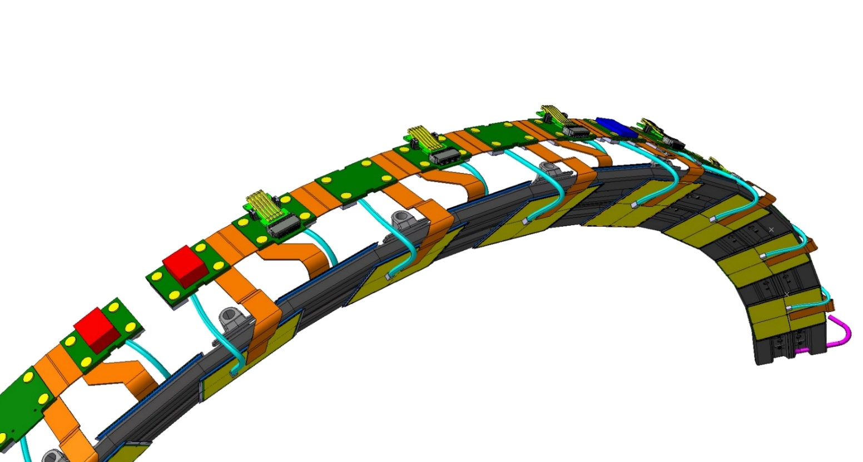
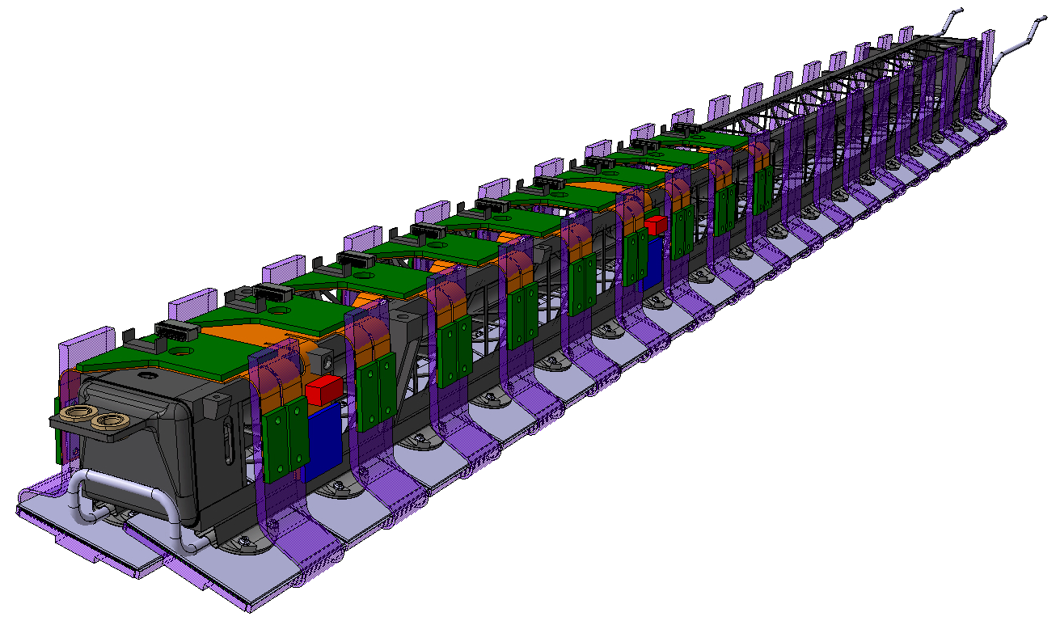
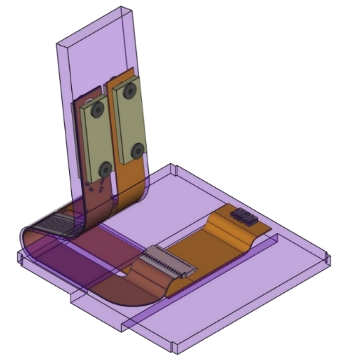
Type-0 Services: CAD Integration
Initial 3D models of the flex-PCBs implemented for the flat and inclined sections (changes to be implemented as the electrical design progresses, e.g. rigid boards in flat section, number of Z-ray connectors, position of Type-1 power connector)
Initial module pigtails included in the 3D models
Need to be adapted to the new connectors on the common hybrid
Strain relieves needed on the module side (not on the Type-0 end – Z-ray secured by screws)
Type-1 Power Connector
Type-1 data Connector (UEC5 +UEC8)
MOPS
Page <number>
Notes:
<number>

Slide 8
Type-0 Services: Thermal Management
Positioning/attachment system of the Type-0 services to the local supports designed to accommodate their thermal expansion/contraction
Flat Section: Thermal deformation converted into longitudinal displacement
60mm long rigid boards fixed with precise hole and a slotted hole (additional Ω for long SP chain)
Total contraction in cool down from 22°C to -55°C < 200µm
~60mm
~60mm
~60mm
Ω
Long SP Chain (Board 2)
Short SP Chain
Long SP Chain (Board 1)
ΔL ≤ 100µm
ΔL ≤ 100µm
ΔL ≤ 100µm
ΔL ≤ 100µm
ΔL ≤ 100µm
ΔL ≤ 100µm
Flexible segment with Ω shape to “decouple” Boards 1 & 2
Schematic of the location/shape of the holes (corresponding pins bonded to the CFRP truss)
Page <number>
Notes:
<number>

Slide 9
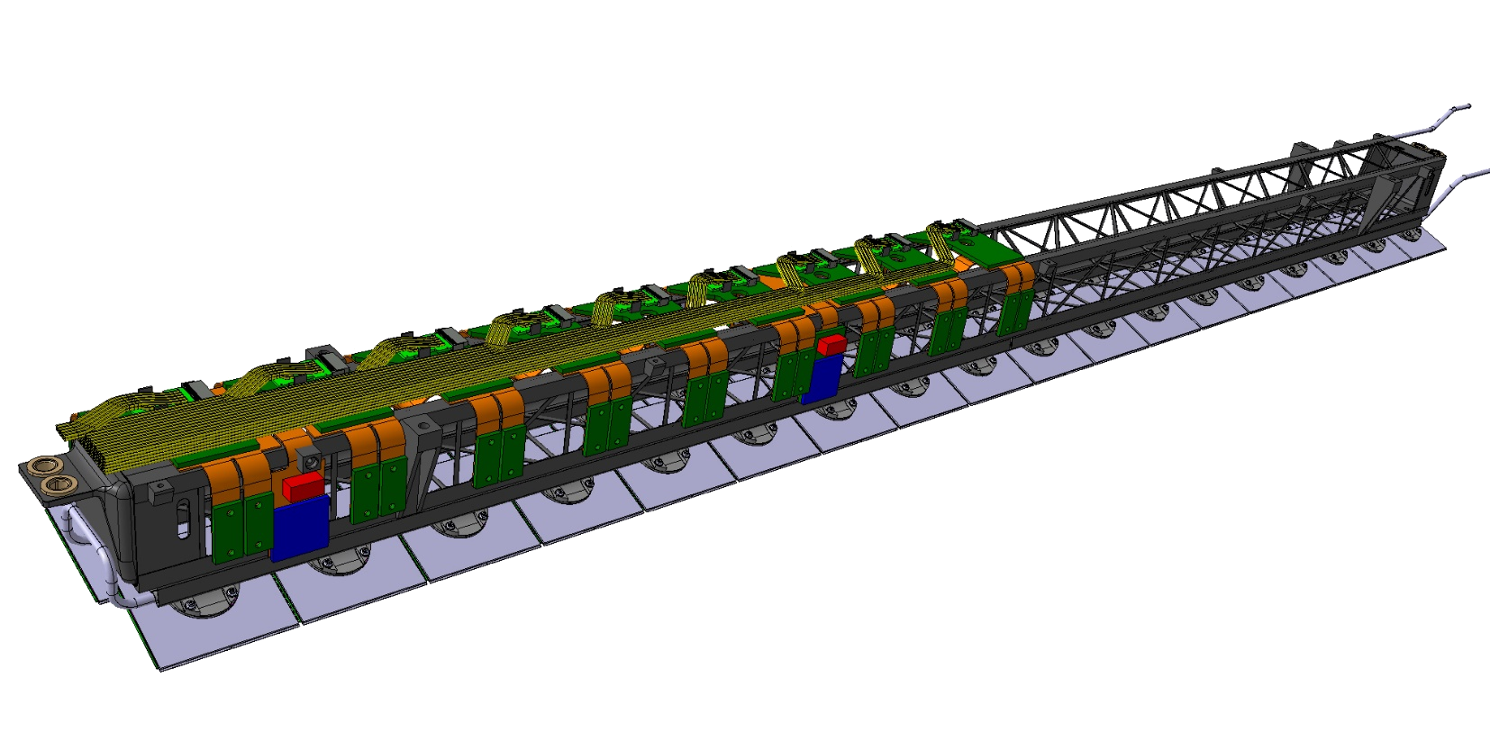
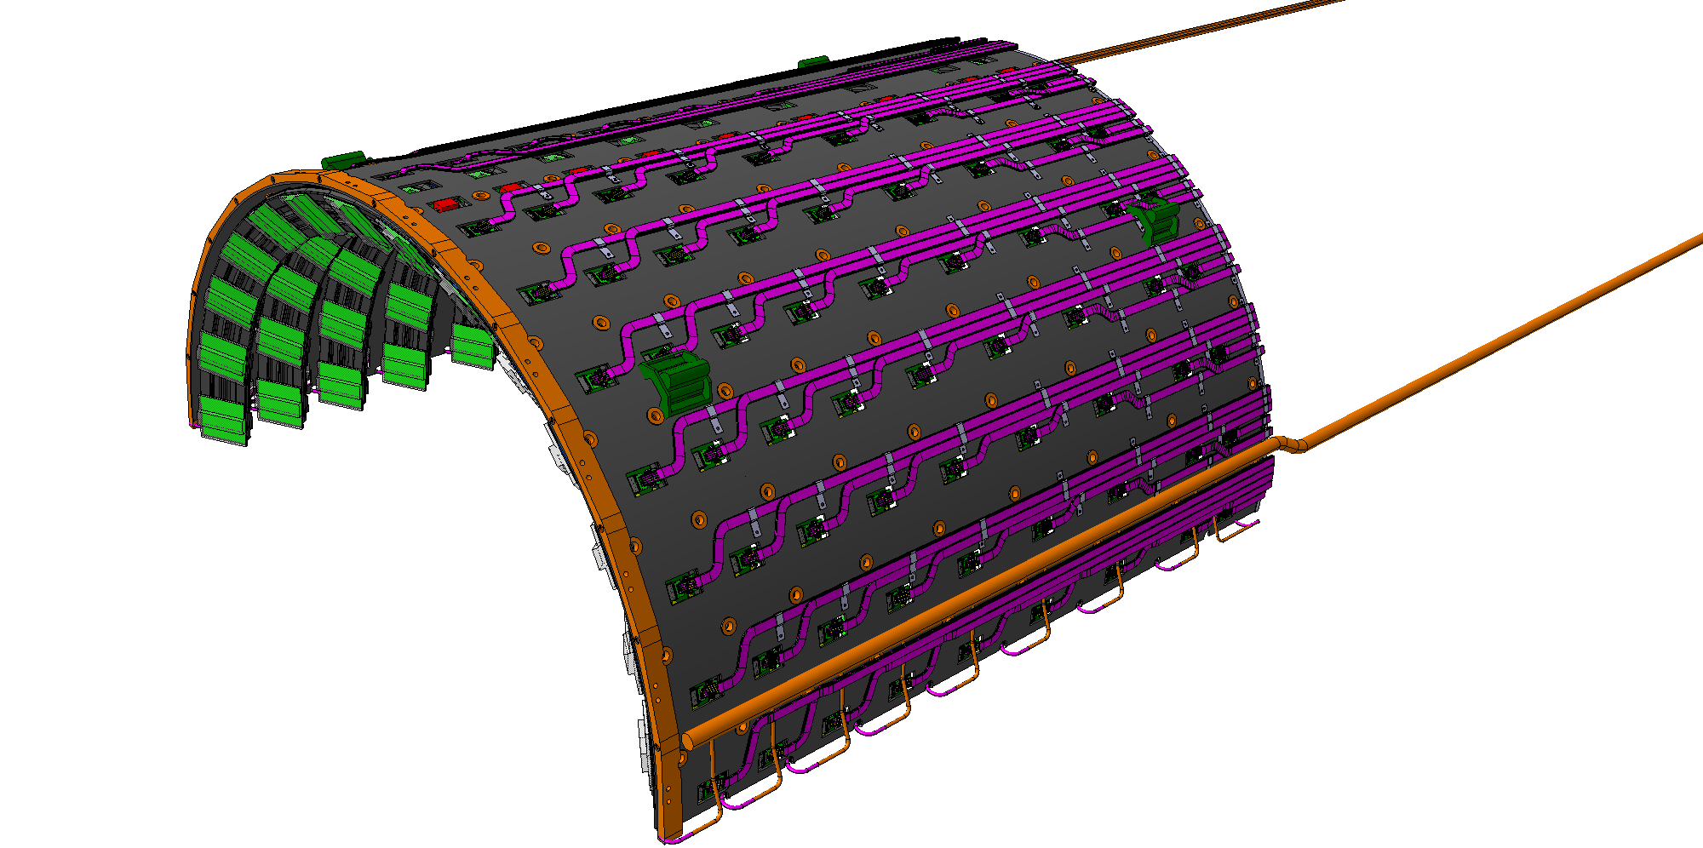
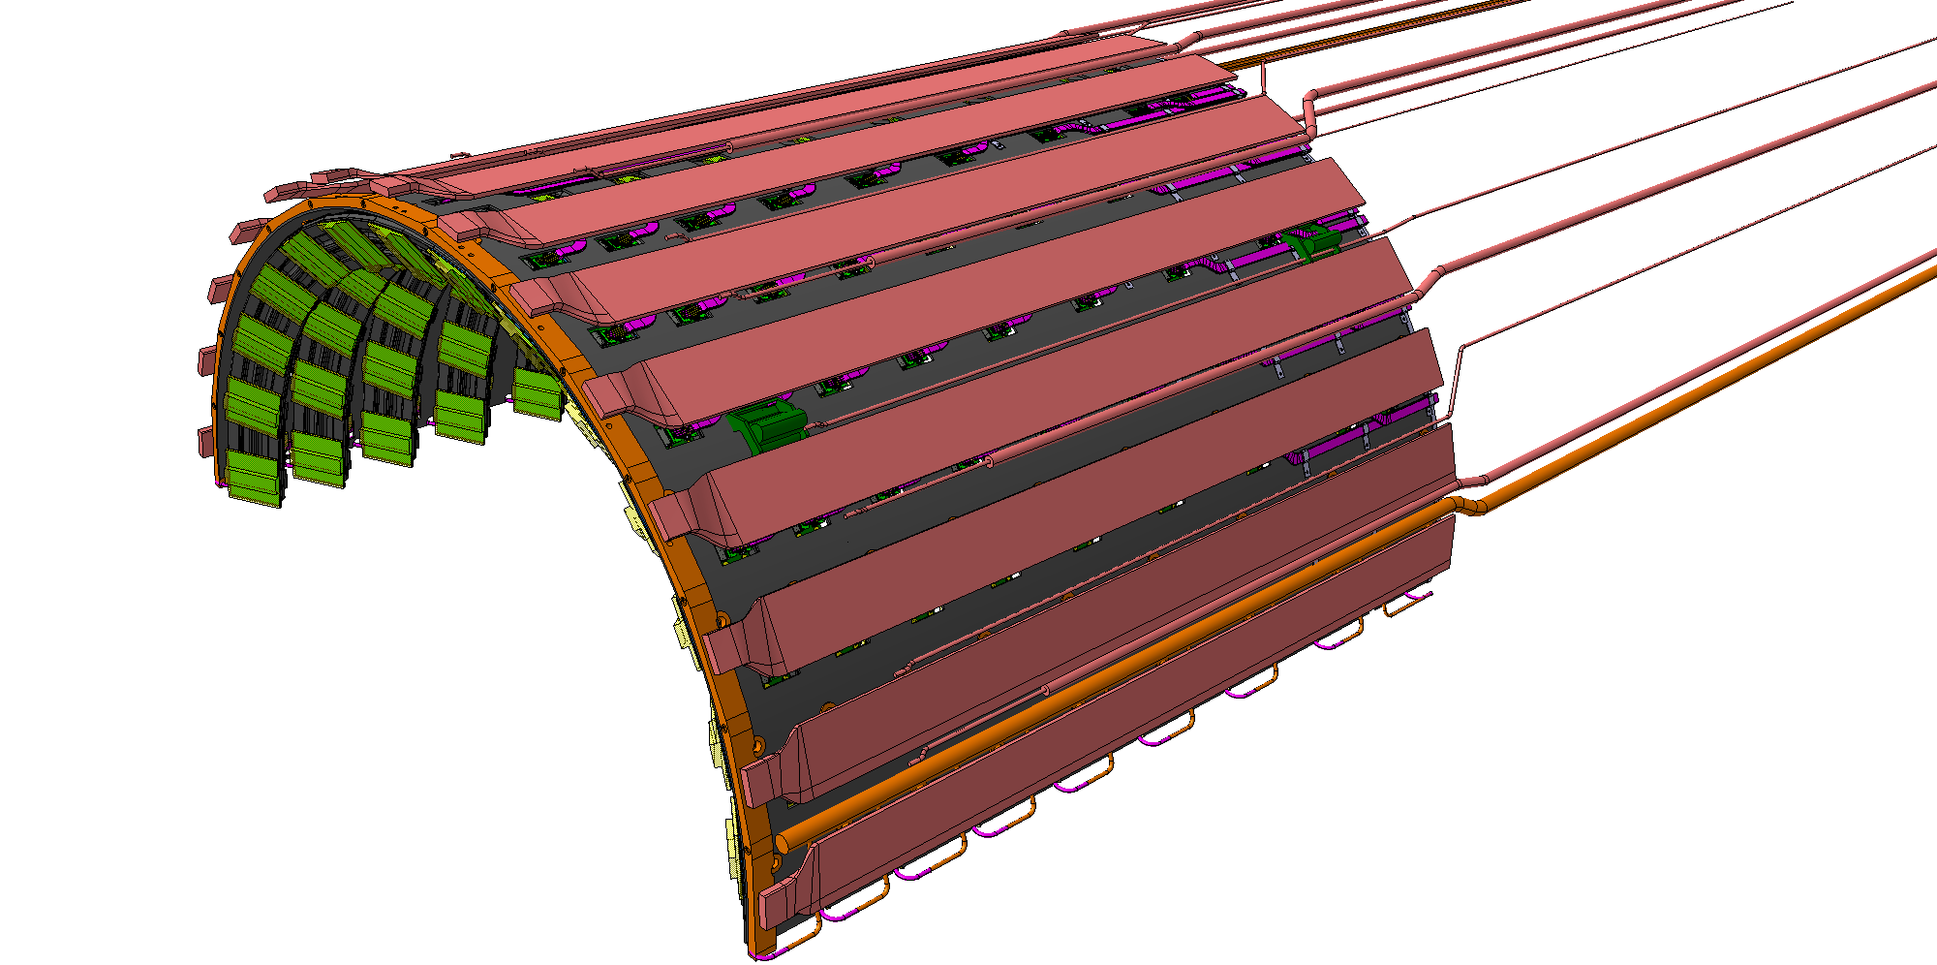
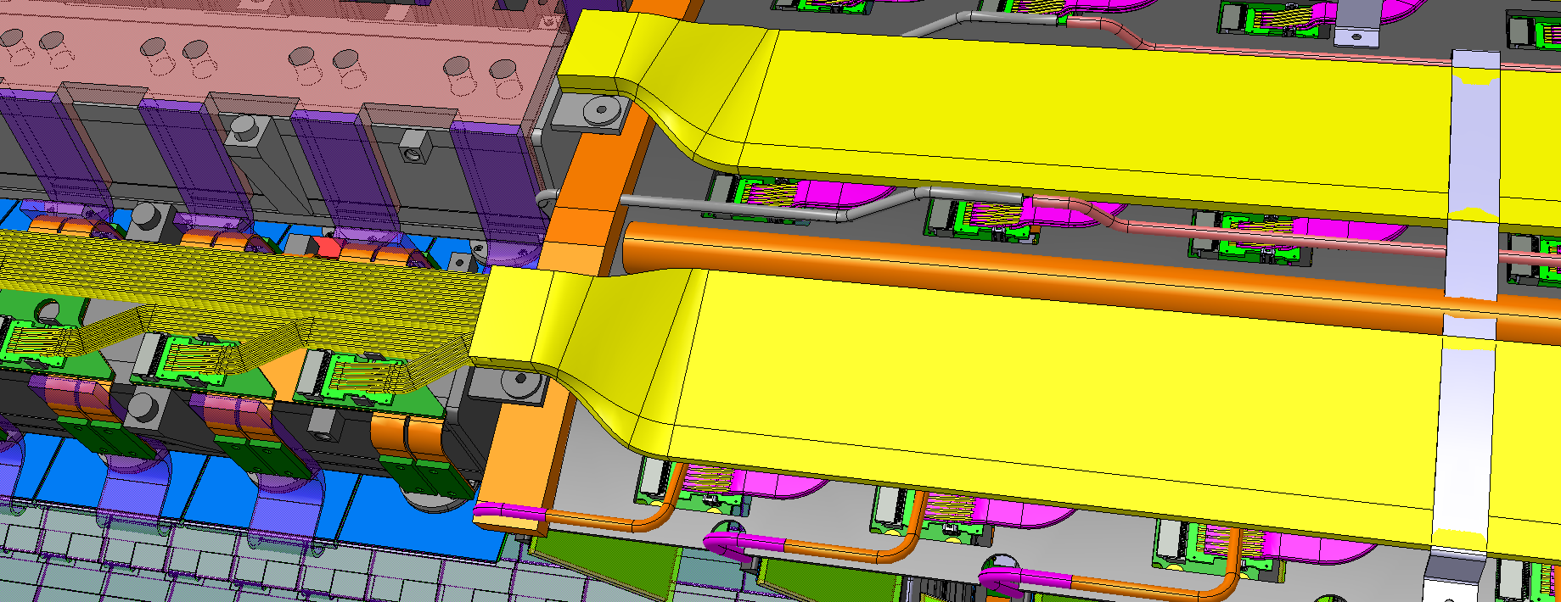
Type-1 Services: CAD Integration
Routing of the Type-1 data cables and pipes implemented atop the longerons and IUs
10 links per FireFlyTM; No CMD forwarding
Data lines from IHRs routed in Z up to PP1
Power lines to be added next (dedicated space allocated in the model)
Preliminary CFRP clamps added on shells for strain relief of Type-1 connectors (extra length – waves – to be added to accommodate thermal expansion/contraction)
Longeron Type-1 bundle
CFRP Clamp for Longeron services
CFRP Clamp
Page <number>
Notes:
<number>

Slide 10
OB flat developments status
Priority: fix issues, define solutions and validate a design for PDR.
We have to prove that the services will do the job and how they will be integrated.
Interfaces have to be defined, then a global architecture (scheme, PP0 stack-up technology), finally prototypes production.
Our baseline architecture: type0 with CMD sharing selectable.
RD53A and ITKpixV1 compatible (implement chip ID, Vmod, LP, etc...).
1- Interfaces
Module interfaces: data&power. Work on ITKpixV1 mandatory for PDR.
Work on RD53A pigtail if needed but later.
Pigtails-PP0 connection: must be compatible RD53A-ITKpixV1.
Superimposed flexes for integration under design. Standard ZRAY chosen with
isolated HV. Pinout not frozen, to be finalized.
Type1 interfaces:
- data: universal firefly design will be soon discussed with inclined people in order to propose a solution to optoboards people.
- power & other services: type1 cables to be understood (who knows?), study of a connection that fits the envelopes.
07/02/2020
LAPP
<number>

Slide 11
OB flat developments status
2- Pigtails
New superimposed flexes version under investigation: better for integration? better for inclined?
Missing point: module pinout for ITKpixV1.
Prototypes: two versions needed? RD53A & ITKpixV1
RD53A prototype: when?
« cell support » + mating tool for pigtail connection under design
3- PP0 L4: compatible RD53A - ITKpixV1
Architecture for PDR: stack-up, resistance budget, transmission simulations...
Missing points for prototype: final envelope, type1 interface, fixations, CTE…
Prototype: when?
Electrical qualifications PP0+pigtails on table: Sparam, BER, eye diag…
Full chain transmission tests to be discussed.
Technical details will be discussed in OB meetings.
07/02/2020
LAPP
<number>

