Slide 1


Handling frames & cell integration status
Jean-Philippe LOGIER | Mathieu NICLAS | françoise riviere | Eric Vigeolas
CPPM PIXEL meeting | 09/01/2020

Slide 2
Handling frames status
Handling frame development overview 1/2
  Prototypes
    1 unit for each HF type tested at CPPM
    Qualification needed for FDR (07/08/20)
  Pre-production
    Based on final design
    4x units (CPPM; CERN; LAPP; LPSC)
    Not part of the final contract (schedule)
FDR requirements for HFs ↓
- Prototypes to be provided
- Safety / functionality tests for each configuration
- Pressure resistance / leak test for pipes connectors
- Metrology verification
- Shipment tests / stress levels due to transport loads
Prototype design (done)
Prototype order x1 (done)
Prototype reception
Tests → Final design
Pre-production order x2 to 4
Bare local supports FDR
Pre-production reception
Pre-production Integration
Jan 20
May 20
Aug 20
Sep 20
Jui 21
Today
Feb 20
May 20
Aug 20
Sep 20
Dec 20
Jui 21
Prototype design
Prototype order x1
Prototype reception
Tests → Final design
Bare local supports FDR
Pre-production order x2 to 4
Pre-production reception
Pre-production Integration
Longeron HF
Half-ring HF
09/01/2020
JP. Logier | M. Niclas | F. RIVIERE | E. Vigeolas
2

Slide 3
Handling frames status
Handling frame development overview 2/2
  Handling frames for production
    HF amount baseline is ¾ of local supports total
      66x longeron units → 50x longeron HF | 92x IHR units → 70x IHR HF
    Same contract for longeron & half-rings HF (1 supplier)
    1 year procedure anticipated
    6 months margin saved for now
    Reception spread over several months before and during integration
Production contract procedure launch
(Pre-production Integration)
Production contract order
Production first units reception
Production Integration
Feb 21
Jui 21
Feb 22
May 22
Dec 22
1 year procedure
Longeron HF
Half-ring HF
09/01/2020
JP. Logier | M. Niclas | F. RIVIERE | E. Vigeolas
3

Slide 4
Handling frames status
Handling frames budget estimation
  Longeron handling frames prototype
    Tooling (truss mold) cost 11K€
    1 unit handling frame cost 8K€
  Estimation for the contract
    Longeron HF
      ≈50 units = 5K€ /unit (ORECA quotation)
      Many points on the design can be optimised for the final version
      ≈ 50 optimised units may cost around 4K€ /unit (TBC)
      Total cost estimation for longeron handling frames:
    Half-rings HF
      ≈70 units; No quotation for now
      Estimation based on the same cost as the longeron HF:
  Transport boxes
    Need to contact suppliers
pre-prod (4x) cost <30K€
prod (46x) cost ≈185K€
pre-prod (4x) cost <30K€
prod (66x) cost ≈265K€
Longeron HFs | 180 K€
Longeron Transport Boxes | 90 K€
Inclined Half-Rings HFs | 250 K€
IHR Transport Boxes | 90 K€
  Budget allowed →
09/01/2020
JP. Logier | M. Niclas | F. RIVIERE | E. Vigeolas
4

Slide 5

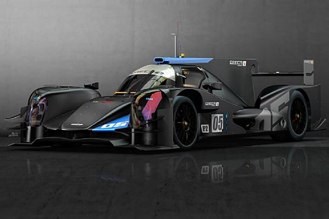
Longeron handling frame
Longeron handling frame development status
  Prototype ordered to Oreca
  Reception mid feb-2020
  Longeron mock-up to be ordered
  Safety / functionnality tests ; points of possible improvement
  Upgrades then implemented in the final version (pre-prod) to be ordered mid-2020
Prototype main functions
  Provide accessibility to the each useful faces
  Hold the system with minimum stress (including @OT)
  Provide interfaces with integration tools
  Hold the services (harnesses, pipes)
  Safe mounting/unmounting procedure
  Safe handling
09/01/2020
JP. Logier | M. Niclas | F. RIVIERE | E. Vigeolas
5

Slide 6
Longeron handling frame
Handling frame configurations
#3 Metrology
(access to cells+metrology refs)
#1 Shipment
+ Storing
#4 Cells integration
(access to the base blocks from 2 sides)
#2 Testing
(access to services)
#5 Services integration
+ Longeron unmounting configuration
09/01/2020
JP. Logier | M. Niclas | F. RIVIERE | E. Vigeolas
6

Slide 7
Longeron handling frame
Handling frame points of design
Services supports
Isostatic mounting to ensure no stress in the longeron
Indexing wheel to move to each configuration
Safe unmounting with extension part centered in the tool
09/01/2020
JP. Logier | M. Niclas | F. RIVIERE | E. Vigeolas
7

Slide 8
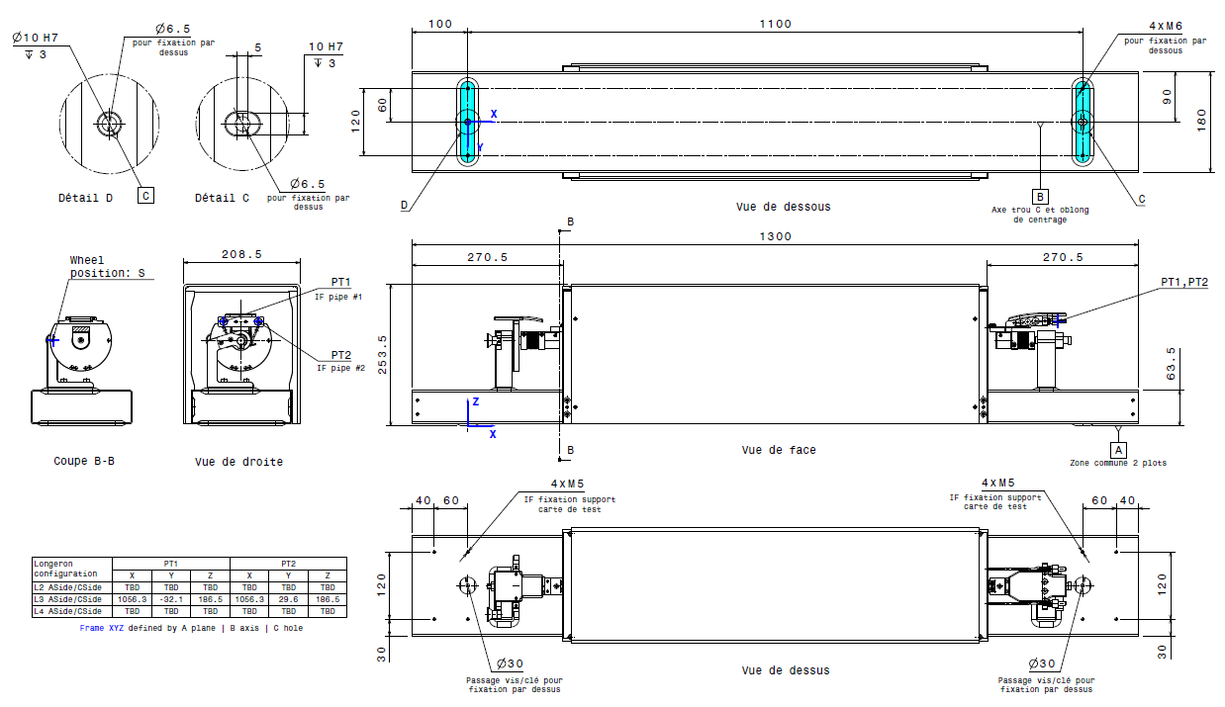
Longeron handling frame
Longeron handling frame interface document (PIXEL-DT-24-01-A)
  Purpose: provide maximum information about useful interfaces for each configuration
  Input for the design of connected tools (Pandore, cells integration tool…)
  To be upgraded with each layer data (services configuration, metrology ref positions..) and later with the final version of the handling frame
Example with L3 longeron in testing configuration:
HF fixation interface
Pipe ends position
Interface for test board support
Overall dimensions
09/01/2020
JP. Logier | M. Niclas | F. RIVIERE | E. Vigeolas
8

Slide 9
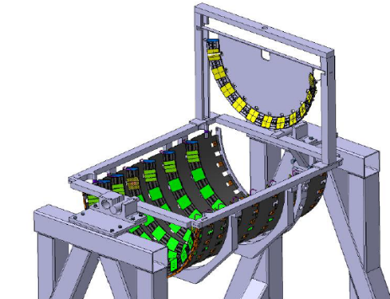

Half-ring handling frame
Half-ring handling frame development status
  Conception just started
  Prototype design and order beginning of 2020
Specifications for design
  Fixation inducing minimum stress (survey)
  No accurate positioning of the HR in the HF
  Safe handling and protection for shipment
  Interfaces compliant with other tools (Pandore, OB integration…)
  Safe unmounting procedure (from the shell)
  Access to the cells on both sides & to metrology references
  Provide safe access for testing (pipes and services)
  Holding services
New services scheme adds constraints on the design
09/01/2020
JP. Logier | M. Niclas | F. RIVIERE | E. Vigeolas
9

Slide 10
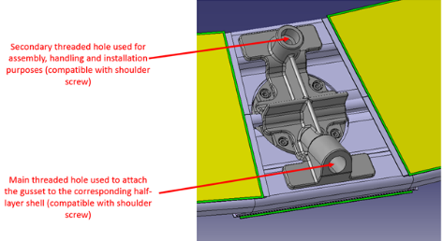
Half-ring handling frame
Interface Half-ring / Handling frame
  Fixation holes on IHR dedicated for tooling → keep main holes free for HR insertion
  Isostatic solution with multiple fixation points → Need no stress fixation points TBD
  Impact on half-ring deformation to be evaluated (CMM)
Handling frame structure
  Carbon frame in contact with HR
  Vertical support for cells integration & metrology
  Arches for protection and cover support
Integration in the OB shell
  Design to be adapted to integration procedure
  System to hold and release services boards TBD
09/01/2020
JP. Logier | M. Niclas | F. RIVIERE | E. Vigeolas
10

Slide 11
Cells integration
Cells integration tool status
  Design to be completed in 2020
  First studies by LAPP & CPPM
  Integration procedure and specifications to be refined
General overview with workpackages:
Flexible hinge
+ local alignment system?
 | CPPM | LAPP | LPSC | CERN | UniGe
Integration baseline procedure | X
Reworking procedure |  | X
Structure + If with HF |  | X
Global alignment system |  | X
Slot alignment system |  | X
Insertion system |  | X
Aiming/overlap control system
Cell holding system | X
Flexible hinge + local alignment system | X
Kinematic mount | X
Screw holder/ tightening tool | X | X
Screw design | X |  |  | X
Cell holding system
Kinematic mount
Z
X
Aiming/overlap control system
Insertion system
Slot alignment system
TX
Pitch /TY
TY-TZ
RX-RY-RZ
Global alignment system
Screw holder /
Screwdriver
Structure
09/01/2020
JP. Logier | M. Niclas | F. RIVIERE | E. Vigeolas
11

Slide 12

Cells integration
Positioning accuracies
  Relative position accuracy of the cooling block vs the base block impossible to guarantee (handling frame + integration tool concatened tolerances).
  Avalaible gaps between adjacent cells can be (very) tight
  Cell insertion needs additionnal clearance (flexible hinge to prevent insertions forces)
Integration procedure options
  Baseline → Alignment for each slot (translations & rotations)
    Manual assembly with optical system overlap control
    Measurement of the target & the cell to be mounted; then alignment correction
    Manual insertion of a cell martyr; lock the DoF; insert the final cell (no measurement) → procedure to be explored
  Tool alignment with 2 external cells; pitch system effective for other slots
    Depends on tool & longeron accuracies + clearance avalaible
Cell edge position accuracy | ± µm
cell envelopp accuracy | 25
cell loading accuracy | 75
Base block distances accuracy | 10
Cell clearance in the base block | 25
Total for 1 cell | 135
Nominal gap between 2 cells = 300µm
Need to improve cell loading accuracy
to avoid possible cell collision
09/01/2020
JP. Logier | M. Niclas | F. RIVIERE | E. Vigeolas
12

Slide 13
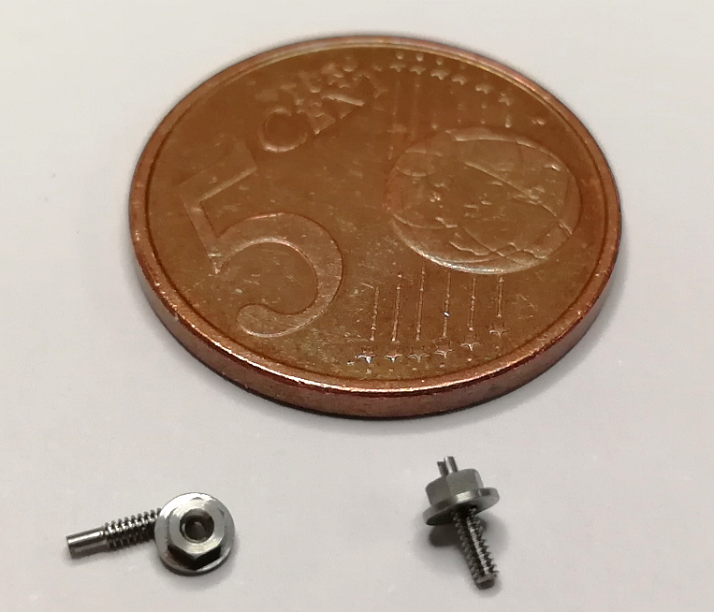
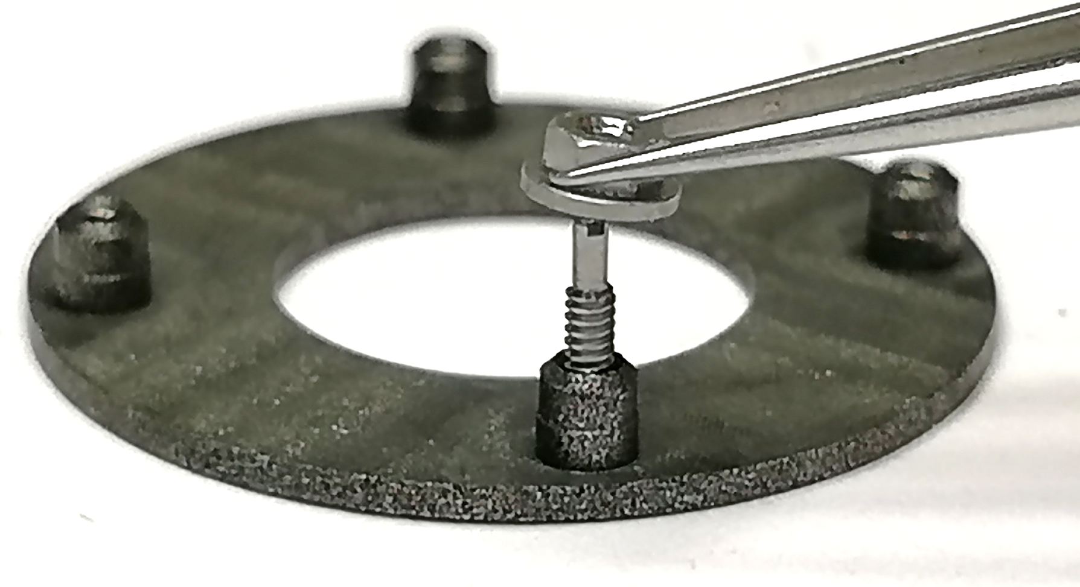
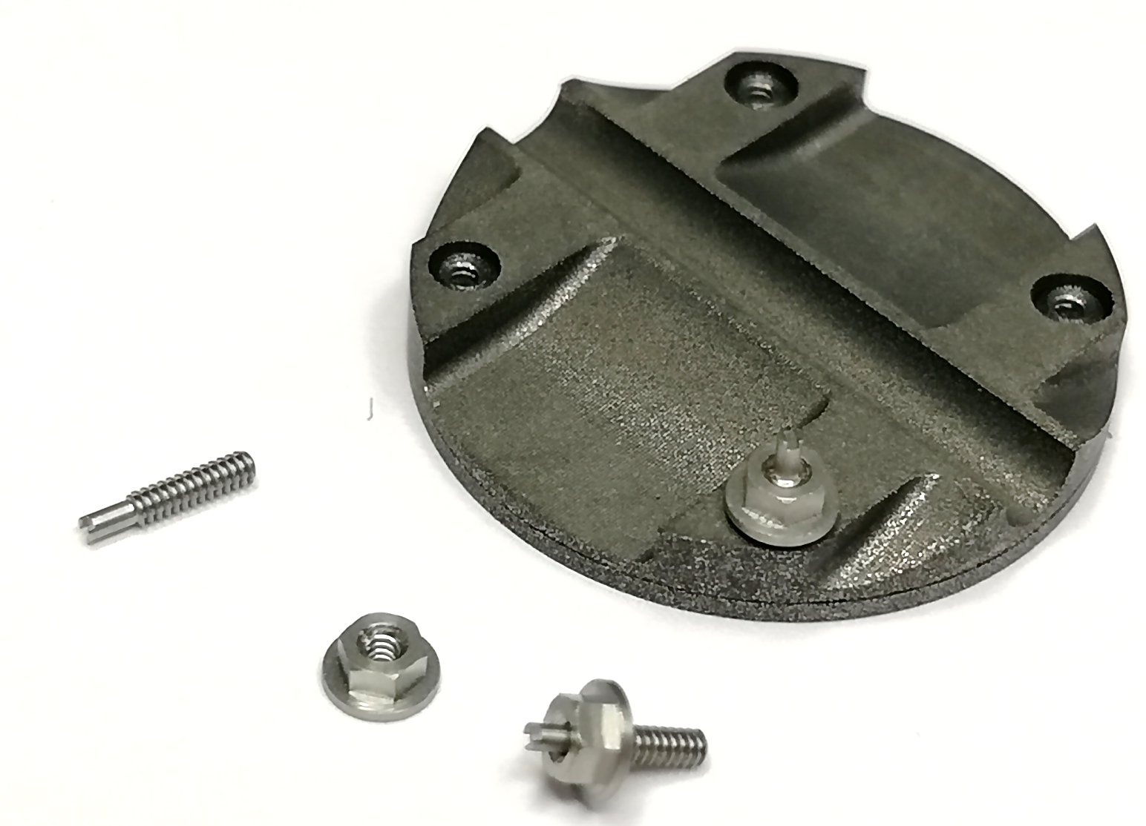
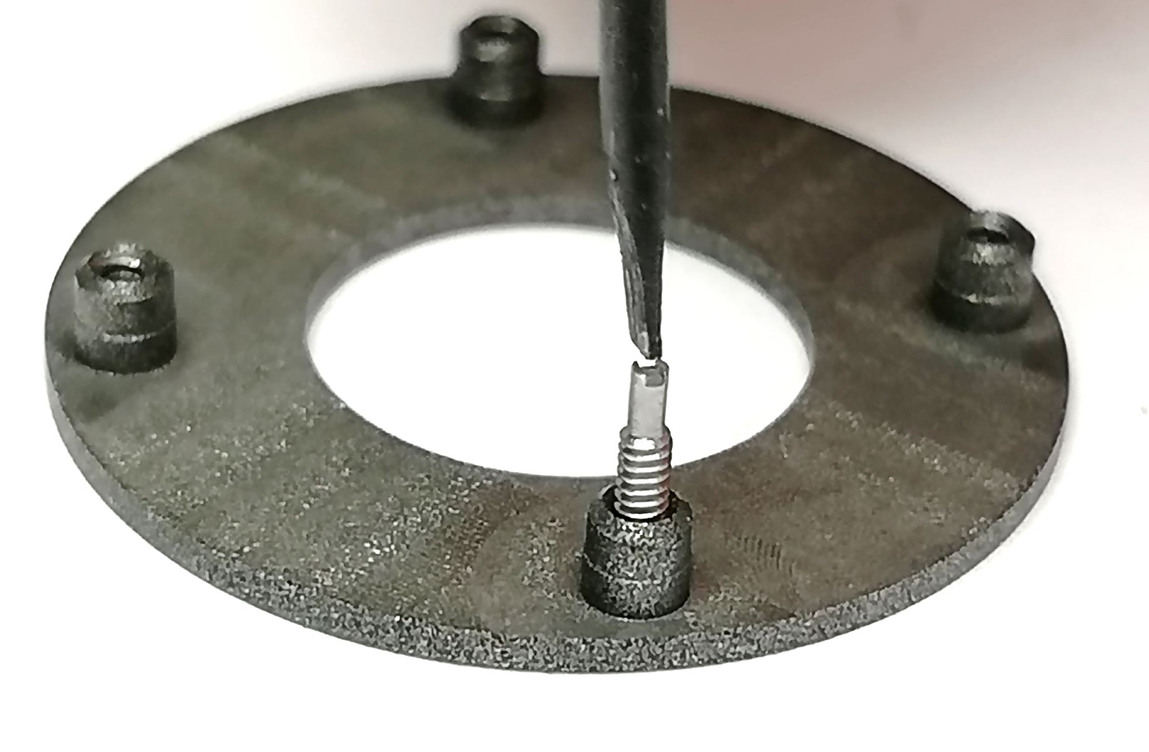
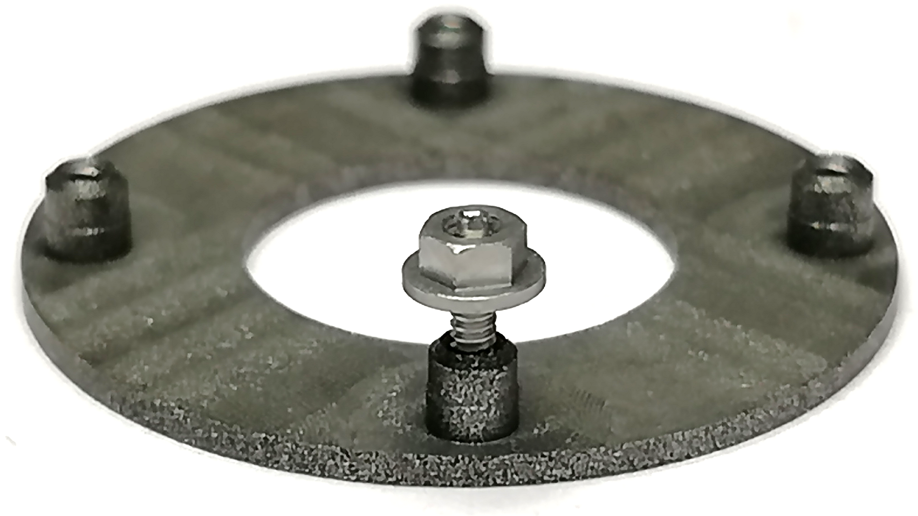
Cells integration
Screws design: Rod & nut concept proposition
  Installation procedure
    Screw the rods first into the cooling block
    Insert the cell on the base block
    Screw the nuts with dedicated tool on the rods
  Status
    M1 prototype batch (x20) from Crozet received
    Manual tests performed for rod and nut integration
    Tools TBD: to ease the rod insertion into the cooling block
        to handle the nut through the longeron structure
→ on table: cooling block threads saved, avoid any risk of damage inside the longeron
→ nut guided on the rod ensure straight insertion
    X16.000
    on the entire OB
09/01/2020
JP. Logier | M. Niclas | F. RIVIERE | E. Vigeolas
13

Slide 14
Thank you
Questions?
09/01/2020
JP. Logier | M. Niclas | F. RIVIERE | E. Vigeolas
14

