Slide 1
Base bloc metrological control
Eric Vigeolas 21/11/2019

Slide 2
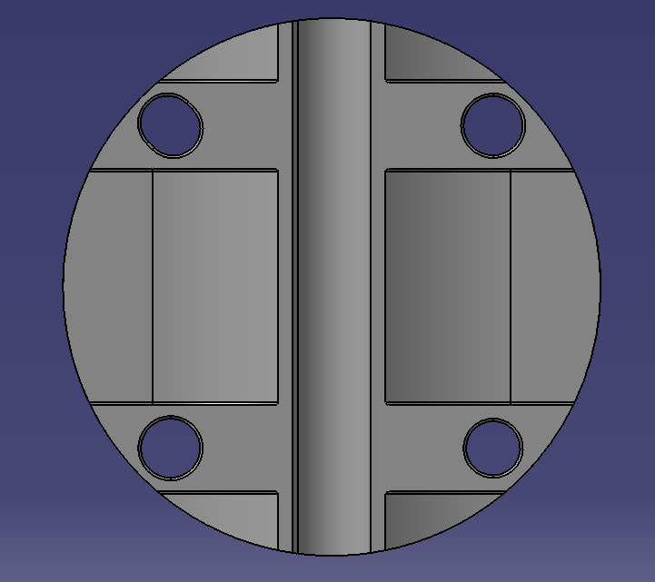
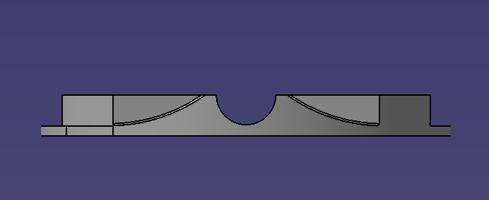
Measurement reference syst
Y
Z
X
X

Slide 3
Foreword
We received recently or 3D scanning syst, this is the first measurement trial with it so be indulgent
The second set of measurement (holes dimensions and positions) was made with the probind device which is more convenient for holes
Concerning the holes dimensions and position I give the coordinates, the diameter and the circularity in the reference measurement frame.

Slide 4
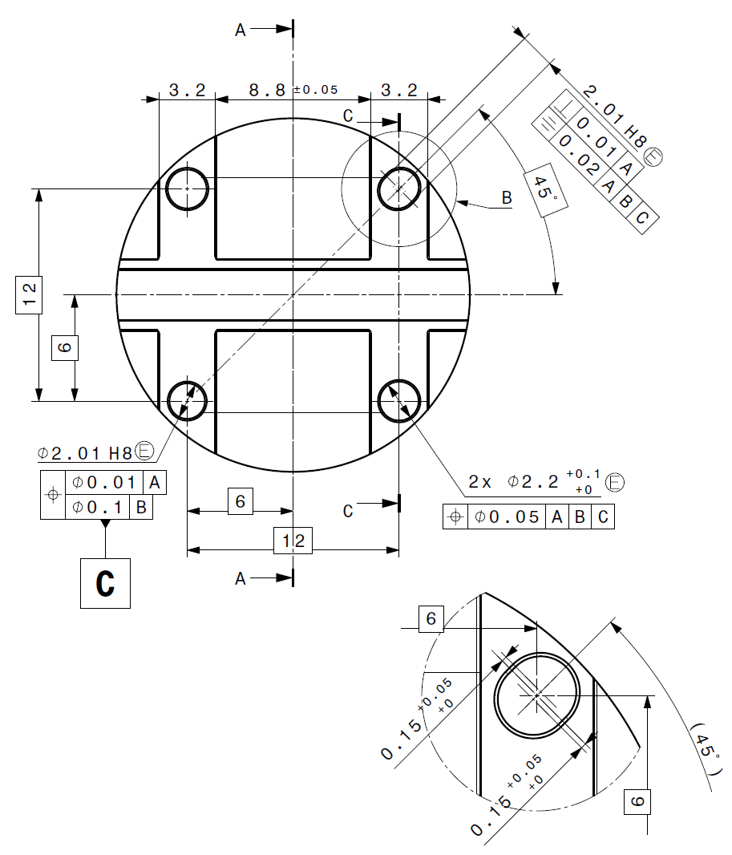
Holes measurements
Circle 1:
X=6.003
Y=6.001
Diameter=2.256
Circularity= 0.01
Circle 2:
X=6.001
Y=-5.999
Diameter=2.021
Circularity=0.012
Circle 3:
X=-5.993
Y=-5.996
Diameter=2.26
Circularity=0.014
Circle4:
X=-6.114
Y=6.124
Diameter=2.014
Circularity=0.014
Circle5:
X=-5.865
Y=8.873
Diameter=2.001
Circularity=0.006
Distance Cicle4/Cirlce5=0.352mm
Circle 3
Circle 1
Circle 2
Circle 4
Circle 5

Slide 5
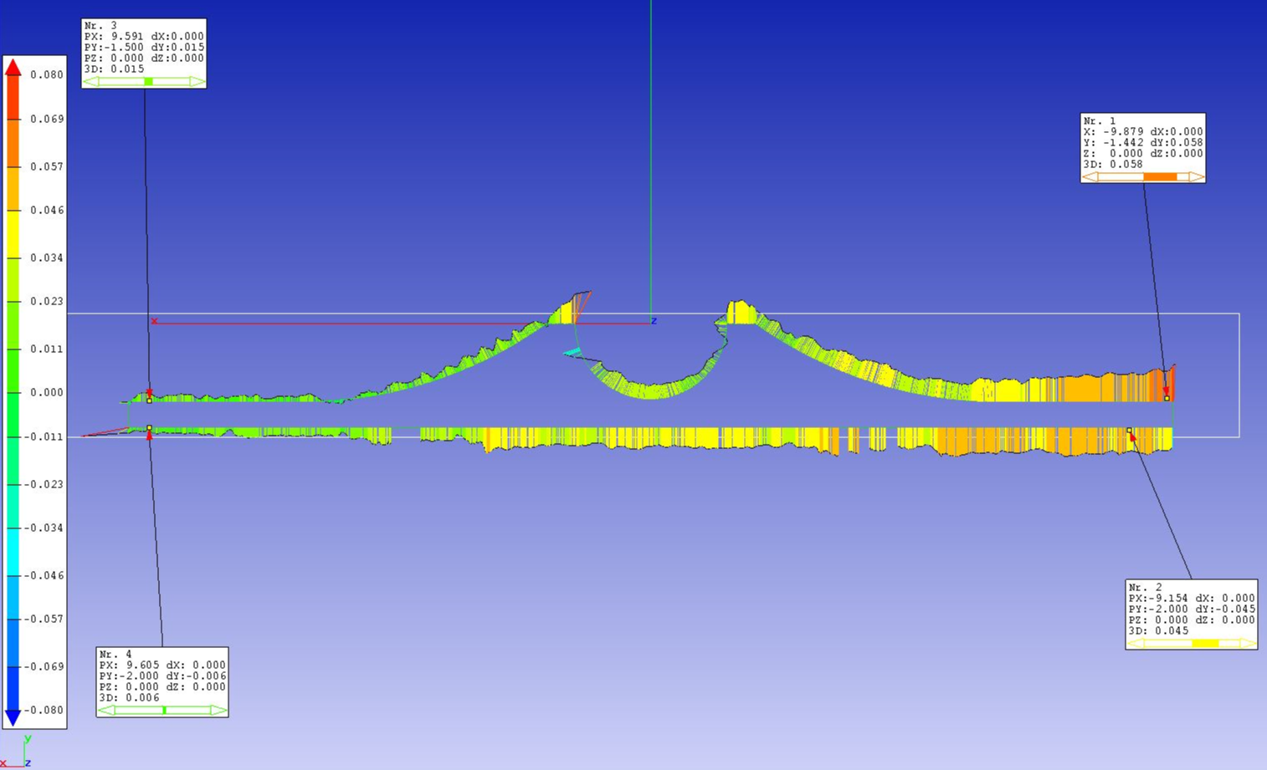
Profile scanning
We did a profile scanning of the base bloc it appear that the two faces are not //
This will have to be confirmed with traditional probing measurements
The following plot shows the dispersion from CAD model
There is artefacts in the corners which should not be taken into account

Slide 6
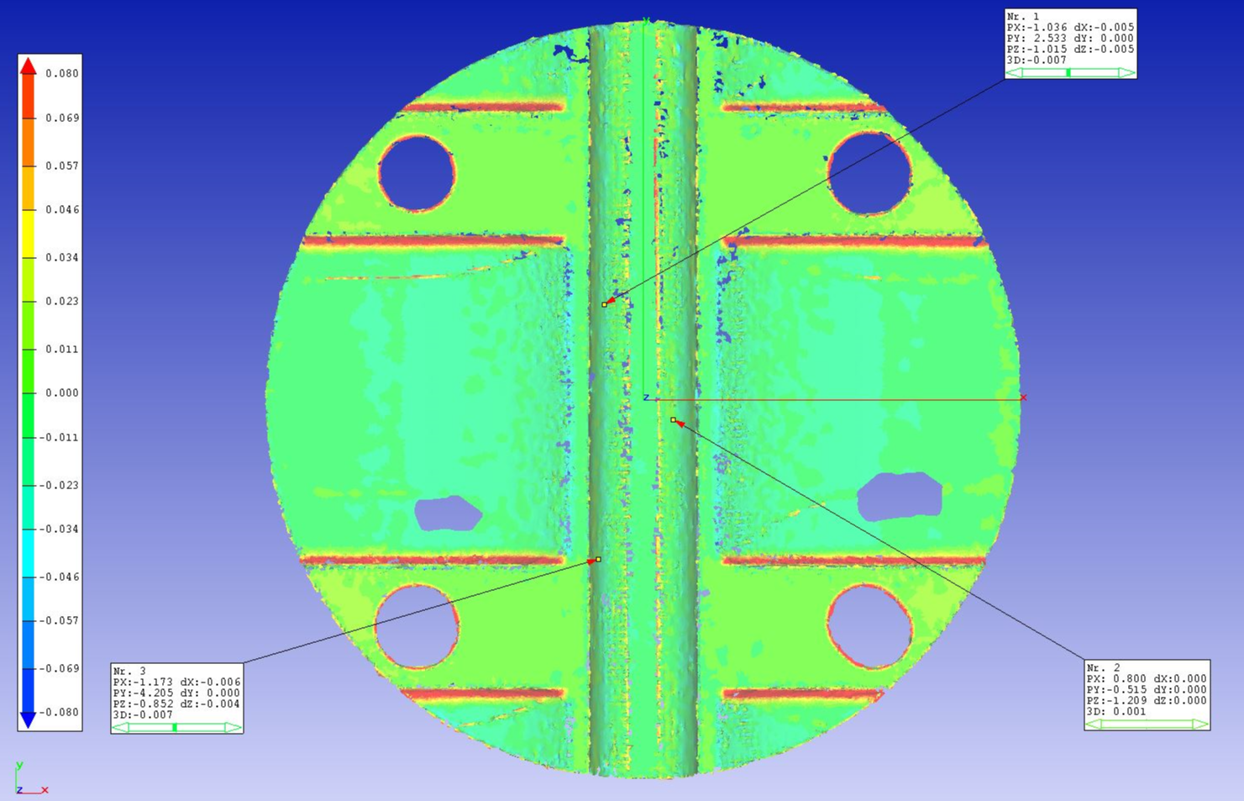
Face Scanning
Distance from ideal CAD surfaces very good within 0.02 mm
Corners should not be taken into account

