Slide 1
Projet SIRIUS
Digital Feedback Charge Sensitive Preamplifier for the Tunnel detector (DFCSP)
N. Karkour and the SIRIUS Collaboration

Slide 2
Outline
SIRIUS Presentation (collaboration, funds, WP Structure)
DFCSP Front End Electronics for the Tunnel detector,
SIRIUS Si detector Back End Electronics
DFCSP Tunnel Firmware
Conclusion and Future roadmap

Slide 3
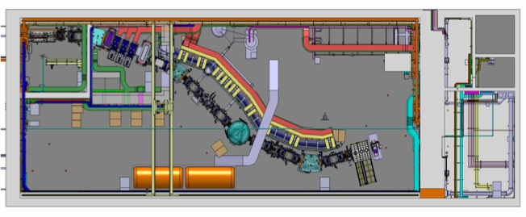
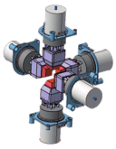
SIRIUS in S3 Hall
Final focal plane Selection & Identification
Time of flight + Energy measurement
Beam
Mass spectrometer
momentum achromatic
2015-2021 : SIRIUS Construction phase Funded from CPIER Contract (La region Basse Normandie Vallée de la Seine)
Partners : IRFU - GANIL – IN2P3 (CSNSM- IPHC-IPNO)

Slide 4
SIRIUS Technical challenges
Si detectors technical specifications
  Total detector Counting rate 10 kHz (100 Hz/channel)
  High energy : 10 MeV to 200 MeV Resolution FWHM 1 %
  Low energy : 100 keV to + 15 MeV FWHM < 20 keV @ 8 MeV.
  Timing resolution 1 ns between TOF and FP
  Electron and escaped alpha detection and identification
Gamma detection: 5 EXOGAM clovers with electronics
Trigger system and architecture :
  Triggerless system with Time stamping

Slide 5
S³ MB
S³ collaboration
board
SIRIUS WP
Structure
2 Focal plane
F. Le Blanc (IPHC)
2.2 Front end DSSD
T. Chaminade (IRFU)
2.3 Silicium Tunnel
O.Dorvaux (IPHC)
2.4 Front end Tunnel detector
N. Karkour (CSNSM)
2.6 Mechanics infrastructure
T Goeltzenlichter(IPHC)
3 Back-End
K. Hauschild (CSNSM)
3.1 Tracker
(BEAST)
G. Wittwer (GANIL)
4 Data Acquisition system
F. Saillant (GANIL)
4.1 Electronic control core
S. Coudert (GANIL)
4.2 Run Control
F. Saillant (GANIL)
4.3 Data Flow
C. Maugeais (GANIL)
4.5 Daq Infrastructure
G. Lebertre (GANIL)
5 Assembly, Integration & test in S3 Hall
J. Piot / S. Herlant (GANIL)
5.1 Detectors mechanical integration
(Tracker & Focal plane & Ge)
F. Lutton (GANIL)
5.2 Control command and Vacuum system (GANIL)
6 Simulation & Data analysis
A. Lopez-Martens (CSNSM)
6.1 Simulation & performances
K. Hauschild (CSNSM)
3.4 DSSD Firmware
H. Leprovost (IRFU)
5.3 EMC and power supply
N.Karkour
6.3 Data analysis
J. Piot (GANIL)
3.3 FADC-DAC development
D. Linget (CSNSM)
3.2 Production Hardware Numexo2
A. Boujrad (GANIL)
3.5 Tunnel Firmware
X. Lafay (CSNSM)
3.6 GTS & Trigger
A. Boujrad (GANIL)
2.1 Detector DSSD& Veto Detector
Theisen/Sulignano (IRFU)
2.5 Germanium detector
K.Hauschild (CSNSM)
5.4 Test & Commissioning of the whole system
J. Piot / S. Herlant (GANIL)
6.2 System validation for physics
A. Lopez Martens (CSNSM)
4.4 Data analysis tool
L. Legeard (GANIL)
SIRIUS Management
Project coordinators: B. Sulignano (IRFU)
Project Manager: F. Le Blanc (IPHC)
Technical coordinator: N. Karkour (CSNSM)
Spokespersons (GANIL, IPHC,CSNSM,IRFU)
1.2 Front end electronic
J. Pancin (GANIL)
L. Caceres (GANIL)
1 Tracker/Diagnostic Box
J. Pancin/L. Cáceres (GANIL)
1.1 Detector
S. Herlant (GANIL)
L. Caceres (GANIL)
1.3 Mechanics
F. Lutton (GANIL)
SIRIUS collaboration board
O. Dorvaux IPHC
K. Hauschild CSNSM
J. Piot GANIL
B. Sulignano IRFU

Slide 6
SIRIUS Instrumentation Architecture
BEAM

Slide 7
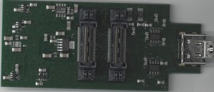
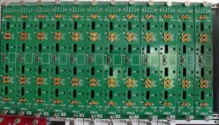
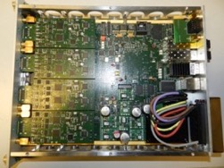
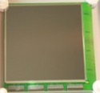


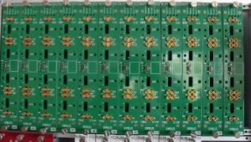
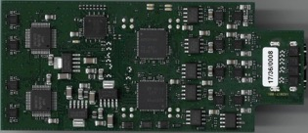
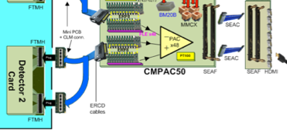
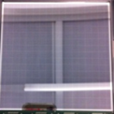

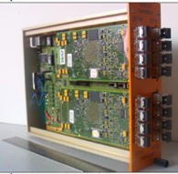

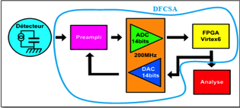
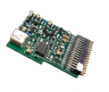
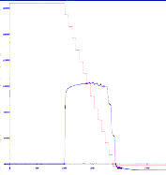

WP2 WP3: Focal Plane Instrumentation
Low gain resolution | 65kev
High gain resolution | 21keV
Linearity | <1.5%
Dead time | 2,5µs
Power by detector | 30W
DSSD Instrumentation 256 Channels (FPCSA)
Tunnel instrumentation 96 Channels (DFCSP)
4 x 64 pixel Si Detector
WP 3.2 : Numexo2 modules
WP3.4 et WP 3.5 FW DSSD and Tunnel
WP3.3: FADC-DAC
WP2.2: DSSD FEE
6 * 16 channels Numexo2 boards
CSP Output
WP2.1: DSSD
switching a feedback capacitor for changing the gain as a function of output signal level
HI/LO Gain Switch
WP2.4: Tunnel FEE
CSP Output
WP2.3: Tunnel
CMPAC50
Feedback Control
High Energy resolution using DFCSP From 20 to 500 MeV | < 0,1 %
Linearity on overall range | < 1.5%
Dead time | < 5 µs
High gain resolution @ 8 MeV | 13,5 keV
High gain resolution @ 500 keV | 9,5 keV
Linearity | < 0,8 %
Dead time using MWD | < 8 µs
DFCSP block
WP 3.6:
Trigger SYSTEM
GTS tree:
GTS NIM Carriers
DFCSP
CSP
FPGA
GTS V3 Mezzanine

Slide 8
DFCSP FEE for the Tunnel detector
From Tunnel detector to Numexo2
V. Alaphilippe, L. Gibelin, N. Karkour, and lot of Internship

Slide 9
DFCSP basic principle
IN
Q_{LE}
Q_{HE}
V_{LE}
Cd
Rf
FADC DAC plus Numexo 2
I
Cf
FPGA
High Energy charge compensation stage
- Q_{HE}
Cc
DAC
14 bits
100 MHz
TEST
50Ω
PACS3
15MeV < E_{HE} < 500 MeV
Cc = 20 pF = > G ≈ 2mV/MeV
Constraints :
2 signals par channel OUT to ADC and In from DAC.
Very high Integration and low coupling between input and output signals
Extreme Low noise signal integrity (few 10s of µV per LSB 14 bits)
Differential signal transmission over 10 m from FEE to BEE
-7,5 MeV < E_{LE} < 20 MeV
Cf = 1 pF = > G ≈ 44 mV/MeV
Rf = 50 MΩ => τ = 47 μs

Slide 10
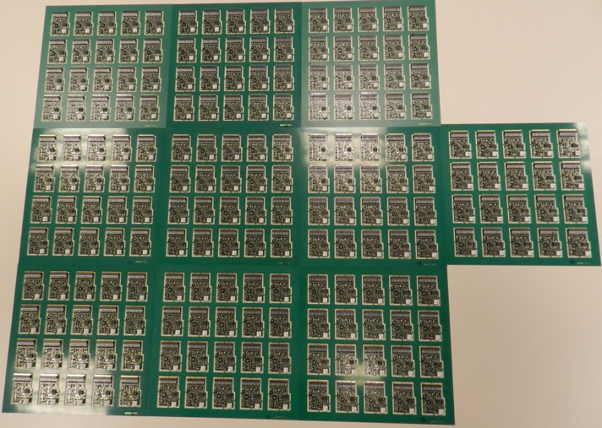
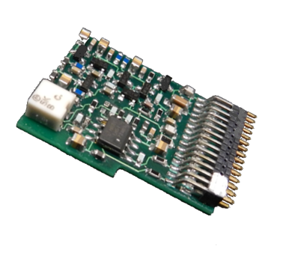
PAC S3
21 / 10 / 16
Collaboration with GANIL
200 CSP produced
Low Energy Spectra 6 MeV alpha source @ IPHC
44 mV/MeV
Range: 30 keV to 60 MeV
< 5keV intrinsic resolution
@ 300 keV electron energy :
9 keV Si detector total resolution is 10.3 keV with the CSP
@ 6 MeV alpha energy :
12 keV detecor resolution 13 keV with the CSP.

Slide 11
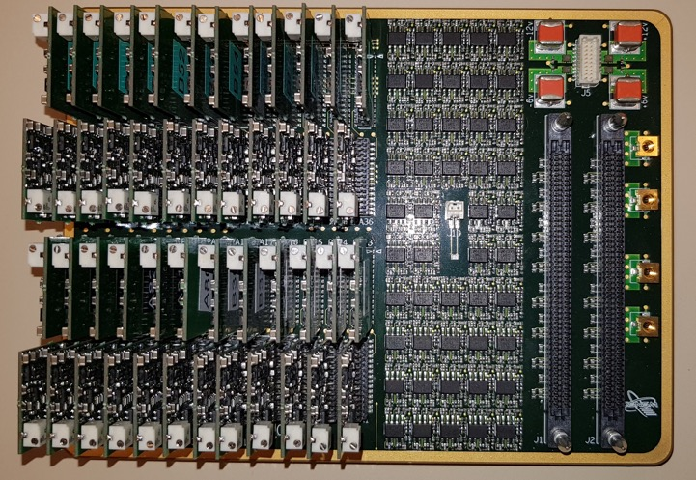
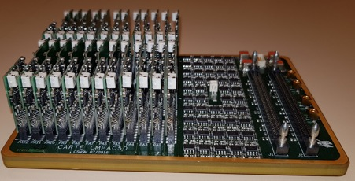
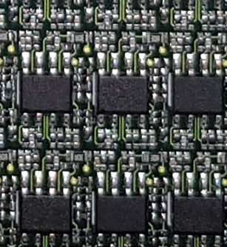
CMPAC 50
48 CSP Mother board
48 Feedback input
48 detector signal processing from vacuum side
signal integrity and Xtalk in a small area of 110 x 160 mm
Top side is in the air bottom side is in vacuum.
20 layers 7 drill sequences 120 µ isolation
6mm thickness with 0.4 mm via !.
All vias are filled for vacuum (10⁻⁷ mbar) constraints.
Mixed types of components very small SMD next to huge 80 mm 200 pin BGA like connecteurs.
Complex Assembly solder thermal cycle (connectors and pcb flatness issue, 12 plane layers).

Slide 12
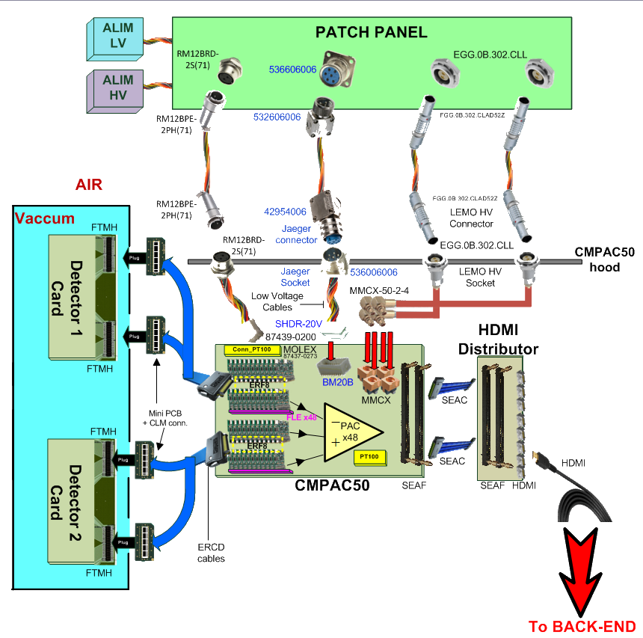
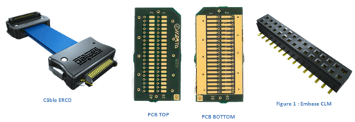
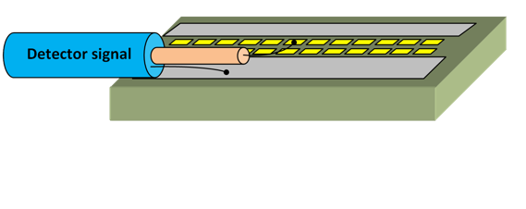
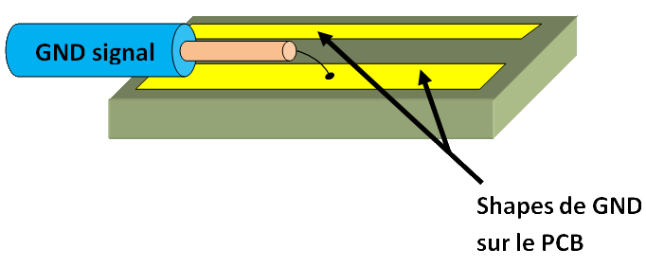

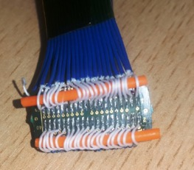
INTERCONNECTIONS
21 / 10 / 16
Detector connections

Slide 13
Si Focal plane Backend Electronic
Flash ADC-DAC Mezzanine development
D. Linget, N. Karkour, L. Gibelin, V. Alaphilippe, X. Lafay and Internships

Slide 14
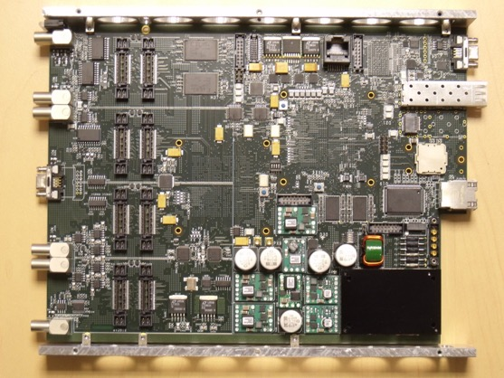
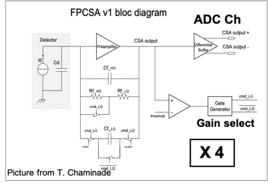
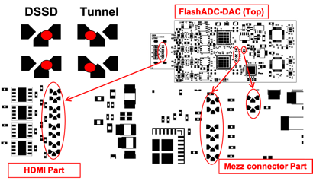
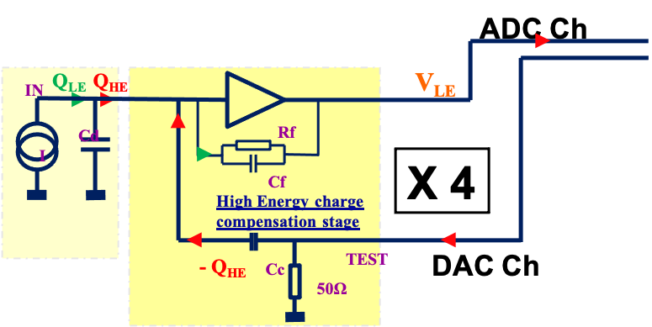
Tunnel detector BEE Configuration
Collaboration with GANIL and IFIC Valencia Spain
16 channels
2 Hardware configurations using solder jumpers
Numexo2 card
Constraints :
Very high integration board, XTalk and Low noise
Components >80% of pcb Area.
14

Slide 15
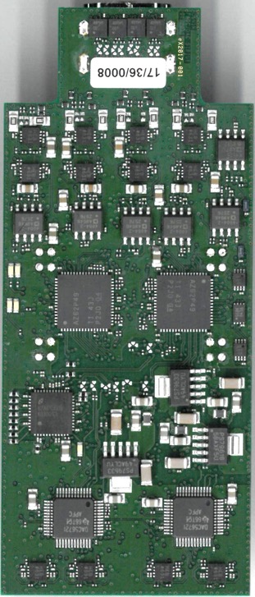
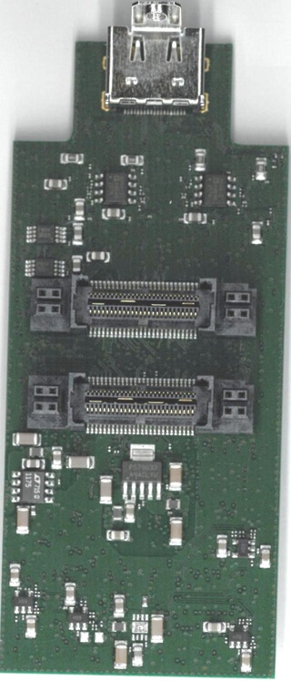
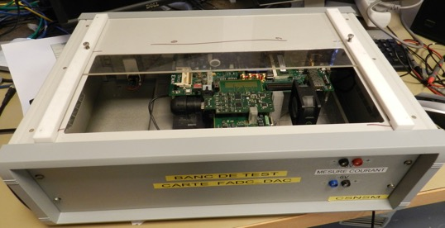
Flash ADC and DAC Mezzanine
Production:
Test bench designed
100 FADC DAC produced tested and mounted.
FADC DAC Production Test Bench

Slide 16
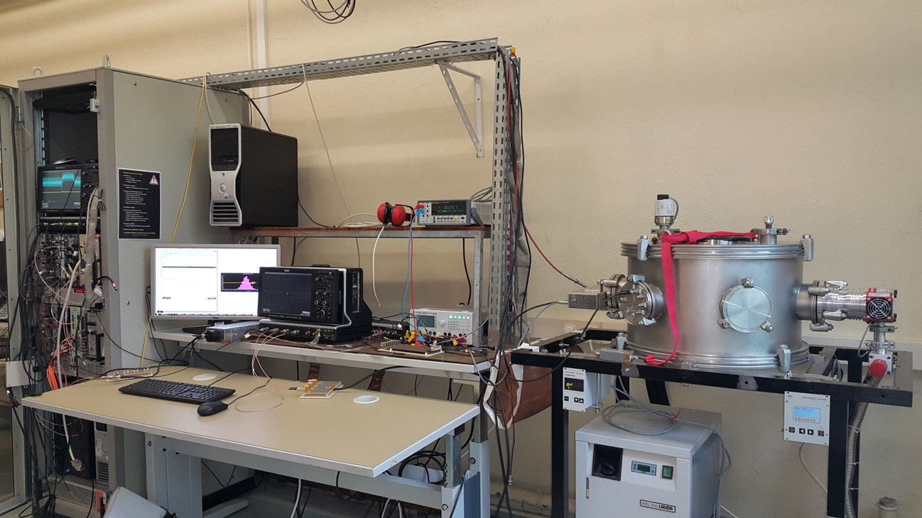
BANC DE TEST DFCSP FEE and BEE
21 / 10 / 16

Slide 17
Firmware tunnel
Firmware numexo2 + ADC_feedback

Slide 18
DFCSP basic principle
IN
Q_{LE}
Q_{HE}
V_{LE}
Cd
Rf
FADC DAC plus Numexo 2
I
Cf
FPGA
High Energy charge compensation stage
- Q_{HE}
Cc
DAC
14 bits
100 MHz
TEST
50Ω
PACS3
15MeV < E_{HE} < 500 MeV
Cc = 20 pF = > G ≈ 2mV/MeV
Constraints :
2 signals par channel OUT to ADC and In from DAC.
Very high Integration and low coupling between input and output signals
Extreme Low noise signal integrity (few 10s of µV per LSB 14 bits)
Differential signal transmission over 10 m from FEE to BEE
-7,5 MeV < E_{LE} < 20 MeV
Cf = 1 pF = > G ≈ 44 mV/MeV
Rf = 50 MΩ => τ = 47 μs

Slide 19
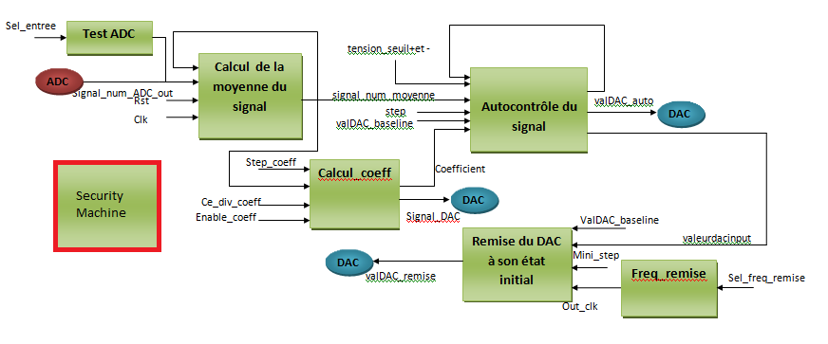
feedback IP Block
Etot = n x Step + residual

Slide 20
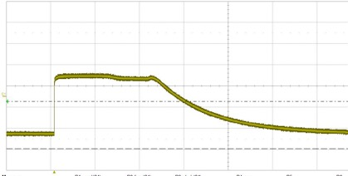
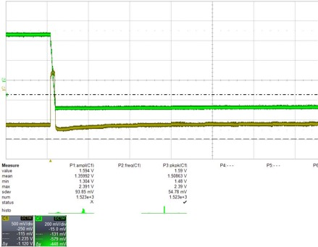
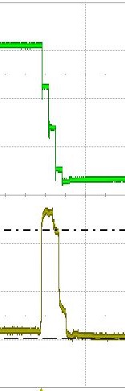
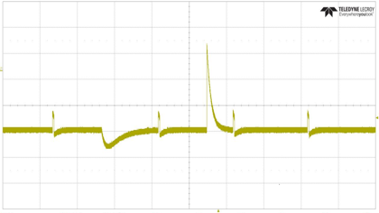
IP feedback
Charge retrived . CSP is discharged to 0 level
Saturating CSP @ High Energy.
DFCSP retrieves that charge
Autocontrol Zoomed image
Coefficient Calculation for residual charge left
8192 pulses are sent and 8192 ADCmax values obtained and added.
20 µs
DAC
Step_coeff
1 ms
max
ADC

Slide 21
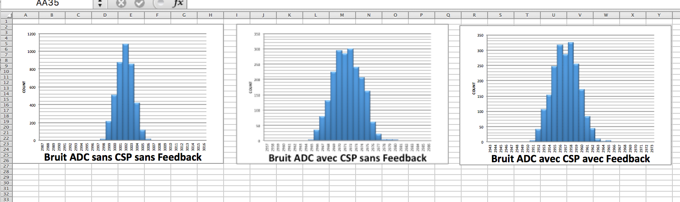
Baseline Spectra measurements to see the Hardware effect
75 MeV
110 MeV

Slide 22
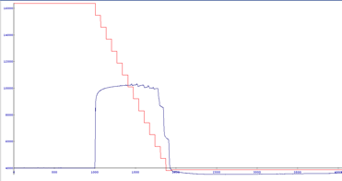
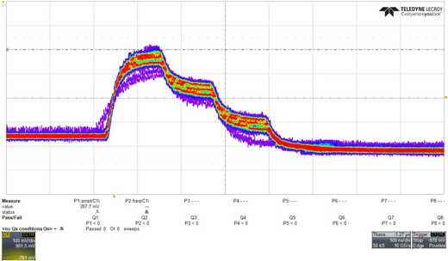
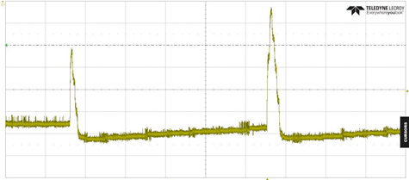
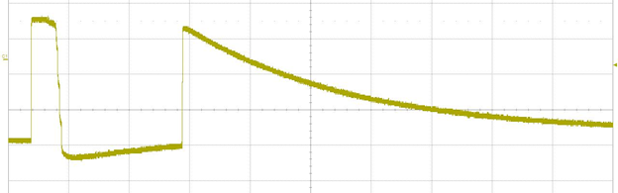
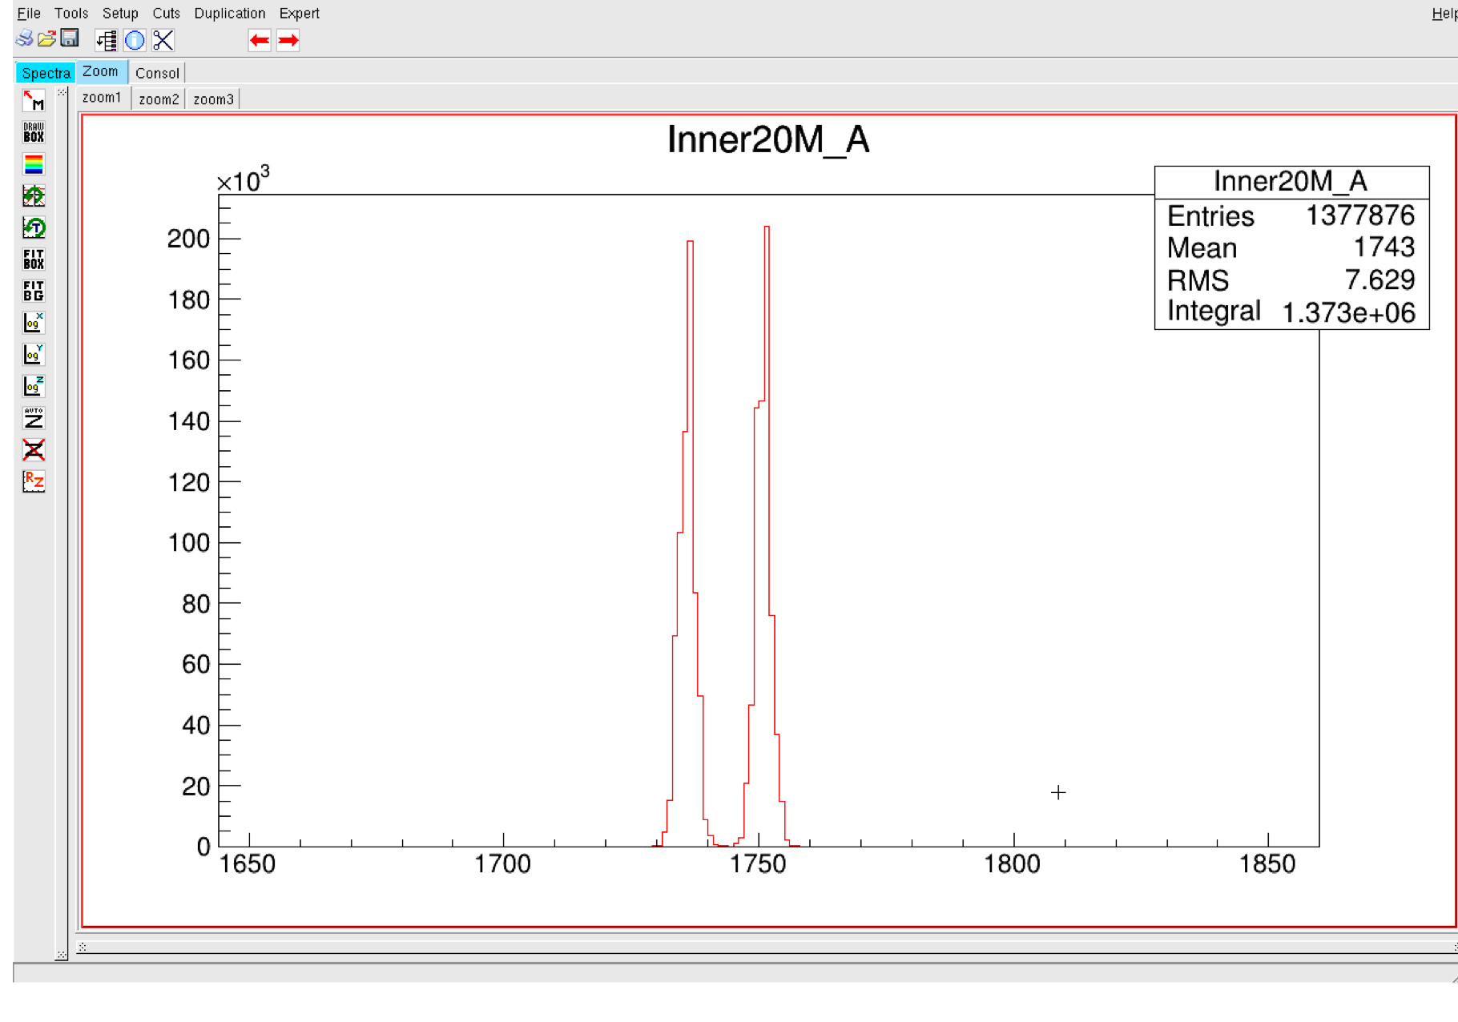
Tests de résolution et de fonctionnements annexes
Digital data processing events
Random events using alpha source
DAC
ADC
Vin_Preamp = 18.86mV @ channel 1736
Vin_Preamp = 19.02 mV @ channel 1751
10.53µV par LSB.
FWHM = 4 canaux sur 16000
Précision = 1/4000 (pour un cdc à 1/100)
High energy followed by a low energy
High energy followed by another High energy

Slide 23
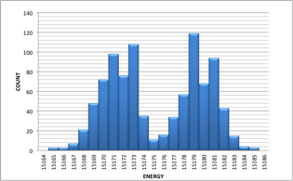
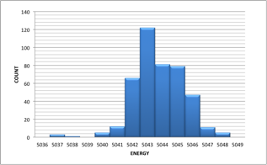
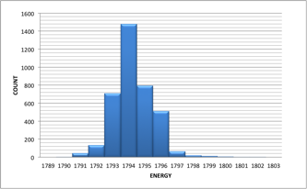
Resolution and Integral non linearity avant correction
Tests avec attenuateur entrée géné fixe :
Att: 30 dB E = 139 MeV FWHM 110 keV
Att : 40 dB E = 46,1 MeV FWHM 36 keV
Linéarité : -8%
Att : 50 dB E = 16,4 MeV FWHM 27 keV
Linéarité : -15% ☹

Slide 24
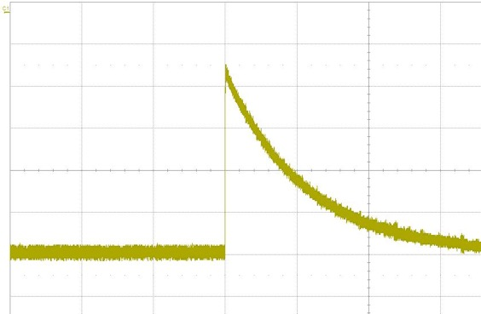
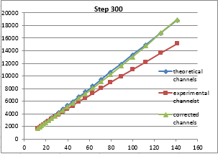
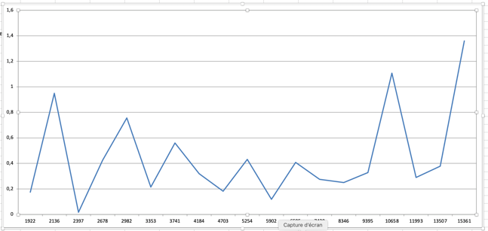
Energy Correction IP
The CSP decaytime is 50 µs The exponential equation V=V₀ e^{-tRC} .
During DFCSP algorithm there is an energy loss.
calculation of the lost energy and add it to the raw energy.
  E_{raw} is the feedback energy injected through the DAC.
  V₀ = E_{raw}* e^{tRC})
RC = 50 M * 1 p, Find t. t= number of steps *timereg *clock period. Deduce e^{tRC}
Energy Loss
Total Energy
Raw Injected Energy
Linearity is submitted to huge number of iterations and acquisitions to choose the right parameter. Each channel has its own calibration value. Automatic calibration is needed before each run to make sure that the signal measurement is perfectly calibrated
INL < 1,2 % after correction

Slide 25
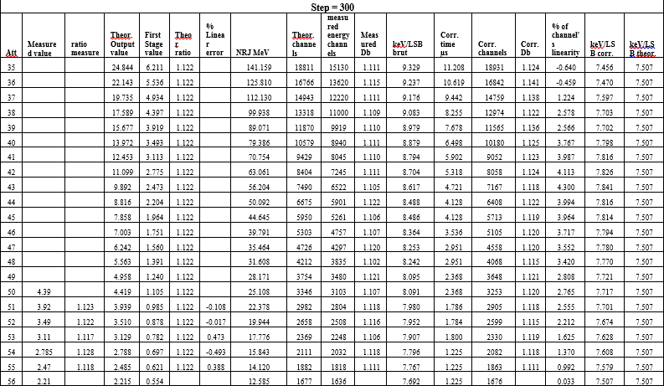
Results of the qualification of the code for step 300

Slide 26
Existing V6 from Exogam2 Firmware modifications
Collaboration with GANIL
IP Feedback
4 channels
DAC FEEDBACK
FPGA V6
DSP IP
COMPUTED Information :
Energy
Time
Shape
Mirror charges
TRIGGER
REQUESTs (16)
ISERDES IP
Deserialized
RAW SAMPLES
READOUT IP
BUILD of FRAMES:
event
oscilloscope
RAW DATA
LOW SPEED
DATA FLOW
EVENT DATA
ASYNCHRONOUS
(16 bits)
< 100 Mb/s
OSCILLOSCOPE IP
4 circulars buffers of 32KB
triggered
OSCILLOSCOPE DATA
HIGH SPEED
DATA FLOW
SETUP_IP SIRIUS
SYNCHRONOUS (8bits)
INSPECTIONS IP
ANALOG &
DIGITAL INSPECTIONS
REGISTERS VALUES
400 MB/s
SPI (Serial link)

Slide 27


Internship was important in the project progress

Slide 28


SIRIUS Now
IRFU 2020
GANIL 2021

Slide 29

QUESTIONS
21 / 10 / 16

