Slide 1





STARE
(Serial Transfert Acquisition and Readout over Ethernet)
un transfert de données à 4*10Gb/s pour
AGATA
Electronic : C. Esnault (CE), L. Gibelin (LG), N. Karkour (NK), X. Lafay (XL), D. Linget (DL)
Computing : N. Dosme (ND), S. Elloumi (SE), E. Legay (EL), M. Taurigna
Students: M. Cahoreau (MC), G. Vinther-Jørgensen (GV)

Slide 2
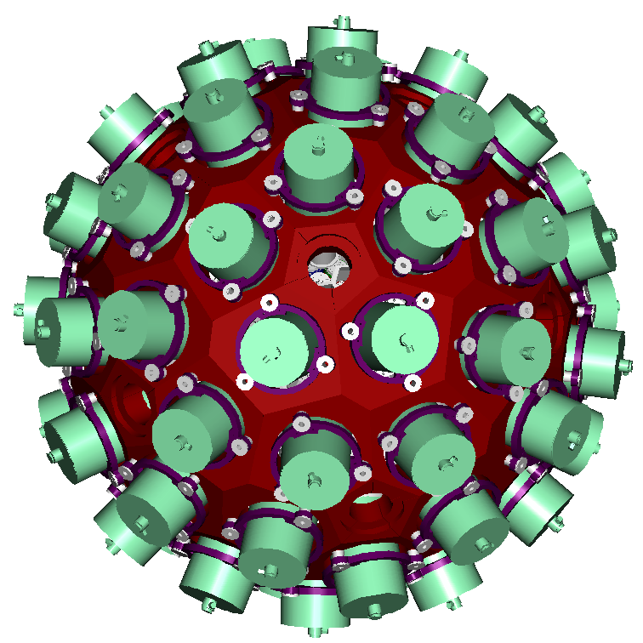
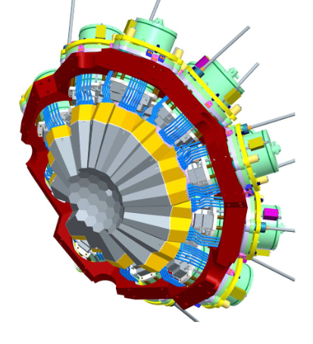











AGATA project
http://www.agata.org
http://agata.in2p3.fr
180 segmented crystals (60 triple clusters)
362 kg of Ge
82 % solid angle
50 kHz Ge crystal counting rate
Energy resolution & range: ~0.2%, 5 keV-180 MeV
Angular resolution : ~1º
Efficiency: 35 % (M_{γ}=1) , 20% (M _{γ} =30)
Pic/Total: 50%(M_{γ}=1), 40% (M_{γ}=30)
Mobile detector
Large inner radius to accommodate ancillary devices

Slide 3
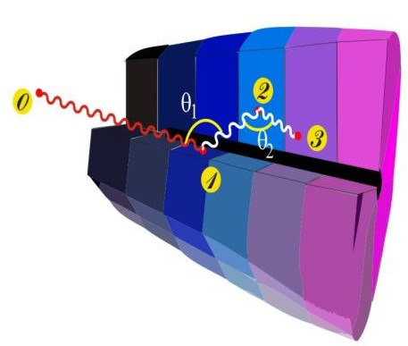
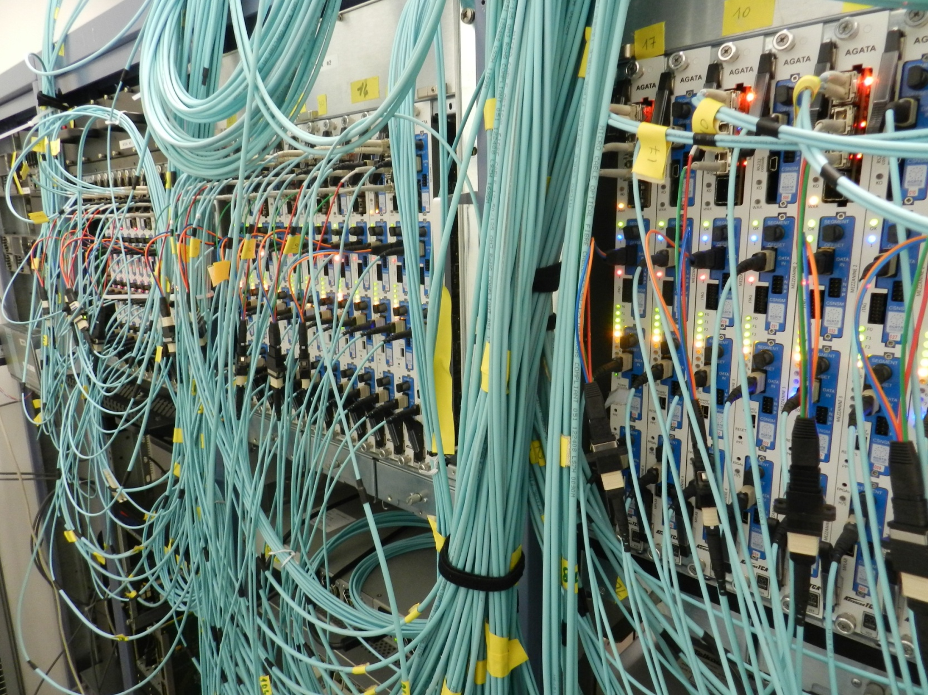
Tracking ingredients
Preprocessing
Identified interaction points
900 MB/s
4
1
36-fold segmented +
CORE
50 kHz event rate/detector
100-sample traces/segment
Reconstruction of photon trajectories by tracking algorithms
(x,y,z,E,t)_{i}
2
3
100 Mhz, 14 bit sampling of segment and central contact signals
1,3 TB/s/detector
<100 MB/s
200 MB/s/segment
7600 MB/s/crystal
reconstructed -ray energies,
emission & scattering directions

Slide 4
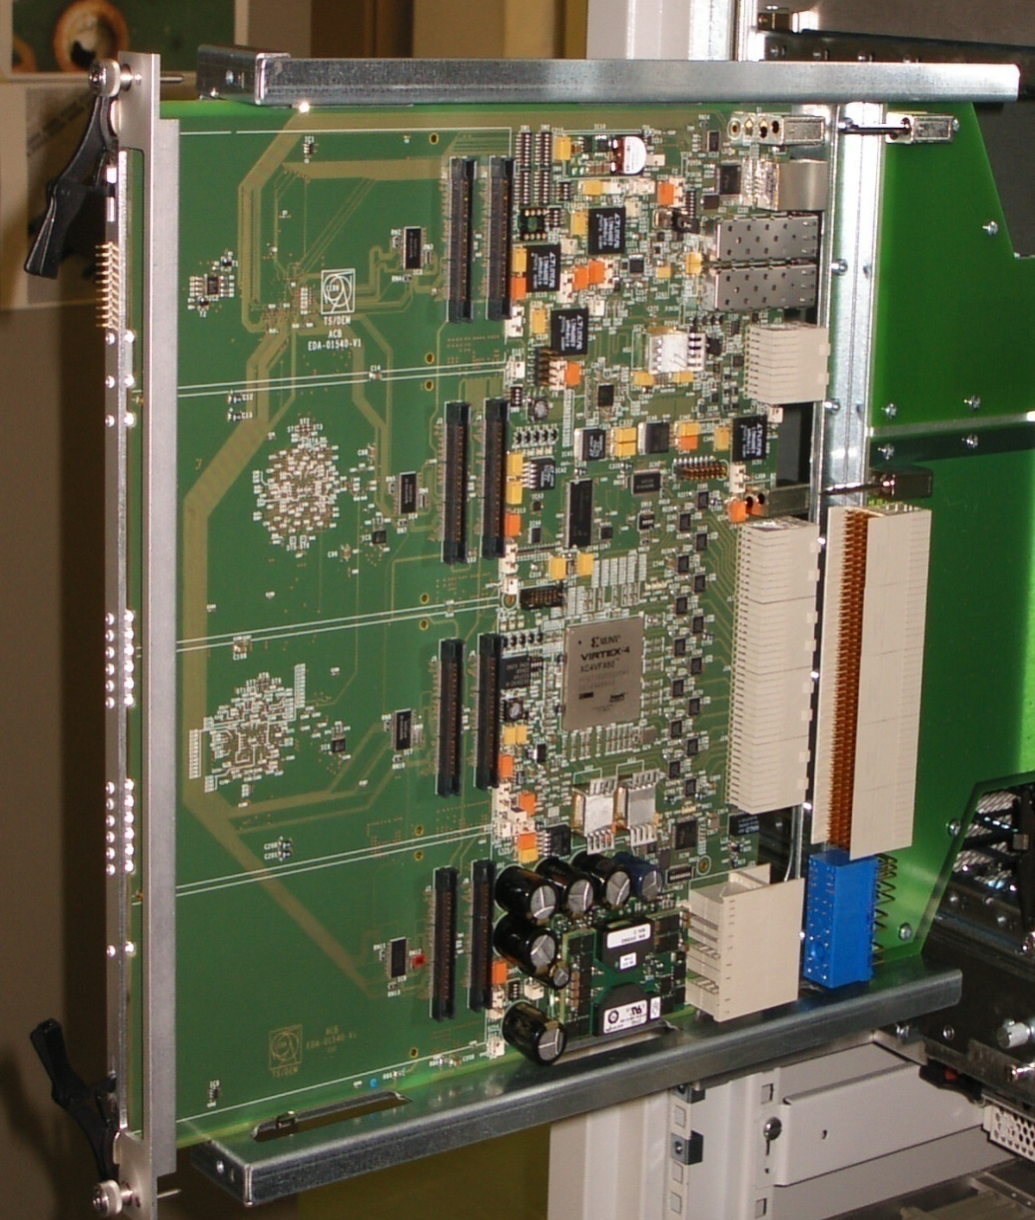
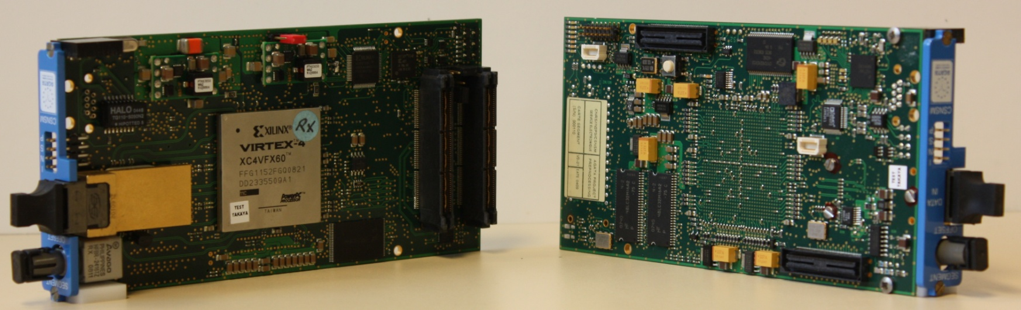
Pre processing 1 crystal phase_0
2 * Carrier (3 FPGAs)
1 * GTS (1 FPGA)
7 * Mezzanines (1 FPGA)
1 Linco (1 FPGA)

Slide 5
Pre processing 1 crystal new electronics
Hardware: IFIC Valencia
IJCLab Orsay
INFN & U. Milano
STARE
Firmware: IPHC Strasbourg

Slide 6
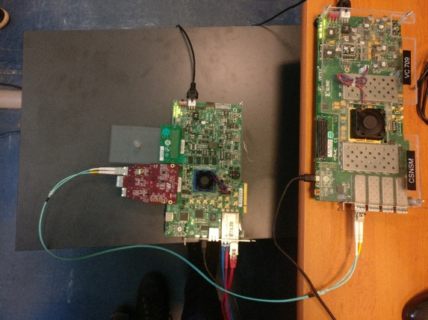
Firmware developments
February – September 2019
Based on code provided by David Sidler (ETH Zurich) and IPBus firmware from CERN (VC709)
=> tested with the CSNSM 10 Gbps network data flow and validate the UDP for AGATA DAQ.
Port the code from the VC709 to the KCU105
As decided by the FEE WG, the future AGATA electronics will be based on the SOM technology plus dedicated carrier boards.
STARE will be composed of a KU040 SOM module plus an FMC based dedicated carrier board.

Slide 7
STARE characteristics
FMC vita 57.1
Input data rate from pre-processing : 4 x 10 Gbps (Aurora).
2 Power supply sources (Internal and external PSU using hot swap mux)
Spare LVDS I/O with the pre-processing for future use
Full clock management inside the SOM and the FMC carrier (SI5338).
Network Bandwidth up to 4 x 10 Gbps in parallel.
1 Gbps IPBus for slow control or slow control coming through SPI.
With this configuration it is absolutely easy to achieve continuous and comfortable 10 Gbps with monitoring and online analysis using multiple 10 Gbps Tx/Rx.

Slide 8
STARE characteristics
EXT Power
Power Manager & Muxs
System On Module
STARE FPGA
KINTEX7
KCU040
10 Gb Transceiver
PACE - FMC Interface
Readout data
4 x 10 Gbps Tx/Rx
Monitoring data
LVDS lines & IPbus
Futur use data flow
CLK generator
IPBUS Slow Control
CLK generator
UDP External Memory

Slide 9
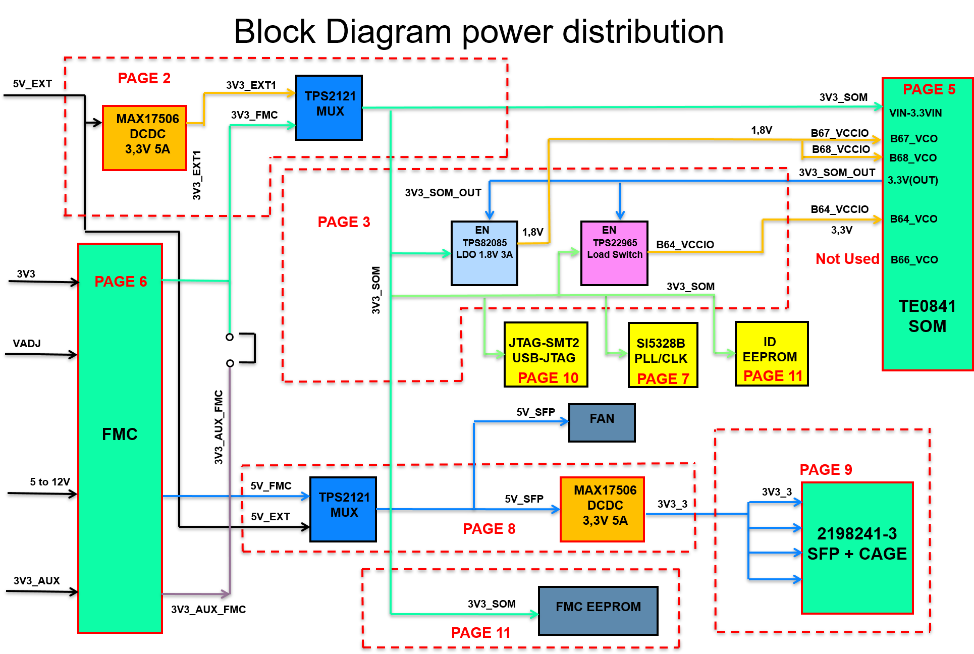
STARE prototype

Slide 10
STARE Prototype Design
Steps during 2020 (Covid constraints):
Design schematic (DL, NK, XL, CE) : Power management, Reset management, SOM-FMC Interface (meetings with PACE people), Mechanical constraints (meetings with PACE People) ➔ During the first confinement - Spring 2020.
PCB placement, footprints creation, PCB routing (LG, DL, NK) ➔ Summer 2020
PCB manufacturing and purchase components ➔ Autumn 2020
PCB cabling ➔ Winter 2020-2021
First delivery : first 5 prototypes ➔ beginning February 2021.
Second delivery: last 5 prototypes ➔ Middle March 2021.
Due to Covid19 : company in 60% of FTE mode

Slide 11
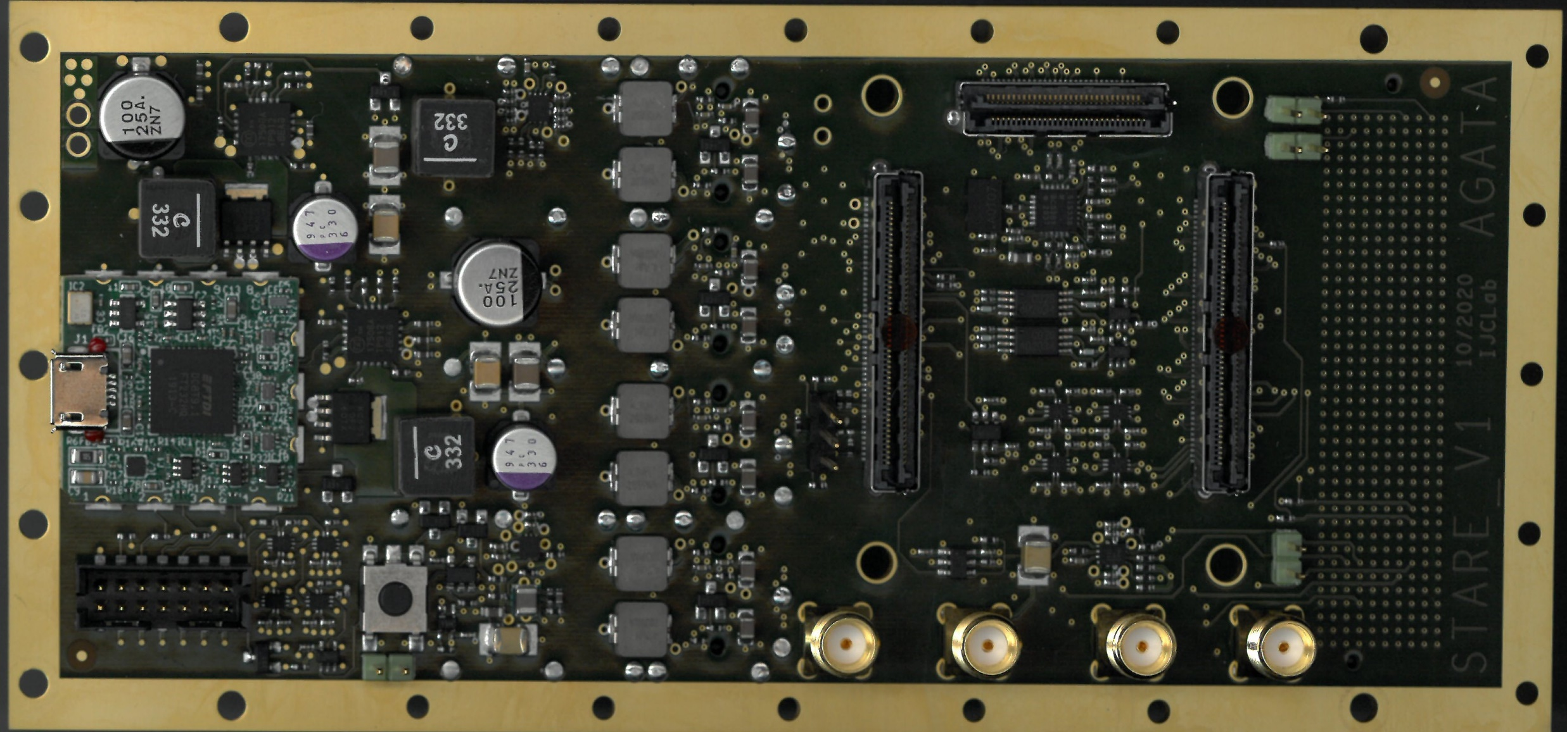
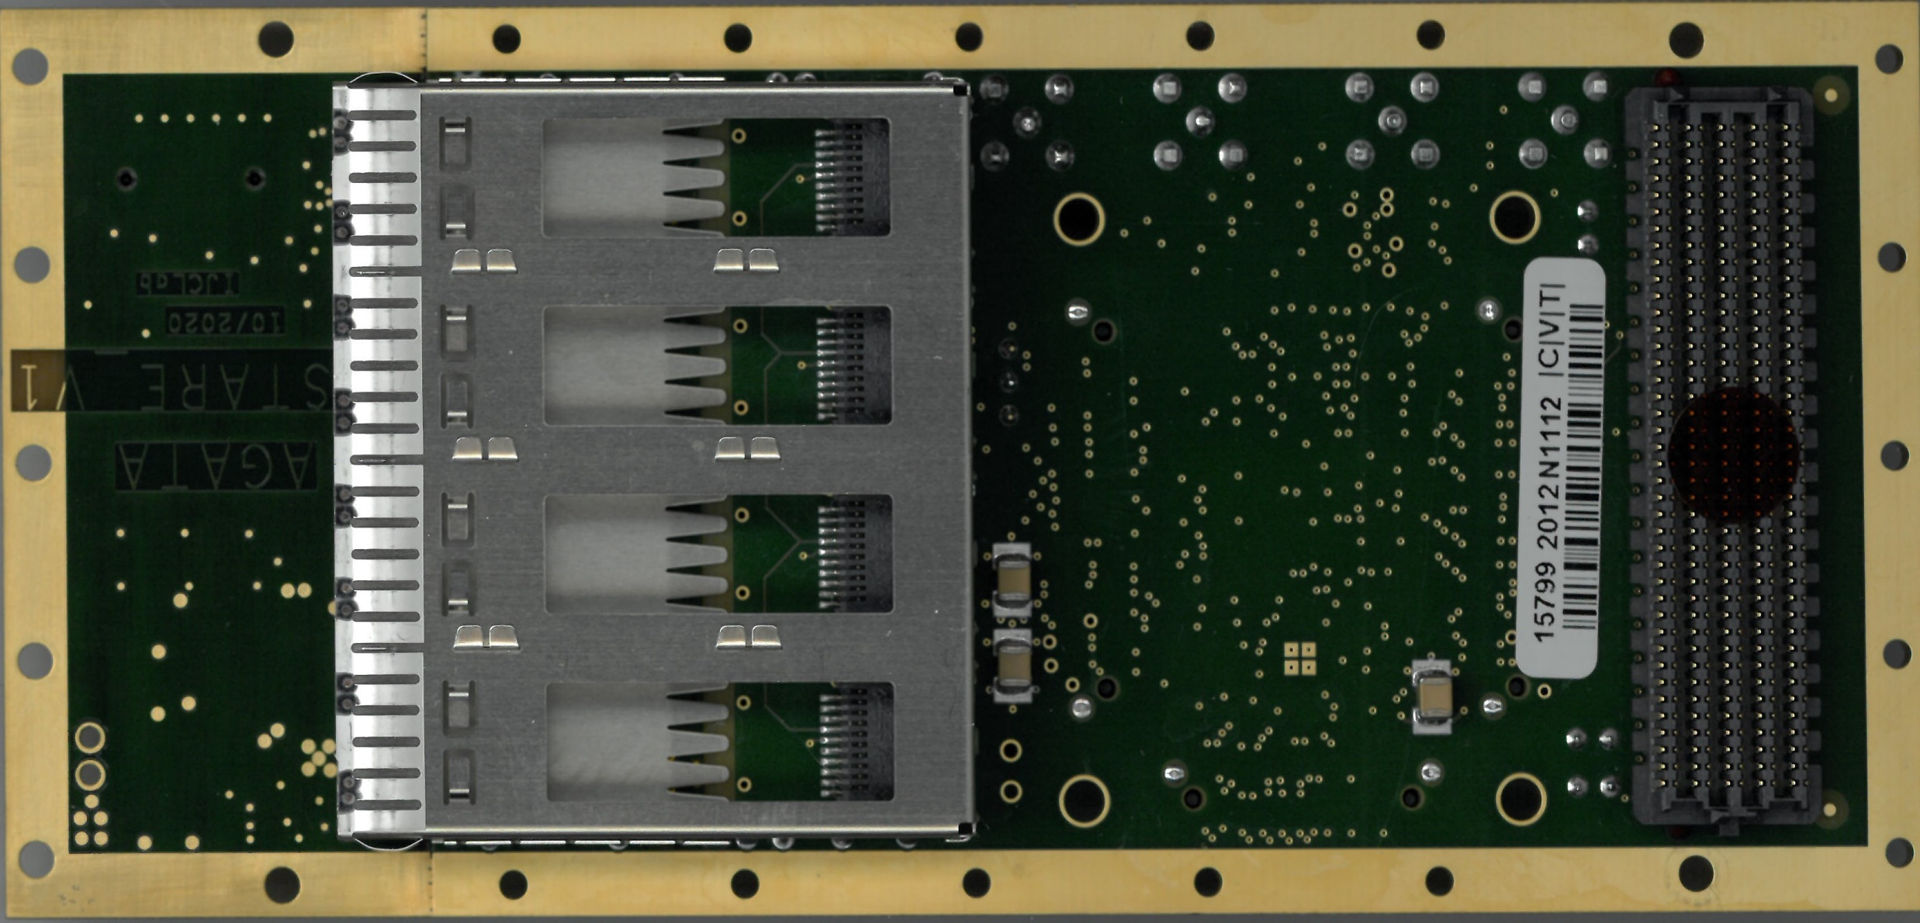
STARE prototype
Top side
Bottom side

Slide 12
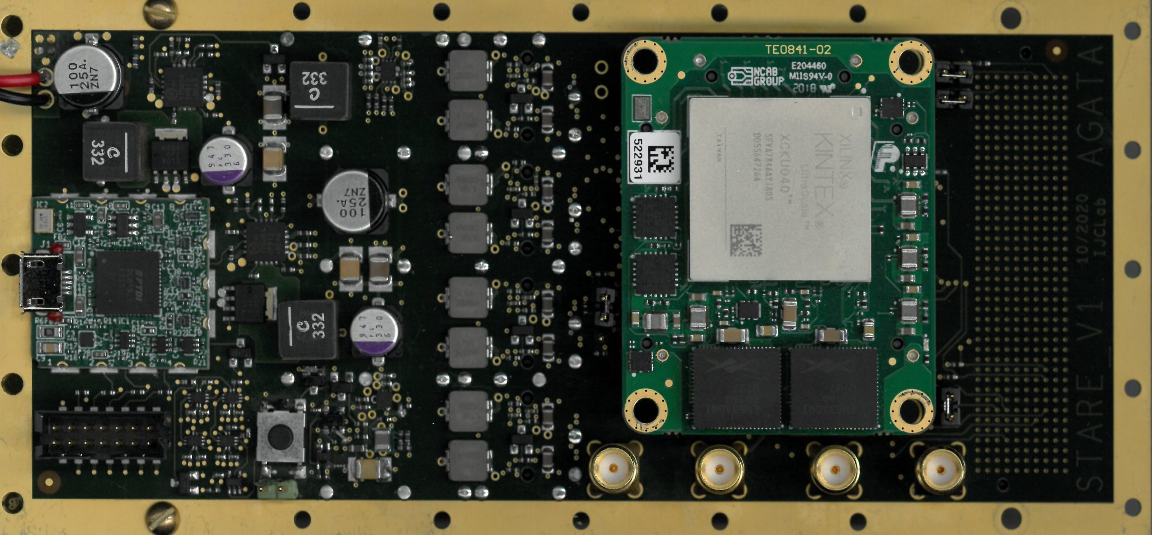
STARE prototype
Power
management &
Debug facilities
SOM
FMC
Conn.
Network
SFP+ cage
4 x 10 Gb/s

Slide 13
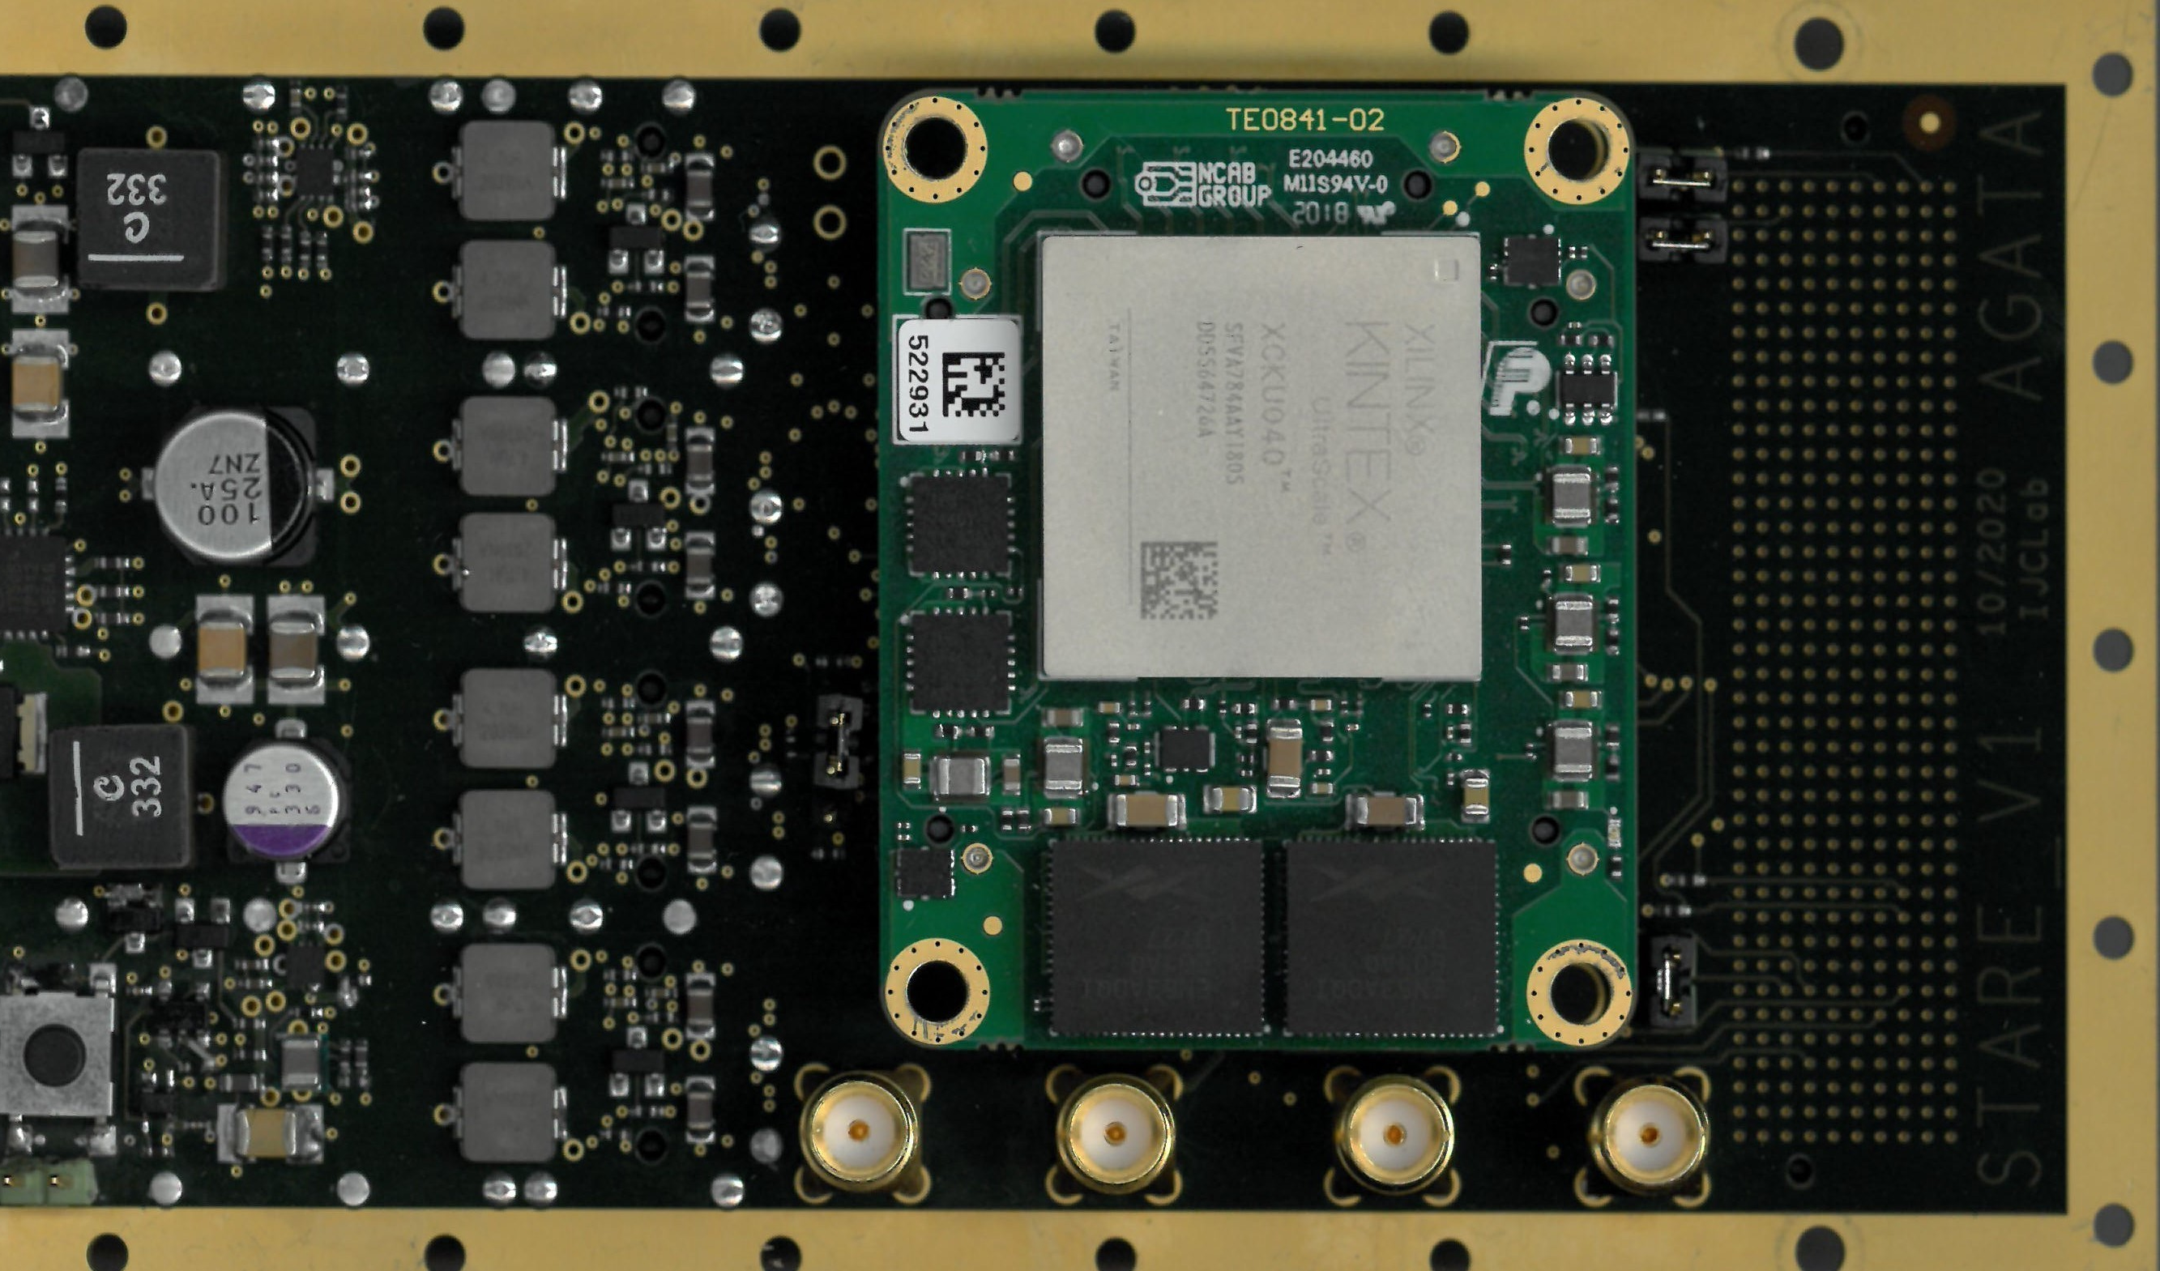
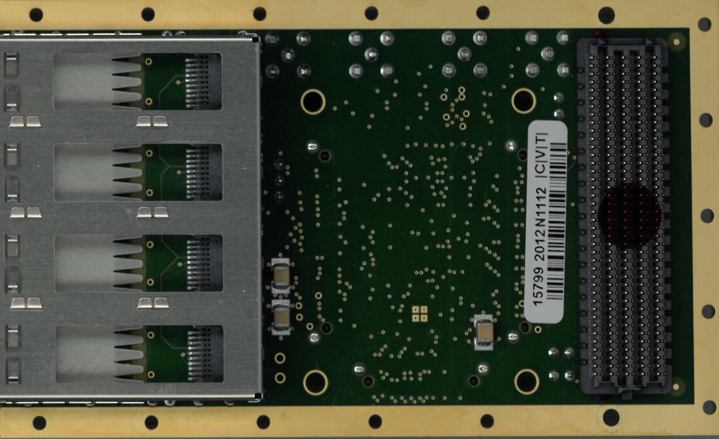
STARE production
Top side
Bottom side

Slide 14
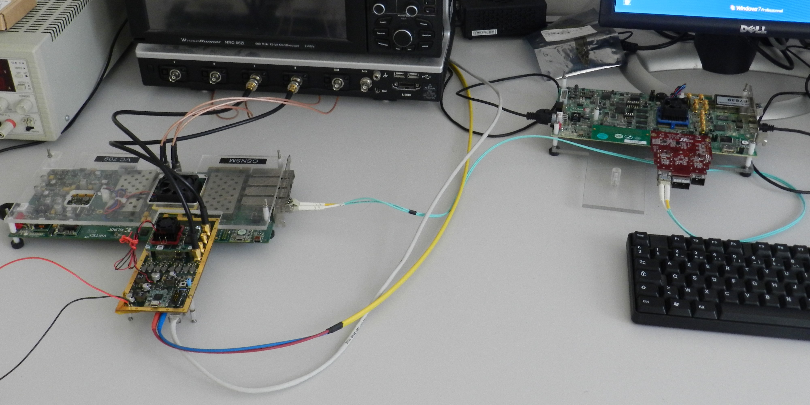
STARE Prototype Testbench
Firmware Dev: MC, CE, XL, (GV)
Xilinx Evaluation board: KCU105
Xilinx Evaluation board: VC709
STARE
Optical fibers: 10 Gb/s
Ethernet câble: IPbus

Slide 15
Data processing
Aurora interface
Data manger
Splicer
UDP interface
(David Zidler – Munich)
10 Gb/s
Aurora
64 bit
@156,25 Mhz
64 bit
@156,25 Mhz
10 Gb/s
Ethernet SFP
Paquets de X KB
X Paquets de 1 KB
_ Slow control
_ EEPROM
_ Clock manager
X.LAFAY

Slide 16
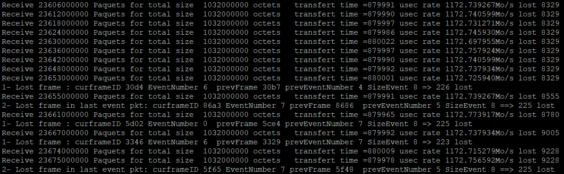
Results
Transfert @10Gb/s
=> 5 hours test : packets loss < 1.10-6 ; no bit error
Transfert @5Gb/s
=> 5 hours test : no packets loss ; no bit error
X.LAFAY

Slide 17
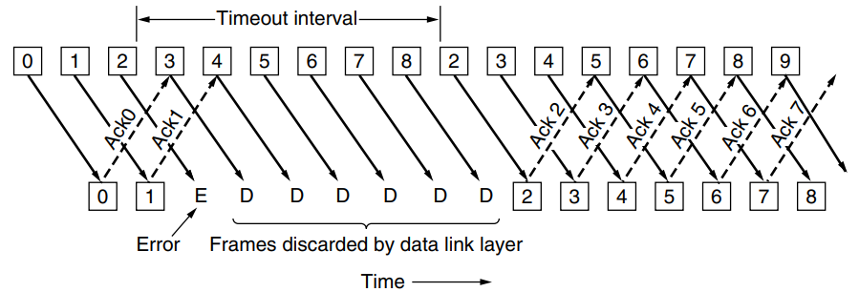
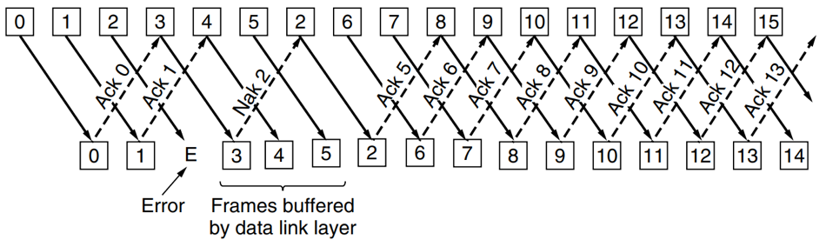
Reliability mechanisms
Go Back N
  Using memory
  Efficiency
Selective Repeat
  Complexity
  Window size
  Better for debugging
  No data loss between FPGA and server
  Generates back
X.LAFAY

Slide 18
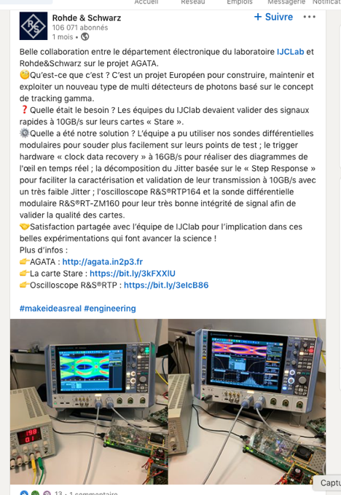
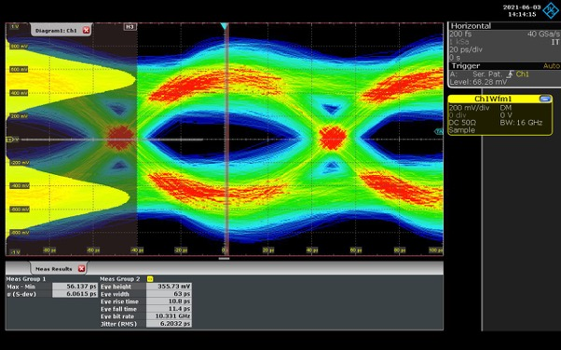
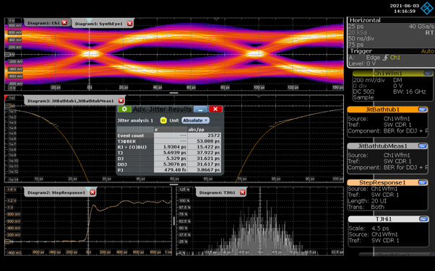
Diagramme de l’œil et article de Rohde et Schwarz

Slide 19
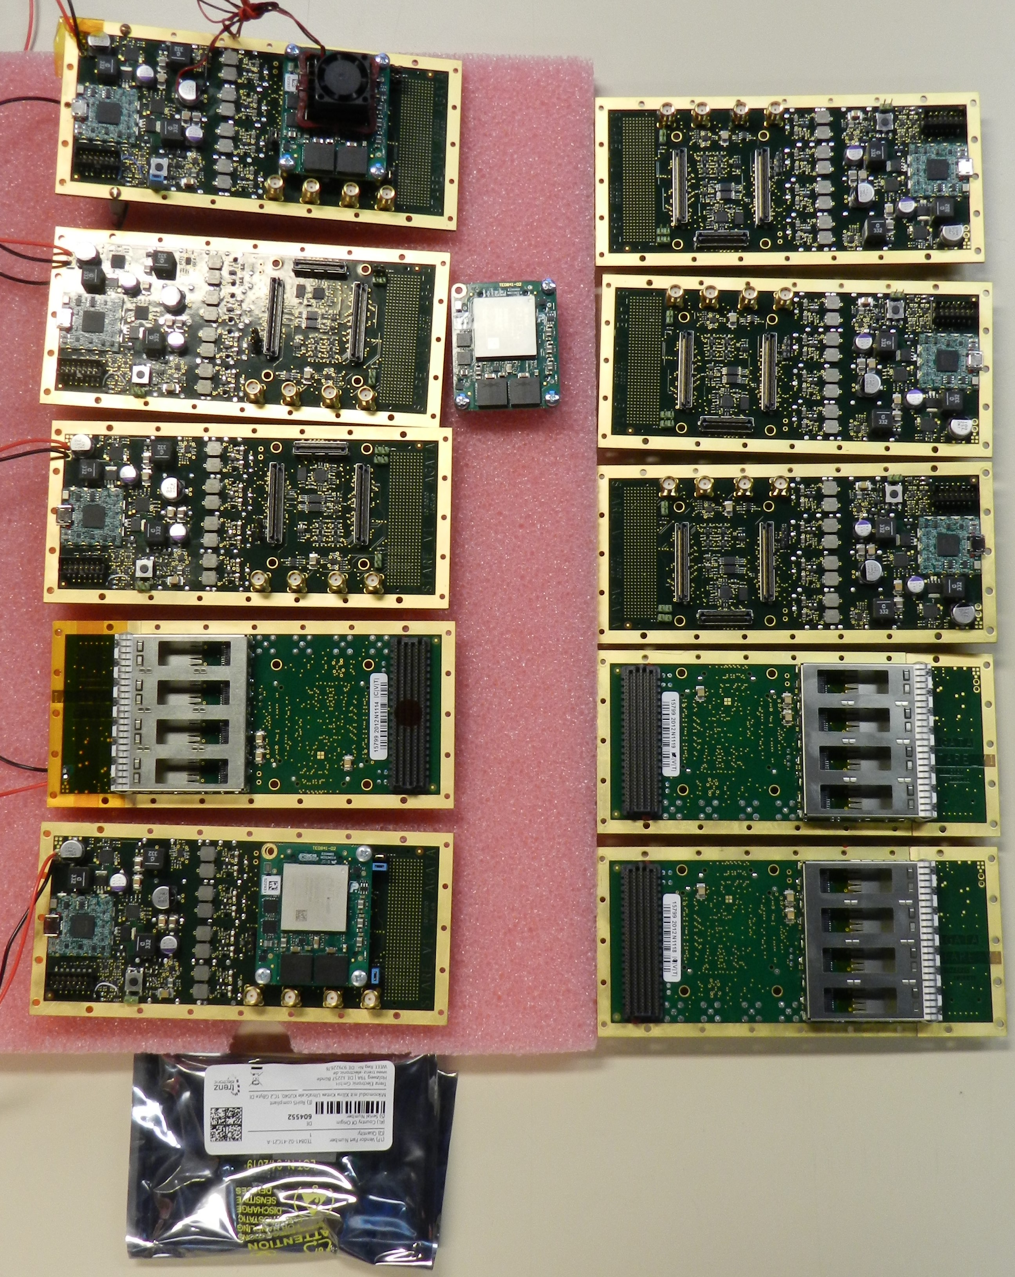
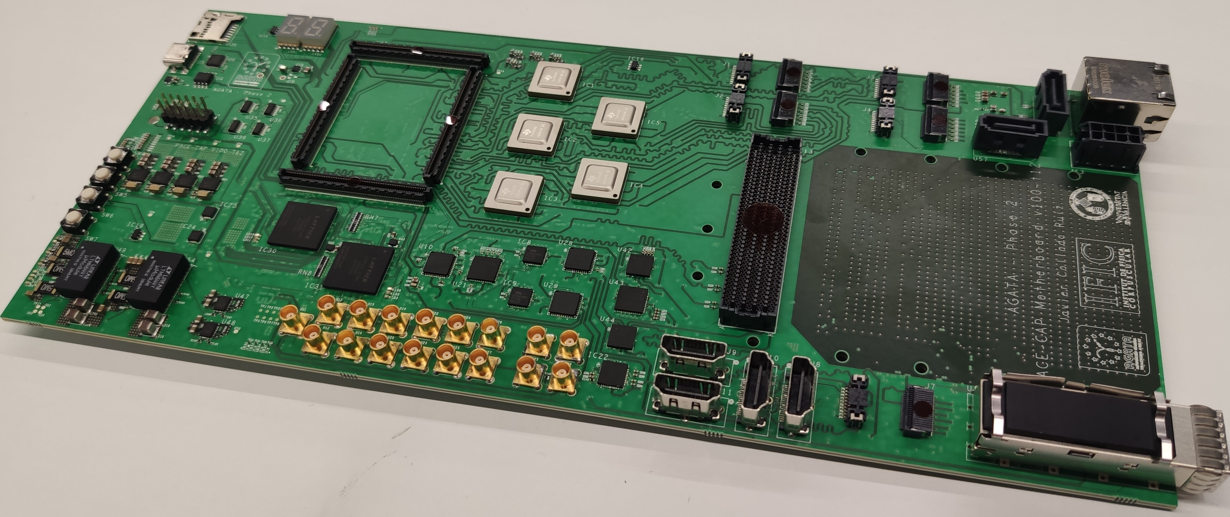
STARE Prototype
Difficulties in purchasing SOM Modules: IJCLab constraints, Covid constraints, global shortage on integrated circuits ➔ only 4 modules are delivered (2 IJCLab & 2 from Andres), 10 modules ordered (delivery August 2021) (for reminder : 10 STAREs are available).
STARE with SOM Module (from Andres) will be sent to Valencia for Mechanical Integration with PACE board and crate.
STARE ready for integration test : from now until begin April…
Integration tests: PACE status, Covid constraints??
STARE Area
PACE Board

Slide 20
STARE Prototype status
10 prototypes Working and tested completely in standalone mode
Integration tests started with Valencia PACE board
2 test benches were prepared by IJCLAB engineers to Valencia
Standalone data transfer from STARE to Server using PACE board is working to the computer server.
PACE firmware is ongoing to send data from PACE to the server
UDP Software is developped using basic data structure mode.
10 Gbps transfer is working during few hours
5 Gbps is fully working
Server configuration is needed
STARE Firmware for the first phase is working completely

