Slide 1
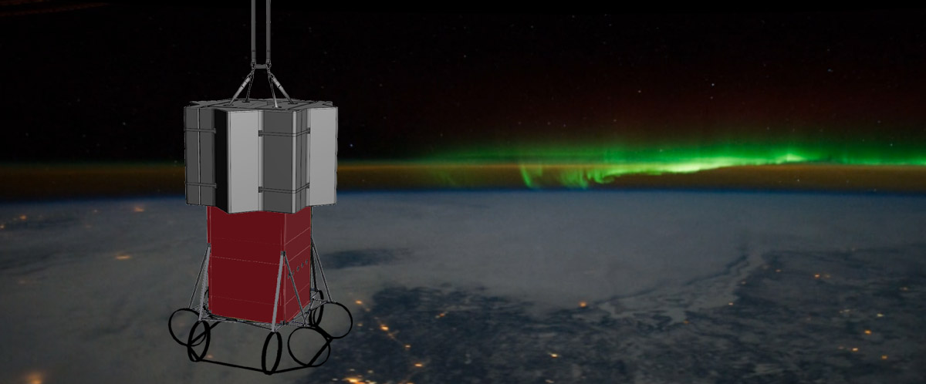
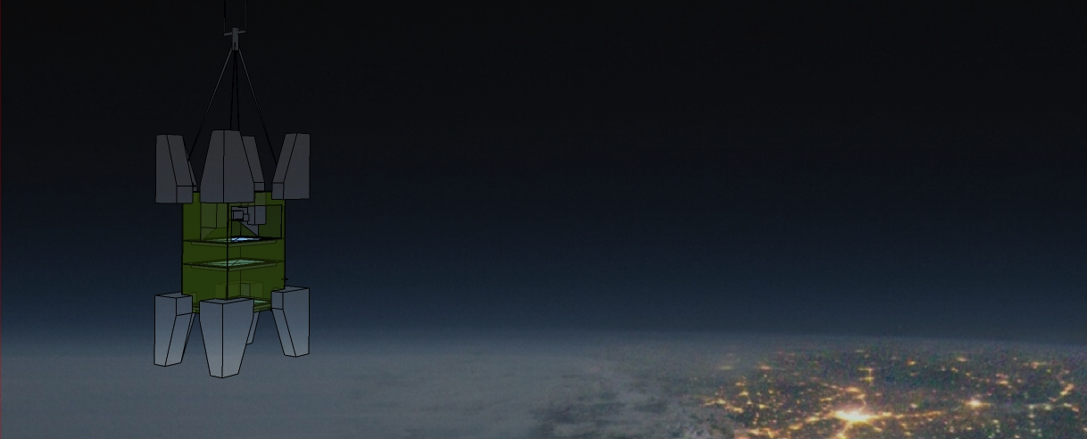
A detection unit designed for the study of the UHECRs from space
Sylvie Blin
Alexandre Creusot
Guillaume Prévôt
Étienne Parizot
APC & Omega (IN2P3 France)

Slide 2
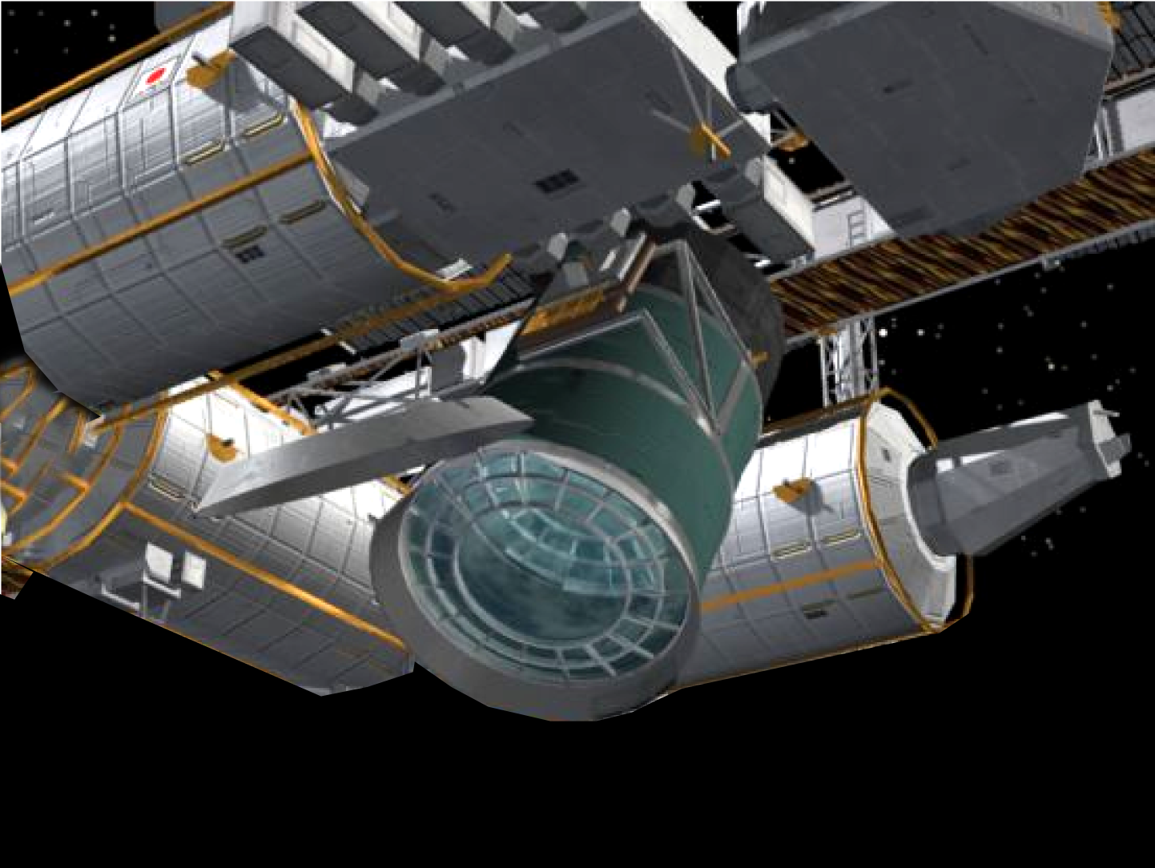

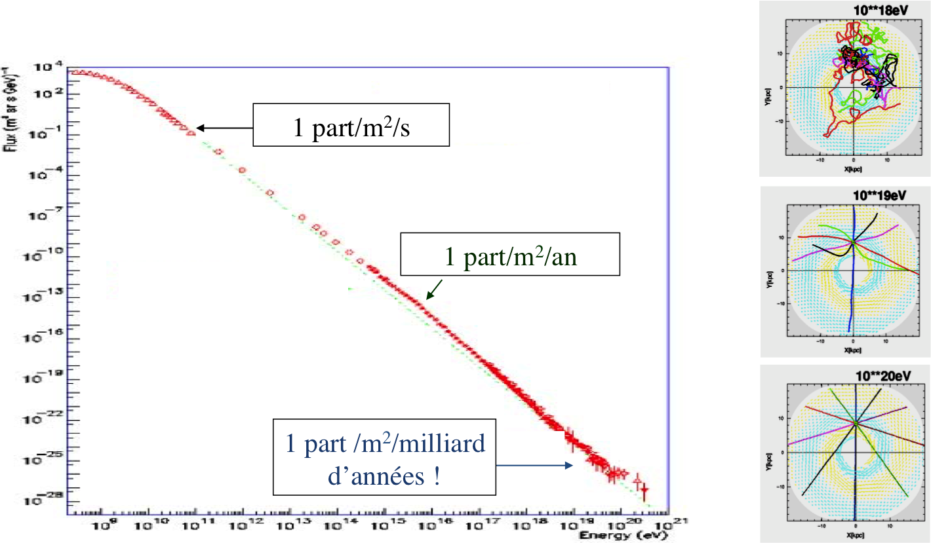
Quelles particules ? Et quelles sources ?
1 part/m²/s
1 part/m²/year
1 part/m²/billions years !

Slide 3
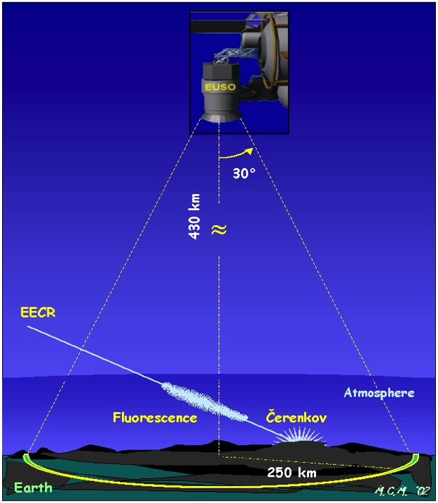
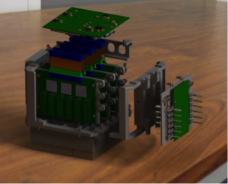
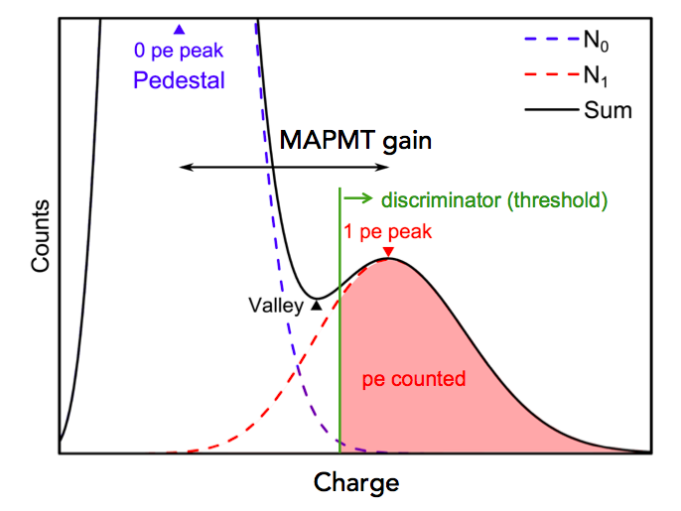
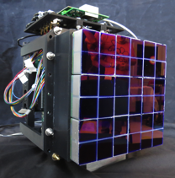
JEM-EUSO space mission detection principle
Ability to detect UHECR from above (fast signal: 50-150 μs), through the UV fluorescence light and the Cherenkov
Photon-couting
MAPMT + ASIC ( + FPGA)
Wide dynamic > 100 pe
Time resolution < 10 ns
GTU = 1 μs
(i.e. time for an event to cross one pixel on ground)
Detection area : 200 000 km²
Previous EUSO UV
camera prototype (2012-2017)
2304 pixels
(20 x 20 x 20 cm):
3

Slide 4
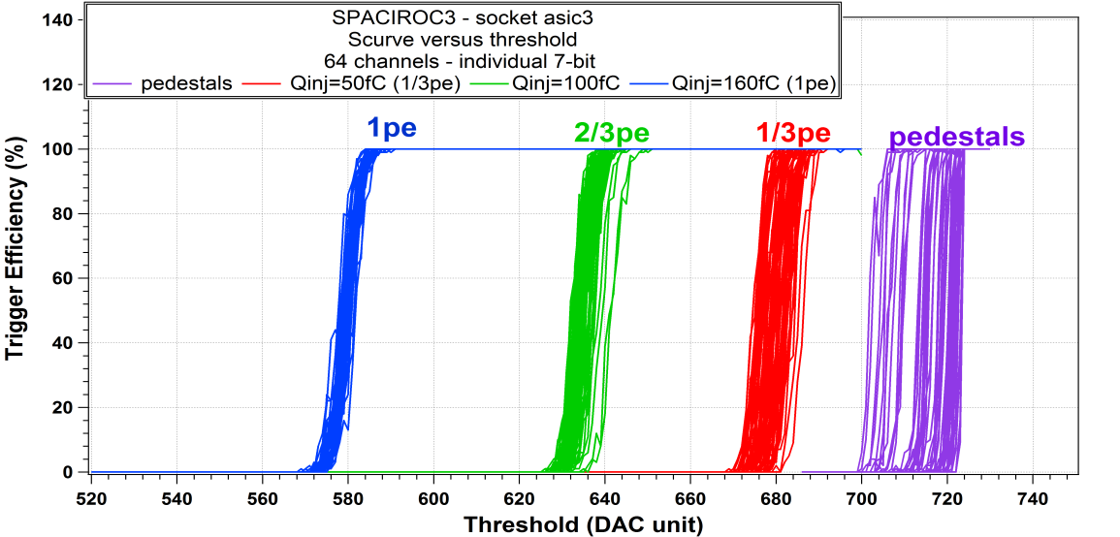
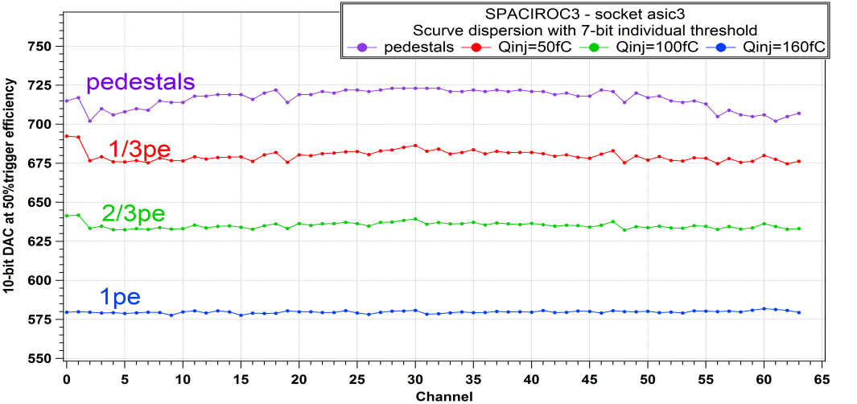
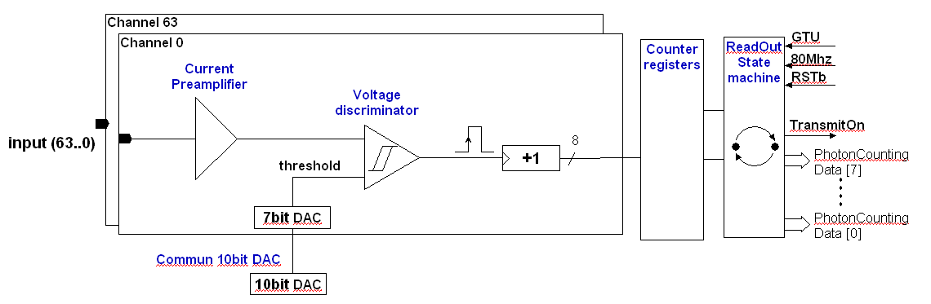
SPACIROC 3 ASIC chip
Developed by OMEGA IN2P3 for the experiment
64 channels photon counting
Single photon counting 100% trigger efficiency: 1/3 pe (~50 fC when MaPMT gain = 10 ⁶)
Internal 8 bits counter (in order to minimize the consumption)
Wide linear dynamic: 1 to 130 pe
MAPMT adjustment trigger by individual threshold for each pixel
Double pulse resolution : 6 ns
Data acquisition & Readout to be done every 1 µs (GTU)
Readout Clock : 80 MHz
Output: 8 multiplexed data lines (to minimize interconnection with the FPGA)
Radiation Hardness By Design : TMR (Triple Module Redundancy)
Power budget : < 0.8 mW/pix
4

Slide 5
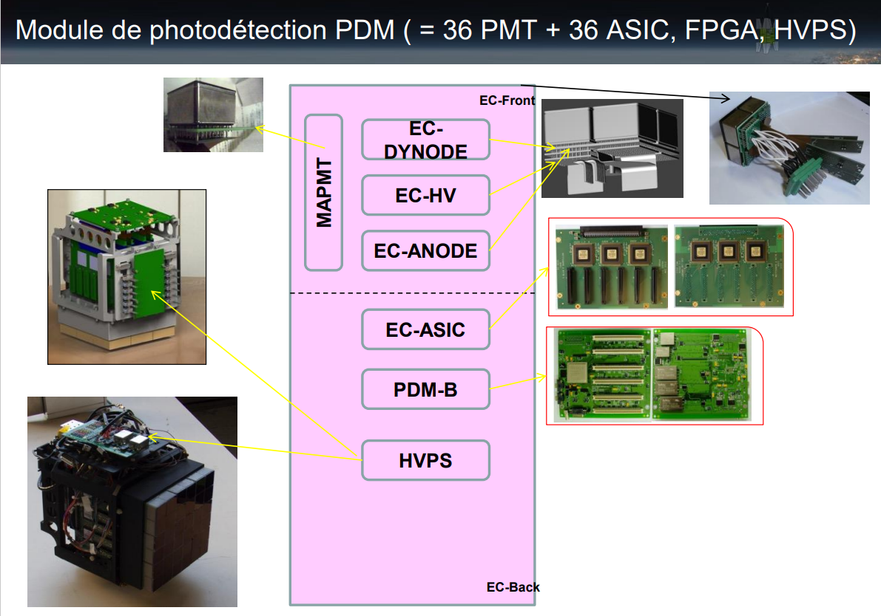

Slide 6
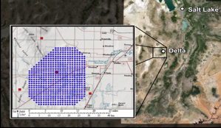
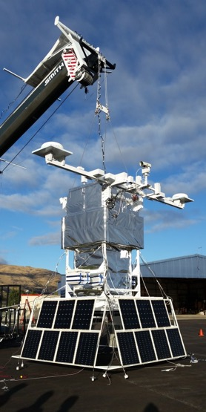
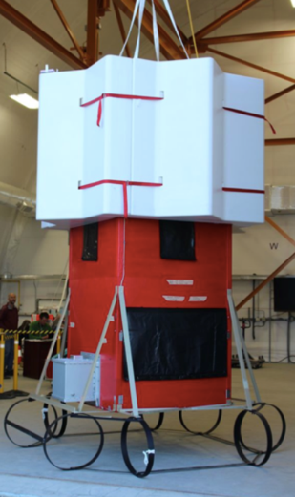
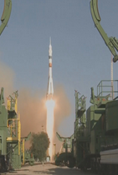
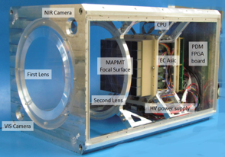
History: previous pathfinders
EUSO-TA (Japon)
Un pathfinder au sol (Utah)
2015-2018
EUSO-SPB (US)
Un pathfinder dans un ballon super-pressurisé
2015-2017
36 SPACIROC1
36 SPACIROC 3
EUSO-Ballon (France)
Un pathfinder dans un ballon stratosphérique ouvert
2011-2014
NEXT STEP
Mini-EUSO (Russie+Italie)
Un pathfinder dans l’ISS
2016-2019
22 août 2019
EUSO-SPB2 (US)
Avril 2023
25 avril 2017
36 SPACIROC 3
36 SPACIROC1
6

Slide 7

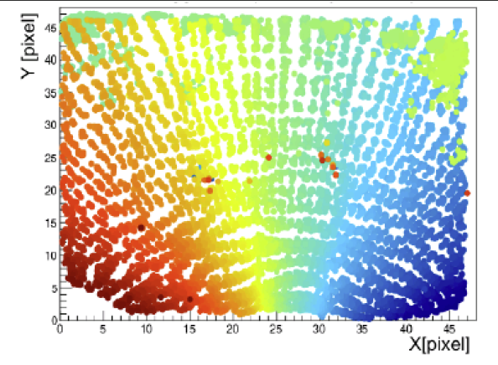
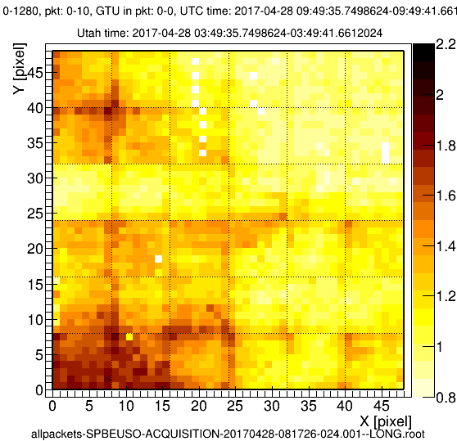
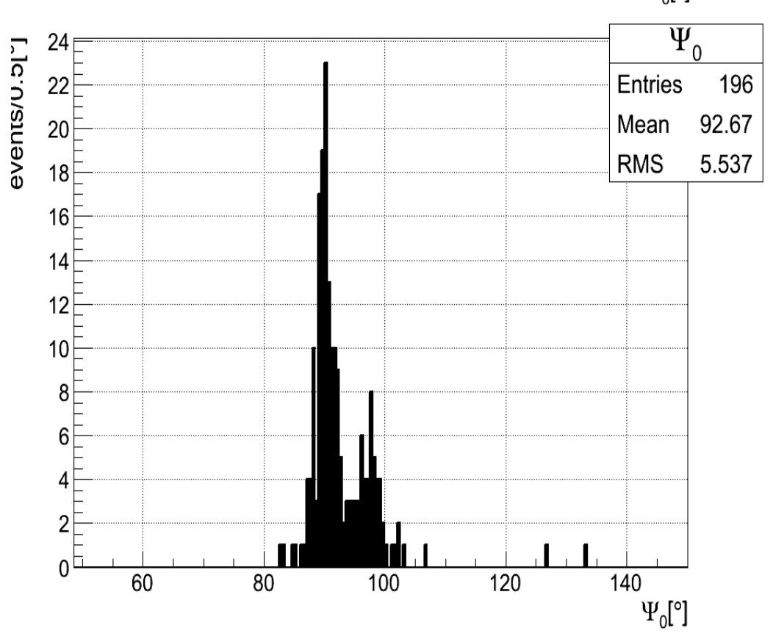
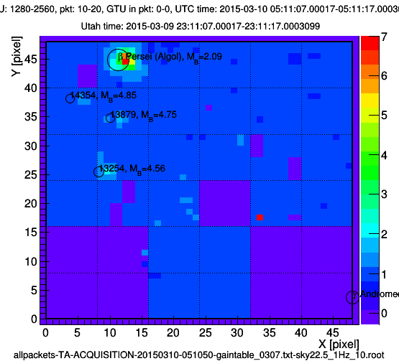
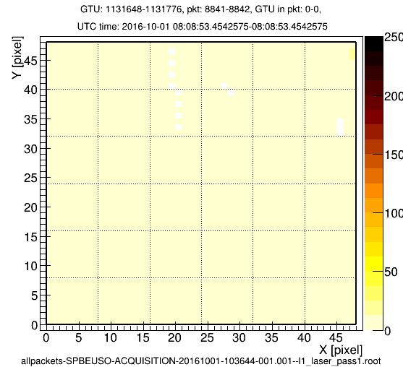
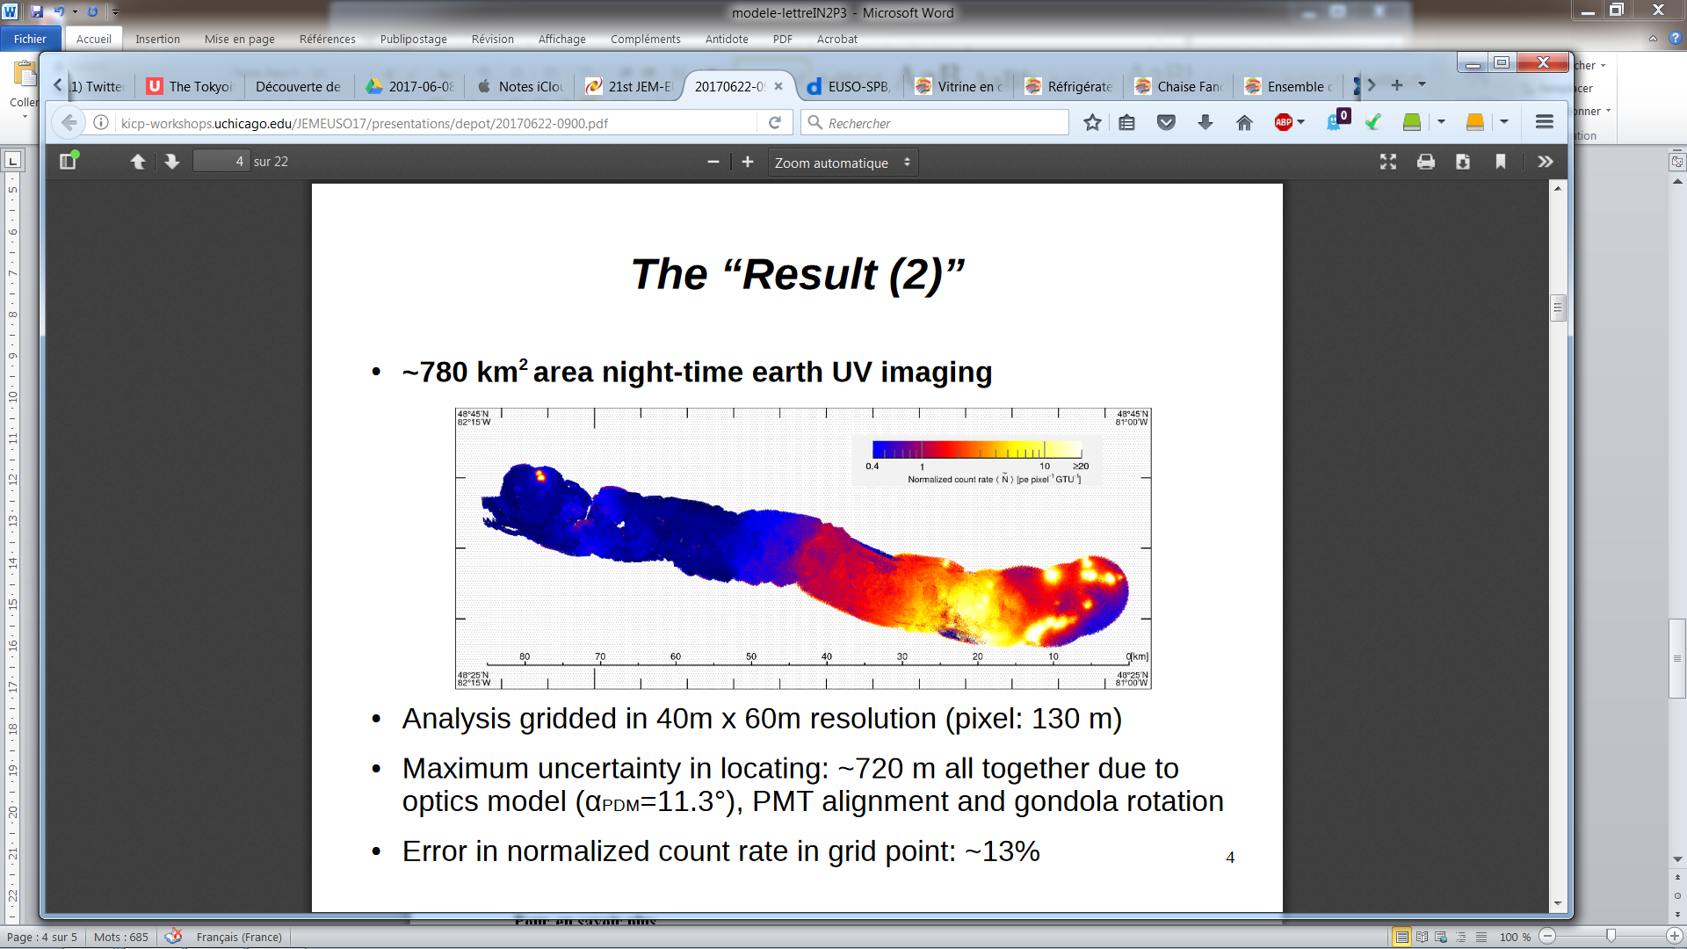
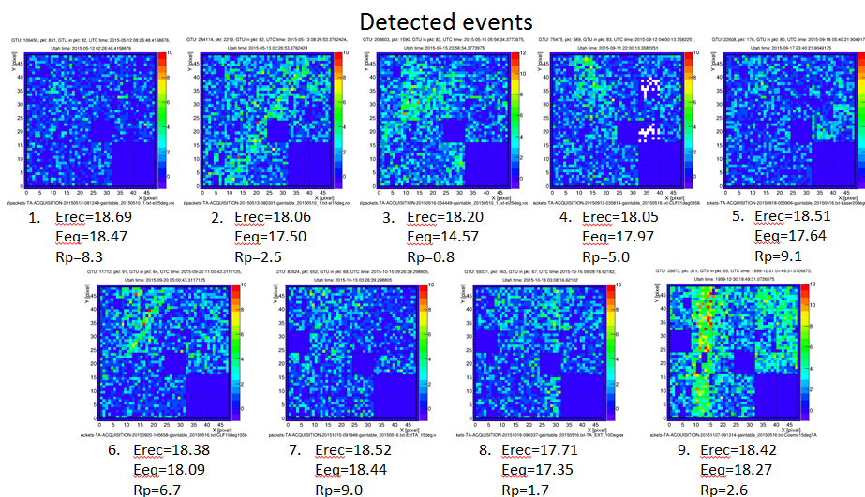
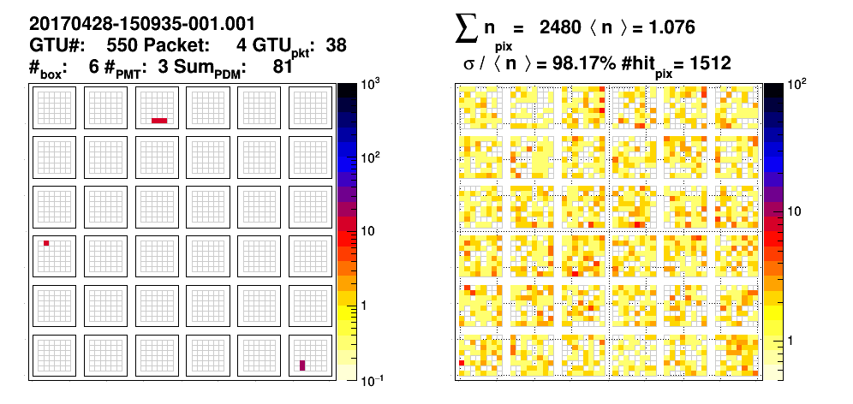
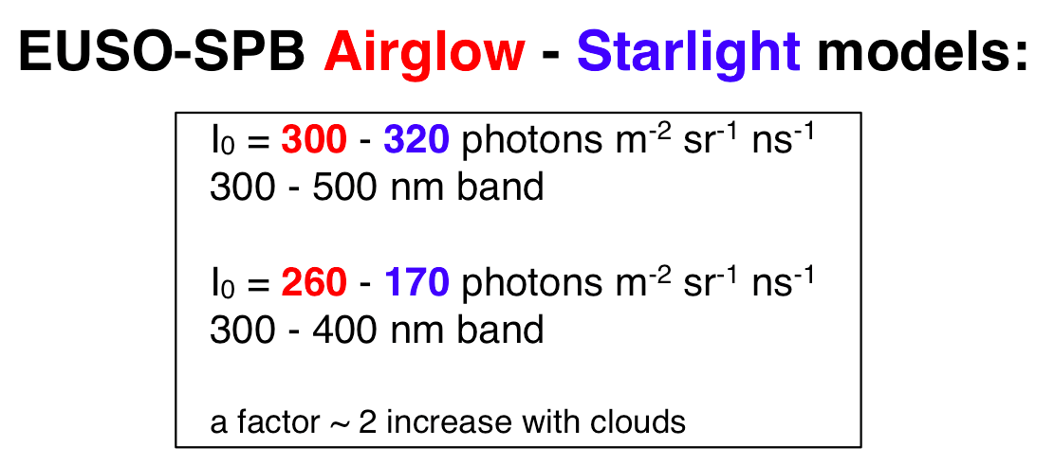
Previous pathfinders main results
EUSO-Balloon 2014
EUSO-TA 2015
EUSO-SPB 2017
7

Slide 8
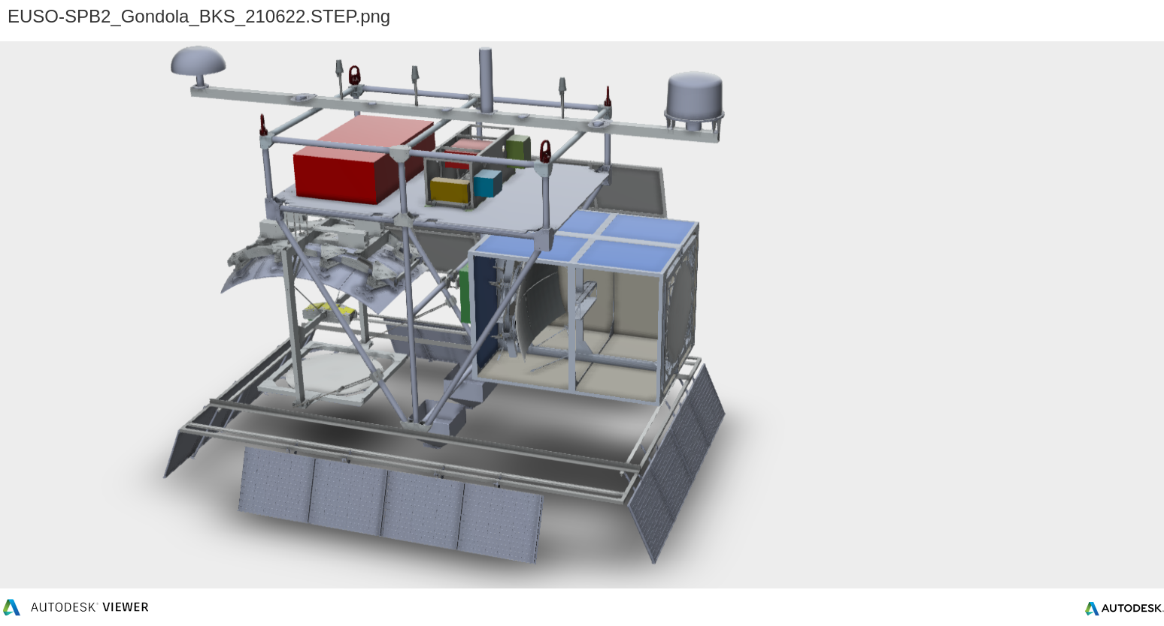
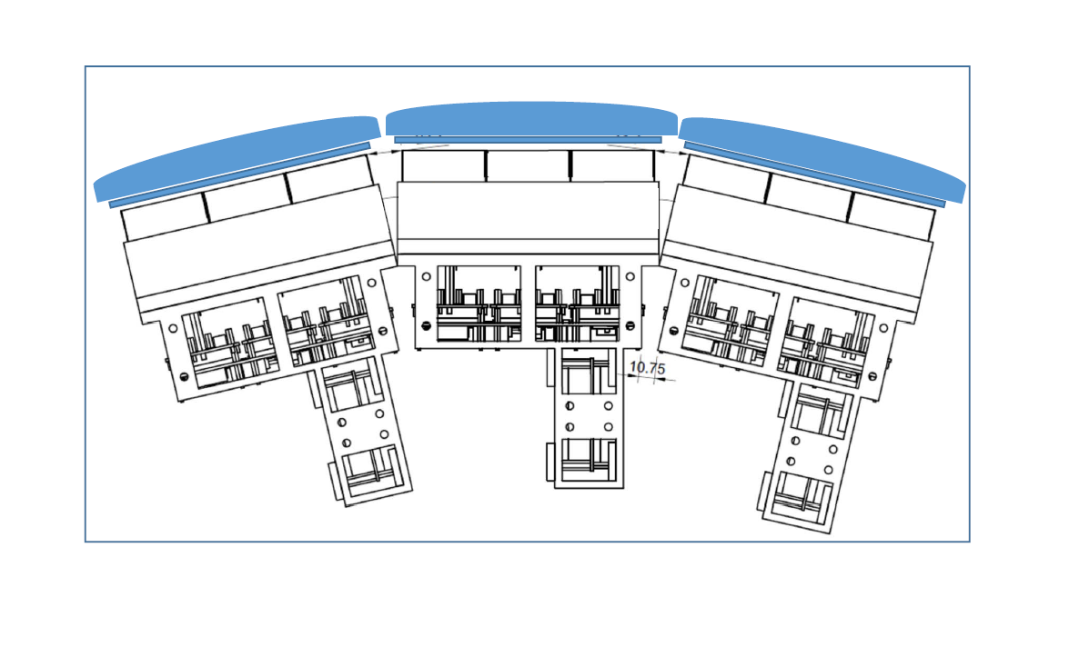
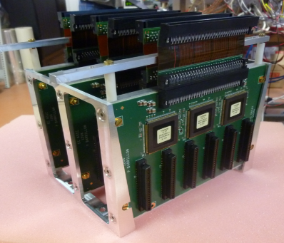
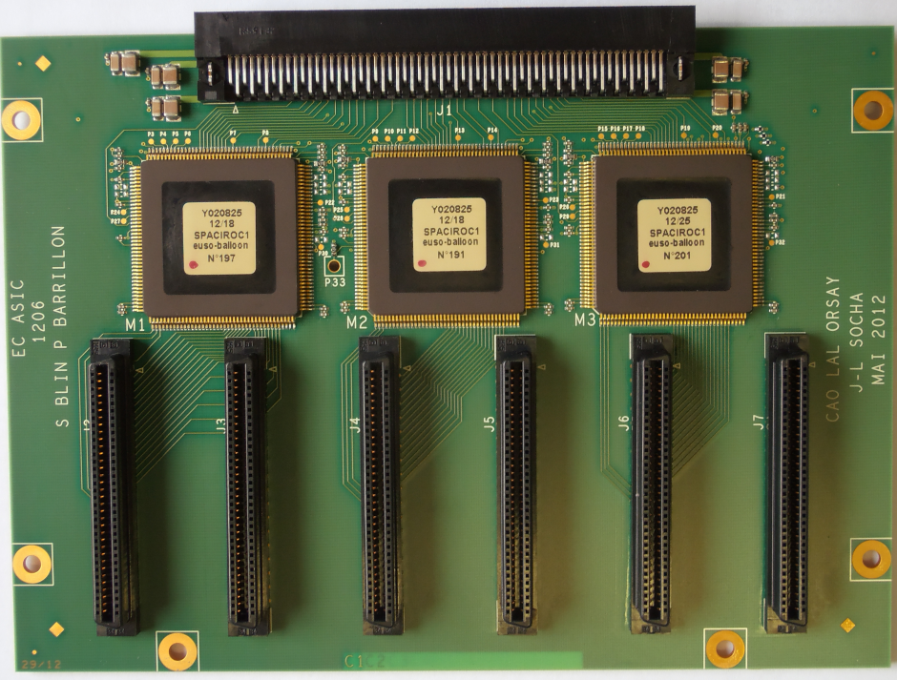
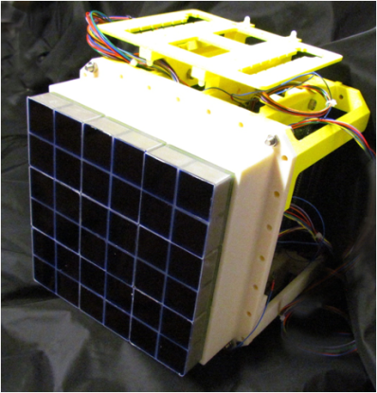
EUSO-SPB2 for 2023
EUSO-SPB2 Operational Requirements –Flight
  We collect data at night, looking down and looking at the Earth Limb.
  Need dark sky, and minimal light pollution, ULDB
Wanaka NZ launch site is best option by far.
Antenna Boom
(CSBF antennas)
Battery-Box
(GCC+batteries)
SIP
Science solar panels
Fluorescence Telescope (FT)
Cherenkov Telescope (CT)
CSBF solar panels
(4 each side)
Z
X
FM PDM
6 FM EC-ASIC in mechanical structure
  Prototype de l’EC-ASIC
Z

Slide 9
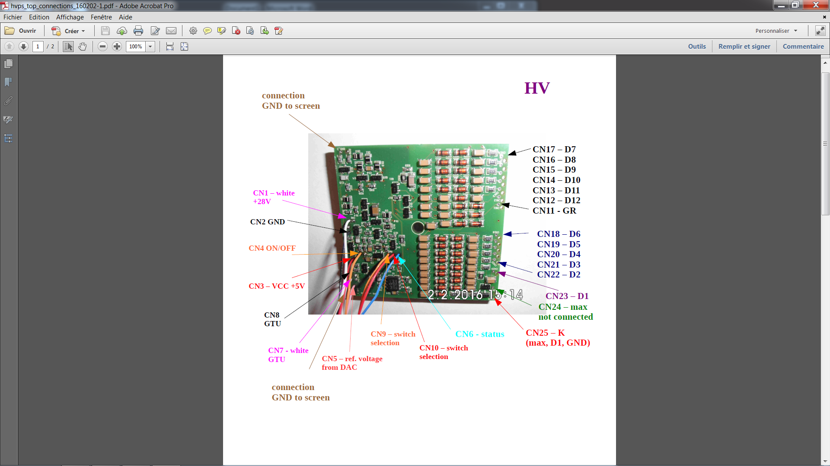
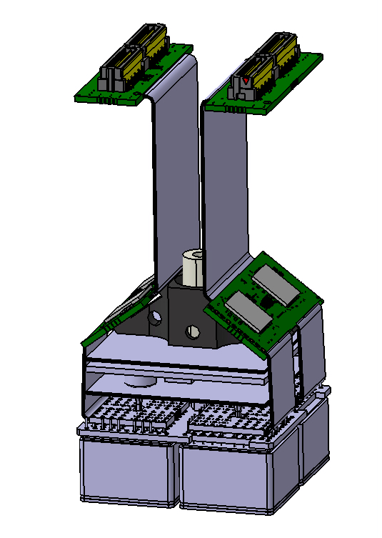
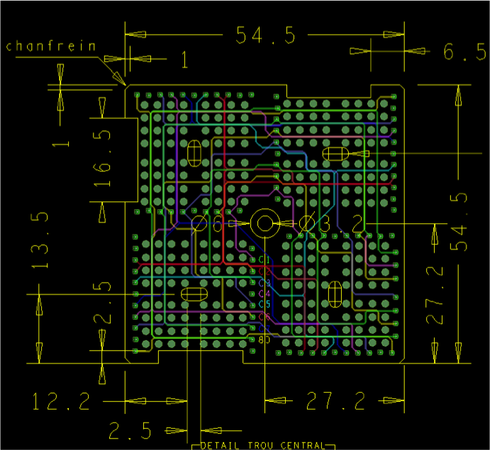
New design: need a more compact detection unit
To minimize the dead zones on the new focal surface, it is mandatory to integrate the ASIC boards inside the unit.
Previous height: 200mm -> new one: height = 55mm (flat camera)
100 pins connector (to FPGA board)
HVPS
55 mm
kapton (output signals)
55 mm
ASIC board
Dynode board
kapton (anodes to ASIC board)
HVPS board
dynode PCB
64 pixels MAPMTs
to FPGA board
9

Slide 10
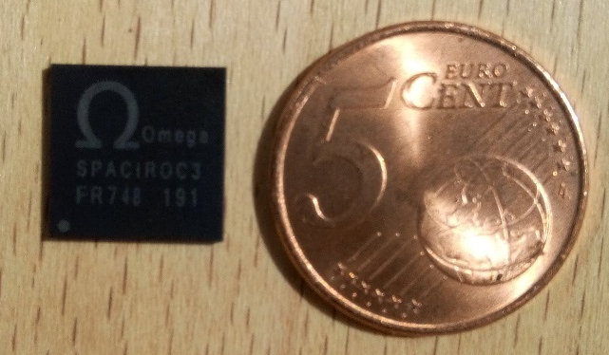
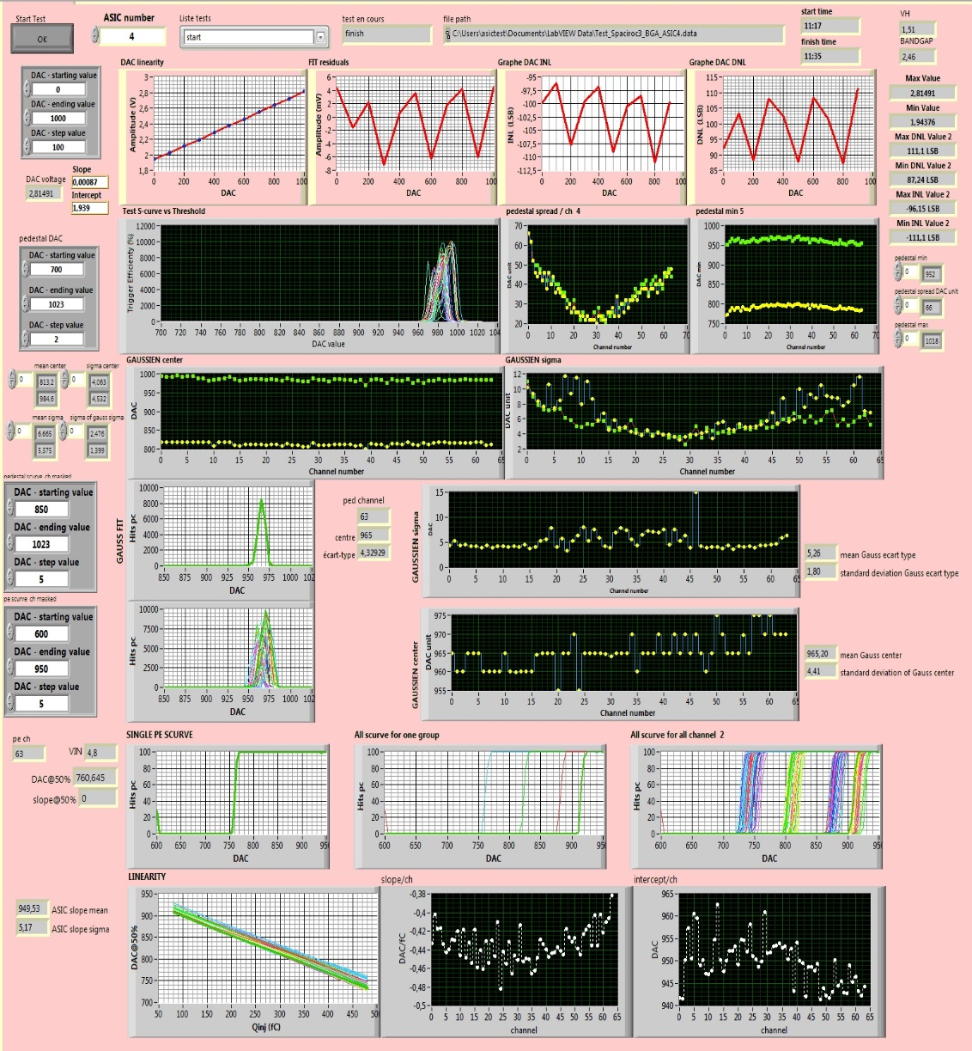
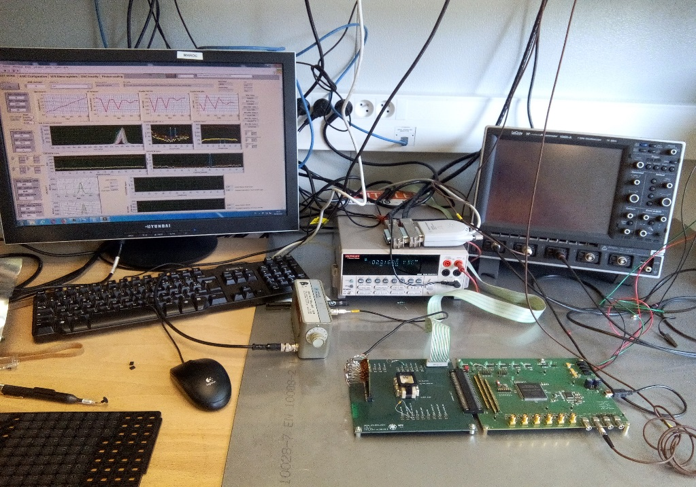
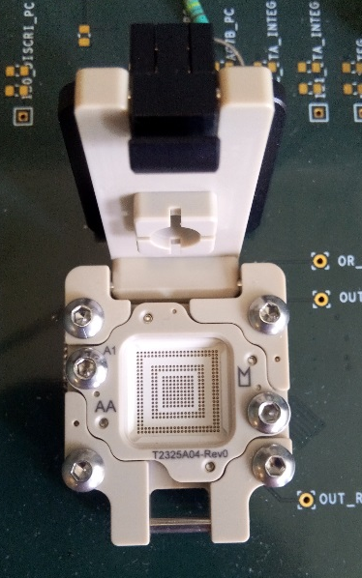
SPACIROC3 BGA serial test
SPACIROC3 BGA:
  Packaging: BGA 12 x 12 mm , 353 balls, pitch 0,5
  Socket Yamaichi Y-red BN0353 MI 0-H-S
SPACIROC3 ASIC automatic test:
  Dedicated test bench: power supply, labview, pulse generator, keithley
  130 SPACIROC3 BGA tested: functionality, linearity of DAC, charge injection
  Good yield = 94%
Issue: need 180 BGA ASICs ( SPB2 and K-EUSO and Spares)
=> Novapak bankrupt
=> Japanese company for packaging
previous
  BGA packaged Spaciroc 3 ASIC
new
10

Slide 11
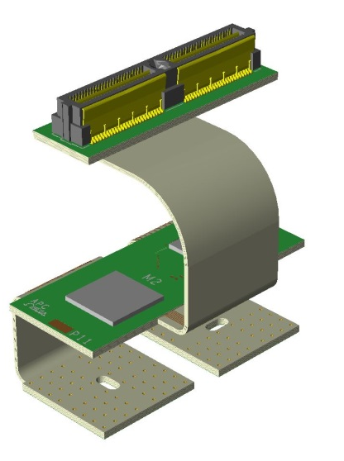
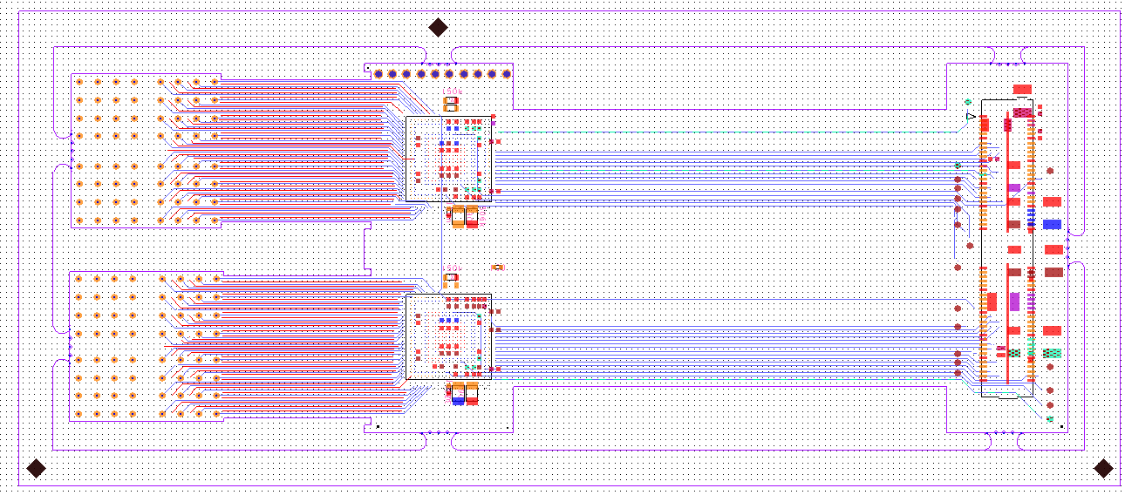
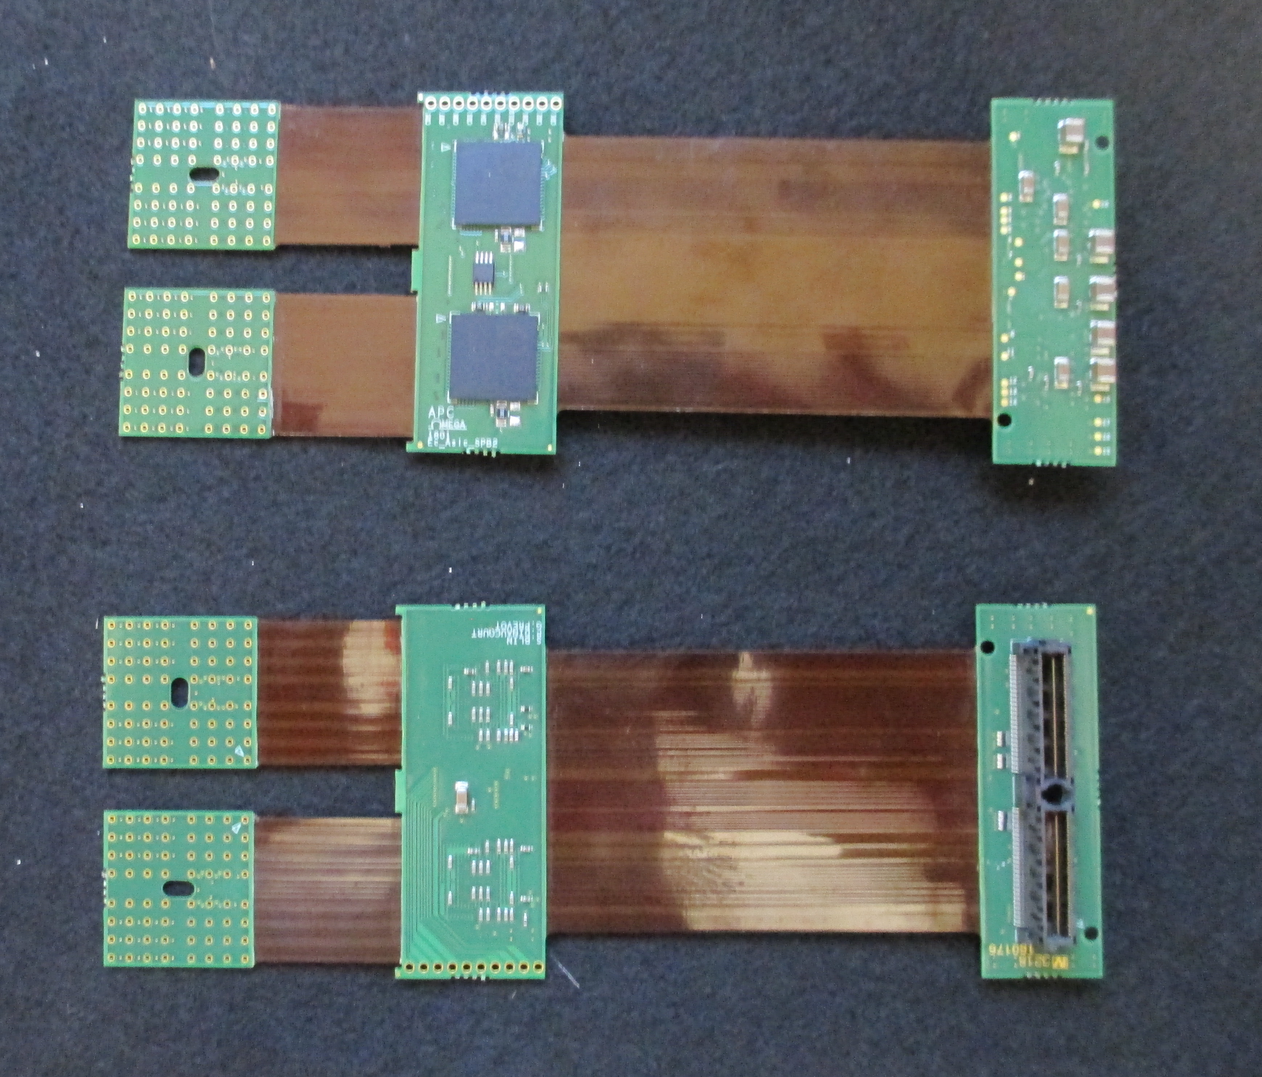
Routing and Dimensions of the new ASIC board
EC_anode boards
BGA ASIC
SAMTEC 100 pins
50 mm
Kapton 1
155 mm
Kapton 2
PCB designer= Pierrick Dinaucourt (OMEGA)
A complicated board:
A board uneasy to integrate inside the EC_Unit
A board challenging to route (inner micro-vias, density)
A board complicated to produce (PCB/kaptons, hard to find a manufacturer, bad yield)
only one manufacturer accepted: SOS electronic for PCB
=> 100 boards June 2018 (K-EUSO: 18, EUSO-SPB2: 54)
1st batch in October 2018:
8 PCB: Yield=50% (delaminated between rigid PCB and Flex)
2nd batch in March 2019:
rigid Kaptons 12 boards with 10 boards OK but intermittent failure or even permanent after some time
Xray campaign + modification process
11

Slide 12
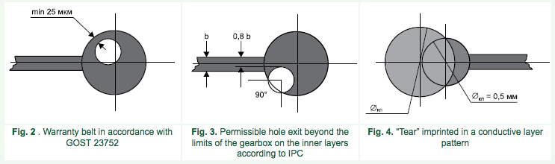
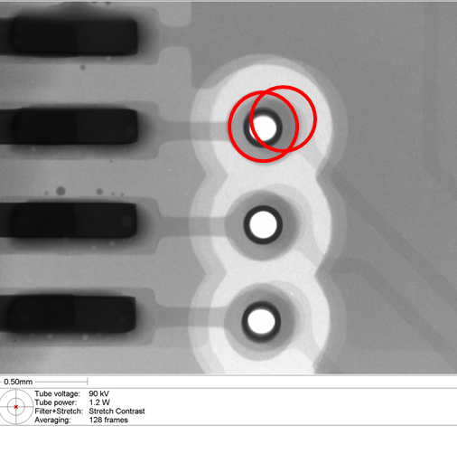
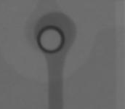
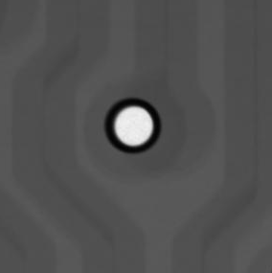
ASIC board PCB issues: X ray campaign
IPC-600A norm
Faulty EC-ASIC boards due to imperfect manufacturing: shifts between different PCB layers
PCB scans
Thanks to Xavier de La Bernardie at Subatech
Discussion with experts and with companies
3rd batch : 22 PCB
4th batch: 45 PCB
Selection PCB by X ray before cabling
Yield=80% => enough for production

Slide 13
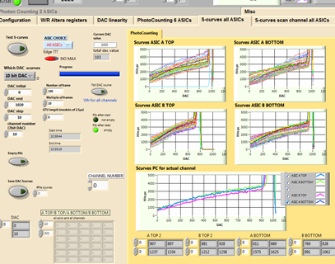
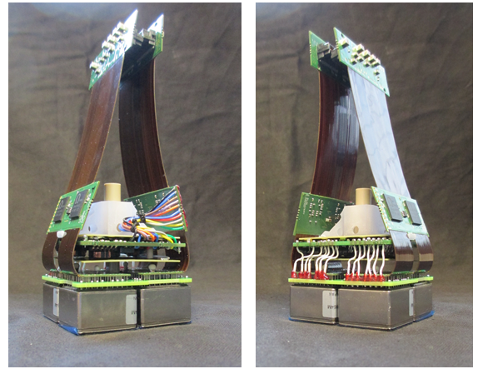
First prototype of our new EC_Unit
  A light (500g) compact (55mm x 55mm x 55mm) detection unit:
  256 pixels
  photocounting
  GTU = 1μs
  consumption = about 250mW
  including HVPS & safety switches
  potted (arathane resin)
  two 100 pins output connectors
13

Slide 14
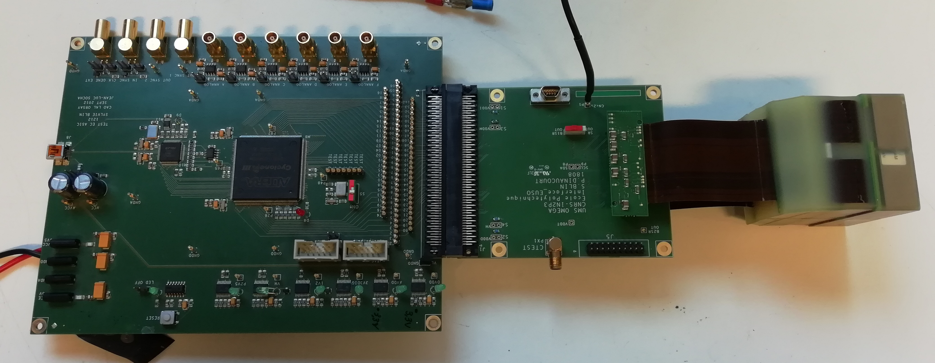
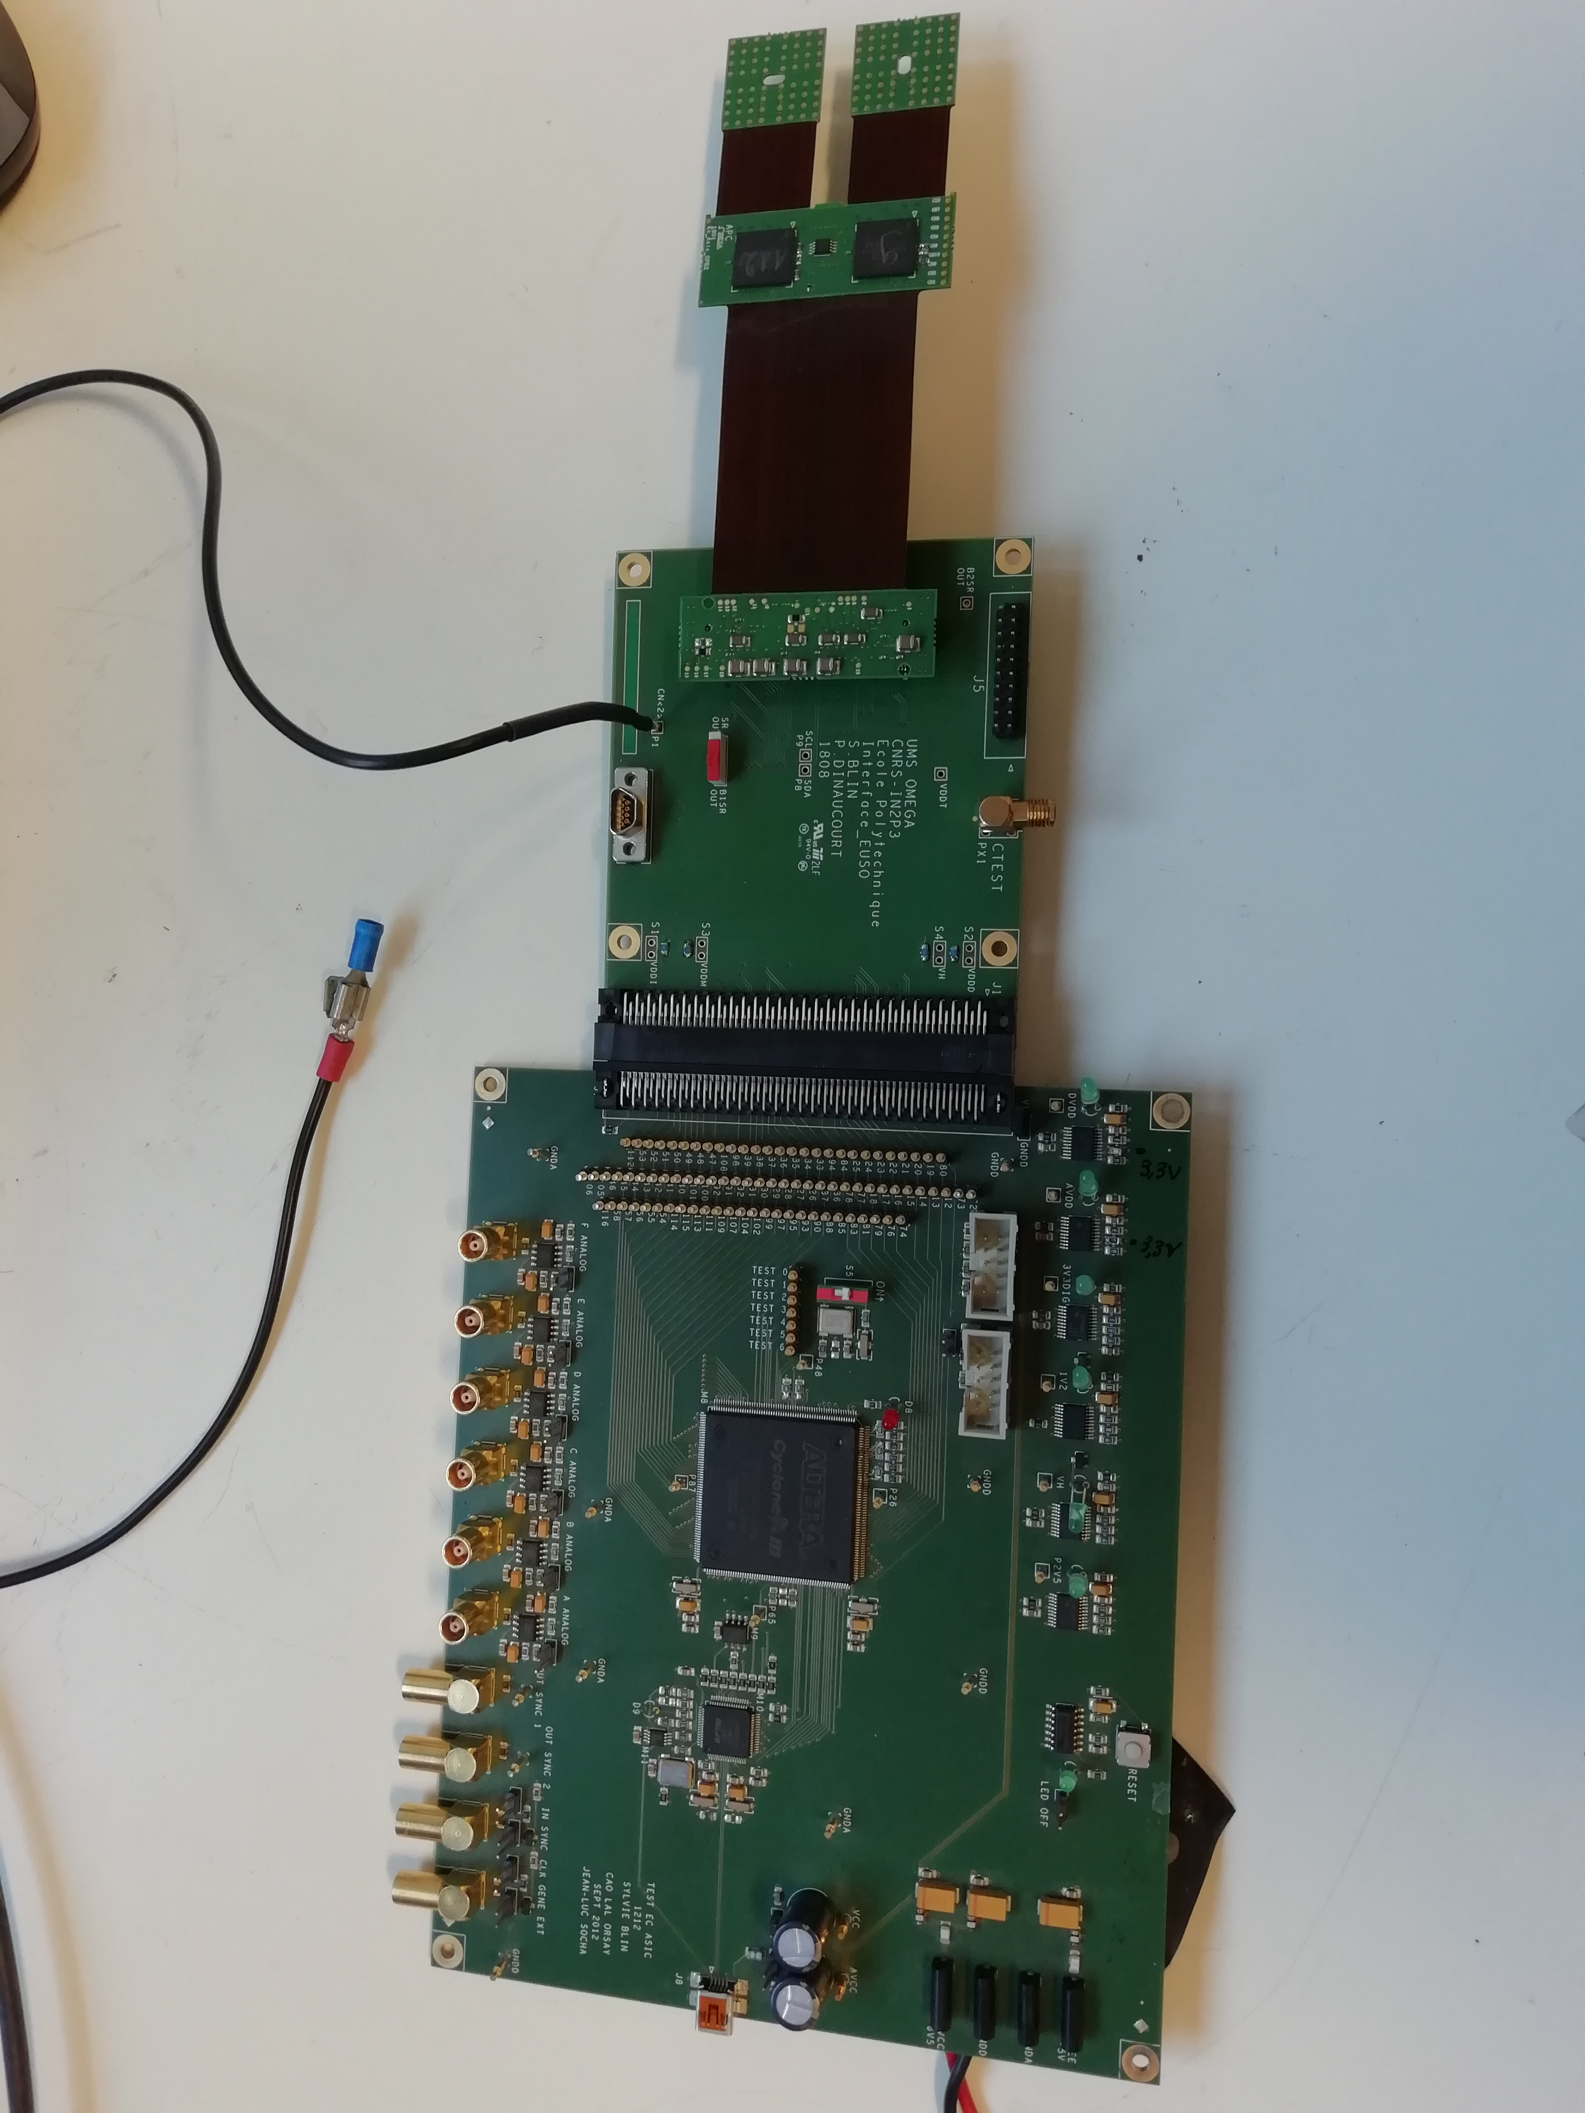
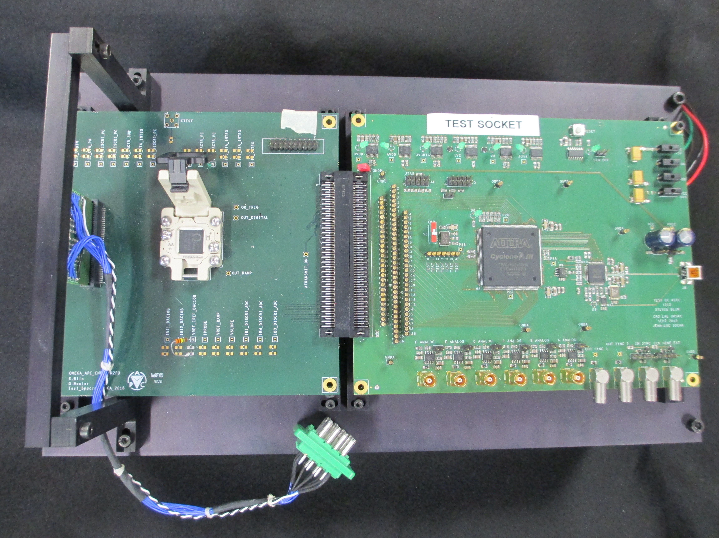


SPACIROC and EUSO boards
TEST_EC_ASIC (1212)
EC-ASIC (SPACIROC1) v1 (1206)
EC-ASIC v2 (SPACIROC3) (1606)
EC_ASIC v3 mini-EUSO (1620)
EC_ASIC_BGA (1801)
test_SPACIROC3_BGA
test_EC_UNIT_SPB2
Elementary Cell test
BGA ASIC test and MAPMT
EC_asic test
EC_asic test

Slide 15






Fluorescence Telescope Camera Development and Fabrication

Slide 16




MAPMT Test
MAPMT test with full illumination
  Efficiencies of the 64 pixels of 1PMT
  Efficiency map of 1 PMT
  Histogram of DAC positions of the inflexion points
16

Slide 17



EC test and PDM test
Detailed scan of the photo-sensitive surface:
We use small steps (about 0.5mm) so we can evaluate the varying sensitivity inside a pixel)
Spot size = 1.5mm (pixel = 2.9 mm x 2.9 mm)
1 PDM
Automatic scan for EC #34 (SPB2)
Total efficiency
Automatic scan for 1 line
Total efficiency (MAX of the light seen for every position)
17

Slide 18

Conclusion
3ème génération:
  Détecteur de K-EUSO (mission ROSCOMOS, phase A)
  Détecteur de POEMMA (sélectionné par NASA) et son démonstrateur est EUSO-SPB 2 (2023)
REX:
- 130 ASICs en BGA chez Novapak (113 pour SPB2 et 36 K-EUSO et Spare)
=> dépôt de bilan de Novapak => manque ~50asics
=> packaging par une compagnie japonaise
- PCB fabrication: délai non prévu => chemin critique du projet pendant quelques semaines
Prospectives:
projet détection de débris au sol (collaboration japonaise de EUSO)
=> SPACIROC3 BGA packaging et production des EC_ASIC_BGA
projet POEMMA ou K-EUSO production
=> stock pour les prochaines missions
=> nouveau design d’ASIC
18

