Slide 1
Challenges and issues about nuclear data for fuel cycle applications
V. Vallet, D. Bernard, A. Chebboubi, G. Noguère, O. Serot, G. Kessedjian, O. Bouland,
et tous les autres…
28/06/2022

Slide 2
Illustrated examples of ND needs and impacts on fuel cycle applications
Outline
Decay Heat:
  TAGS experiments
  Correlations in Fission Yields and Decay Data
  Np239 decay data: need for a re-evaluation?
Dose rate:
  Example of ¹³⁶Cs

Slide 3
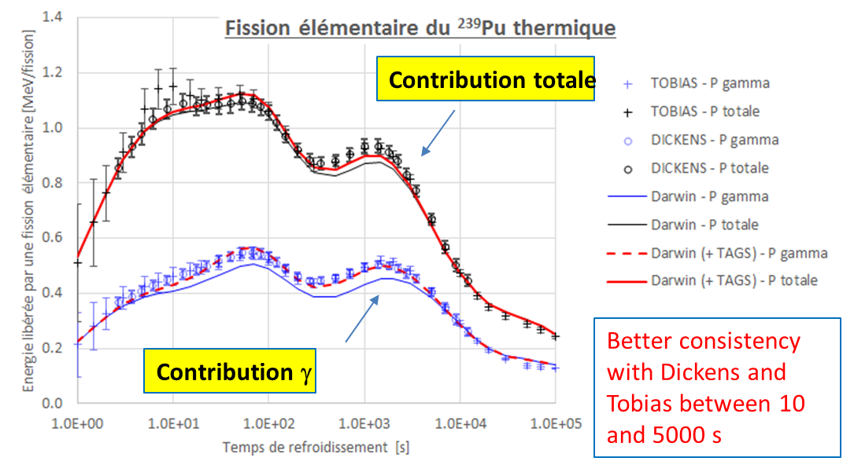
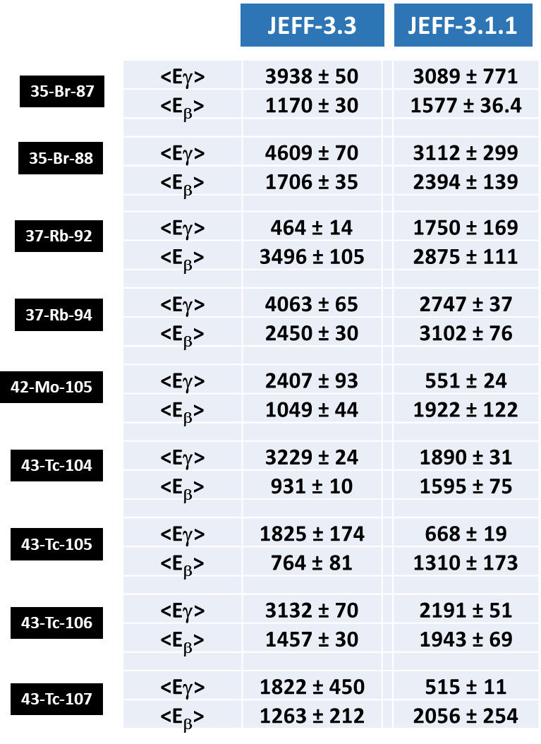
TAGS data for Decay Heat
New TAGS data on mean β/γ decay E are included in JEFF-3.3
Test on Fission Burst Experiments
JEFF-3.1.1 versus JEFF-3.1.1 + 9 TAGS: better agreement with exp. data
Phys. Review Letters, 105 (202501), 2010
Phys. Review C, 95 (024320), 2017
Phys. Review Letters, 115 (102503), 2015

Slide 4
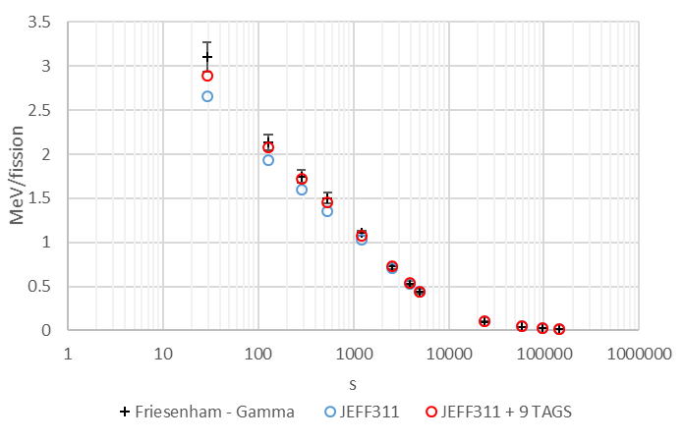
TAGS data for Decay Heat
Impact of new JEFF-3.3 TAGS data on ²³⁹Pu thermal Fission Burst with long irradiation
Jurney: irradiation time of 2e4 sec (~5.6 h)
Lower C/E discrepancies for time < 1e4 s
Impact of new <E>gamma TAGS on the gamma contribution compared to Jurney’s exp. data
E. T. Jurney, LA-7620-MS, 1979

Slide 5
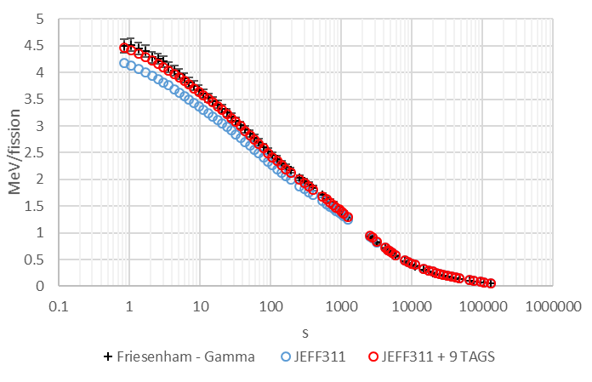
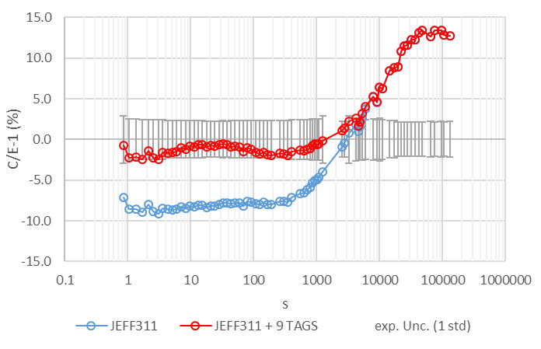
TAGS data for Decay Heat
Impact of new JEFF-3.3 TAGS data on ²³⁹Pu thermal Fission Burst with long irradiation
Friesenham : irradiation time of 8.64e4 sec (1 day)
Lower C/E discrepancies for time < 1e4 s
Impact of new <E>gamma TAGS on the gamma contribution compared to Friesenham’s exp. data
S. J. Friesenham, EPRI-NP-180, 1976

Slide 6
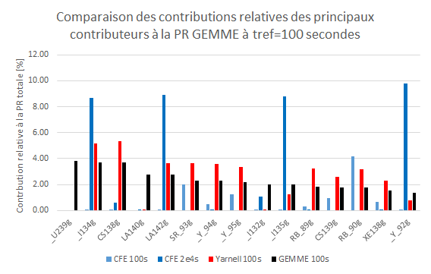

TAGS data for Decay Heat
Impact of new JEFF-3.3 TAGS data on ²³⁹Pu thermal Fission Burst with « long irradiation »
Comparison of relative DH isotopic contributions to the total DH of a PWR UOX fuel at 100 s of cooling
The DH emitted by a« fission burst with long irradiation » is closer to what’s happening in a real fuel.
Use those exp. data to quantify the impact of new TAGS measurements
review the list of Pandemonium candidates, provide sensitivity profiles
T1/2 [s] | Irrad. Time | no | 5.6 h | 1 d
55.7 | BR_87g | 1.09 | 0.23 | 0.21
16.5 | BR_88g | 0.17 | 0.01 | 0.01
35.6 | MO105g | 2.69 | 0.36 | 0.33
4.492 | RB_92g | 0.00 | 0.00 | 0.00
2.702 | RB_94g | 0.00 | 0.00 | 0.00
1098 | TC104g | 0.88 | 5.17 | 4.64
456 | TC105g | 1.31 | 2.55 | 2.29
36 | TC106g | 5.01 | 0.68 | 0.61
21.2 | TC107g | 0.78 | 0.06 | 0.06
 | Total | 11.93 | 9.06 | 8.14
PWR UOX
Fission bursts
Fission bursts
with « long Irrad. Time »

Slide 7
Illustrated examples of ND needs and impacts on fuel cycle applications
Outline
Decay Heat:
  TAGS experiments
  Correlations in Fission Yields and Decay Data
  Np239 decay data: need for a re-evaluation?
Dose rate:
  Example of ¹³⁶Cs

Slide 8
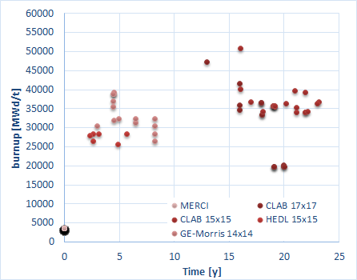
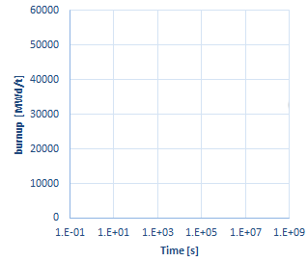
Decay Heat uncertainty: importance of correlation/covariances data
A need for reliable and accurate ND covariances
Decay Heat: Cooling times ~from 0 s to geological times (accidents, storage, transport, reprocessing…) / Burnups ~from 0 to 100 GWd/t / Fissile content [ 1-5% ²³⁵U], [2-11% Pu]
Not enough integral experimental data to assess bias and uncertainties on the whole domaine of application
Nuclear data covariance propagation is of paramount importance and a key element in the safety demonstration but the results (and then the safety margins) strongly depend on covariance reliability, completeness and accuracy
  → 2 examples : FY and DD cov
UOX exp. coverage
MOX exp. Coverage
= la tête à toto
Integral DH exp. for ND+code validation

Slide 9
Decay Heat uncertainty: Fission Yields covariances
New CEA/NNL evaluation for ²³⁵U(n_{th},f) FY -> 3 main goals
Reduce the dependency to phenomenological models,
ensure consistency between all fission yields quantities (independent, cumulative,…)
Produce full covariance matrices consistent with nominal values
  Correlations come from pure experimental mass yield analysis, conservation laws (no correlations from isotopic model parameters at this moment)
²³⁵U fission burst
Fission Yields were the main contributors to the total DH uncertainty
With new eval+cov -> strong reduction of the uncertainty, around 1% at 1 std !
JEFDOC-2128 (2022)

Slide 10
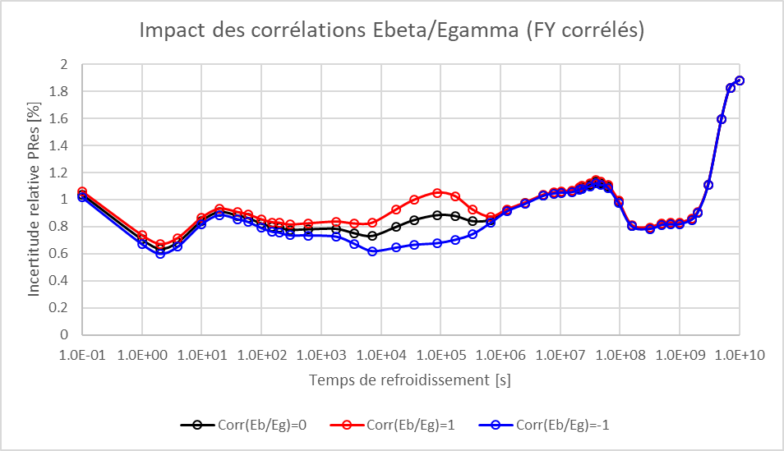
Decay Heat uncertainty: Decay data covariances
With FY cov: other uncertainties are to be considered
Covariance evaluation: not performed at the moment during Decay Data evaluations
As an illustration, arbitary correlation (=0, -1 ou +1) between mean E_{β} and E_{γ} are tested
With the strong reduction of the
uncertainty due to FY cov, other sources are to be consolidated

Slide 11
Illustrated examples of ND needs and impacts on fuel cycle applications
Outline
Decay Heat:
  TAGS experiments
  Correlations in Fission Yields and Decay Data
  Np239 decay data: need for a re-evaluation?
Dose rate:
  Example of ¹³⁶Cs

Slide 12
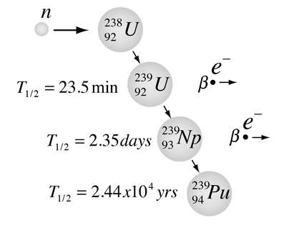
Decay Heat: ²³⁹Np decay data
Until 15 days, DH = FP + ²³⁹U/²³⁹Np contributions
A preliminary study of the decay data of ²³⁹Np in JEFF-3.1.1 / JEFF-3.3 and ENDF/B-VIII.0 show some inconsistencies and underline the need for a new evaluation!
See JEFDOC-2063 (Nov-2021) (D.Bernard)
Decay Heat of an UOX fuel (3.25% ²³⁵U, 33 GWd/t)

Slide 13
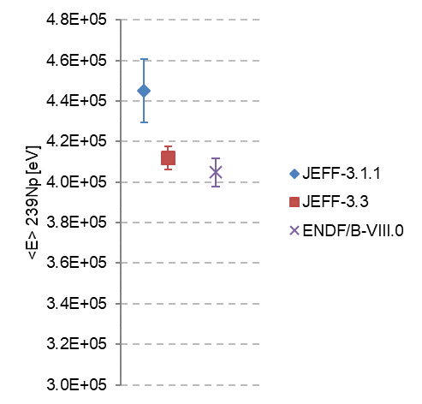
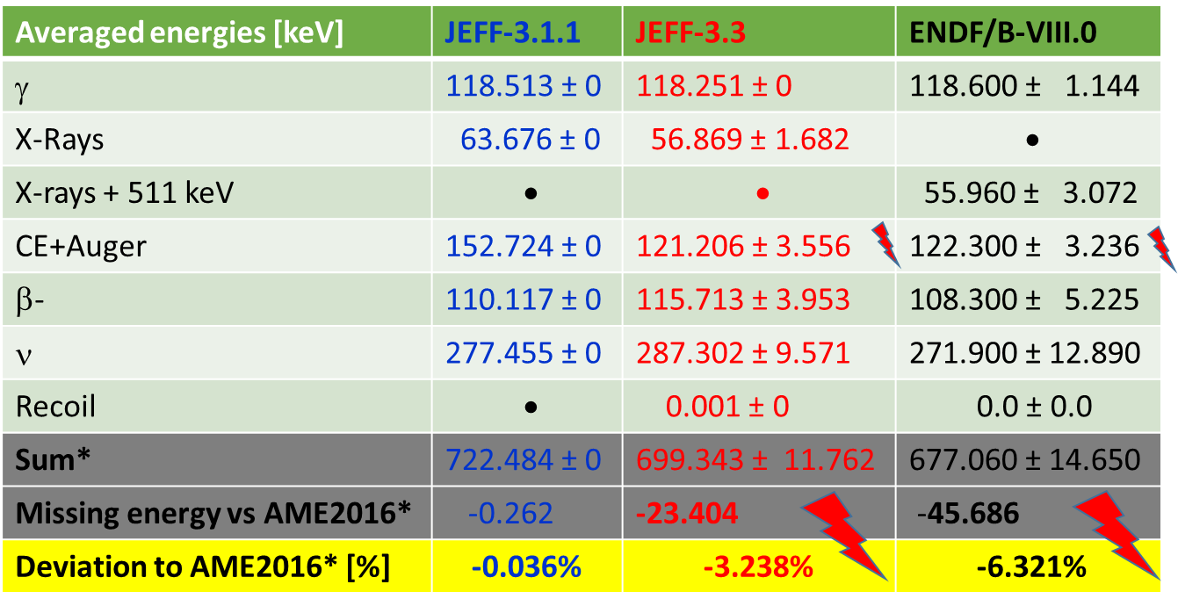
²³⁹Np/DD: central value deviations btw evaluations can inform on uncertainty quality
JEFF-3.1.1: A. L. Nichols nov-2007 (rev2/1991) from UKHEDD25
JEFF-3.3: V.P. Chechev, N.K. Kuzmenko from ensdf/jul-2006
ENDF/B-VIII.0: from ensdf/feb-2018
40keV ∼ 10%
Mean deposited energy [keV]
ΔM(AME2016) = 722.746 272(3) keV
*: reconstructed
JEFDOC-2063

Slide 14
Analysis of ²³⁹Np/DD difference btw evaluations
²³⁹Np Decay Data/detailed deposited energy
Averaged deposited energies [keV] | JEFF-3.1.1 | ENDF/B-VIII.0
Light particles (β⁻ + conversion + eA + e^{+/-}) | 262.840 ± 13.837 | 230.583 ± 6.146
Electromagnetic particles (γ+X) | 182.189 ± 7.235 | 174.346 ± 3.253
Total (quadratic unc. for DARWIN…) | 445.029 ± 15.614 | 404.929 ± 6.954
-40.100 keV btw ENDF8 vs JEFF-3.1.1 :
  -32.257keV light particles
  -7.843 keV EM particles
JEFDOC-2063

Slide 15
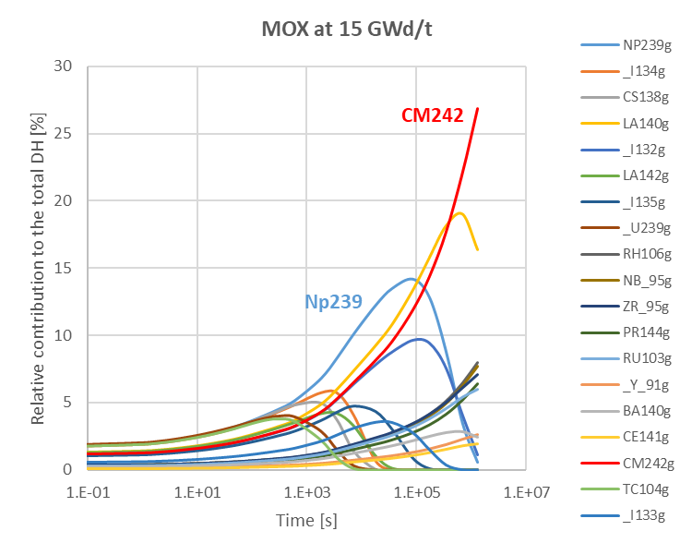
Conclusion of ²³⁹Np/DD difference btw evaluations: 40keV on deposited energy
ENDF/B-VIII.0 is more rigorous than JEFF-3.1.1 but the analysis of the spectrum of light particles shows that β⁻ lines are incorrectly normalized (+2.4%) and the file is incomplete versus total Q_{β-}: Atomic Mass Evaluation (-6.3%)…
Still work to de bone for Decay Data files !!!
²³⁹Np is not the only isotope candidate for
a review of its decay data and
uncertainties: ²⁴²Cm,²³⁸Pu, ¹⁴⁰La, ¹⁰⁶Rh, ¹⁴⁴Pr, ⁹⁵Nb, ¹³²I …

Slide 16
Illustrated examples of ND needs and impacts on fuel cycle applications
Outline
Decay Heat:
  TAGS experiments
  Correlations in Fission Yields and Decay Data
  Np239 decay data: need for a re-evaluation?
Dose rate:
  Example of ¹³⁶Cs

Slide 17
Dose Rate: the ¹³⁶Cs example
Example of ¹³⁶Cs, in the TOP’10 of the main contributors of the integrated dose received by the equipments in accidental scenarios
Too large uncertainty on its isotopic concentration due to nuclear data covariance propagation (11% at 1 std)
Sensitivity/variance analysis

Slide 18
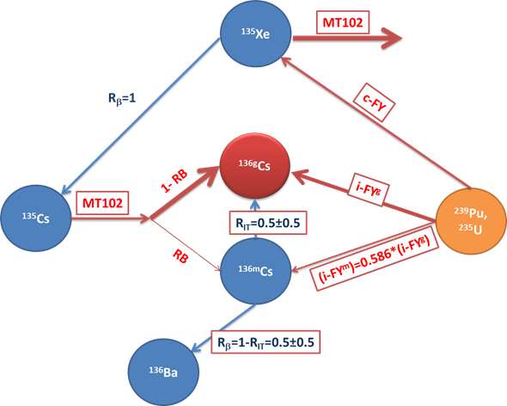
Dose Rate: the ¹³⁶Cs example
After re-analysis by U. Koster and thanks to measures at ISOLDE@CERN:
R_{IT} = 0.996 ± 0.005
+ new decay scheme of ^{136m}Cs
<Eγ> = 501 keV (JEFF311= 816.6 keV)
D. Bernard, A. Chebboubi, U. Koster

Slide 19
Dose Rate: the ¹³⁶Cs example
New evaluation of ¹³⁵Cs(n,g)
-> -10% sur [¹³⁶Cs]
and ¹³⁵Xe(n,g)
-> not tested yet
New evaluation of RB as a function of incident neutron E and spin/parity of the coumpound sys. before desex γ -> FIFRELIN + new decay scheme
RB = 0.0 ± 0.0 (=0.16 dans JEFF-3.0/A)
(G. Noguère , O. Bouland)-> JEFF-4)

Slide 20
Dose Rate: the ¹³⁶Cs example
Improvement of isomeric FY (FY^{g/m}) with FIFRELIN
+
New experimental campaign at Lohengrin@ILL in june 2021 : ²³⁹Pu(n_{th},f)¹³⁶Cs
New measurement method! …Analysis in progress
(A. Chebboubi, et al.)

Slide 21
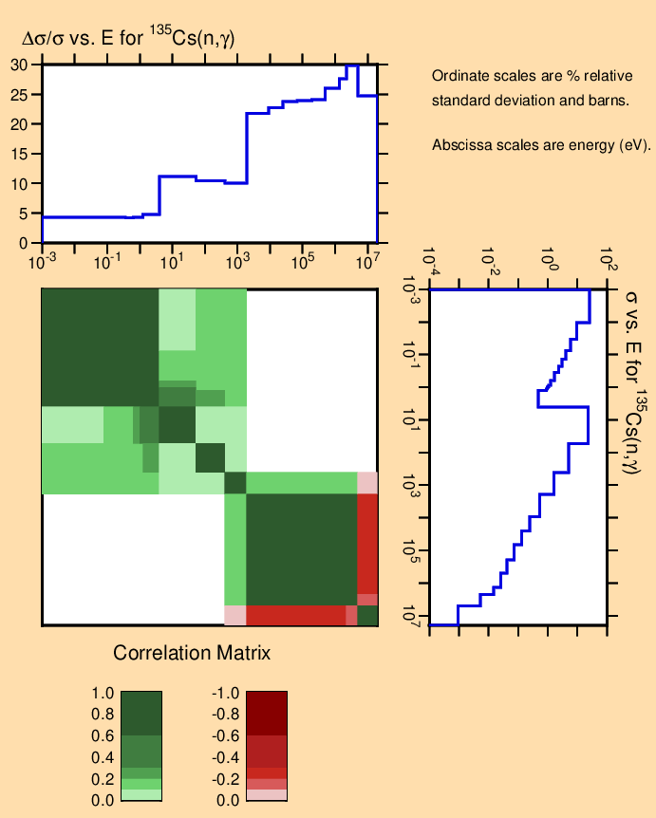
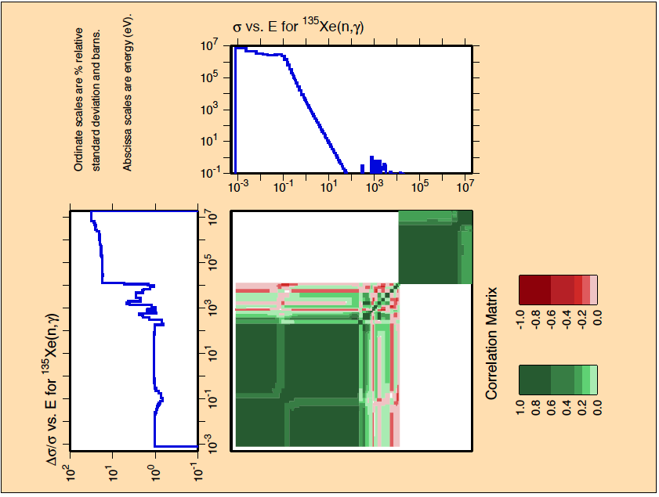
Dose Rate: the ¹³⁶Cs example
Some analysis are still in progress, the total impact has to be assessed
A reduction of the 4/5% of the isotopic concentration of ¹³⁶Cs in depleted calculation is expected
A reduction of its uncertainty is expected thanks to the new measurement of the ²³⁹Pu(n_{th},f)¹³⁶Cs fission yield (35% in JEFF-3.1.1)

Slide 22

To conclude
Needs in fuel cycle applications (decay heat, dose rate, fuel reprocessing, …) are a strong source of interesting studies involving needs in nuclear data
Sensitivity analysis / experimental validation / data assimilation are powerful tools to identify and drive improvements in nuclear data
The ¹³⁶Cs is a good example of the work we do:
  Identification of an “industrial”/”application” need
  Study of the nuclear data involved, identification of the possible improvements
  Action! New experiment / evaluation / theoretical calculation / etc…
  Feedback, JEFF project
Shopping list:
¹²⁹I (period, branching of its precursors),
²³⁵U(n_{th},f)¹³⁷Cs (new measurement)

Slide 24
Comparaison avec les bibliothèques des données évaluées et les données expérimentales
Cas du 137-Cs-55
Préconisation d’A. Rizzo sur Yc(137-Cs, 235U):
Pas compatible avec JEFF-3.1.1
Pas compatible avec les autres évaluations
Pas compatible avec les données expérimentales
  Nouvelle mesure par spectrométrie γ recommandée
Préconisation d’A. Rizzo sur Yc(137-Cs, 239Pu):
Compatible avec JEFF-3.1.1
Compatible avec les autres évaluations
Compatible avec la plupart des données expérimentales
  Conserver JEFF-3.1.1 pour JEFF-4.0

