Slide 1

Nuclear structure studies by (n,xn) at NFS.
E. Clément – NACRE Workshop 2022

Slide 2
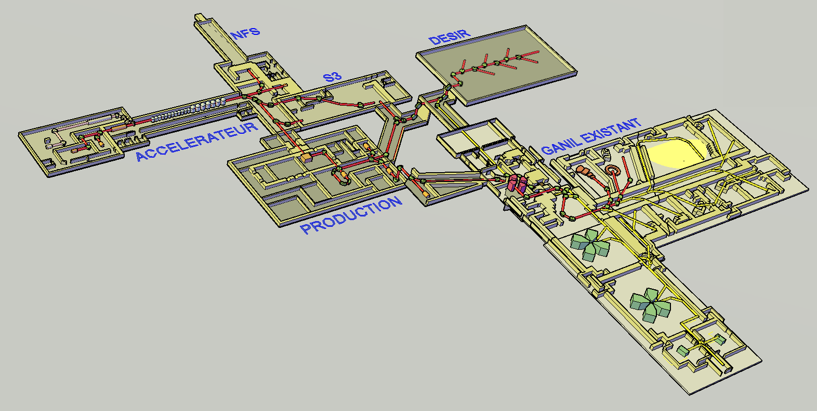
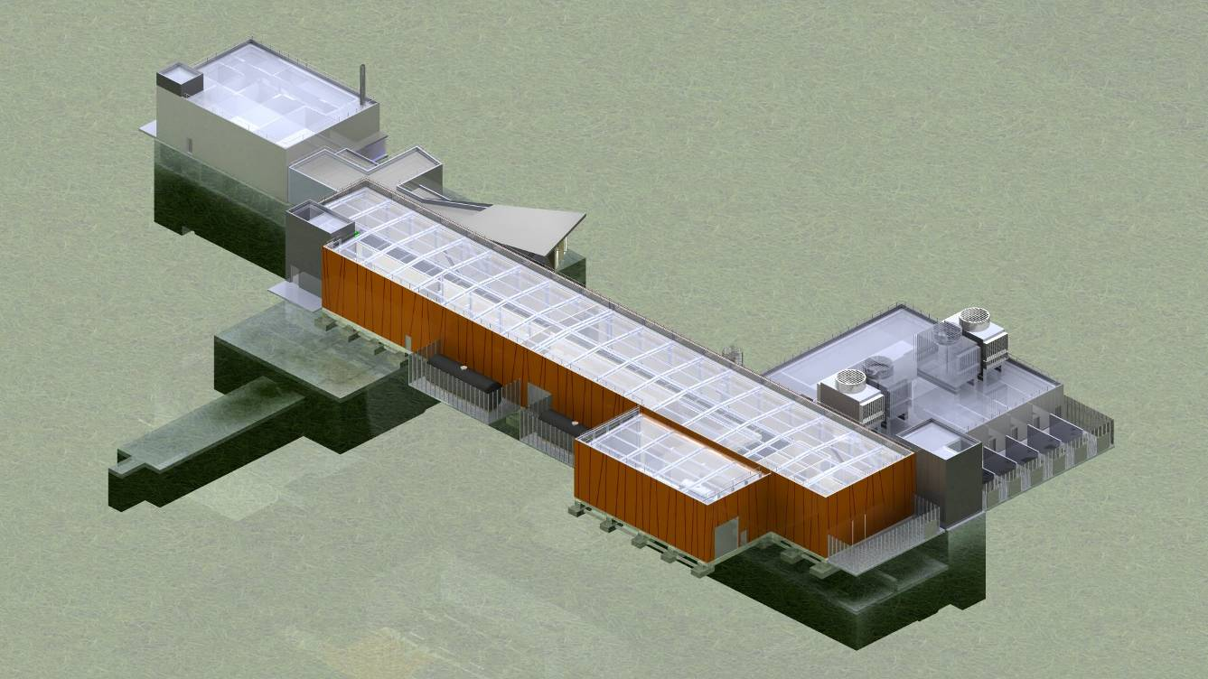
SPIRAL-2 phase 1 building
Building
height : +8,80 m
Depth : -9,5 m
1 chimney: +12m
≈ 100 rooms
7200 m²
S3
LINAC
NFS

Slide 3
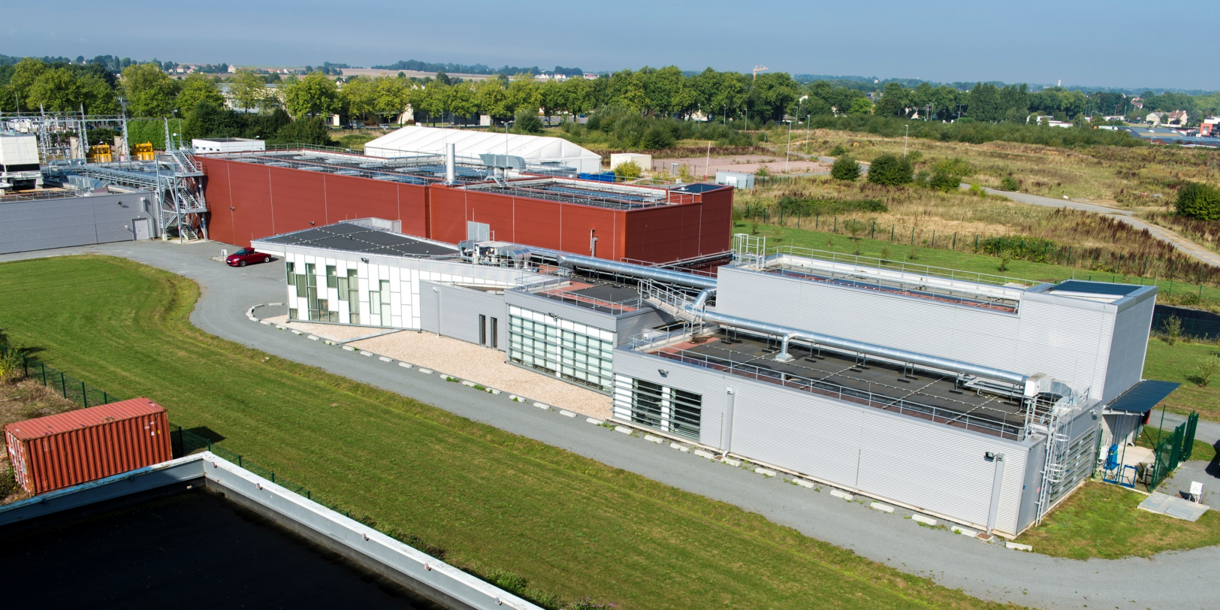
SPIRAL-2 phase 1 building
entrance
Control room
Nuclear lab
Ground floor

Slide 4
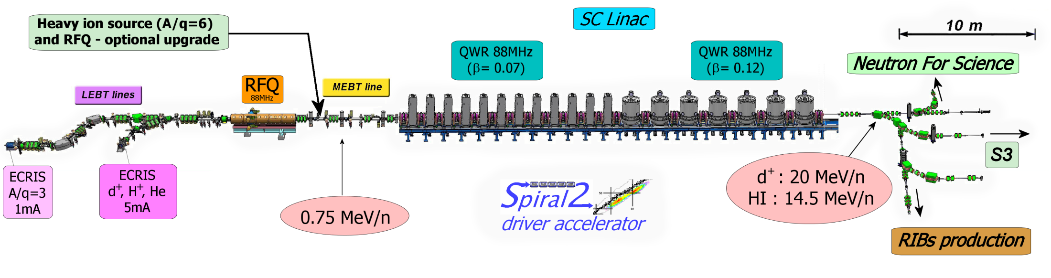
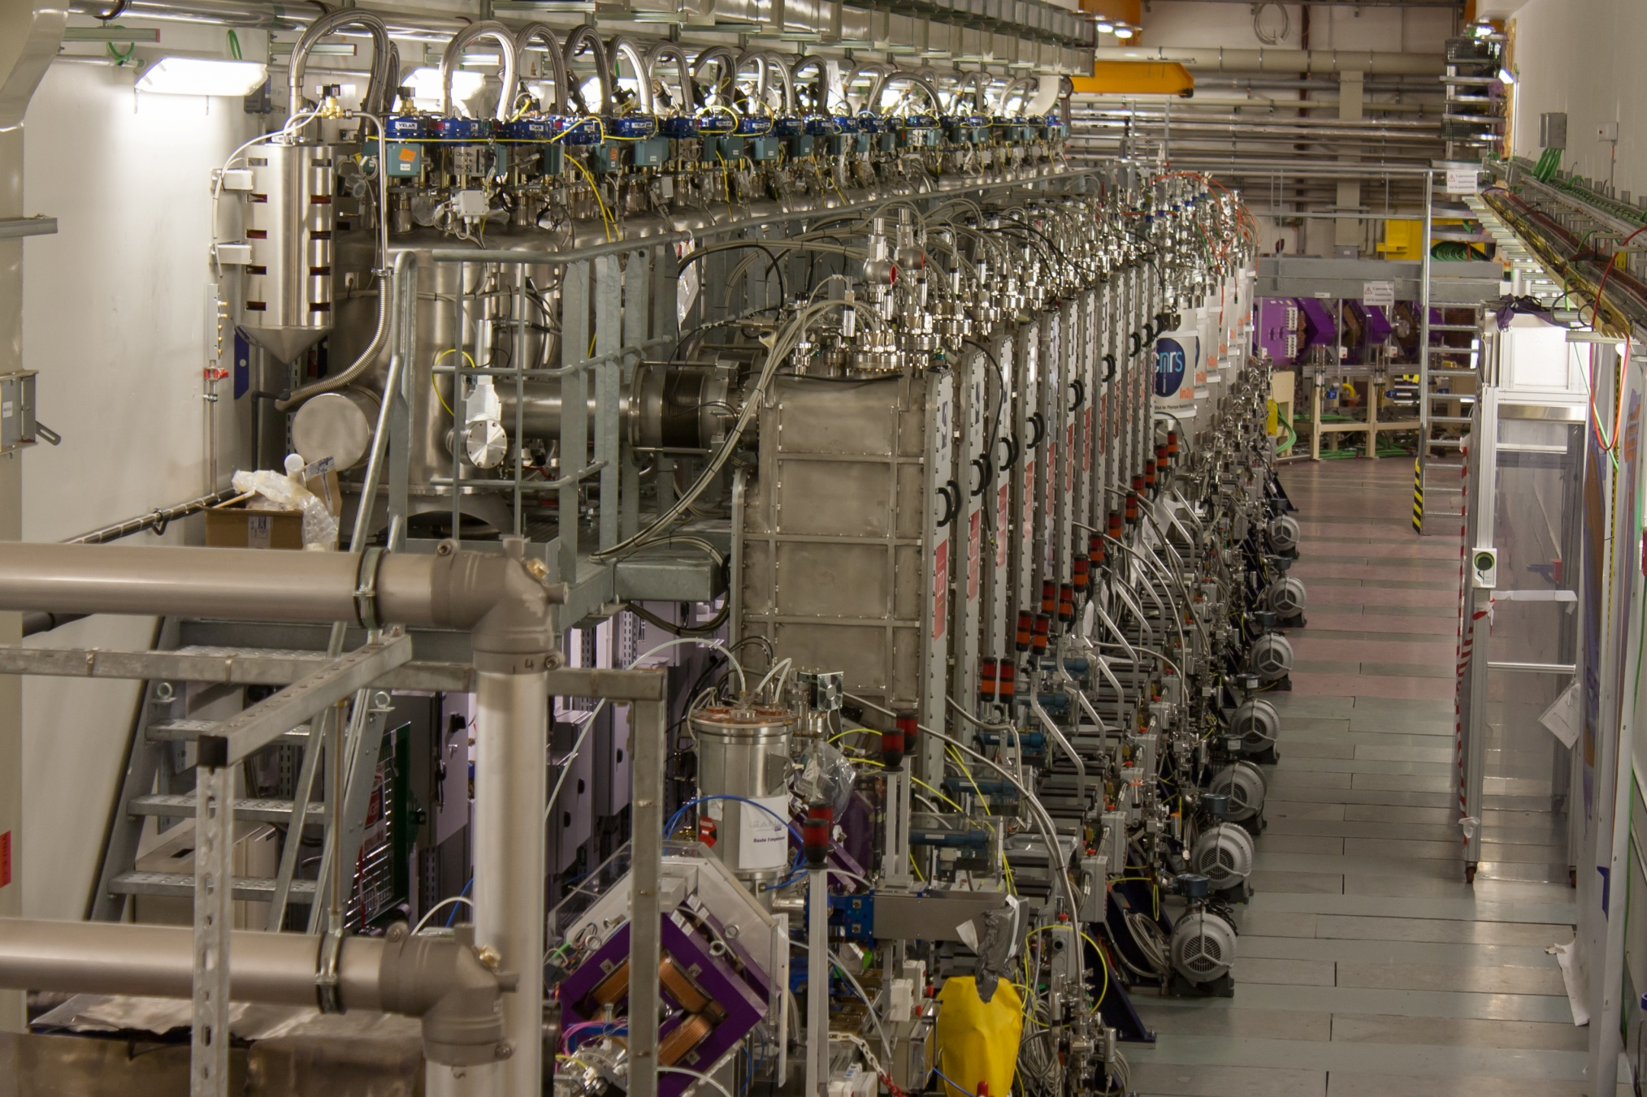
The Linear Accelerator of SPIRAL-2
Total length: 65 m (without HE lines)
Slow (LEBT) and Fast Chopper (MEBT) RFQ (1/1, 1/2, 1/3) & 3 re-bunchers
12 QWR beta 0.07 (12 cryomodules) 14 (+2) QWR beta 0.12 (7+1 cryomodules) 1.1 kW Helium Liquifier (4.5 K) Room Temperature Quadrupoles Solid State RF amplifiers (10 & 20 KW)
RFQ frequency F = 88MHz

Slide 5
X. Ledoux, et al. Eur. Phys. J. A, 57, 257 (2021)

Slide 6

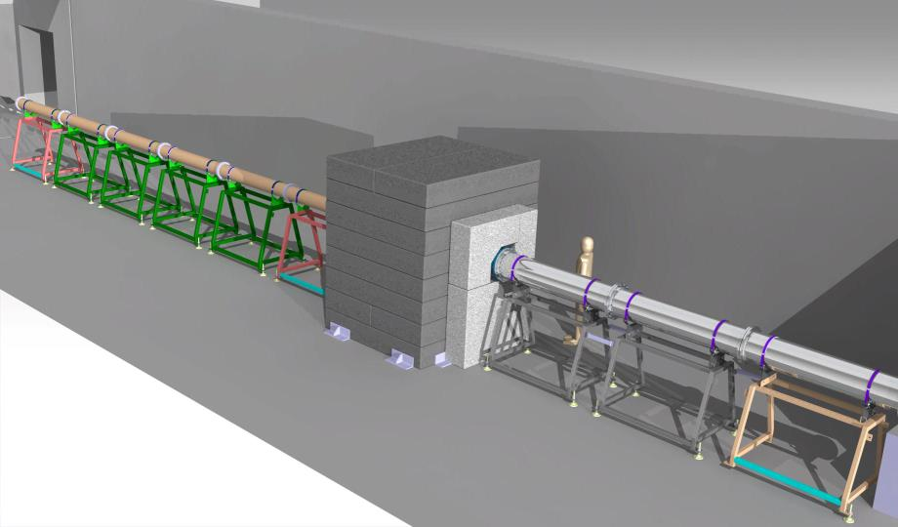
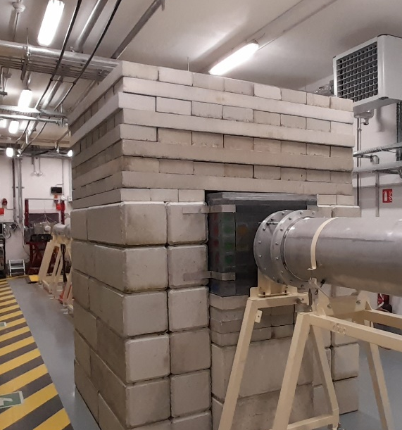
Beam spot size
The beam has a conical shape
  set 1 of nozzles r=20 mm at 5 m r=133 mm at 30 m
  set 2 of nozzles r=15 mm at 5 m r=68 mm at 30 m
For experiment at long distance, a 2ND collimator is needed for:
  resizing the neutron beam r=28 mm at 30 m
  shielding detectors from background
Study, design and construction realized by IPHC Strasbourg
The central part can be disassembled

Slide 7

Prochain PAC : Dec. 2022
deadline October 24, 2022

Slide 8
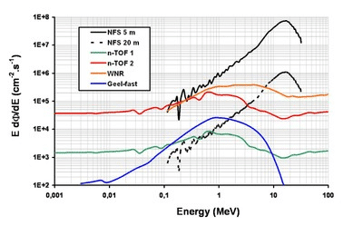
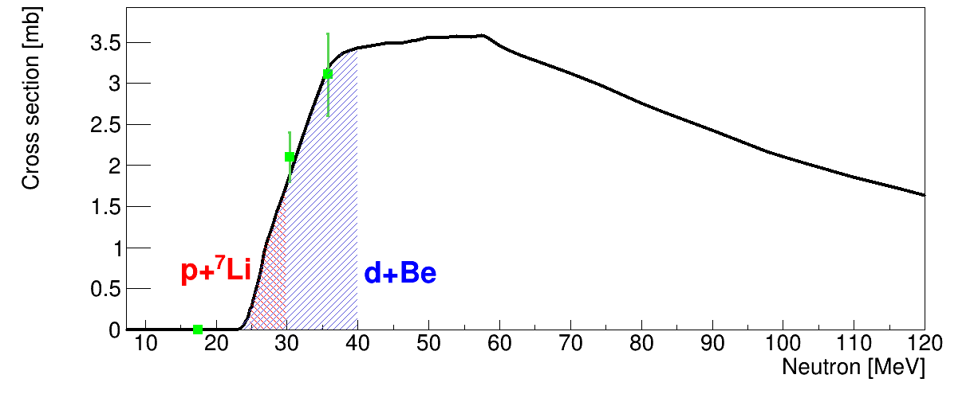
Nuclear structure spectroscopy using fast neutron beams
NFS offers unique opportunities with the highest neutron flux > 10 MeV world-wide
Unique flux for (n,xn) reactions → known technique in the framework of the design of the Generation-IV nuclear reactors.
Most of the studies are on heavy elements for nuclear fuel (U, Th) or structural materials (^{nat}Fe, Cr, Mg/Na, W) with focus on the cross section measurements to improve models included in reaction codes such as talys.
What can we learn in nuclear structure spectroscopy using this reaction ?
(n,xn)

Slide 9
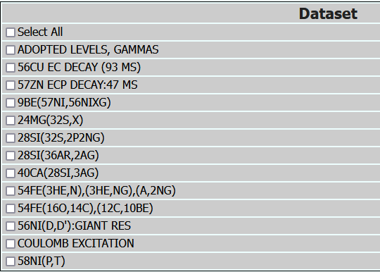
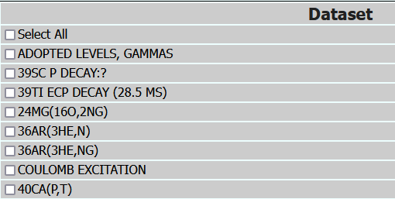
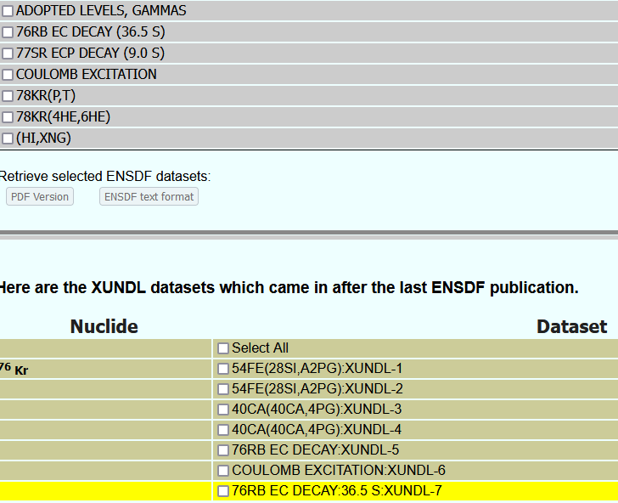
Nuclear structure spectroscopy using fast neutron beams
NFS offers unique opportunities with the highest neutron flux > 10 MeV world-wide
Unique flux for (n,xn) reactions → known technique in the framework of the design of the Generation-IV nuclear reactors.
Most of the studies are on heavy elements for nuclear fuel (U, Th) or structural materials (^{nat}Fe, Cr, Mg/Na, W) with focus on the cross section measurements to improve models included in reaction codes such as talys.
What can we learn in nuclear structure spectroscopy using this reaction ?
https://www.nndc.bnl.gov/
⁵⁶Ni
(shape coexistence close sdf)
⁴⁰Ca(n,3n)³⁸Ca
never measured
(shape coexistence close sd)
⁷⁸Kr(n,3n)⁷⁶Kr never measured
⁷⁰Ge(n,3n)⁶⁸Ge never measured
(shape coexistence open pfg)
(n,xn)

Slide 10
Nuclear structure spectroscopy using fast neutron beams
NFS offers unique opportunities with the highest neutron flux > 10 MeV world-wide
Unique flux for (n,xn) reactions → known technique in the framework of the design of the Generation-IV nuclear reactors.
Most of the studies are on heavy elements for nuclear fuel (U, Th) or structural materials (^{nat}Fe, Cr, Mg/Na, W) with focus on the cross section measurements to improve models included in reaction codes such as talys.
What can we learn in nuclear structure spectroscopy using this reaction ?
https://www.nndc.bnl.gov/
⁵⁶Ni
(shape coexistence close sdf)
(p,t)
Low angular momentum
From gs to Sn
Yrast (90%) / non-yrast (10%)
⁴⁰Ca(n,3n)³⁸Ca
never measured
(shape coexistence close sd)
⁷⁸Kr(n,3n)⁷⁶Kr never measured
⁷⁰Ge(n,3n)⁶⁸Ge never measured
(shape coexistence open pfg)
(n,xn)

Slide 11
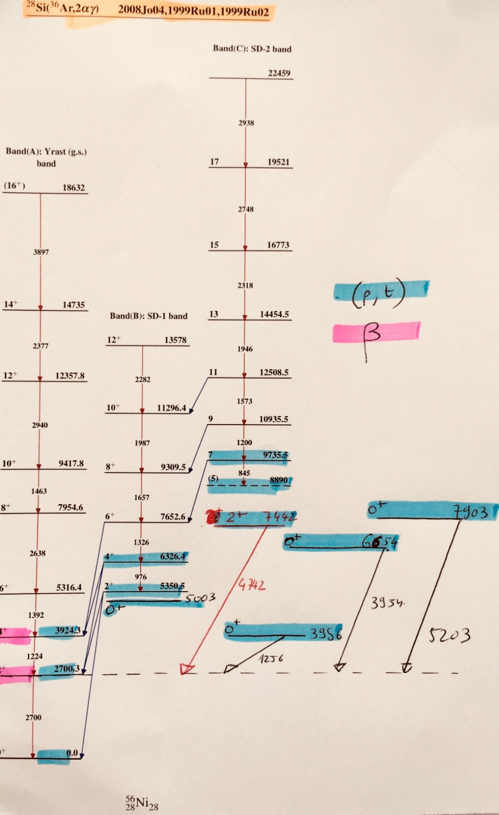
Test case : ⁵⁶Ni
⁵⁶Ni is a doubly magic nuclei, therefore all spectroscopic information's are relevant for nuclear structure studies.
⁵⁶Ni has an extended level scheme populated by :
⁵⁸Ni(p,t)⁵⁶Ni H. Nann and W. Beneson Phys. Rev C 10, 1880 (1974)
⁵⁴Fe(³He,n)⁵⁶Ni J. Blomqvist et al, Z. Phys. A322, 169 (1985)
Heavy ions reactions, D. Rudolph et al, Phys. Rev. Lett. 82, 3763 (1999)
β-decay, R. Borcea et al, Nucl. Phys. A 695, 69 (2001)
Heavy ions fusion reaction populate to high spin the GSB and the 2 SD band.
β-decay has very strong selection rules ⁵⁶Cu(J^{π} = 4⁺)
(p,t) reaction is limited to low angular momentum and highly selective
But shed light on many non-yrast structures, i.e 4 excited 0⁺ states.
No feeder or band structures have been observed later.
→ observing the 2⁺ states feeding these states is of great interest

Slide 12
Test case : ⁵⁶Ni
4p-4h
from f-shell
The Yrast structure of ⁵⁶Ni is rather well understood with the ground state band of a doubly magic nuclei and a shape coexistence scenario at 5 MeV based on a 4p-4h configuration from the f-shell.
State-of-the-art Shell Model calculations :
Low-lying 0⁺ states calculated (exp.) at 3.6 (3.9) , 4.94 (5.0) , 6.16 (6.6) , and 6.8 (7.9) MeV.
Not clear interpretation for the 1st , 3rd and 4th excited 0⁺ states.
The 3.9 MeV state is proposed as a two-phonon structure but no experimental confirmation
Others ?
→ Need for more spectroscopic data
M. Horoi, B. A. Brown, T. Otsuka, M. Honma, and T. Mizusaki, Phys. Rev. C 73, 061305(R) (2006)

Slide 13

Test case : ⁵⁶Ni
Nuclear structure (level scheme, including levels' spin, parity and lifetime, as well as transitions' intensity and multipolarity) is a key input of nuclear reaction codes (e. g. Talys), it needs to be as complete as possible.
Uncertainty on transition branching ratios and unknown states affects negatively the quality of the calculations.
Many level spectroscopy studies are done via charged particles induced reactions or decay reaction, the selectivity in angular momentum and excitation energy of these channels may leave some area of the J, E* plane unexplored, leading to a limited knowledge of the level scheme there.
The IPHC - JRC-Geel - IFIN collaboration has highlighted the shortcomings in terms of nuclear structure that prevent the production of accurate (n,xn) cross section from the measured (n,xn g) ones.
M.Kerveno et al., European Physical Journal N 4, 23 (2018)
Direct comparison for ⁵⁸Ni with
H. Nann and W. Beneson Phys. Rev C 10, 1880 (1974)

Slide 14
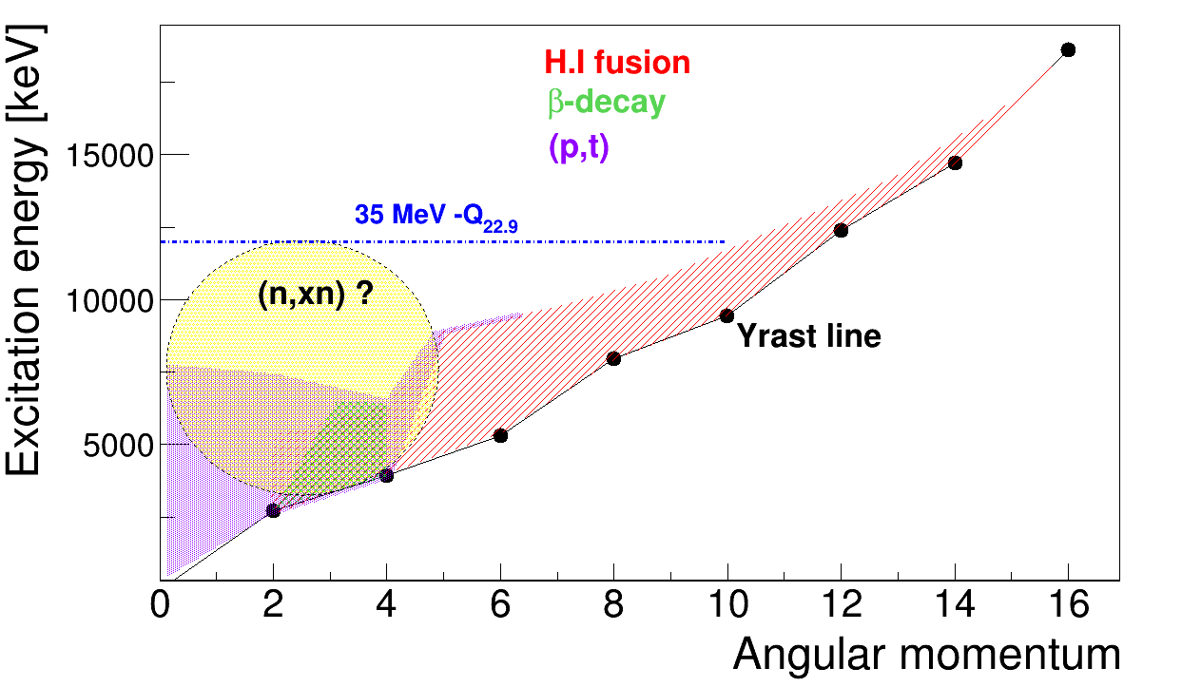
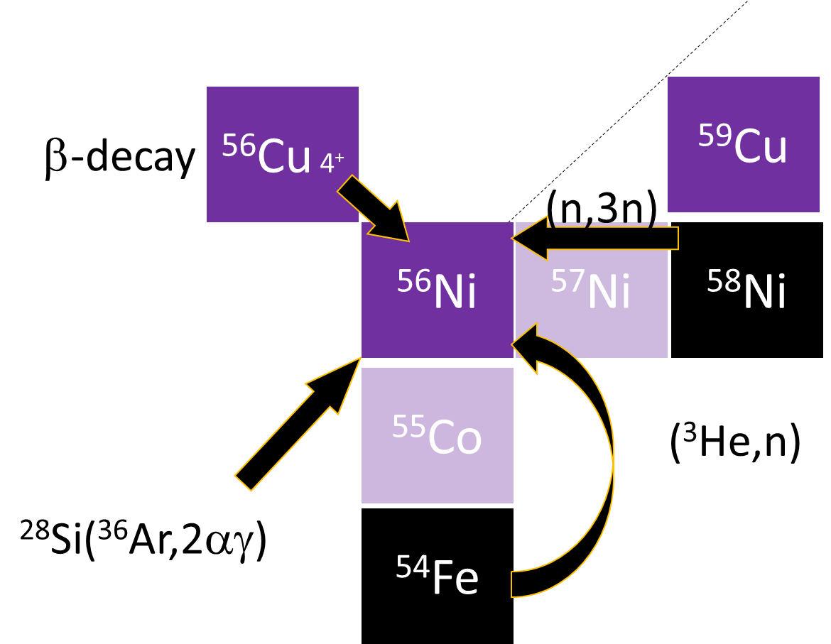
Test case : ⁵⁶Ni
⁵⁶Ni population
The basic questions are :
Which states are populated in the (n,xn) reaction from the nuclear structure point of view ?
Which area of the Yrast surface is populated ? (Angular momentum generated vs E*?)
Is this so different from the (p,t) reaction ? → Direct surrogate method validation
Could we access unknown low spin, high excitation energy states such as the 2⁺ states built on the 0⁺_{2,4,5} ?

Slide 15
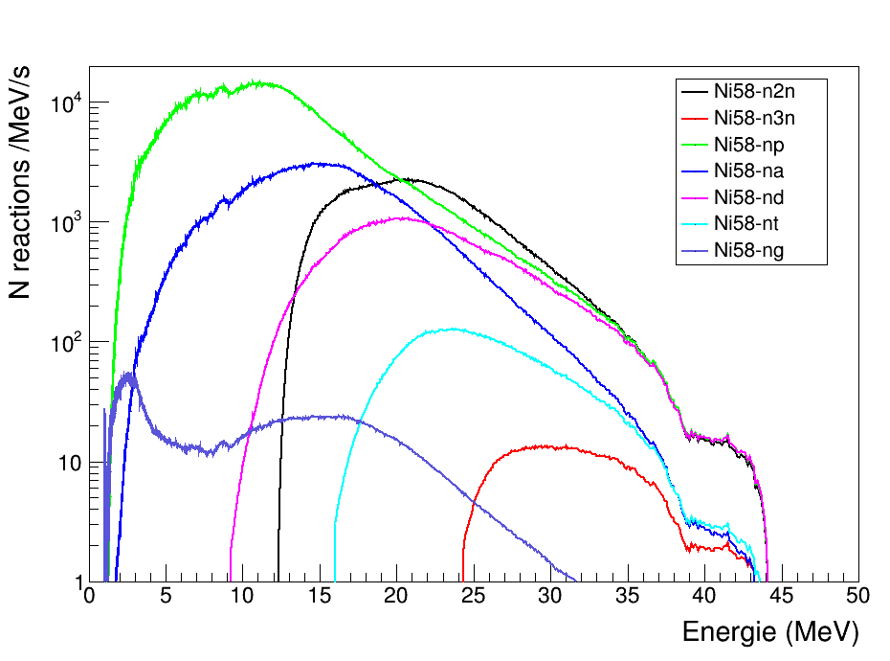
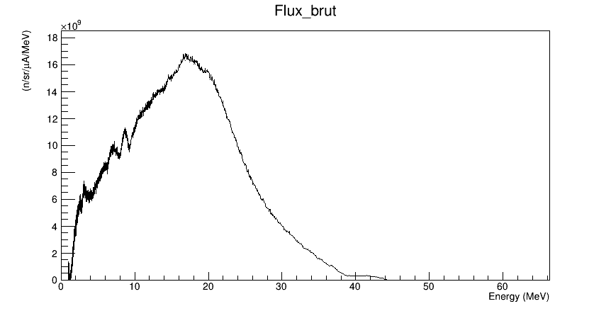
Rates
1‰
3‰
p+⁷Li/Be, produces slighly lower energies but the all the flux of 5.10⁶ n/sec/cm² à 5 meters is in the range [25-30]MeV
d+Be allows to reach ~up to 40 MeV In this energy range, there is no competitors…. NFS is unique in term of flux at these energies.
Complete calculation in d induced neutron 700 Hz with 1mm target
Complete calculation in p induced neutron 14 Hz
X. Ledoux courtesy
~1MHz gamma in 4π
~10 kHz/core – Free CFD
~few kHz events for all neutron energies
~few hundred of Hz event for E_{n}>20 MeV

Slide 16
Rates
p+⁷Li/Be, produces slighly lower energies but the all the flux of 5.10⁶ n/sec/cm² à 5 meters is in the range [25-30]MeV
d+Be allows to reach ~up to 40 MeV In this energy range, there is no competitors…. NFS is unique in term of flux at these energies.
Complete calculation in d induced neutron 700 Hz with 1mm target
Complete calculation in p induced neutron 14 Hz
 |  | E>0 |  | E>20 MeV
Réaction | Σ (barn) | Reaction rater/gramm | Fraction | E neutron> 20 MeV | Fraction | Isotope
Ni58-n2n | 0,042261 | 2,55E+04 | 11% | 1,50E+04 | 35% | ⁵⁷Ni
Ni58-n3n | 0,000241 | 1,45E+02 | 0,1% | 1,45E+02 | 0,3% | ⁵⁶Ni
Ni58-np | 0,263352 | 1,59E+05 | 67,2% | 1,18E+04 | 27,9% | ⁵⁸Co
Ni58-na | 0,061221 | 3,69E+04 | 15,6% | 6,17E+03 | 14,5% | ⁵⁵Fe
Ni58-nd | 0,021535 | 1,30E+04 | 5,5% | 7,93E+03 | 18,7% | ⁵⁷Co
Ni58-nt | 0,002304 | 1,39E+03 | 0,6% | 1,26E+03 | 3,0% | ⁵⁶Co
Ni58-ng | 0,000759 | 4,57E+02 | 0,2% | 6,43E+01 | 0,2% | ⁵⁸Ni
total |  | 2,36E+05 | 100,0% | 4,24E+04 | 100,0%
~1MHz gamma in 4π
~10 kHz/core – Free CFD
~few kHz events for all neutron energies
~few hundred of Hz event for E_{n}>20 MeV
X. Ledoux courtesy

Slide 17
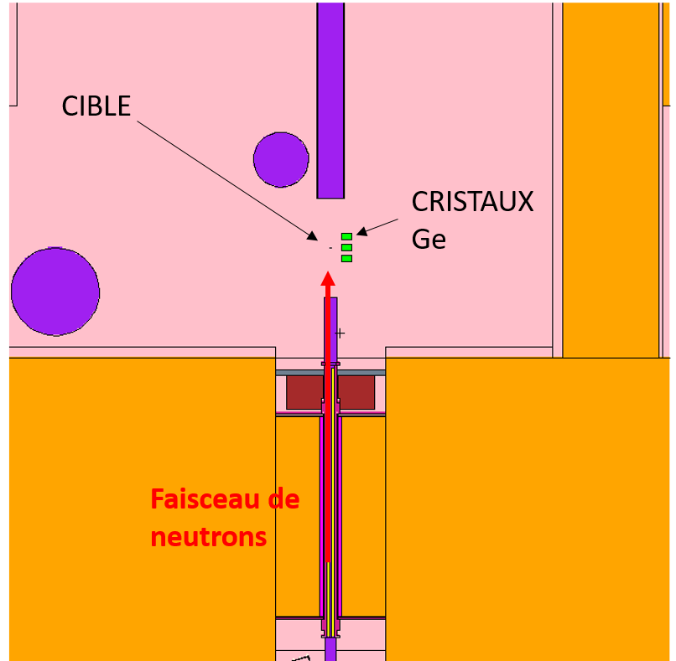
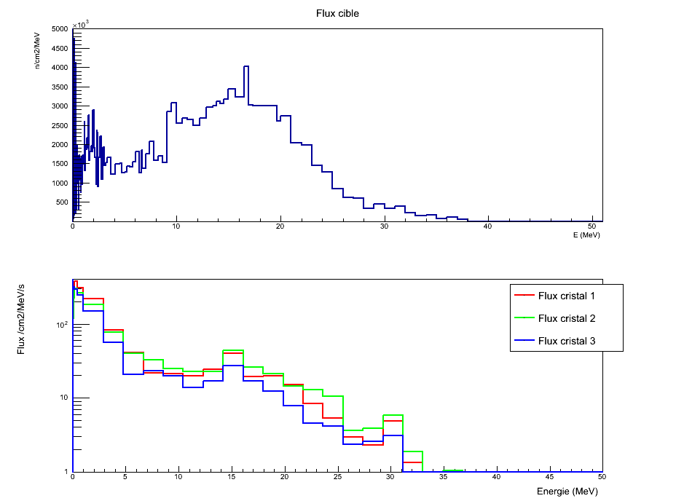
Fast Neutron and HPGe detectors
MCNP6
X. Ledoux courtesy
Crystal | E>0 | E>5
1 | 1,39E3 | 4,68e2
2 | 1,31E3 | 5,44e2
3 | 1,01E3 | 3,32e2
Neutron (en n/cm²/s) for 50 µA deutons
Integrated dose of fast neutron (> 5 MeV) will be 0.3.10⁹ n/cm²

Slide 18
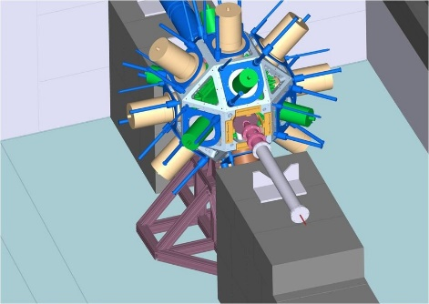
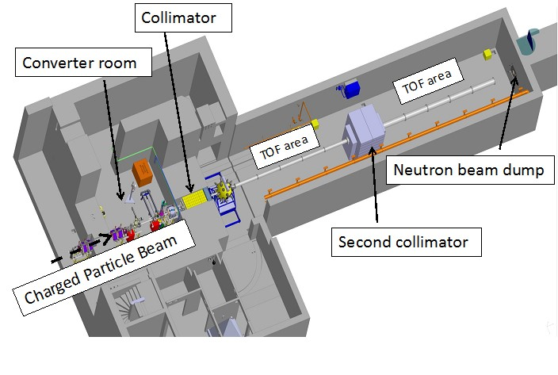
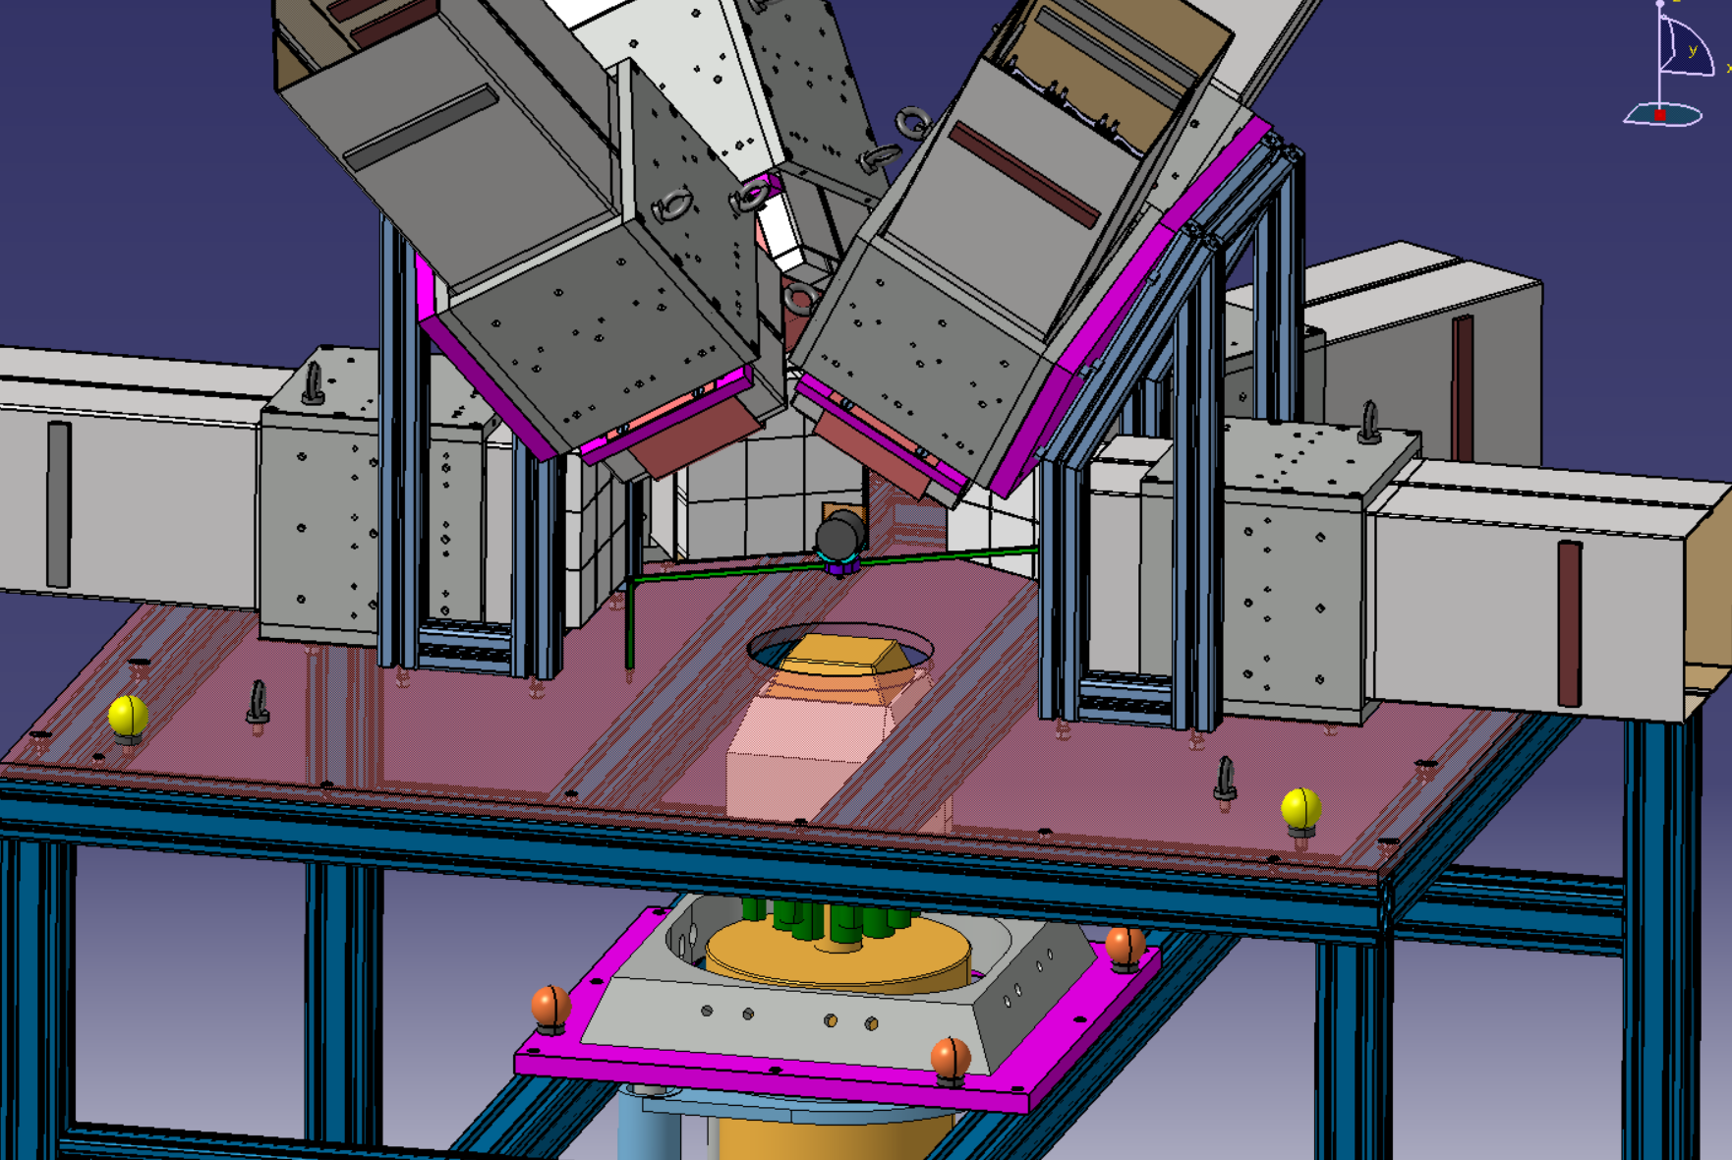
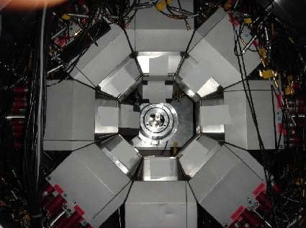
Experiment #1
12 EXOGAM clover detectors placed at 5 meters from the production target
Using 45μA of deuteron beam on the thick Be target
→700 Hz of ⁵⁶Ni with a 1mm target
Triggered in γγ in coincidence with the fastest neutrons
With 21 UT of beam on target → ~5.10⁶ γγ coincidences
Methodology
M. Kerveno et al Eur. Phys. J. A (2015) 51: 167
⁵⁸Ni(n,3n)⁵⁶Ni
J. Vrzalova et al NIM A, 726 (2013)84-90
= Neutron T.o.F
PARIS
M. Vandebrouck(CEA)
I. Matea (IJClab)
September 2022 @ 5 meters
EXOGAM
+MONSTER

Slide 19

Experiment #2
⁴⁰Ca(p,t)³⁸Ca reaction measurements
A. M. Long et al, PRC 95, 055803 (2017)
The proposition is a EXOGAM@NFS campaign starting in 2023
Second proposal will be ⁴⁰Ca(n,3n)³⁸Ca
All proposals are welcome !!
Sp
Prochain PAC : Dec. 2022
deadline October 24, 2022

Slide 20
Conclusion
NFS is unique in term of flux at the (n,xn) energies.
State-of-the-art instrumentations
Beam time available
Campaign strategy

Slide 22
⁵⁶Cu 4⁺
⁵⁹Cu
β-decay
(n,3n)
⁵⁶Ni
⁵⁷Ni
⁵⁸Ni
⁵⁵Co
(³He,n)
²⁸Si(³⁶Ar,2αγ)
⁵⁴Fe

